Slide 1
SDI GRB Appliance – A cost effective method of retrieving GOES-R L1 data
Scott Mindock, Jonathan Beavers, Rick Kohrs
University Of Wisconsin Madison

Slide 2
What do I need to Ingest the GRB data stream with SDI?
Antenna
Demodulator
SDI GRB Appliance

Slide 3
What is a SDI?
SSEC GRB Data Ingestor - SDI
It’s Hardware – A preconfigured server
It’s Software – CSPP GEO and ADDE
It’s Service – We are here for you!
SSEC has long history of Geostationary data ingest and service.
1980’s Mainframe frame syncs and software.
1990’s SDI-104 for GVAR
SDI GRB Appliance Continues a SSEC Tradition

Slide 4
What do I get? (1 of 2)
CSPP (Community Satellite Processing Package)
CSPP Geo GRB software converts GOES-R GRB data stream into mission compliant netCDF files
16-channel Advanced Baseline Imager (ABI) Level 1b
Geostationary Lightning Mapper (GLM)
Level 2+Space Environment In-Situ Suite (SEISS)
Level 1bMagnetometer (MAG) Level 1bSolar Ultraviolet Imager (SUVI)
Level 1bExtreme Ultraviolet and X-ray Irradiance Suite (EXIS) Level 1b

Slide 5
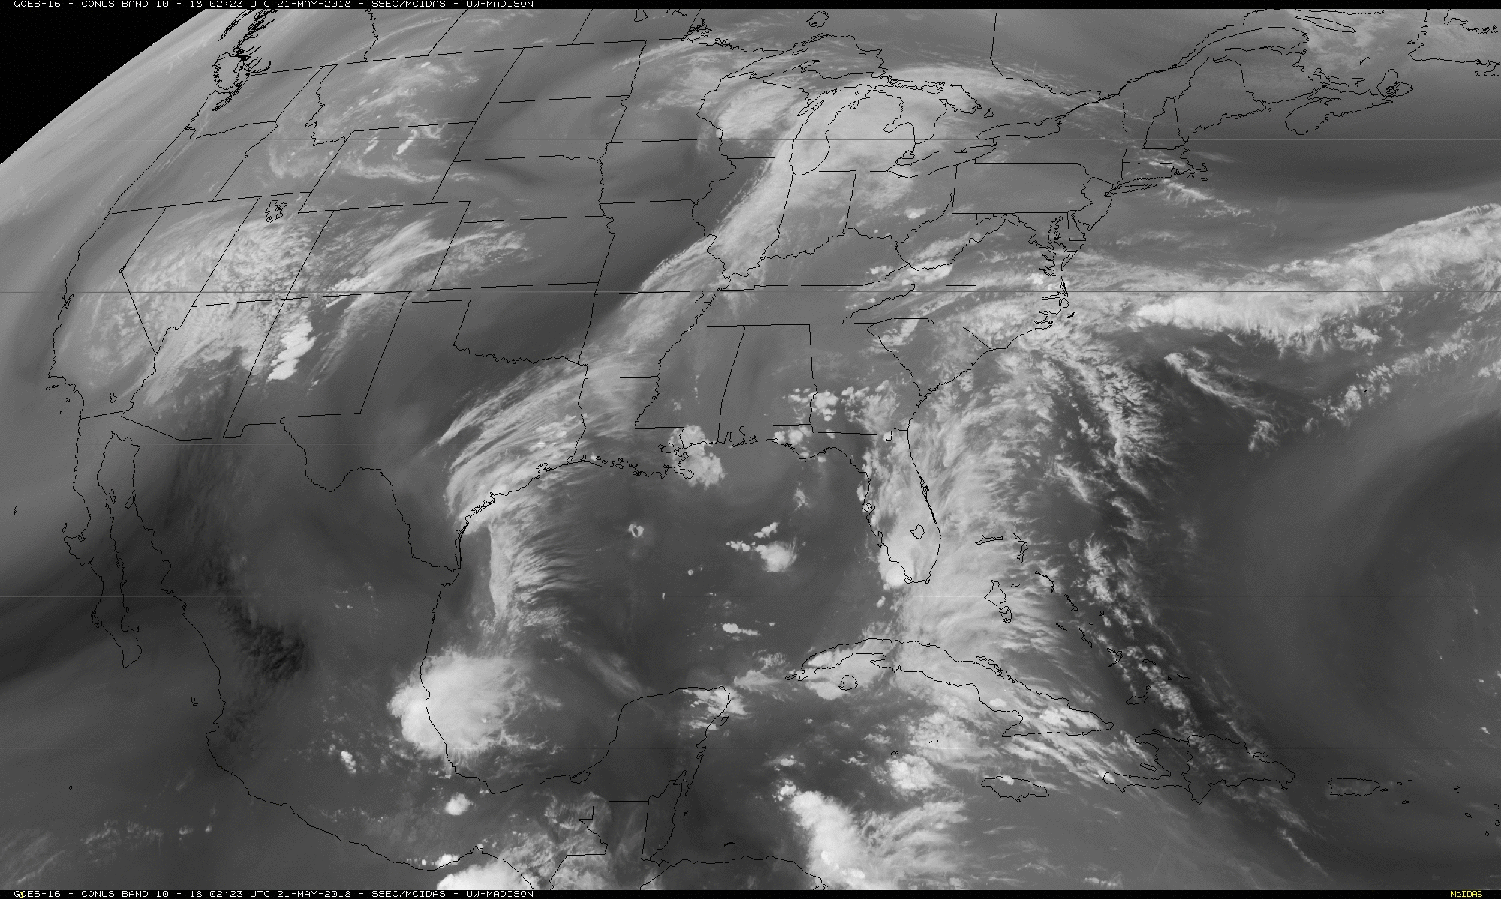
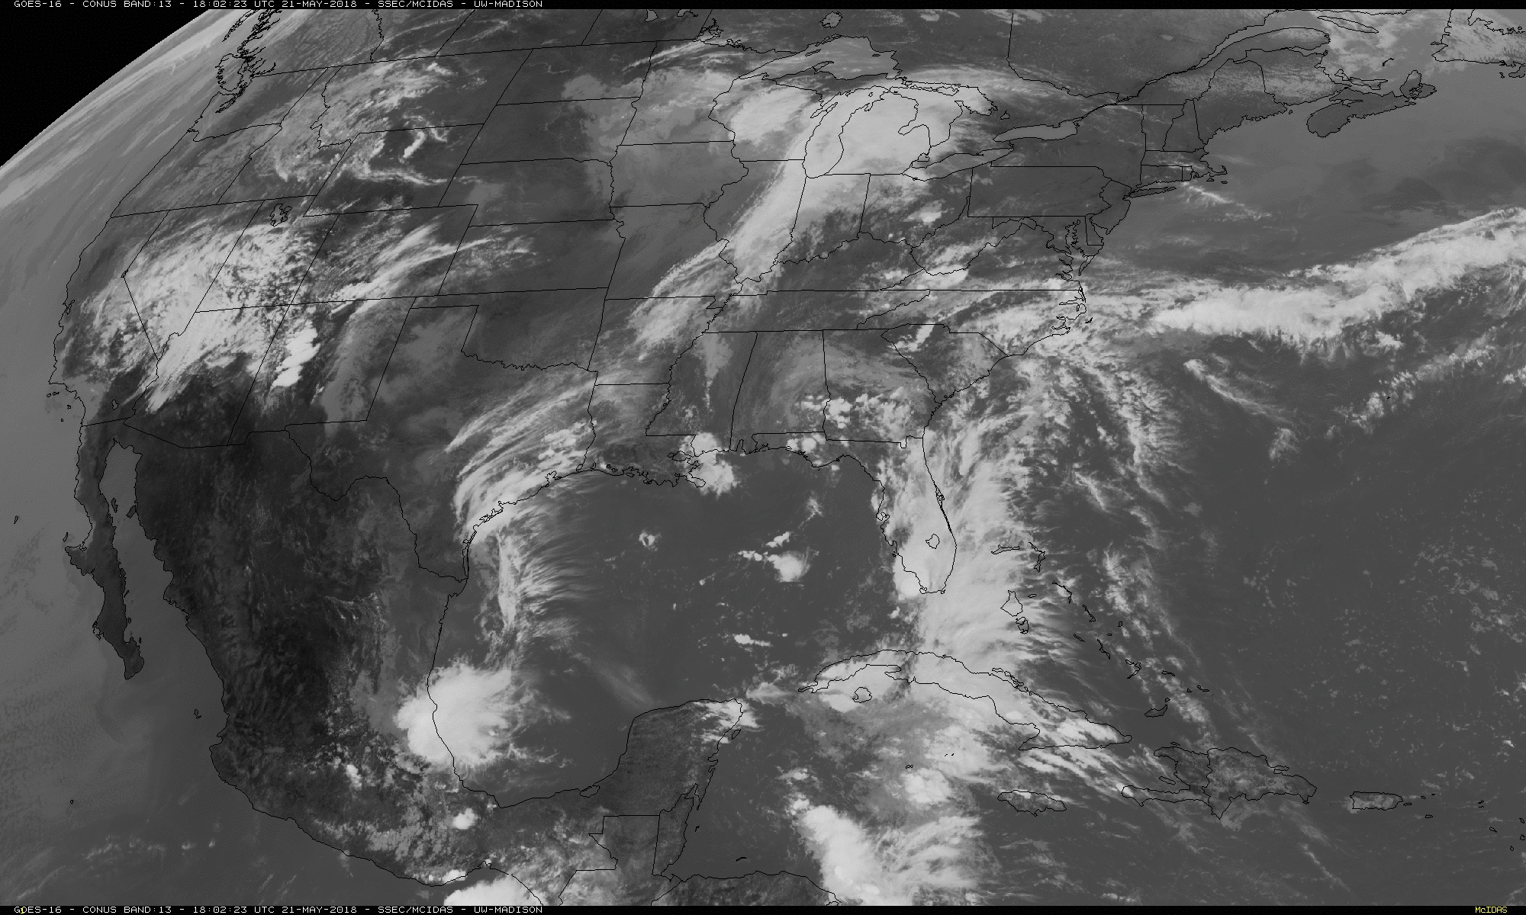
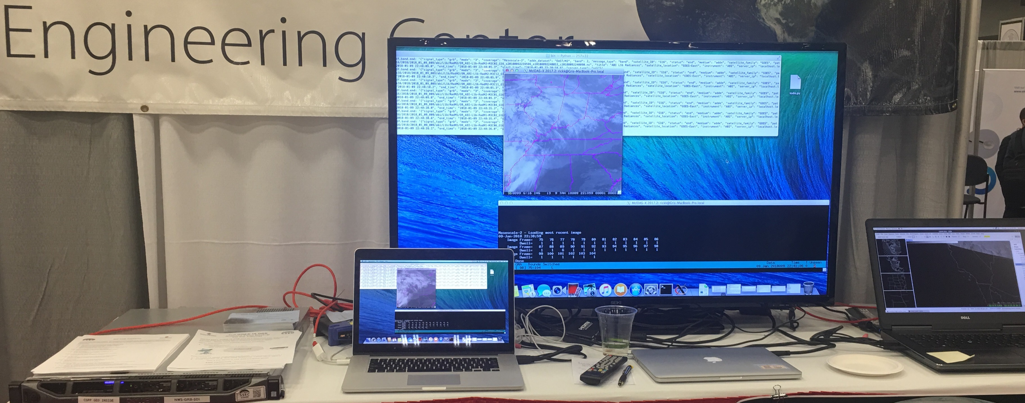
What do I get? (2 of 2)
GRB netCDF products available via SFTP or NFS or LDM
Application software logs available via SFTP
McIDAS ADDE access (optional)
AMQP Event Notifications via RabbitMQ serviceData availability notifications, no need to poll
16-channel ABI Level 1b netCDF files available via ADDE
GLM Level 2+ product available via ADDE
System configured and operationally tested at SSEC/CIMSS
Support for both local area and air-gapped networks
System installation / restore accomplished with USB stick

Slide 6
Summary
SDI GRB Appliance mission compliant software
SDI GRB Appliance provides suitable matched hardware.
SDI GRB Appliance provides standard data access.
SDI GRB Appliance provides ADDE access.
The SDI GRB Appliance Team thanks you for your attention.

