Slide 1
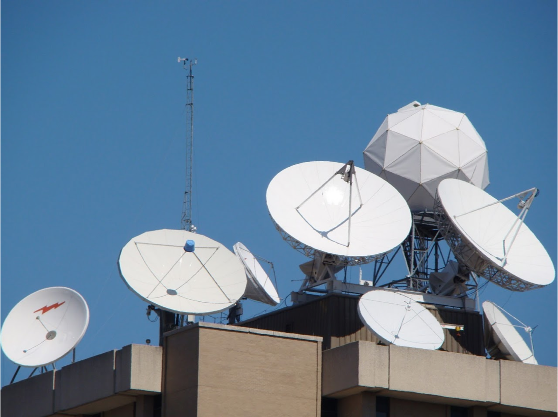
University of Wisconsin SSEC
Datacenter
Satellite Data Services
Jerrold Robaidek
Satellite Data Services Program Manager

Slide 2
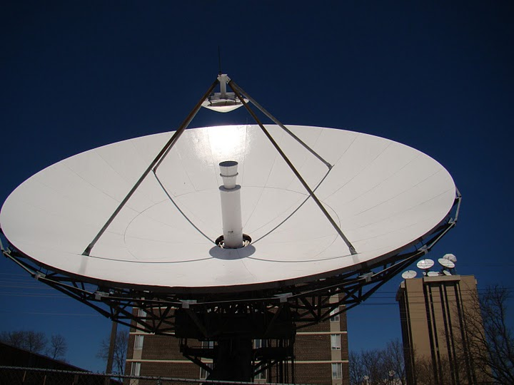
SSEC Satellite Data Services Update
SDS Status
SDS Projects

Slide 3
SSEC SDS
Staffed M-F , 7:30 AM - 11:00 pm Central time.
4 Student QC assistants/programmers (2nd shift)
2 FTE ~100% time
Computer Operator (1st shift)
Computer Operator (1st shift)
5 FTE ~portions of their time
Program Manager
System Programmer
DataBase/Web Programmer
Research Specialist (PM assistant)
Antenna/Communication technician

Slide 4
SSEC SDS
Staffed M-F , 7:30 AM - 11:00 pm Central time.
Ops, QC, Programing
Rosie Spangler, Douglas Ratcliff
QC, Ops, Inventory/Archive, Contracts
Nancy Troxel-Hoehn
Programmer, UI, DataBase
Clayton Suplinski
Programing, Product Generation, AMQP
Rick Kohrs
System Programing, Ingestors
Dan Forrest
Antennas
Istvan Bocsi

Slide 5
Data Center Facilities
Over 2100 ft.
The Data Center’s disk storage exceed 12-18 PBs.
The entire room is on four 72 KW UPSs, of which, about 200+ KW are in use. Non UPS power usage is ~17 KW. An additional 72 KW UPS for a smaller 5th floor computer room
Cooling provided by campus chilled water and outside air in the winter. Racks are cooled by 16 in row APC coolers.
Gigabit and 10 Gigabit network (also 100 MB admin network, 40 Gigabit InfiniBand).

Slide 6
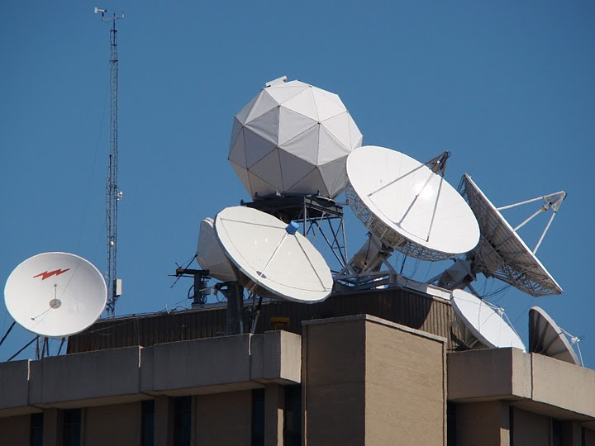
Antennas @ SSEC
C-Band
11 meter heated (87° West – SES-2, POES Wallops Relay, MSG)
6.3 meter heated (101° West – SES-1, POES Fairbanks Relay)
4.5 meter (101° West – SES-1, Noaaport)
3.7 meter GEONETcast (58º West INTELSAT 21)
L-Band
7.3 meter (75° West –GOES-East Primary/GOES-16)
7.3 meter (89.5° West –GOES-West Primary/GOES-17)
4.6 meter (135° West –GOES-West Primary)
4.5 meter (135° West –GOES-East auto tracking)
X-Band
4.4 meter (Tracking – EOS)
X/L Band
2.4 meter (Tracking – Suomi NPP, EOS, Metop A&B, NOAA-18, 19 and FY3)

Slide 7
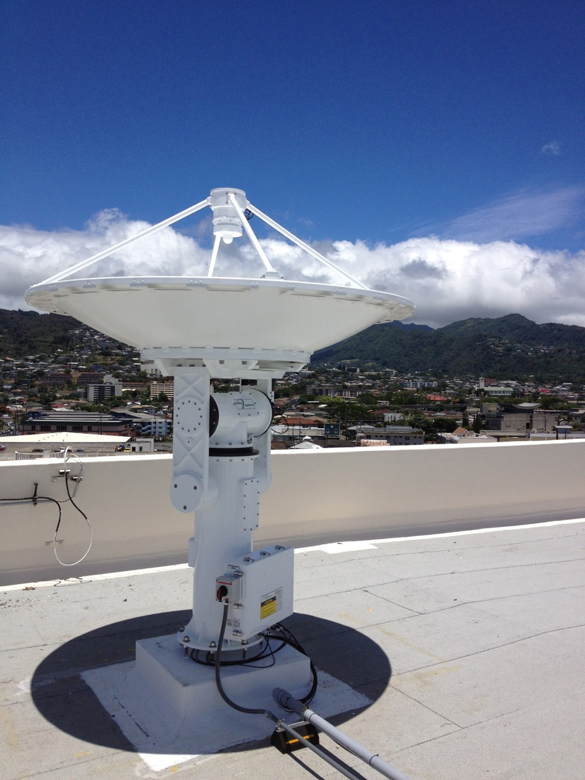
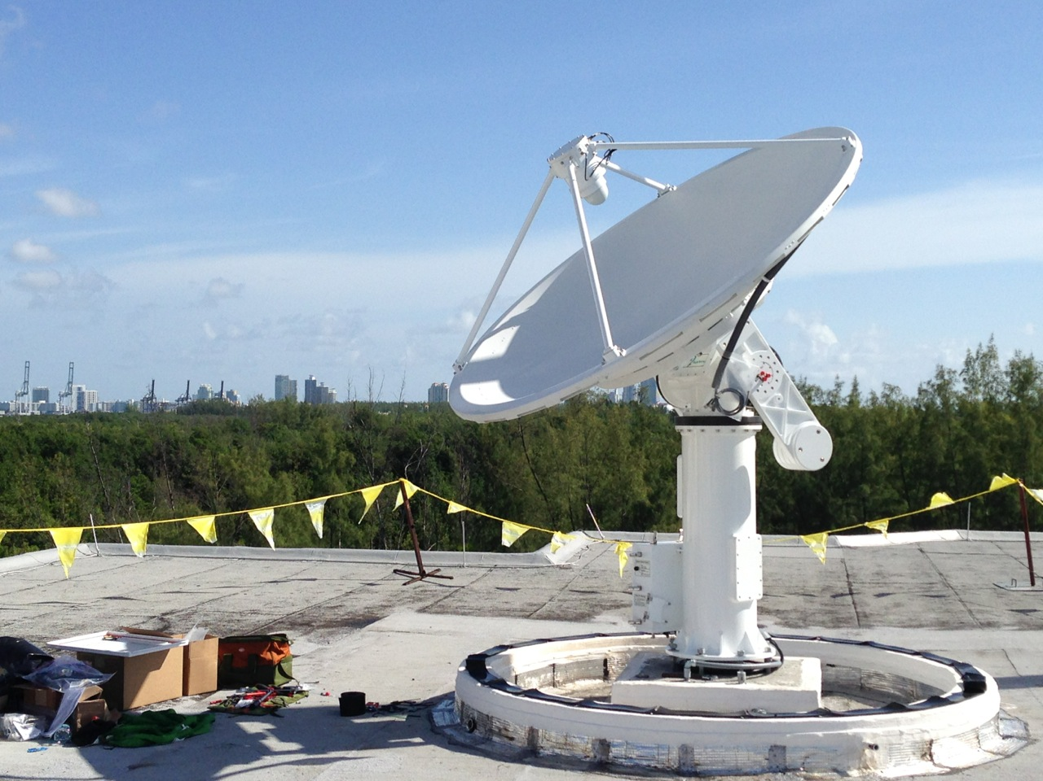
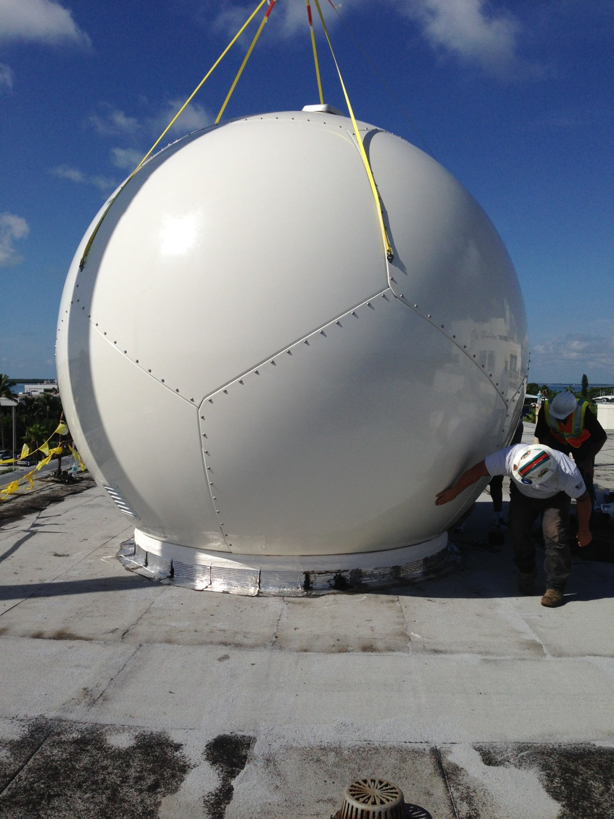
UW SSEC SDS Antennas Remotely Managed
X/L Band
Honolulu Community College
Atlantic Oceanographic & Met Lab , Miami, FL
University of Puerto Rico
Guam
All are 2.4 m used for Tracking – Aqua, Terra, Suomi NPP, EOS, Metop A&B, NOAA-18, 19, NOAA-20 and FY3
Supports
NOAA NWS NCEP
Eumetcast
GTS

Slide 8
Data Distribution
Realtime
McIDAS ADDE (Abstract Data Distribution Environment)
ftp
http
Ldm
Direct access via mount
WMS (Web map service)
Archive
ADDE
Direct Access (in-house only)
WMS (experimental)
McFETCH
THREDDS

Slide 9
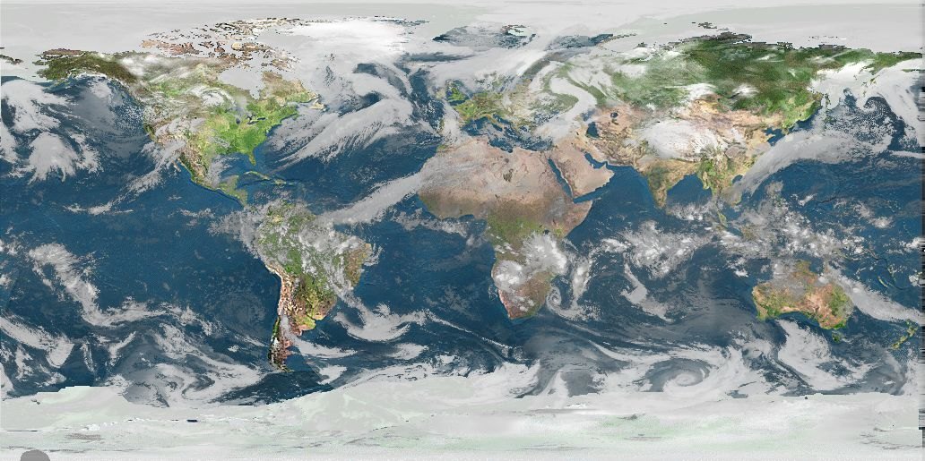
Real-time Data
The SSEC Data Center receives data from 9-12 different geostationary satellites and 12 different polar orbiting satellites. Most data are available in near real-time via ADDE. Other methods of data access are available upon request.

Slide 10
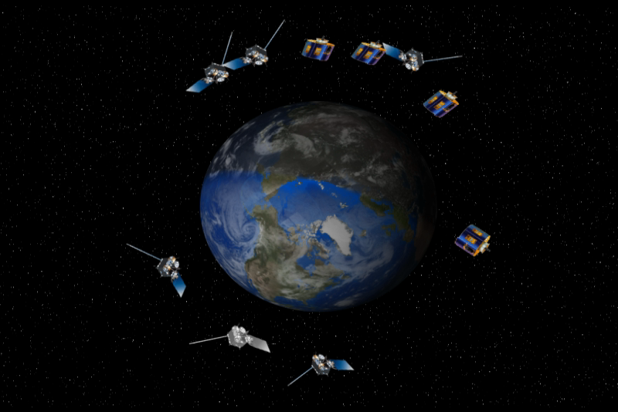
Geostationary Satellites received
GOES-16 -East (75.2°W)
GOES-15 -West(135°W)
GOES-14 -Test (105°W) (not currently sending)
GOES-17 -Test (89.5°W)
Meteosat-11 (0ºE)
Meteosat-8 (near 41.5°E)
COMS (128ºE)
FY-2E (86°E)
FY-2G (105° E)
Himawari-8 (140° E)
Kalpana(74° E)
INSAT-3D(83° E)

Slide 11
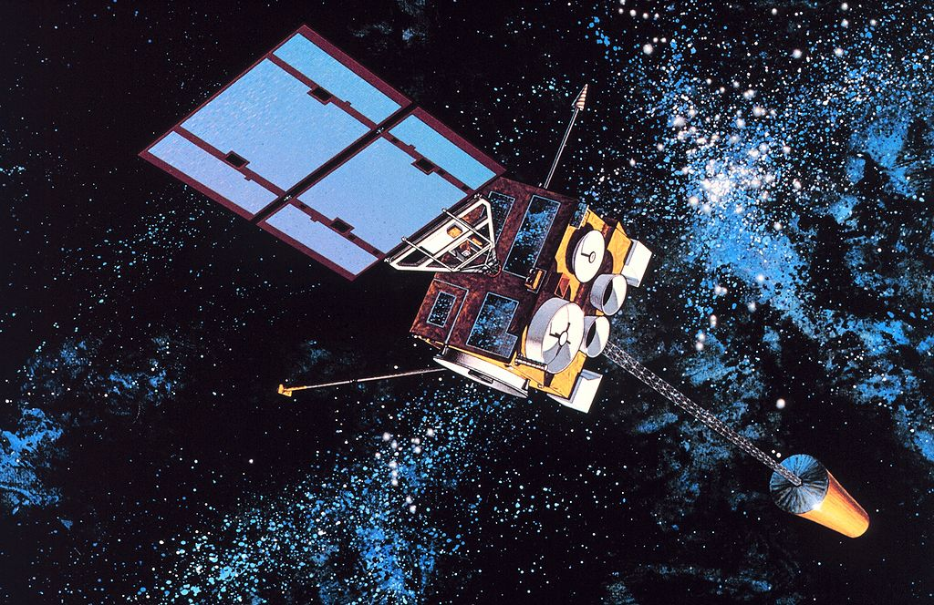
Geostationary Satellites Received at UW SSEC in 2016
 | Sub-Point | Reception Method | Source | Latency | Daily Volume
GOES-16 | 75.2° West | L-Band | DB | <10 seconds | 130-400 GB
GOES-14 | 105° West | L-Band | DB | <2 minutes | 23 GB
GOES-15 | 135° West | L-Band | DB | <2 minutes | 23 GB
GOES-17 | 89.5ºWest | L-Band | DB | <10 seconds via DB | 130-400 GB
Meteosat-11 | 0° East | C-Band Relay | DB Relay | <15 minutes | 24 GB
Meteosat-8 | 41.5° East | Network Relay | NOAA STAR | ~30 minutes | 24 GB
Himawari-8 | 140° East | Network Relay | NOAA STAR | ~ 10 minutes | 300 GB
Himawari-8 | 140° East | Himawari Cast Network Relay | Hawaii NWS | ~ 10 minutes | 62 GB
Kalpana | 74° East | Network Relay | ISRO | 45-120 minutes | 1.4 GB
Insat-3D | 83° East | Network Relay | ISRO | 45-180 min | 19 GB
FY2E | 86° East | Network Relay | ABOM | 15-30 minutes | 4.7 GB
FY2G | 105° East | Network Relay | ABOM | 15-30 minutes | 4.7 GB
COMS | 128° East | Network Relay | KMA | 9-24 minutes | 11 GB

Slide 12
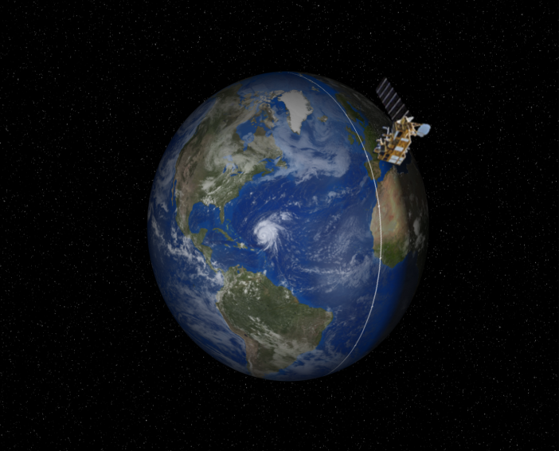
Polar Satellites received
NOAA-15
NOAA-18
NOAA-19
NOAA-20 (JPSS-1)
METOP-A
METOP-B
Aqua
Terra
Suomi-NPP
Landsat-8 (RE only)
FY-3B
FY-3C
GCOM-W1
12

Slide 13
Polar Satellites Received at UW SSEC in 2018
 | Reception Method | Domain | ADDE Latency | Instruments | Access
NOAA-15 | C-Band relay, NOAA-STAR | DB CONUS Global | DB <1 minutes after pass | AVHRR, AMSU, DCS->level-1 | ADDE
 |  |  |  | All other instruments Level-0 | NA
NOAA-18 | DB L-Band, C-Band relay, NOAA STAR | DB CONUS Global | DB <1 minutes after pass | AVHRR->level-1 | ADDE
 |  |  |  | All other instruments Level-0 | NA
NOAA-19 | DB L-Band, C-Band relay, NOAA STAR | DB CONUS Global | DB <1 minutes after pass | AVHRR->level-1 | ADDE
 |  |  |  | All other instruments Level-0 | NA
NOAA-20 | DB XL-Band, NOAA STAR, CLASS | DB CONUS Global | DB <1 minutes after pass | VIIRS>level-1 | ADDE
 |  |  |  | VIIRS,ATMS, CrIS | DB ftp (sips)
Metop-A | DB L-Band, NOAA STAR Relay | DB CONUS Global | CONUS <15 minutes after pass | AVHRR ->level-1 | ADDE
 |  |  |  | AVHRR, IASI | DB ftp (sips)
Metop-B | DB L-Band, NOAA STAR Relay | DB CONUS Global | CONUS <15 minutes after pass | AVHRR ->level-1 | ADDE
 |  |  |  | AVHRR,IASI | DB ftp (sips)
Suomi-NPP | DB X/L Band, NOAA STAR, CLASS | DB CONUS Global | CONUS <15 minutes after pass | VIIRS | ADDE
 |  |  |  | VIIRS,ATMS, CrIS | DB ftp (sips)
Aqua | DB X-Band, NASA Relay | DB CONUS Global | DB <15 minutes after pass | AIRS, MODIS -> Level-1 | ADDE
 |  |  |  | AIRS, MODIS | DB ftp (sips)
Terra | DB X-Band, NASA Relay | DB CONUS Global | DB <15 minutes after pass | MODIS -> Level-1 | ADDE
 |  |  |  | MODIS | DB ftp (sips)
Landsat-8 | Network Relay (USGS) | CONUS | <24 hours | Level-1 | ADDE, WMS
Shizuku GCOM-W1 | DB X-Band | CONUS | DB <1 min after pass | Level-0 | SSEC ftp
FY-3B/C | DB X/L Band | CONUS | DB <1 min after pass | Level-0 | SSEC ftp

Slide 14
Non-Satellite data
NOAAport
Text/Point
Model Grids
Radar

Slide 15
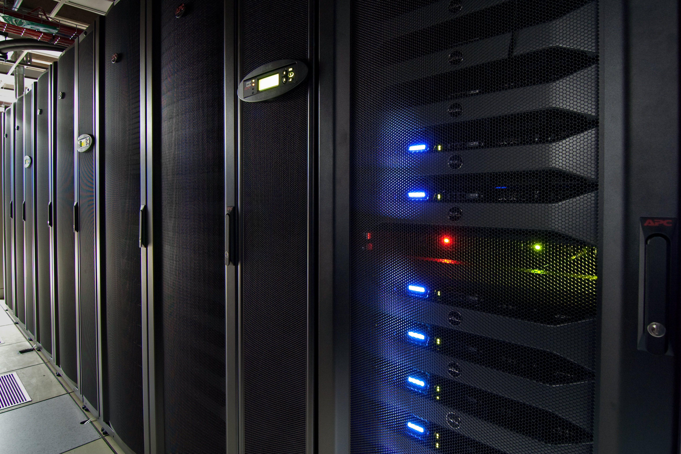
Archive Data
As of May 2018, over 1,400 TBs online.
Grows approximately about ~350+ TB/year
US Geostationary Satellites
GOES-8 through GOES-17 (1994-Present) (East, West , South America and test)
GOES-1 through GOES-7 (1978-1996)
SMS-1&2 (1978-1981)

Slide 16
Archive Data
International Geostationary Satellites
GMS/MTSAT (1998-2015)
Meteosat/Meteosat IODC (1998-Present)
Meteosat-1 FGGE (1978-1979)
FY2 (2004-Present)
Kalpana (2005-2017)
Insat-3D (June 2014-2017)
COMS (June 2012 – Present)
Himawari-8 (March 2015 – Present)

Slide 17
Archive Data
NOAAPORT/Conventional Data
Model Output (1996-Present)*
In situ Point Observations (1976-Present)

Slide 18
Other SDS Projects

Slide 19
McFETCH Satellite Data Server
Dave Parker, Dave Santek, Bill Bellon, Clayton Suplinski, Rick Kohrs, Jerry Robaidek

Slide 20
McFETCH Satellite Data Server
Multi-format client-agnostic File Extraction Through Contextual HTTP
Allows access to ADDE archive servers
Heavily dependent on McIDAS-X
Outputs all formats McIDAS-X can plus others

Slide 21
McFETCH Satellite Data Server
Output formats:
AREA | Flat Binary
NetCDF | Gif
Geotiff | JPEG
Flat text | PNG

Slide 22
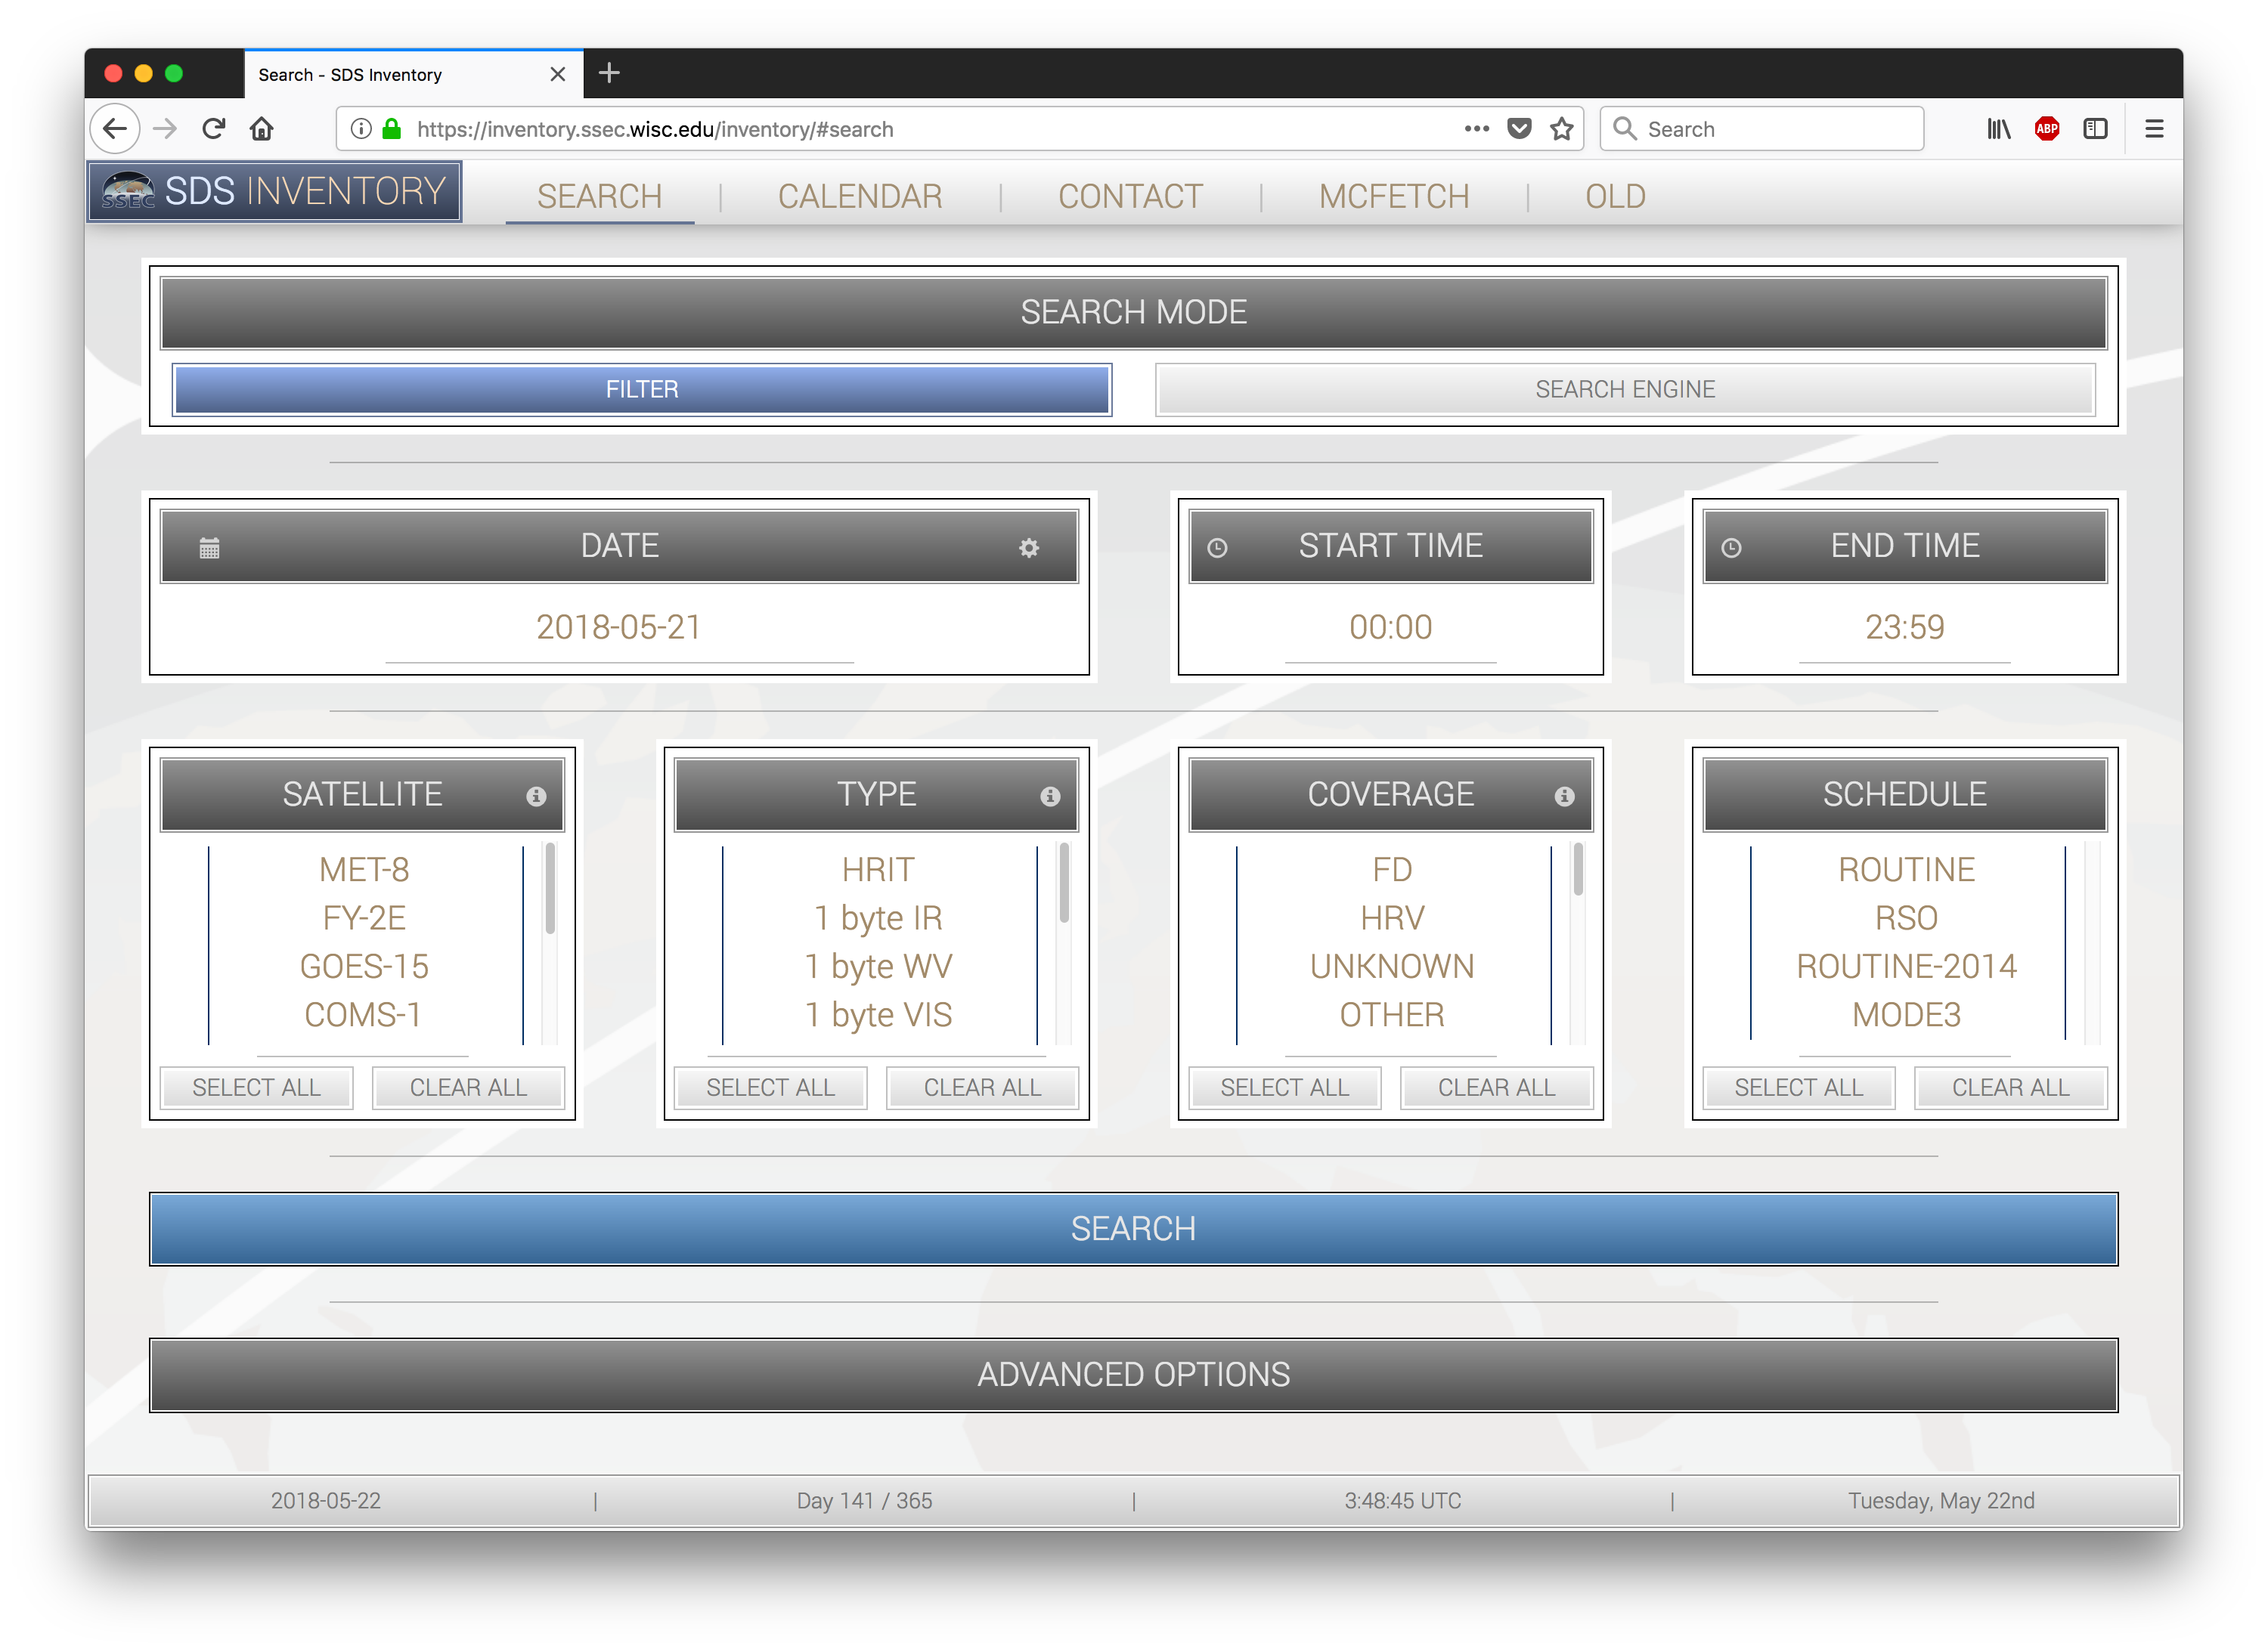
McFETCH Satellite Data Server
Access via HTTPS
Any client that can request a URL, can access, subset, and remap satellite data from an ADDE server
Integrated with inventory

Slide 23
McFETCH Satellite Data Server
Must register for a unique data key
1 GB daily limit
1000 transaction per day daily limit
Data must be 180 days or older (30 Days or older for Unidata Community)

Slide 24
McFETCH Satellite Data Server

Slide 25
McFETCH Satellite Data Server

Slide 26
McFETCH Satellite Data Server

Slide 27
McFETCH Satellite Data Server

Slide 28
McFETCH Satellite Data Server

Slide 29
McFETCH Satellite Data Server

Slide 30
McFETCH Satellite Data Server

Slide 31
McFETCH Web Interface

Slide 32
McFETCH Users
As of May 21, 2018
276 Users
29 users in last 30 days
52,750 transactions in last 30 days

Slide 33
McFETCH Satellite Data Server
Upcoming updates (summer 2018)
Improved performance for archive requests
Original “archived” format data output

Slide 34
McFETCH Satellite Data Server
To get a data access key:
Go to https://mcfetch.ssec.wisc.edu

Slide 35
McIDAS in Python
Uses code developed by Kevin Hallock and Jon Beavers
New McIDAS scripts in Python
Available in McIDAS 2017.1 XRD

Slide 36
AMQP RabbitMQ
AMQP -> Advanced Message Queuing Protocol
RabbitMQ
amqpfind
Himawari
GOES-16/17
Expand to other GEOs and Polar

Slide 37
GRB Fanout server
Developed by Dan Forrest

Slide 38
GRB Fanout Server
The Problem:
Quorum Demodulator
Single UDP stream
Multicast broadcast
Multiple Ingestors needed GRB stream
Not all Co-located
Multicast through router data loss
Development planned in 2015
Only SDS/Datacenter funds were used for this.
Quorum GRB-200 Demodulator

Slide 39
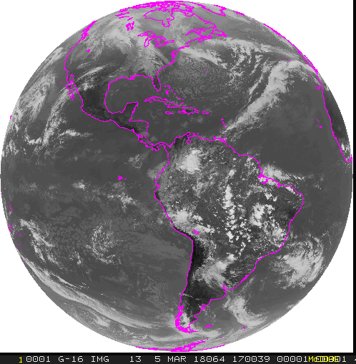
GRB Fanout Server
TCP/IP
Remote CSPP
ingestor
GRB
GRB-200 Demodulator
UDP
Fanout
server
Network
switch/router
internet
31 Mbps
Unidata in Boulder
31 Mbps
31 Mbps
n X 31 Mbps
2 x 31 Mbps
31 Mbps
AWS Cloud
31 Mbps
31 Mbps
31 Mbps
Remote CSPP
ingestor
UW SSEC
CSPPGEO
UW SSEC
SDI appliance
UW SSEC
inge

Slide 40
Fanout server hardware specs
Dell PE R430
Single Intel Xeon 2.4GHz 6 core processor
8GB RAM
2TB disk (2 x 200GB & 1 x 1.6TB)
$3,600 USD

Slide 41
GRB Fanout Server
Compatible with CSPP-GEO, SDI GRB Appliance
Still in “ALPHA”
Need additional resources to move to mature distribution

Slide 42
GRB Fanout switching
Sometimes you need to switch to a different fanout server due to:
Swapping Antennas
Swapping demodulators
Antenna down time (planned or unplanned)
Local RFI (E.g. Solar RFI)

Slide 43
GRB Mixer
Developed by Dan Forrest

Slide 44
GRB Mixer
Allows mixing of 1 or more fanout feeds …. automatically
Mix feeds at the “CADU” level
Great solution for local Radio Frequency Interference mitigation

Slide 45
GRB Fanout Server with Mixer
TCP/IP
Remote CSPP
ingestor
GRB
GRB-200 Demodulator
UDP
Fanout
server
Network
switch/router
internet
31 Mbps
Unidata in Boulder
31 Mbps
31 Mbps
n X 31 Mbps
2 x 31 Mbps
31 Mbps
AWS Cloud
31 Mbps
31 Mbps
31 Mbps
Remote CSPP
ingestor
UW SSEC
CSPPGEO
UW SSEC
SDI appliance
UW SSEC
inge

Slide 46
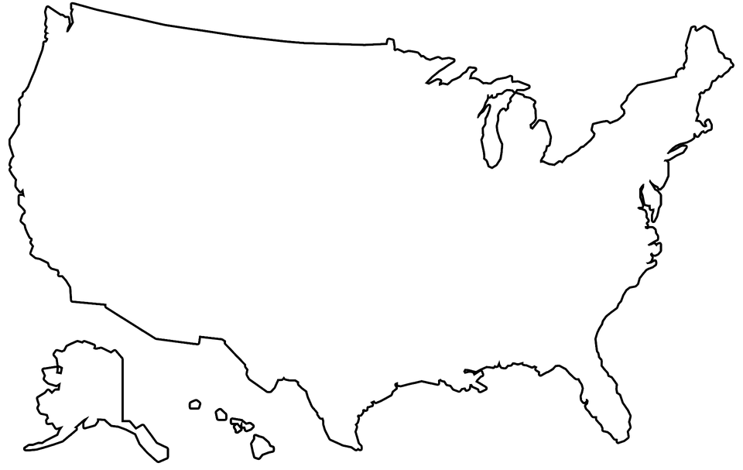
Fanout and Mixer in the Cloud
Fanout/mixer
server
Fanout/mixer
server
Fanout/mixer
server
GRB-200 Demodulator
Fanout/mixer
server
AWS Cloud
Fanout/mixer
server
Network
switch/router
Fanout & Mixer
server
CSPP
CSPP
UW SSEC
CSPPGEO
UW SSEC
SDI appliance
UW SSEC
inge
Fanout/mixer
server

Slide 47
GRB Mixer
Great for RFI!
Some RFI Sources
Solar (annually near equinox)
Local terrestrial … Powerlines, stray RF
Lightning

Slide 48
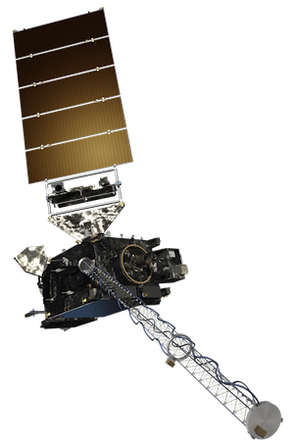
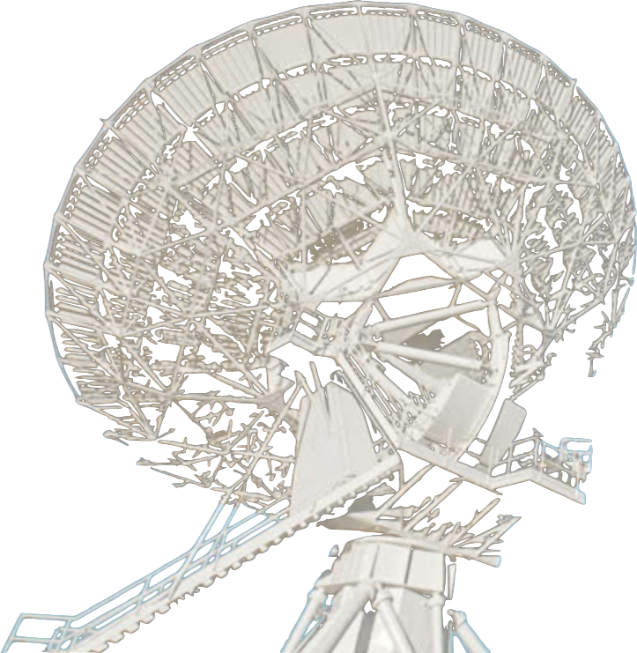

Slide 49
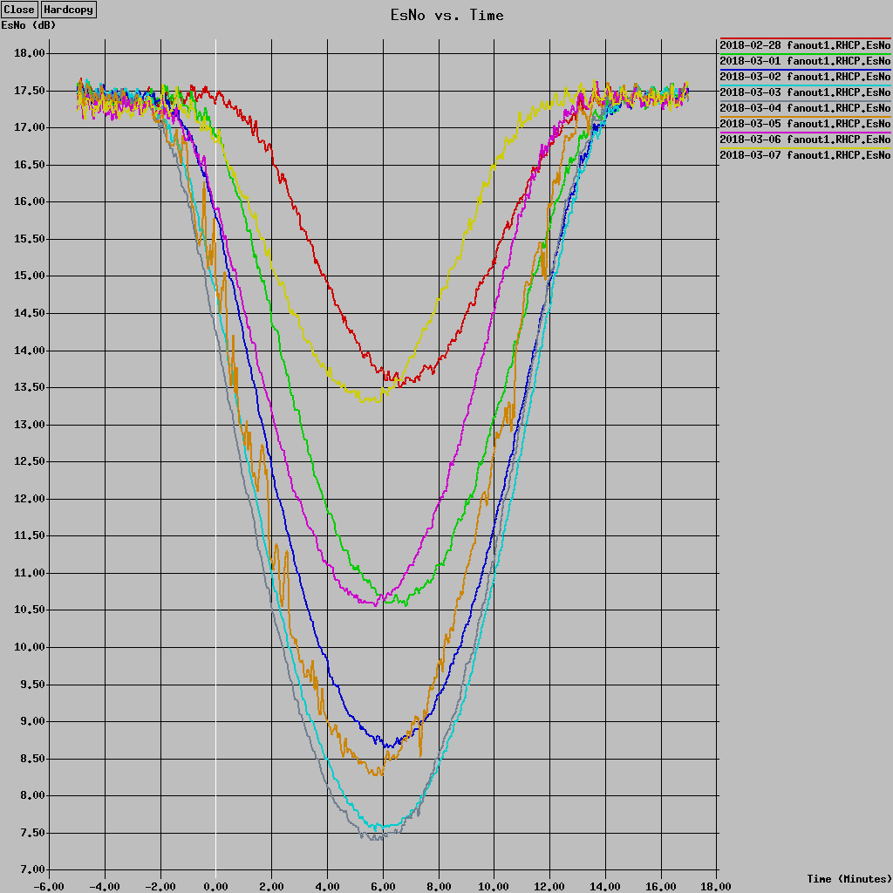
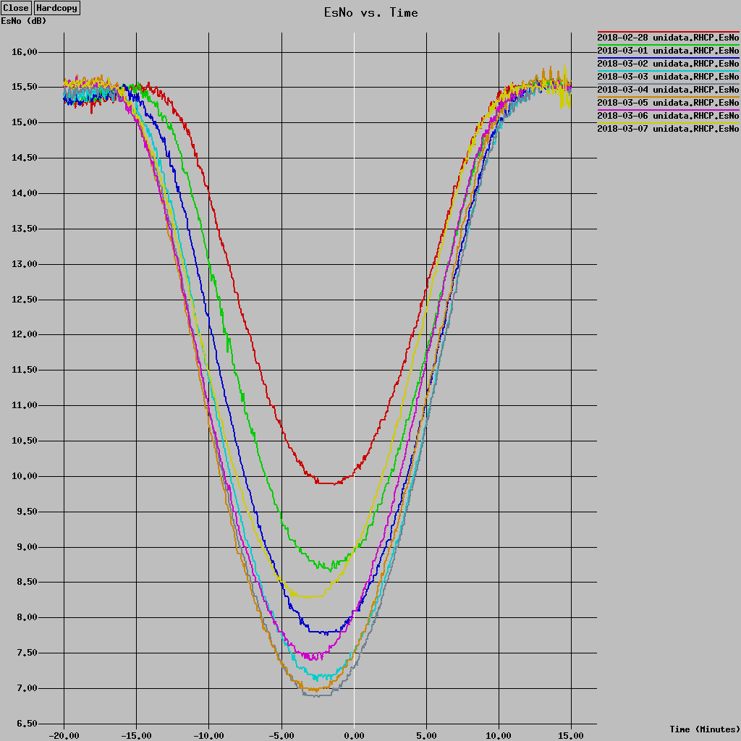
Solar RFI Graphs

Slide 50
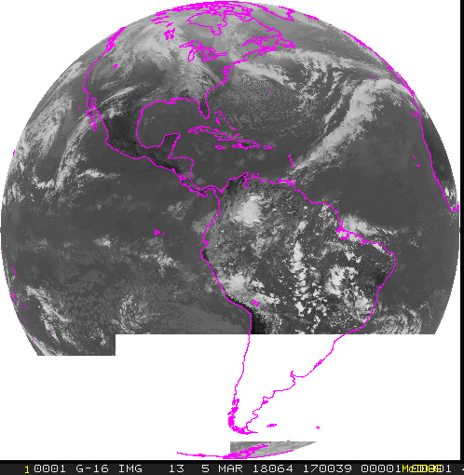
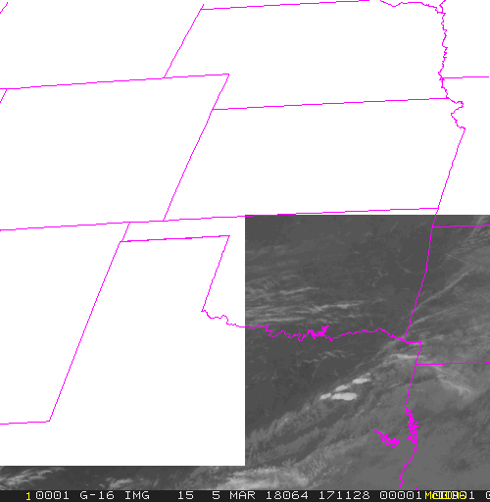
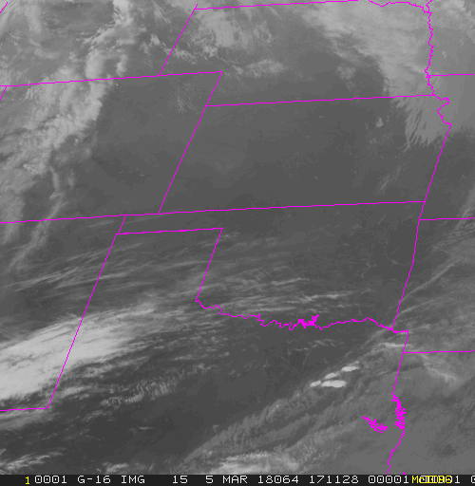
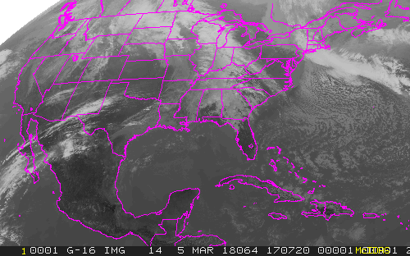
Solar RFI at PDA ground station March 5, 2018
03/05/2018 17:06:38 - 17:15:57 UTC
Affected 7 Meso-scale sectors
5 entire images lost
2 partial images
Affected 1 Full Disk
8 Channels partial loss
8 channels No loss
Affected 1 CONUS (all 16 channels lost)
PDA
SSEC

Slide 51
SSEC

Slide 52
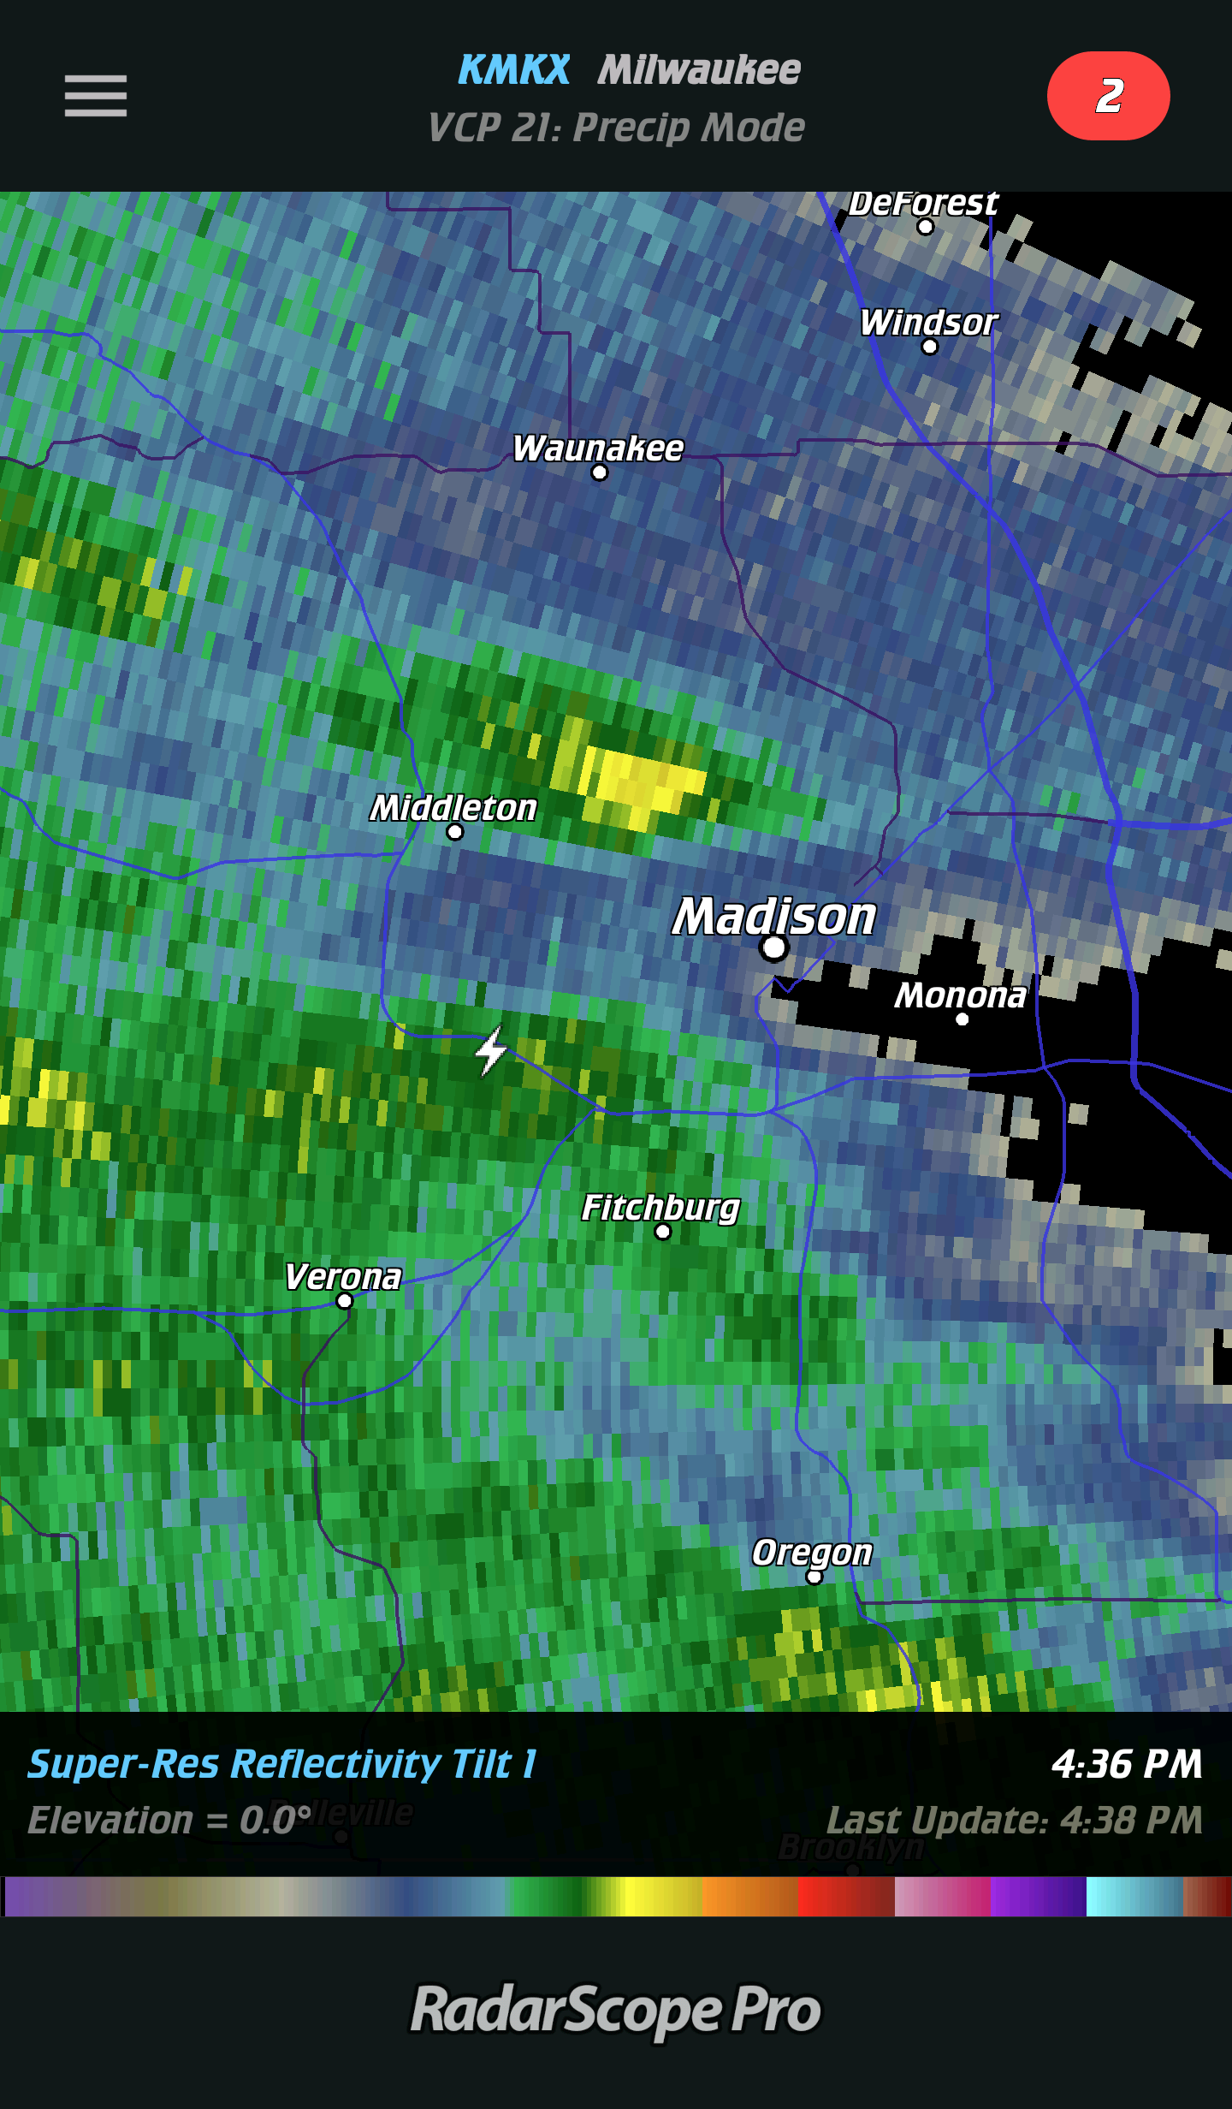
RFI due to Lightning
Lightning Flash
4.3 Miles away
SSEC Antenna
Location
Lightning Flash occurred at 22:36:36Z on March 5, 2018

Slide 53
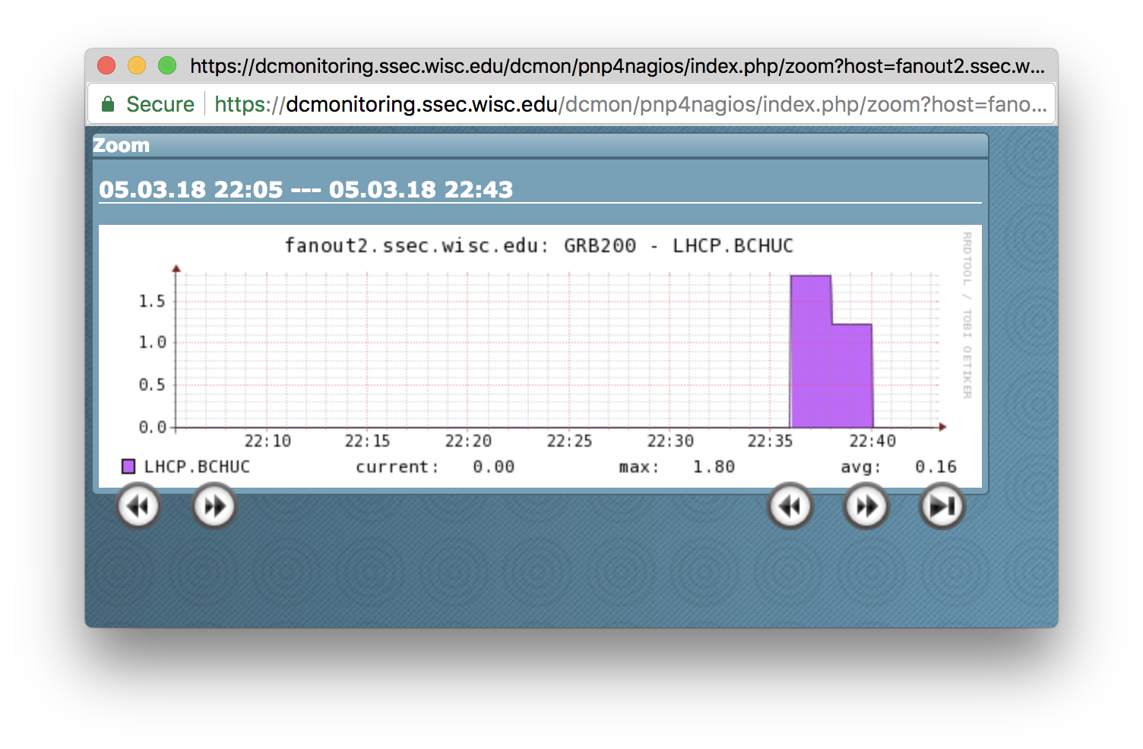
BCH* UnCorrectable
*Bose–Chaudhuri–Hocquenghem

Slide 54
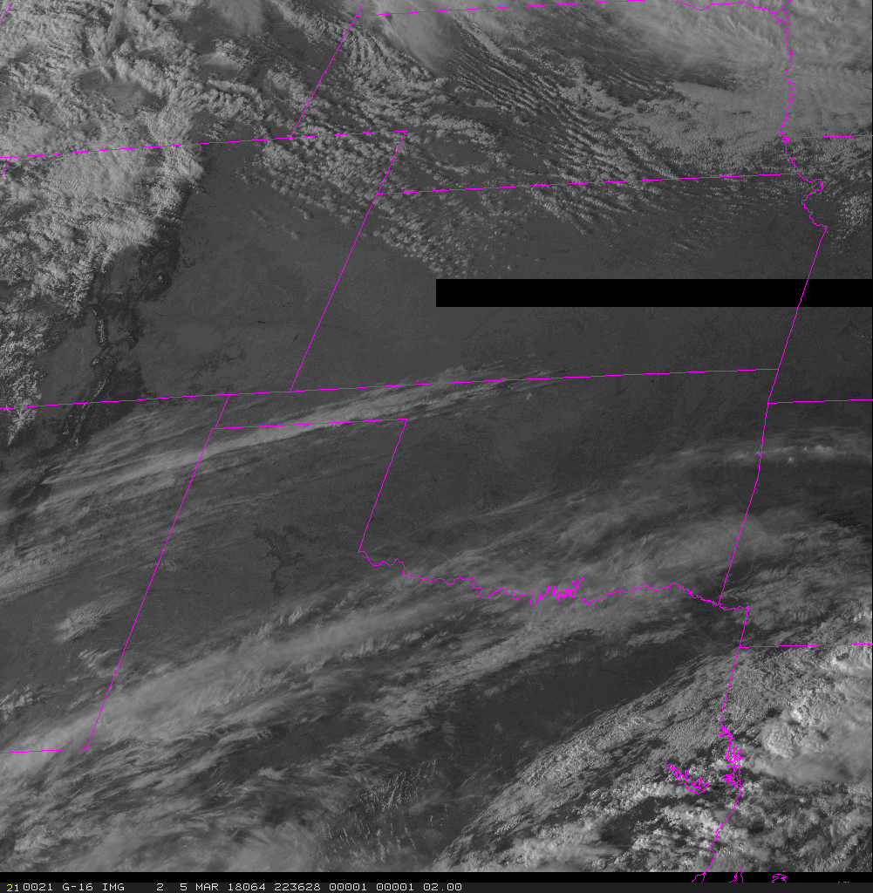
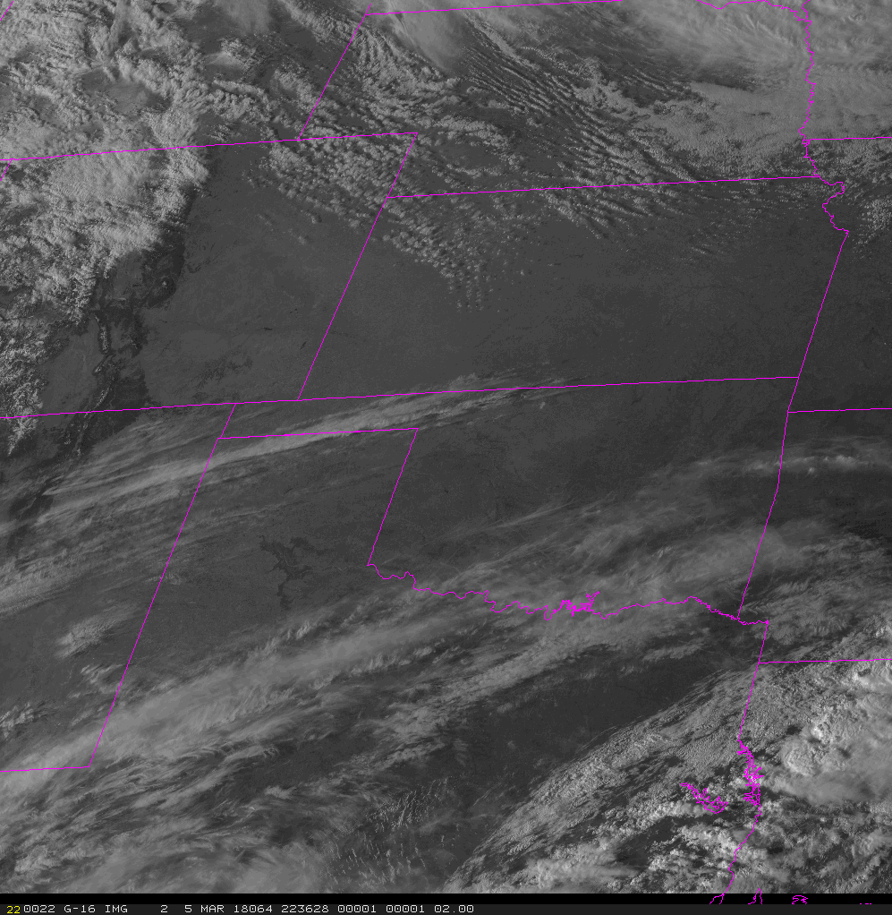
RFI Due to Lightning

Slide 55
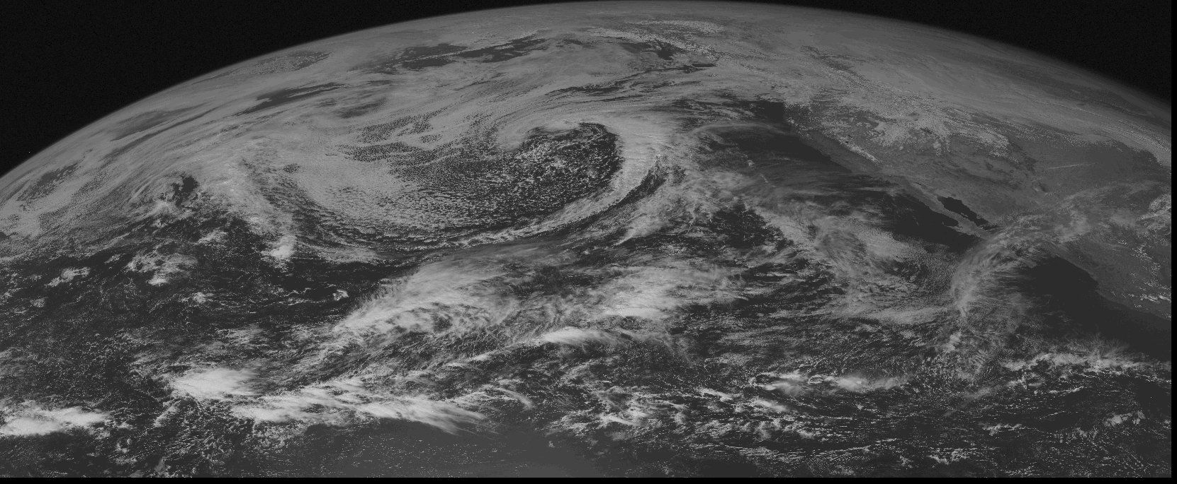
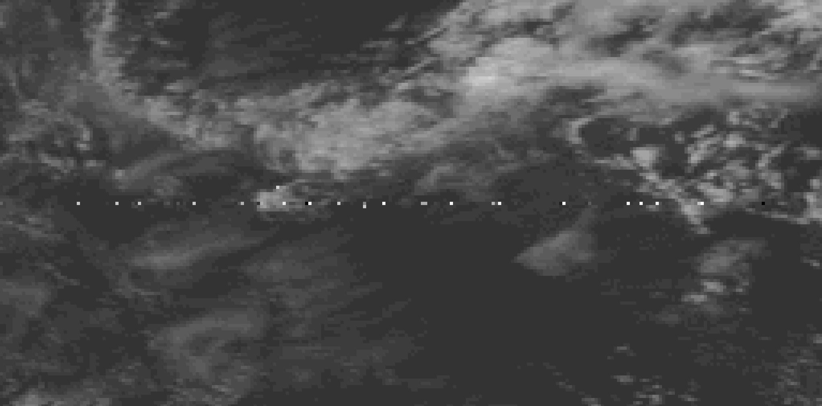
What about GVAR?

Slide 56
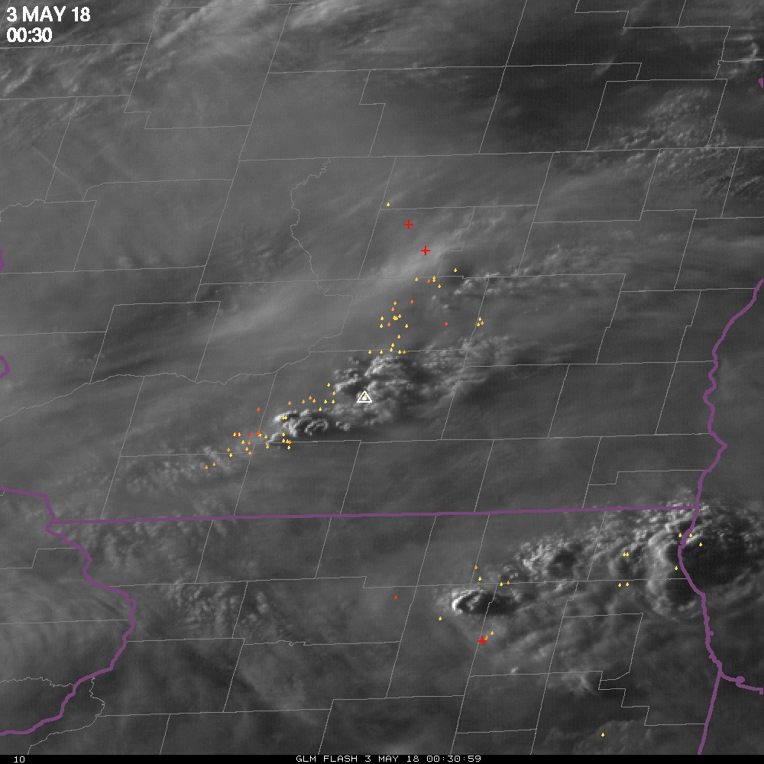
RFI due to Lightning (May 3, 2018 00:37 UTC)
SSEC Antenna
Location
Lightning event at 00:35 - 00:40Z on May 3, 2018

Slide 57
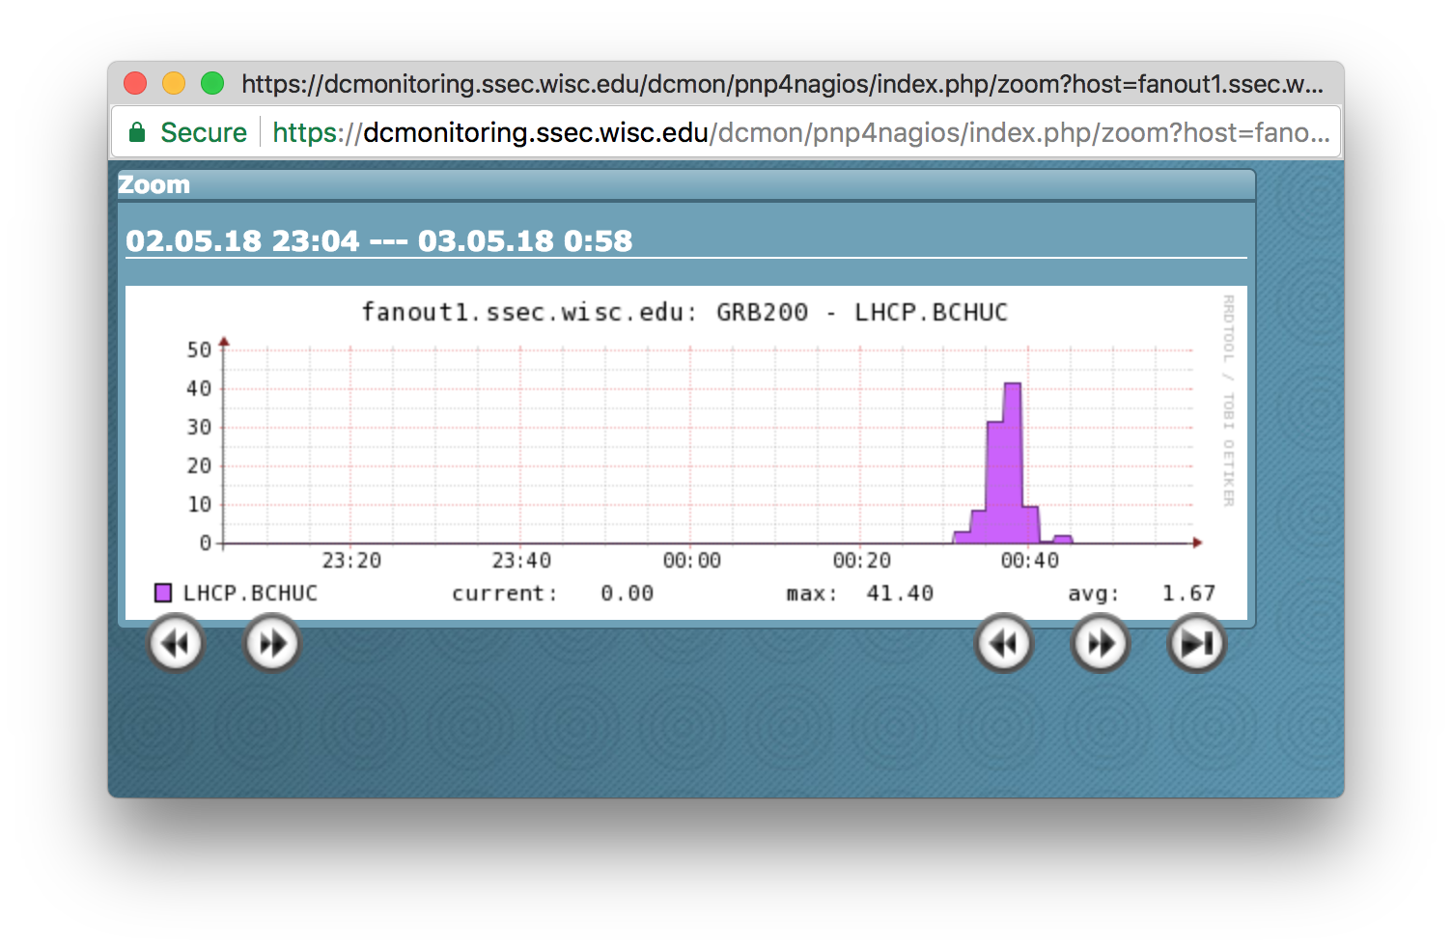
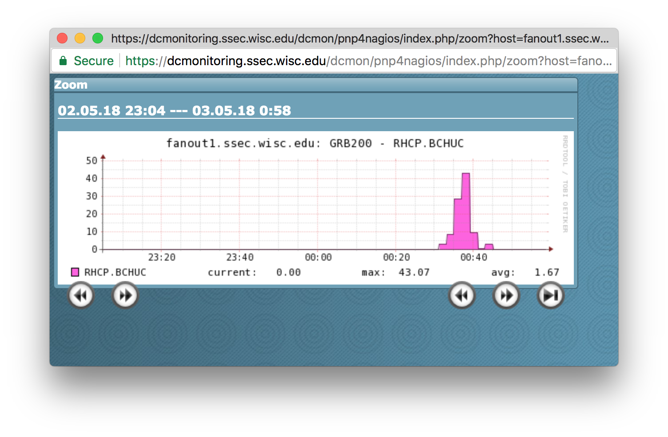
BCH* UnCorrectable
Left Hand Circular Polarized (LHCP)
Right Hand Circular Polarized (RHCP)
*Bose–Chaudhuri–Hocquenghem

Slide 58
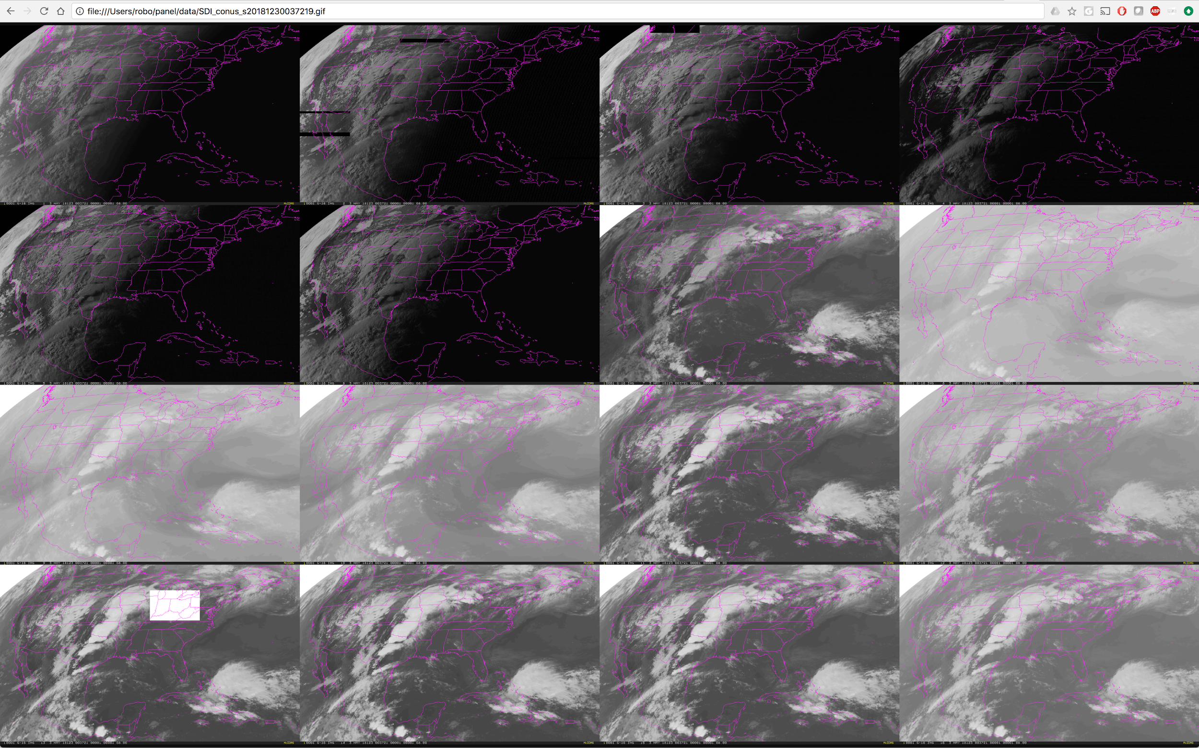
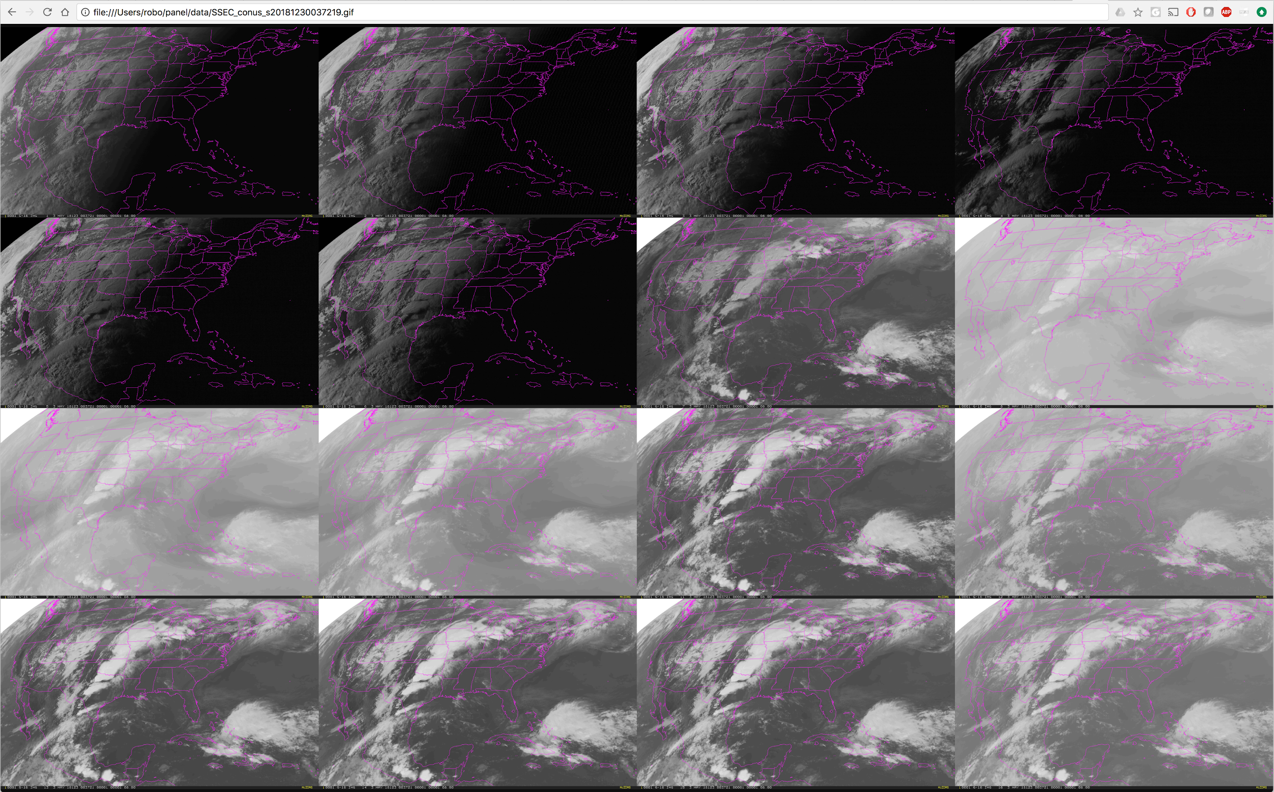
RFI Due to Lightning
CONUS
May 3, 2018
00:37:22 UTC
2 Antennas through Mixer
Antenna Only

Slide 59
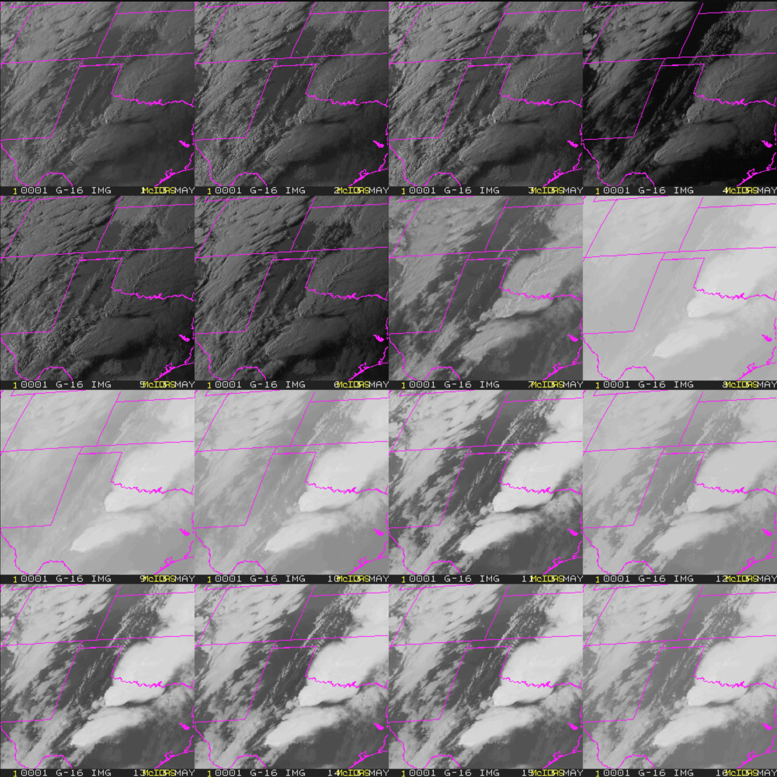
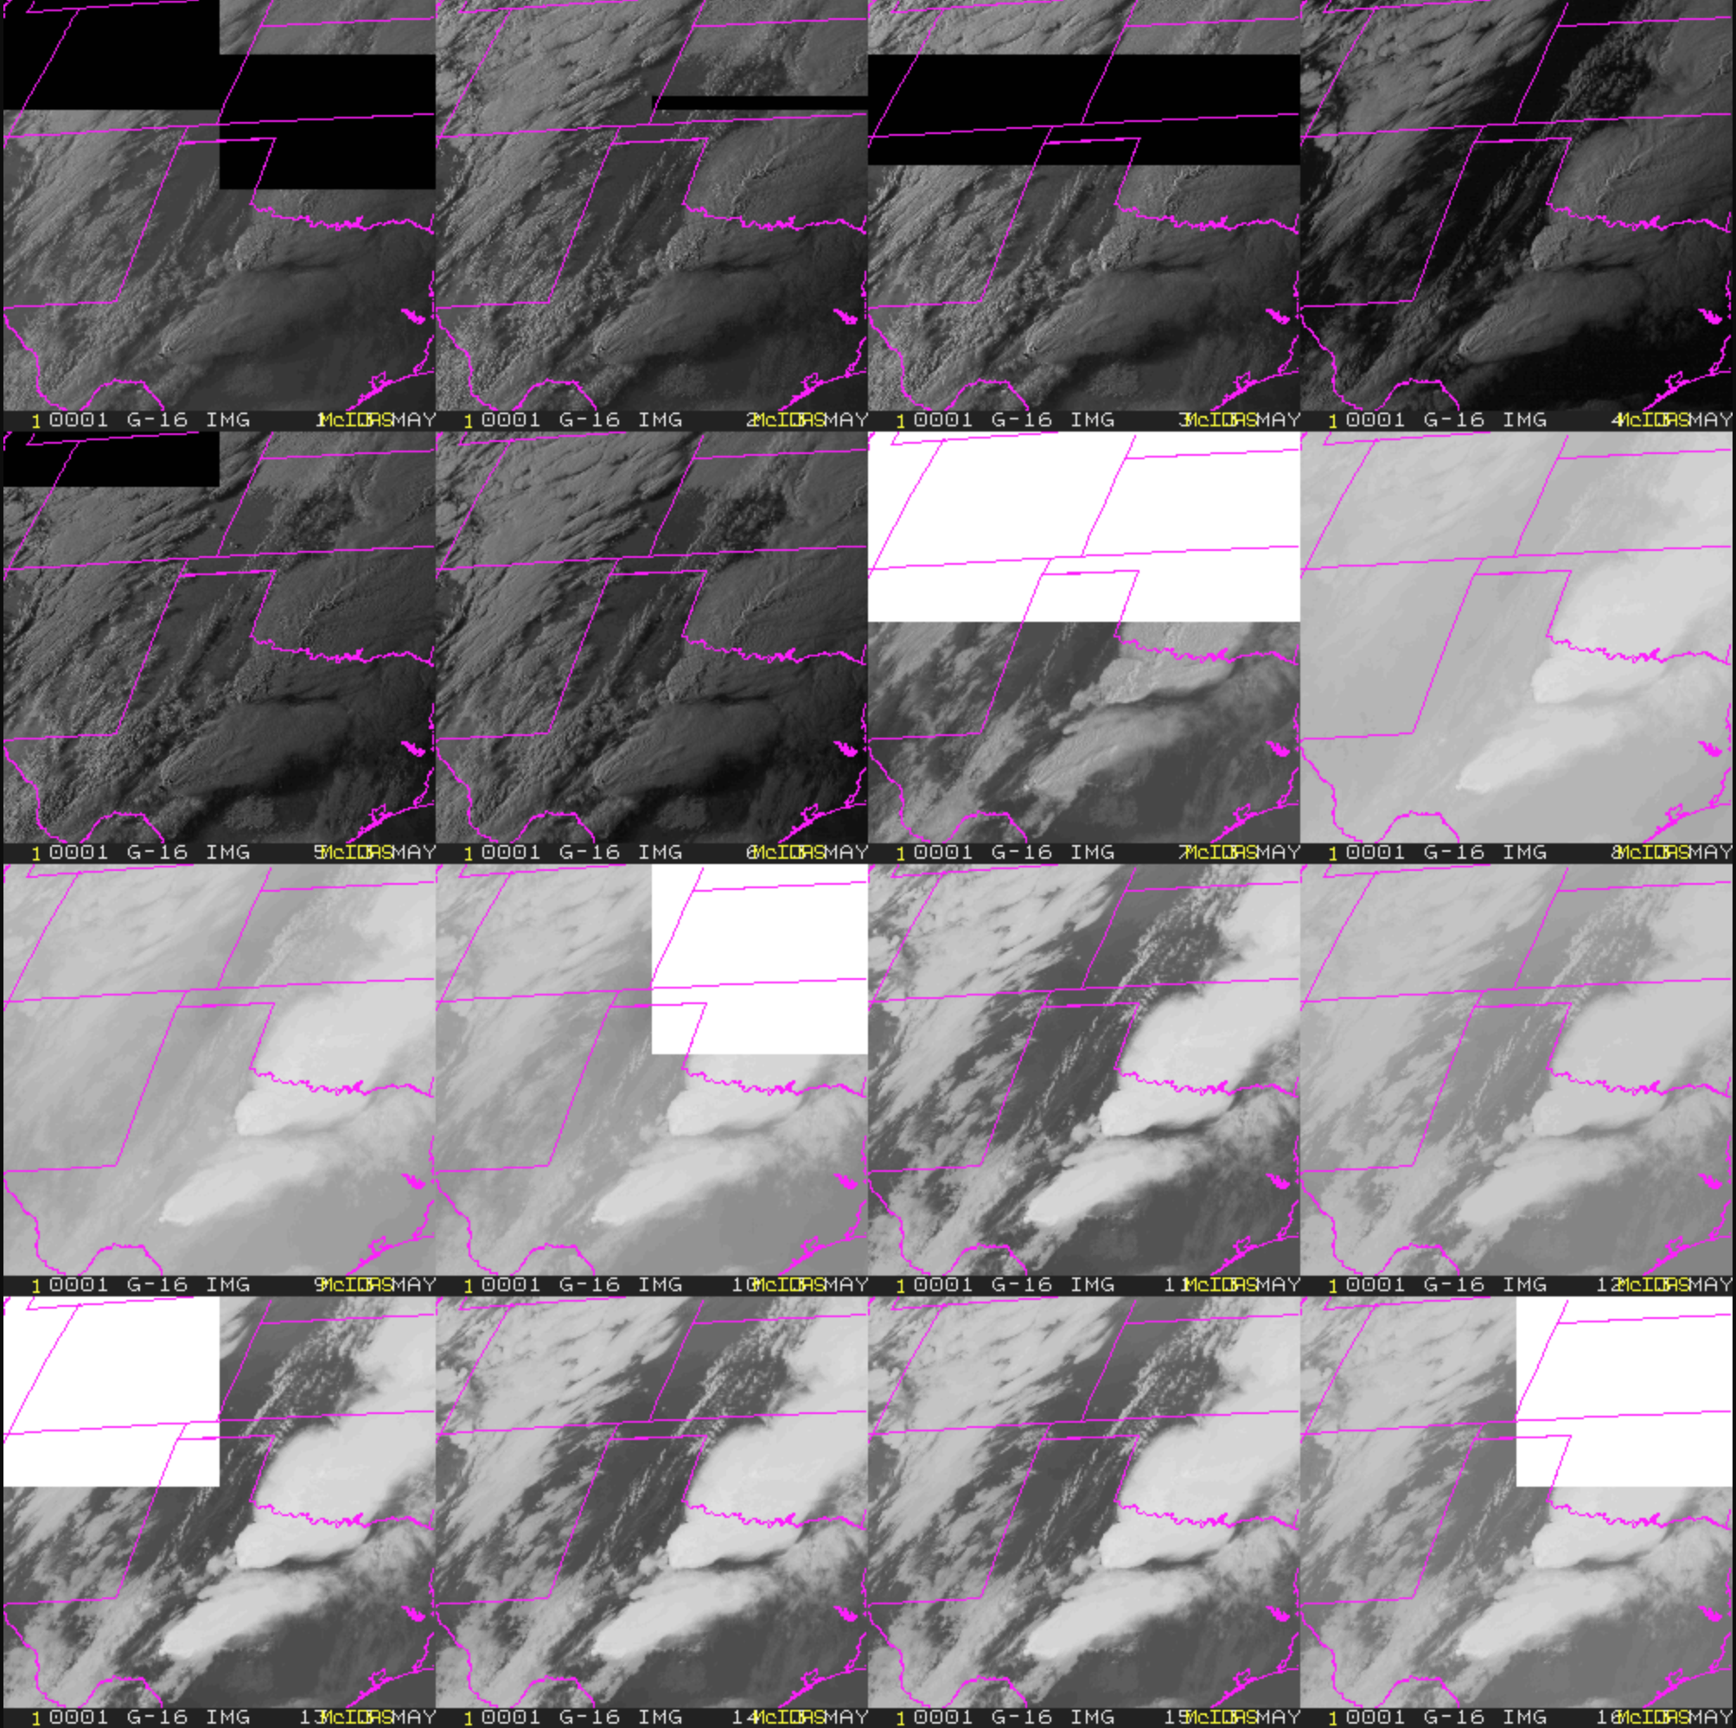
RFI Due to Lightning
Meso 1
May 3, 2018
00:38:30 UTC
2 Antennas through Mixer
Antenna Only

Slide 60
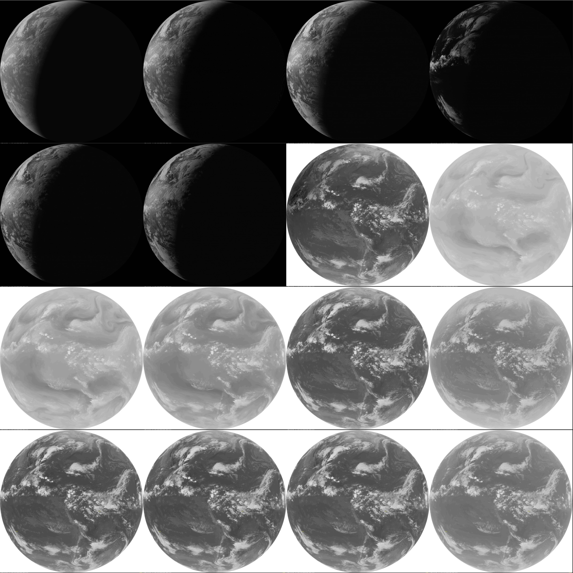
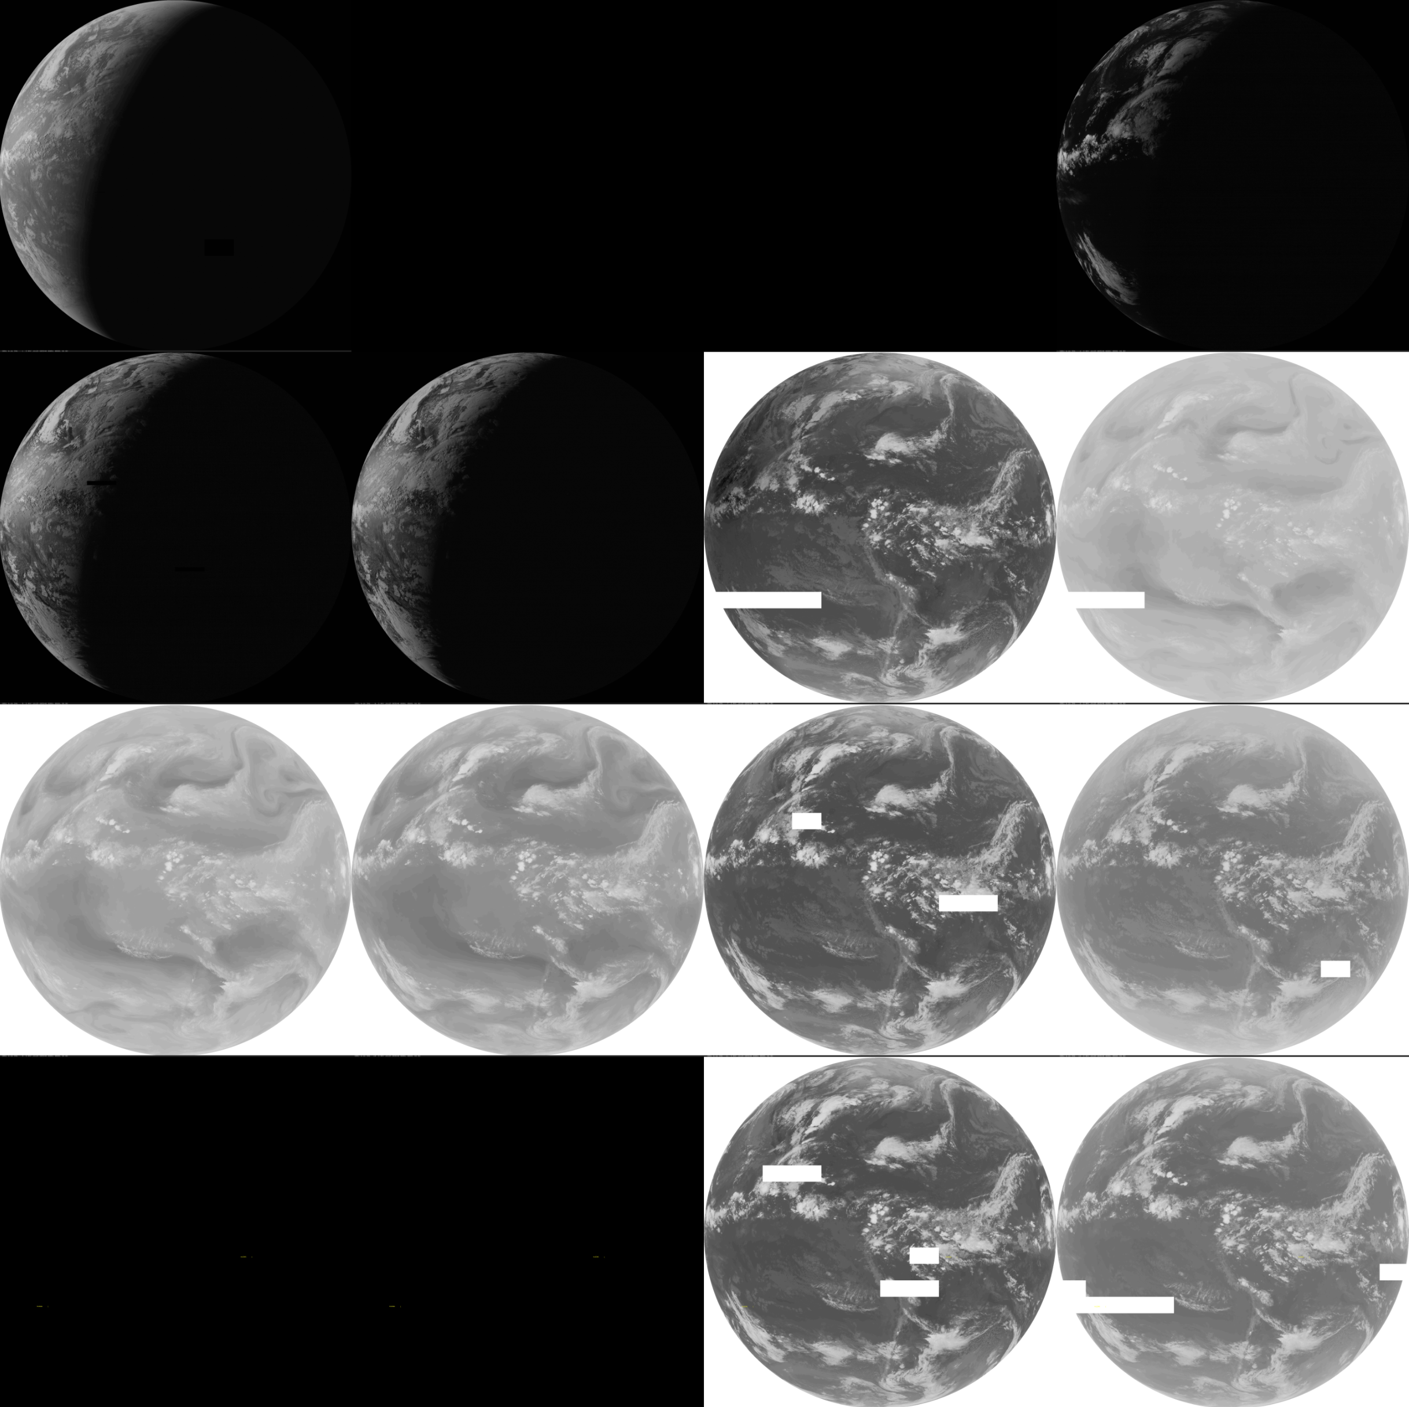
RFI Due to Lightning
Full Disk
May 3, 2018
00:30:41 UTC
2 Antennas through Mixer
Antenna Only

Slide 61
GRB Mixer
Compatible with CSPP-GEO, SDI GRB Appliance
Still in “ALPHA”
Need additional resources to move to mature distribution

Slide 62
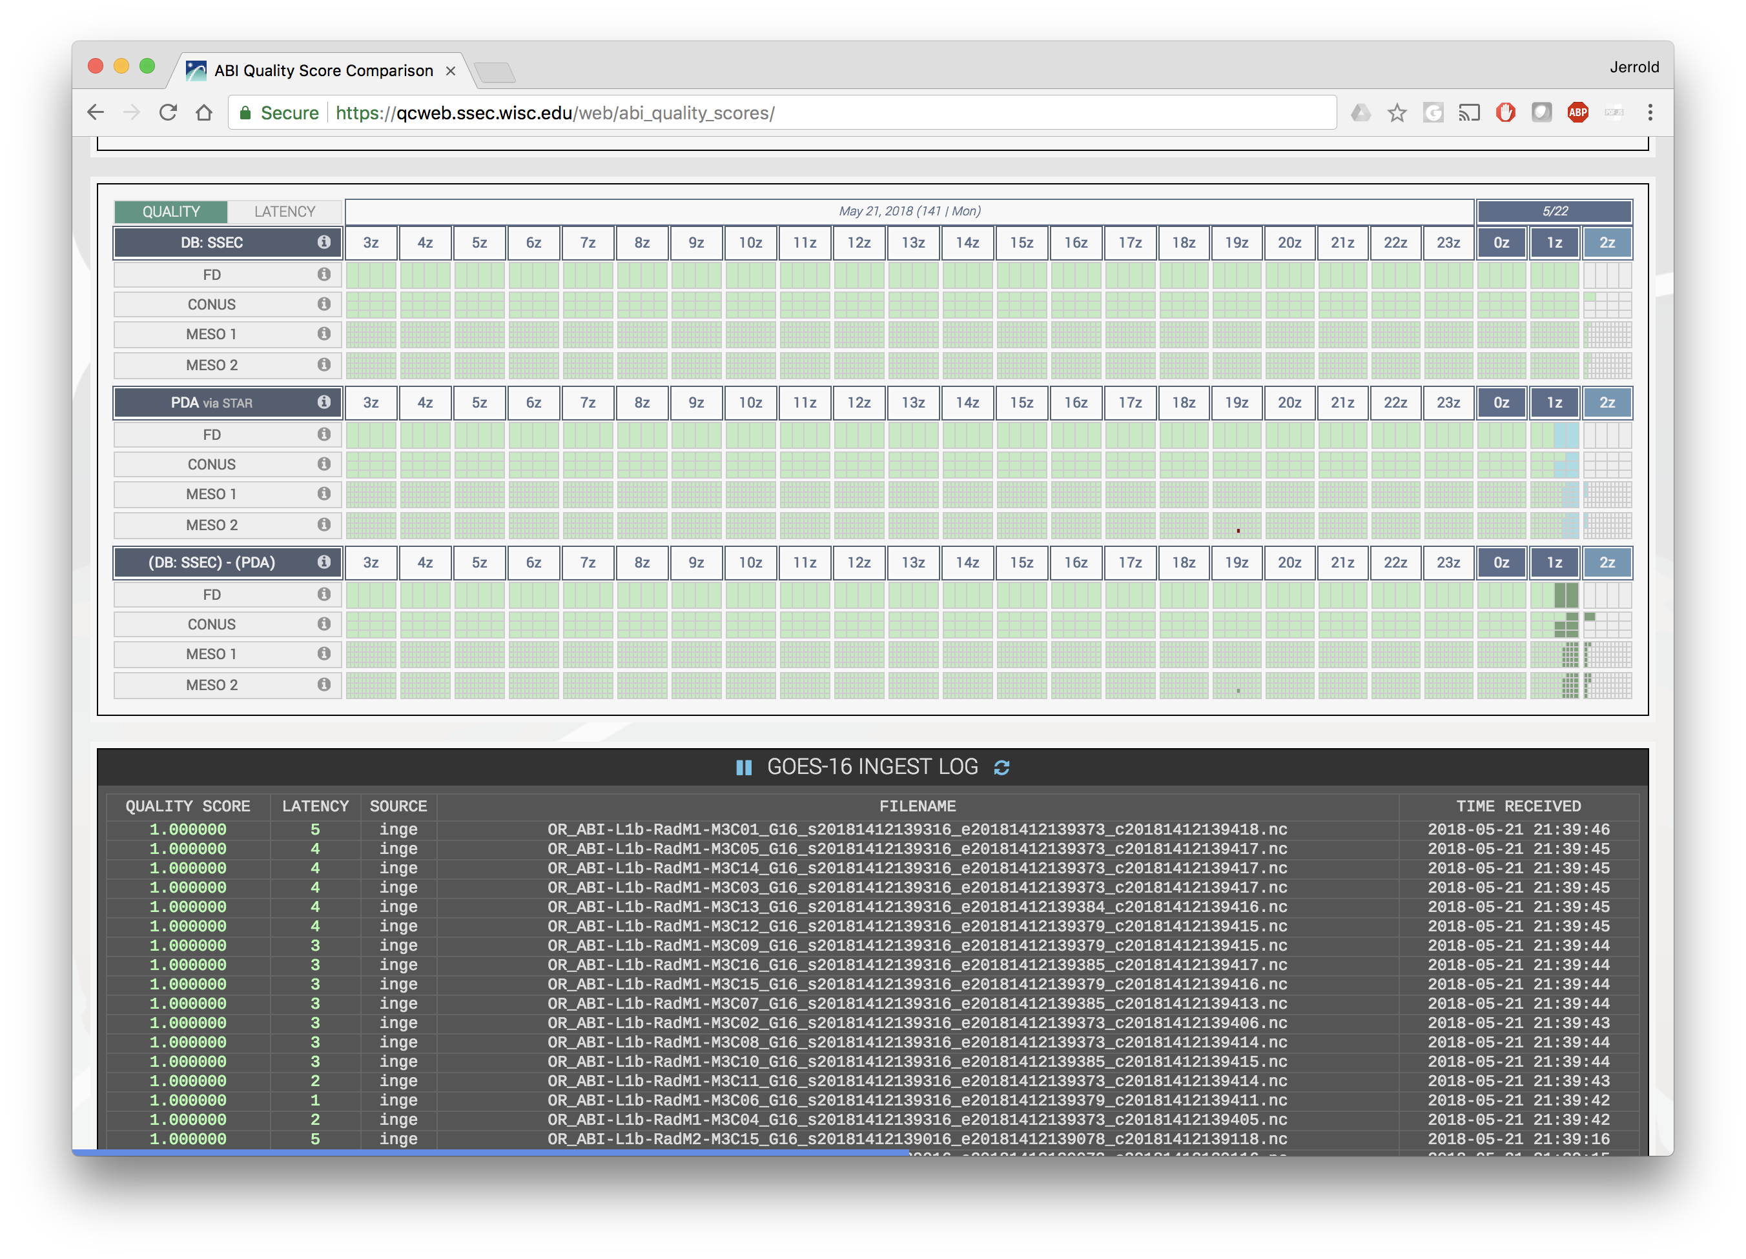
ABI Monitor

Slide 63
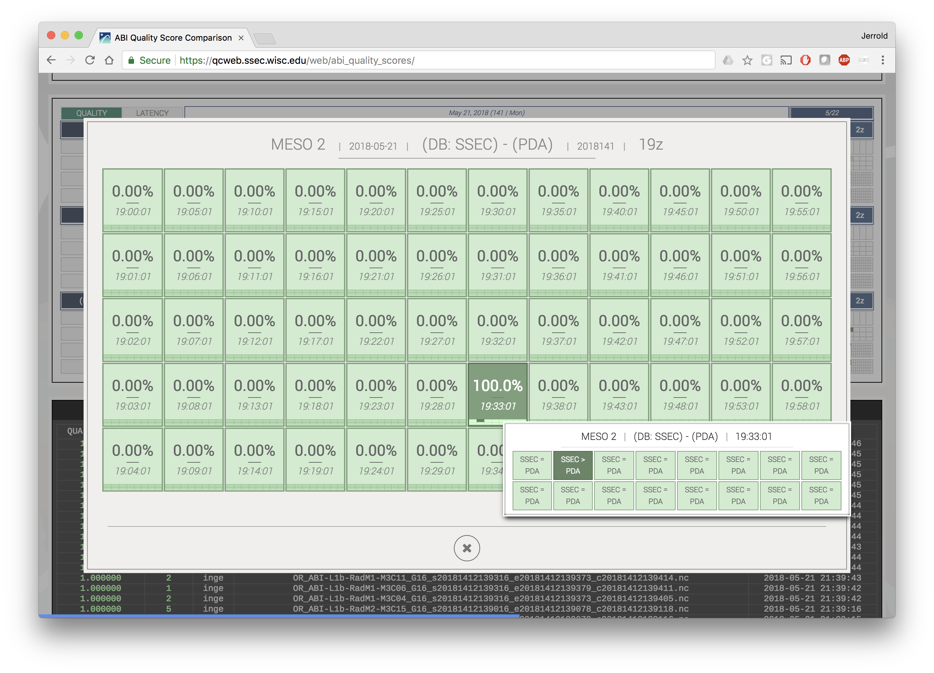
ABI Monitor

Slide 64
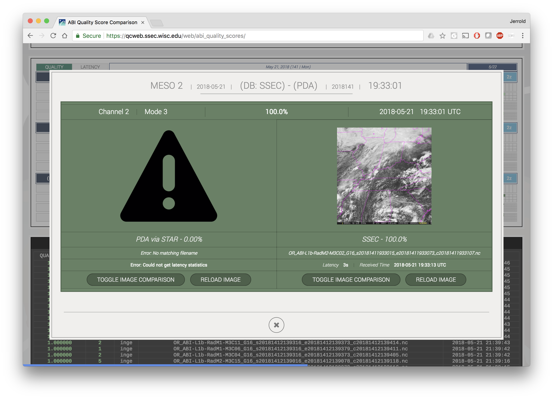
ABI Monitor

Slide 65
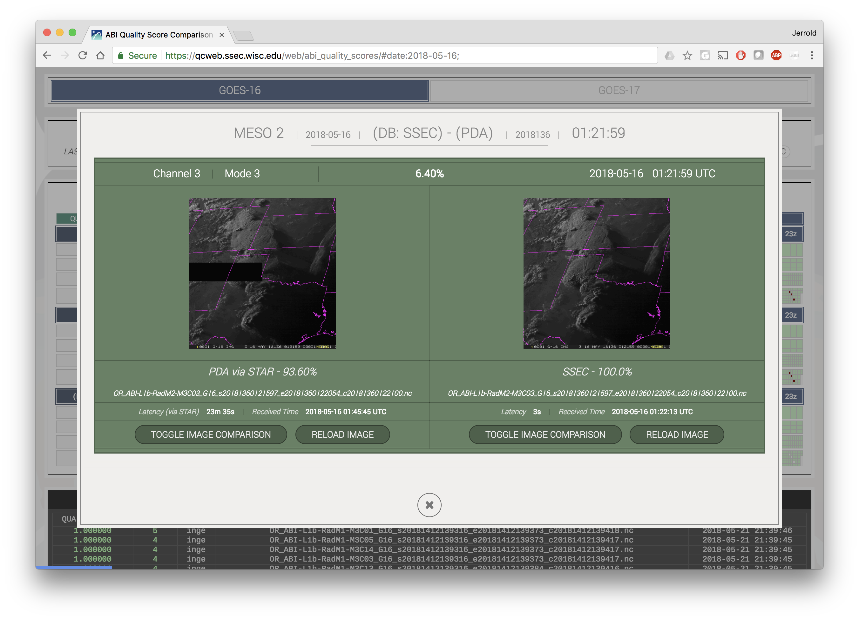
ABI Monitor

Slide 66
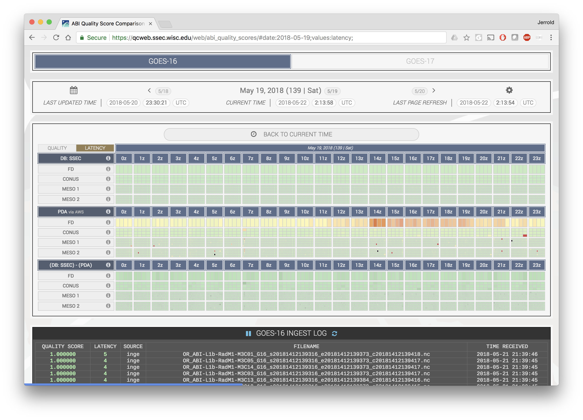
ABI Monitor

Slide 67
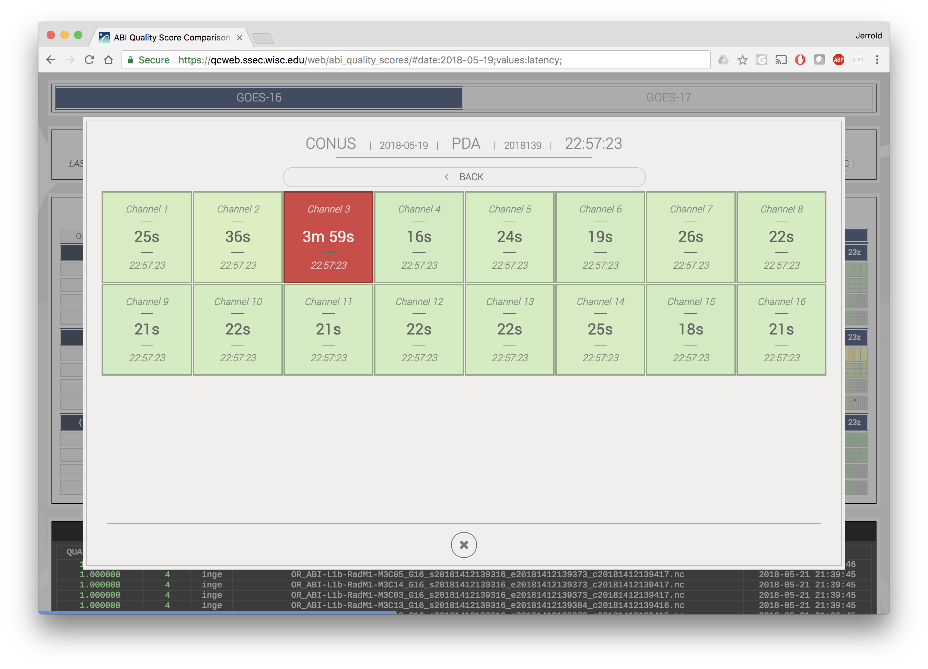
ABI Monitor

Slide 68
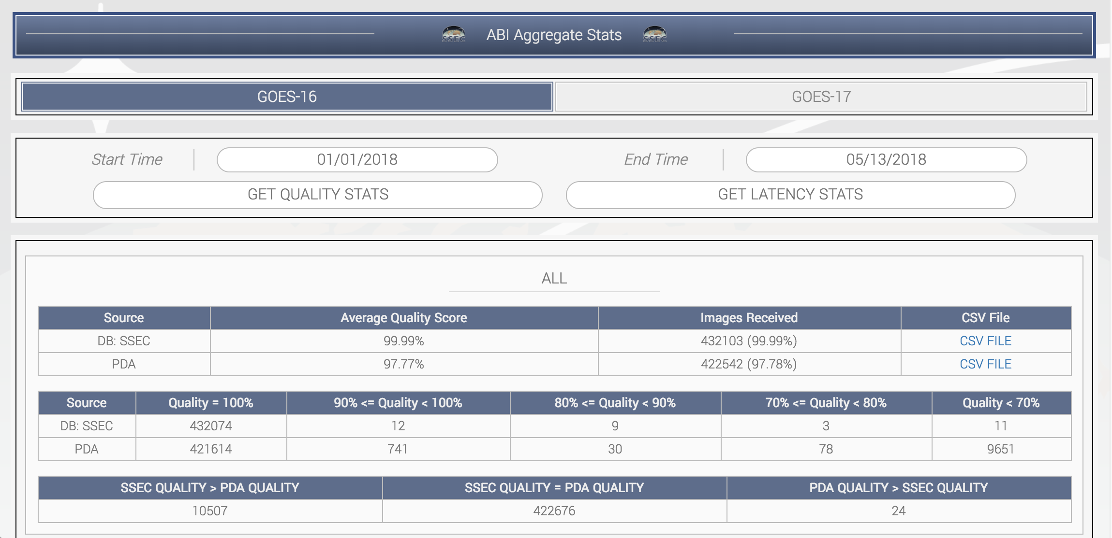
ABI Monitor
Statistics
January 1 through May 13, 2018.

Slide 69
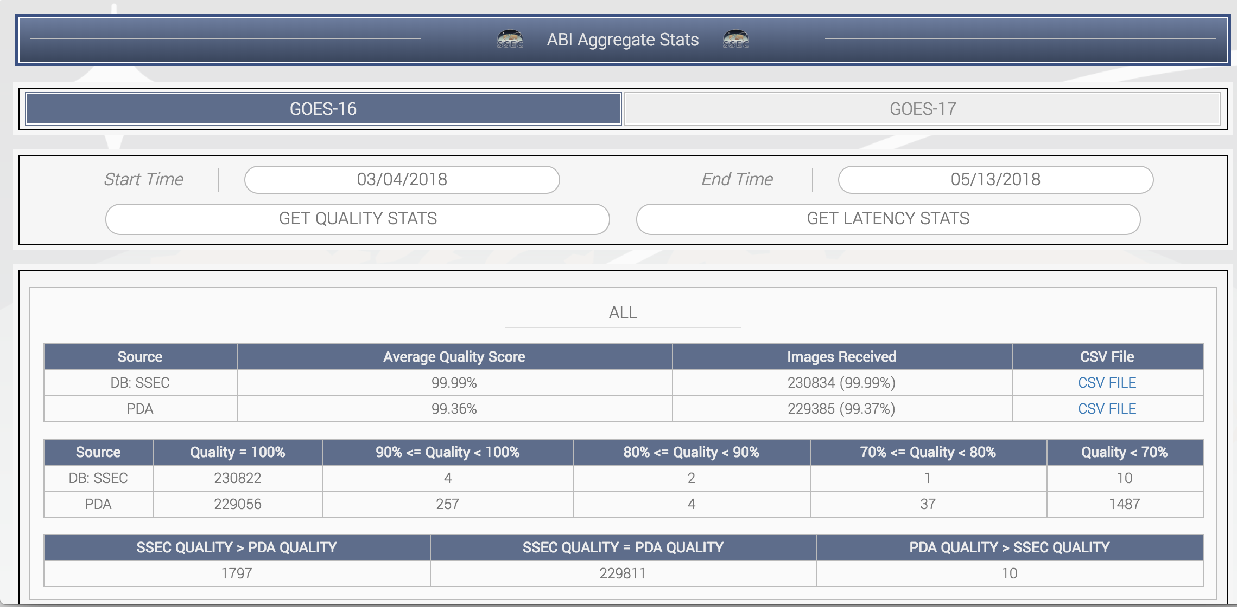
ABI Monitor
Statistics
March 4 through May 13, 2018.

Slide 70
ABI Monitor
Uses McFETCH
Generic image QC code
All GEOs planned to be added to a QC monitor

Slide 71
Data Access Page
Real-time Data

Slide 72
Data Access Page
Archive Data

Slide 73
GEONETcast
Used to monitor polar data uplinks

Slide 74
GEONETcast

Slide 75
Cloud initiatives
McIDAS client container
McIDAS ADDE server container
Fanout server container

Slide 76
Questions?

