Slide 1
McIDAS Users’ Group MUG Update
Becky Schaffer
Program Manager
McIDAS User Services
2018 MUG Meeting – Madison WI – May 22-23

Slide 2
MUG Update
MUG Personnel
What’s New in 2018
Who uses McIDAS-X and McIDAS-V?
McIDAS Support Requests
How long will McIDAS-X be supported?

Slide 3
MUG Personnel – Current MUG Staff
Kevin Baggett: -XCD programming
Jon Beavers: -V programming
Bob Carp: Help Desk, testing & -V doc
Jay Heinzelman: Help Desk & testing
Dave Parker: Systems programming
Barry Roth: Help Desk & documentation

Slide 4
MUG Personnel – Programmers
McIDAS-X SSEC: Russ Dengel Rick Kohrs Scott Lindstrom Dave Santek Unidata: Tom Yoksas | McIDAS-V and VisAD SSEC: Tommy Jasmin Tom Rink Unidata: Julien Chastang Yuan Ho Wisconsin: Curtis Rueden

Slide 5
MUG Personnel – Unidata Collaboration
Working Together on VisAD, IDV, -V
Monthly Teleconferences
Merged our developer tools (git, redmine)
MUG testers helping to test new functionality coming from IDV

Slide 6
MUG Personnel – Training and Outreach
Demonstrations & Talks
AGU Conference - San Francisco CA (2016, 2017)
AMS Annual Meeting Seattle WA (2017) Austin TX (2018)
EUMETSAT Meteorological Satellite Conference Rome, Italy (2017)
JPSS Science Week – College Park MD (2017)
NOAA Environmental Data Management Workshop Silver Spring MD (2018)
NOAA Satellite Conference - New York NY (2017)
NWA Annual Meeting - Garden Grove CA (2017)

Slide 7
What’s New in 2017 – McIDAS–X Releases
2017.1 – February 2017
- Updates of ABI servers, calibration & navigation
- Preliminary GLM access using netCDF point servers
- Added support for Himawari-9
2017.2 – October 2017 GOES-16 Updates:
- larger frames for 21696 x 21696 0.64µm band 2 VIS
- larger number of frames from 999 to 9,999
- enhanced color shading for greater bit depth
- preliminary GLM servers & commands

Slide 8
What’s New in 2018 – McIDAS–X Releases
2017.2u1 – May 2018
- for satellite sub-point change (now set for July 11, 2018)
2018.1 – May 2018
- RGBDISP displays RGB images in McIDAS image frames
- GLMDISP displays lightning data from GOES-16 GLM
- GLMLIST lists lightning data from GOES-16 GLM
- GLMIMG creates a density image from GOES-16 GLM
- Added future support for GOES-17,18,19
- Updated WWDISP to plot flood watches & warnings, severe storm & tornado warnings as polygons
- WXTLIST search is now case-insensitive NO MORE ALL CAPS!!!

Slide 9
What’s New in 2018 – OS Support for –X
Vendor | Operating Systems | Compilers Supported
Apple –Mac Intel | OS X 10.11.5 | gfortran/gcc 5.3.0
 | macOS 10.12.6 | gfortran/gcc 7.1
beyond | We’ll evaluate 10.13 when it's supported at the University of Wisconsin SSEC, and then support only 10.12 and 10.13.

Slide 10
What’s New in 2018 – OS Support for -X
Vendor | Operating System | Compilers Supported
Microsoft | Windows 7 Enterprise with SUA | g77 3.3 gcc 3.3 (packaged with SUA)
We have no plans to support Windows 8. We’ll evaluate Windows 10 and beyond when they’re supported at the University of Wisconsin SSEC.

Slide 11
What’s New in 2018 – OS Support for -X
Vendor | Operating System | Compilers Supported
Red Hat | Enterprise Linux WS
 | 6.7 Intel | gfortran 4.4.7 gcc 4.4.7
 | 7.2 Intel | gfortran 4.8.5 gcc 4.8.5
We will evaluate 8.0 when it's supported at the University of Wisconsin SSEC.

Slide 12
What’s New in 2018 – OS Support for -X
Vendor | Operating System | Compilers Supported
SUN | Solaris 10 OS SPARC | sunset support with 2016.2
 | Solaris 10 OS x86 | sunset support with 2015.2
2016.2 – In February 2017, our Solaris machine failed. We continue to support current users, but will no longer support Solaris SPARC for new users.
2015.2 - In order to use the hdf5 and netcdf4 libraries for the new INSAT-3D, GOES-R, and Kalpana servers, we switched to gcc and gfortran, and removed support for x86.

Slide 13
What’s New in 2018 – OS Usage for -X
A survey was conducted in September 2015 and again in October 2017 with 100% McIDAS sites reporting. Thank you!
Only one question -- What operating system(s) are you using on your machines running McIDAS-X?
Operating System | # of Sites | Version(s) In Use
Apple macOS | 4 | 10.10 and higher (up from 10.4)
Linux | 33 | 4.x – 7.x RHEL (20), CentOS (17), Ubuntu (6) (none on SUSE)
Microsoft Windows | 3 | Win7 and Win10
Sun/Oracle Solaris | 2 | 10 and 11.3 OS SPARC

Slide 14
What’s New in 2018 – 2019 MUG Fees Announced
2019 MUG Fees
McIDAS (increased 5% over 2018)
SX (1-2 workstations) $10,860
DX (3-5 workstations) $21,720
MX (6+ workstations) $43,440
XCD (increased 5% over 2018) $15,780
SDI (decreased from $8,340 in 2016 to better match actual support costs) $ 5,100

Slide 15
What’s New in 2018 – New MUG Members
NASA Columbia Scientific Balloon Facility - Palestine TX
ENSCO - Cocoa Beach FL
NOAA National Severe Storms Laboratory - Norman OK

Slide 16
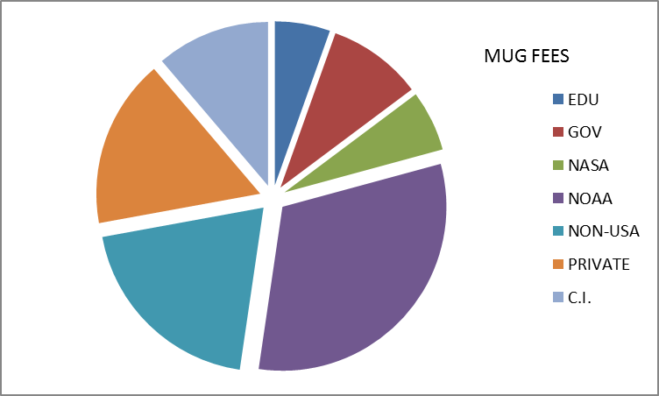
Who uses McIDAS-X? 33 Current MUG Members
NOAA (10) AWC, CLASS, ESPC, NCO, NHC, NSSL, NWS-JSC, NWS-PACIFIC REGION, SPC, STAR NOAA CI (2) CIMSS/SSEC,CIRA NASA (3) CSBF, Langley, MSFC Other Gov’t (2) NTSB, Patrick AFB
 |  | Non-USA (6) AEMET, ABoM, EUMETSAT, Green Power Labs, HKO, Mexico SMN EDUCATION (1) Unidata
PRIVATE (9) AccuWeather, AST, Boeing, ClearAg, DTN, ENSCO, StormGeo, the Weather Co, Weather Decision Technologies

Slide 17
Who uses McIDAS-V?
McIDAS-V is now used in…
research projects & publications
satellite blogs
satellite meteorology classes
visualization of EUMETCast and GEONETCast
international training courses: EUMETSAT, CIRA
private industry: recent inq from Aerolineas Argentinas

Slide 18
Who uses McIDAS-V? from the usage statistics
 | 2014
Total Uses* | 370 K
.edu/.gov | 20 K
All others | 350 K
2015
600 K
20 K
580 K
2016
1.31 M
22 K
1.29 M
2017
2.52 million!!
14 K
2.51 M
*each time a script is run or McIDAS-V is started
-V Forums have ~1100 users | Usage Statistics show ~4200 unique IPs in 2017

Slide 19
McIDAS Support – User Support Requests
With so many new non-paying users, how do we prioritize our support?
McIDAS-X, –XCD and SDI questions from MUG members to the McIDAS Help Desk
McIDAS-V questions from MUG members to the Help Desk and Support Forums
McIDAS-V questions from non-MUG users to the Support Forums
ALL bug reports are put into the McIDAS Inquiry System

Slide 20
McIDAS Support – User Support Requests
X/XCD/SDI users receive answers from the Help Desk
McIDAS-V users receive answers from the Help Desk or from other forum users. Users of McIDAS-V are encouraged to answer the forum questions of other users and to share their knowledge and expertise.
 | 2015 | 2016 | 2017
McIDAS-X total Inquiries non-SSEC | 222 | 248 | 247
 | 145 | 141 | 166
McIDAS-V total Inquiries non-SSEC | 331 | 236 | 146
 | 46 | 46 | 30
McIDAS-V Forum Topics | 112 | 124 | 89

Slide 21
How long will –X be supported?
SSEC plans to support McIDAS–X through the current GOES-R Satellite Series, which is currently listed as 2036 ➔ NO END DATE IN SIGHT!!!
No plans for support fee structure changes
MUG members will continue to receive priority support for –X and –V
Continue to release –X as needed for bugs, updates, improvements, and new OS & data/satellite changes (~2 times per year)

Slide 22
How long will –X be supported?
SSEC plans to support McIDAS–X through the current GOES-R Satellite Series, which is currently listed as 2036 ➔ NO END DATE IN SIGHT!!!
Important Issues
ADDE written in Fortran and C → Python?
XCD becoming brittle → beta coming in 2018
Larger datasets mean larger images, maps, and grids than currently allowed in McIDAS-X
The McIDAS-X GUI is written in tcl/tk and becomes more fragile with each OS upgrade

Slide 23
Looking for more user input!
Use the McIDAS-V Support Forums or contact the McIDAS Help Desk
Join the McIDAS Advisory Committee
Fill out the MUG Meeting Survey at the end of the meeting on Thursday
Do you have suggestions for improving the MUG Meeting?
What data types do you need to read/write with McIDAS?
On what platform(s) do you currently run McIDAS?
Do you use the McIDAS-X GUI?
If you have specific development needs, contact me about helping to fund development.

Slide 24
In Summary…
McIDAS Users’ Group is still going strong!
MUG Membership staying steady for –X, -XCD, and SDI → still our #1 Priority
McIDAS-X will be fully supported, updated & maintained through the GOES-R Series
McIDAS-V usage growing every day
If –X works for you, then stay with –X. When new features or data types are added in –V, then do your new development in –V.

Slide 25
We need input from you to make all of McIDAS better for everyone!
THANK YOU!!!

