Slide 1
CIMSS support of JPSS
William Straka III¹
Tommy Jasmin¹, Bob Carp¹, Dan Lindsey², Steve Miller³, Don Hillger²
¹Cooperative Institute for Meteorological Satellite Studies, Space Science and Engineering Center, University of Wisconsin-Madison
²NOAA, RAMMB
³Cooperative Institute for Research in the Atmosphere, Colorado State University
1

Slide 2
Outline
Overview of McIDAS-V
Examples
McIDAS-V summary
Other work

Slide 3
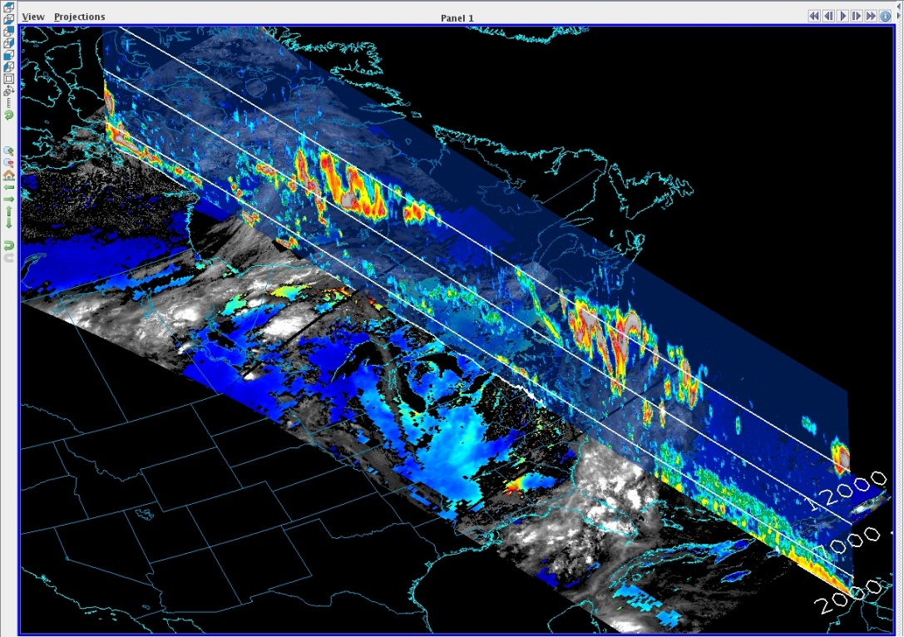
What is McIDAS-V
McIDAS-X → VisAD + IDV + HYDRA =
Integration of Geophysical Data
Remote and Local Data Access
Powerful Analysis Tools
3D Visualization
Ease of Re-projection

Slide 4
Key Aspects of McIDAS-V
Built on top an extensible framework for adapting new sources of data (format and type, local or remote), user interface components and for creating novel displays and analysis techniques
Developed in the Java programming language – object oriented, write once run anywhere, very portable
Persistence mechanism (bundles) for saving and sharing interesting displays/analysis with other McIDAS-V users
Python based user defined computation
Open source, freely available, community driven software
Is able to easily load and manipulate Suomi NPP (Block 1 and 2) and JPSS-1 simulated Block 2 data without any special readers
Notes:
HYDRA = Hyper-spectral data research application

Slide 5
Suomi NPP
It has 5 instruments which retrieve data regarding the atmosphere, land and ocean. 3 of these instruments can be displayed in McIDAS-V
VIIRS
CERES
CrIS
ATMS
OMPS
5

Slide 6
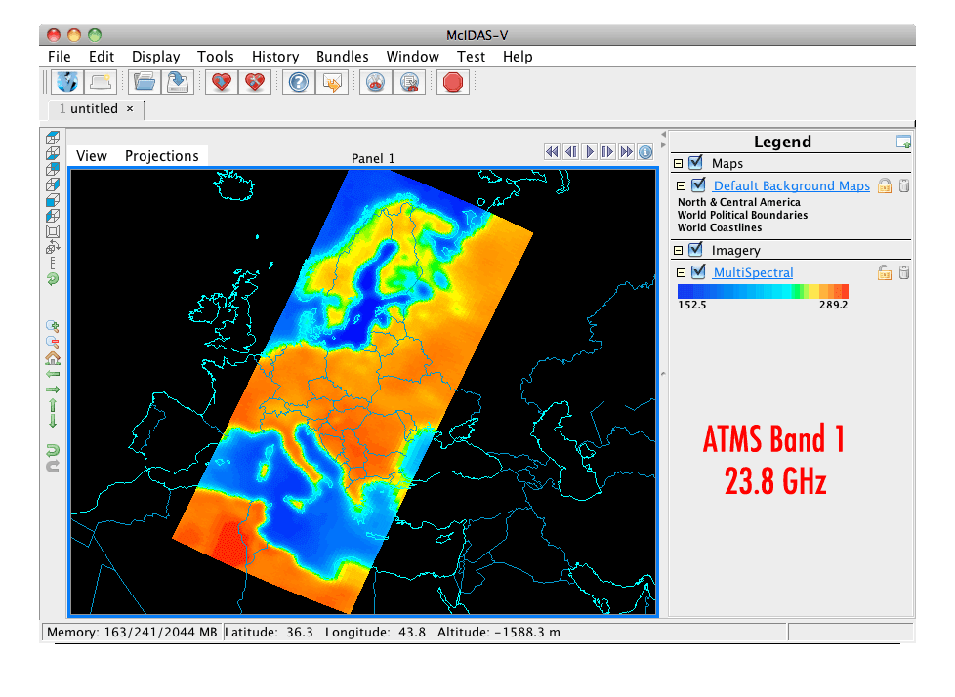
Advanced Technology Microwave Sounder (ATMS)
22 microwave channels, combining all the channels of the preceding AMSU-A1, AMSU-A2, and AMSU-B sensors into a single package
Provides sounding observations needed to retrieve profiles of atmospheric temperature and moisture for forecasting models and continuity for climate monitoring purposes.
6

Slide 7
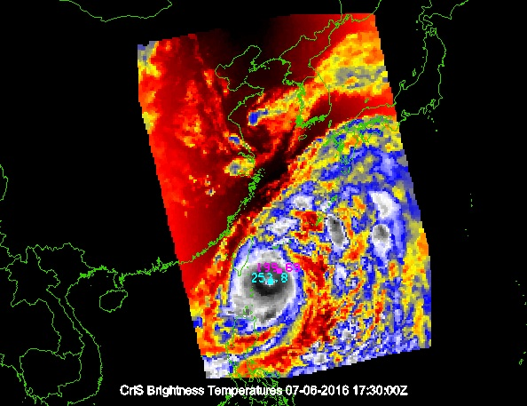
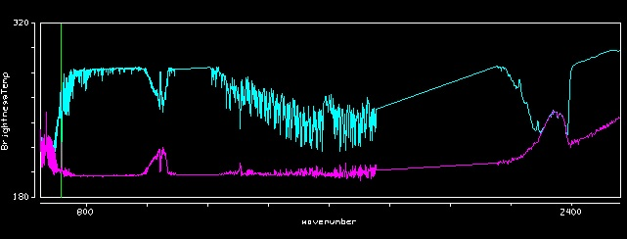
Cross-track Infrared Sounder (CrIS)
1,305 infrared spectral channels
Designed to provide high vertical resolution information on the atmosphere's structure of temperature and water vapor.
7

Slide 8
Visible Infrared Imaging Radiometer Suite (VIIRS)
Has 22 channels at three different resolutions
16 Moderate Band (M-Band) channels (~750 m at nadir)
5 high resolution (I-Band) channels (~375 m at nadir)
Day Night Band (~750 m at nadir)
M and I band data encompass data from 412 nm to 12 μm
Used to produce Level 2 products
8

Slide 9
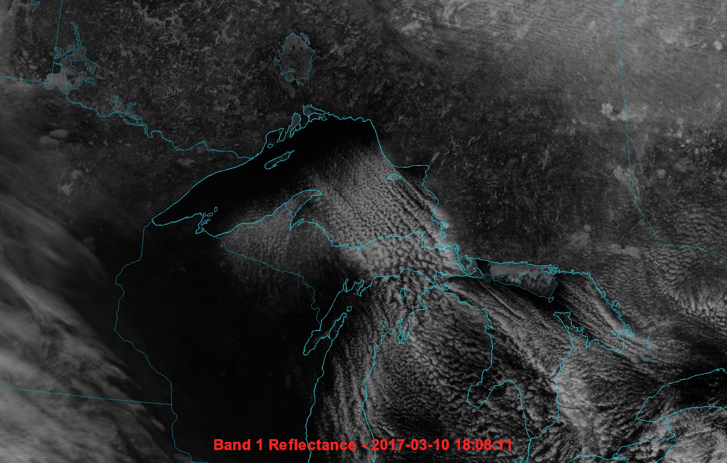
Multi-channel animation

Slide 10
RGB composite

Slide 11
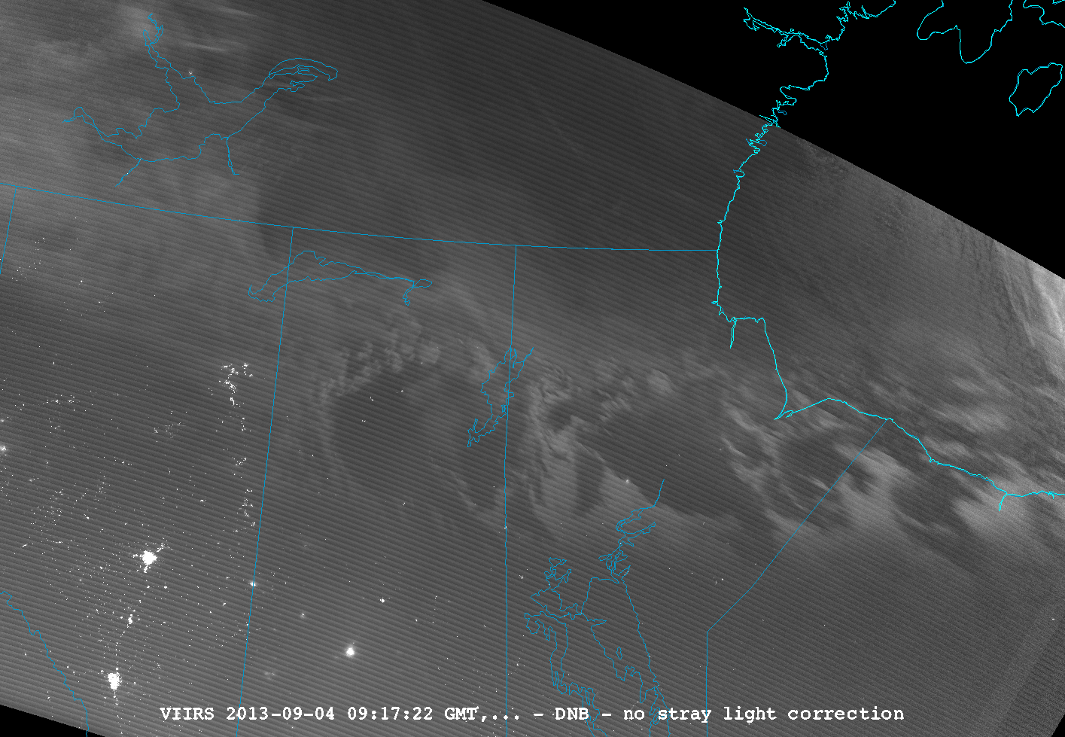
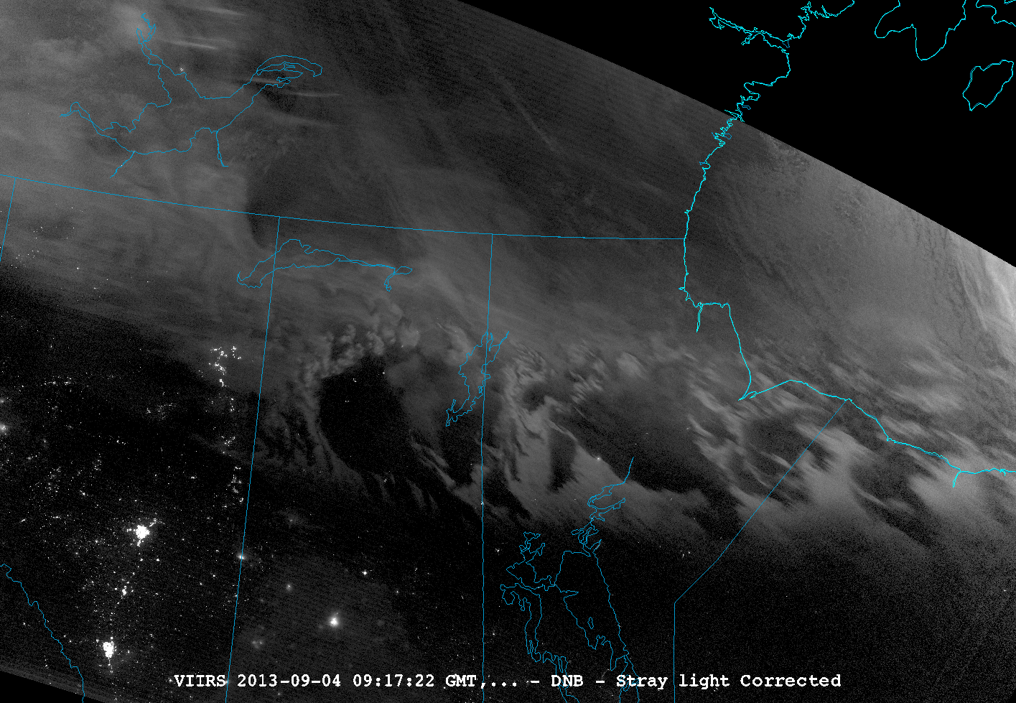
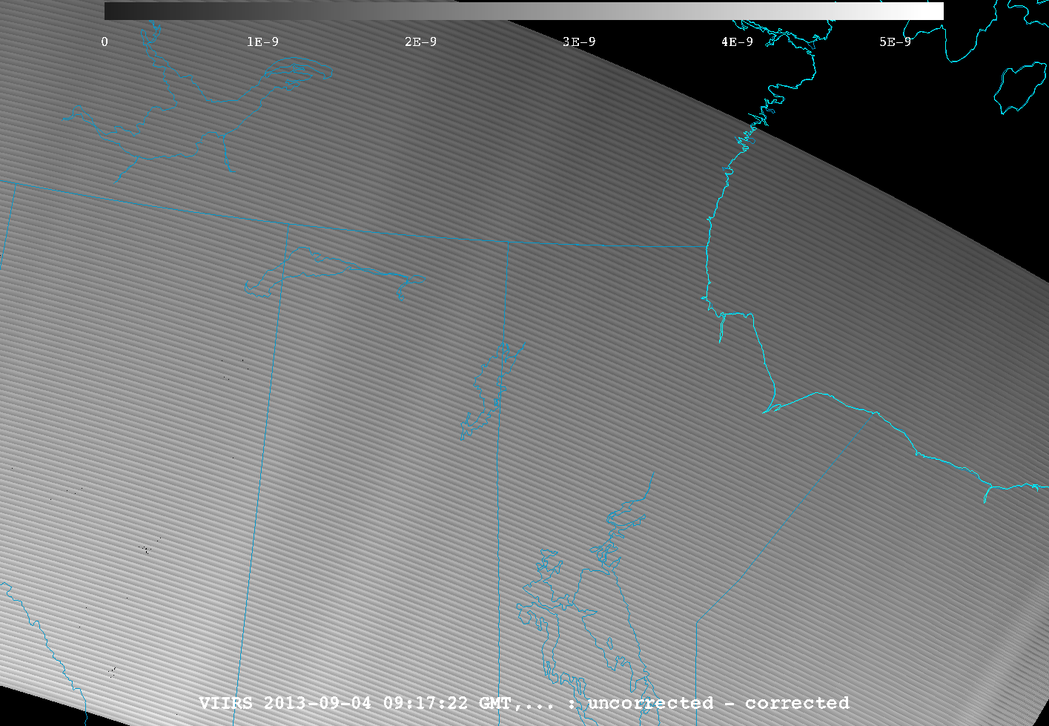
VIIRS Channel Differencing DNB Stray light example
11

Slide 12
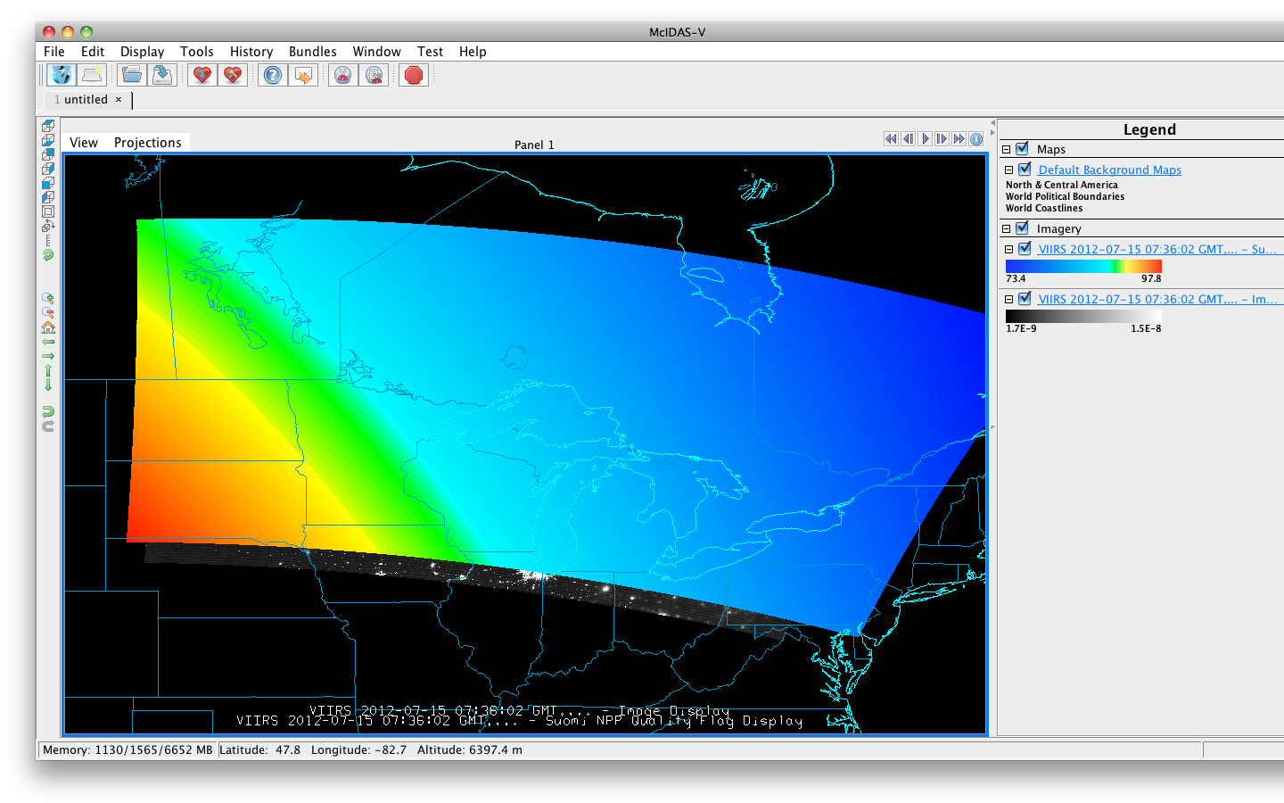
VIIRS SDR Ancillary data
12

Slide 13
Visible Infrared Imaging Radiometer Suite (VIIRS) EDR
There are a series of 20 Environmental Data Records (EDRs) produced from VIIRS
McIDAS-V has been able to successfully ingest all EDRs including NDE Enterprise output
McIDAS-V can unpack and display bit level data.
Ex. Displaying VCM test results
13

Slide 14
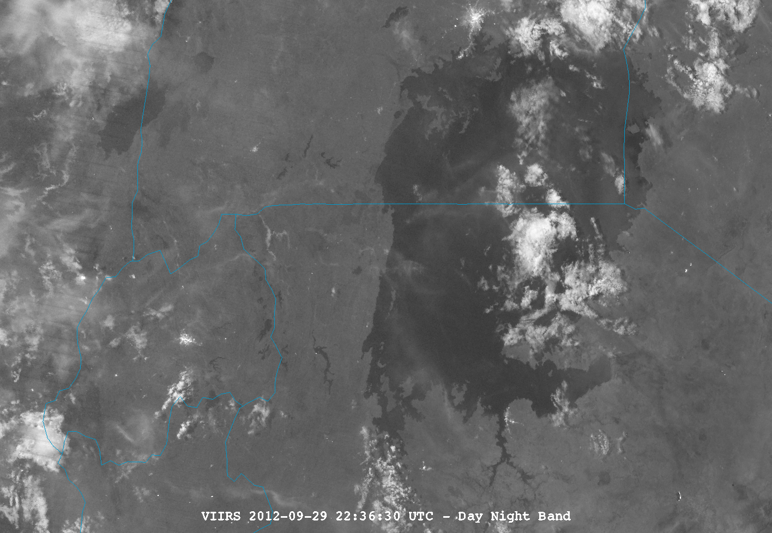
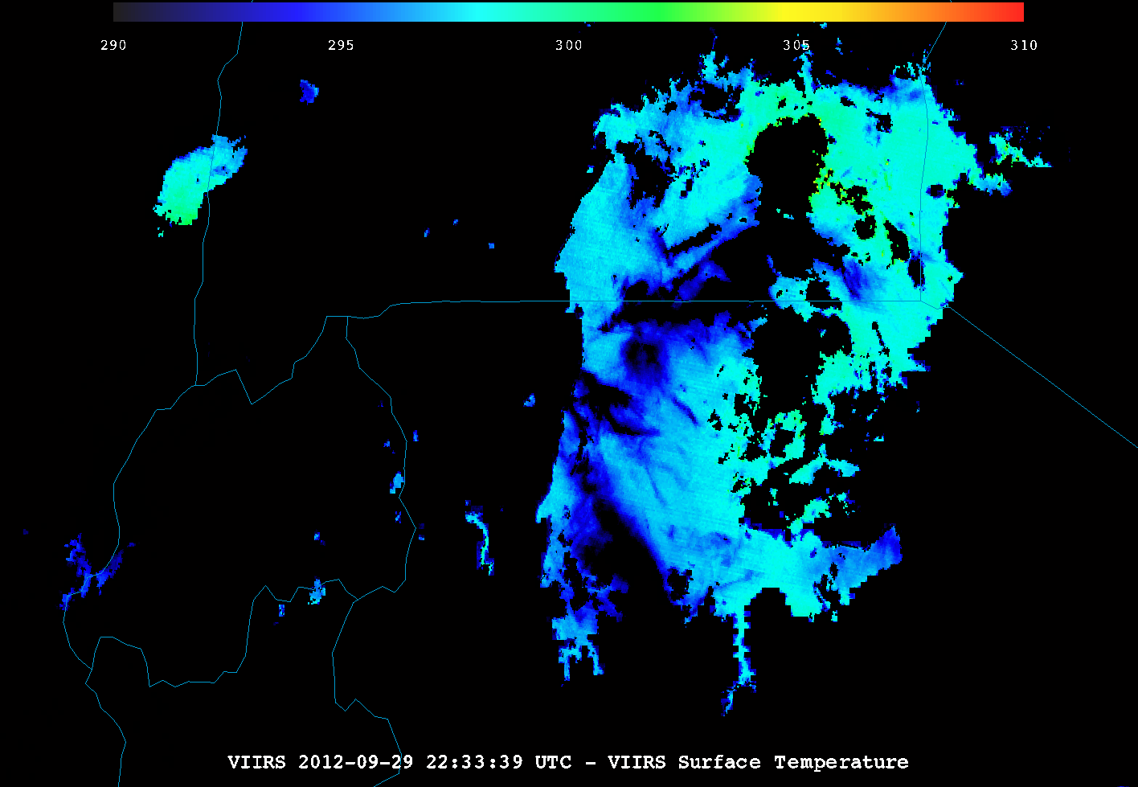
VIIRS DNB and Surface temperature EDR 2236Z, 09/29/2012
Kampala
Lake Albert
Fog
Kigali
Mwanza
Lake Victoria
14

Slide 15
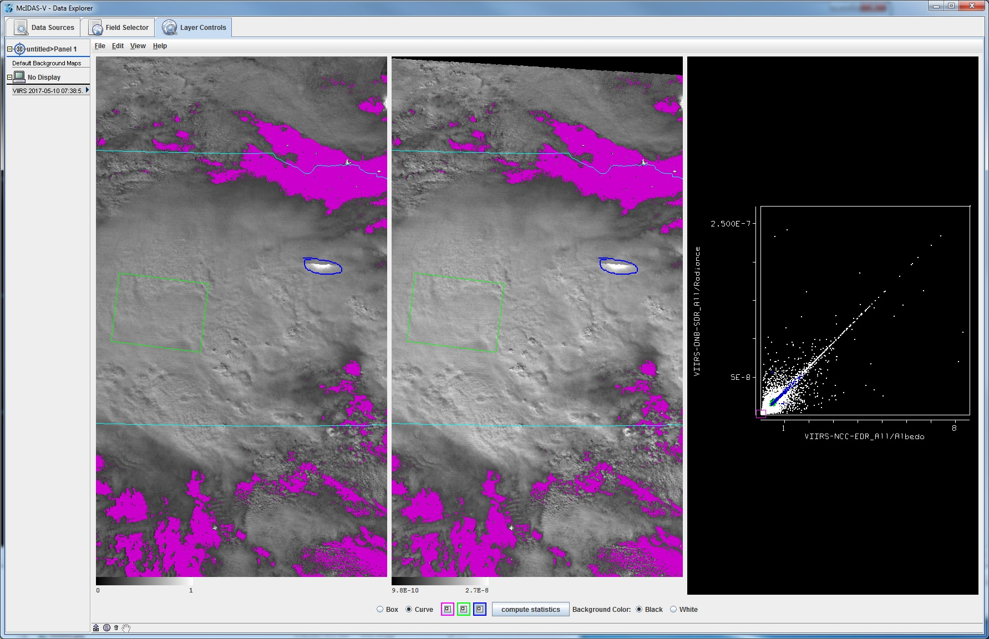
Imagery EDR example Scatter analysis

Slide 16
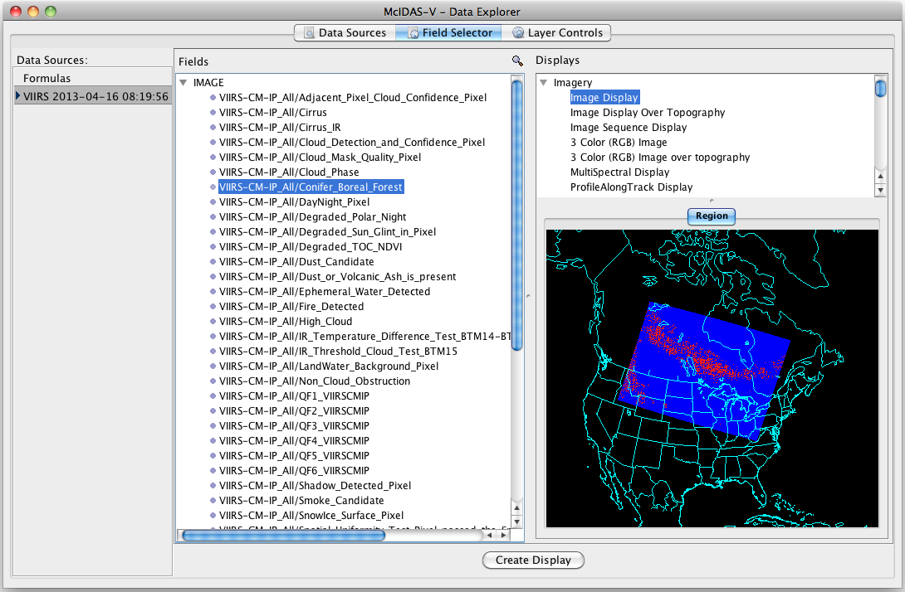
Product EDR Variable selection
Notes:
May want to mention the image is for an expanded and appropriately masked bit-level variable.

Slide 17
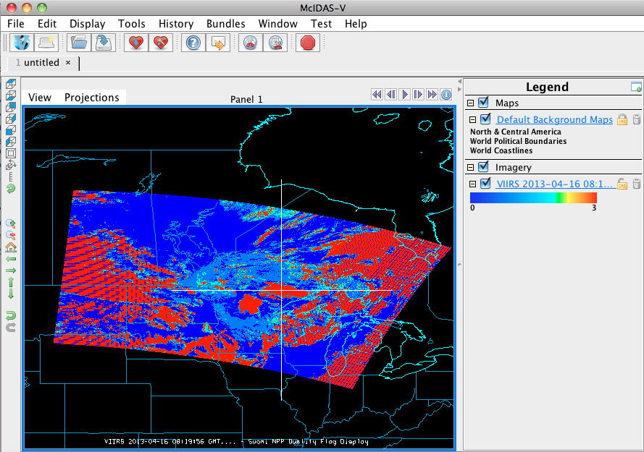
Product EDR Data Probe

Slide 18
S-NPP/NOAA-20 specific McIDAS-V 1.7 Updates
Support for the VICMO cloud mask EDR (released March 2017) as well as backwards compatibility with IICMO data.
Added a new "show variables" button to the Field Selector tab of the Data Explorer which can show the variable shortname or (if present) long name.
VIIRS Formulas plugin that gives formulas to remove the bowtie deletion and create RGB displays without the bowtie
Added several VIIRS specific Scripting functions to load and grab information from SNPP/J1 files.
18

Slide 19
S-NPP/NOAA-20 Updates since McIDAS-V 1.7 in Nightly Build
Support added for CrIS Full Spectrum data.
Chooser rename to JPSS (it's not just for Suomi any more!)
Reordering of fields provided now (e.g. M bands used to be listed out of order in multibanded VIIRS files)
Better time formatting in scripting functions
Generalization and renaming of scripting functions, with deprecation warnings provided
19

Slide 20
Examples of McIDAS-V USED for JPSS

Slide 21
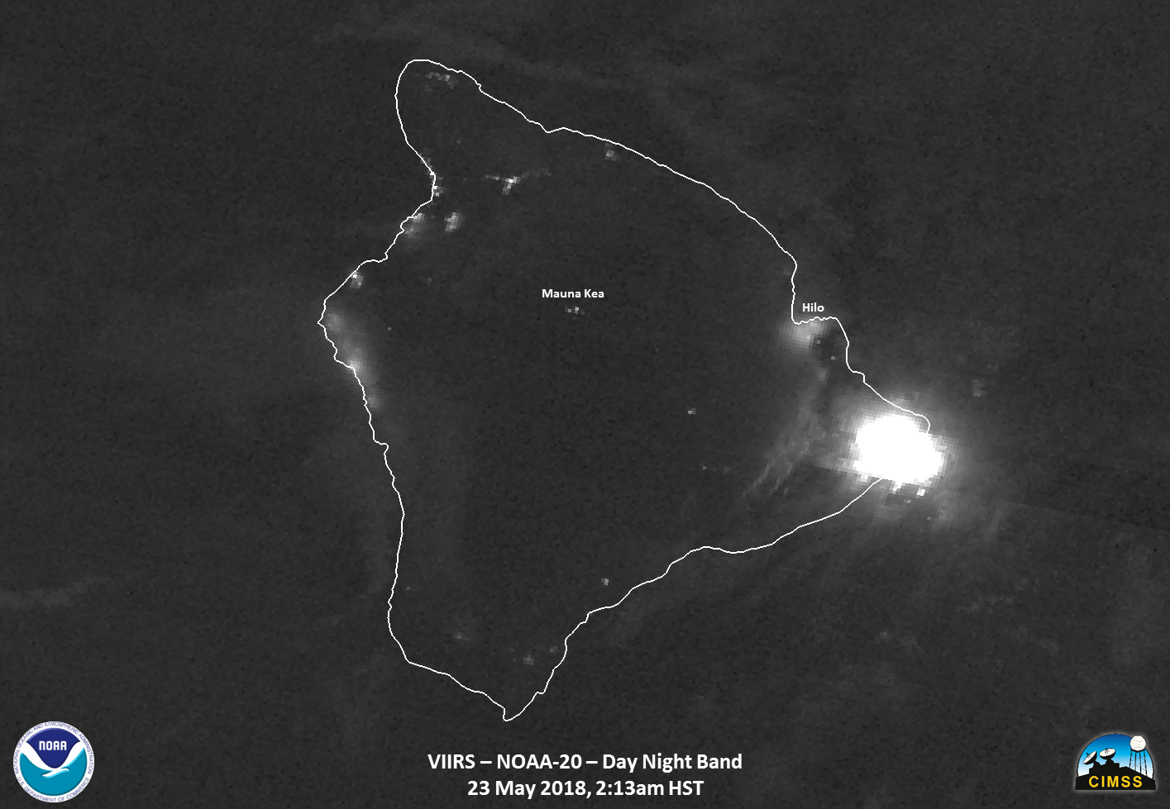
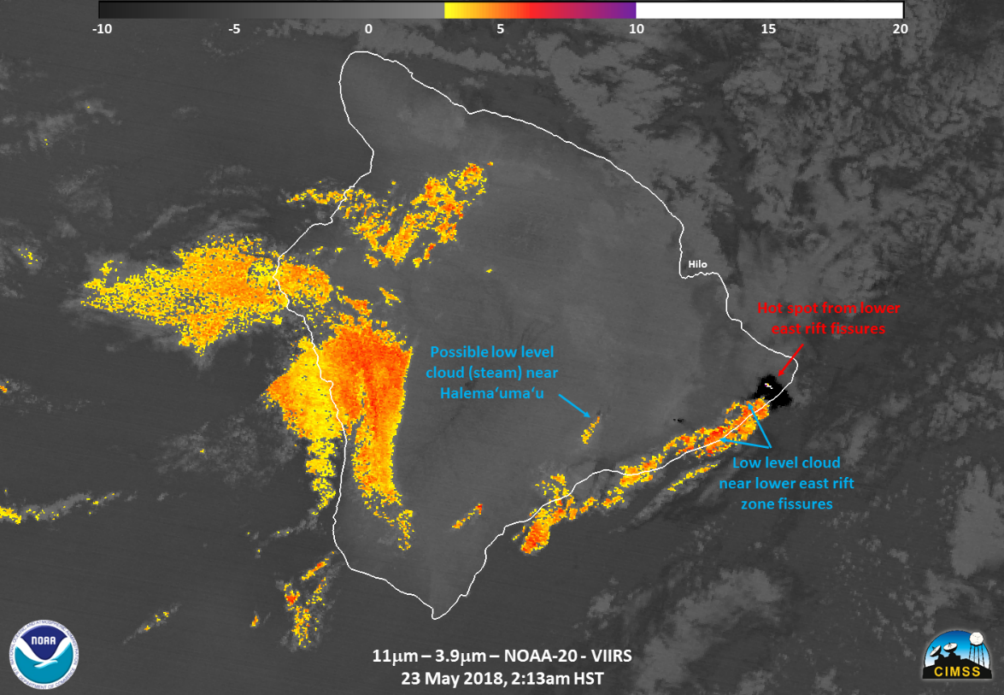
NOAA-20
2018 lower Puna lava outbreaks

Slide 22
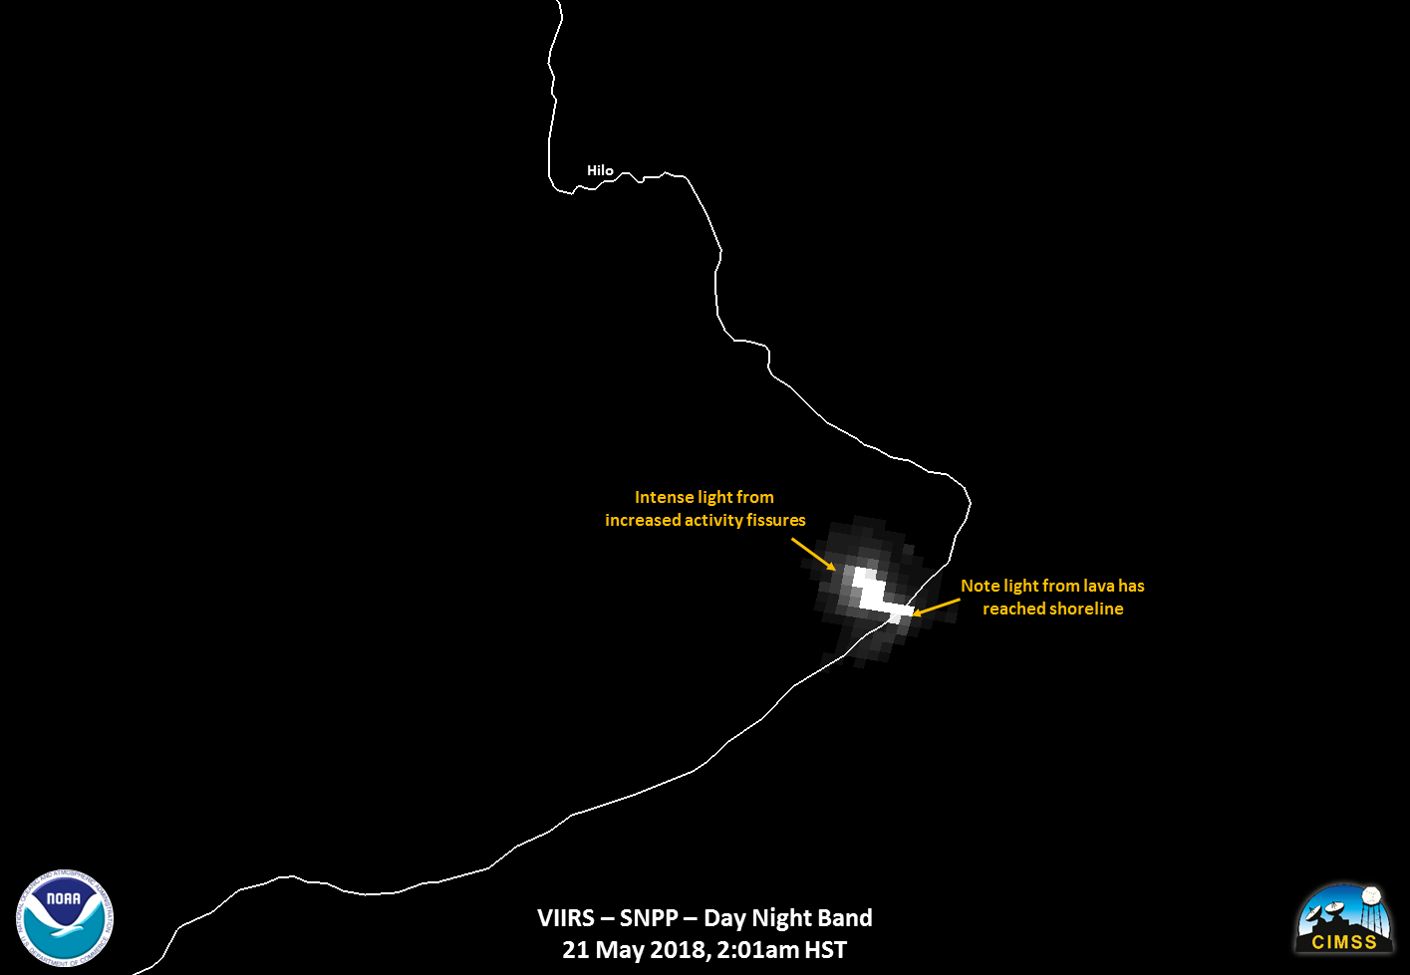
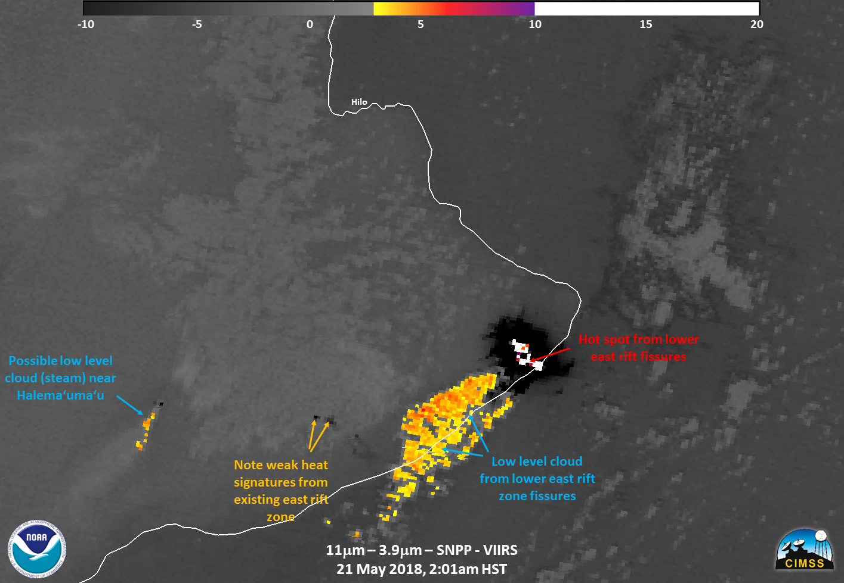
SNPP
2018 lower Puna lava outbreaks

Slide 23
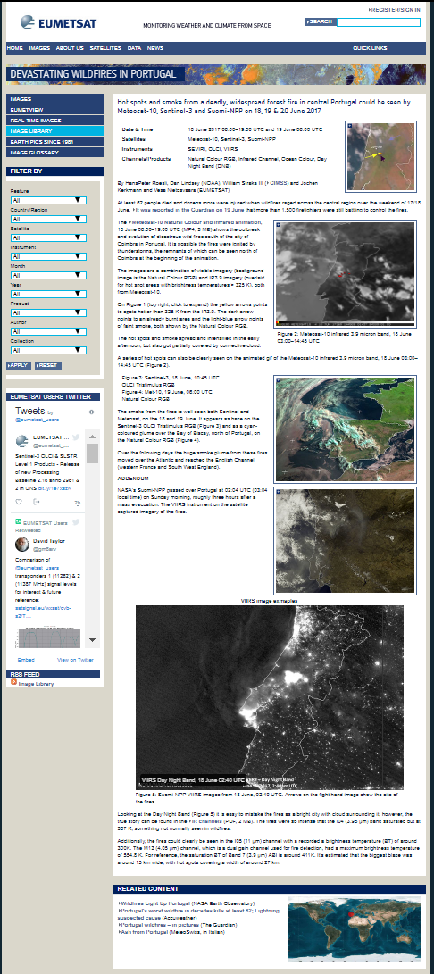
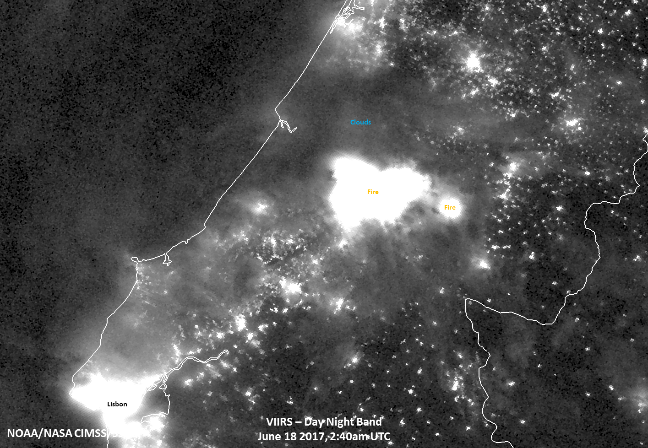
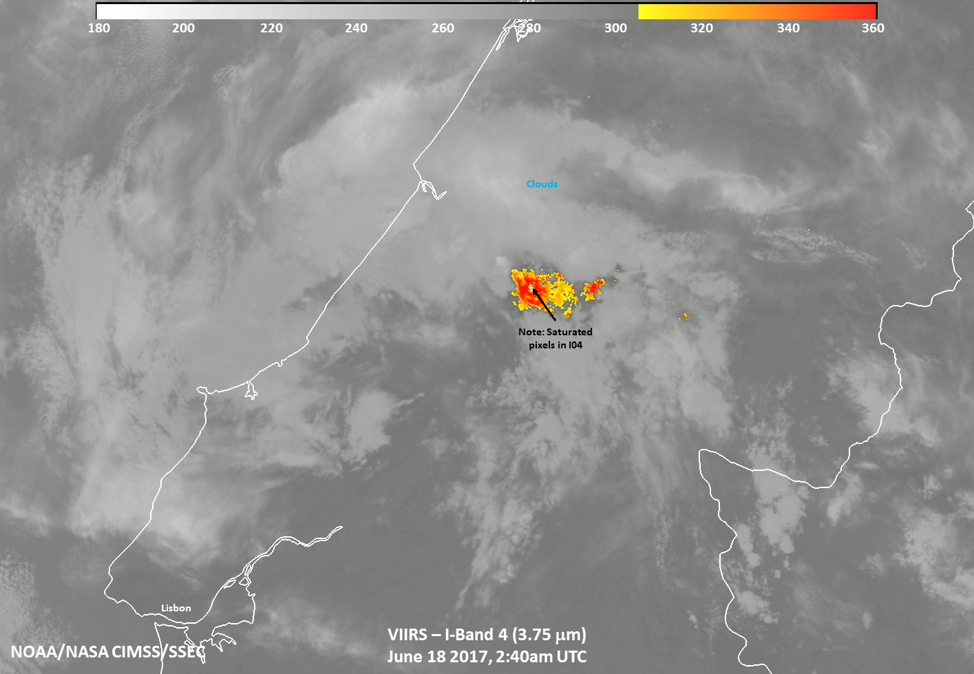
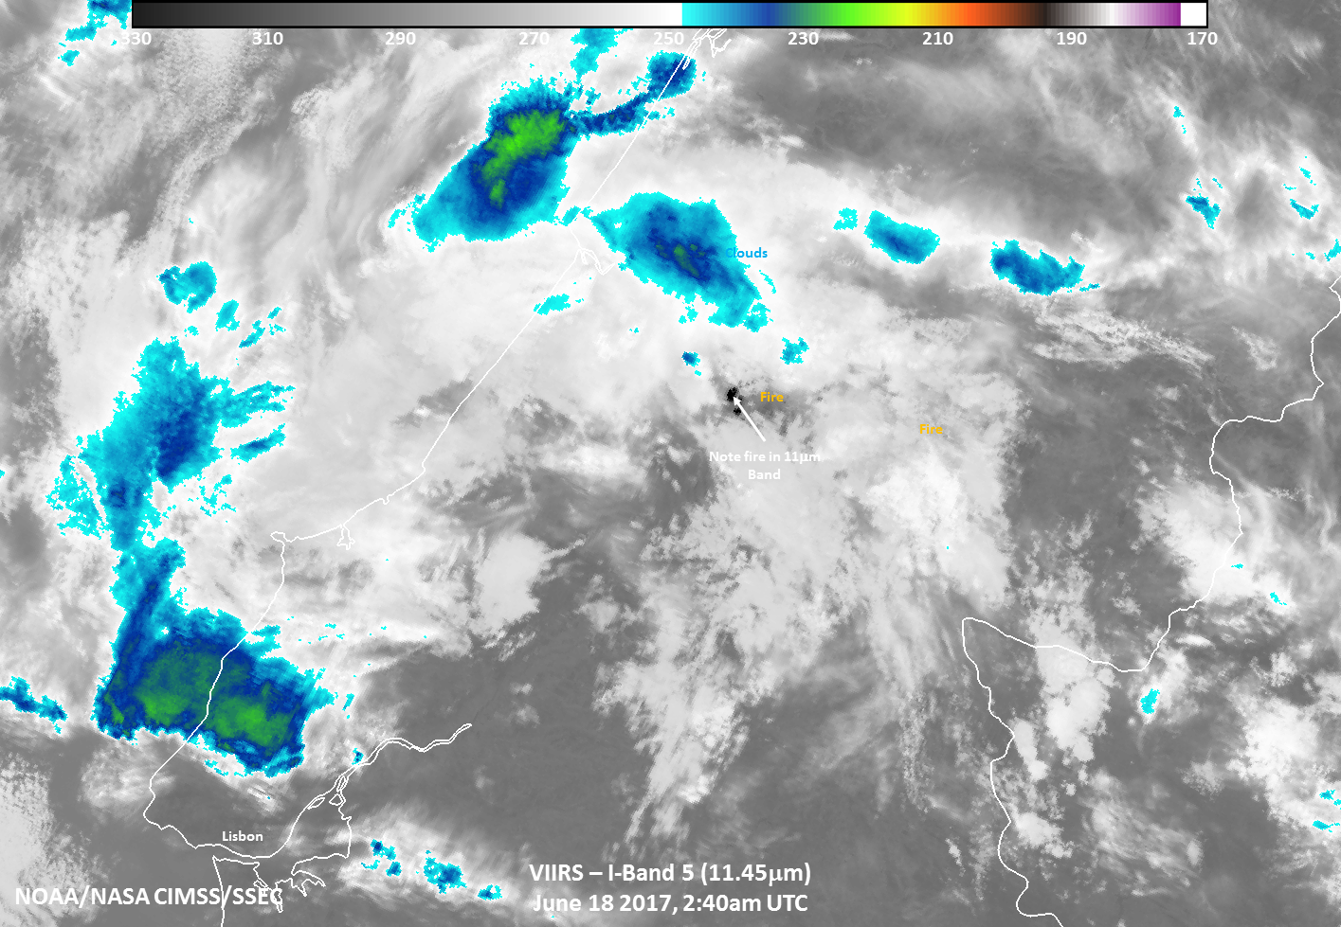
Disaster monitoring
Fires and Smoke support
https://www.eumetsat.int/website/home/Images/ImageLibrary/DAT_3524803.html

Slide 24
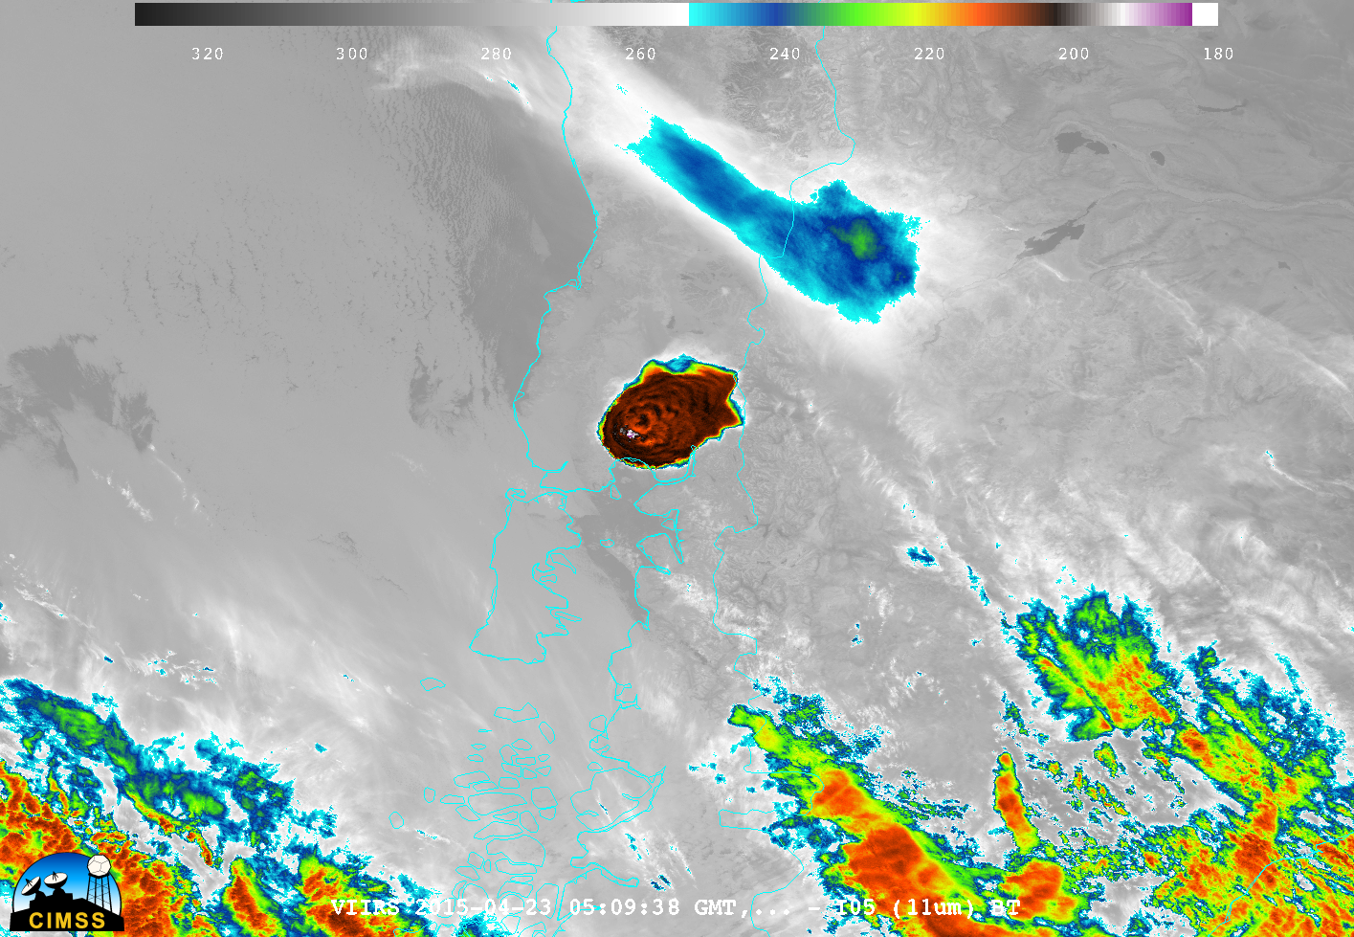
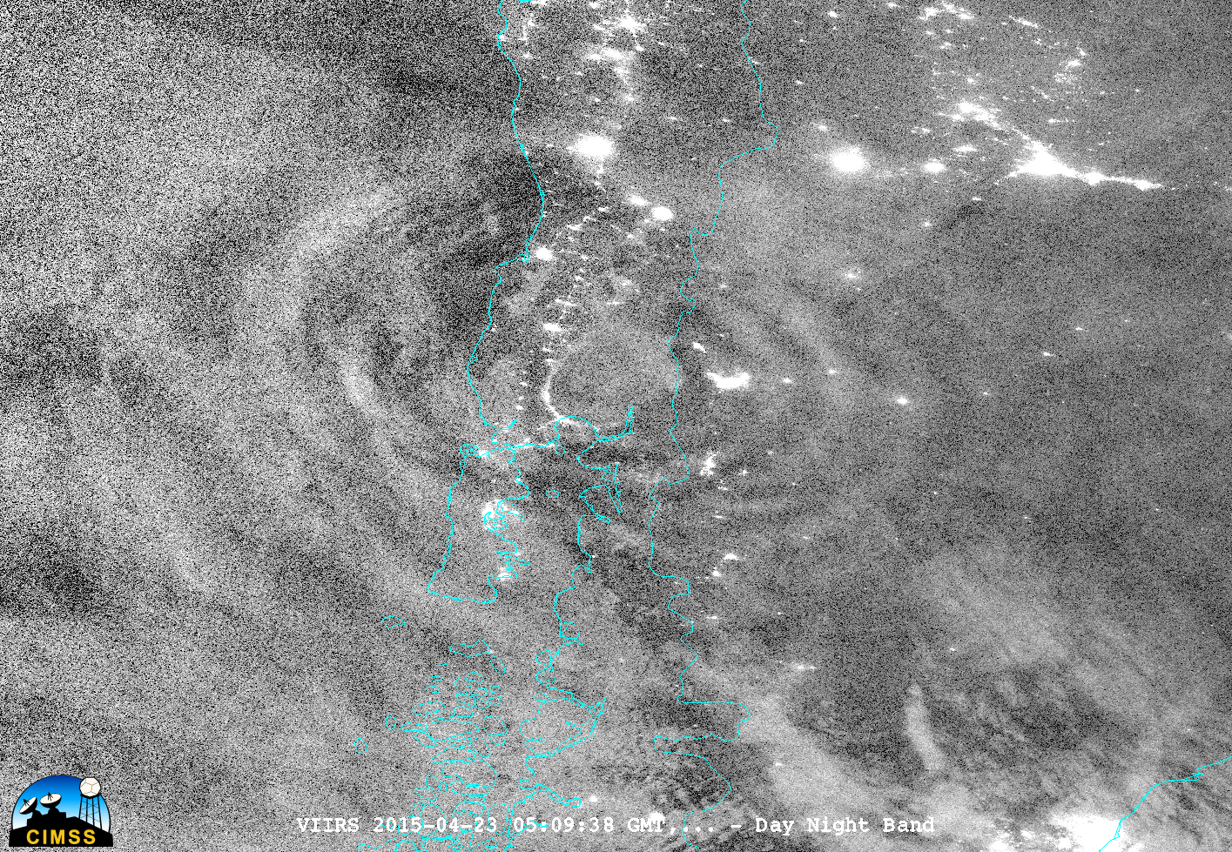
Mesospheric Gravity Wave monitoring

Slide 25
Needed features for JPSS activities
Support for visualizing granules which straddle the dateline (note, this issue occurs with other polar and geo data)
Support for OMPS
Needed for comparisons and visualizations with other instruments
Support for NUCAPS
Output in other GIS-type formats (ex. geoTIF)
Google KML/KMZ files often either don’t display properly in other GIS viewers other than Google Earth.
This is needed for comparisons and interactions with other groups, both in cal/val and other activities.

Slide 26
Extra slides

Slide 27
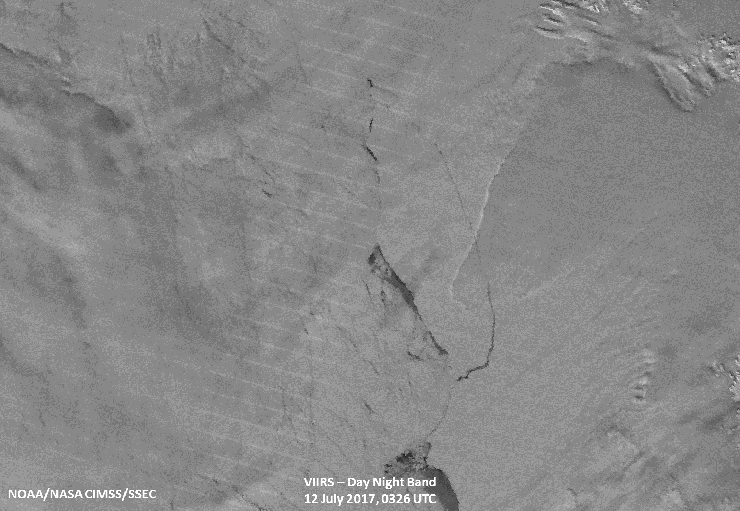
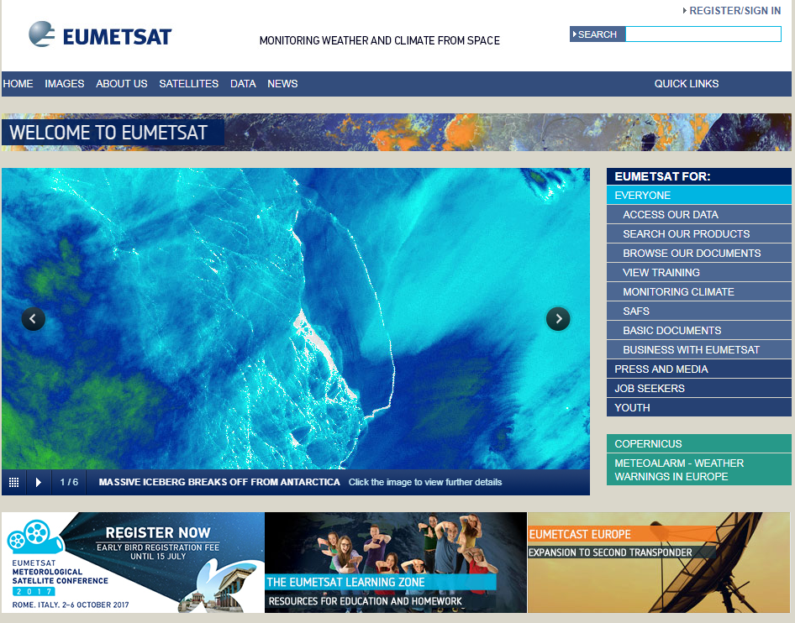
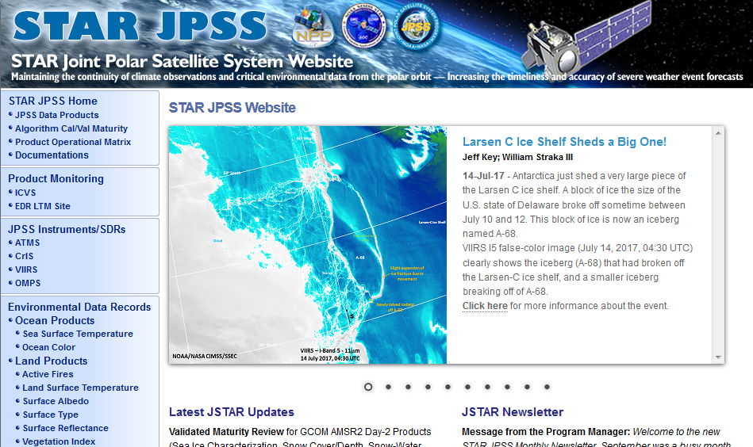
Polar Monitoring
Public Outreach

