Slide 1
Aviation Weather center and mcidas-x utility
Amanda Terborg
NCEP/AWC and CIRA/CSU
MUG meeting – Madison, WI
22-23 May 2018

Slide 2
McIDAS-X concepts
Aviation Weather Center utility
Vis/IR combination for ceiling & visibility – day to night continuity
Producing GOES-16 version now
Global mosaics – GEO/LEO composites
Water Vapor and expanded display with 2017.2 – adjustment for SDI
Other band differences/derived products
Includes ABI L2 derived products (SST)
GOES-16 ash difference for mosaic imagery

Slide 3
McIDAS-X concepts
Aviation Weather Center utility
CONUS scale mosaic
GOES-15/GOES-16 composite
INSAT data display
INSRO ADDE servers
EUMETSAT data availability

Slide 4
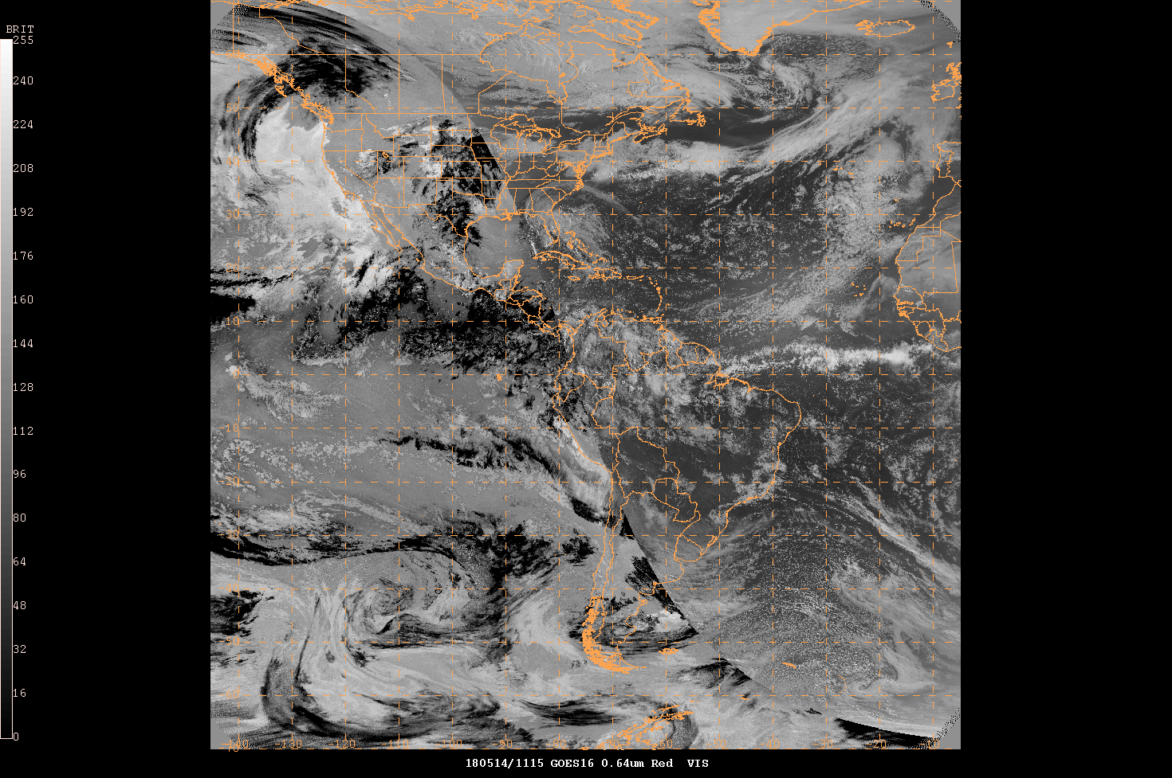
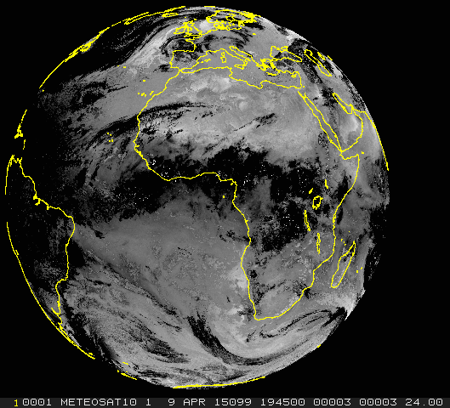
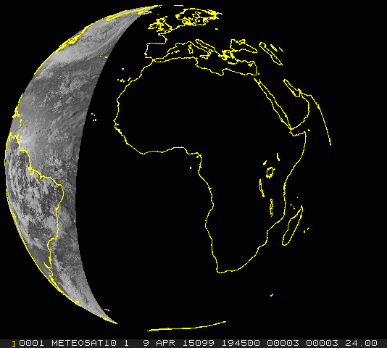
Vis/Fog Difference
GOES-16 version

Slide 5
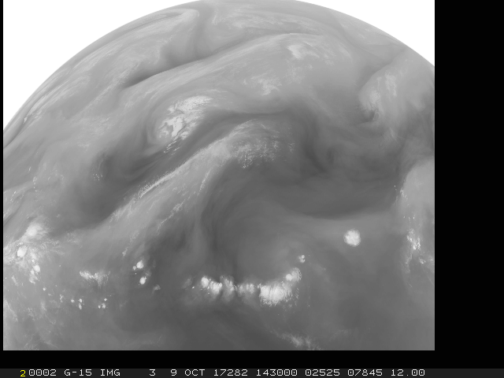
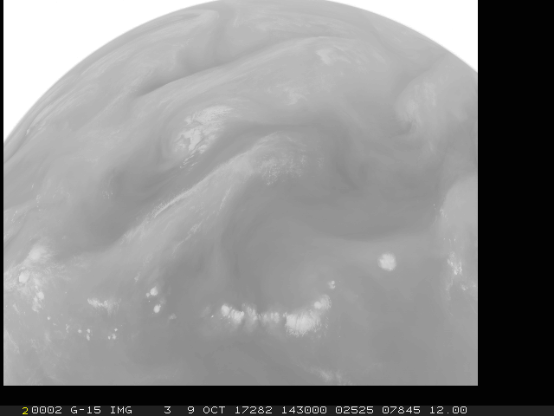
Water Vapor imagery
Expanded display with 2017.2
2017.2
2017.1
2017.2 expanded stretch feature added more contrast to WV channels
Discovered the SDIs were still using the original contrast. Added MCS=ORIGINAL to mitigate until the SDI software can be updated

Slide 6
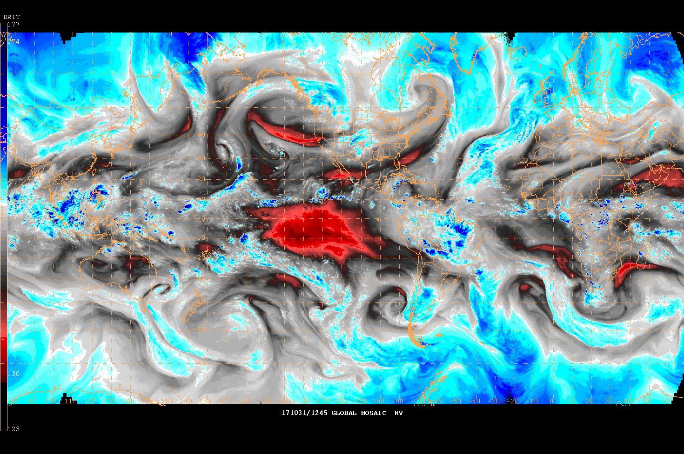
Global Mosaics
Using GOES-16
Global WV composite

Slide 7
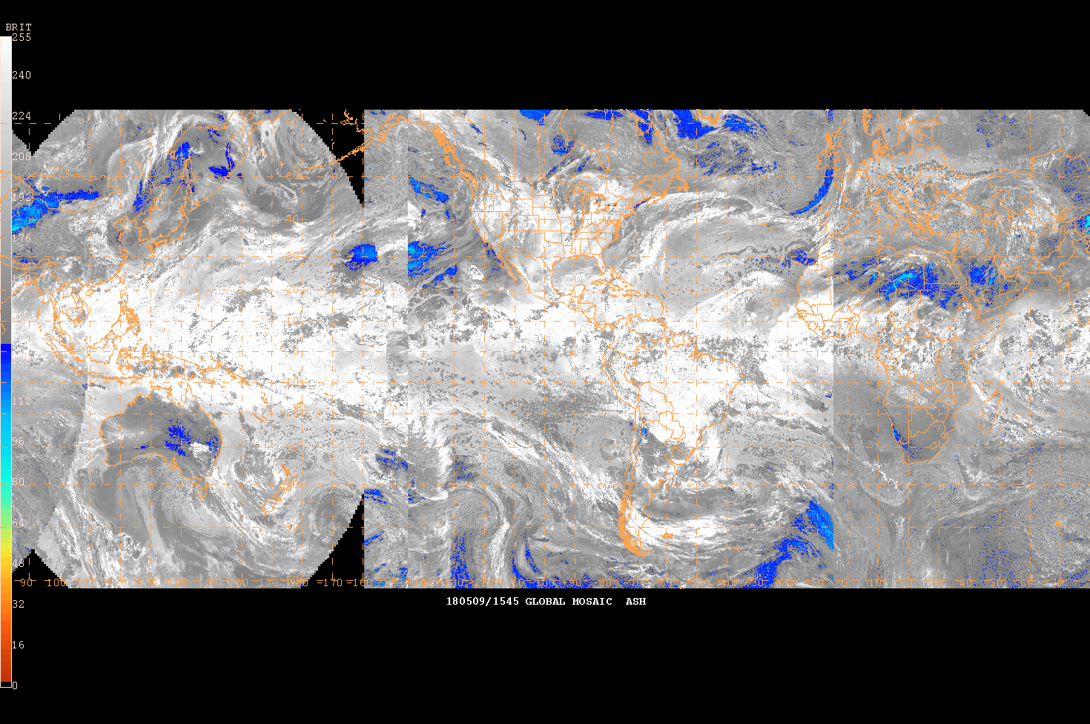
Global Mosaics
Using GOES-16
Global WV composite
Global Ash composite

Slide 8
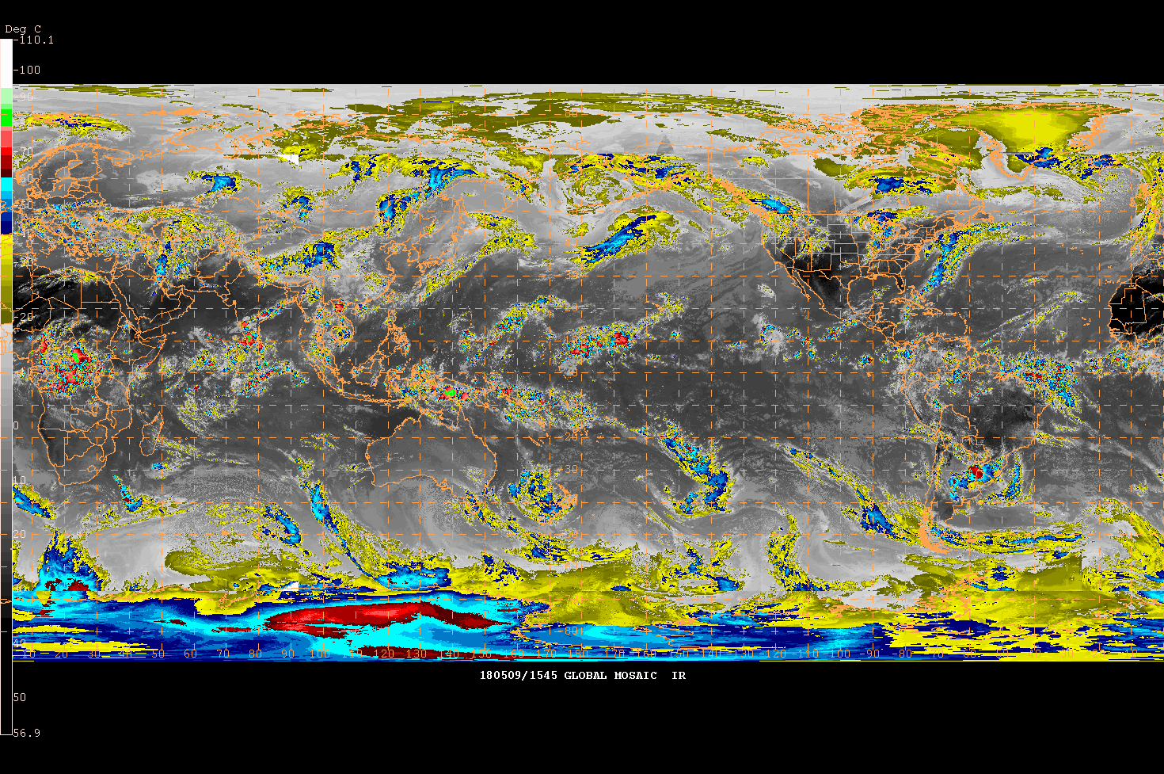
Global Mosaics
Using GOES-16
Global WV composite
Global Ash composite
Global IR composite

Slide 9
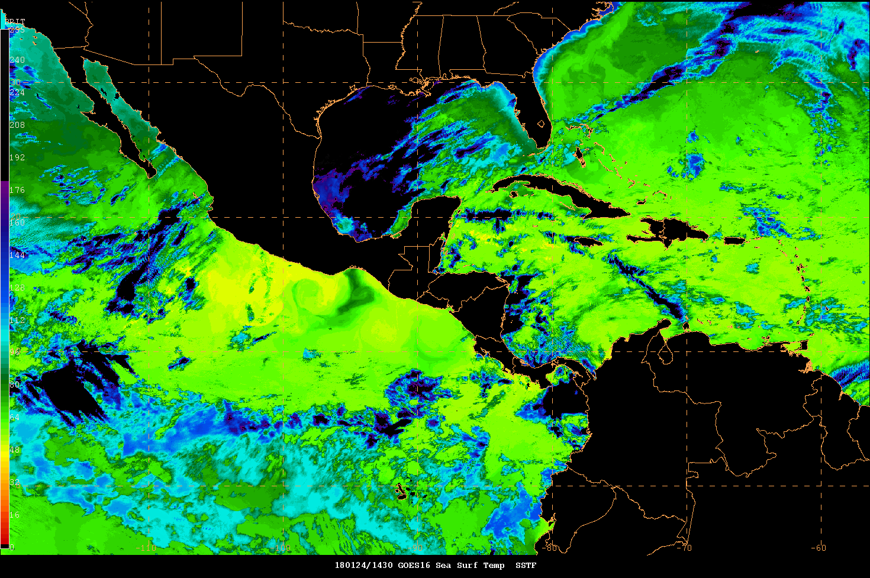
Derived Products
GOES-16 Sea Surface Temperatures
16 June 2017 1957 UTC

Slide 10
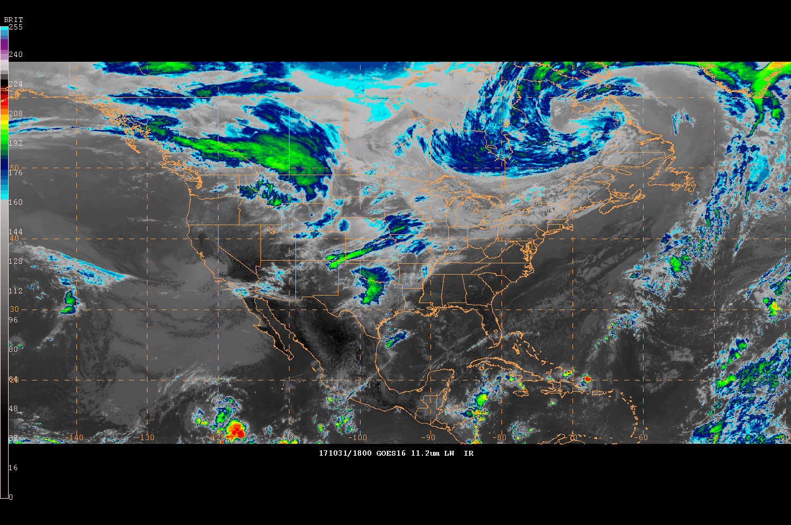
CONUS composites
GOES-16 and GOES-15
IR composite

Slide 11
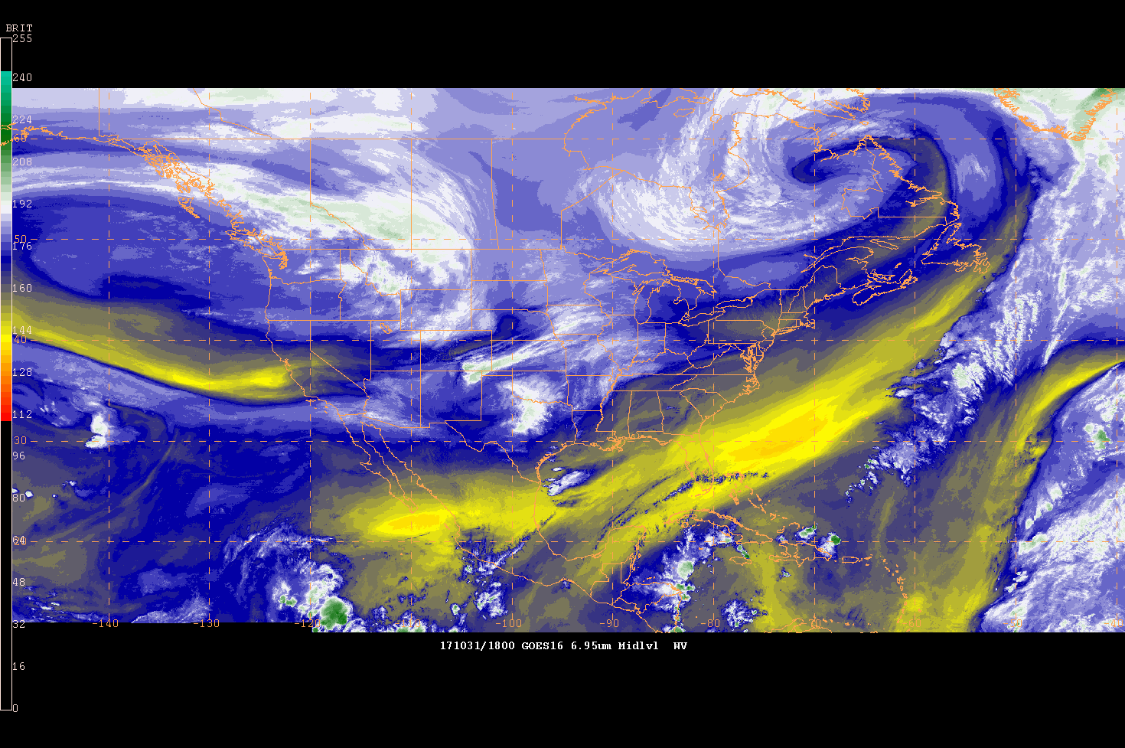
CONUS composites
GOES-16 and GOES-15
IR composite
WV composite

Slide 12
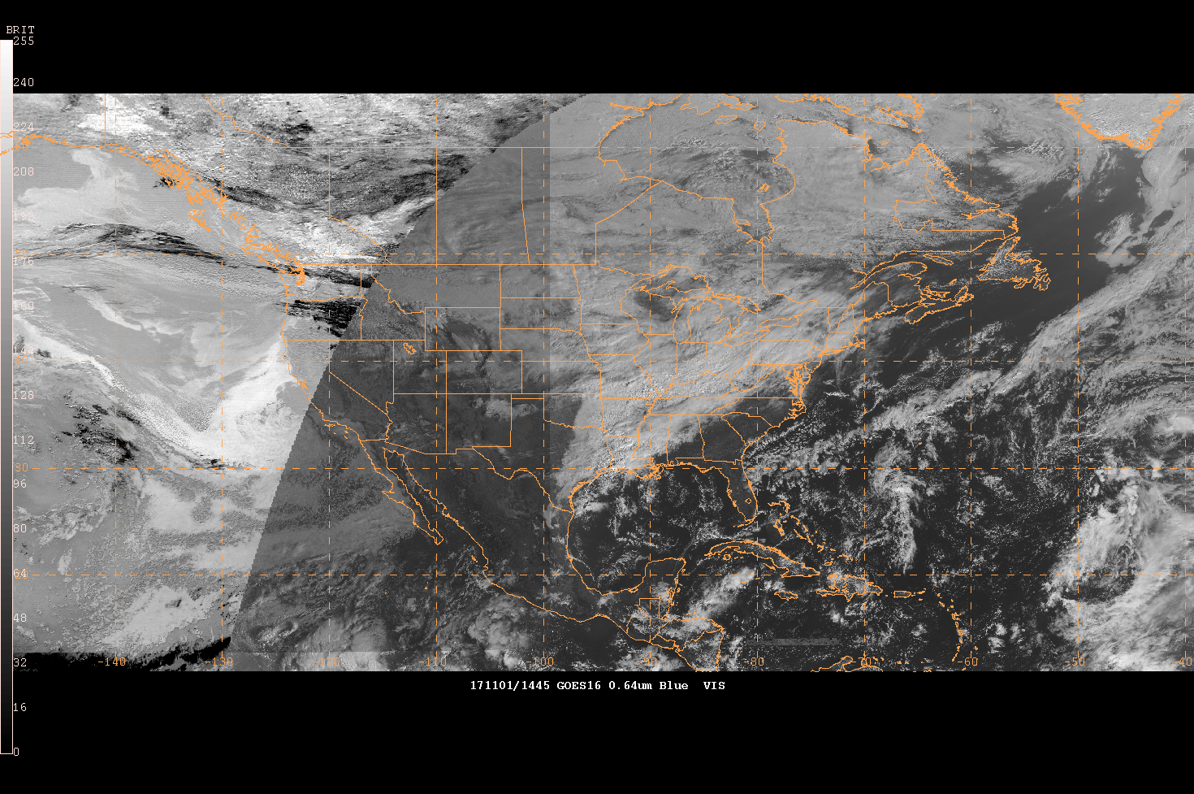
CONUS composites
GOES-16 and GOES-15
IR composite
WV composite
Vis/Fog composite

Slide 13
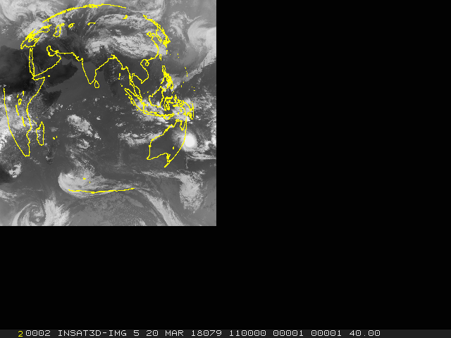
ISRO ADDE servers
Testing INSAT data at AWC
ISRO L1C imager data from EUMETSAT
Viewable through the ADDE IIND keyword
Not meant for L1C data though, so map and navigation were incorrect
Then the feed from EUMETSAT died…

Slide 14
McIDAS-V Utility

Slide 15
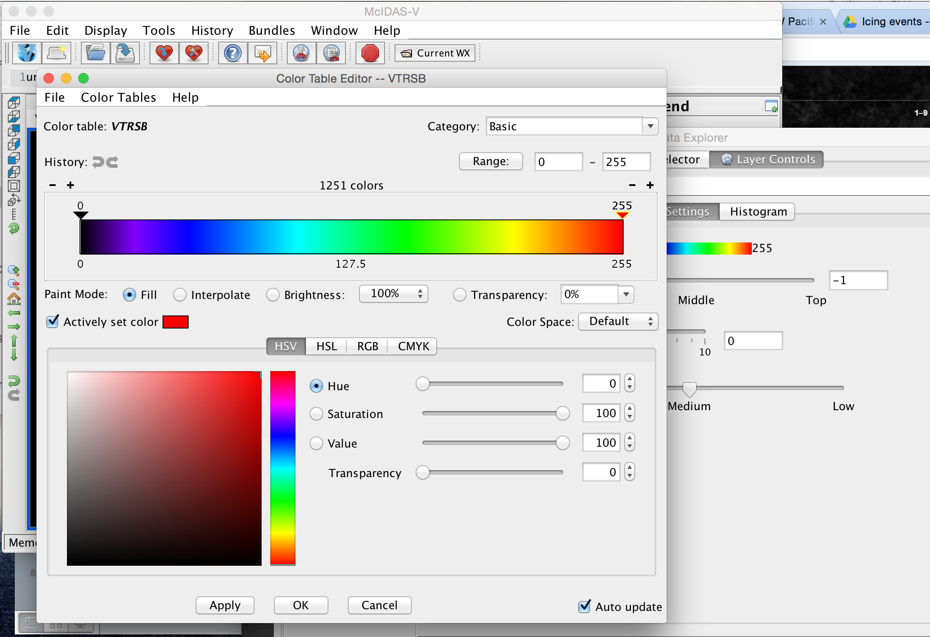
McIDAS-V concepts at the AWC

Slide 16
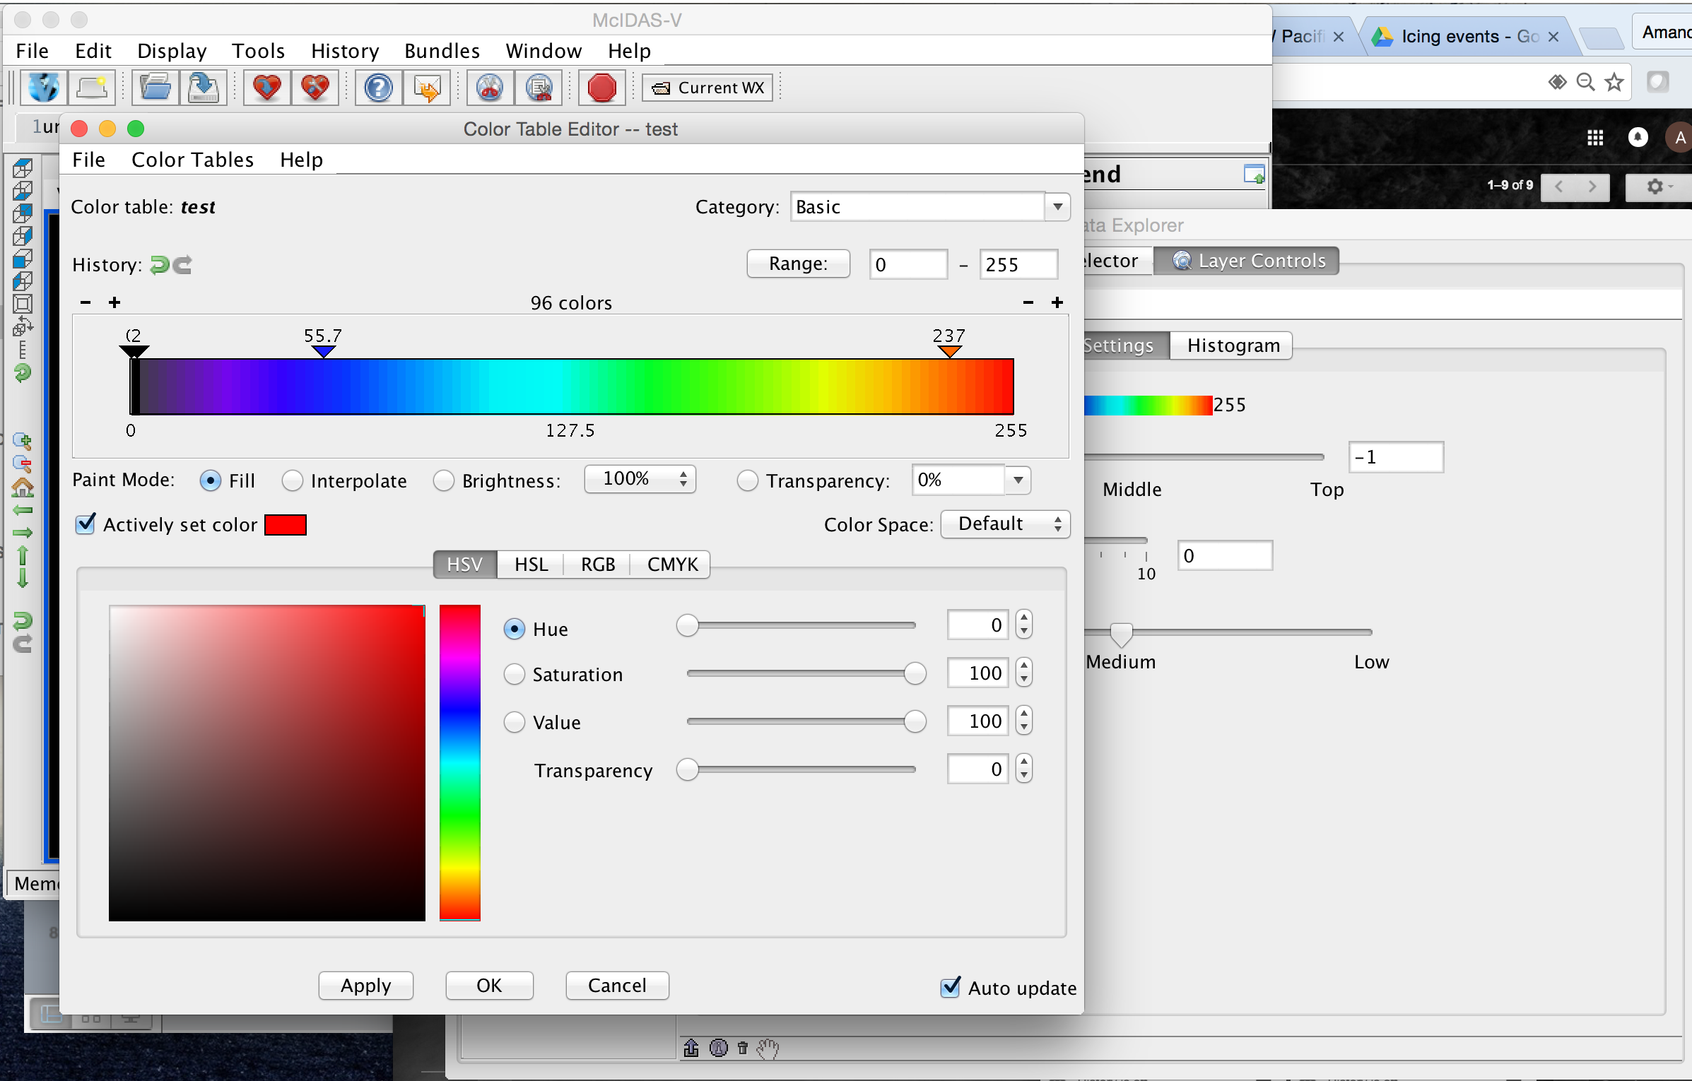
McIDAS-V concepts at the AWC

Slide 17
Questions?
Thanks!

