Slide 1
McIDAS-X Software Development and Demonstration
Dave Santek and Jay Heinzelman
22 May 2018

Slide 2
Overview
McIDAS-X 2017.1, 2017.2, 2018.1
McIDAS-XCD 2017.2, 2018.1
Software development and plans for 2018 and beyond…

Slide 3
Plans from last MUG meeting
November 2016
VIIRS ADDE Server to –XRD
Multi-band transfers for GOES-R ABI
Increase maximum image size beyond 4096 elements (graphics limitation)
Next generation ADDE servers

Slide 4
Imagery
GOES-R ABI
ABI ADDE servers released
Level 1B
Multi-band IMGCOPY
From NOAA PDA server or output from CSPP Geo
Compatible with PLAX (parallax)

Slide 5
Imagery
MCSTRETCH
Improved display of water vapor, shortwave IR, and specific visible channels
Modification to calibration modules and ADDE servers
Initial changes for operational satellites and sensors
Based on ‘stretch tables’ (SU command and keyword)

Slide 6
Imagery
MCSTRETCH
Water vapor bands
ABI, AHI: 8, 9, 10
SEVIRI: 5, 6
GVAR, COMS: 3
MODIS: 27, 28
Old: 163 – 330 K New: 180 – 280 K

Slide 7
Imagery
MCSTRETCH
Shortwave IR bands
ABI, AHI: 7
SEVIRI: 4
GVAR, COMS: 2
MODIS: 20, 21, 22
AVHRR: 3
Old: 160 – 330 K New: 190 – 400 K

Slide 8
Imagery
MCSTRETCH
Visible bands
ABI: 2
AHI: 3
Old: 0 – 100 % New: 0 – 116 %

Slide 9
Imagery
MCSTRETCH= keyword
Improved stretch is the default
Can be overridden with environment variable (MCSTRETCH) or MCStretch= command line keyword
Options are EXPanded or ORIGinal
EU CONV to convert enhancement tables to match new stretch
http://www.ssec.wisc.edu/mcidas/software/x/mcstretch_info.html

Slide 10
Imagery
ABI Level 2 Products
Satellite-derived products
Some netCDF files contain more than one product
Color tables (*.ET) that are similar to those in AWIPS

Slide 11
Imagery
ABI Level 2 Products
McIDAS name | Product name
CMSK | Cloud Mask
CTPR | Cloud Top Pressure
CTH | Cloud Top Height
CTT | Cloud Top Temperature
CTPH | Cloud Top Phase
COD | Cloud Optical Depth
CPS | Cloud Particle Size
LI | Lifted Index
CAPE | CAPE

Slide 12
Imagery
ABI Level 2 Products
McIDAS name | Product name
TT | Total Totals
SI | Showalter Index
KI | K-Index
TPW | Total Precipitable Water
FARA | Fire Detection Area
FT | Fire Detection Temp
FMSK | Fire Detection Mask
FPWR | Fire Detection Power
LST | Land Surface Temperature

Slide 13
Imagery
ABI Level 2 Products
McIDAS name | Product name
ARSL | Aerosol Detection
SMOK | Aerosol Detection Smoke
DUST | Aerosol Detection Dust
AOD | Aerosol Optical Depth
FSC | Fractional Snow Cover
QPE | Rain Rate / QPE
SST | Sea Surface Temperature
VAH | Volcanic Ash Height
VAML | Volcanic Ash Mass Loading

Slide 14
GLM
Global Lightning Mapper
Events, Groups, Flashes
Parallax corrected

Slide 15
GLM
Global Lightning Mapper
Ground System groups lightning flashes from the smallest increments (Events) to aggregates of Events (Groups) to aggregates of Groups (Flashes)
Events are on a grid; each gridpoint is a GLM Field of View
Groups are at the centroid of the Events that comprise the Group
Flashes are at the centroid of the Groups that comprise the Flash
Number of Events > number of Groups > number of Flashes
Real-time GLM datasets consist of netCDF files; each with 20 seconds of data

Slide 16
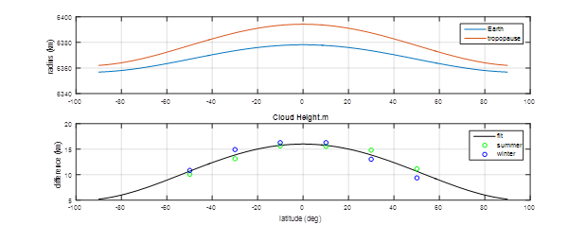
GLM Parallax Model
GLM products are geolocated assuming latitude dependent cloud height.

Slide 17
Display
Large frame size
From 4000x4000 to 32,000x32,000
Large number of frames
999 increased to 9999
RGBDISP
Examples from GOES-16, Himawari, and Meteosat

Slide 18
Imagery
Himawari
Updates for Himawari data (WARI)
Support for landmark regions
Handling undefined values

Slide 19
Imagery
Meteosat
Updates to correct for navigation error
½ visible line and element error
Corrected at EUMETSAT in December 2017

Slide 20
Miscellaneous
Update to maps and station database (NOAA sources)
More precision in output from DIST

Slide 21
McIDAS-XCD
WWDISP, WWLIST
Cancellations, updates, etc.
Polygons
Hourly synoptic
More stations for both METARs and synoptic reports
Case sensitive searching

Slide 22
McIDAS-XRD
GLMIMG
Density image
VIIRS server
S-NPP and NOAA-20
Unidata: ABI Sectorized Cloud and Moisture Imagery (SCMI) ADDE server

Slide 23
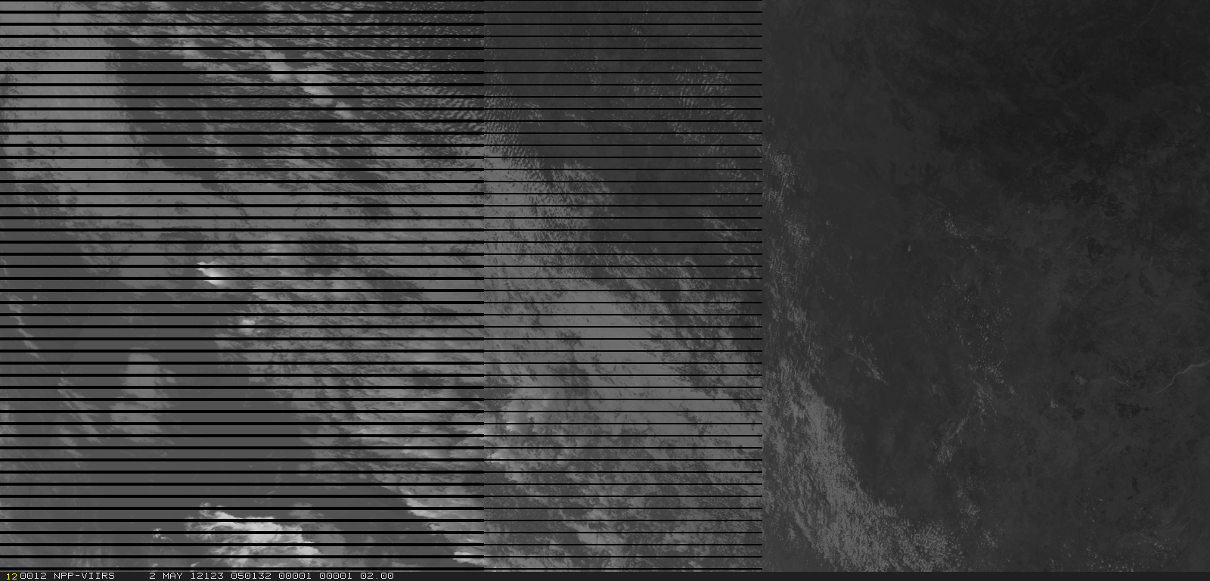
VIIRS ADDE Server
Left half of VIIRS granule with bowtie deletion

Slide 24
Plans for 2018 and beyond
Refine major recent changes:
Number of frames and large frames
MCSTRETCH
RGB display

Slide 25
Plans for 2018 and beyond
Promote from -XRD:
VIIRS server
SCMI server
GLMIMG

