Slide 1
McIDAS –XCD and –XCD Replacement Update
2019 McIDAS Users’ Group Meeting

Slide 2
McIDAS-XCD Team
Kevin Baggett, Jonathan Beavers, Dan Forrest, Jay Heinzelman, Dave Parker, Cameron Penne, Jerrold Robaidek, Becky Schaffer, Clayton Suplinski

Slide 3
McIDAS-XCD
McIDAS X
Conventional Data
Decoder
McIDAS-XCD files, decodes and indexes the NOAAPORT data stream into formats that can be served by McIDAS-X ADDE servers.
Output formats include McIDAS MD files, Text files, McIDAS GRID files, GRIB
Version 1 and 2 files, NEXRAD files, and BUFR files.

Slide 4
Recent Updates to McIDAS-XCD
Latest version is 2019.1
Many station additions/updates to STNDB.CORE and accompanying MD files
Additions/updates to RTGRIDS datasets with increased volume of GRIB data coming across NOAAPORT/CONDUIT data feeds
Added TEMP SHIP data category, radiosonde observations from ships
Not many readings, but requested by Johnson Space Center
Mandatory levels only at this time

Slide 5
Replace -XCD?
McIDAS –XCD has been reliably providing data to McIDAS-X users for many years but has its issues behind the scenes:
Installation is difficult
Upgrades are difficult
System is overly complex, large learning curve for operators, and very large learning curve for new programmer
System was written for a mainframe then ported to UNIX
A powerful system is needed to run -XCD, otherwise data can be lost
A data format change can mean bad data, and a fix can be difficult to implement, and is only effective for future data

Slide 6
Goals
Replace 4 parts of -XCD filing and decoding:
GRIB
NEXRAD
Text
POINT/MD serving
Utilize LDM direct filing
Reduce or eliminate compiled code
Remove legacy mainframe complexity
Utilize simple open-source database, SQLite
Match or exceed current filing and serving performance on existing hardware

Slide 7
-XCD Replacement: Packaging and Installation
Existing servers and decoders (compiled code) are to be migrated into McIDAS-X
-XCD replacement beta GRIB and text software have been packaged as Docker containers and tested on a Linux RHEL 7 machine
We utilize Unidata LDM that can be packaged as a Docker container as well
Docker has the goal of simplifying the installation, running, and upgrading of the replacement –XCD components for the benefit of system administrators.

Slide 8
-XCD Replacement: Requirements
Linux (RHEL 7)
Docker (most recent version)
docker-compose
Unidata LDM or LDM Docker container
Need to modify with configuration files specific to –XCD and the site
pqact.conf
ldmd.conf
registry.xml

Slide 9
-XCD Replacement System
-XCD/site-specific config files
docker-compose up
Future
Unidata LDM
xcdtext
xcdgrib
xcdbufr
Raw NEXRAD (WSR & TDWR) files
Raw .XCD text files
Raw .grib1/grib2 files
Raw .bufr files
SQLite daily
text databases
SQLite GRIB databases separated by
date, model, and GRIB version
SQLite BUFR databases separated by date and BUFR version
ptdb* servers
nexr* servers
wtxgserv
gribdb* servers
bufrdb* servers

Slide 10
-XCD Replacement: GRIB Data
RTGRIDS dataset
LDM files GRIB messages to a temporary directory
A Python daemon watches for GRIB data, extracts information and files metadata into a SQLite database
SQLite databases are separated by version, model and date
Volume of GRIB data has increased greatly to 500 GB/day over the last few years
A big challenge!

Slide 11
-XCD Replacement: NEXRAD Data
RADAR, WSR and TDWR datasets
LDM directly files NEXRAD files (WSR and TDWR) into a directory structure similar to the existing -XCD Decoder
Data served by the existing NEXRAD server

Slide 12
-XCD Replacement: Text Data
RTWXTEXT dataset
LDM files text data directly to disk as a daily .XCD file
A bash daemon script watches for new data and extracts metadata for insertion into a daily SQLite database
Text servers (wxtgserv and obtgserv) query the daily SQLite databases to find data and return information to the client
Commands: WXTLIST, WWLIST, WWDISP, *RPT

Slide 13
-XCD Replacement: Point Data
RTPTSRC dataset
Uses certain text data identified by WMO headers filed in the daily SQLite text database (e.g. SA and SP for SFCHOURLY)
No MD files are created, but structure created on the fly when serving via ADDE
At the start of each UTC day, the replacement –XCD creates a station table in the database based on the current version of STNDB.CORE
Commands: PTLIST, PTDISP and PTCOPY
Retrieve metadata from the SQLite database, then extract data from the daily *.XCD files created by LDM

Slide 14
Point Data Improvements
Replacement –XCD captures more surface hourly data than existing –XCD
Existing –XCD: Hourly & 2 Specials
Replacement –XCD: Hourly & All Specials

Slide 15
Point Data Issues
Number of hourly records of PTCOPY for SFCHOURLY data needs to be increased, but can be a variable number
Up to 10 specials per hour?
Certain searches in new –XCD take longer than in –XCD 2019.1
SFCLIST CO=US DAY=21/MAY/2018 TIME=0 23 SEL=‘T[F] 60 90’ takes about 2-3 seconds in –XCD 2019.1 vs 60+ seconds in the replacement –XCD due to MD files storage of temperature data versus replacement –XCD having to calculate the temperature data on the fly from the raw text data

Slide 16
BUFR Data (Binary Universal FoRmat)
Filed directly using LDM
Using the ecCodes Python API from ECMWF, we have been able to set up a prototype BUFR Version 3 and 4 SQLite database system similar to the GRIB system with aspects of text data
We have been able to serve BUFR data from this prototype using the PTLIST/PTDISP commands
Not delivered with the current replacement -XCD package due to slow performance and other issues from what appears to be from the ecCodes side

Slide 17
Local Data
A couple -XCD sites have local (non-NOAAport) feeds of data
We have contacted those sites in the past
So far, no core -XCD decoder dependencies are known i.e. sites have written their own decoders
If there is local data that do depend on -XCD libraries, sites will be able to continue to use -XCD libraries, or may link to McIDAS-X libraries as needed. Contact Jerry Robaidek or Becky Schaffer if you have concerns.

Slide 18
-XCD Replacement Monitoring
Command line
ldmadmin watch
gribadmin
Graphical
HTML based
Does not require apache to be installed

Slide 19
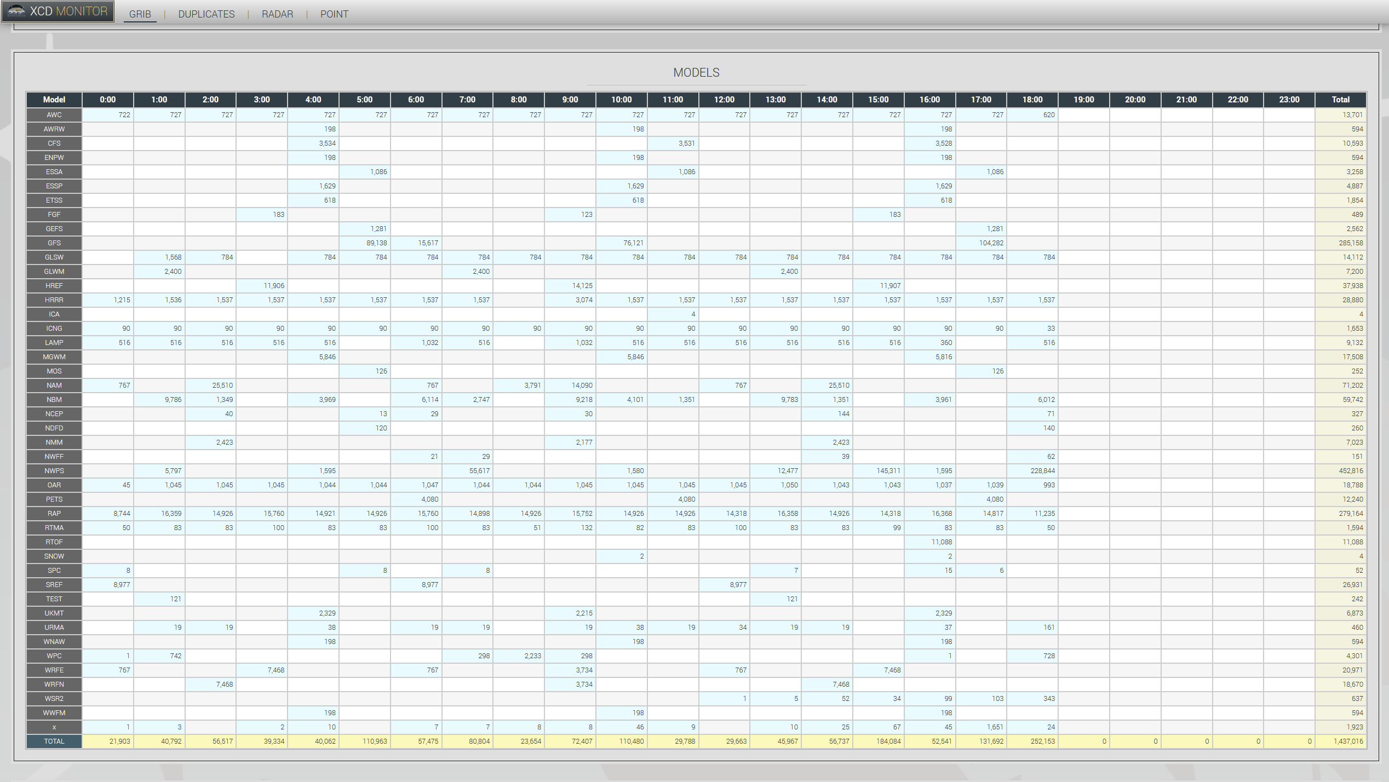
-XCD Replacement Monitoring

Slide 20
-XCD Replacement Meeting
-XCD sites can meet with our team tomorrow at this location from 9:00 to 9:30 am
Sample download and installation process of beta version of –XCD replacement and the related McIDAS-X servers
Bring any questions you may have

