Slide 1

McIDAS Imagery Produced for NCAR/EOL Field Campaigns
Carol Costanza and Greg Stossmeister
National Center for Atmospheric Research (NCAR)
Earth Observing Laboratory (EOL)

Slide 2
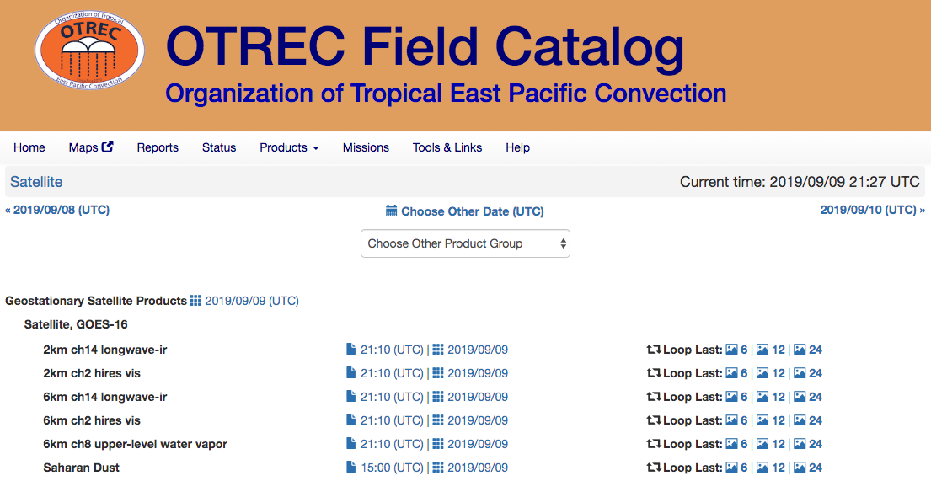
What is the Field Catalog?
Real-time Imagery
Quicklooks
Reports
Mission Table
Catalog Maps
http://catalog.eol.ucar.edu/
102nd Field Catalog since 1995

Slide 3
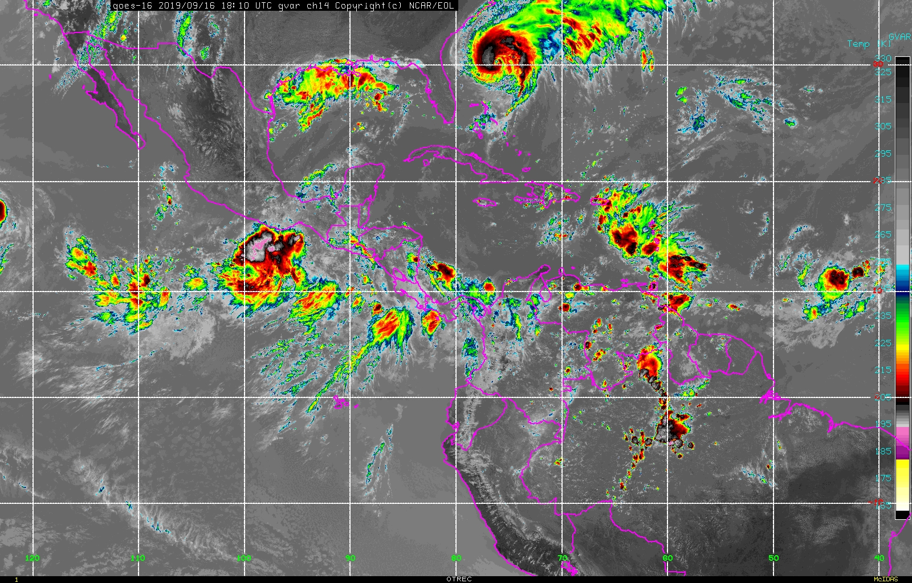
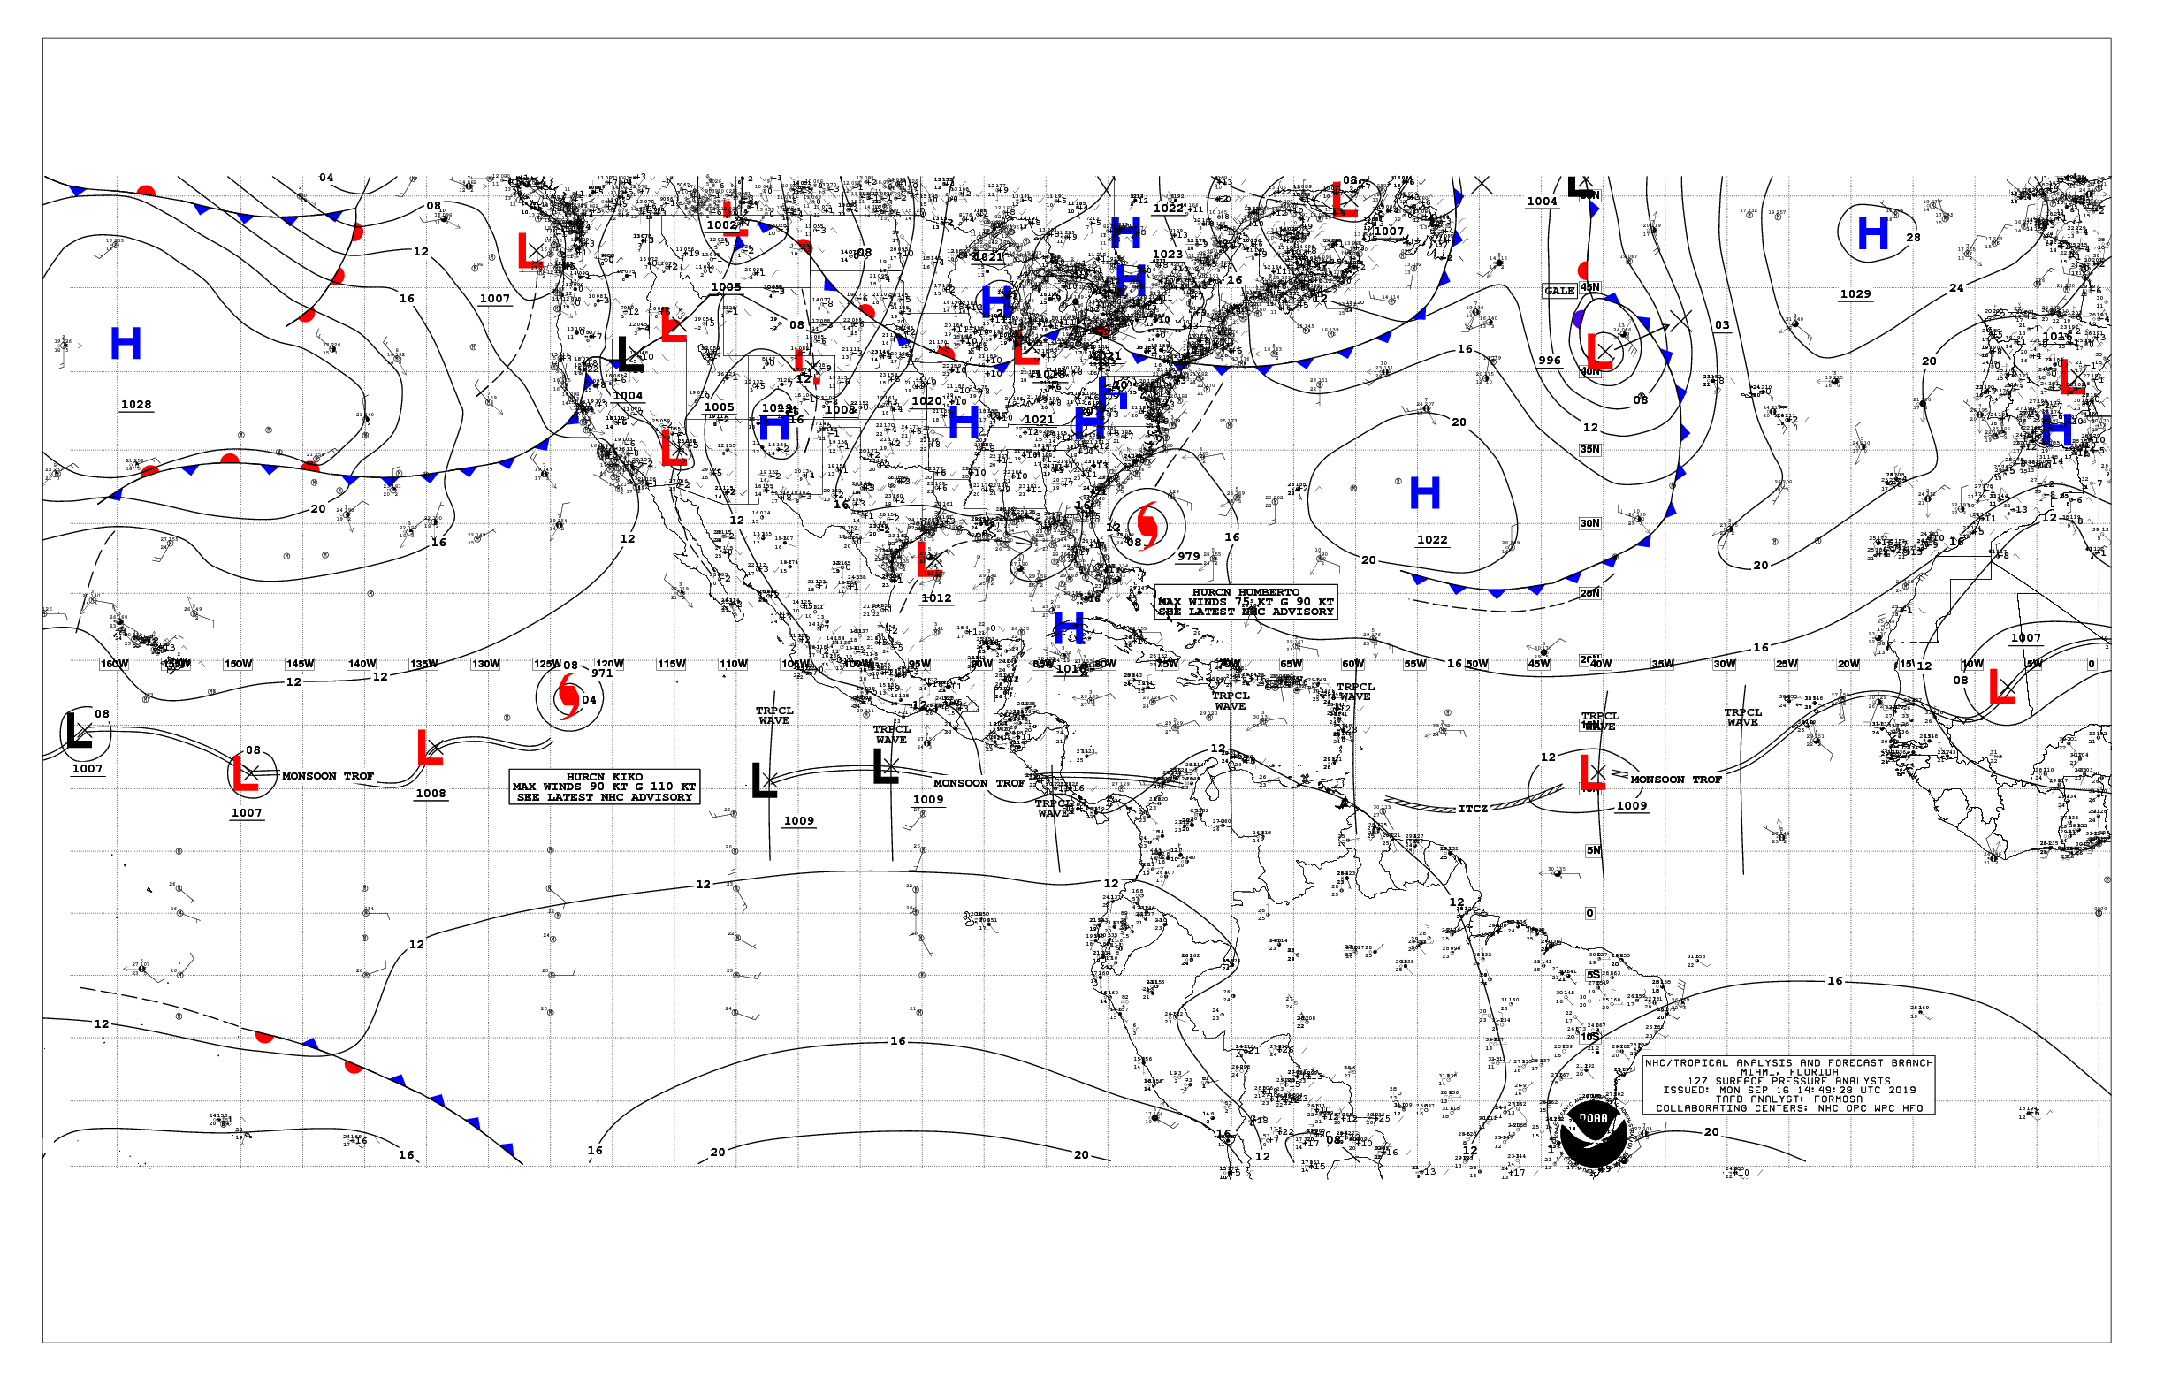
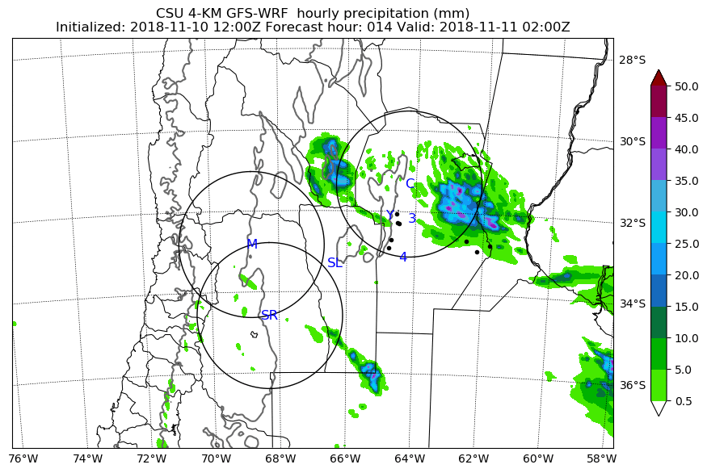
In-House Products
Web Products
PI Generated Products

Slide 4
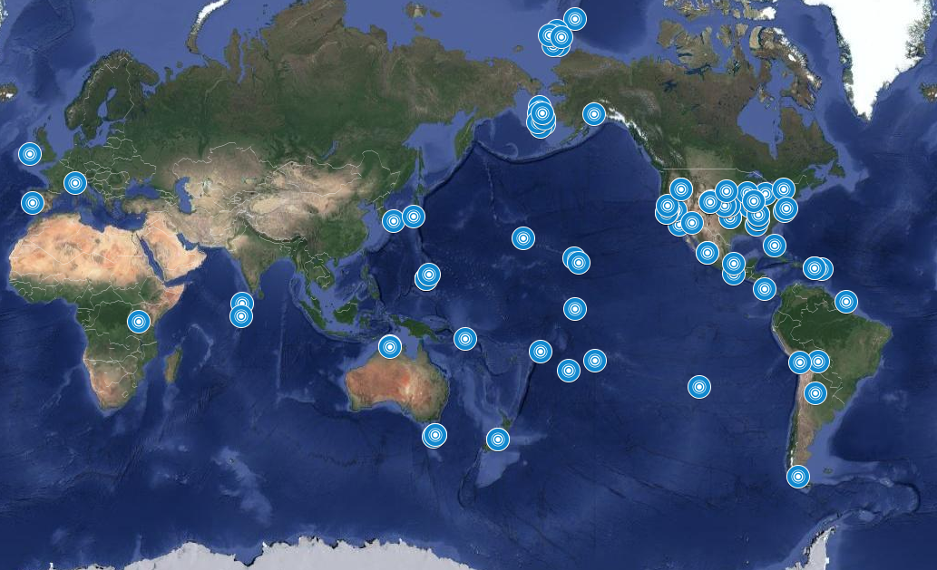

Slide 5
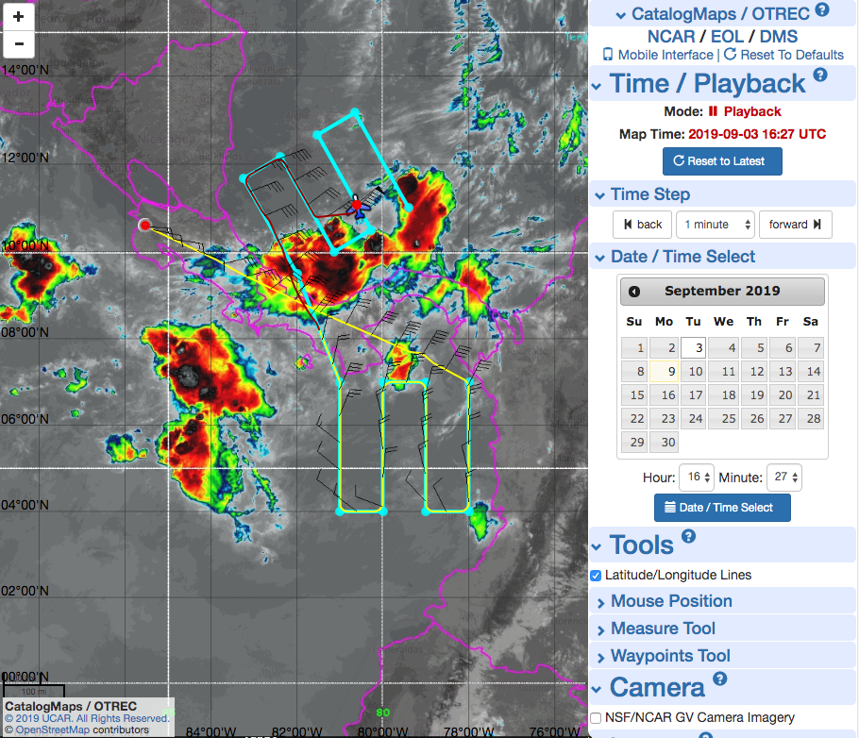
Catalog Maps
Flight Tracks
Flight Plans
Radar Overlays
Satellite Imagery
Lightning
Playback

Slide 6
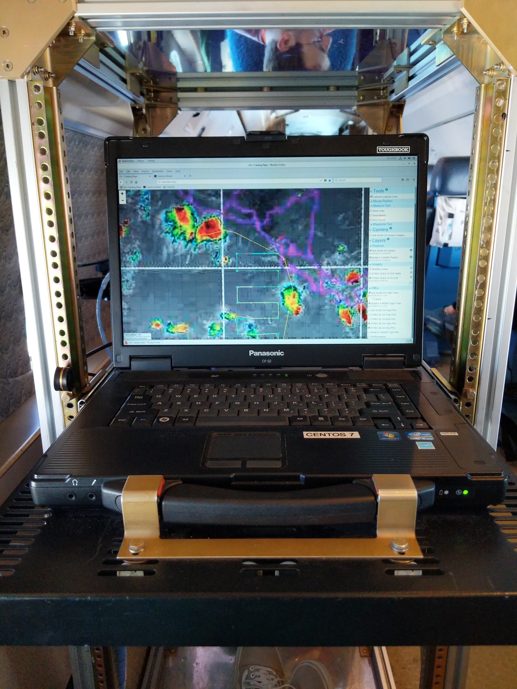
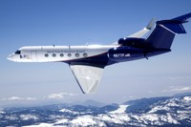
Other Features
Relay McIDAS imagery to research aircraft
Scaled down Catalog Maps
IRC chat
Instrument status
Burn charts
NSF NCAR GV

Slide 7
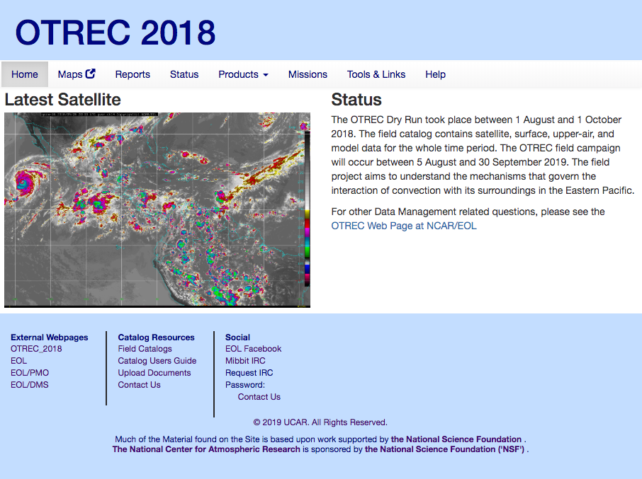
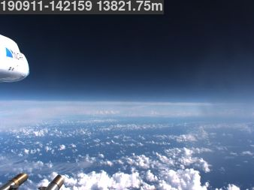
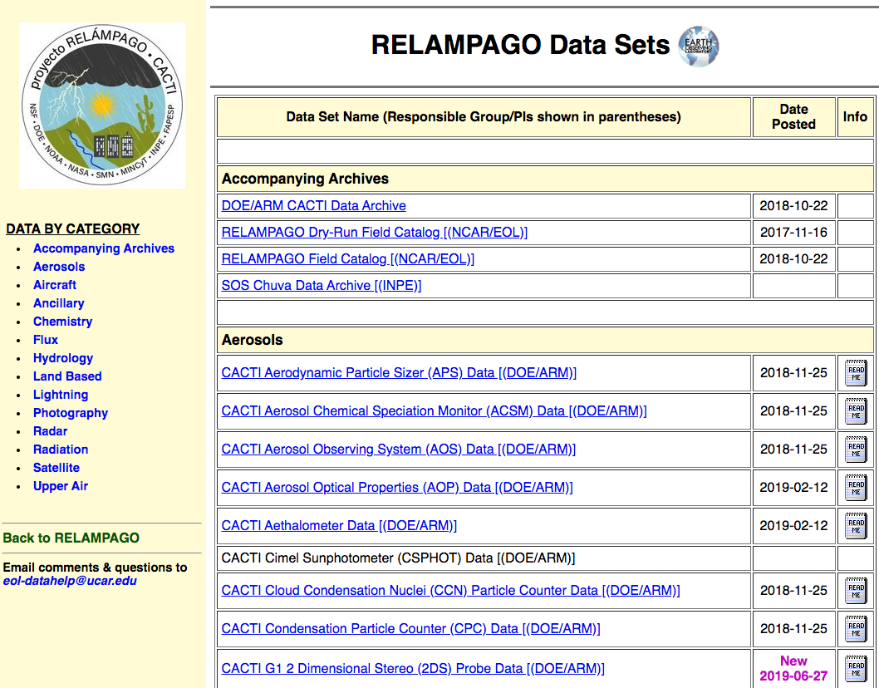
Planning
Operations
Post

Slide 8
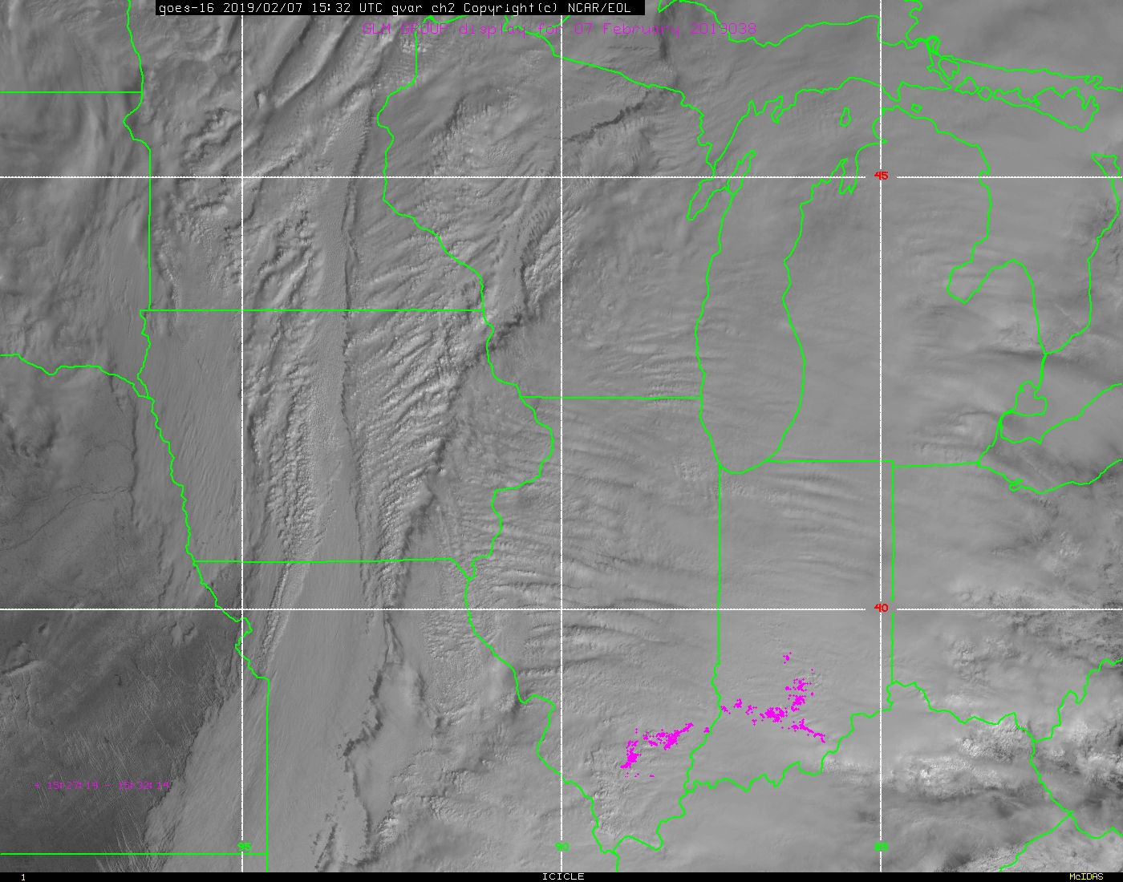
How do we use McIDAS?
GOES-16
HIMAWARI-8
METEOSAT-11
Other Polar Orbiters
Creating 5, 10, or 15 minute imagery over project domains
Mercator

Slide 9
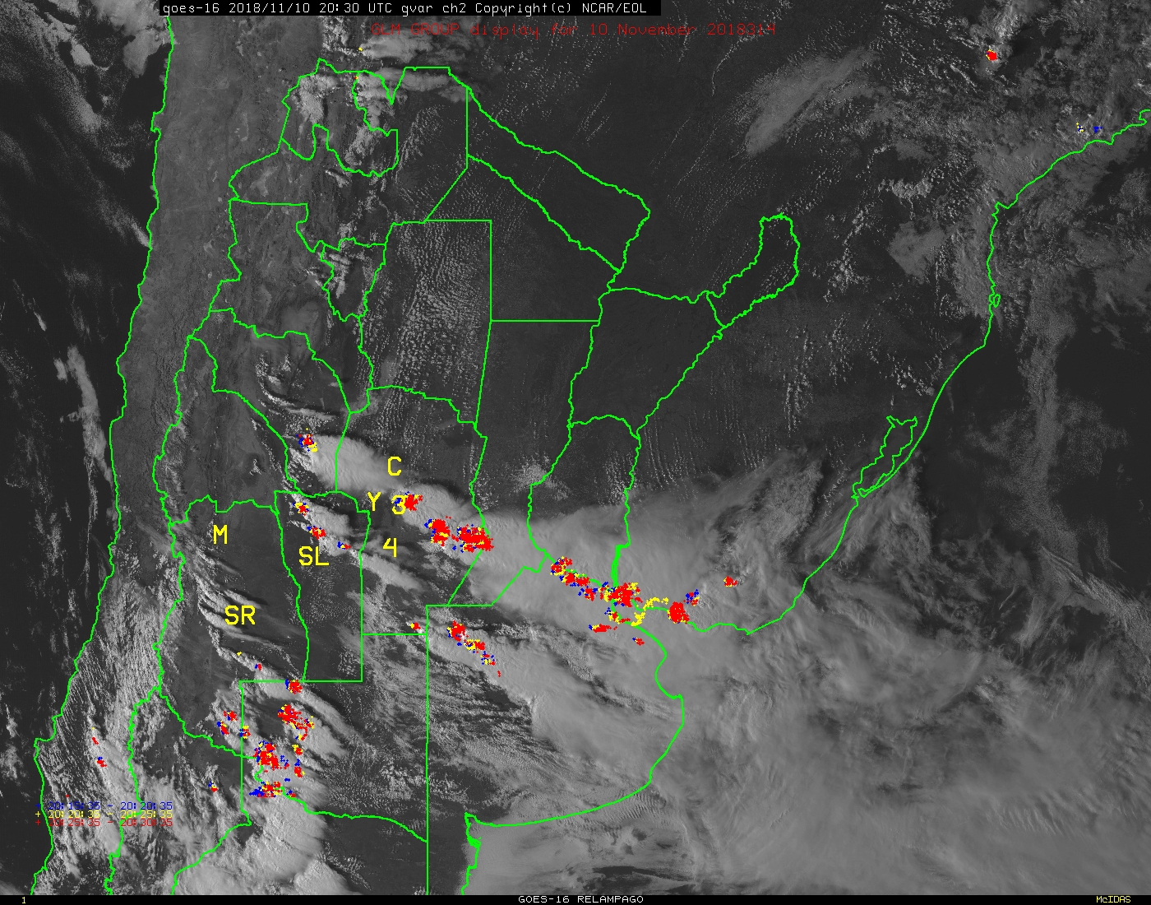
GLMDISP
Started in Fall 2018
Plotting GROUP
Full Disk intervals every 5 minutes
Especially useful outside USPLN

Slide 10
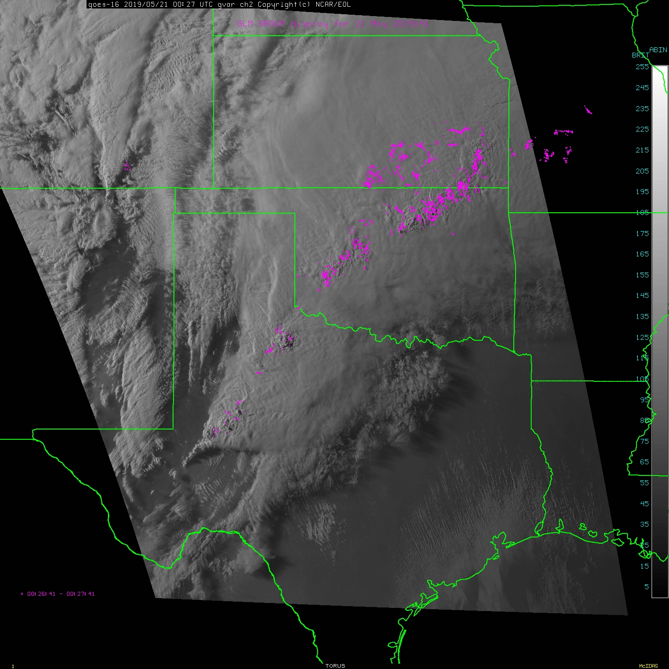
Moving MDS with GLM
PIs can request their own MDS over a given project domain
Searching over a 10 ° by 10 ° area
1 minute imagery with 1 minute GLM data

Slide 11
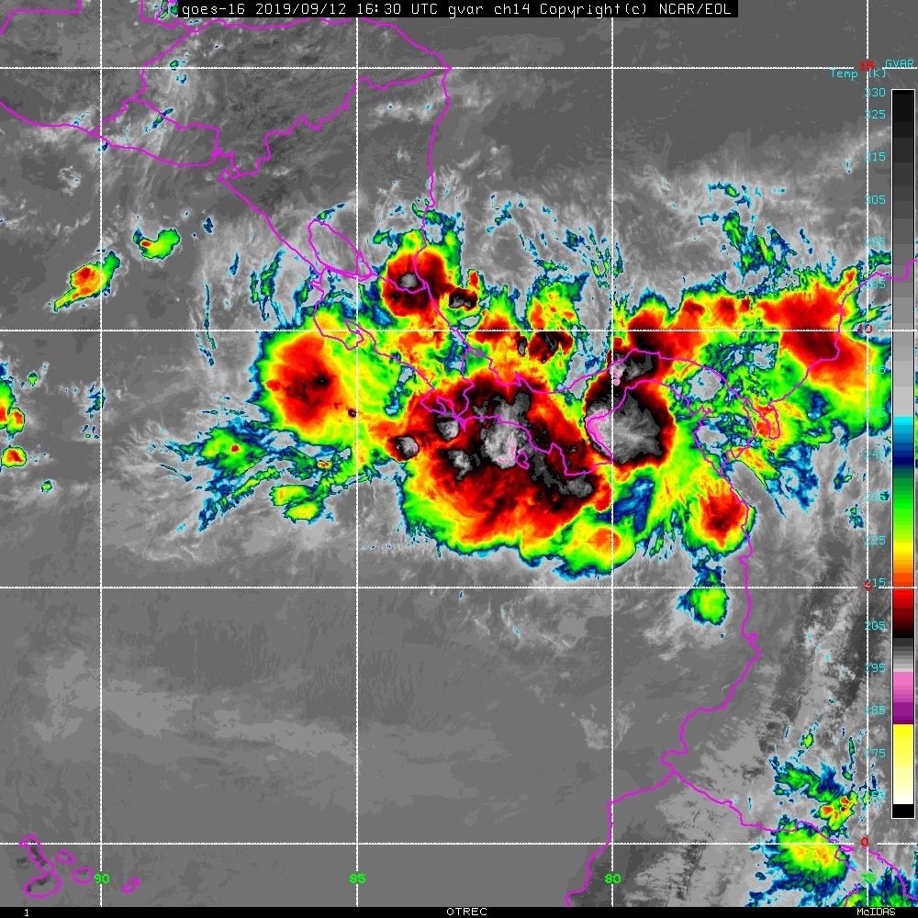
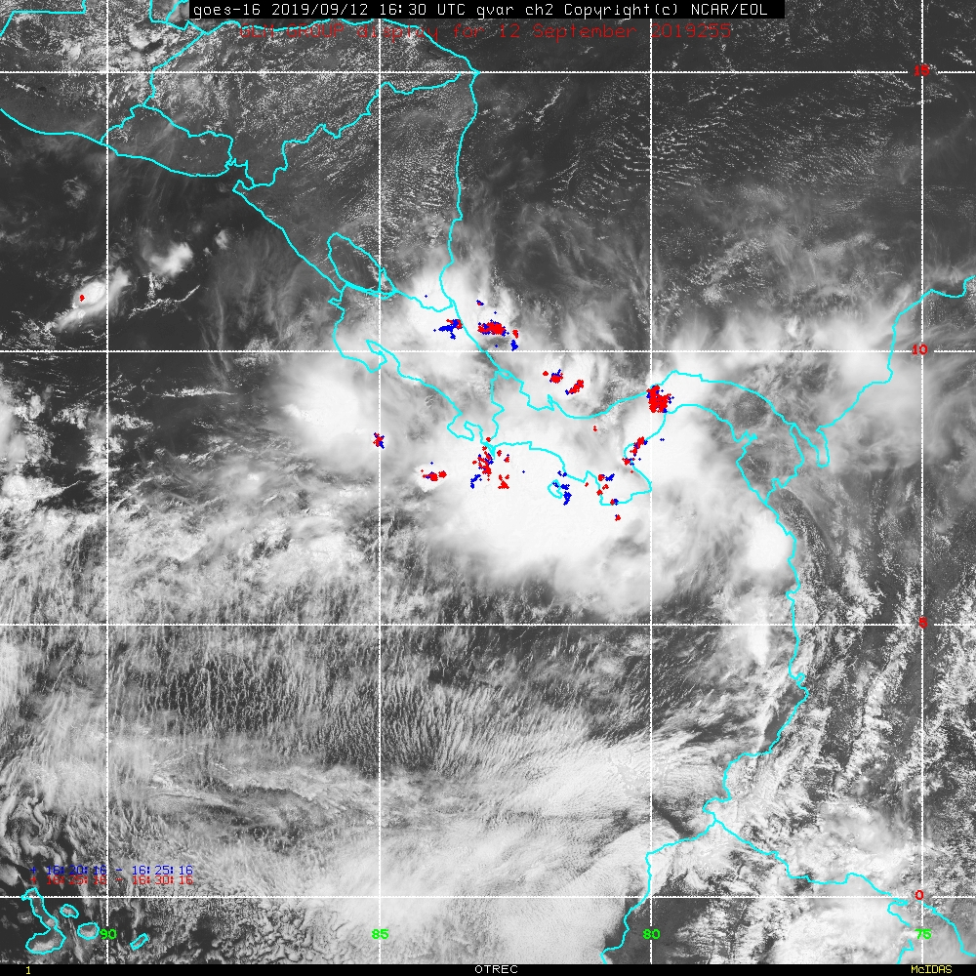
Thank you!
Field Catalog is a requestable resource NCAR/EOL can provide for any field campaign
Contact Carol (costanza@ucar.edu) or Greg (gstoss@ucar.edu) for more information

Slide 12
Demos
General OTREC Field Catalog
http://catalog.eol.ucar.edu/otrec/satellite/209/loop?utf8=%E2%9C%93&category=15&subcategory=209&date=2019%2F09%2F09&platform=1299&hours%5B%5D=+0&hours%5B%5D=+1&hours%5B%5D=+2&hours%5B%5D=+3&hours%5B%5D=+4&hours%5B%5D=+5&hours%5B%5D=+6&hours%5B%5D=+7&hours%5B%5D=+8&hours%5B%5D=+9&hours%5B%5D=10&hours%5B%5D=11&hours%5B%5D=12&hours%5B%5D=13&hours%5B%5D=14&hours%5B%5D=15&hours%5B%5D=16&hours%5B%5D=17&hours%5B%5D=18&hours%5B%5D=19&hours%5B%5D=20&hours%5B%5D=21&hours%5B%5D=22&hours%5B%5D=23&loop_dataset_290205.x=7&loop_dataset_290205.y=2
http://catalog.eol.ucar.edu/relampago/satellite/209/loop?utf8=%E2%9C%93&category=15&subcategory=209&date=2018%2F11%2F10&platform=1299&hours%5B%5D=10&hours%5B%5D=11&hours%5B%5D=12&hours%5B%5D=13&hours%5B%5D=14&hours%5B%5D=15&hours%5B%5D=16&hours%5B%5D=17&hours%5B%5D=18&hours%5B%5D=19&hours%5B%5D=20&hours%5B%5D=21&hours%5B%5D=22&loop_dataset_242748.x=10&loop_dataset_242748.y=9
http://catalog.eol.ucar.edu/icicle/satellite/209/loop?utf8=%E2%9C%93&category=15&subcategory=209&date=2019%2F02%2F23&platform=1299&hours%5B%5D=12&hours%5B%5D=13&hours%5B%5D=14&hours%5B%5D=15&loop_dataset_266224.x=6&loop_dataset_266224.y=4
TORUS May 20th 18:00 UTC catalog maps
OTREC Sept. 3rd 14:30 UTC catalog maps

