Slide 1
McIDAS at ESPC

Slide 2
SAB Use of McIDAS
SAB is 24x7 operation of 5 disaster mitigation desks (Heavy Precipitation, Volcanic Ash, Fire/Smoke/Dust, Marine Pollution, Tropical Cyclones) All desk use Mc-X in some capacity, except Marine which is ArcGIS
McIDAS-X Usage: ~10 operational Linux systems with 24 GB RAM each and multiple monitor visualization setup
A persistent daemon (image loop refresh) “SPIDER” uses ADDE protocol to display ~100 imagery loops per system
Use Fnc keys to switch loops and pan entire globe through SPIDER loaded frames (e.g. NW Pacific IR, Shift+F1 - NW Pacific Vis, F2 - Central US IR) and still use command line (grudgingly)
Lots of batch commands and everything is scripted by business work flow
Uses McIDAS AREA files for web site as do NWS offices across country, namely NHC, AWC, NWS Western Region
RGBs delivered by bash script !looprgb.sh as well as function keys
Notes:
SAB uses McIDAS-X operational to monitor Heavy Precipitation, Volcanic Ash, Fire/Smoke/Dust, Marine Pollution, Tropical Cyclones.
ADDE protocol used to display ~100 imagery loops in support of operations.
McIDAS AREA files support OSPO website imagery displaying functionality.

Slide 3
RGBs in SAB
Background script continuously builds/saves RGB components for fast loading
13 RGBs being made full-time in FDSK
Volcano: PAVA, PAVB, ASH, SO2
Weather: DTMP, NTMP, AIRMAS, SEVST
Imagery: TRUE, NATCOL, SNOW
Air quality: SMOKE, DUST
6 in CONUS
PAVA, ASH, SMOKE, TRUE, DTMP, NTMP

Slide 5
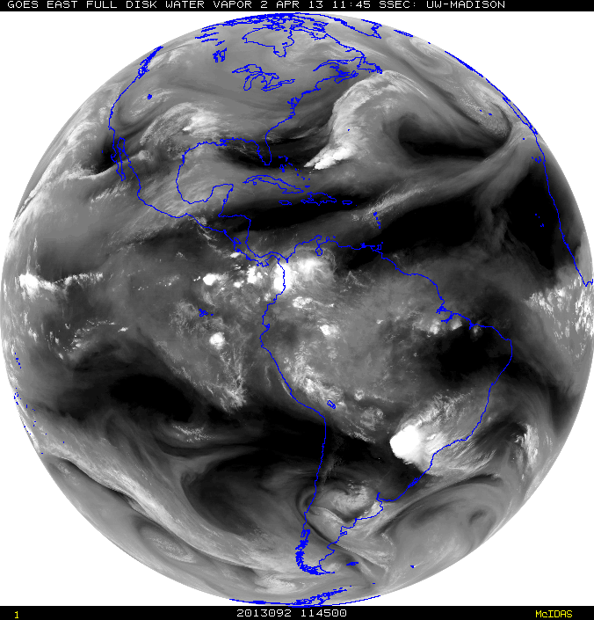
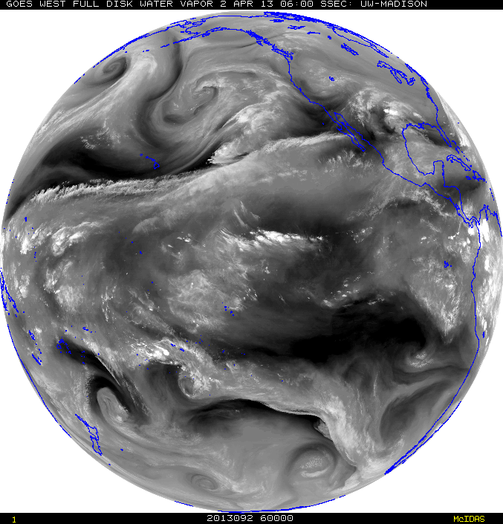
McIDAS Advantages in SAB
Institutional knowledge - SAB Analysts have great familiarity with McIDAS
Ability to have near-global coverage at multiple domain scales and resolution (>2000 frames) of quickly and routinely loaded (SPIDER) imagery at the tap of a button (TU Hotkeys) to perform interrogation, manipulation and value-added analysis when every second counts for time sensitive and rapidly evolving natural and man-made hazards, such as volcanic eruptions, flash flooding, fires, etc.
This cannot be done presently with NAWIPS or HMS. In fact, depending on the area of concern up to 20 minutes is lost waiting for imagery to show up on these other systems vs McIDAS
HOWEVER, since the NWS is the primary user of many SAB products (e.g. volcanic ash and heavy precipitation), there are benefits for SAB to conduct PG on NAWIPS like, quick overlays and seamless in-tool distribution. Fire uses HMS for analysis.
Notes:
There are several advantages for SAB in using McIDAS.
Some advantages are existing institutional knowledge, near global coverage ability, data manipulation functions, and faster image loading compared to other applications.
SAB analyst also like the advantage of using McIDAS vs other systems for its ability of toggle quickly between VIS and IR.

Slide 6
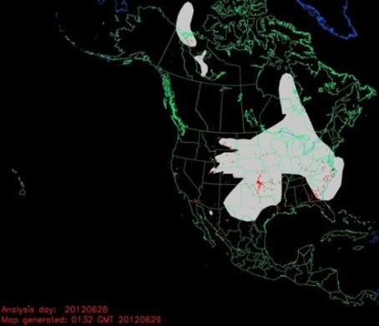
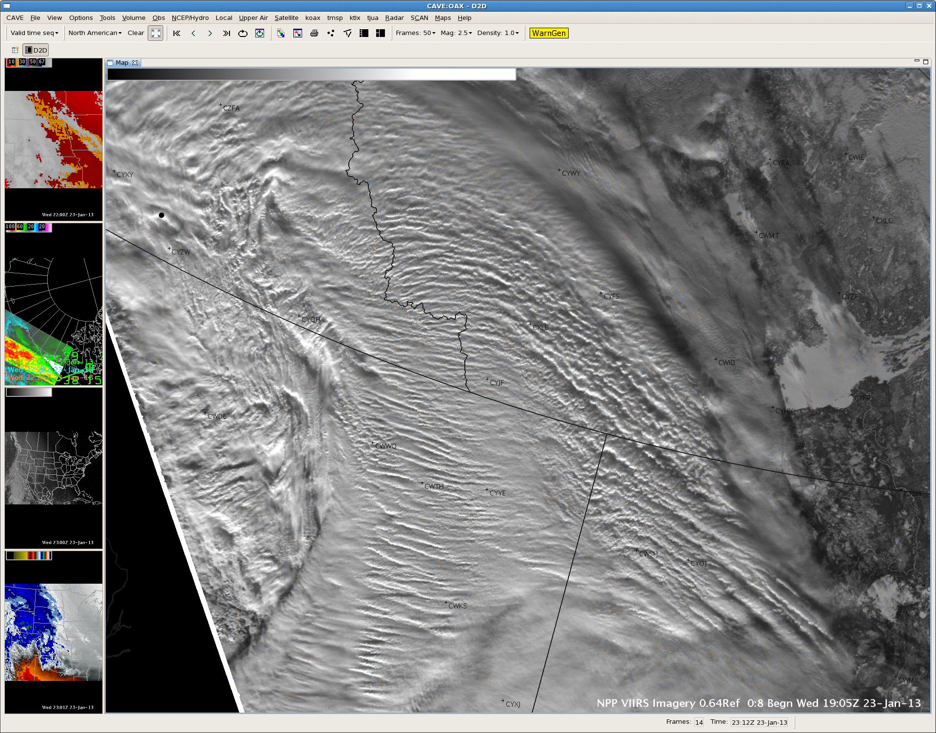
SAB Use of McIDAS for GOES-16/17
Dedicated servers to ingest GOES-R series data – hold seven days
Redundant data feeds from GRB antenna (NCEP, College Park, via LDM) and by PDA (local curl scripts)
Soft links between old AREAnnnn names and netcdf files allow Spider to continue its distribution role
Numeric limit extended to 10K per directory, from 10K total
Setting up to have most RGB components pre-generated
Notes:
What does the future hold for McIDAS use at ESPC and SAB?

Slide 7
RGB Image in the Washington Post…

Slide 8
From the NWS…

Slide 9
From NOAA/STAR…

Slide 10
Which made it with McIDAS

Slide 11
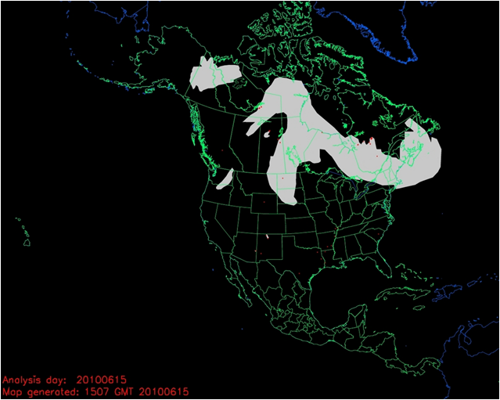
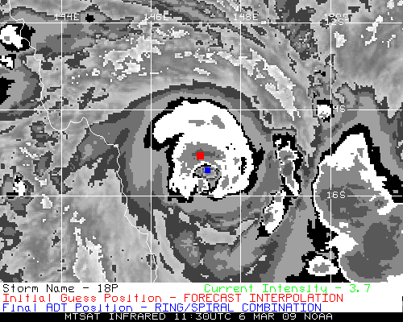
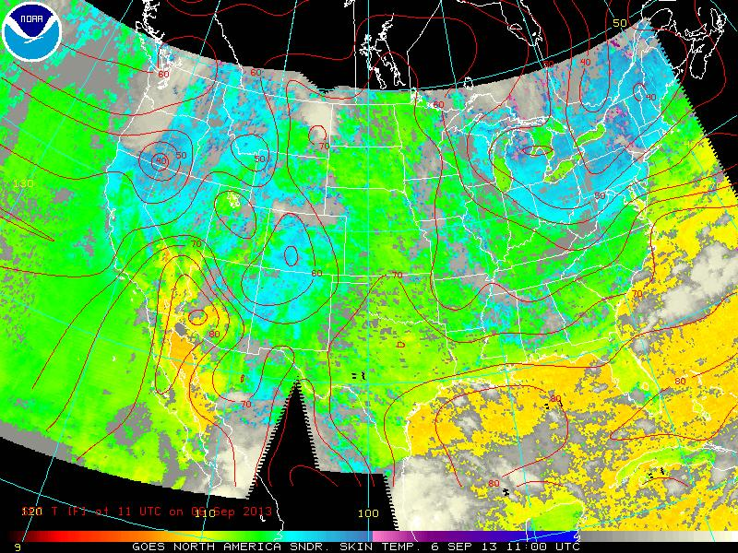
McIDAS & ESPC Applications
Over 50 applications in ESPC use McIDAS, McIDAS libraries, input & serve McIDAS AREA Files, MD point files, GRID (McIDAS GRID Format), and Text via ADDE
ADT, ABBA, CSBT, HMS, others…
Notes:
ESPC has over 50 applications that use some form of McIDAS.

Slide 12
Global Mosaics

Slide 13
Arctic Composite Imagery

Slide 14
Dorian Rainfall (GHE)

Slide 15
E-TRaP

Slide 16
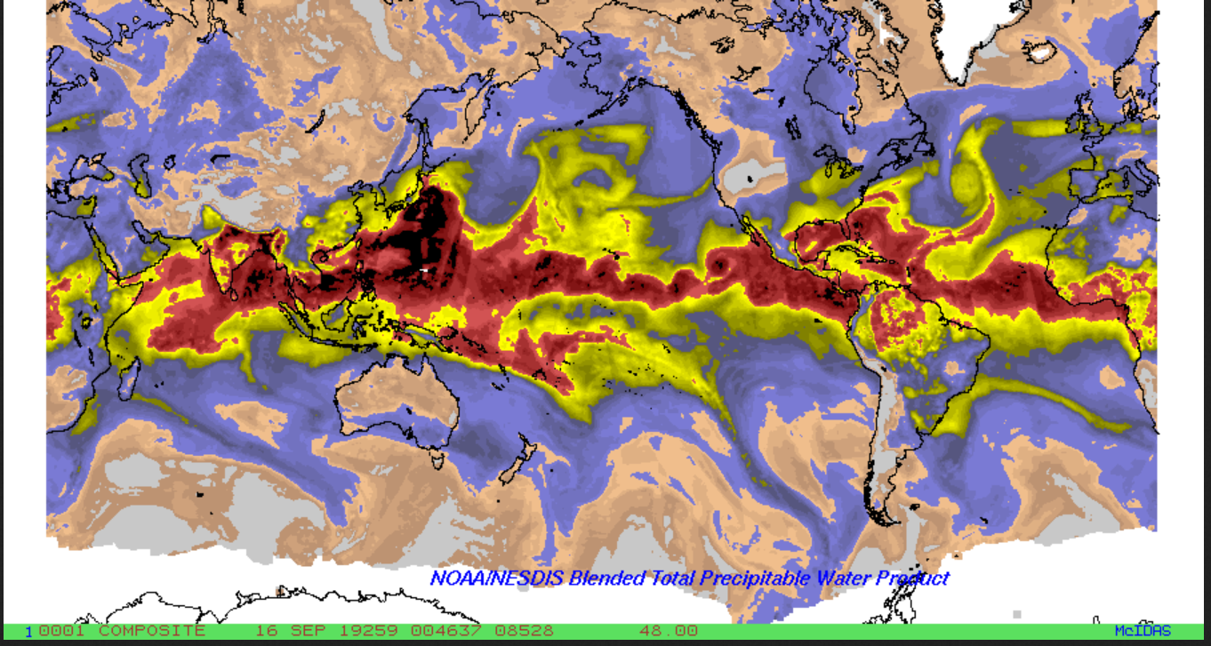
Blended TPW
Notes:
OMI data from Aqua/Modis processed in McIDAS

Slide 17
Satellite Winds

Slide 18
MTCSWA

Slide 19
Fire Products

Slide 20
Smoke Products

Slide 21
NOAA-20 88 GHz

Slide 22
S-NPP 88 GHz

Slide 23
GPM 89 Ghz

Slide 24
AMSR-2 89 GHz

Slide 25
S-NPP 88 GHz (pre-Humberto)

Slide 26
N-20 88 GHz (pre-Humberto)

Slide 27
GPM 89 GHz (pre-Humberto)

Slide 28
AMSR-2 89 GHz (pre-Humberto)

Slide 29
Other Ad hoc McIDAS Usage at ESPC
Heavy usage of the local GINI server in McIDAS format for validation checks (image previews) for conversion of GOES-15 data to NWS AWIPS
Great reliance on GINIs during GOES anomalies to confirm the output images quickly and efficiently (Generated mock AWIPS files to confirm changes to use GOES-14).
Deliver GOES-16/-17 data to select legacy applications
Spoofs GOES-13 and 15 AREA file appearance with IMGREMAP
No or minimal changes required in legacy code to process
Usable by older (pre-GOES-R) McIDAS versions
Imagery on OSPO web page generated by McIDAS-X client-side software.
GHE and Arctic Composite – because they use so many different datasets -act as “coalmine canaries” for ingest issues
Notes:
There is heavy ad hoc McIDAS usage for image format validation.
Also McIDADS is used to confirm anomalies/outages.
McIDAS-X client-side software is used to create all of the imagery on the OSPO web page.

Slide 30
McIDAS Data Delivery Summary
GEODIST –
Geostationary satellite data is ingested, converted to McIDAS AREA format and placed on a server.
In addition, some foreign geostationary data, polar data, model data and derived products are converted into McIDAS.
This data is served via McIDAS ADDE:
Data NSOF Server ADDE Name
Derived Products GEODIST1e DPD
GOES-E GEODIST2e GER PDA/NCDF Only
GOES-15 GEODIST3e GWR
Polar GEODIST4e PLR , MIRS
Model data GEODIST5 MOD
Global Mosaic 5 Sat. Comp. GEODIST6 MOS
MSG/MIO GEODIST6e MSG, MIO
Himawari GEODIST7e HIM
Select requested data SATEPSANONE PUB (not operational)
Surface/Ship Buoy/RAOBs FOS2 FOS (Family of Services)
Notes:
Here a summary of McIDAS Data Delivery at ESPC.
GEODIST is used to serve most data.
Satespone is a non operational server that also stores selected data that is publically accessible.
Family of Services provides surface, ship, and RAOB data.

Slide 31
Data Access Services
Current Access Services (in addition to Direct Broadcast)
Product Distribution and Access (PDA) – Operational*
NWS Telecommunications Gateway
GINI (GOES Ingest and NOAAPORT Interface) / NOAAPORT for Advanced Weather Interactive Processing System (AWIPS) display
GEODIST – GOES, POES, and Derived Products; McIDAS *
Shared Processing DAPE Gateway – for military partners *
MODIS server – subset of products made by NASA *
Websites - http://www.ospo.noaa.gov/
* Require Data Access Request (Government)
Archival
NCEI archive data products using CLASS
Notes:
Current data assess services for customers include: DDS, NWS Telecommunications Gateway, GINI for AWIPS, GEODIST, DAPE, MODSI, Websites, and Achieve.
Customer Use of Servers…
GINI: NOAAPort/AWIPS, NWS, Unidata
GEODIST: NWS/NCEP, DOD, STAR, SAB, Universities, Private Industry
DDS: NWS/NCEP/EMC, ECMWF, UKMET, STAR, DOD

Slide 32
ESPC Notifications, Status, and Contacts
24/7 Help Desk | ESPCOperations@noaa.gov
ESPC Messages | http://www.ssd.noaa.gov/PS/SATS/messages.html
WMO GTS Bulletins | Urgent: http://www.weather.gov/view/validProds.php?prod=ADM&node=KNES Routine: http://www.weather.gov/view/validProds.php?prod=ADA&node=KNES
User Services | SPSD.UserServices@noaa.gov
Data Access | NESDIS.Data.Access@noaa.gov
Webmaster | SSDWebmaster@noaa.gov
Facebook | www.facebook.com/NOAANESDIS
Twitter | www.twitter.com/noaasatellites
Satellite Ops Status | http://noaasis.noaa.gov/NOAASIS/ml/status.html
Press releases | http://www.nesdis.noaa.gov/news_archives/
Web | www.ospo.noaa.gov
Notes:
Please reference the OSPO contact information listed for a variety of resources.

Slide 33
Thank you!
Questions?

