Slide 1
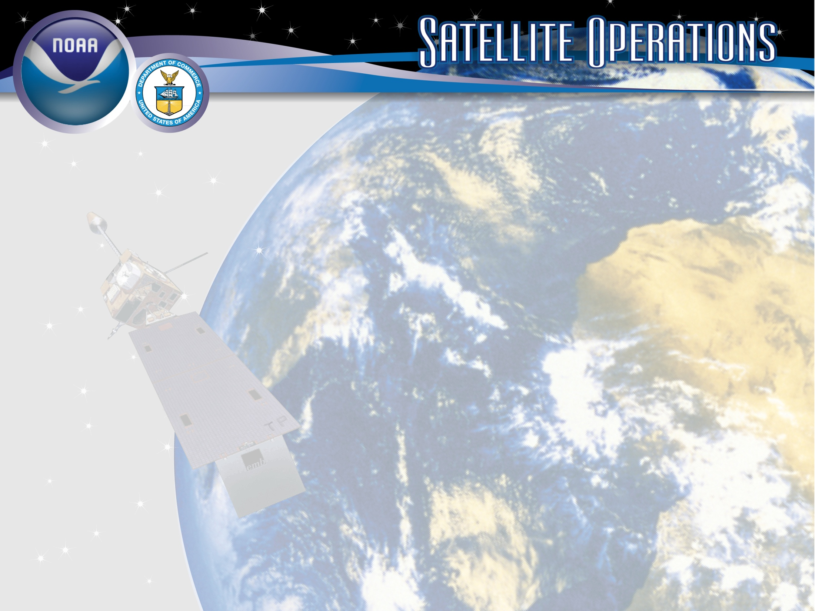
Status of NOAA Satellite Operations & McIDAS at ESPC
Josh Jankot– User Services Cooridinator
Clay Davenport – Chief Programmer
NESDIS/Office of Satellite and Product Operations (OSPO)
2019 McIDAS Users’ Group Meeting
September 16-17, 2019
Madison, WI
Notes:
Title Slide Background and Banner were designed by TeddyPavlis@gmail.com

Slide 2
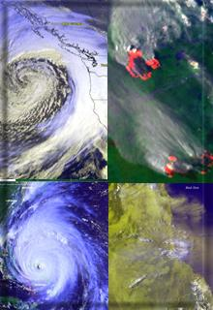
Presentation Outline
Overview of the Office of Satellite and Product Operations (OSPO)
Status of Satellite Operations
Status of McIDAS at ESPC
Q&A

Slide 3
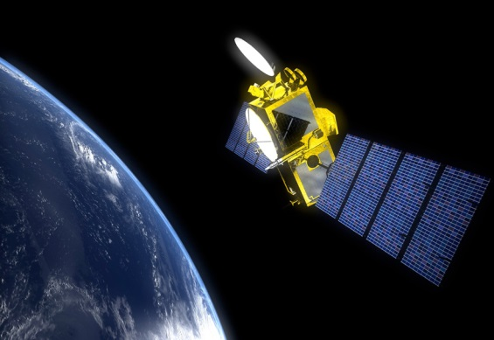
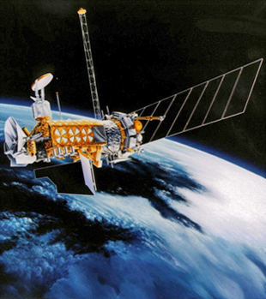
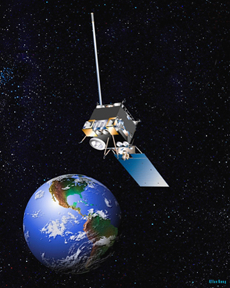
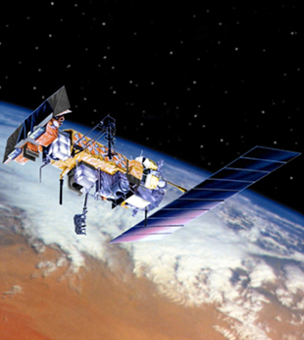
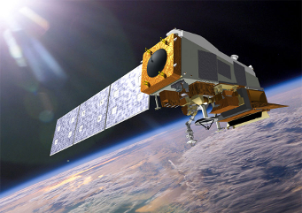
NESDIS Office of Satellite and Product Operations (OSPO)
Operates the Nation’s 17 environmental satellites:
  4 Geostationary (GOES) by NOAA
  2 Joint Polar Satellite Systems by NOAA + NASA (NOAA-20, Suomi-NPP)
  3 Polar-Orbiting (POES) by NOAA
  5 Defense Meteorological Satellite program (DMSP) operated by NOAA
  2 OSTM Jason-2 & Jason-3 (Ocean Surface Topography Mission) - Joint NOAA, NASA, CNES, EUMETSAT effort
  1 DSCOVR (Deep Space Climate Observatory) by NOAA
Notes:
The NESDIS Office of Satellite and Product Operations (OSPO) currently commands and controls nations 18 environmental satellites (listed are various types).

Slide 4

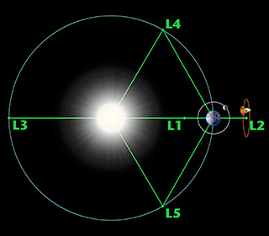
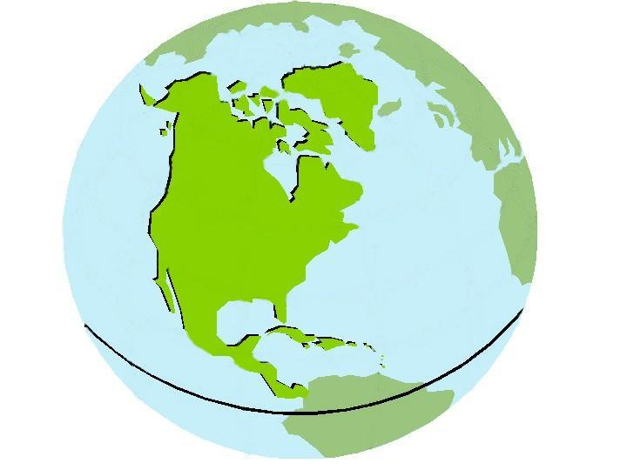



Three Observation Vantage Points
Polar-orbiting Operational
Environmental Satellites
Geostationary Operational
Environmental Satellites
Deep Space
at Lagrange 1 Point
22,300 Miles
540 Miles
Each satellite covers the Earth
twice per day
  Pole-to-pole orbit is 101 minutes and views each location at the same time of day; capability for ½ orbit dumps with JPSS-1
  Global coverage every 12 hours with one satellite
  EUMETSAT - mid-morning orbit
  NOAA - early afternoon orbit
Continuous monitoring
of the Americas
  Coverage over the same geographic location
  Constant monitoring for nowcast purposes and for forecast applications (NWP, etc.)
Continuous monitoring
of the Sun
  Uninterrupted view of the sun
  Information is used for solar winds monitoring for Space Weather warnings
Notes:
The satellites provide three observational vantage points for coverage of Earth.
Polar-orbiting satellites orbit the globe twice per day (pole to pole) for morning and afternoon coverage.
Geostationary satellites provide coverage over the same geographic location for constant nowcast monitoring.
Deep Space satellite (DSCOVR) provides an uninterrupted view of the sun.

Slide 5
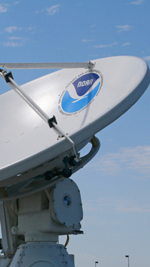
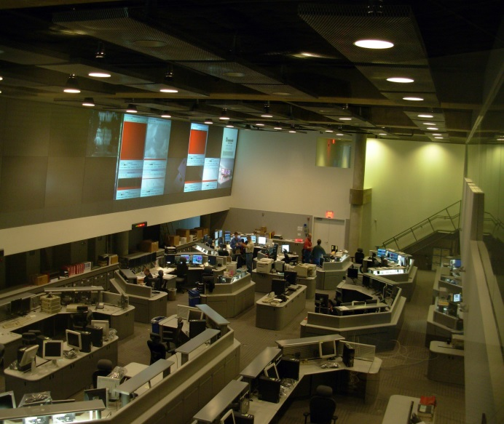
OSPO’s Key Roles
Ground System Command & Control, Ingest, Generation, and Distribution
Pre-Launch and Post-Launch Testing
Operational Testing, Validation, and Verification
User Readiness for Broadcast Services and Product Delivery
Long-Term Continuity of Products and Services
Notes:
OSPO manages and directs the operation of the central ground facilities which ingest, process, and distribute environmental satellite data and derived products to domestic and foreign users.
Responsible for:
Ground System Command and Control,
Pre-Launch and Post-Launch Testing,
Operational Testing, Validation, and Verification
User Readiness for Broadcast Services and Product Delivery
Long-Term Continuity of Products and Services

Slide 6
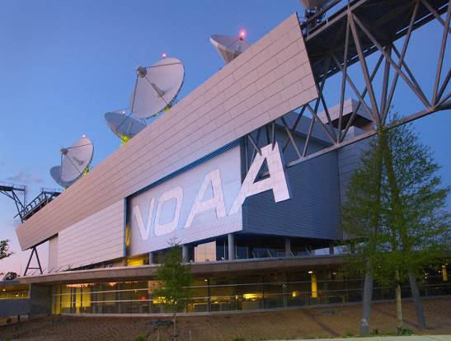
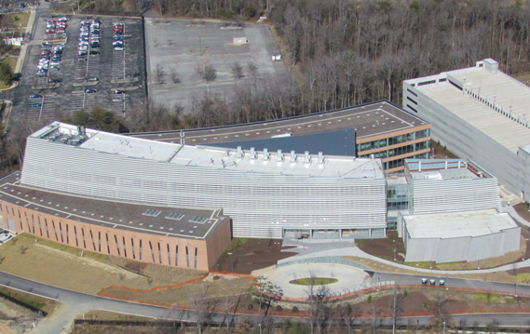
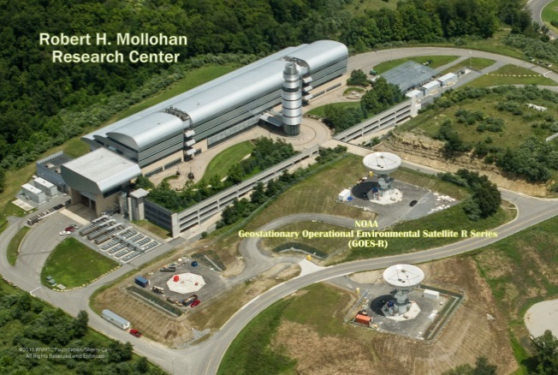
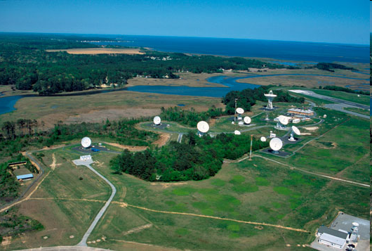
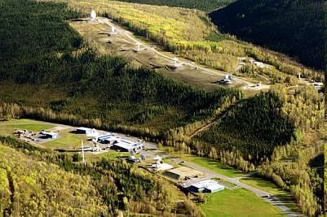
OSPO Operational Facilities
Over 500 staff supporting or operating the satellites, receptors, and processing systems
Suitland, MD
College Park, MD
Fairmont, WV*
Wallops, VA
Fairbanks, AK
* GOES-R and JPSS (New) Backup Facility
Notes:
OSPO has locations at four major facilities housing over 500 people.
NOAA Satellite Operations Facility (NSOF) in Suitland, Maryland
Mission Operations Division (MOD)
NOAA Center for Weather & Climate Prediction (NCWCP) in College Park, Maryland.
Satellite Product and Services Division (SPSD)
OSPO has Command and Data Acquisition Stations in Fairbanks, Alaska and Wallops, Virginia.

Slide 7
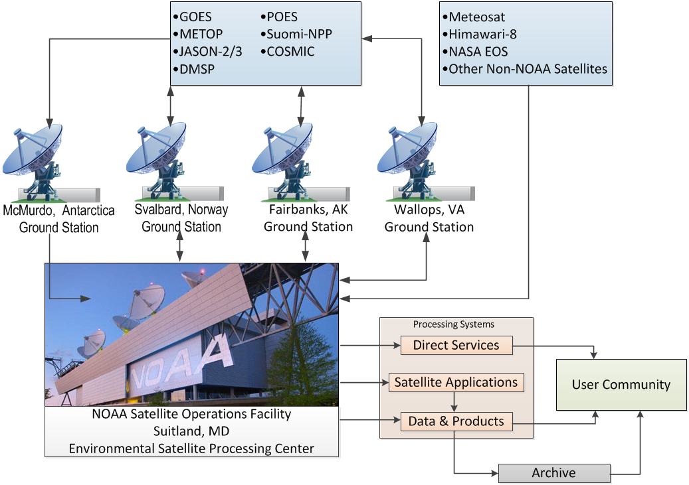
Nominal Satellite Data Flow
GOES NOP (14 + 15)
GOES-R (16 +17)
METOP
Jason- 2/3
DMSP
POES
NPP/NOAA-20
COSMIC
Meteosat
Himawari-8
NASA EOS
Other Non-NOAA Satellites
Notes:
Here’s a depiction of the nominal satellite data flow as data from the satellites is ingested and processed by ESPC.
Processing systems provide the data to the user community and archive (NCEI).

Slide 8
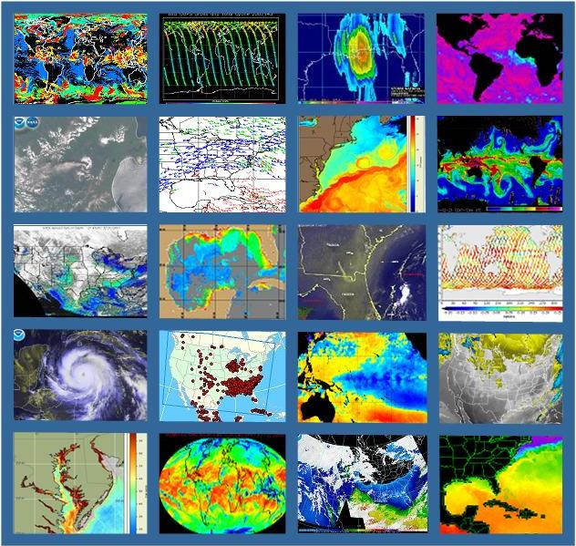
OSPO’s Satellite Products and Services Division
Provides 24x7 interpretive analyses of satellite data
  Atmospheric temp/moisture
  Hurricane intensity & position
  Volcanic Ash
  Fire and Smoke
  Oil Spills
  Significant Precipitation (20x7)
Manages automated environmental products
Collaborates with partners to support transition of research products into operations
Notes:
OSPO’s Satellite Products and Services Division leads production, adaptive maintenance, and monitoring activities for a variety of derived and interpretive environmental products.
Satellite Analysis Branch (SAB) provides operational 24X7 interpretive analyses of satellite data.
Satellite Products Branch (SPB) collaborates with STAR - Satellite Products and Services Review Board (SPSRB) to effectively manage the product life cycle process from product development, transition into operations, enhancements, and retirement.

Slide 9
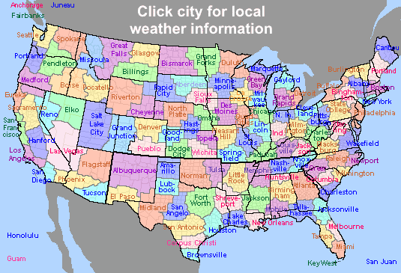
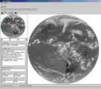
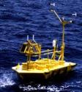
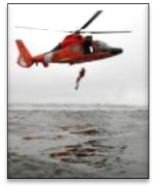

Direct Service Operations
Emergency Managers Weather Information Network (EMWIN):
NOAA satellites relay critical information to users across the country.
GOES Rebroadcast (GRB):
The GRB provides the primary GOES-16 and GOES-17 relay of full resolution, calibrated, near-real-time direct broadcast Level 1b data from each instrument and Level 2 data from the Geostationary Lightning Mapper (GLM). https://www.noaasis.noaa.gov/GOES/GRB/grb.html
Data Collection:
NOAA satellites are used to collect and relay scientific data from around the globe.
  http://www.noaasis.noaa.gov/DCS/ http://www.noaasis.noaa.gov/ARGOS/
Search and Rescue Satellite Aid Tracking (SARSAT):
NOAA satellites are used to relay distress alerts from aviators, mariners and
land-based users (http://www.sarsat.noaa.gov/
Geonetcast Americas:
Data from NOAA for diverse societal benefits - agriculture, energy, health, climate,
weather, disaster mitigation, biodiversity, water resources, and ecosystems.
  http://www.geonetcastamericas.noaa.gov/index.html
Notes:
OSPO partners with NWS to provide data and products through the Emergency Managers’ Weather Information Network (EMWIN).
OSPO also manages GOES Data Collection Services (*more than 21,000 active Argos platforms collecting data for over 1,900 distinct projects in 100+ countries).
Though the assistance of OPSO’s Search and Rescue Satellite Aid Tracking (SARSAT) program – (*250 individuals were rescued in calendar year of 2015 alone).
Since 1982, there have been a total of 7,740 SARSAT saves in the US, and more than 39,000 worldwide (as of December 31st, 2015)

Slide 10
GEO Status

Slide 11
Geostationary Operational Environmental Satellite (GOES-NOP)
Performance Status – July 2019
Payload Instrument | GOES-13 (Storage) Launch: May 06 Activation: Apr 10 | GOES-14 (Backup) Launch: Jun 09 Activation: | GOES-15 (West Backup) Launch: Mar 10 Activation: Dec 11
Imager | G | G | G
Sounder | R (4) | G | Y (3)
Magnetosphere Proton and Electron Detectors (MAGPD/MAGED ) | G | G | Y (5)
Magnetometers | G | G | G
Energetic Proton, Electron, and Alpha Detectors (EPEAD/HEPAD) | G | G | G
X-Ray/EUV Sensors (XRS/EUV) | Y (1) | G | G
Solar X-Ray Imager (SXI) | Y (2) | G | G
Spacecraft Subsystems
Telemetry, Command & Control | G | G | G
Attitude and Orbit Control | G | G | G
Fuel for Inclination Control | G | G | G
Propulsion | G | G | G
Mechanisms | G | G | G
Electrical Power | G | G | G
Thermal Control | G | G | G
Communications Payloads | G | G | G
Key
Operational
Operational with limitations
Non-operational
G
Y
R
Notes:
1
GOES-15
Sounder roll blanket raised above cooler
User has been notified
Yaw flip at Equinox to keep Sun angle below cooler plane
MAGPD/MAGED reached thermal high limit
User has been notified
Turn off MAGPD and MAGED around winter solstice
Degradation due to aging
User use GOES-14 as primary data source

Slide 12
Geostationary Operational Environmental Satellite (GOES-16 and 17)
Performance Status – July 2019
Payload Instrument | GOES-16 (East) Launch: Nov 16 Activation: Dec 17 | GOES-17 (West) Launch: Mar 18 Activation: Feb 19
Advanced Baseline Imager (ABI) | G | Y(2)
Space Environment I-Situ Suite (SEISS) | G | G
Solar Ultraviolet Imager (SUVI) | G | G
EUV and X-ray Irradiance Sensors (EXIS) | G | G
Magnetometer | Y(1) | G
Geostationary Lighting Mapper (GLM) | G | G
Spacecraft Subsystems
Command Data & Handling (CD&H) | G | G
Guidance Navigation Control (GNC) | G | G
Electrical Power Subsystem (EPS) | G | G
Propulsion | G | G
Mechanisms | G | G
Electrical Power | G | G
Thermal Control | G | G
Communications Payloads | G | G
Key
Operational
Operational with limitations
Non-operational
G
Y
R
Notes:
1
G16: . Mag performance impacted by thermoelectric effect, temp compensation error and Arc Jet Thruster firing
Work underway on Mag FSW change.
Work underway on ground algorithm corrections based on orbital trend
Impacts:
Inability to meet Mag 1.7 nT accuracy and 0.3 nT fluctuation L1 requirements
G17: ABI loop heat pipes anomaly
Semi-annual Yaw-flip required
Cryocooler operations changes
Focal plane operations changes
Algorithm tuning to minimize impact of IR channel loss
ABI on-orbit optimization has resulted in restoring >97% of ABI L1B data

Slide 13
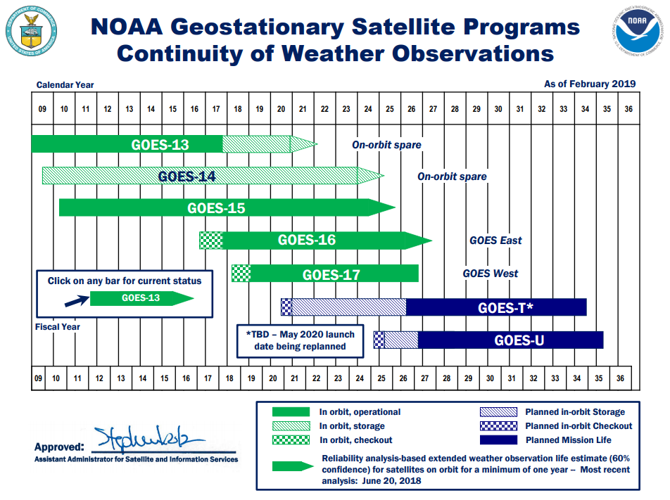
GOES Flyout Schedule
http://www.nesdis.noaa.gov/FlyoutSchedules.html http://www.goes-r.gov
Notes:
Here is the Flyout Schedule showing the continuity of the GOES Mission.
GOES-R is the next generation of GOES satellites that will provide a major improvement in quality, quantity, and timeliness of data collected.

Slide 14
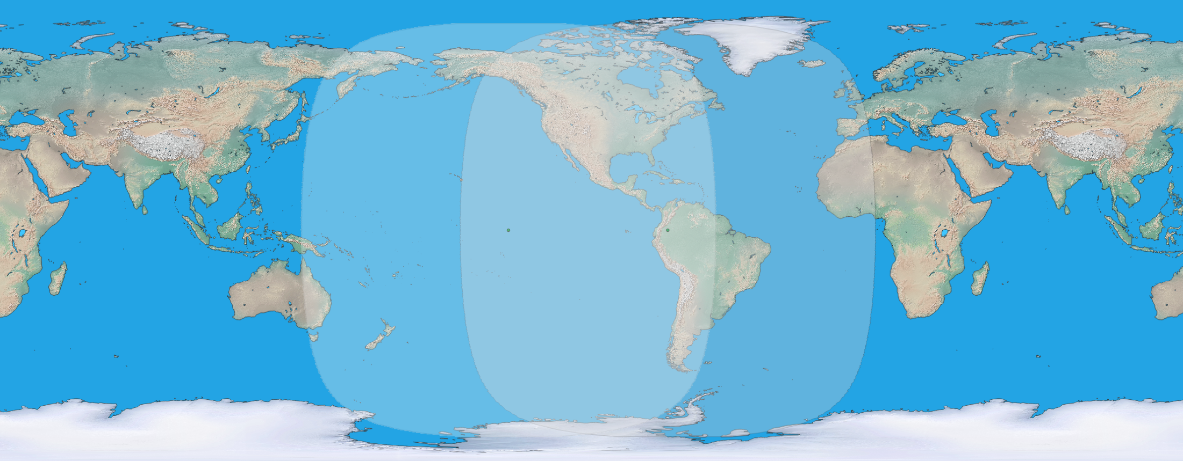

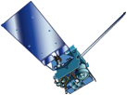
GOES Constellation
GOES-West
GOES-15
135° West
GOES-East
GOES-13
75° West
GOES-West
Standby
GOES-East
  Primary source of data for short term forecasting, especially of severe weather such as tropical storms
Continuity of Operations since 1974
Notes:
GOES- East: G-16 75.2W
GOES-West: G-17 137.2W
GOES-14 standby 105W
GOES-15 parallel ops 128W

Slide 15
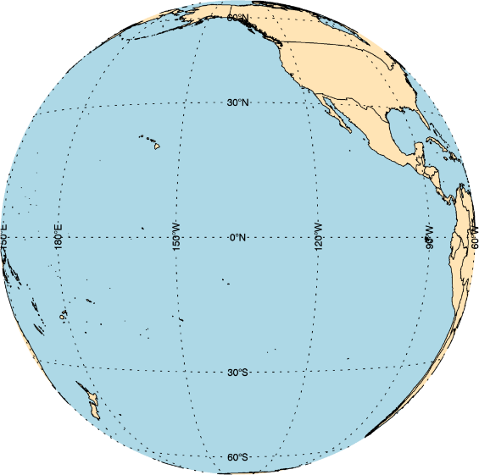
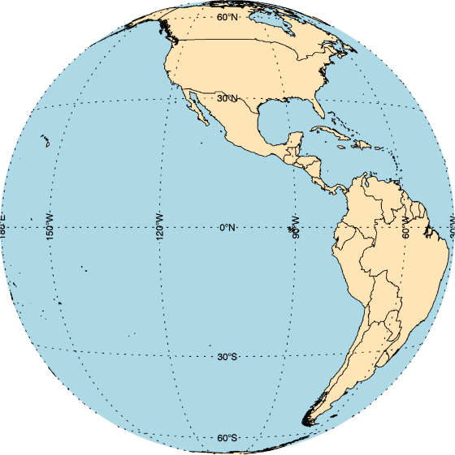

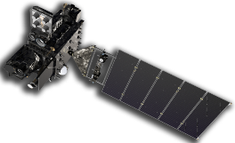
GOES Constellation
GOES-West
GOES-17
137.2° West
Supplemental Ops until Dec, 2019
GOES-15
128° West
Standby
GOES-14
105° West
GOES-East
GOES-16
75.2° West
Currently, supplemental operations are enabled for GOES-15 products and services and GOES-14 EMWIN and MDL services (excludes SXI and XRS/EUV)
  These are mitigations for the GOES-17 operations promotion, meant to lessen risk associated with ABI LHP (loop heat pipe) anomaly and space weather products operations status
Effective in Dec, 2019, GOES-15 and GOES-14 will return to their respective storage and standby roles
  Conversations are underway between NWS and NESDIS regarding a request to extend GOES-14/15 supplemental operations due to Space Wx, EMWIN, and ABI hot period concerns
Notes:
Multi-Use Data Link (MDL)

Slide 16
GOES- R Series Data Access
Acronym | System Name
GRB | GOES Rebroadcast
HRIT/ EMWIN | High Rate Information Transmission/ Emergency Managers Weather Information Network
PDA | Product Distribution and Access
CLASS | Comprehensive Large Array-data Stewardship System
GNC-A | GEONETCast Americas
Websites | Websites on the Internet
BDP | Big Data Project
SBN/NOAAPort | NWS Satellite Broadcast Network

Slide 17
GOES-16 Update

Slide 18
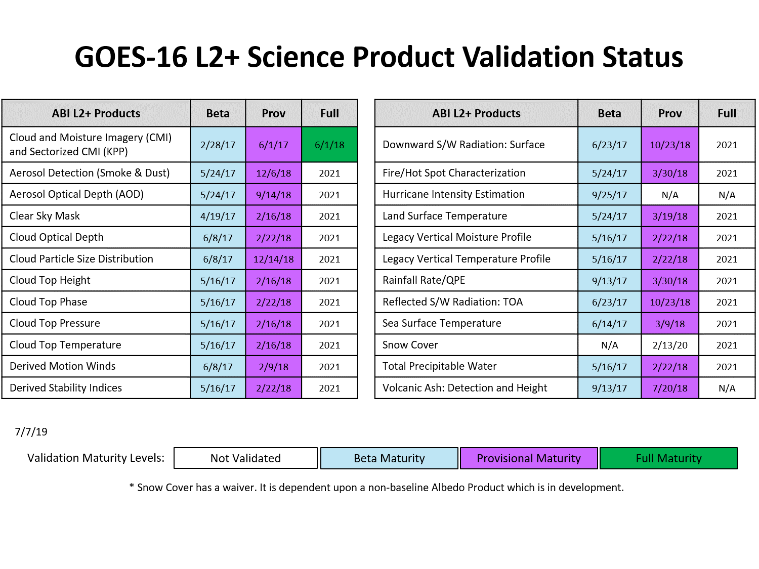
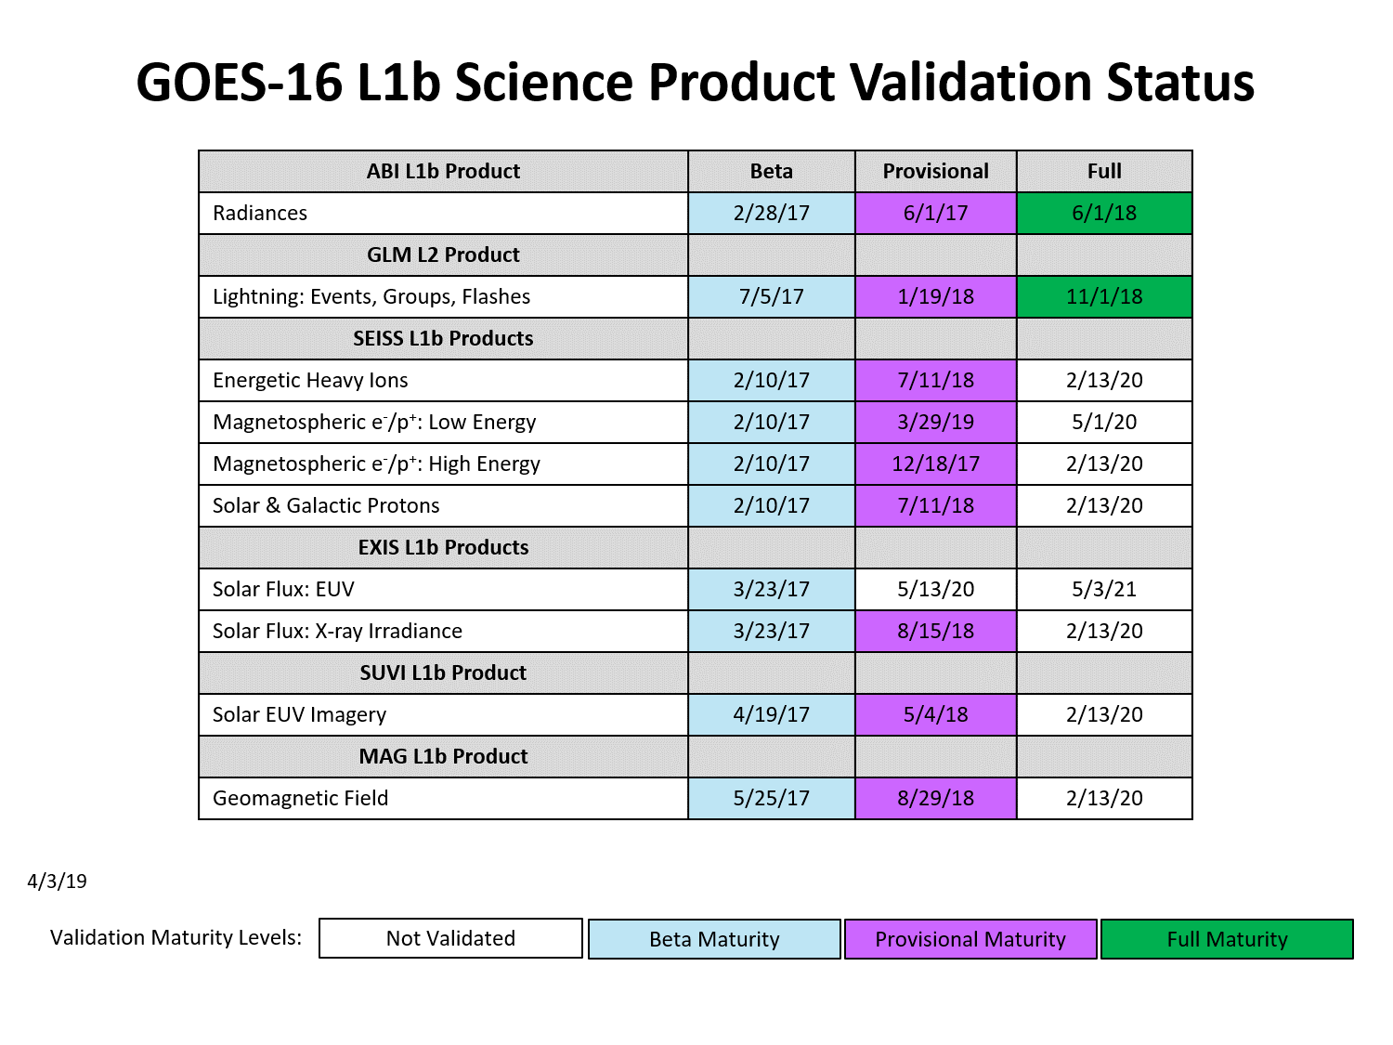
GOES-16 L1b
Science Product Validation Status
Notes:
Beta: Data are preliminary and non-operational; undergoing testing and initial calibration and validation. Products are made available to users to gain familiarity with data formats and parameters in accordance with the GOES-R Product User Guide (PUG). Beta products have been minimally validated and may still contain significant errors. They are not optimized for operational use.
Provisional: Data are ready for operations and use in cal/val activities. Performance has been tested and documented over a subset of conditions, locations, and periods. Validation is still ongoing, not all anomalies are known but all known are documented and available to the user community.
Full: Product is operational. All known anomalies are documented and shared with the user community. Performance has been tested and documented over a wide range of conditions. Users are engaged and feedback is assessed

Slide 19


Slide 20
GOES-17 Update

Slide 21
GOES-17 ABI Timeline
(Optimizations & Mitigations appear in blue italics)
2018 Mar 1 Launch
2018 Apr 13 Optical port cover opened
2018 Apr 29 Thermal anomaly discovered
2018 May Thermal system troubleshooting & recovery
2018 Jun Began working optimization strategy in parallel to
troubleshooting & recovery
2018 Jul 30 ABI post-launch tests began
2018 Aug Increased measurement frequency of onboard blackbody
2018 Oct Operations procedure at handover includes yaw flip
2018 Oct 24 GOES-17 began drift from -89.5 to -137.2 degrees
2018 Nov 15 GOES-17 resumed data distribution after drift
2019 Feb 12 GOES-17 transitioned to operations as NOAA’s GOES West
2019 Apr 8 GOES-17 Temperature Data Quality Flags promoted to
operations for users to track temp of focal plane module
2019 Jun Mitigate with pseudo-operations for Himawari-8 data to NWS
2019 Jul Implement predictive calibration in operational data
2020 Mitigate with operationalized Himawari-8 generation in cloud
Notes:
-Shortly after GOES-17 launch last March, we identified a thermal issue -- a heat pipe was not transferring heat from the cryocooler to the radiator as it was designed.
-Since heat could not be removed from the Cryocooler, the detector could not be cooled to the temperature we needed.
-One team was formed to investigate the thermal problem, but it turns out that it could not be fixed.
-Another team was formed to find a way to squeeze out performance despite this higher operating temperature.
-This optimization team worked though post launch testing and into initial operations as GOES-17 transitioned to GOES-West.
-One of the big changes developed by the optimization team is predictive calibration and this will be implemented this summer --

Slide 22
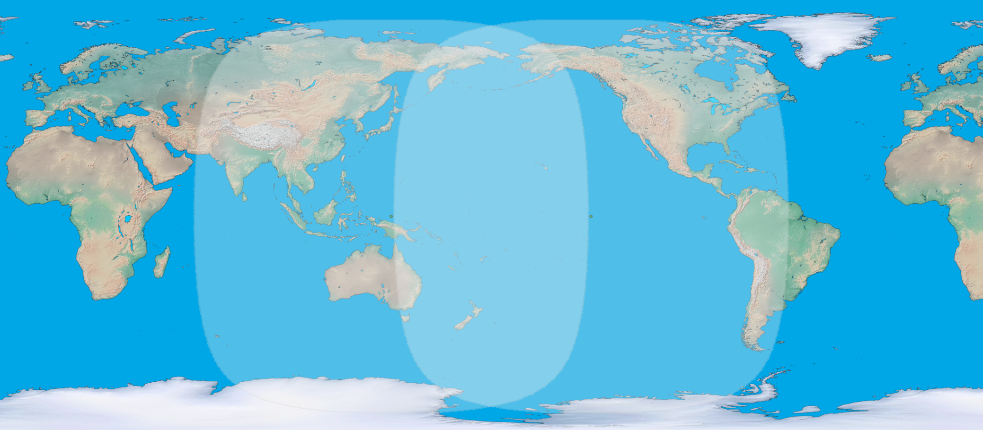
GOES-17 Mitigation using
Overlap with Himawari-8
Himawari-8
Full Disk Domain
GOES-17 (West)
Full Disk Domain
Overlap
2019 Jun: Mitigate with pseudo-operations for Himawari-8 data to NWS
Sept 2021: Mitigate with operationalized Himawari-8 product generation in NESDIS cloud

Slide 23
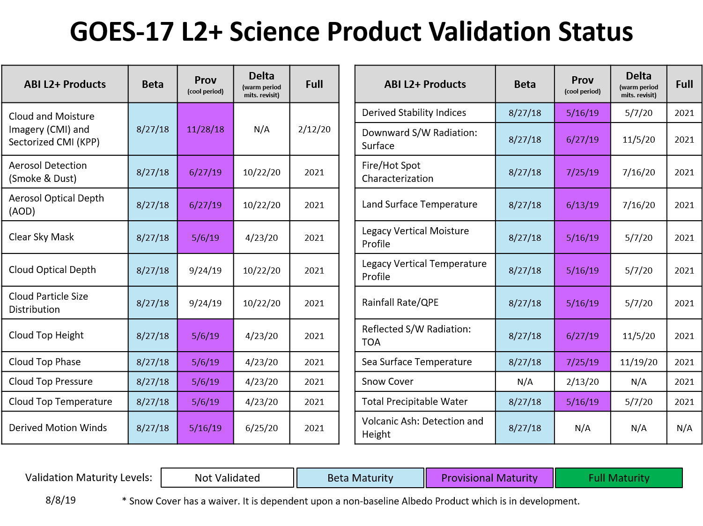
Notes:
Delta Reviews: Incorporate analysis of warm periods and algorithm-specific mitigations including incorporation of temperature data quality flags, channel swapping, and flexible enterprise algorithms (includes new science)!

Slide 24
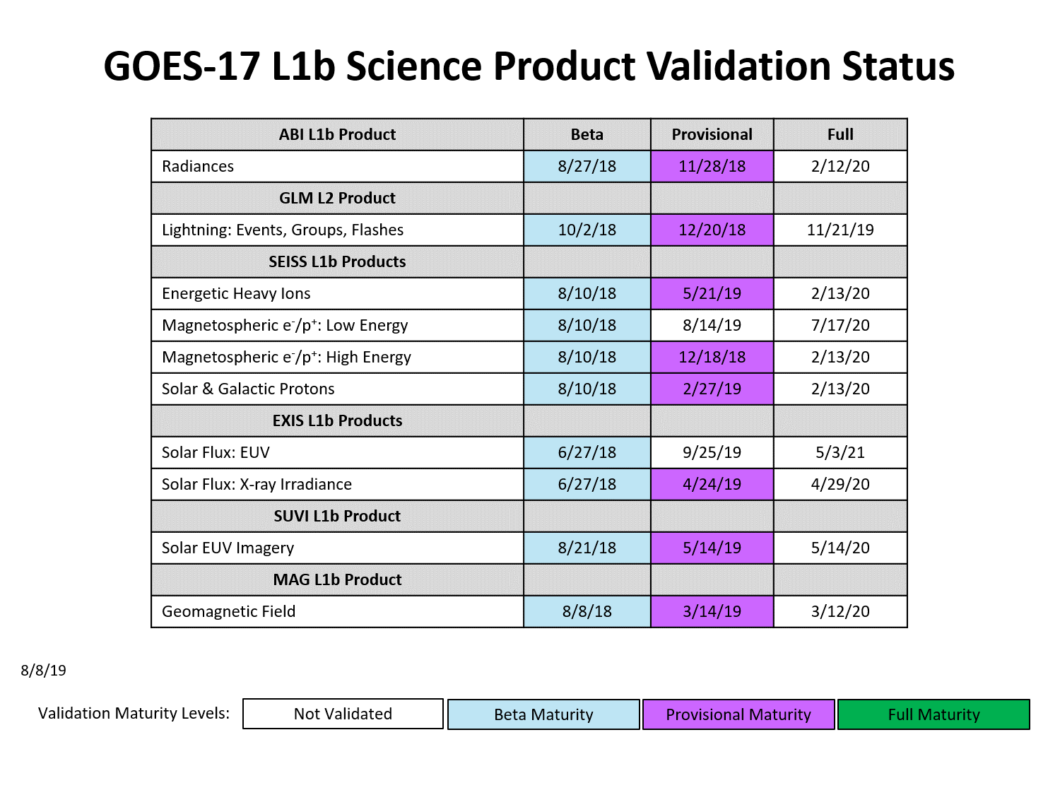
9/20/19

Slide 25
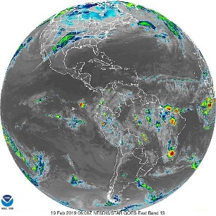
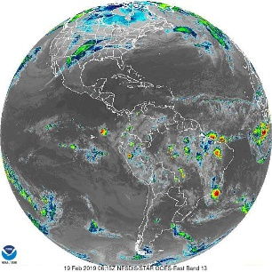
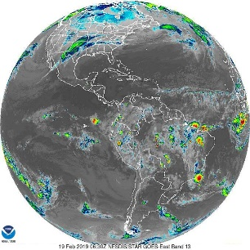

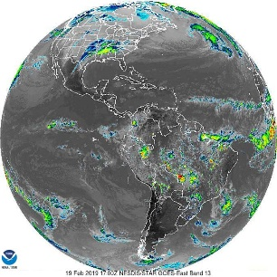
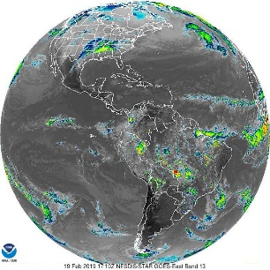
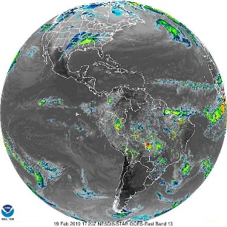
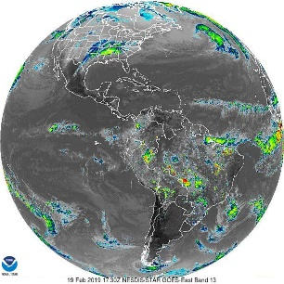
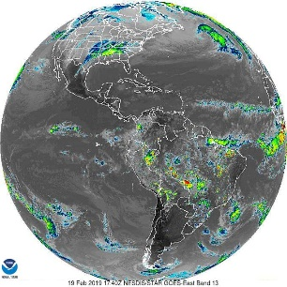
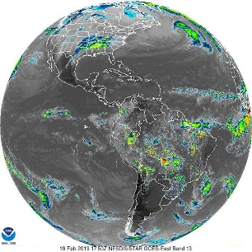
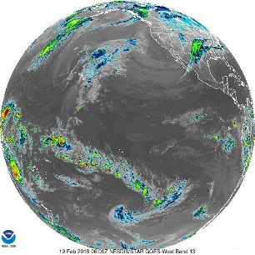

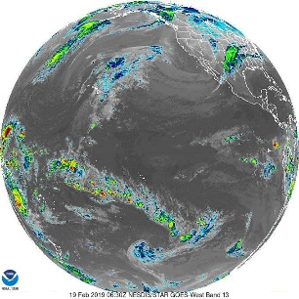

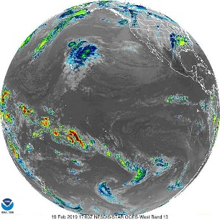





GOES-16/17 ABI Mode 6
Effective April 2, 2019 | 50% more Full Disk Imagery
  GOES-East
Mode 3
15-minute
Full Disk
2/19/19 0600-0645 UTC
Mode 6
10-minute
Full Disk
2/19/19 0600-0645 UTC
GOES-West
Mode 3
15-minute
Full Disk
2/19/19 0600-0645 UTC
Mode 6
10-minute
Full Disk
2/19/19 0600-0645 UTC

Slide 26
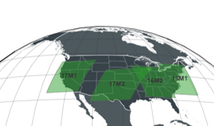
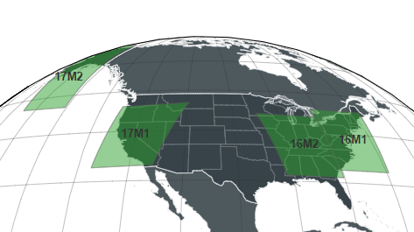
New Location for GOES-17 Default Meso-2 Domain Sector
Effective March 5, 2019, the default center-point changed to coordinates chosen by Alaska Region (56N, 150W)
Prior GOES-17
Meso-2 location
New GOES-17
Meso-2 location
Rationale
  Alaska only receives 15-minute GOES-17 imagery routinely as they are outside of 5 minute PACUS domain
  CONUS NWS Regions felt the area covered by the prior default Meso-2 was sufficiently covered by 5-minute CONUS GOES-16 imagery, plus slight overlap from GOES-16 default Meso-2
  Hawaii Region was covered by 5-minute PACUS imagery

Slide 27
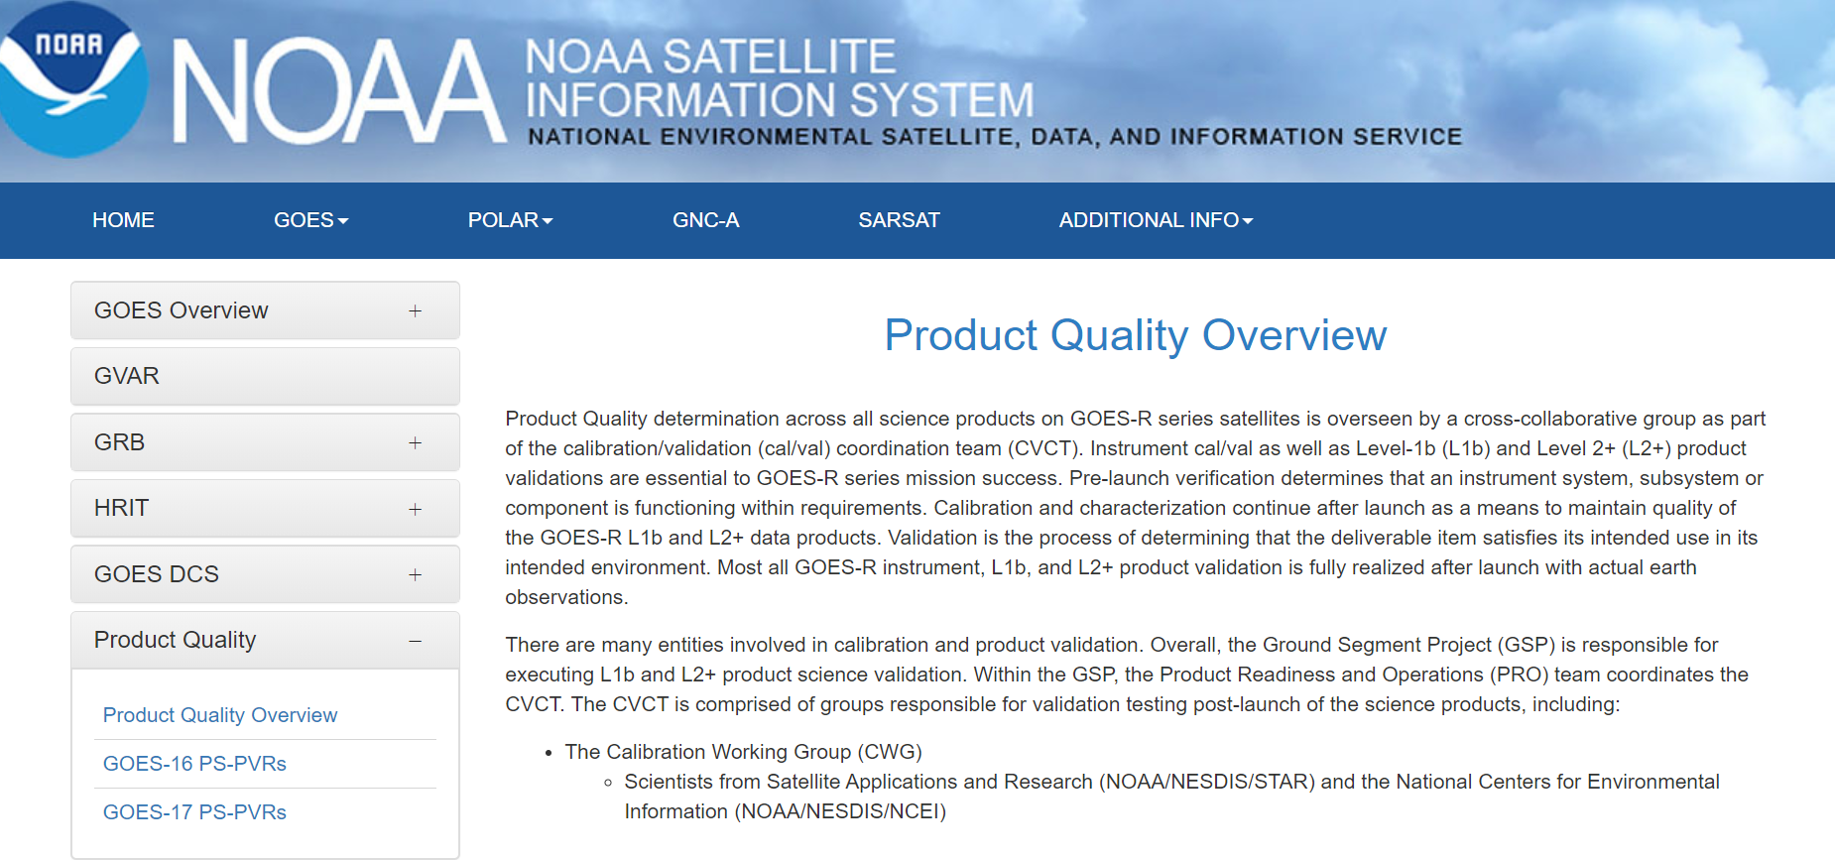
Documentation of Product Status
A comprehensive listing of data quality assessments for GOES-16/17 ABI L2 products:
https://www.noaasis.noaa.gov/GOES/product_quality.html
Notes:
Beta: Data are preliminary and non-operational; undergoing testing and initial calibration and validation. Products are made available to users to gain familiarity with data formats and parameters in accordance with the GOES-R Product User Guide (PUG). Beta products have been minimally validated and may still contain significant errors. They are not optimized for operational use.
Provisional: Data are ready for operations and use in cal/val activities. Performance has been tested and documented over a subset of conditions, locations, and periods. Validation is still ongoing, not all anomalies are known but all known are documented and available to the user community.
Full: Product is operational. All known anomalies are documented and shared with the user community. Performance has been tested and documented over a wide range of conditions. Users are engaged and feedback is assessed

Slide 28
POES Status

Slide 29
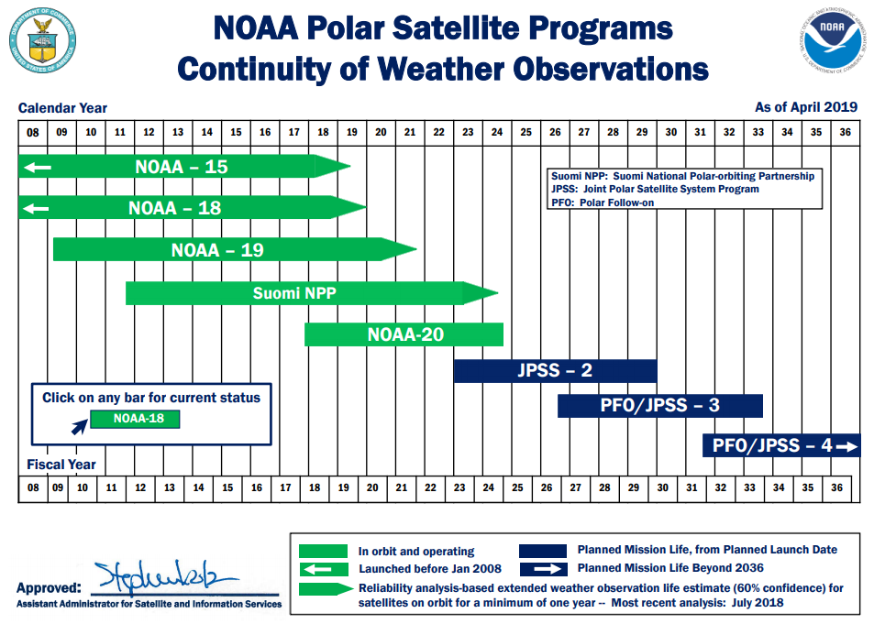
LEO Flyout Schedule
http://www.nesdis.noaa.gov/FlyoutSchedules.html http://www.jpss.noaa.gov
Notes:
Here is a depiction of the Low Earth Orbit Flyout Schedule.
S-NPP is a risk reduction mission for JPSS-1 and provides data continuity for NASA EOS Missions.
Highest priority is to launch the follow-on polar satellite Joint Polar Satellite System (JPSS-1/NOAA-20) with launch expected Mid-March 2017 while JPSS-2 launch readiness is planned for 4th quarter FY 2021
The JPSS will succeed NOAA's POES satellites and ground systems by leveraging investments made in NOAA POES, NASA's Earth Observing System (EOS), and the SNPP to maintain continuity of global, operational, space-based observations.

Slide 30
POES Status (Aug 2019)
http://www.ospo.noaa.gov/Operations/POES/status.html
Spacecraft Subsystems | METOP-A | METOP-B | METOP-C | NOAA-19 | NOAA-18 | NOAA-15
Launch Date | Oct 2006 | Sept 2012 | Nov 2018 | Feb 2009 | May 2005 | May 1998
Operational Date | May 2007 | April 2013 | April 2019 | Jun 2009 | Aug 2005 | Dec 1998
Mission Data Category | Secondary (AM) | Primary (AM) | Operational (AM) | Prime Services Mission (PM) | Secondary (PM) | Secondary (AM)
Payload Instruments
AVHRR | G | G | G | G | G | Y(19)
HIRS | Y(40) | P(32) | N/A | O (31) | R (3,43) | Y (5)
AMSU-A1 | O (30) | Y(36) | P (44) | G | P (33) | Y(20)
AMSU-A2 | G | G | G | G | G
AMSU-B | N/A |  | N/A | N/A | N/A | R (11)
MHS | G | G | P(45) | Y (6) | R(42) | N/A
SEM | Y(38) | G | G | Y(39) | Y(37) | G
SBUV | N/A |  | N/A | S/C (9) | R(27) | N/A
Spacecraft Subsystems
Telemetry, Command & Control | G | G | G | G | G | G
ADACS | G | G | G | G | Y (41) | O (10)
EPS | G | G | G | G | G | G
Thermal Control | G | G | G | G | G | Y(21)
Communications | Y (1) | G | G | G | G | Y(22)
APT/LRPT | R (2) | R (2) | R (2) | G | G | G
DCS | N/A | N/A | N/A | N/A | G | G
ADCS | G | O(29) | G | Y(34) | N/A | N/A
SAR: SARR & SARP | G | Y(35) | N/A | G | G | Y(23)
Operational | G
Spacecraft Issue but No User Impact | S/C
Investigating Performance Issue which will Impact Users | P
Operational with Limitation | Y
Operational with Degradation | O
Non-Operational | R
Not Applicable
Notes:
Here’s a depiction of POES stoplight chart showing the status of payload instruments and spacecraft subsystems.
OSPO still flies legacy POES. Not only does POES support the weather mission, but POES also supports SARSAT (rescue) and ARGOS (data collection) missions.
Some issues affecting certain POES satellites are mitigated though use of fellow POES satellites.
For time’s sake, I won’t go through all the specific issues (please reference the web link).
(4/26/2016), the instrument group announced that channel-8 on Metop-A AMSU-A1 has gone red. Recall; Channels 7 and 8 have been bad for a long time back (December 2014?) and since then we (NOAA) have taken out channels 7 and 8 from ATOVS application for Metop-A. After substituting these channels ATOVS products are fine in terms of quality.
Metop-B AMSU-A channel 15 became unusable starting with sensing time at 00:53:00 UTC, October 17, 2016. The anomaly causes degradation to the MIRS (Microwave Integrated Retrieval System) Metop-B products. Users were notified about the degradation while OSPO was working with STAR to develop a possible mitigation for the anomaly. On October 21, a solution was tested and implemented to mitigate the impact of the AMSU-A channel-15 anomaly. The MHS (Microwave Humidity Sounder) channel-1, which has the same frequency (89GHz) as AMSU-A channel-15, is now used to replace AMSU-A channel-15 in the MIRS Metop-B retrievals. The impact assessment indicates that the mitigation solution has restored the MIRS retrieval quality.

Slide 31
Suomi National Polar-orbiting Partnership (S-NPP) and NOAA-20
Performance Status – August 2019
Spacecraft | Suomi-NPP
Launch Date | Oct 28, 2011
Mission Category | LTAN 1325 (PM) Operational (secondary)
Spacecraft | NOAA-20
Launch Date | Nov 18, 2017
Mission Category | LTAN 1325 (PM) Primary Satellite in PM orbit
S-NPP
Payload - Instruments | Status
ATMS | G
CERES | G
CrIS | G
OMPS – Nadir | G
OMPS – Limb | G
VIIRS | G
NOAA-20
Payload - Instruments | Status
ATMS | G
CERES | G
CrIS | G
OMPS – Nadir | G
VIIRS | G
S-NPP Notes:
24-Aug-2019: All instruments operating normally Extensive monitoring of the S-NPP ATMS scan drive motor current loads and temperatures is ongoing. Spacecraft and sub-systems are power positive and operating nominally.
NOAA-20 (JPSS-1) Notes:
24-Aug-2019: All instruments operating normally and are meeting/exceeding their established performance specifications.
Operational (or capable of)
Operational with degraded performance
Operational with limitations (or in standby)
Not functional

Slide 32
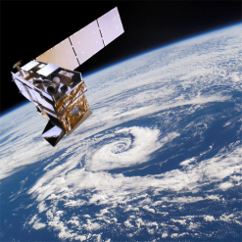

SNPP & NOAA-20 Concurrent Operations at OSPO
The NOAA-20 mission profile is substantially similar to S-NPP as NOAA-20 leads S-NPP by ½ orbit (i.e. ~51 min.)
With the launch of NOAA-20, NOAA will operate two satellites within the same environment.
S-NPP northern contact will often coincide with NOAA-20 southern contact.
  NOAA-20 SMD playback data latency significantly improved vs. S-NPP( 140 to 80 min.)
The Community Satellite Processing Package (CSPP) supports direct readout users in making the transition from POES to SNPP and subsequently to JPSS.
Notes:
NOAA will operate two satellites within the same environment.
The JPSS-1 mission profile is substantially similar to S-NPP as JPSS-1 will lead S-NPP by ½ orbit (i.e. ~51 min.)
S-NPP northern contact will often coincide with JPSS-1 southern contact.
Once JPSS-1 is launched scheduling or commanding for the POES satellites will not change as
Dedicated antennas at SVL (north pole) and MCM (south pole). POES antennas are at FBK and WAL.

Slide 33

Deep Space Climate Observatory (DSCOVR)
Performance Status – Aug 2019 (in Safe-Hold)
Spacecraft | DSCOVR
Launch Date | Feb 11, 2015
Activation | June 2015
Payload Instruments | Status
EPIC
PlasMag
NISTAR
Faraday Cup
ESA
Magnetometer
PHA
Spacecraft Subsystem | Status
Telemetry, Command & Control | O ⁽¹⁾
Guidance, Navigation and Control | O ⁽¹⁾
Attitude Control System | Y ⁽¹⁾
Propulsion | G
Mechanisms | G
Electrical Power | G
Thermal Control | G
Communications Payloads | G
Flight Software | G
1394 | G
Operational (or capable of)
Operational with limitations (or in standby)
Operational with degraded performance
Not functional
DSCOVR will remain in Safe-Hold until delivery and upload of Star Tracker Flight Software planned Feb 14, 2020.
Functional but turned off
No status reported
Notes:
DSCOVR and GOES-R will work together to help better predict and monitor geomagnetic storms.
GOES-R Solar Ultraviolet Imager (SUVI) telescope will monitor the sun in the extreme ultraviolet wavelength range
GOES-R X-Ray Spectrometer will locate and measure the size of solar flares.
DSCOVR MIMU Anomaly requiring Spacecraft/Instrument SafeHold
On June 27, 2019 at 18:13 UTC the DSCOVR space weather instrument data and other instrument data was suspended as the spacecraft was placed into safe-hold upon high level decision to preserve the remaining life of Miniature Inertial Measurement Unit (MIMU) Z-axis laser gyro.
A significant drop in laser intensity of the DSCOVR MIMU Z-Axis laser gyro led to a projection of ~5 weeks remaining before a complete failure of that MIMU occurs.
The spacecraft and instrument payload has been in SafeHold since Jun 27 to preserve the affected MIMU until a solution can be implemented.
Based on telemetry data from July31st, Honeywell confirmed the laser gyro is near end-of-life.
Star Tracker only flight software delivery is expected by Jan 14, 2020 for OSPO testing. Recovery operation planned for Feb 14, 2020.
Successfully Completed Flight Software requreiments review on Aug 15.
Team is testing the algorithms on the DSCOVR software simulator

Slide 34

Jason-2 Status
No Safe Holds.
97.32% data capture within 3 hours, requirement 75% within 3 hours (May 27 – Sep 1, 2019)
May 29: New TM-NRTs connected to operational (old) NJGS.
June 17: Began Site Acceptance Testing of new NJGS.
July 12: The first proactive gyro swap was performed. Until the end of September, Jason-2 will be running on gyros 2 and 3, letting gyro 1 rest for a while.
July 15: Cabling between ESPC and SOCC for the NJGS Refresh completed.
July 31: Jason-2 station-keeping maneuver over land
Aug 13: Began receiving yellow alarms, potentially due to PCE (Power Conditioning Equipment) section failure (investigations are currently on-going).
Sept 4: Meeting with Law on Space Operations (LOS) bureau was held at CNES.
Sept 11: Exceptional Joint Steering Group held to discuss Jason-2 end-of-life.

Slide 35

Jason-3 Status
Spacecraft nominal. No Safe Holds.
98.38% data capture within 3 hours, requirement 75% within 3 hours (May 27 – Sep 1, 2019)
May 29: New TM-NRTs connected to operational (old) NJGS.
June 16: Jason-3 braking maneuver performed. One OGDR impacted.
June 17: Began Site Acceptance Testing of new NJGS.
July 15: Cabling between ESPC and SOCC for the NJGS Refresh completed.
August 6: Jason-3 station-keeping maneuver over land. No impact.

Slide 36
Meteosat and Himawari

Slide 37
Specific Products Generated at NESDIS/ESPC from Himawari or Meteosat Data
NESDIS H-8 Product | Data Format(s)
Visible and IR Imagery | McIDAS Area
Tropical Cyclone Formation Probability | McIDAS Area
Wildfire Automated Biomass Burning Algorithm | McIDAS Area
Global Hydro-Estimator Satellite Rainfall Estimates | McIDAS Area, GRIB2, NetCDF4, PNG
Advanced Dvorak Technique | McIDAS Area
Volcano Multi-Spectral Imagery | McIDAS Area
Volcano Principle Component Imagery | McIDAS Area
Snow Cover, Ice Cover, Snow Depth, and Ice Concentration | McIDAS Area, GRIB2, ASCII
One-hourly NH Composite for AWIPS | AWIPS/GINI
Global Mosaic of Geostationary Satellite Imagery (GMGSI) | McIDAS Area, NetCDF4
Arctic Composite Imagery | McIDAS Area
Notes:
Transfer of data from STAR to the ESPC PDA will begin sometime in mid 2017.

Slide 38

Current MSG Constellation
SATELLITE | LIFETIME | POSITION | SERVICES
Meteosat-11 | 15/07/2015 2024 | 0° | 0º SEVIRI Image Data. Real-time Imagery.
Meteosat-9 | 22/12/2005–Fuel lifetime is until 2024 | 3.5° E | Rapid Scan Service gap filling spacecraft and back-up to prime Met-11 spacecraft
Meteosat-10 | 05/07/2012–2024 | 9.5° E | Rapid Scan Service Real-time Imagery.
Meteosat-8 | 28/08/2002 – Fuel lifetime is until 2022 | 41.5° E | Full IODC service
Primary Imaging Operations

Slide 39
Current Networks Used for MSG
Data Access
OSPO receives Meteosat data several ways
  JEUNO link between EUMETSAT and NOAA/NESDIS
    Higher capacity (5 Gb/sec vs 1)
    Delivers to PDA at NSOF
    Able to deliver both Met-11 and Met-8 data
    Caveat – extra processing steps (PDA initiates pull, security scans, PDA distribution) create 2-6 minute latencies compared to previous DOMSAT network

Slide 40
Current Networks Used for MSG
Data Access
OSPO’s Meteosat Data Access Back-up
  NOAA/STAR
    Maintains ftp server receiving data from EUMETCAST broadcast service
    Used by OSPO as backup data source to primary operational JEUNO network
    STAR support 8x5, best effort

Slide 41
Change in EUMETSAT MSG Data Policy
Effective January 2019
EUMETSAT shall make its Hourly Meteosat [HRIT] Data, all Derived Products and Advance Image Products available to all users world-wide on a free and unrestricted basis as "Essential" Data and Products in accordance with WMO Resolution 40

Slide 42
Future Meteosat Third Generation (MTG) Satellites
MTG-I1 (imager mission)
  Projected launch date Q3/CY2021, operational by October 2022
  16 channel imager and lightning mapper
    Temporal and spatial resolutions similar to GOES-R series
MTG-S1 (sounder mission)
  Projected launch date Q3/CY2023
  Two Spectral bands: MWIR (4.44–6.25 µm) and LWIR (8.26–14.70 µm)
  Spatial resolution of 4 km x 4 km at nadir

Slide 43

Himawari-8/9 Constellation
Himawari-8 is operational at 140E
Himawari-9 is in standby at 140.7E
  Slated for prime 140E operations in 2022
  Himawari-9 end of life around 2030

Slide 44
NOAA’s Himawari-8
Operational Plans
Himawari Tiger Team
Phase 1 Short Term (1-2 months)
  NESDIS provides Himawari Level 2 products via the Center for Satellite Applications and Research (STAR) ftp server with 24/7 monitoring capability provided by the Office of Satellite Products and Operations (OSPO) and 24/7 troubleshooting capability provided by STAR.
    Current Himawari L2 products available from STAR
      Cloud Products: Cloud Mask, Cloud Phase, and Cloud Height
      Derived motion winds
    L1b data also available in native HSD format from STAR via JMA’s HimawariCloud service

Slide 45
Himawari-8 Operational Plans
Himawari Tiger Team
Phase 2 (2020-2021)
  NESDIS will move L2 PG to cloud service - products will flow from NESDIS cloud to PDA and from PDA to customers
  Distribution of level 1b HSD data also from PDA
  Himawari L2 products planned for generation and distribution:
    Cloud and Moisture Imagery
    Rainfall Rate
    Sea Surface Temperature
    Cloud Products
      Cloud Top Height, Clear Sky Mask, Cloud Top Phase
Initial demonstration of capability ~ March 2020
Full operational capability ~ September 2021

Slide 46
Thank you!
Questions?

