Slide 1
McIDAS-X and -V at RAMMB/CIRA
Debra Molenar
NOAA/NESDIS Regional and Mesoscale Meteorology Branch/Cooperative Institute for Research in the Atmosphere (RAMMB/CIRA)
Debra.Molenar@noaa.gov

Slide 2
McIDAS-X and -V at RAMMB/CIRA
RAMMB/CIRA is a NOAA/NESDIS/StAR Cooperative Institute focused on development of advanced satellite data products
Several paths are utilized to get experimental satellite products to field forecasters for testing and evaluation as important part of R2O
McIDAS has been a critical component of both product and training development since early 1990’s

Slide 3
McIDAS-X and -V at RAMMB/CIRA
RAMSDIS (RAMMB Advanced Meteorological Satellite Demonstration and Interpretation System (US NOAA) -1994)
McIDAS-X based low cost PC
640x480 256 color display
Highly successful ‘shoestring’ project
Provided ‘high res’ NESDIS GVAR data to NWS FO’s for 7 years prior to AWIPS deployment
Eventually provided GVAR data to the global weather community
RAMSDIS Online still exists for web based data access
http://rammb.cira.colostate.edu/ramsdis/online/

Slide 4
McIDAS-X and -V at RAMMB/CIRA
Once AWIPS I was deployed, experimental satellite products in McIDAS AREA file format were sent to WFO’s via the LDM
McIDAS-X was used extensively to provide simulated GOES-R products for AWIPS II to prepare forecasters
With the successful deployment of GOES-16 and 17, satellite products created with McIDAS-X are utilized to exploit the advanced capabilities of the satellites and of AWIPS II display

Slide 5
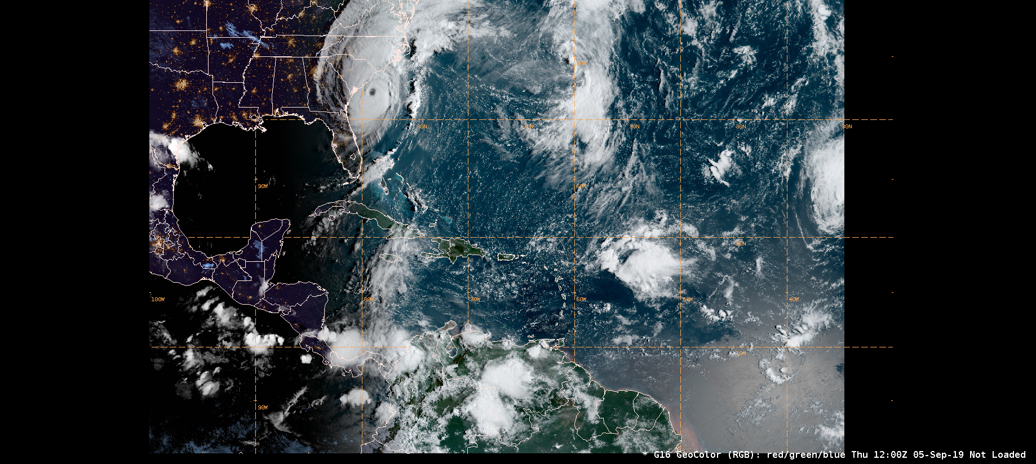
McIDAS-X and -V at RAMMB/CIRA
GOES-16/17, H8 GeoColor
24 bit - red, green and blue AREA files generated at CIRA
Used at the NHC media desk for press briefings
On path for operational implementation at NESDIS

Slide 6
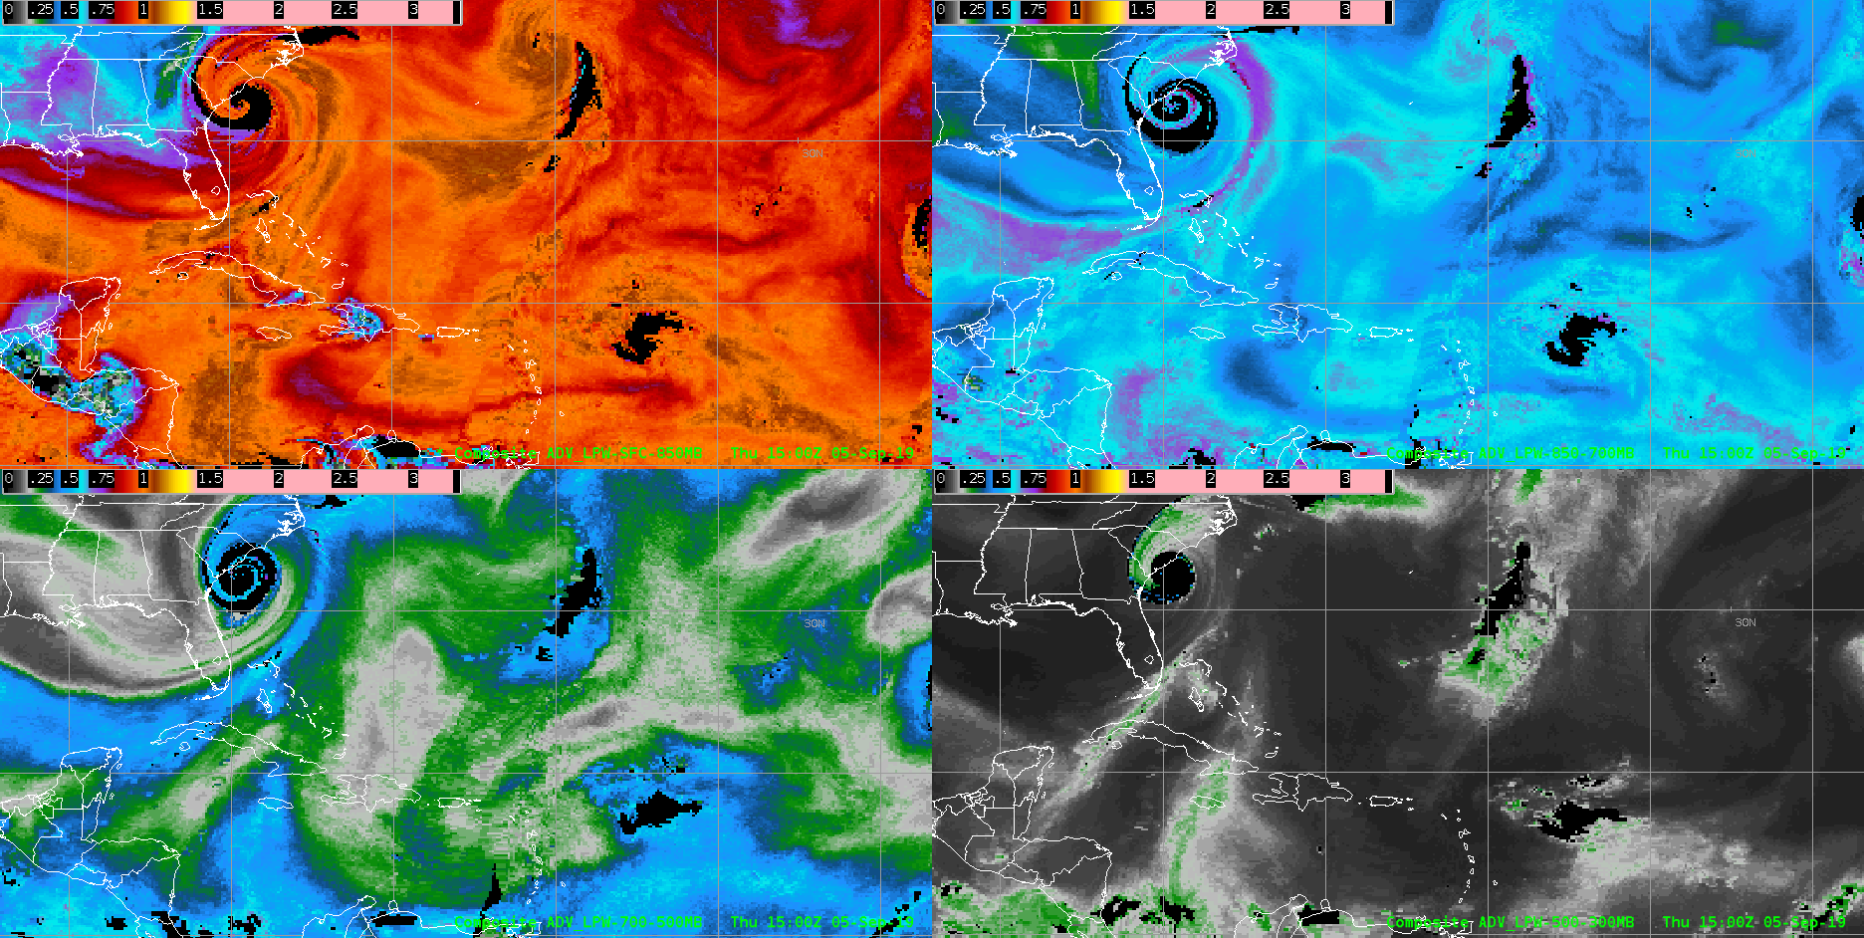
McIDAS-X and -V at RAMMB/CIRA
Advected Layered Precipitable Water
AREA files, SPoRT McIDAS netCDF3
Microwave Integrated Retrieval System (MiRS) retrievals of moisture and temperature derived from 7 polar orbiting satellites
Offers a 4D structure of water vapor (sfc-850, 850-700, 700-500 and 500-300 hPa)
On path for operational implementation at NESDIS

Slide 7
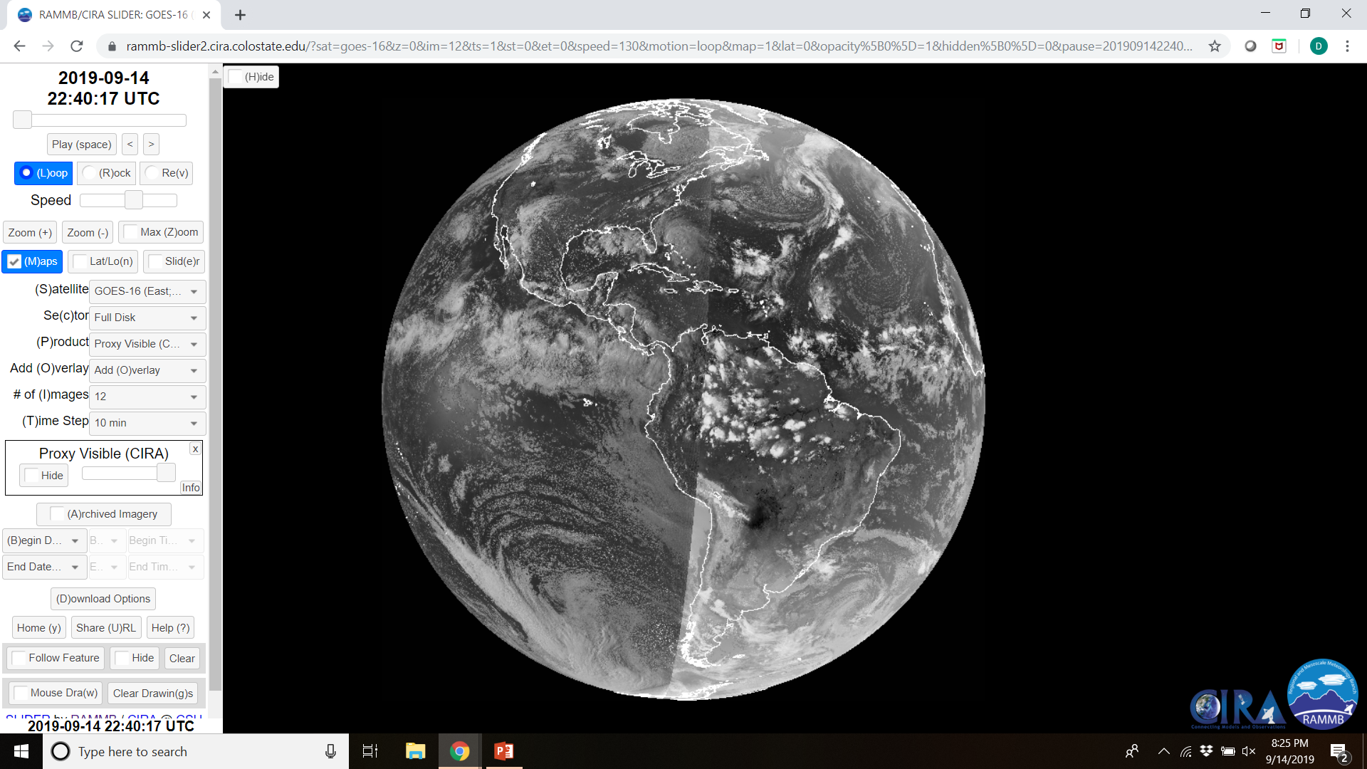
McIDAS-X and -V at RAMMB/CIRA
GOES 16/17 Proxy Visible
Uses IR channels to create visible-like imagery at night, with emphasis on displaying low-level clouds

Slide 8
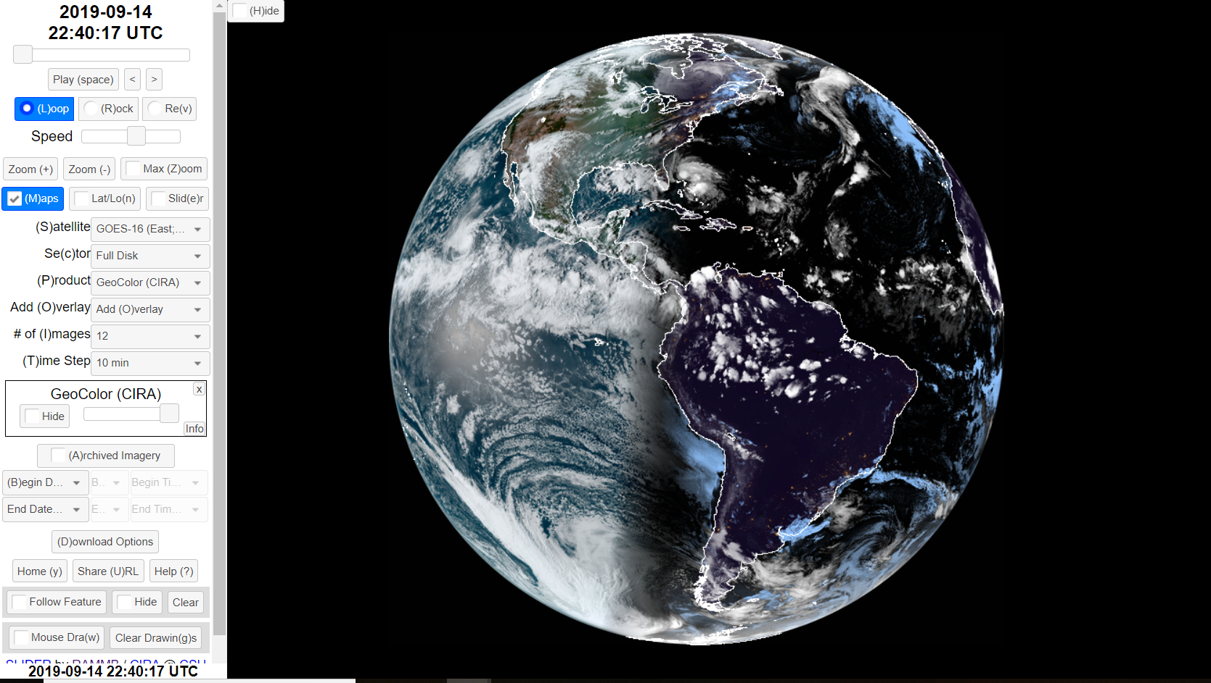
McIDAS-X and -V at RAMMB/CIRA
Satellite Loop Interactive Data Explorer in Real-Time (SLIDER)
Provides access to every pixel from the GOES-16 & 17, Himawari-8, SNPP and NOAA-20 satellites in real time

Slide 9
McIDAS-X and -V at RAMMB/CIRA
SLIDER
McIDAS is used extensively in processing imagery for SLIDER
Because the full resolution datasets are so large, users are not able to access them in real time with conventional ways of viewing satellite imagery over the web
McIDAS is utilized to create full-resolution imagery for the native bands for each sector of the GOES-16, GOES-17, Himawari-8, SNPP and NOAA-20 satellites
Called from a Python wrapper so that the giant images it produces can then be chopped up into small "image tiles" for use in the front end of the SLIDER interface.
http://rammb-slider.cira.colostate.edu

Slide 10
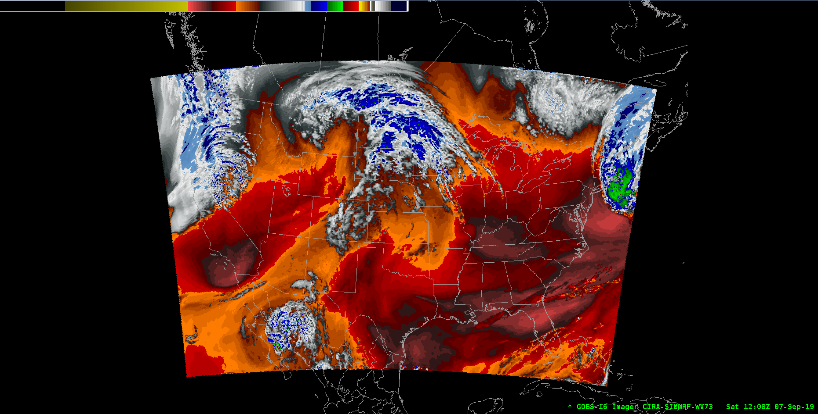
McIDAS-X and -V at RAMMB/CIRA
Simulated WRF and NAM imagery
Forecast cloud model output is created as imagery in a McIDAS AREA file
Can be used to evaluate each model run
For example, one might compare a simulated water vapor band to observed GOES-R imagery from 12-18 UTC to see how well the model is handling the timing and location of upper level features, such as shortwaves
Also used as visual forecast aid

Slide 11
McIDAS-X and -V at RAMMB/CIRA
VIIRS Granule Display

Slide 12
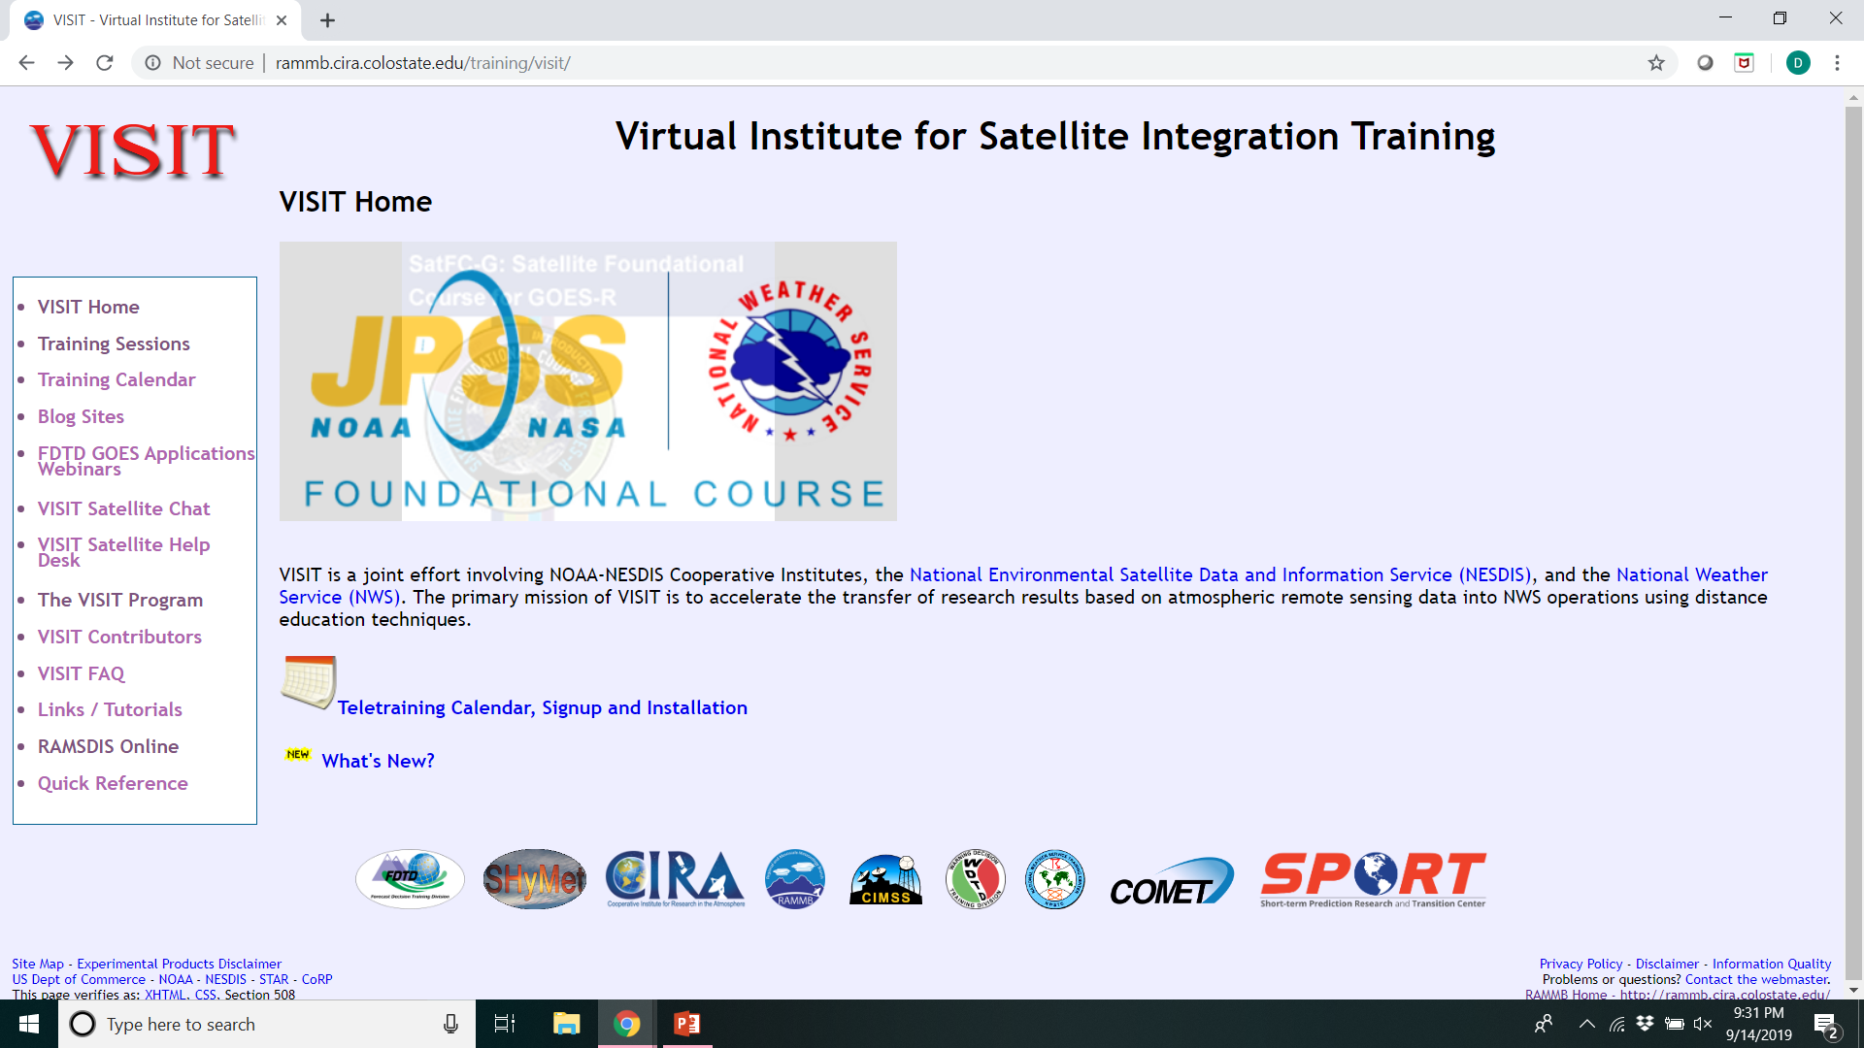
McIDAS-X and -V at RAMMB/CIRA
VISIT Teletraining

Slide 13
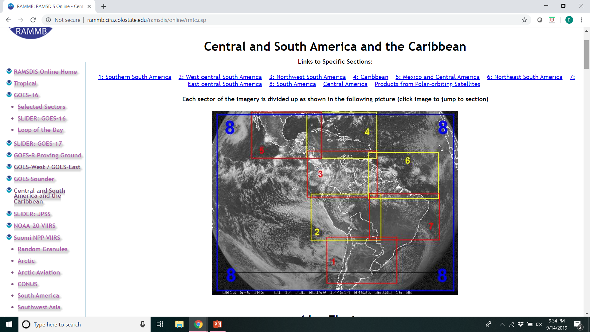
McIDAS-X and -V at RAMMB/CIRA
Central and South America Outreach

