Slide 1
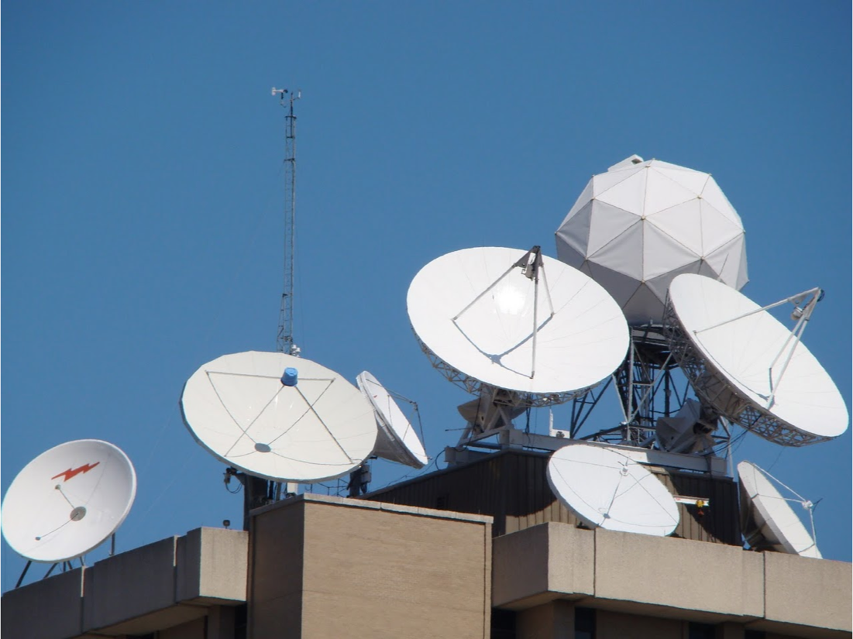
University of Wisconsin SSEC
Satellite Data Services Update
McIDAS Users Group Meeting
September 16-17, 2019

Slide 2
SSEC SDS
Staffed M-F , 8:30 AM - 5:00 pm Central time.
Antenna/Communication technician
3 Student QC assistants/programmers
SDS operations and QC lead
Senior Systems Programmer
Senior Research Application Programmer
Visualization, Database, and Web programmer
Research Intern
Program manager

Slide 3
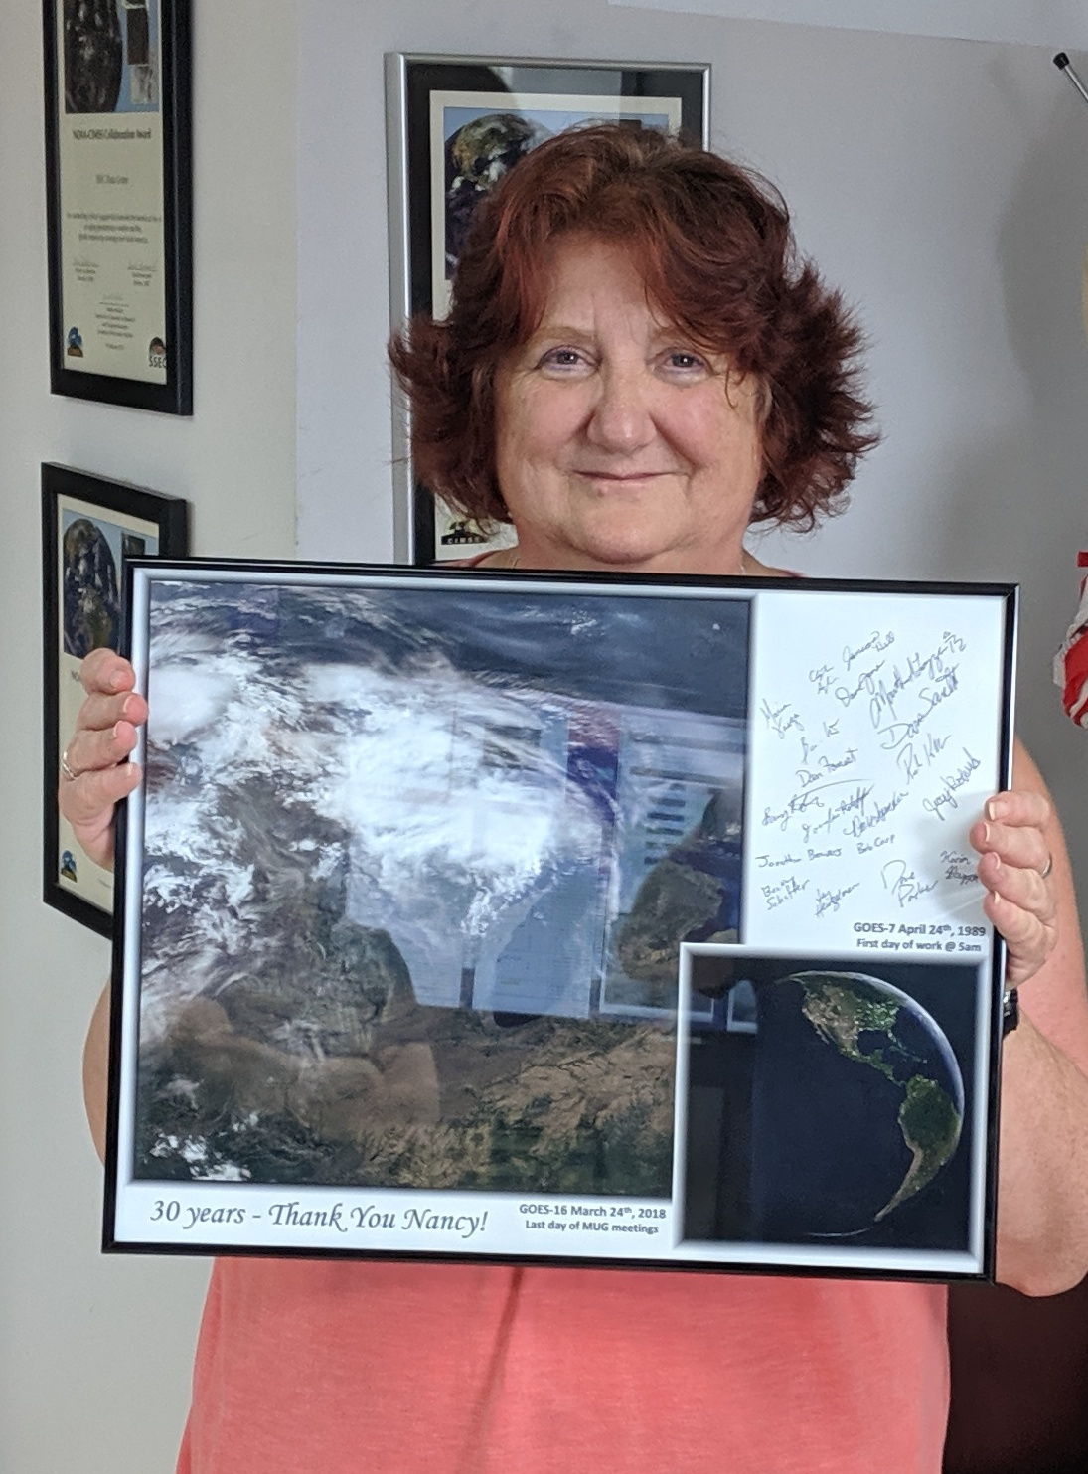
Retirements
Rosie Spangler (33 years)
Nancy Troxel-Hoehn (30 years)

Slide 4
Data Center Facilities
Over 2100 ft.
The Data Center’s disk storage exceed 15-20 PBs.
The entire room is on four 72 KW UPSs, of which, about 200+ KW are in use. Non UPS power usage is ~17 KW. An additional 72 KW UPS for a smaller 5th floor computer room
Cooling provided by campus chilled water and outside air in the winter. Racks are cooled by 16 in row APC coolers.
Gigabit and 10 Gigabit network (also 100 MB admin network, 40 Gigabit InfiniBand).

Slide 5
Data Center Facilities
UW Provisioned Off-site Data Center
Tier 3, backup power, cooling
Essential systems
Ingest, Distribution
On UW network
Plans to expand for projects that demand high availability

Slide 6
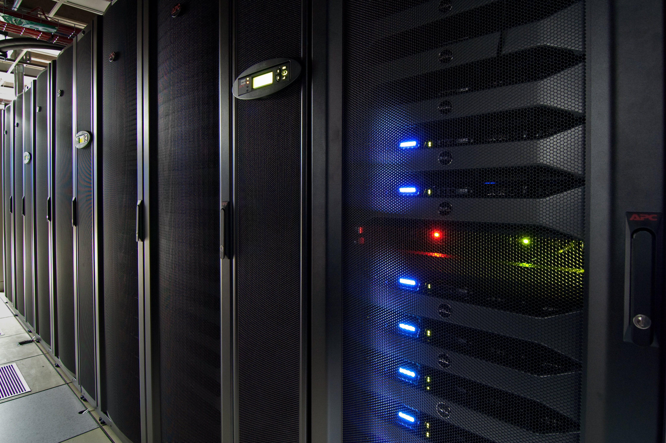
S4 Super Computer
Funded in 2018 by NOAA
2,560 cores
15 TB memory
4 PBs of storage
Researching satellite data assimilation into operational NOAA models
This is the 3rd enhancement(2011,2013)

Slide 7
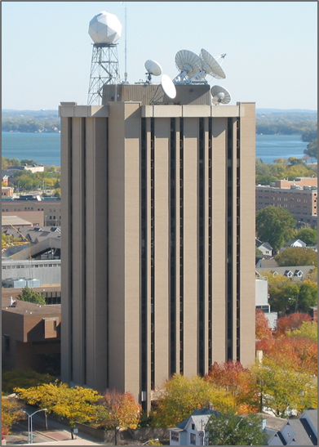
SSEC Data Center Incoming Data October, 2018
CIMSS & SSEC at the UW-Madison
1,033+ GB/day
via Satellite
(C-band. L-band, X-band)
GOES satellites ~690 GB/day
International Geo Satellites ~500+ GB/day
NOAA 15-19 Polar ~27 GB/day
Landsat-8 ~50 GB/day
MODIS polar ~150 GB/day
SUOMI NPP (VIIRS CrIS ATMS) 3,400+ GB/day
Noaaport, GNC-A, misc* 3,700+ GB/day
* Some data are duplicates pulled from multiple sources
7,330+ GB/day
via Internet*
(ftp, LDM, ADDE, http)
CIMSS = Cooperative Institute for Meteorological Satellite Studies
SSEC = Space Science &Engineering Center

Slide 8
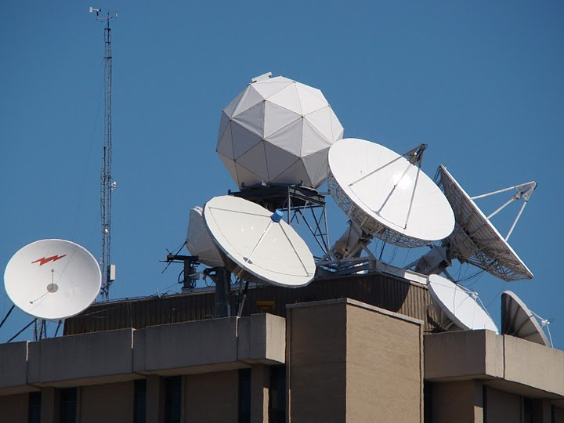
Antennas @ SSEC
C-Band
11 meter heated (101° West – SES-1, POES Fairbanks Relay )
6.3 meter heated (87° West – SES-2, POES Wallops Relay)
4.5 meter (101° West – SES-1, Noaaport)
3.7 meter GEONETcast (58º West INTELSAT 21)
L-Band
7.3 meter (75° West –GOES-East Primary/GOES-16)
7.3 meter (137° West –GOES-West Primary/GOES-17)
4.6 meter (128° West –GOES-15)
4.5 meter (60° West –GOES-13/GOES-14/GOES-15 backup )
X-Band
4.4 meter (Tracking – EOS)
X/L Band
2.4 meter (Tracking – Suomi NPP, EOS, Metop A&B, NOAA-18, 19, 20 and FY3)

Slide 9
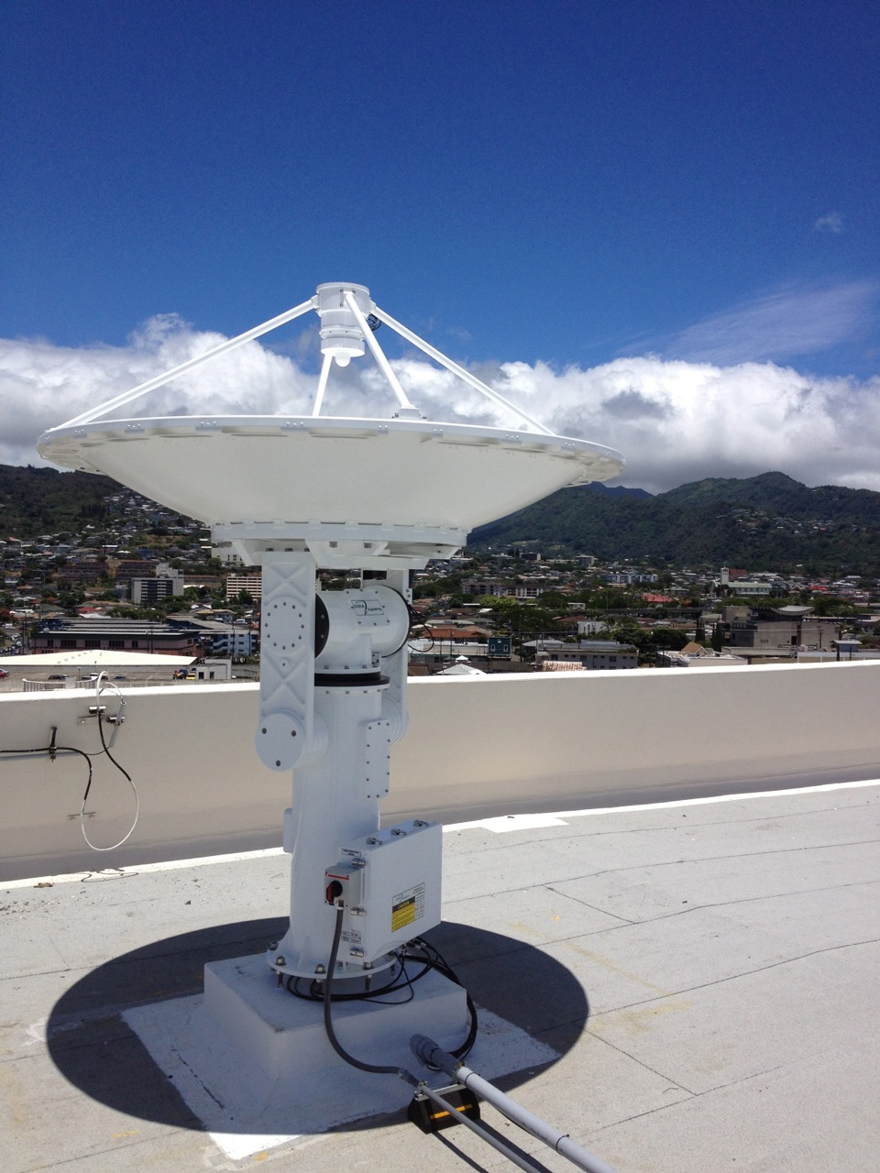
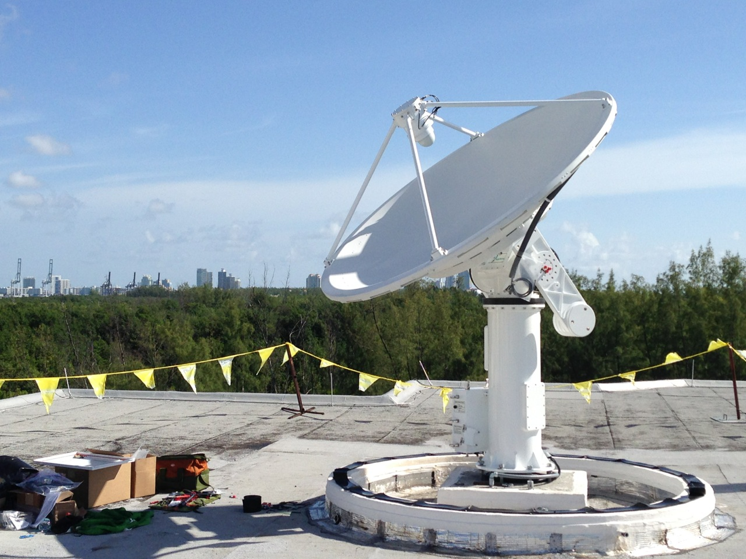
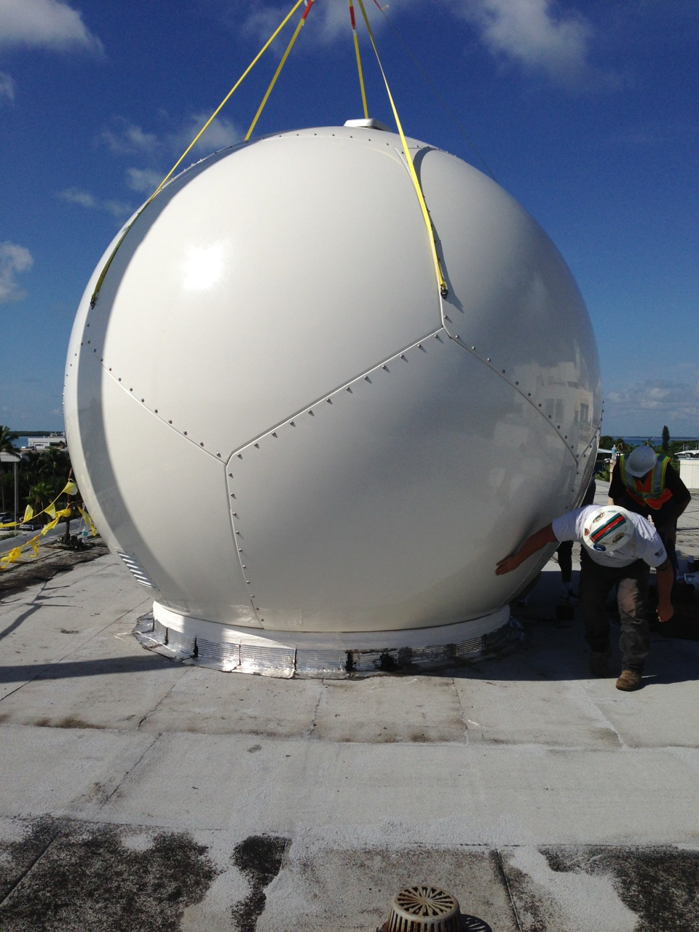
UW SSEC SDS Antennas Remotely Managed
X/L Band
Honolulu Community College
Atlantic Oceanographic & Met Lab , Miami, FL
University of Puerto Rico
Guam
All are 2.4 m used for Tracking – Aqua, Terra, Suomi NPP, EOS, Metop A,B&C, NOAA-18, 19, NOAA-20 and FY3
Supports
NOAA NWS NCEP
Eumetcast
GTS

Slide 10
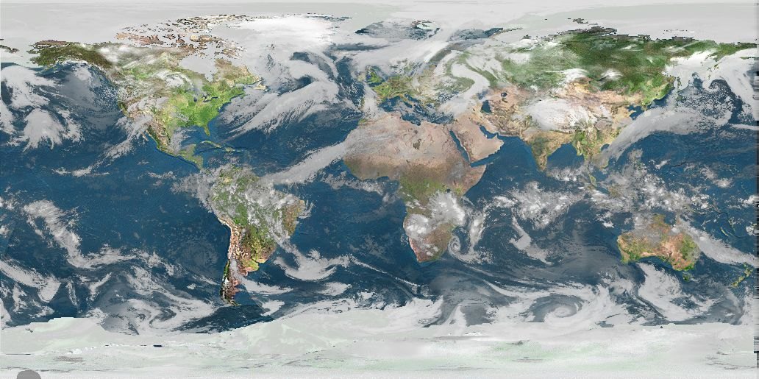
Real-time Data
The SSEC Data Center receives data from 10+ different geostationary satellites and 13+ different polar orbiting satellites. Most data are available in near real-time via ADDE. Other methods of data access are available upon request.

Slide 11
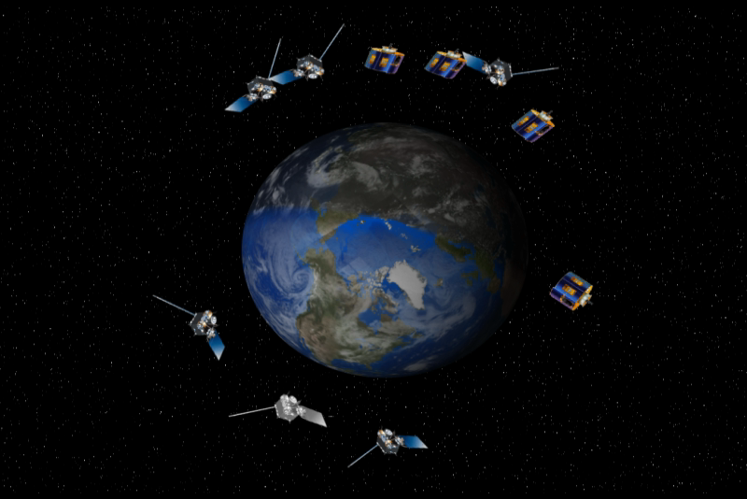
Geostationary Satellites received
GOES-16 -East (75.2°W)
GOES-15 -West(128°W)
GOES-13/14 -Test (141º/104ºW)
GOES-17 -West(137°W)
Meteosat-11 (0ºE)
Meteosat-8 (near 41.5°E)
COMS (128ºE) *
FY-2H (79°E)
FY-2G (99.5° E)
Himawari-8 (140° E)
FY-4A GIIRS only(105° E)
INSAT-3D(83° E)
*GEO-KOMPSAT-2A being pursued

Slide 12
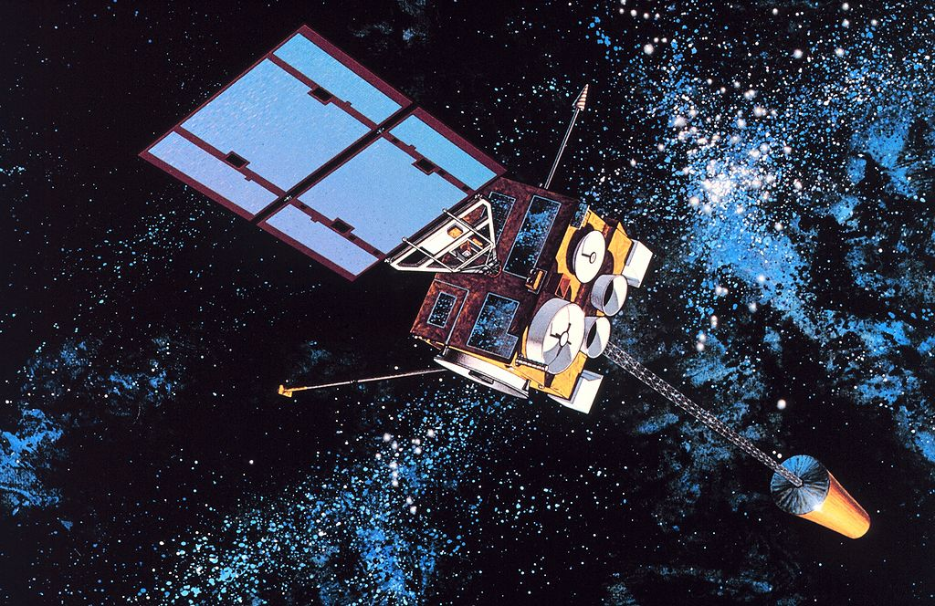
Geostationary Satellites Received at UW SSEC in 2019
 | Sub-Point | Reception Method | Source | Latency | Daily Volume
GOES-16 | 75.2° West | L-Band | DB | <10 seconds | 130-400 GB
GOES-13/14 | 141°/104º West | L-Band | DB | <2 minutes | 23 GB
GOES-15 | 128.5° West | L-Band | DB | <2 minutes | 23 GB
GOES-17 | 137ºWest | L-Band | DB | <10 seconds | 130-400 GB
Meteosat-11 | 0° East | Network Relay | NOAA STAR | ~30 minutes | 24 GB
Meteosat-8 | 41.5° East | Network Relay | NOAA STAR | ~30 minutes | 24 GB
Himawari-8 | 140° East | Network Relay | NOAA STAR ABOM (backup) | ~ 10 minutes | 300 GB
Himawari-8 | 140° East | Himawari Cast Network Relay | Hawaii NWS | ~ 10 minutes | 62 GB
FY2H | 79° East | Network Relay | ABOM | 15-30 minutes | 4.7 GB
FY2G | 99.5° East | Network Relay | ABOM | 15-30 minutes | 4.7 GB
COMS | 128° East | Network Relay | KMA | 9-24 minutes | 11 GB
FY-4A (GIIRS only) | 105º East | Terrestrial Eumetcast | Eumetsat | 10-15 minutes | ~5 – 13 GB

Slide 13
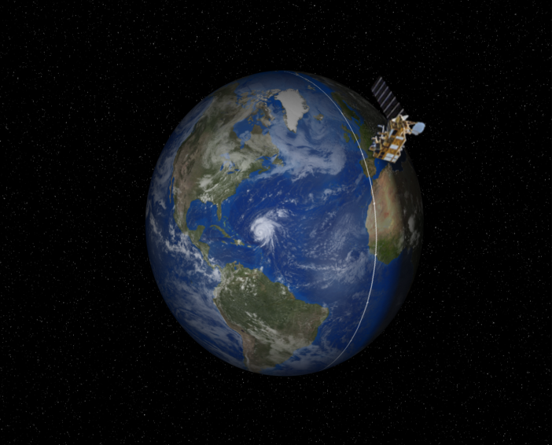
Polar Satellites received
NOAA-15
NOAA-18
NOAA-19
NOAA-20 (JPSS-1)
METOP-A
METOP-B
METOP-C
Aqua
Terra
Suomi-NPP
Landsat-8 (RE only)
FY-3B
FY-3C
GCOM-W1
13

Slide 14
Polar Satellites Received at UW SSEC in 2019
 | Reception Method | Domain | ADDE Latency | Instruments | Access
NOAA-15 | C-Band relay, NOAA-STAR | DB CONUS Global | DB <1 minutes after pass | AVHRR, AMSU, DCS->level-1 | ADDE
 |  |  |  | All other instruments Level-0 | NA
NOAA-18 | DB L-Band, C-Band relay, NOAA STAR | DB CONUS Global | DB <1 minutes after pass | AVHRR->level-1 | ADDE
 |  |  |  | All other instruments Level-0 | NA
NOAA-19 | DB L-Band, C-Band relay, NOAA STAR | DB CONUS Global | DB <1 minutes after pass | AVHRR->level-1 | ADDE
 |  |  |  | All other instruments Level-0 | NA
NOAA-20 | DB XL-Band, NOAA STAR, CLASS | DB CONUS Global | DB <1 minutes after pass Global network relay ~45 min | VIIRS>level-1 | ADDE
 |  |  |  | VIIRS,ATMS, CrIS | DB ftp (sips)
Metop-A/B/C | DB L-Band, NOAA STAR Relay | DB CONUS Global | CONUS <15 minutes after pass | AVHRR ->level-1 | ADDE
 |  |  |  | AVHRR, IASI | DB ftp (sips)
Suomi-NPP | DB X/L Band, NOAA STAR, CLASS | DB CONUS Global | CONUS <15 minutes after pass Global network relay ~45 min | VIIRS | ADDE
 |  |  |  | VIIRS,ATMS, CrIS | DB ftp (sips)
Aqua | DB X-Band, NASA Relay | DB CONUS Global | DB <15 minutes after pass | AIRS, MODIS -> Level-1 | ADDE
 |  |  |  | AIRS, MODIS | DB ftp (sips)
Terra | DB X-Band, NASA Relay | DB CONUS Global | DB <15 minutes after pass | MODIS -> Level-1 | ADDE
 |  |  |  | MODIS | DB ftp (sips)
Landsat-8 | Network Relay (USGS) | CONUS | <24 hours | Level-1 | WMS
Shizuku GCOM-W1 | DB X-Band | CONUS | DB <1 min after pass | Level-0 | SSEC ftp
FY-3B/C | DB X/L Band | CONUS | DB <1 min after pass | Level-0 | SSEC ftp

Slide 15
Data Distribution
Realtime
McIDAS ADDE (Abstract Data Distribution Environment)
ftp
http
LDM
Direct access via mount (in-house only)
WMS (Web map service)
Archive
ADDE
Direct Access (in-house only)
WMS (experimental)
McFETCH
THREDDS

Slide 16
Non-Satellite data
NOAAport (500+GB/day)
Text/Point
Model Grids
Radar

Slide 17
Archive Data
As of May 2019, over 1,700 TBs online.
Grows approximately about ~350+ TB/year
US Geostationary Satellites
GOES-8 through GOES-17 (1994-Present) (East, West , South America and test)
G16 and G17 L1 ABI and L2 GLM in Netcdf
G16 and G17 CADUs (essential for SDS and CSPP-GEO debugging)
GOES-1 through GOES-7 (1978-1996)
SMS-1&2 (1978-1981)

Slide 18
Archive Data
International Geostationary Satellites
GMS/MTSAT (1998-2015)
Meteosat/Meteosat IODC (1998-Present)
Meteosat-1 FGGE (1978-1979)
FY2 (2004-Present)
Kalpana (2005-2017)
Insat-3D (June 2014-2017)
COMS (June 2012 – Present)
Himawari-8 (March 2015 – Present)

Slide 19
Archive Data
NOAAPORT/Conventional Data
Model Output (1996-Present)*
In situ Point Observations (1976-Present)

Slide 20
SDS related initiatives
AMQP Events
Satellite QC API
GRB Fanout/Mixer
Other projects

Slide 21
AMQP status
image complete
image start
Messaging
Queue
band end
Publisher
Client
http://www.ssec.wisc.edu/datacenter/amqpfind
AMQP == Advanced Message Queuing Protocol
Provides end user notification of data events
Python program amqpfind
Allows end user better reliability, shorter latencies
Will run both at SSEC and at remote Datacenter (eventually the cloud?)
Will move to as many datasets as possible/practical

Slide 22
AMQP status
image complete
image start
Messaging
Queue
band end
Publisher
Client
http://www.ssec.wisc.edu/datacenter/amqpfind
Satellites
GOES-16/17
L1b - all instruments
GLM
L2 products
Himawari (HDS)
NOAA-20 (VIIRS only)
SNPP (VIIRS only)

Slide 23
AMQP status
image complete
image start
Messaging
Queue
band end
Publisher
Client
http://www.ssec.wisc.edu/datacenter/amqpfind
Python requirements
Multi-server: Python 2.7 and greater Single Server: Python 2.6 and greater
Tested operating systems
Redhat/CentOS 6 and 7 OS X 10.0

Slide 24
Satellite QC API
https://qcweb.ssec.wisc.edu/web/abi_quality_scores/

Slide 25
Satellite QC API
https://qcweb.ssec.wisc.edu/web/abi_quality_scores/#values:latency;

Slide 26
Satellite QC API

Slide 27
Satellite QC API
Will migrate all GEOs to API first
Integrated with inventory
Will eventually add Non-GEOs
Public accessible interface

Slide 28
Fanout/Mixer Server
Fanout allows:
Transmission of GRB CADU/CCSDS packets via TCP/IP
Distribution of GRB via internet
Feed multiple ingestors without using multicast

Slide 29
Fanout/Mixer Server
Mixer allows:
Multiple antenna inputs
Mix feeds at the “CADU” level
Can allow selective data distribution
Great for RF interference mitigation
Automatic redundancy

Slide 30
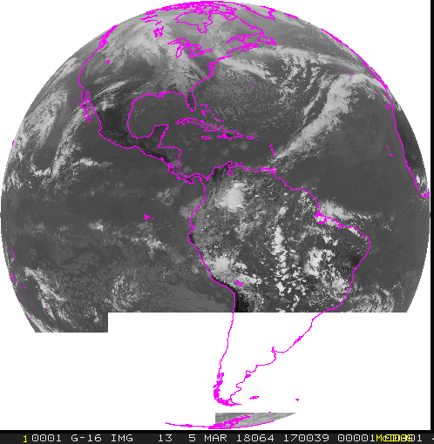
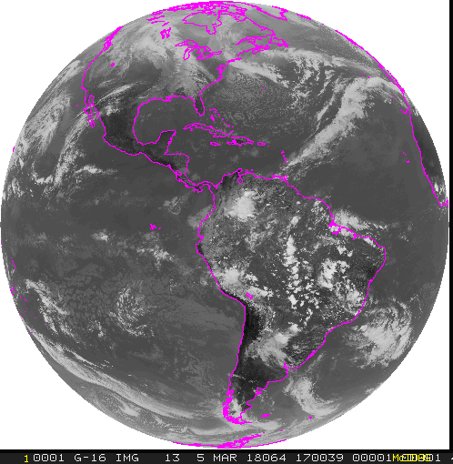
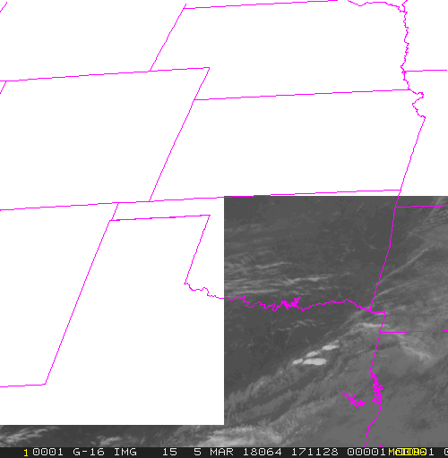
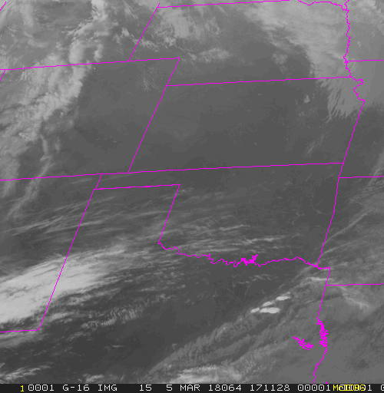
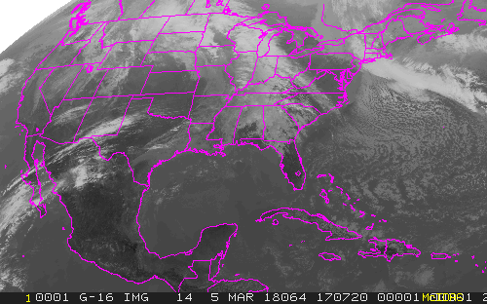
Solar RFI at PDA ground station March 5, 2018
03/05/2018 17:06:38 - 17:15:57 UTC
Affected 7 Meso-scale sectors
5 entire images lost
2 partial images
Affected 1 Full Disk
8 channels partial loss
8 channels No loss
Affected 1 CONUS (all 16 channels lost)
PDA
SSEC

Slide 31
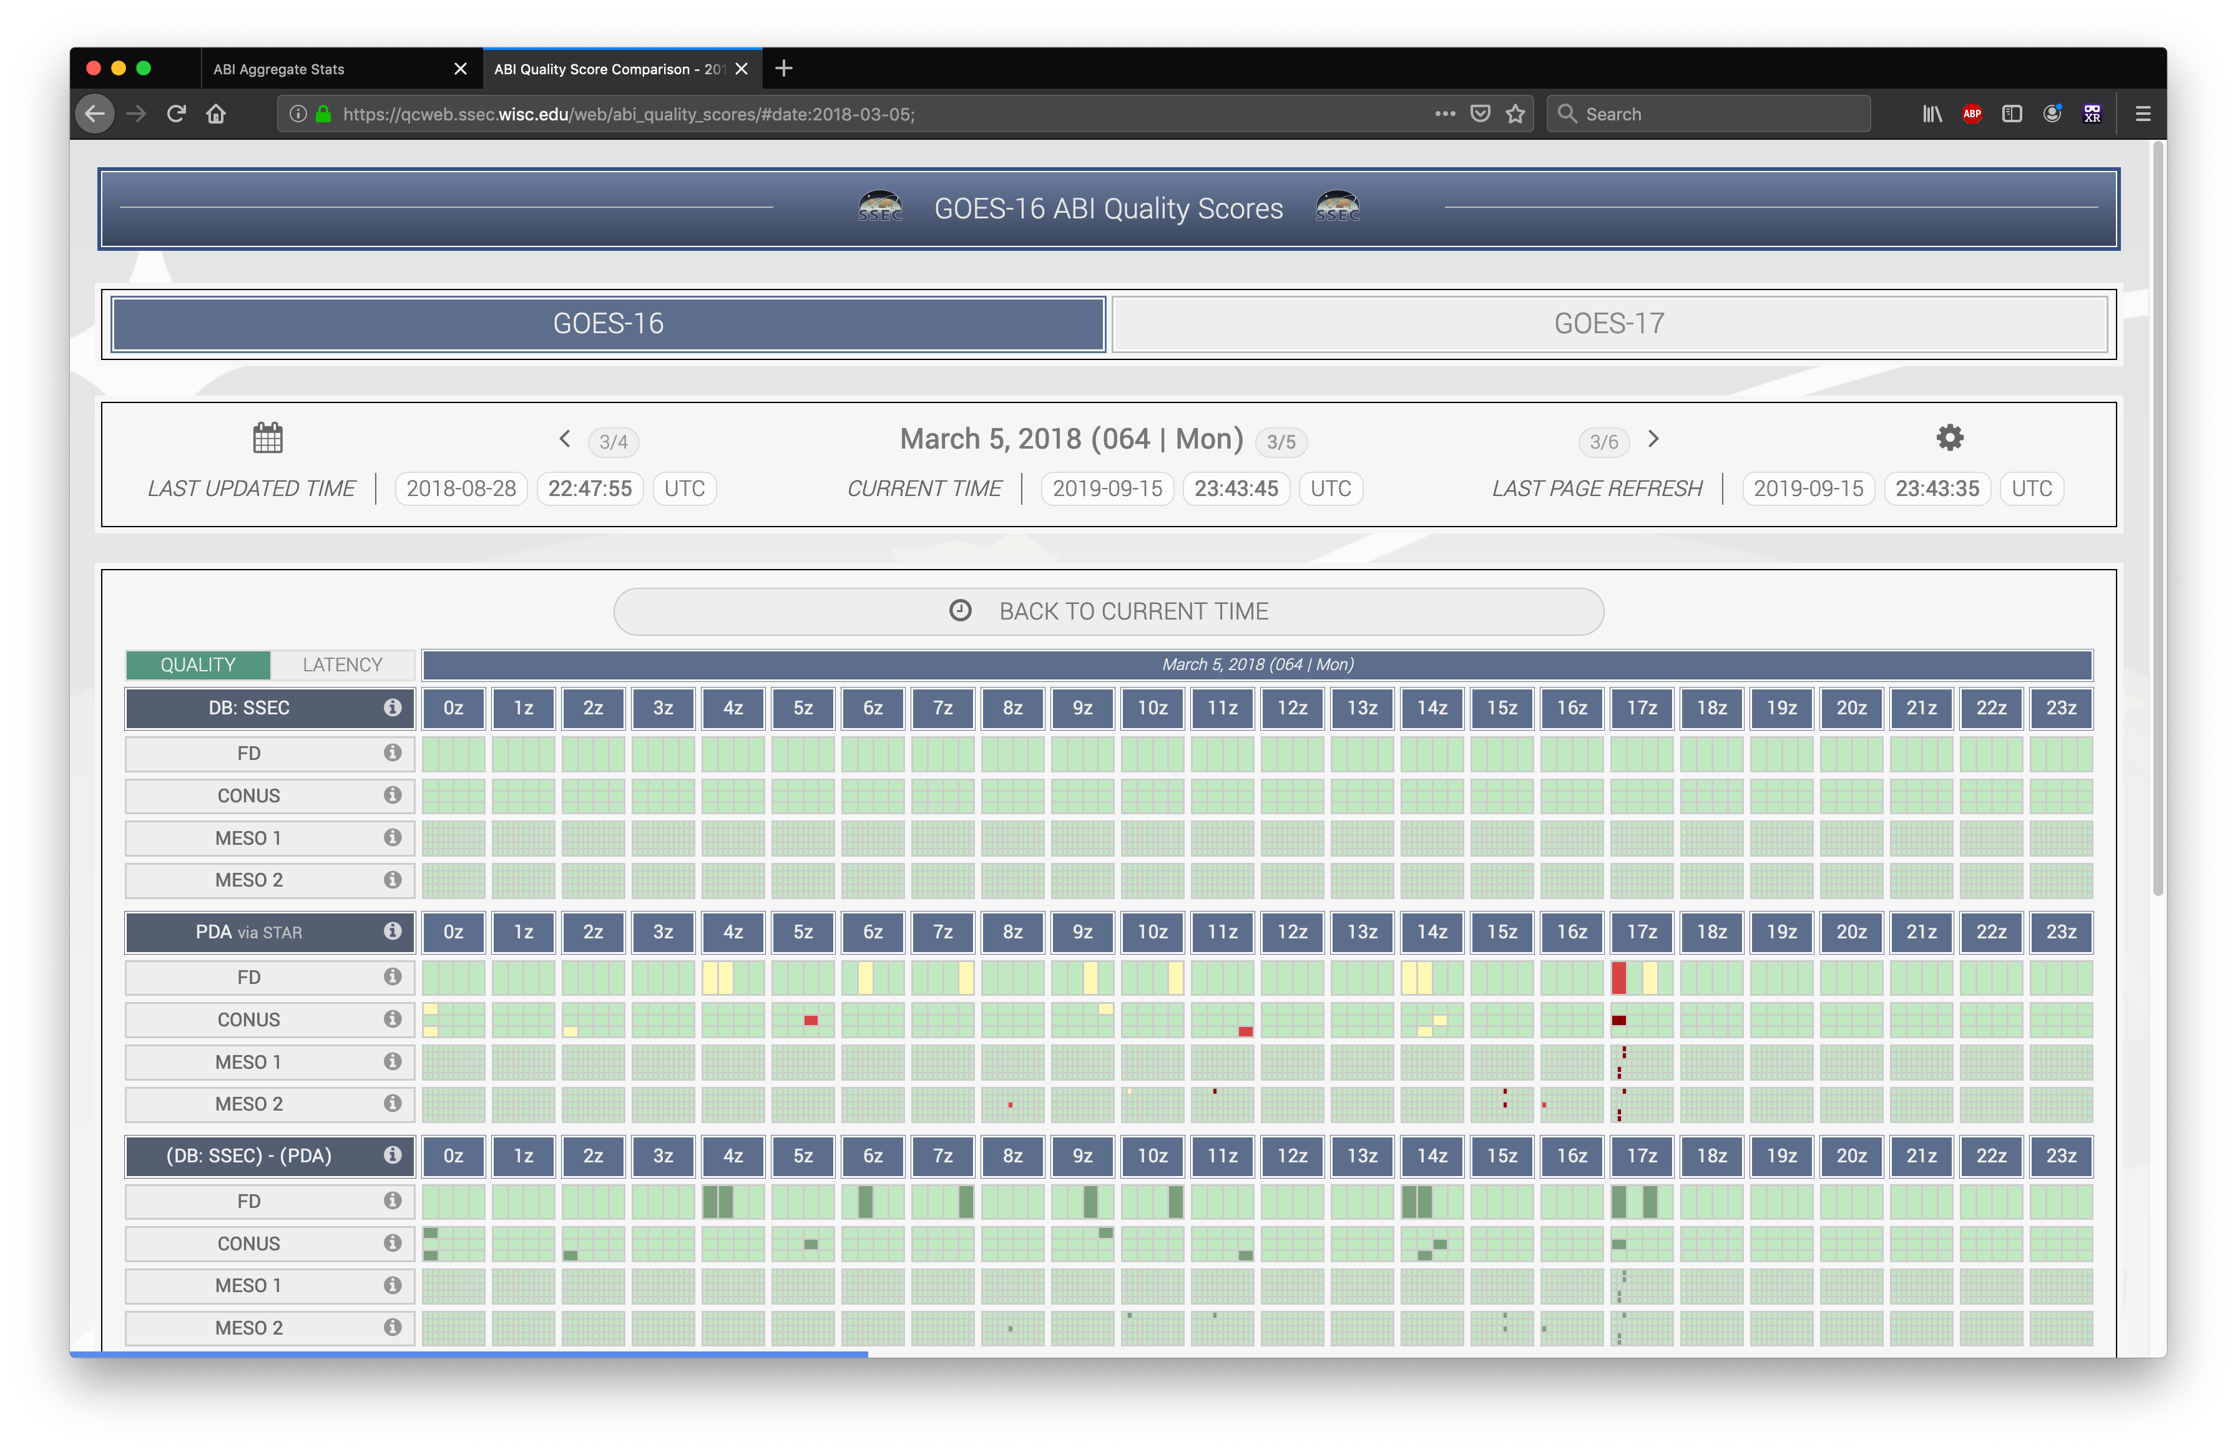
Fanout/Mixer Server

Slide 32
Fanout/Mixer Server

Slide 33
Other projects
GOES-17 detector cooling problem imagery mitigation (Fusion)
Mission-level netCDF are created experimentally
FY-4A GIIRs checkout
Outreach activities
Climate digest
Virtual Reality (VR) demos

Slide 34
Thanks!

