Slide 1
McIDAS Program Status
David Santek
2019 McIDAS Users’ Group Meeting
16 September 2019

Slide 2
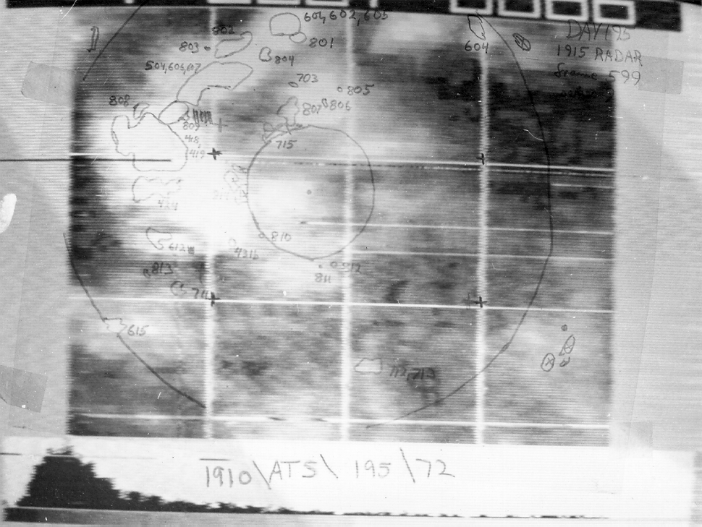
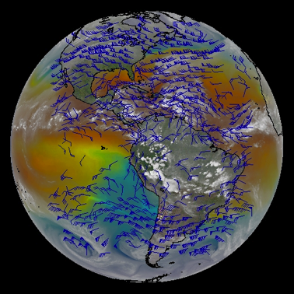
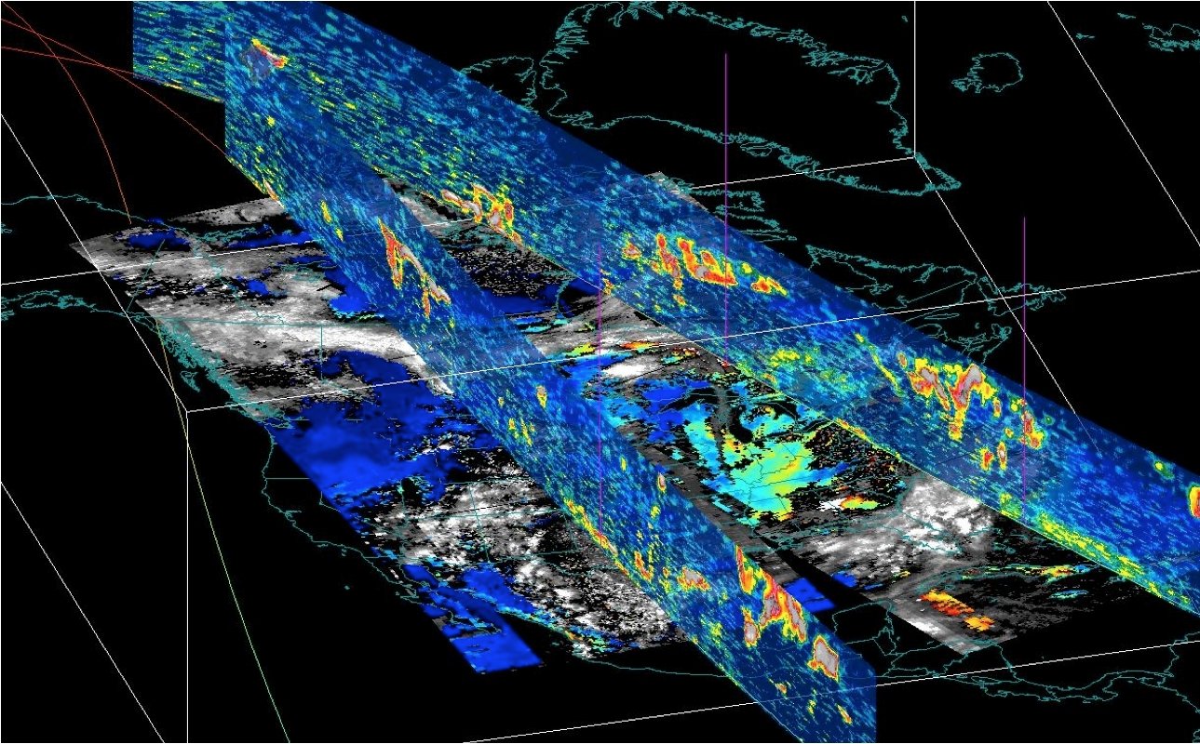
McIDAS Status
SSEC Overview
McIDAS-X
McIDAS-XCD
McIDAS-XRD
McIDAS-V
SSEC Data Ingestor (SDI)

Slide 3
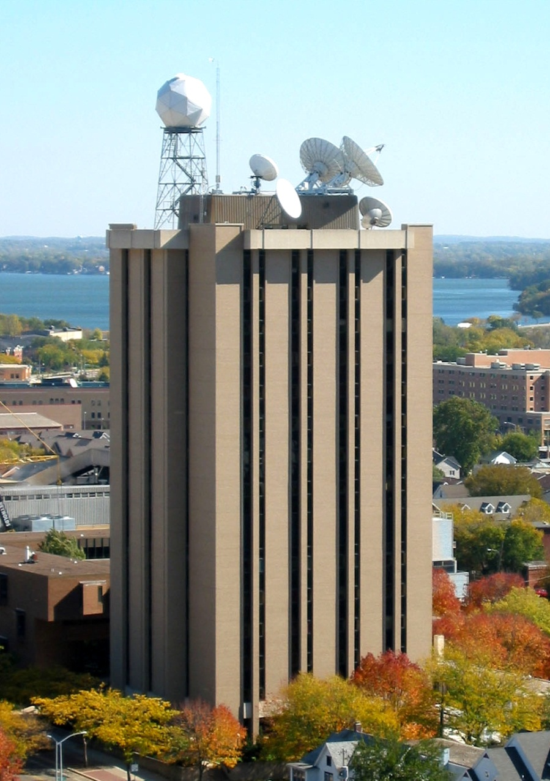
Space Science and Engineering Center
Graduate School, UW-Madison
Mission: To conduct atmospheric, oceanic, environmental, and astronomical research using space or space-age techniques to discover and apply the physical properties of our universe for the benefit of humanity
From Idea, to Concept, to Implementation, to Information about the world
Symbiotic relationship with Department of Atmospheric & Oceanic Sciences symbolized by shared building provided by NSF, NASA, & the State of Wisconsin
3

Slide 4
CIMSS/SSEC/AOS
ASPB
NCEI
Symbiotic relationship between CIMSS, SSEC and AOS
Notes:
The relationship between entities in the building.

Slide 5
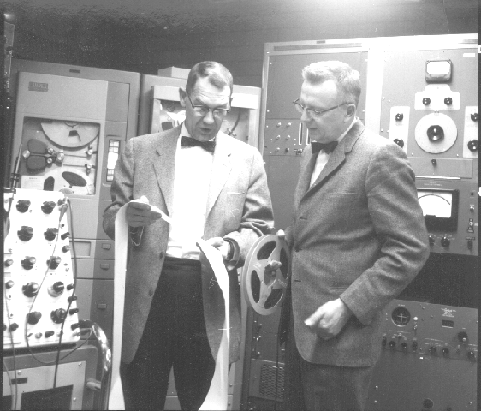
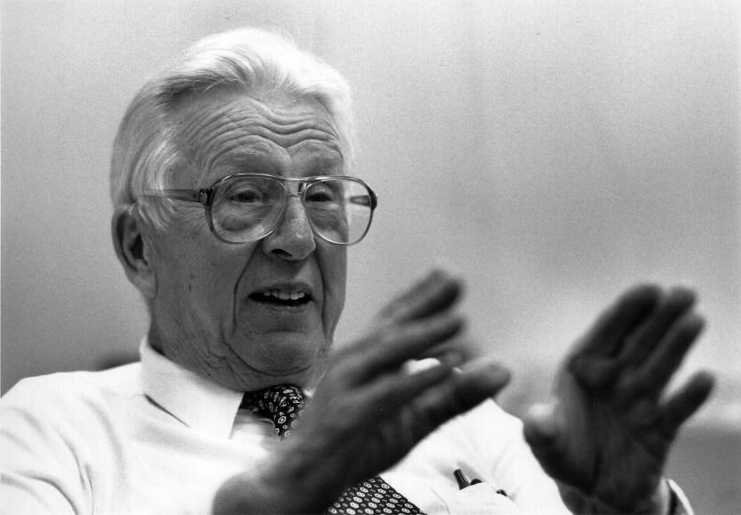
SSEC works to maintain the spirit of exploration of its founder, Verner E. Suomi (1915-1995)
with cofounder, Bob Parent (L)
1959: 1st Meteorological
Satellite Experiment
  Earth Radiation Balance Observations on Explorer VII
  1966: 1st Earth Imaging
  from GEO
  Spin-scan Camera on 1st
  Advanced Technology Satellite
  1980: 1st Infrared Sounder
  from GEO
  VISSR Atmospheric Sounder
  on GOES-4
“Father of Satellite Meteorology”
5

Slide 6
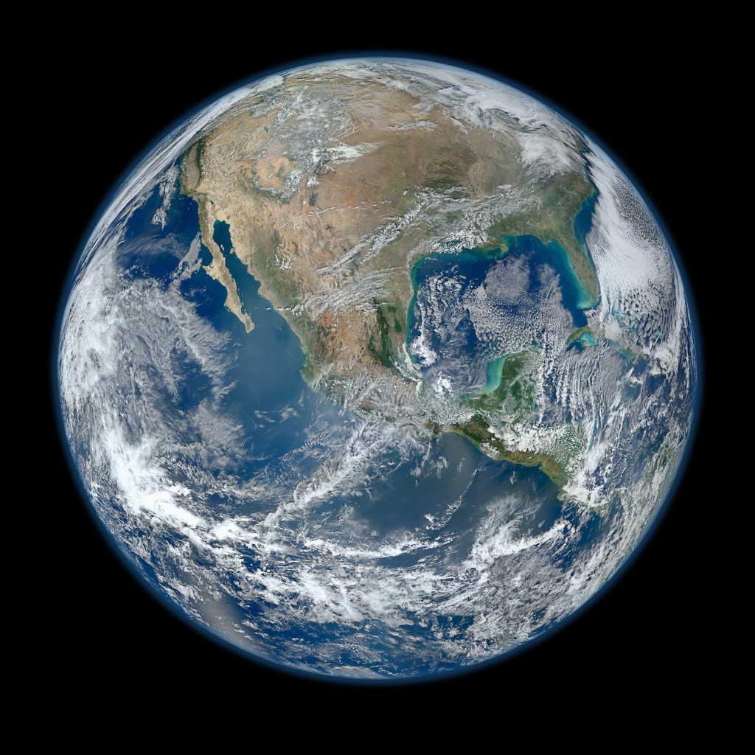
Weather Satellite renamed “Suomi NPP”
On 25 January
2012
NASA & NOAA
renamed
their newest
Earth-observing satellite after UW-Madison space pioneer
Blue Marble
NPP VIIRS Image, GSFC
6

Slide 7
Nature of the Organization
Space Science & Engineering Center
Matrix Organization: PIs are the Cornerstone (about 30)
Staff / Budget: About 250 staff members
A diverse Center: support distributed among agencies, including NASA, NOAA, NSF, DoD, DoE, Private Sector
Brad Pierce –Director/Scientist supported by 3 Associate Directors
  Executive Director for Administration: Jenny Hackel
  Executive Director for Science: Wayne Feltz
  CIMSS Executive Director
  Executive Director for Technology: Fred Best
7

Slide 8
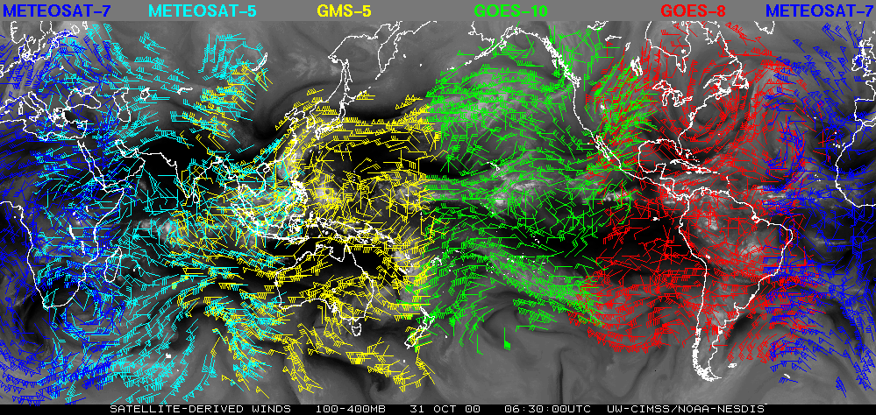
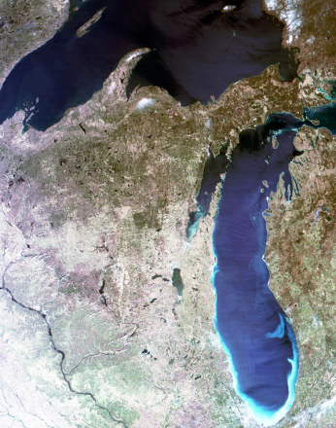
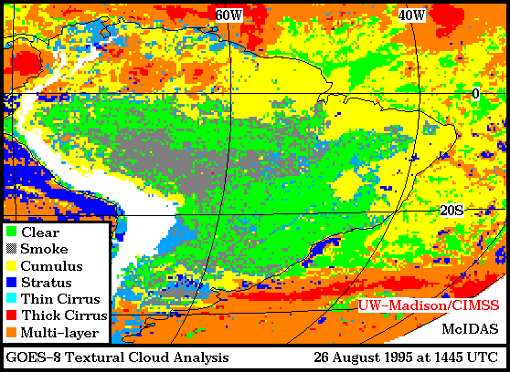
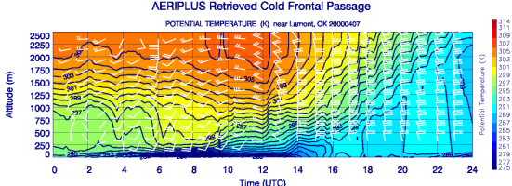
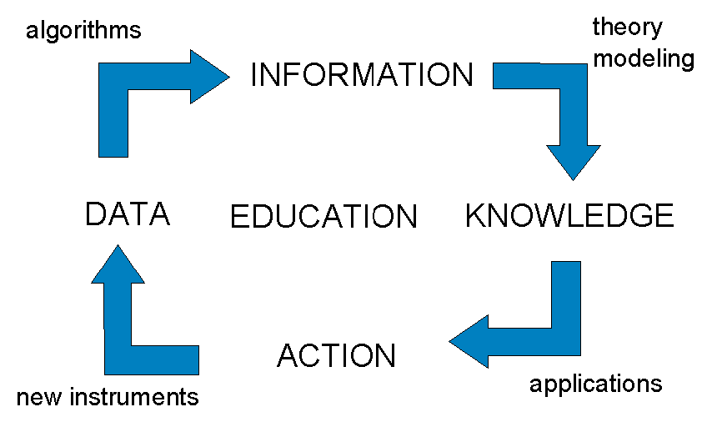
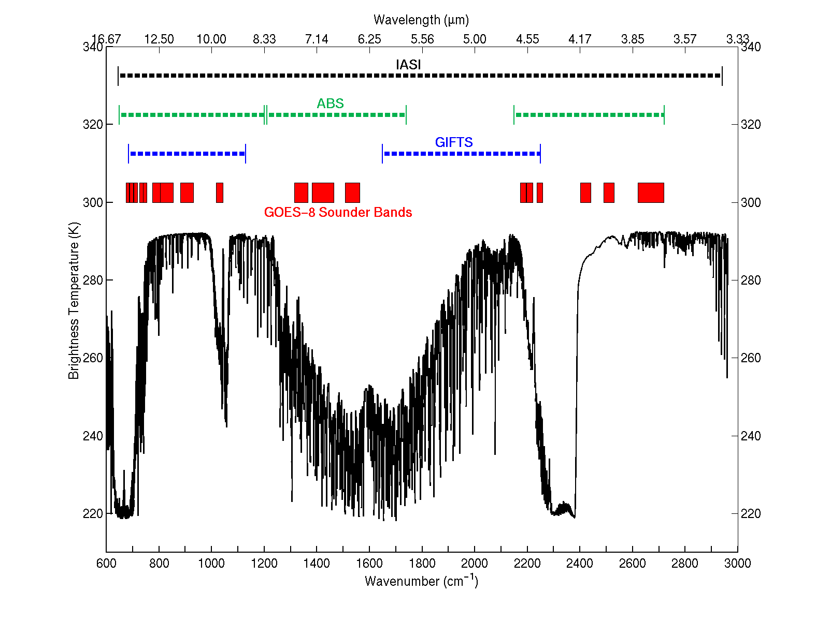
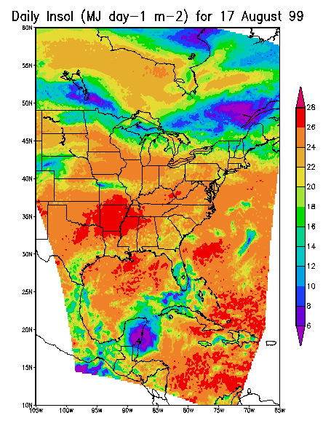
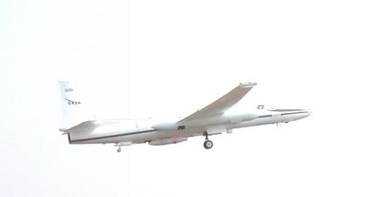
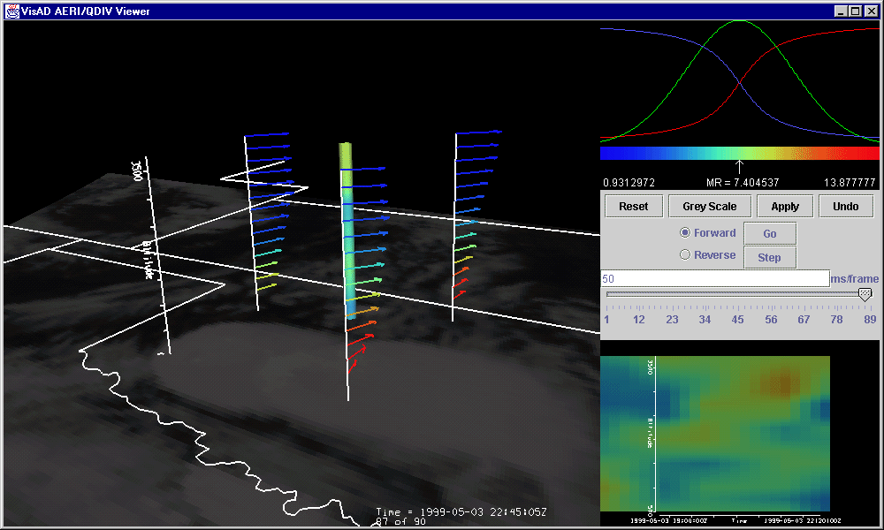
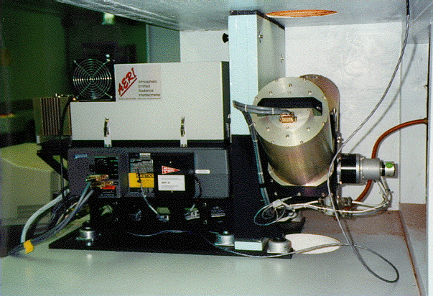
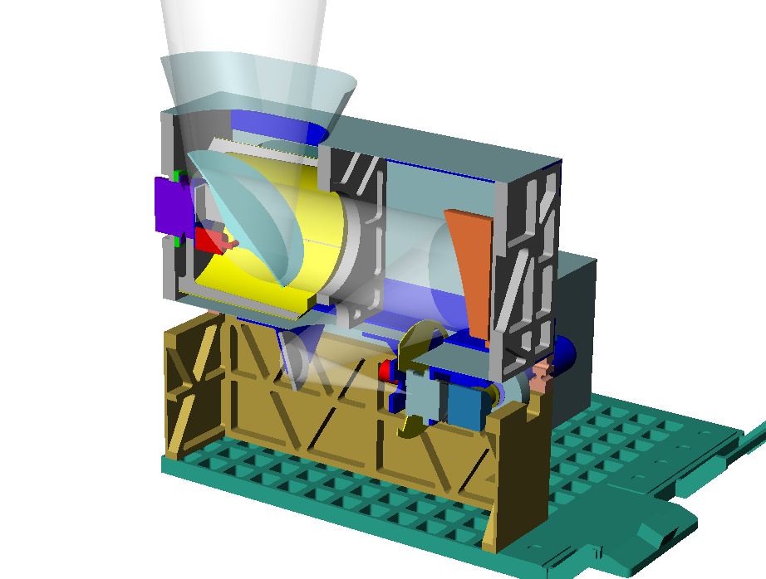
Cooperative Institute for Meteorological Satellite Studies (CIMSS)
8

Slide 9
Cooperative Institute for Meteorological Satellite Studies (CIMSS)
SSEC/CIMSS Legacy for over 90% of current GOES Operational Products
9

Slide 10
GOES-R ABI Baseline Products at CIMSS
Product | CIMSS Lead | ASPB Lead
Clear Sky masks | William Straka | Andy Heidinger
Cloud and Moisture Imagery | Mat Gunshor | Tim Schmit
Cloud Optical Depth | Andi Walther | Andy Heidinger
Cloud Particle Size Distribution | Andi Walther | Andy Heidinger
Cloud Top Height | Steve Wanzong | Andy Heidinger
Cloud Top Phase | Corey Calvert | Michael Pavolonis
Cloud Top Pressure | Steve Wanzong | Andy Heidinger
Cloud Top Temperature | Steve Wanzong | Andy Heidinger
Derived Motion Winds | Chris Velden | -
Derived Stability Indices | Jun Li | Tim Schmit
Fire/Hot Spot Characterization | Chris Schmidt | -
Hurricane Intensity Estimation | Chris Velden | -
Legacy Vertical Moisture Profile | Jun Li | Tim Schmit
Legacy Vertical Temperature Profile | Jun Li | Tim Schmit
Snow Cover | Xuanji Wang | Jeff Key
Total Precipitable Water | Jun Li | Tim Schmit
Volcanic Ash: Detection, Height | Justin Sieglaff | Mike Pavolonis
Notes:
These products were developed by CIMSS/SSEC/ASPB scientists and will run operationally at NOAA (OSPO). Most of them will also be run at CIMSS/SSEC, where updated algorithms will be tested.

Slide 11
GOES-R ABI NOAT Priority Research Algorithms at CIMSS
Product | CIMSS Lead | ASPB Lead
Fog / Low Cloud Products | Corey Calvert | Mike Pavolonis
Turbulence ?? | Tony Wimmers | Mike Pavolonis
SO2 Detection | Justin Sieglaff | Mike Pavolonis
Icing | Andi Walther | Andy Heidinger
Overshooting Top Detection | Sarah Griffin/Chris Velden
GOES-R ProbSevere | John Cintineo | Mike Pavolonis
Cloud Cover Layers | Steve Wanzong | Andy Heidinger

Slide 12
SSEC areas of technical expertise
Observational Science
  Spacecraft system/mission design, instrumentation, field programs, spaceflight instrument fabrication, including campus science support to Physics, Astronomy, Botany, Geology
Computational & Visualization Science
  Hardware & software systems for information generation, data management, & communication
Analytical Science & Applications
  Satellite & conventional data analysis, technical development & analysis
12

Slide 13
McIDAS-X
Current
Periodic updates (1-2 times per year)
Improvements to display
  More channel combination tools (RGB, sandwich)
Capability with newest and future satellites:
  GOES-R ABI and GLM (more metadata and product access)
  S-NPP and NOAA-20 (JPSS-1) VIIRS ADDE server (SDR)

Slide 14
ADDE Servers
Implementing Python-based ADDE servers
  Easier for others to write servers
  Will be compatible with McIDAS-X and –V
  More details tomorrow: Python ADDE Project

Slide 15
McIDAS-X
Future
MUG responsible for general improvements, bug fixes, maintenance (updates for current and new satellites), and OS and external library updates
  Considering current Korean satellite GEO-KOMPSAT-2
  Thinking toward Metop-SG (Second Generation) and Meteosat Third Generation (MTG) in early 2020s
Unique enhancements continue to be funded outside the MUG and code contributed by internal projects and external sites
McIDAS-X is expected to be supported into the 2030s for the GOES-R series satellites. No sunset date in sight.

Slide 16
McIDAS-XCD
Conventional Data
Ingest conventional weather data from NOAAPORT
Current version to be supported for at least another year
Beta of new version will be available in late 2019
  Currently tested in parallel with XCD 2019.1
More information in McIDAS-XCD 2019.1 and Replacement Update

Slide 17
McIDAS-XRD
Research and Development
A collection of R&D code that is not formally tested by McIDAS User Services:
  Over 100 McIDAS commands
  Over 15 ADDE servers
  Testing is limited to ensuring code builds on supported platforms
  Occasionally promote to core
Status: Current support level continues
Future: Coincides with McIDAS-X future

Slide 18
SDI
SSEC Data Ingestor
SDI (SSEC Desktop Ingestor) 1997 - 2005
SDI-104 (SSEC Data Ingestor) 2005 – ?
SDI-GRB Appliance 2016 - ?
Status: SDI-104 supported; SDI-GRB supported
Future:
  SDI-104: supported as long as GOES GVAR satellites are operational or backup
  SDI-GRB Appliance: throughout the GOES-R era
More details in SSEC Data Ingestor (SDI)

Slide 19
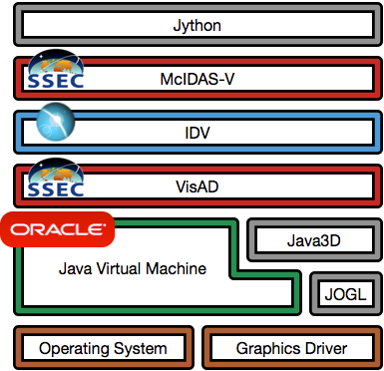
McIDAS-V Status
Major components by Unidata, SSEC, Oracle, open source community
Additional components include file format libraries, math libraries, packaging and build utilities; all open source
OS vendors Linux,Windows, Mac
Hardware drivers from manufacturers
Notes:
who maintains VisAD?primarily Rink, Whittaker, Don Murray
https://github.com/visad/visad/graphs/contributors

Slide 20
McIDAS-V
Java 3D Replacement
Effort begun to replace Java3D with Ardor3D:
Ardor3D has a more general framework for both alternate windowing environments and 3D graphics APIs
Started with Jogamp's JOGL; may move to a version based on LWJGL (Lightweight Java Game Library).
A graphics-dependent sub package of VisAD core has been developed using only Ardor3D
  Many of the VisAD basic unit tests functioning as expected

Slide 21
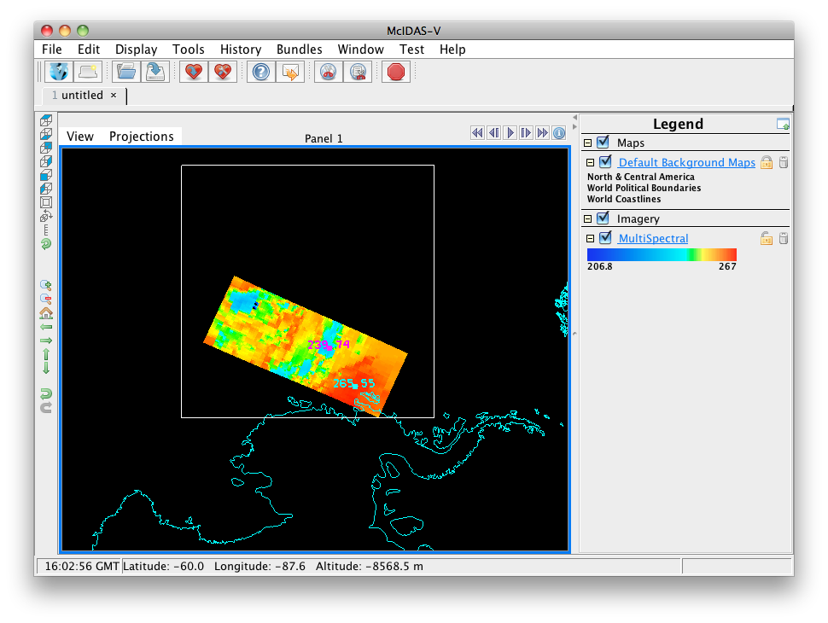
McIDAS-V Funding
MUG
Several CIMSS grants for S-NPP/JPSS and GOES-R
On the watch for other proposal opportunities (e.g., NASA)

Slide 22
McIDAS-V
MUG Support
User-level Infrastructure: User Interface, Scripting
Bug fixes: Prioritize, coordinate internally and with Unidata
Testing
Documentation: Includes maintaining tutorials
Help Desk: Includes maintaining forums

Slide 23
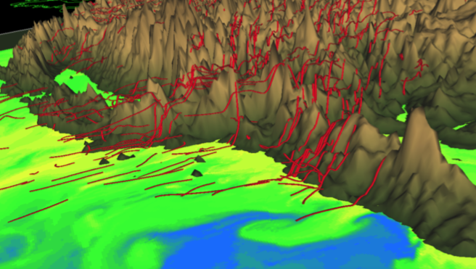
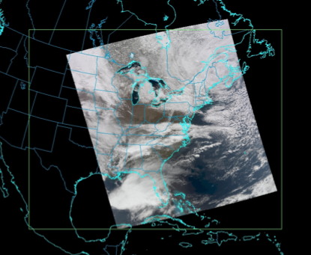
McIDAS-V
CIMSS Grants
Improvements for
trajectories
(terrain-following)
Handle S-NPP granules that span dateline
Scripts to create VIIRS RGB images
TROPOMI sensor support

Slide 24
McIDAS-V Priorities
  Fix Critical and Quick bugs (MUG, Unidata)
  Incorporate enhancements from CIMSS projects, especially those that are not possible in McIDAS-X (CIMSS, MUG)
  Ensure new data sources are usable (MUG, CIMSS)
    Geo and Leo missions
    Test with new data in standard formats (netCDF, HDF, BUFR, GRIB)
  Maintain compatibility with Unidata’s IDV (Unidata, MUG)

Slide 25
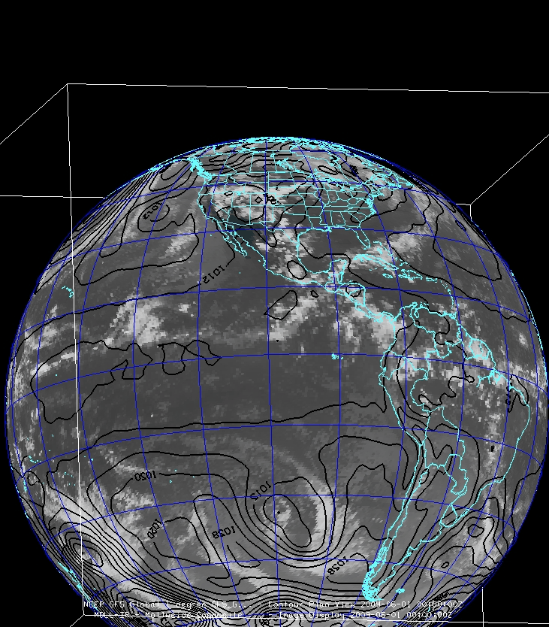
McIDAS-V
Future
Continue to engage new researchers:
  Workshops and training
  Classroom
Appeal to researchers:
  Input/output data formats
  Scripting
  More data fusion

