Slide 1
Python ADDE Project
David Santek, Becky Schaffer, Jon Beavers,
Tommy Jasmin, Jerry Robaidek, Dave Hoese
2019 McIDAS Users’ Group Meeting
17 September 2019

Slide 2
Overview
A cornerstone of McIDAS is the modular and extensible Abstract Data Distribution Environment (ADDE):
Servers for both local and remote data access
All satellite data in SSEC’s Satellite Data Services are accessible via ADDE
Used throughout the McIDAS community by both McIDAS-X and McIDAS-V
We expect the ADDE data delivery protocol to be important for many years to come.

Slide 3
Overview
ADDE servers primarily written at SSEC, with Unidata, EUMETSAT, and AEMET also contributing.
More than 20 servers, including:
Satellite: GOES ABI, Himawari AHI, MODIS, AVHRR, VIIRS, Meteosat, COMS
Grid: GRIB, McIDAS Grid
Other: netCDF, HDF, GeoTIFF, Text

Slide 4
Objectives
ADDE infrastructure refactoring:
Move ADDE server development into a modern programming environment.
Ensure a future for ADDE for new satellites and other image data:
Motivated by the fact that current SSEC ADDE developers are semi-retired
ADDE continues to be an important data delivery mechanism for SSEC, Unidata, and many of the current McIDAS-X and McIDAS-V users.
Outcome will be Python library and functional ADDE server that will:
Interface and be packaged with McIDAS-X and –V
Work on Linux, Windows, and Mac
Enable a programmer or scientist with 1 year of Python experience to create their own ADDE server without knowledge of underlying McIDAS Fortran and C code.

Slide 5
pyADDE Status Phase 1: Study - Complete
Investigate the current ADDE protocol and implementation:
Evaluate the feasibility, and
Estimate the effort to enable the use of Python to write ADDE servers.
Yes, it is programmatically possible to develop servers independent of McIDAS-X

Slide 6
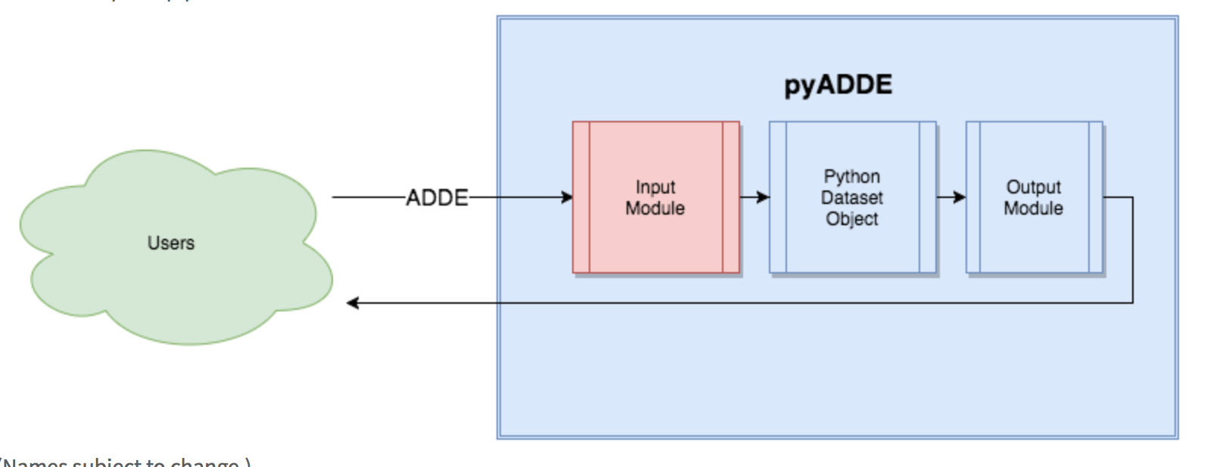
Python ADDE Servers
Write a new server without McIDAS-X knowledge
Only Input Module will need to be written:
Read native file
Compute lat/lon for each n^{th} point
Reshape into Python Dataset Object
pyADDE does the rest

Slide 7
pyADDE Status Phase 2: Prototype - Complete
A Python directory server was written
A Python data server was written
A basic server to read a PNG file and return the data along with McIDAS-necessary metadata (directory and navigation block)
The ADDE protocol tests were successful for both local and remote instances of the Python directory and data servers on Linux
Note: This uncovered an unexpected issue in the transmission protocol not seen with typical McIDAS-X ADDE servers. Python seemingly does not block by default on stdout going to a socket (remote serving), whereas going to a pipe works fine (local serving). Issue resolved by calling os.set_blocking(1, True).

Slide 8
pyADDE Status Phase 3: Refactoring – Beginning Oct. 1
Rewrite low-level C and Fortran routines into Python:
Python ADDE servers and library (pyADDE) is a stand-alone package
ADDE servers can be written without in-depth knowledge of McIDAS-X
Investigate interfacing Python ADDE servers to the SatPy library:
Access to a variety of geostationary and polar satellite data, through a common API
New Python ADDE servers could be written without a deep understanding of data formats used by the different satellites
Write a Python version of the McIDAS-X ABI server
Document and test with Windows and Linux

Slide 9
Summary
Advantages:
Evolution rather than revolution
May make use of McIDAS-X Fortran and C library functions in the short-term
Extensions more easily implemented
Return other formats (e.g., netCDF), not only McIDAS-X Area
Perhaps additional geographic projections (using proj.4)
Status:
Prototype server being developed
Plan is to have first version of pyADDE available by mid-2020

