Slide 1
McIDAS History and Future
David Santek, Becky Schaffer
17 September 2019

Slide 2
McIDAS Man computer Interactive Data Access System
46th anniversary in October 2019, current versions:
McIDAS-X
AIX then X Window System
McIDAS-V
Visualization using VisAD

Slide 3
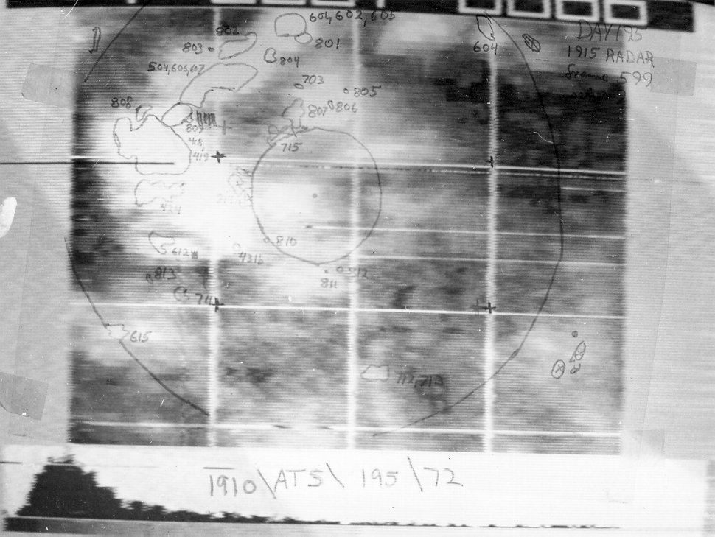
McIDAS History
1960s: Prof. Vern Suomi was striving to exploit the geostationary satellites for time domain information
McIDAS was initially developed with the goal to mass produce the cloud drift winds
For the last 46 years, McIDAS has evolved through 5 generations of hardware/software as an internationally renowned system

Slide 4
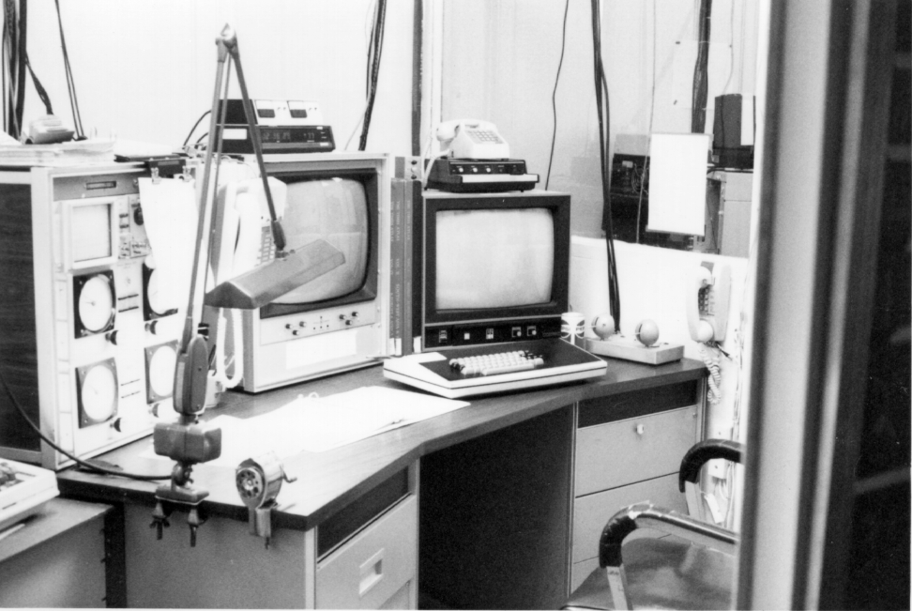
McIDAS Significant Milestones
12 October 1973: McIDAS was first used in a research project by Dave Martin
1977: McIDAS installed at WTVT in Tampa, FL; active site until 2013!
1978: Cloud-drift winds were manually generated from five geostationary satellites for a year as part of the First GARP Global Experiment (FGGE)

Slide 5
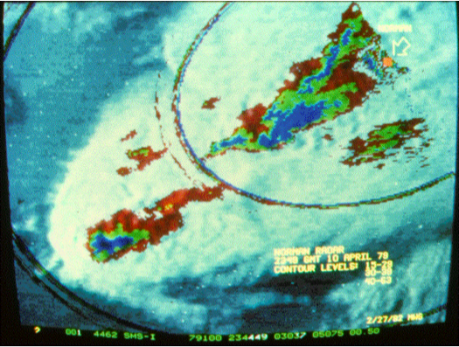
McIDAS Significant Milestones
1979: Congressional delegation visited SSEC to learn about advances in severe storm forecasting in wake of tornadoes in Wichita Falls, TX
1982: McIDAS installed at NSSFC to aid in severe weather forecasting.
Mesoscale Discussions began in 1986, partly in response to the availability of timely analyses
1982: Port to mainframe; funded by People’s Republic of China

Slide 6
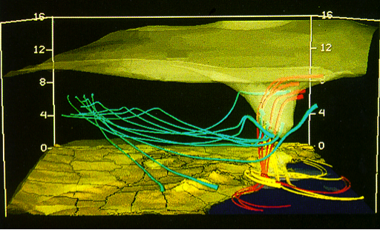
McIDAS Significant Milestones
1982: Interactive Flash Flood Analyzer (IFFA) based on McIDAS installed at NOAA
1989: McIDAS Users’ Group formed
mid-1980s: McIDAS installed at Cape Canaveral and Johnson Space Center in support of the space shuttle
late-1980s: Installed at NHC

Slide 7
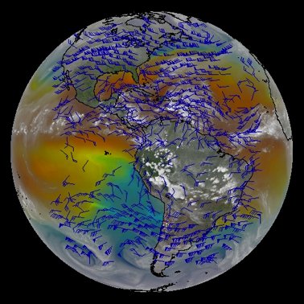
McIDAS Significant Milestones
1992: McIDAS-X, Unix-based system
1994: CIRA RAMSDIS – GOES satellite data into NWS
mid-1990s: Abstract Data Distribution Environment (ADDE)

Slide 8
McIDAS-X Current Chapter

Slide 9
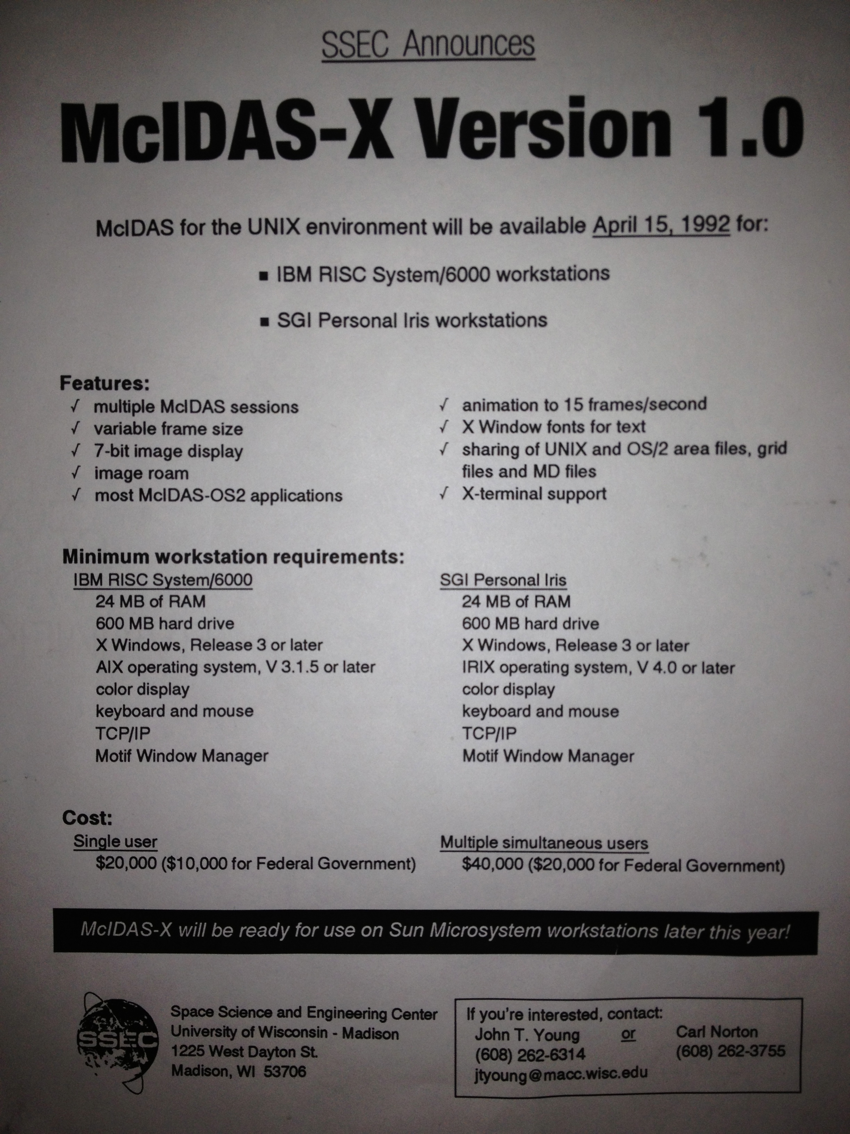
McIDAS-X Introduction
Ported code from mainframe and DOS- and OS/2-based computers to IBM AIX workstations
Released April 1992
A distributed system as opposed to previous mainframe

Slide 10
McIDAS-X Keys to Success
Port to Unix
ADDE (Abstract Data Distribution Environment)
McIDAS-X Reglue
Resulted in the longevity of McIDAS-X
Reliability, Stability
Solid infrastructure

Slide 12
McIDAS-V Motivation in 2006
McIDAS-X software (currently written in Fortran 77 and C) has a 40-year heritage resulting in limited extensibility potential
New visualization concepts cannot be incorporated
Forthcoming environmental satellite data cannot be utilized efficiently (GOES-R & JPSS operational systems)

Slide 13
McIDAS-V Goals
McIDAS-V shall be a powerful and versatile software system for environmental data processing, analysis and visualization
McIDAS-V shall support existing and evolving needs of scientific research and algorithm/applications development for new programs, such as NPOESS and GOES-R as well as for retrospective data, such as that from GOES and POES
McIDAS-V shall support data fusion and algorithm interoperability from existing and future sources
The McIDAS team shall continue to fully support the MUG and McIDAS-X functionality as users transition to McIDAS-V
McIDAS-V shall support operational users by providing tools and interfaces that enable a natural transition path for research results into operations
McIDAS-V shall be used to educate students in remote sensing and physical sciences, and students must be integrally involved in its development, evolution and use

Slide 14
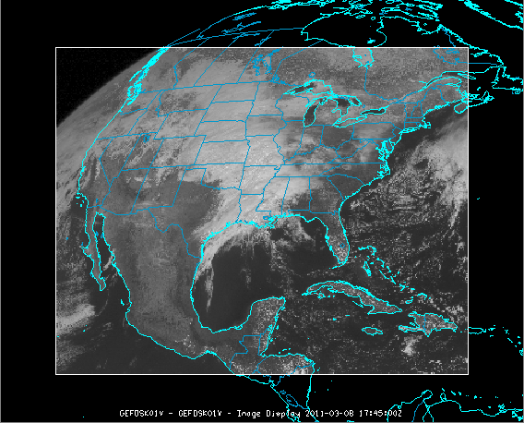
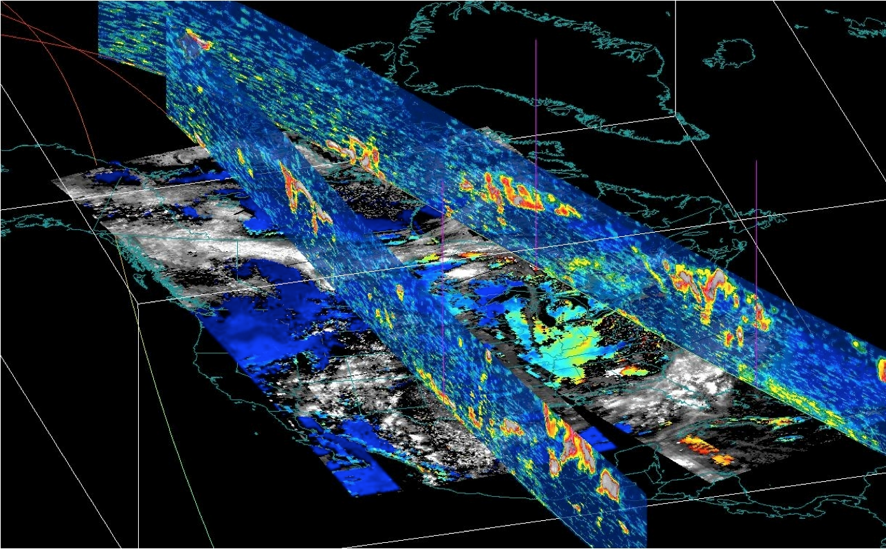
McIDAS-V Innovative
Develop new capability in visualization and data analysis Move beyond 2D to 3D

Slide 15
McIDAS-V Milestones
2003: Whittaker and Santek present a McIDAS-V plan to the SSEC Directors
2006: Investigations of a “new approach” to data analysis and visualization
2007: Collaboration with Unidata to advance VisAD and IDV as the basis of McIDAS-V
2008: McIDAS-V becomes an “alpha”
January 2009: beta 1
January 2010: beta 5
September 2010: V1.0

Slide 16
McIDAS-X Future
More support and compatibility with Python
Fewer Fortran and C programmers
Important for new ADDE servers to incorporate many more data types
Keep current with changes in Python and migrations to languages of the future
Keep an eye future graphics (visualization) packages
X Window Systems is 30-year old technology
McIDAS-X dependency is isolated
Cloud computing

Slide 17
McIDAS-V Future
Stay true to mission and goals
Continue to investigate unique functionality for visualizing and fusing data
Improve interface to data
Stay relevant with changing technology
Replacement for Java3D: Ardor3D
Cloud computing
Interoperability with other software and systems

