Slide 1
McIDAS Users’ Group MUG Update
Becky Schaffer
Program Manager
McIDAS User Services
2019 MUG Meeting – Madison, Wisconsin

Slide 2
MUG Update
MUG Personnel
What’s New in 2019
Who uses McIDAS-X and McIDAS-V?
McIDAS Support Requests
How long will McIDAS-X be supported?

Slide 3
MUG Personnel – Current MUG Staff
Kevin Baggett: -XCD programming
Jon Beavers: -V programming
Bob Carp: Help Desk & testing -V doc & programming
Jay Heinzelman: Help Desk & testing
Dave Parker: Systems programming
Barry Roth: Help Desk & documentation

Slide 4
MUG Personnel – Programmers
McIDAS-X SSEC: Russ Dengel Rick Kohrs Scott Lindstrom Dave Santek William Straka Unidata: Tom Yoksas | McIDAS-V and VisAD SSEC: Tommy Jasmin Tom Rink Unidata: Julien Chastang Yuan Ho Wisconsin: Curtis Rueden

Slide 5
MUG Personnel – Unidata Collaboration
Working Together on VisAD, IDV, -V
Monthly Teleconferences
Merged our developer tools (git, redmine)
MUG testers helping to test new functionality coming from IDV

Slide 6
MUG Personnel – Training and Outreach
Demonstrations & Talks
EUMETSAT Meteorological Satellite Conference Tallinn, Estonia (2018)
STAR JPSS Science Week – College Park MD (2018)
AGU Conference – Washington DC (2018)
AMS Annual Meeting – Phoenix AZ (2019)

Slide 7
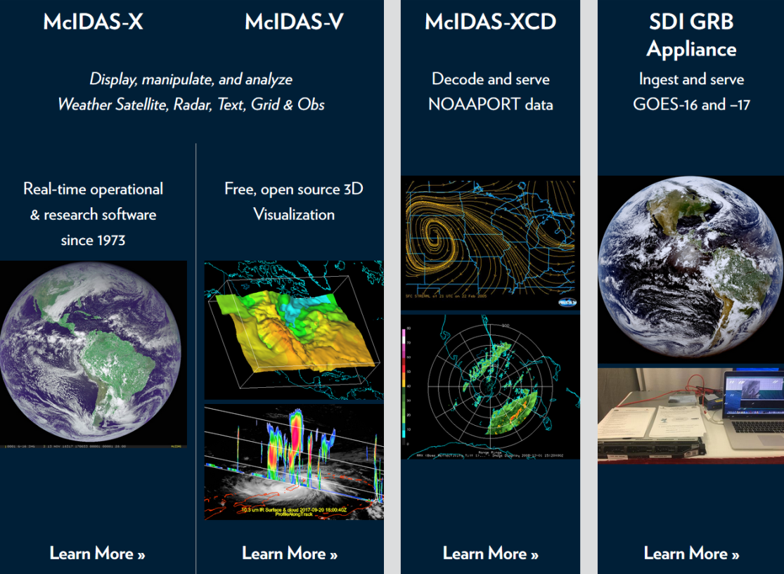
What’s New in 2019 – New McIDAS Website

Slide 8
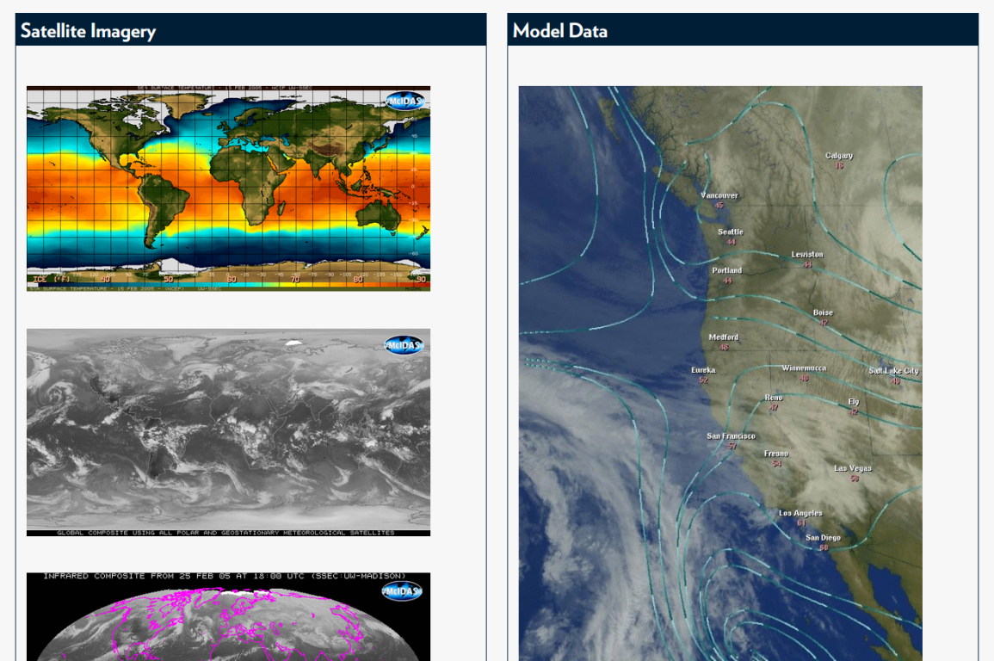
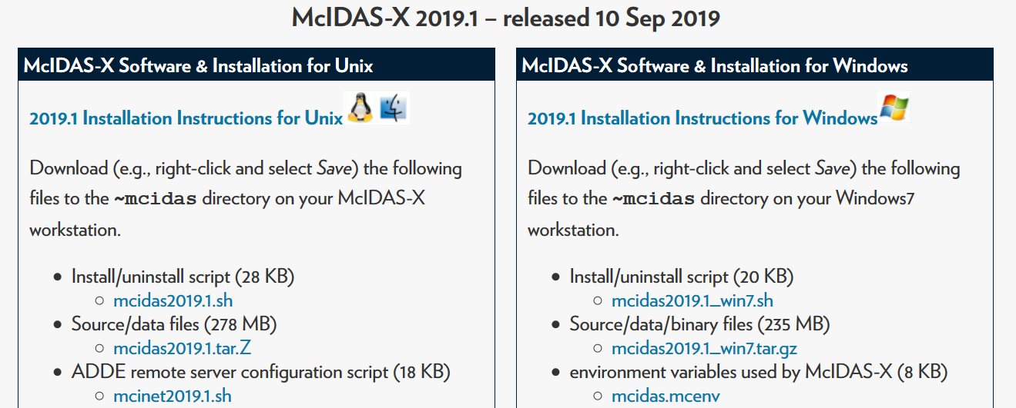
What’s New in 2019 – New McIDAS Website

Slide 9
What’s New in 2018 – McIDAS–X Releases
2018.1 – May 2018
- RGBDISP displays RGB images in McIDAS image frames
- GLMDISP/GLMLIST for lightning data from GOES-16 GLM
- GLMIMG creates a density image from GOES-16 GLM
- Added future support for GOES-17,18,19
- Updated WWDISP to plot flood watches & warnings, severe storm & tornado warnings as polygons
- WXTLIST search case-insensitive: NO MORE ALL CAPS!!!
2018.2 – December 2018
- Promoted Suomi-NPP (–XRD to –X) for NOAA-20 VIIRS
- Improvements for GOES-17

Slide 10
What’s New in 2019 – McIDAS–X Releases
2019.1 – September 2019
- GOES 16/17 ABI Updates
TDQF – Temperature Data Quality Flags
Server updates for NOAAPort distributed image tiles and to better handle corrupt files from GRB
- VIIRS server improvements
Better performance
Allow for larger datasets – up to 20,000 files
- added DAY= and TIME= to IMGPROBE and alt-D
- updated FRMLABEL, RGBDISP, ZA (DAYJ) placeholder = 16 SEP 2019259
- updated GOES descriptions: GOES-16 instead of G-16 IMG

Slide 11
What’s New in 2019 – OS Support for –X
Vendor | Operating Systems | Compilers Supported
Apple | macOS 10.13.6 | gfortran/gcc 7.3
 | macOS 10.14.6 | gfortran/gcc 8.3
We’ll evaluate 10.15 (release date - Oct 2019) when it's supported at the University of Wisconsin SSEC, and then support only 10.14 and 10.15.

Slide 12
What’s New in 2019 – OS Support for -X
Vendor | Operating System | Compilers Supported
Microsoft | Windows 7 Enterprise with SUA | g77 3.3 gcc 3.3 (packaged with SUA)
Windows 7 End of Life is January 14, 2020 What’s next for McIDAS users on Windows?

Slide 13
What’s New in 2019 – OS Support for -X
Windows 7 End Of Life is January 14, 2020
McIDAS Support
Windows 7 - Support will end with last 2019 release
Windows 8 - No plans to support Windows 8
Windows 10 support options:
Windows Subsystem for Linux (WSL)
New Windows 10 feature that enables you to run native Linux command-line tools directly on Windows
Preliminary test results are encouraging!
Linux Virtual Machine

Slide 14
What’s New in 2019 – OS Support for -X
Vendor | Operating System | Compilers Supported
Red Hat | Enterprise Linux WS
 | 6.10 Intel | gfortran 4.4.7 gcc 4.4.7
 | 7.7 Intel | gfortran 4.8.5 gcc 4.8.5
We will begin evaluating 8.0 (released in May 2019) soon and then support only RHEL 7 & 8 in 2020.

Slide 15
What’s New in 2019 – OS Usage for -X
A survey was conducted in September 2015 and again in October 2017 with 100% McIDAS sites reporting. A new survey will be coming this fall…
Only one question -- What operating system(s) are you using on your machines running McIDAS-X?
Operating System | # of Sites | Version(s) In Use in 2017
Apple macOS | 4 | 10.10 and higher (up from 10.4)
Linux | 33 | 4.x–7.x RHEL(20), CentOS(17), Ubuntu(6) (none on SUSE)
Microsoft Windows | 3 | Win7 and Win10
Sun/Oracle Solaris | 2 | 10 and 11.3 OS SPARC

Slide 16
What’s New in 2019 – 2019 MUG Fees Announced
2020 MUG Fees
McIDAS (increased 5% over 2019)
SX (1-2 workstations) $11,400
DX (3-5 workstations) $22,800
MX (6+ workstations) $45,600
XCD (increased 5% over 2019) $16,560
SDI (decreased from $8,340 in 2016 to better match actual support costs) $ 5,100

Slide 17
What’s New in 2019 – New MUG Members
SEMAR (Secretaria de Marina) – Mexican Naval Secretariat (1 year)
IMAA/CNR – National Research Council of Italy, Institute of Methodologies for Environmental Analysis
No sites dropped MUG Membership

Slide 18
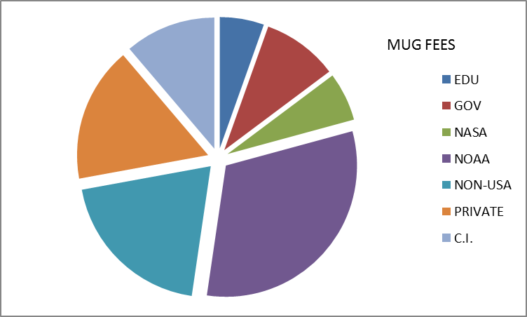
Who uses McIDAS-X? 33 Current MUG Members
NOAA (10) AWC, CLASS, ESPC, NCO, NHC, NSSL, NWS-JSC, NWS-PACIFIC REGION, SPC, STAR NOAA CI (2) CIMSS/SSEC,CIRA NASA (3) CSBF, Langley, MSFC Other Gov’t (2) NTSB, Patrick AFB
 |  | Non-USA (6) AEMET, Australia BoM, EUMETSAT, Green Power Labs, HKO, IMAA/CNR
PRIVATE (9) AccuWeather, AST, Boeing, ClearAg, DTN, ENSCO, IBM the Weather Co, StormGeo, Telvent EDUCATION (1) Unidata

Slide 19
Who uses McIDAS-V?
McIDAS-V is now used in…
research projects & publications
satellite blogs
satellite meteorology classes
visualization of EUMETCast and GEONETCast
international training courses: EUMETSAT, CIRA
private industry

Slide 20
Who uses McIDAS-V? from the usage statistics
 | 2014
Total Uses* | 370 K
Forum Posts | 692
2016
1.31 M
615
2018
2.43 million!!
275
*each time a script is run or McIDAS-V is started
Interpret the Statistics…
-V Forums have ~1100 users On pace to hit 10,000,000 Total Uses in 2019! | Usage Statistics show ~4000 unique IPs in 2018 Uses Up, but Forum Posts Down?

Slide 21
McIDAS Support – User Support Requests
With so many new non-paying users, how do we prioritize our support?
McIDAS-X, –XCD and SDI questions from MUG members to the McIDAS Help Desk
McIDAS-V questions from MUG members to the Help Desk and Support Forums
McIDAS-V questions from non-MUG users to the Support Forums
ALL bug reports are put into the McIDAS Inquiry System

Slide 22
McIDAS Support – User Support Requests
X/XCD/SDI - answers from the Help Desk
McIDAS-V - answers from Help Desk or other forum users. Users of McIDAS-V are encouraged to answer forum questions of other users and share their knowledge & expertise.
 | 2016 | 2017 | 2018
McIDAS-X total Inquiries non-SSEC | 248 | 247 | 217
 | 141 | 166 | 123
McIDAS-V total Inquiries non-SSEC | 236 | 146 | 132
 | 46 | 30 | 24
McIDAS-V Forum Topics | 124 | 89 | 57

Slide 23
How long will –X be supported?
SSEC plans to support McIDAS–X through the current GOES-R Satellite Series, which is currently listed as 2036 ➔ NO END DATE IN SIGHT!!!
No plans for support fee structure changes
MUG members will continue to receive priority support for –X and –V
Continue to release –X as needed for bugs, updates, improvements, and new OS & data/satellite changes (~2 times per year)

Slide 24
How long will –X be supported?
SSEC plans to support McIDAS–X through the current GOES-R Satellite Series, which is currently listed as 2036 ➔ NO END DATE IN SIGHT!!!
Important Issues
ADDE written in Fortran and C → Python?
XCD becoming brittle → beta coming in 2019
Larger datasets mean larger images, maps, and grids → improvements have been made
-X tcl/tk GUI more fragile with each OS upgrade
Display Quality Issues with fonts and labels

Slide 25
Looking for more user input!
Use the McIDAS-V Support Forums or contact the McIDAS Help Desk
Fill out the MUG Meeting Survey at the end of the meeting on Tuesday
Do you have suggestions for improving the MUG Meeting?
What data types do you need to read/write with McIDAS?
On what platform(s) do you currently run McIDAS?
Do you use the McIDAS-X GUI?
Add your comments on the back of the survey!
If you have specific development needs, contact the Help Desk or contact me about helping to fund site-specific development.

Slide 26
In Summary…
McIDAS Users’ Group is still going strong!
MUG Membership staying steady for –X, -XCD, and SDI → still our #1 Priority
McIDAS-X will be fully supported, updated & maintained through the GOES-R Series
McIDAS-V usage growing every day
If –X works for you, then stay with –X. It’s not going away!
When new features or data types are added in –V, then do your new development in –V.

Slide 27
We need input from you to make all of McIDAS better for everyone!
THANK YOU!!!

