Slide 1
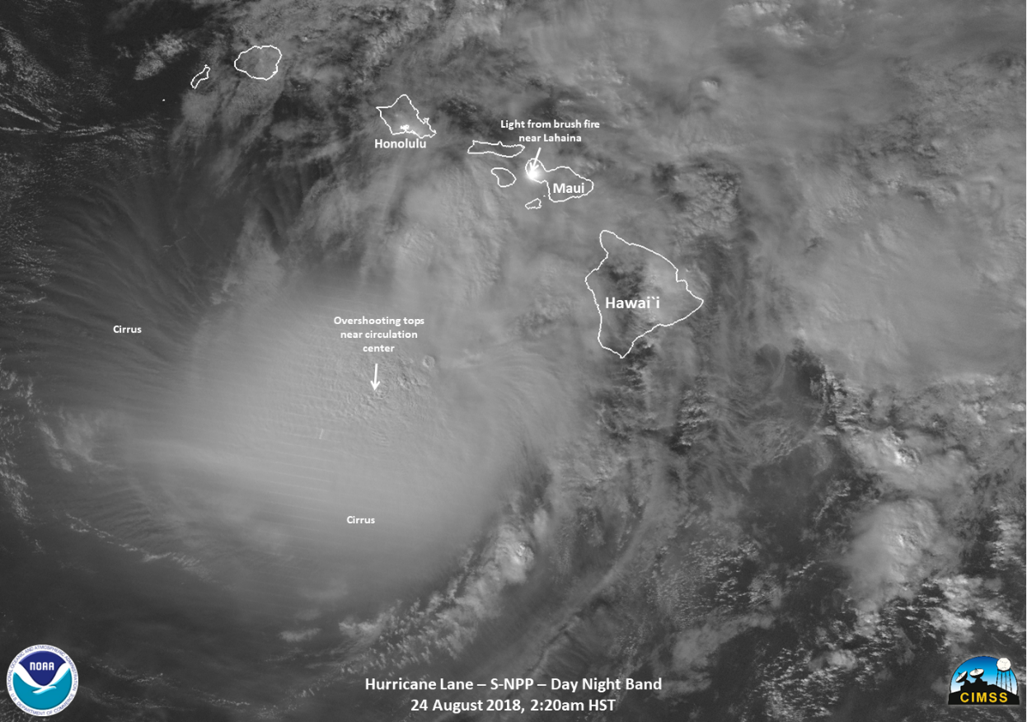
How McIDAS-V can support JPSS activities
William Straka III¹
Tommy Jasmin¹, Bob Carp¹, Steve Miller², Mitch Goldberg³, Don Hillger⁴
¹CIMSS/University of Wisconsin-Madison
²CIRA/Colorado State University
³NOAA, JPSS
⁴NOAA, RAMMB

Slide 2
Outline
Utilization of McIDAS-V in JPSS activities
Overview of instruments supported
Current Capabilities and Gaps of McIDAS-V
Examples

Slide 3
Utilization of McIDAS-V
McIDAS-V has proven useful in the creation of imagery used in both social media as well as in the analysis of imagery
Multiple products, including Level 2 products, from the JPSS program can be displayed
However, there are some critical gaps in McIDAS-V that if addressed, could make it a more powerful tool.

Slide 4
Suomi NPP/NOAA-20
It has 5 instruments which retrieve data regarding the atmosphere, land and ocean. 3 of these instruments can be displayed in McIDAS-V
VIIRS
CERES
CrIS
ATMS
OMPS

Slide 5
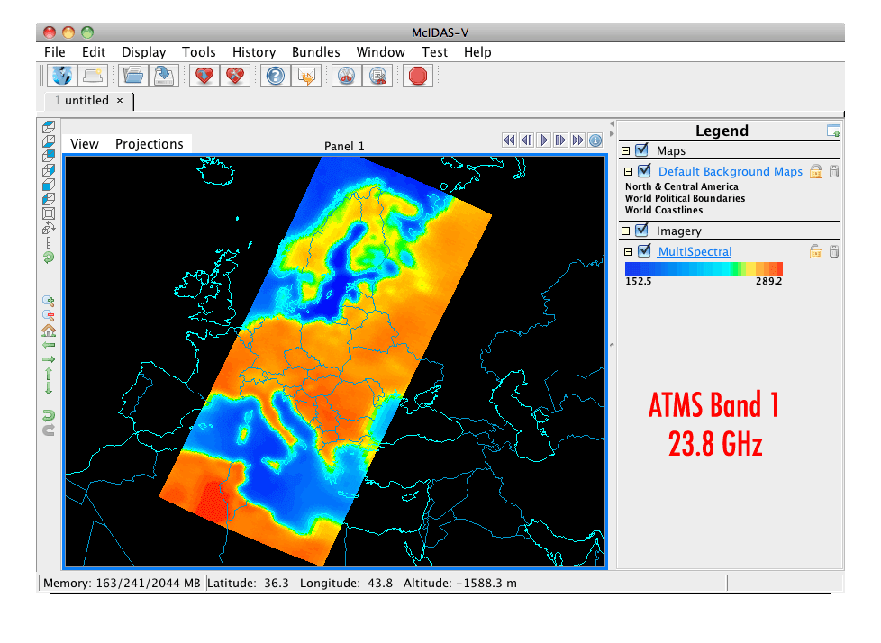
Advanced Technology Microwave Sounder (ATMS)
22 microwave channels, combining all the channels of the preceding AMSU-A1, AMSU-A2, and AMSU-B sensors into a single package
Provides sounding observations needed to retrieve profiles of atmospheric temperature and moisture for forecasting models and continuity for climate monitoring purposes.

Slide 6
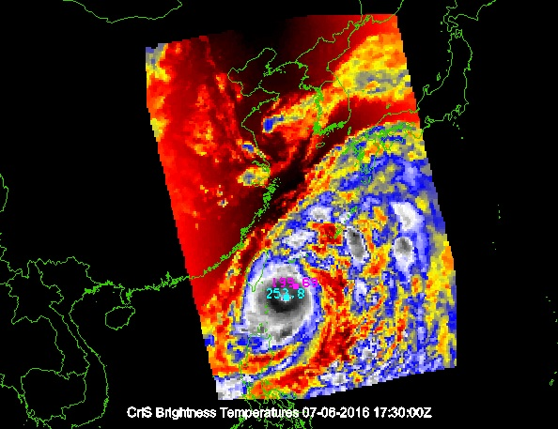
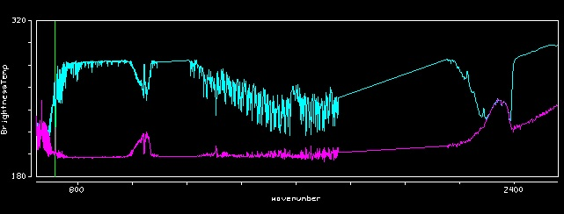
Cross-track Infrared Sounder (CrIS)
1,305 infrared spectral channels
Designed to provide high vertical resolution information on the atmosphere's structure of temperature and water vapor.

Slide 7
S-NPP/NOAA-20 Capabilities
Support for CrIS Full Spectrum data.
Chooser rename to JPSS (But still under development?)
Reordering of fields provided now (e.g. M bands used to be listed out of order in multibanded VIIRS files)
Better time formatting in scripting functions
Generalization and renaming of scripting functions, with deprecation warnings provided
Support for visualizing granules which straddle the dateline (note, this issue occurs with other polar and geo data)

Slide 8
McIDAS-V Gaps for JPSS
Support for OMPS
Needed for comparisons and visualizations with other instruments
Support for Active Fires product
While there is a work around using data from FIRMS, being able to read in the VAFP would be of great help to users for training
Support for NUCAPS
Currently there is no method to display the profiles as well as other products from NUCAPS outside of IDL/MATLAB and AWIPS2 This means that users outside of the NWS (ex. JMA, EUMETSAT) are not able to realize or display NUCAPS data easily. There is also no training tool for NUCAPS.
McIDAS-V could fill that gap by allowing NUCAPS soundings and other products to be displayed on top of other products
Output in other GIS-type formats (ex. geoTIF)
Google KML/KMZ files often either don’t display properly in other GIS viewers other than Google Earth.
This is needed for comparisons and interactions with other groups, both in cal/val and other activities.
Automatic support for MiRS products
Right now it is either a special plugin for older MiRS data or a “secret” plugin for newer MiRS data. Standardizing this as a core part of McV would allow it to be used as a training tool and for better usage by non-US users.
Default support for JPSS Enterprise EDR products
With the transition to enterprise algorithms, the ability to aggregate these products and visualize a swath would be useful to users of the L2 products. Right now, you have to do select each granule individually.

Slide 9
Examples

Slide 10
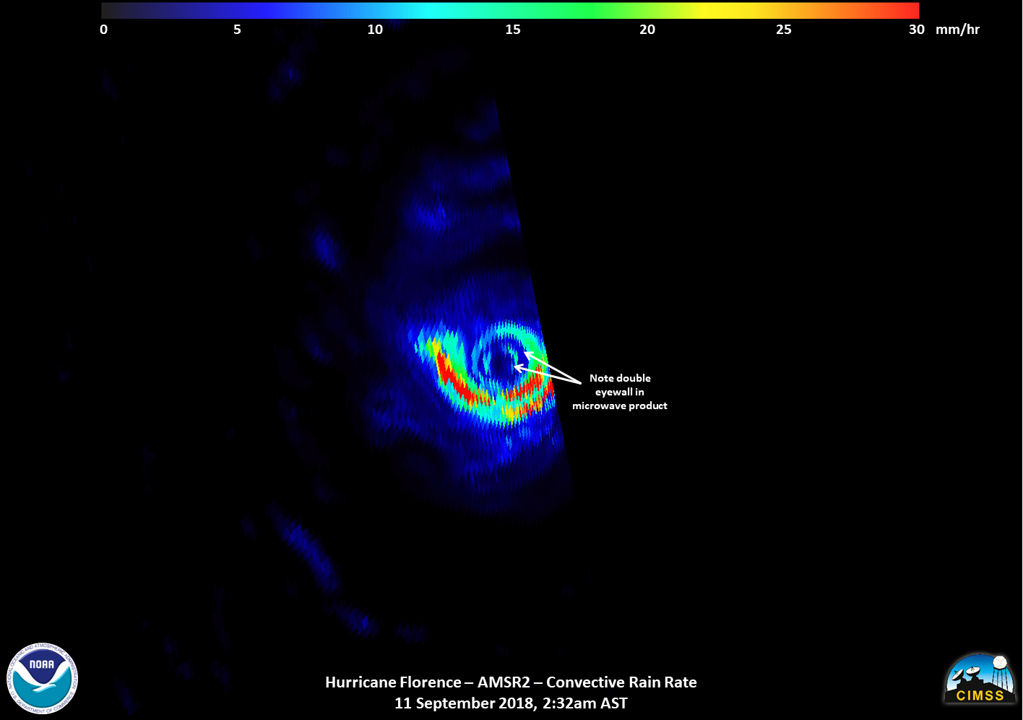
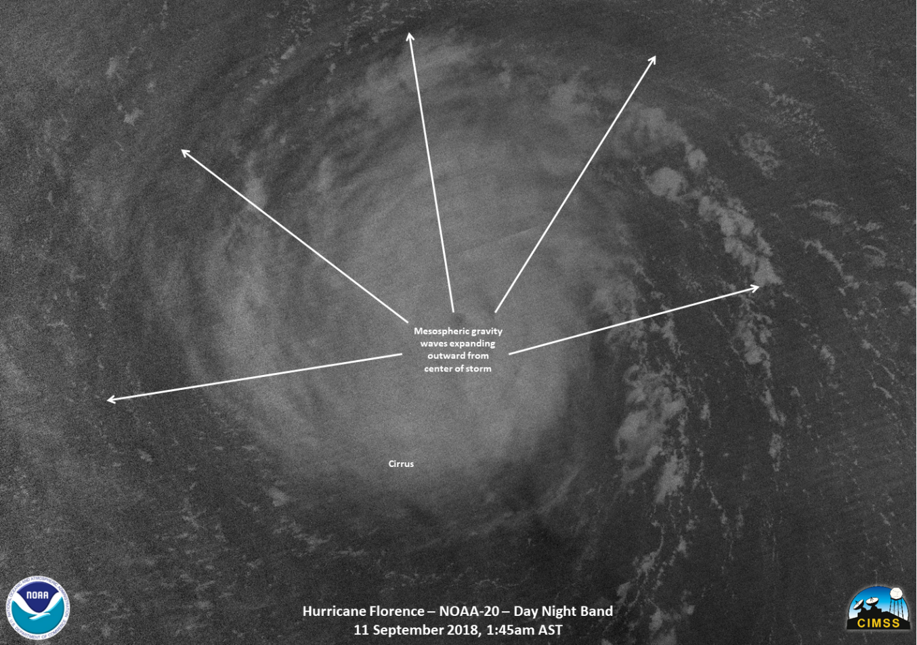
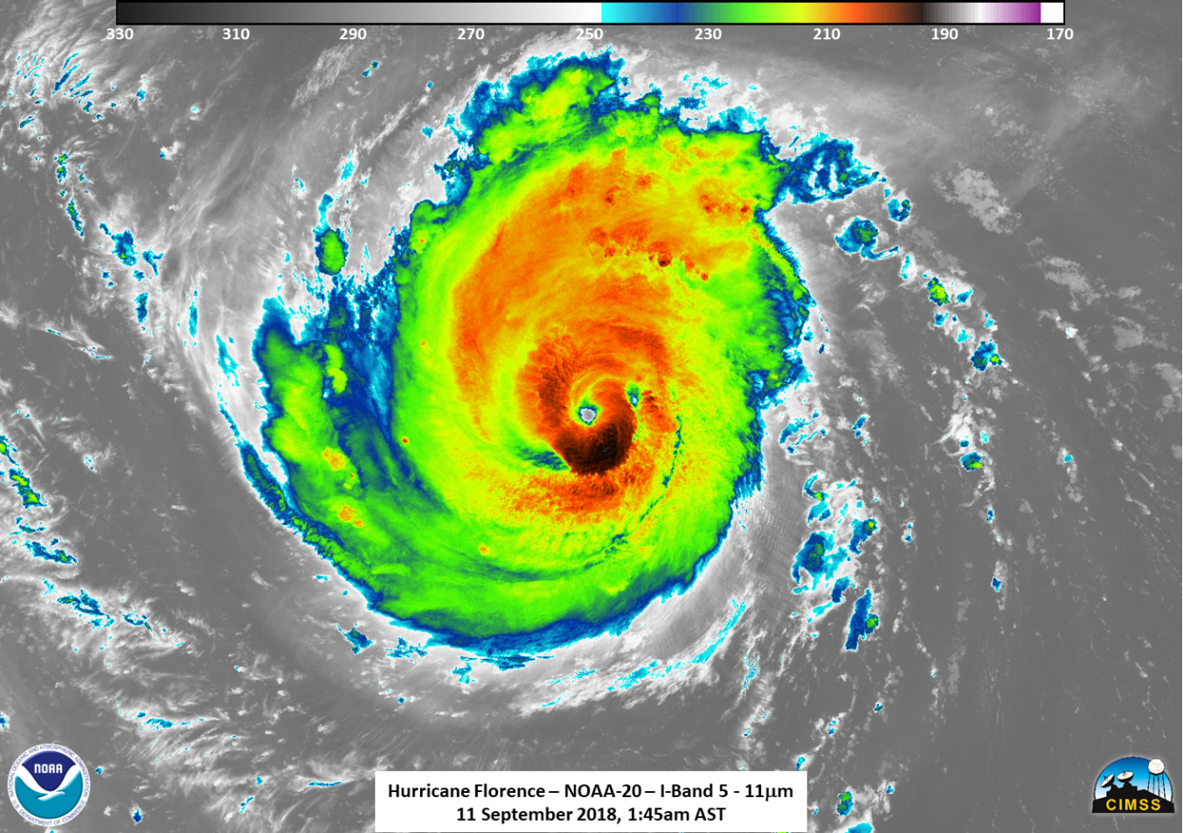
Pre-storm examples Hurricane Florence

Slide 11
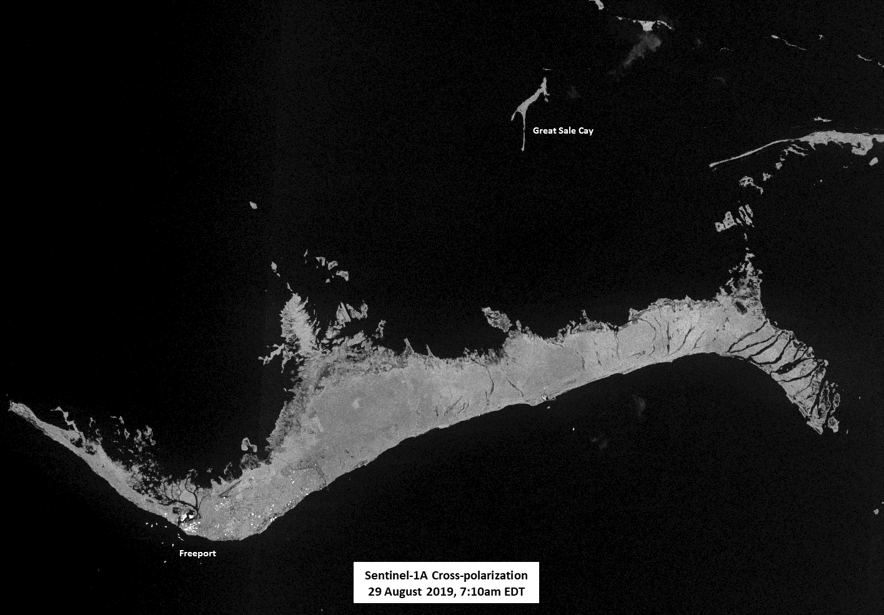
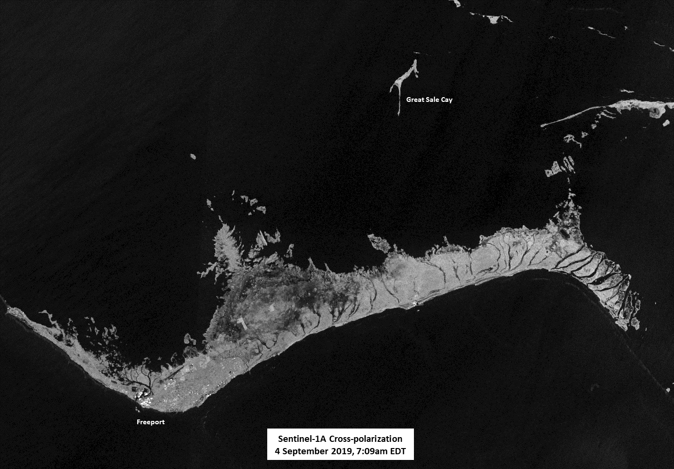
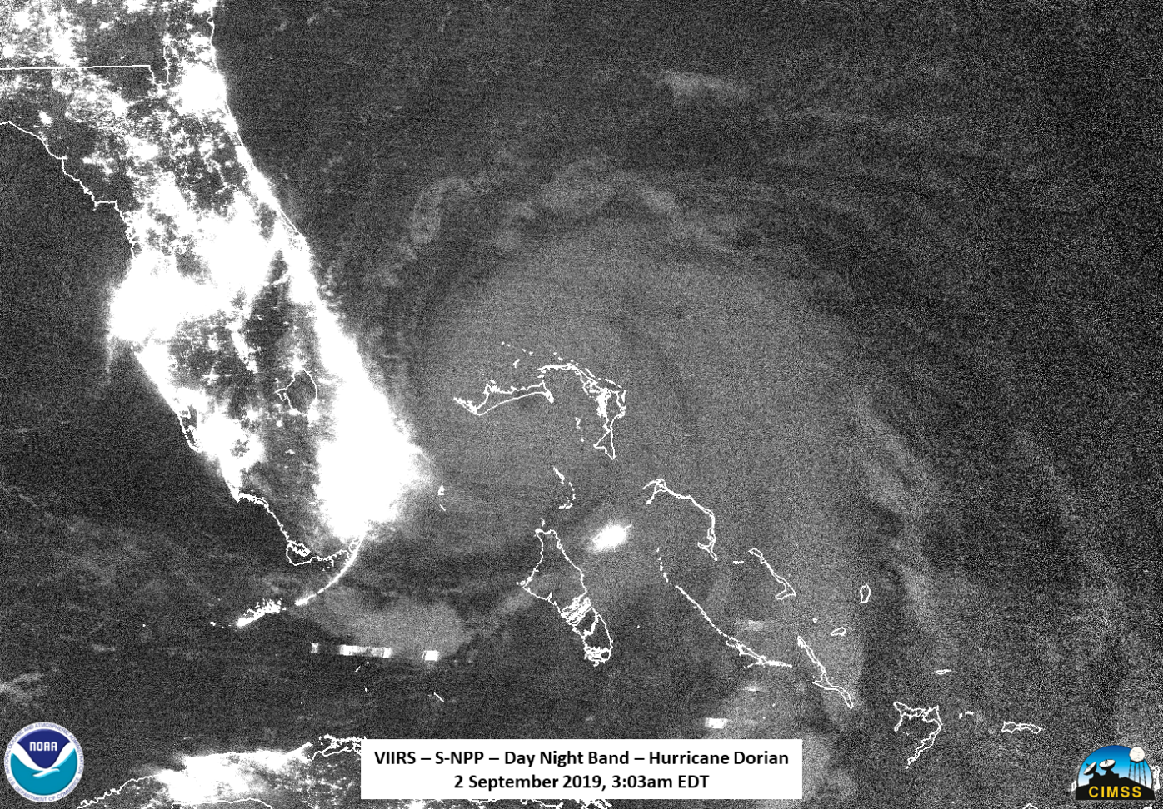
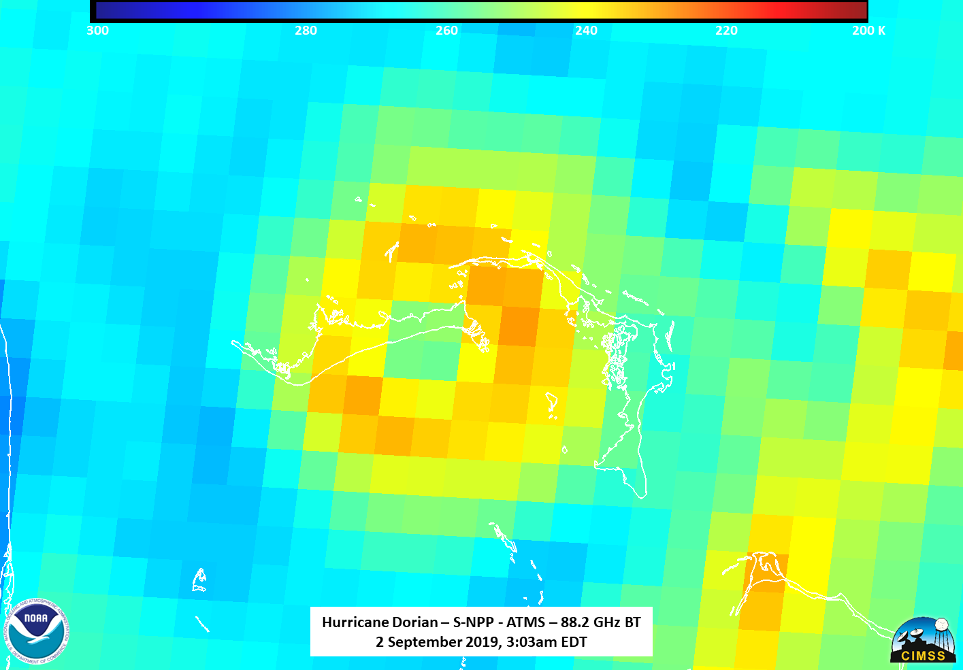
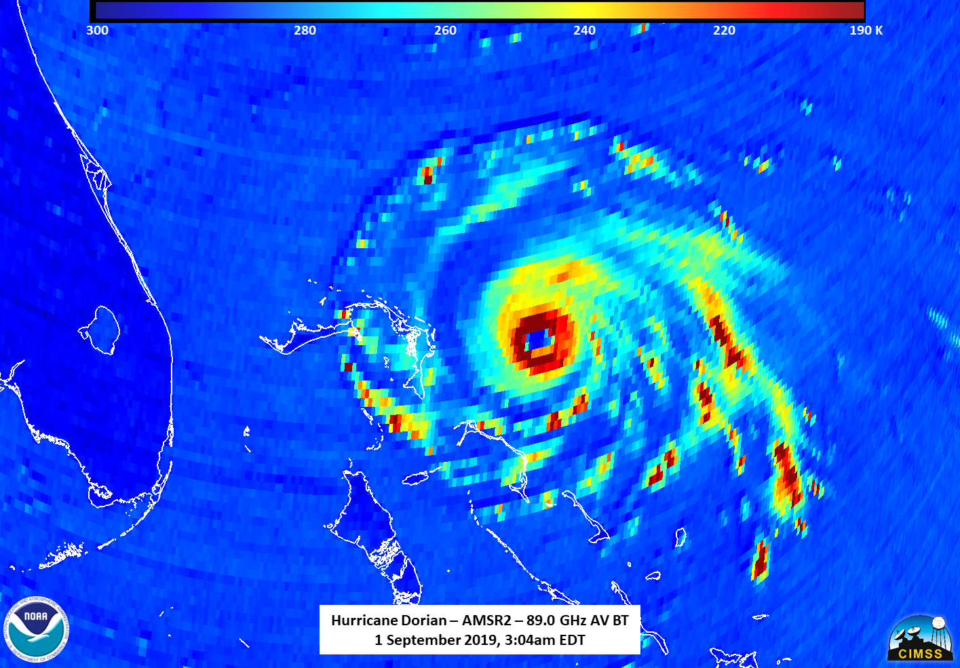
Hurricane Dorian
Sentinel-1A/B acquired by ESA/Copernicus, provided by Christopher Jackson, NOAA/STAR/SOCD
Contains modified Copernicus Sentinel data 2019

Slide 12
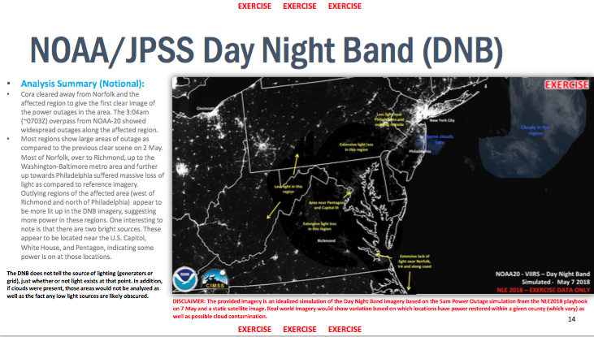
Support of FEMA’s National Level Exercised 2018 (“Hurricane Cora”)

Slide 13
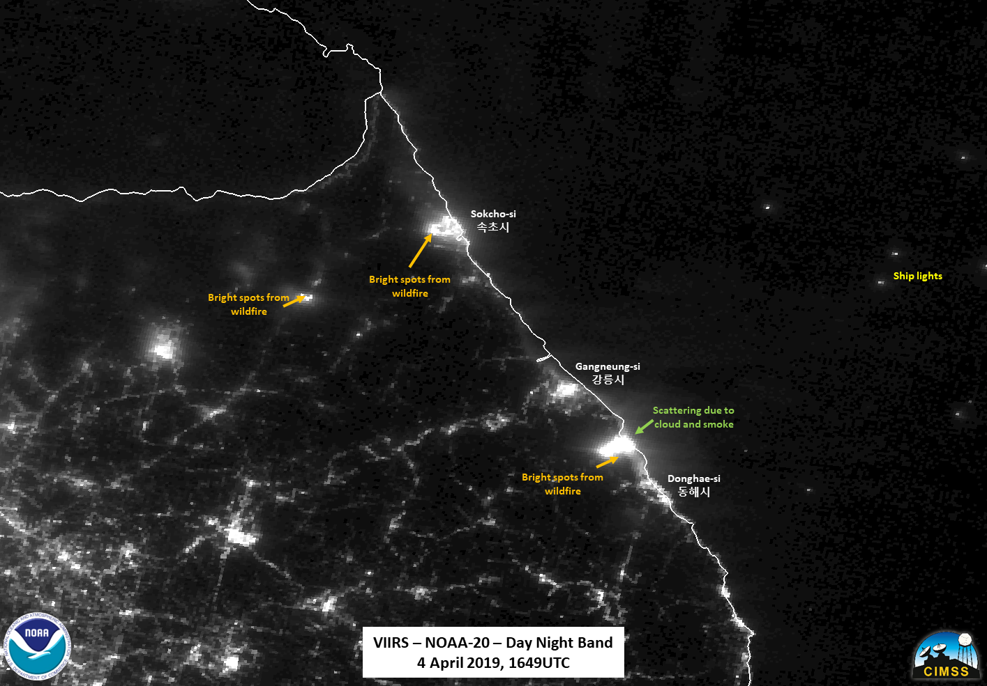
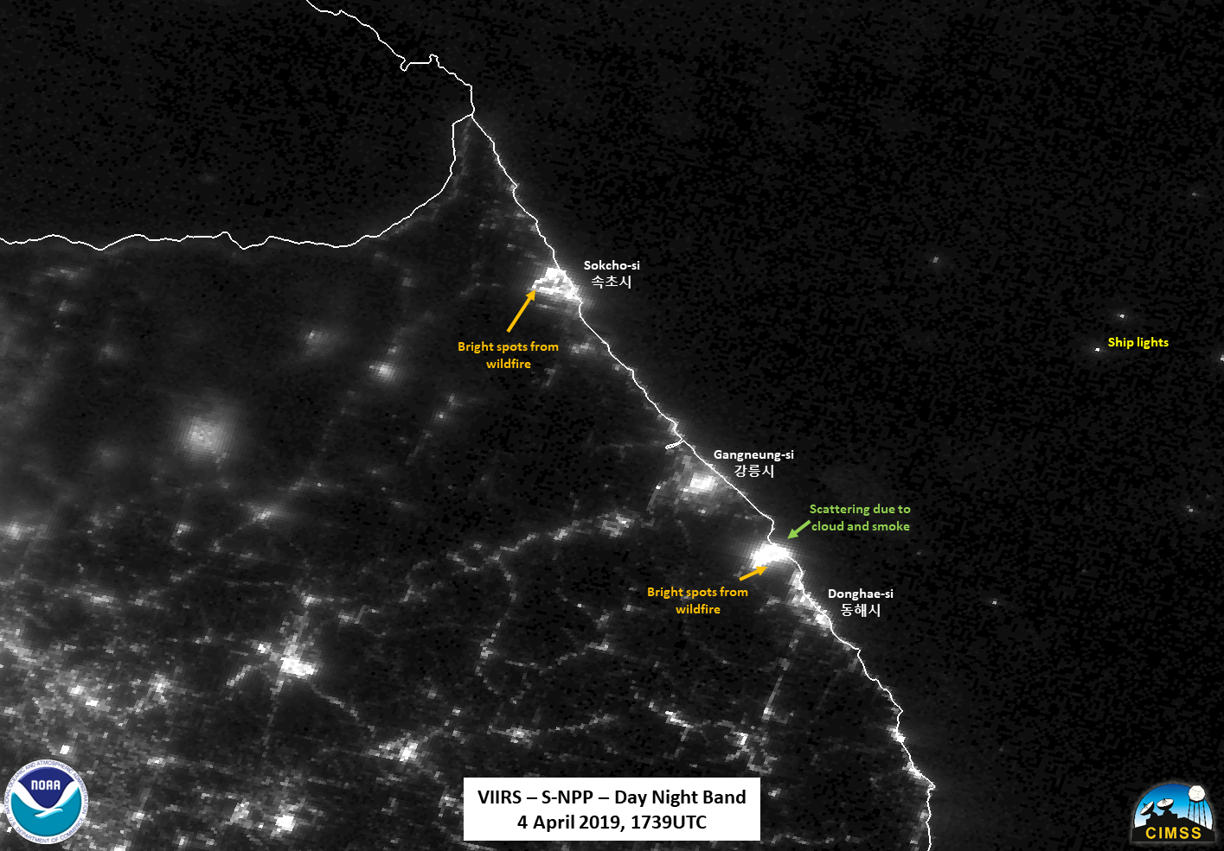
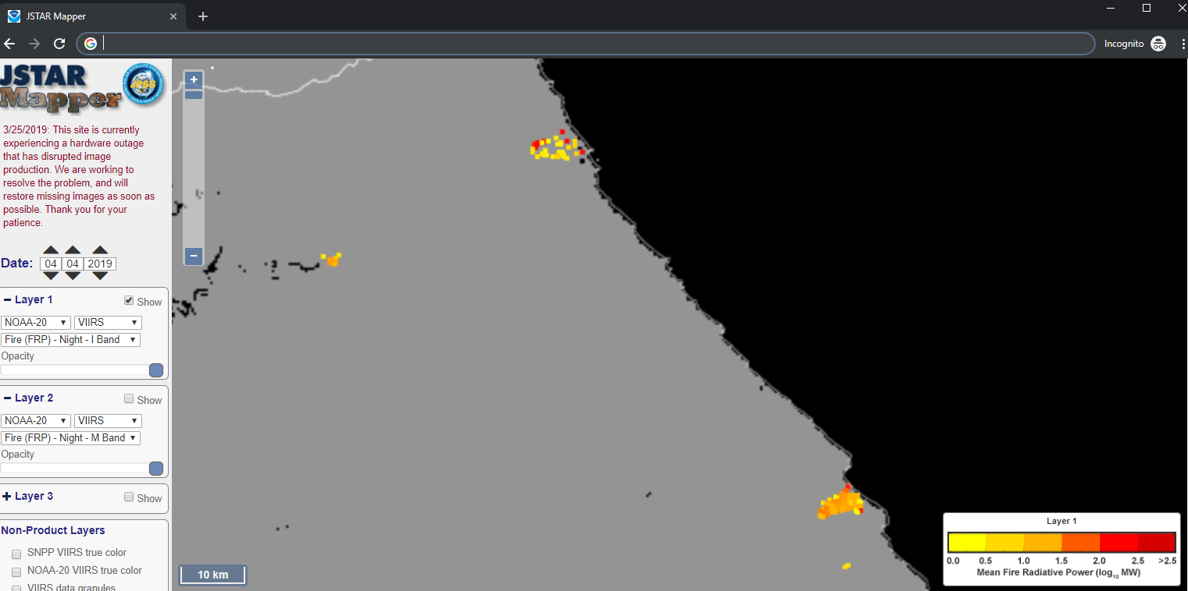
South Korean Wildfires
Notes:
On 4 April, an apparent transformer spark near a resort in the mountainous region along the north east coast of the Republic of Korea (대한민국 大韓民國), along with strong winds (20m/s or ~45mph, according to KMA), caused a wind driven fire to engulf the border town of Sokcho (속초시), In addition, there is a major fire further south along the coast near Donghae (동해시), which is also in the Gangwon (강원도) province, which resulted in the shutdown of the highways and train services in that region. Roughly 4000 people have fled the various fires going on, which have been impacting various cities in South Korea. By the morning of 5 April 2019, the fires in Sokcho (속초시) had been contained (per media reports) and South Korean President Moon Jae-in visited the region and called for all available resources to be deployed. No Olympic facilities have been reported damaged by the fire.
The focus of this discussion is on what can be seen from polar orbiters. Both fires could easily be seen in the VIIRS instrument from yesterday (4 April) in both NOAA-20 (~1649 UTC) and 50 minutes later from S-NPP (~1739UTC). As can often be seen, each of the fire channels as well as the DNB. In the case of the DNB, one can see the scattering of the light to the east of the fires, likely caused by the smoke as well as clouds (in the case of the NOAA-20 pass) off the coast.

Slide 14
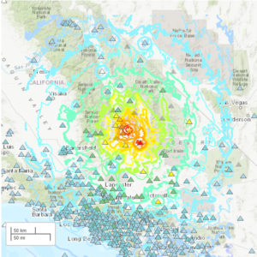
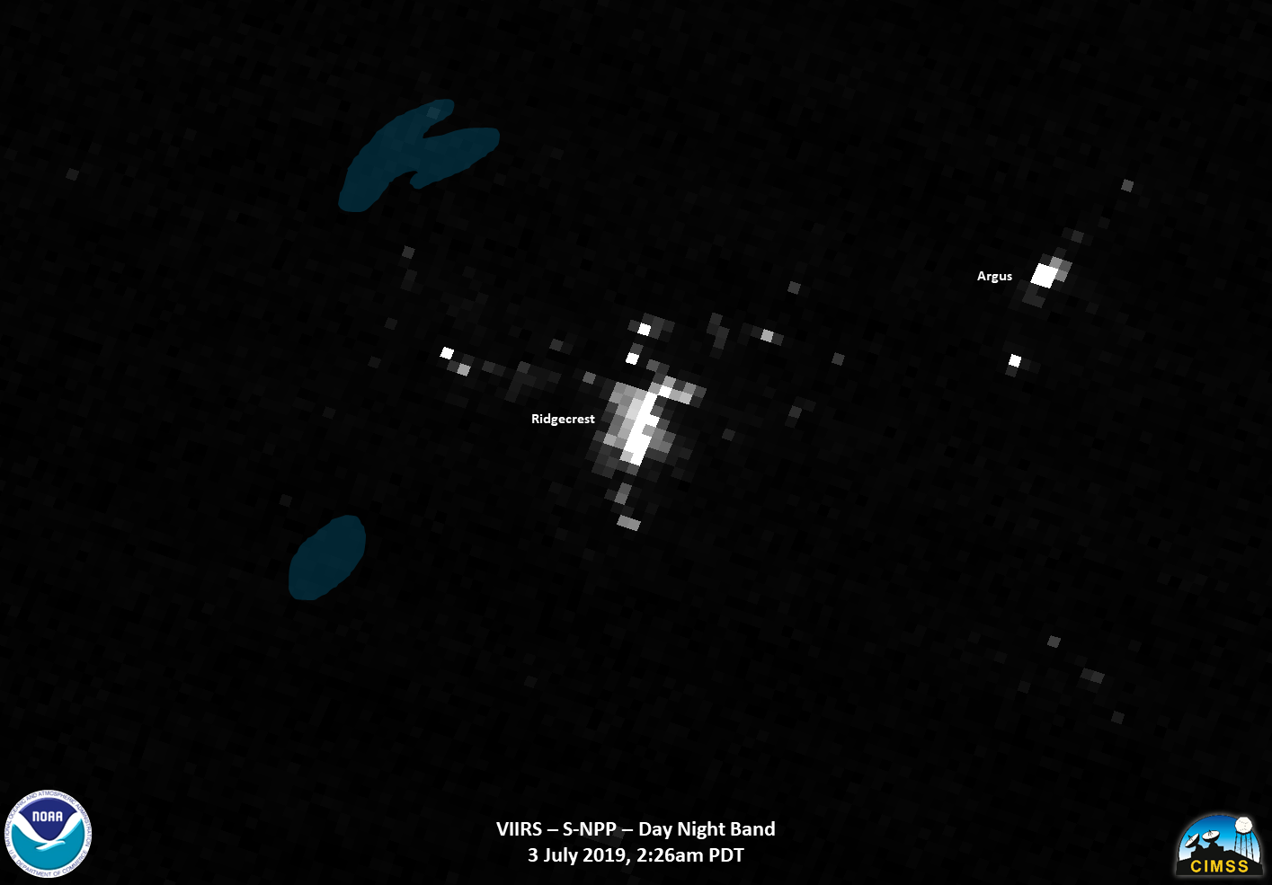
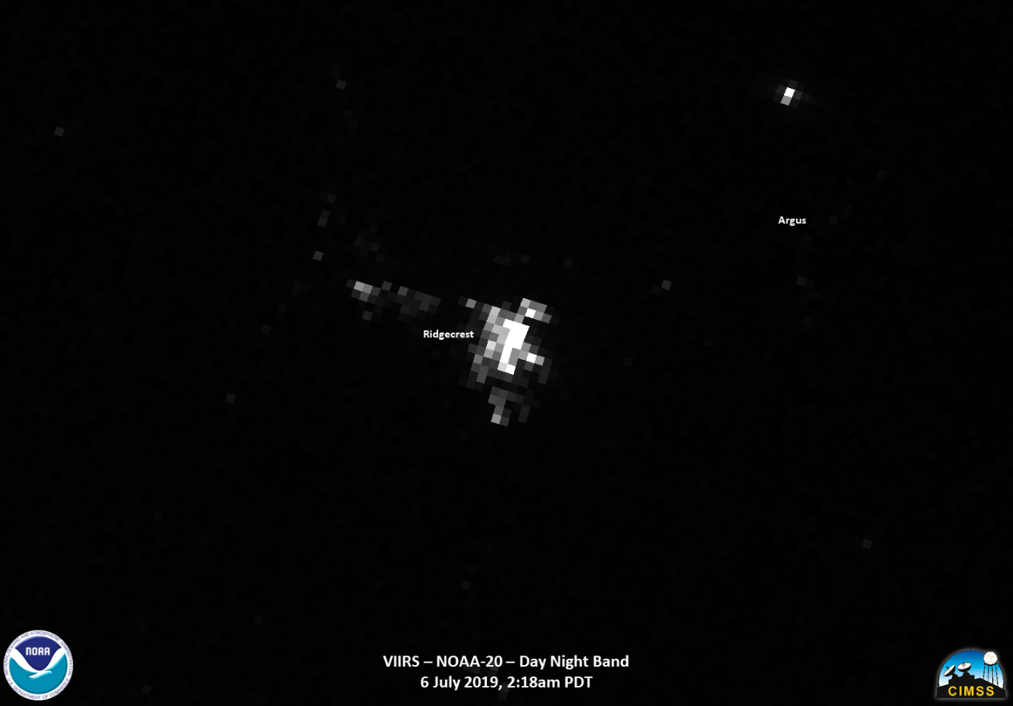
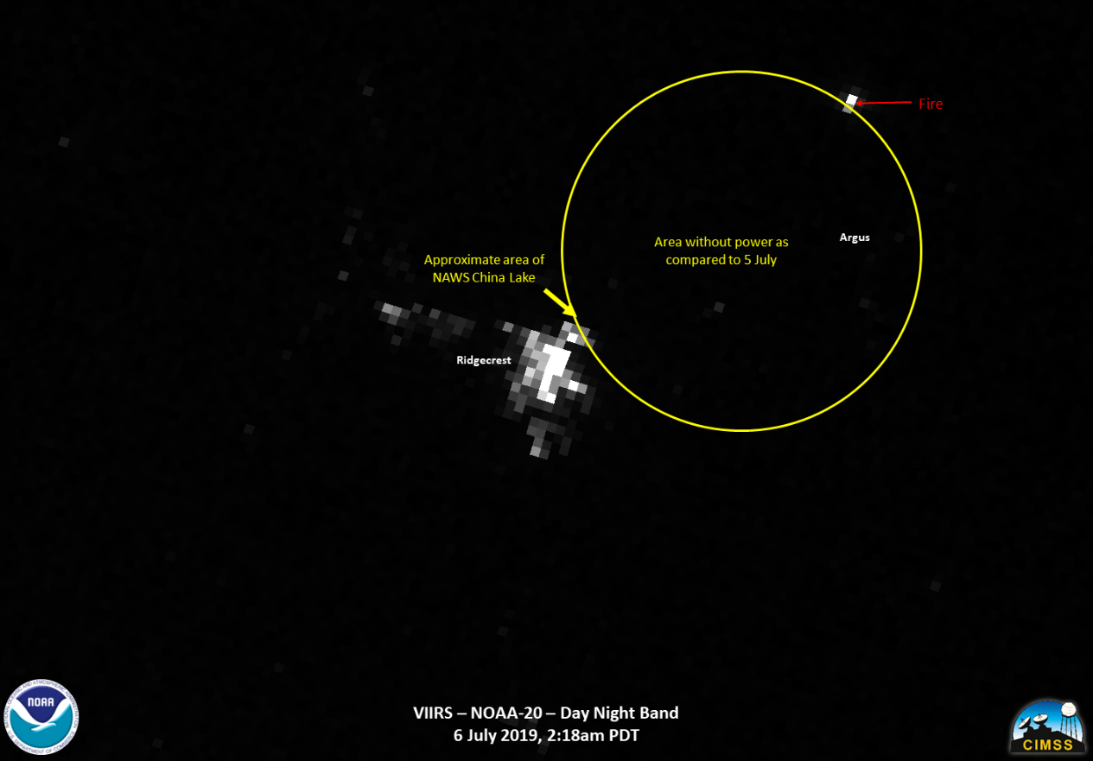
7.1M Ridgecrest Earthquake response
At 10:33am PDT on 4 July, a 6.4M earthquake centered in the Searles Valley, a remote area of Kern County about 100 miles north of Los Angeles, occurred. The next day, a 7.1M occured at 8:20 pm PDT on 5 July (03:20 UTC, 6 July) https://www.usgs.gov/news/update-magnitude-71-earthquake-southern-california
The difference between reference Day Night Band imagery from 3 July and imagery on the morning of 6 July 2019 (2:18am PDT) showed large areas of power areas. These area were consistent with information from the public utilities
This imagery was provided to FEMA, who provided it to other stakeholders.

Slide 15
Summary
McIDAS-V is a very versatile tool, helping to bring in a number of datasets that can be used for a wide variety of purposes (imagery analysis, training, etc.)
However, there are some improvements to McIDAS-V which would allow for more wide-spread usage. These are primarily in the ability to read in Level-2 products from the JPSS Program

