Slide 1
GOES-16 Local Noon Cloud Free Image (a work in progress)
Rick Kohrs
Satellite Data Services
Space Science & Engineering Center
University of Wisconsin – Madison
2019 McIDAS Users's Group Meeting
16-17 September 2019
Madison, WI

Slide 2
Why
Create a GOES-16 specific basemap – replacing Big Blue Marble
Watch seasonal changes in land features
Technique used for compositing of GOES-16/17
Because its cool!
How
Stretched GOES-16 RGB images
CSPP-GEO AITF / STAR Cloud Mask / ACHA
Sectorize each image
Composite sectors
Apply Cloud Mask to RGB images
Update with Cloud Free Pixels
What Next
Continue work with GOES-17
Correct offset – ACHA group has 4 categories instead of binary cloud/no cloud
Basemap for Day/Night products – replace Big Blue Marble

Slide 3
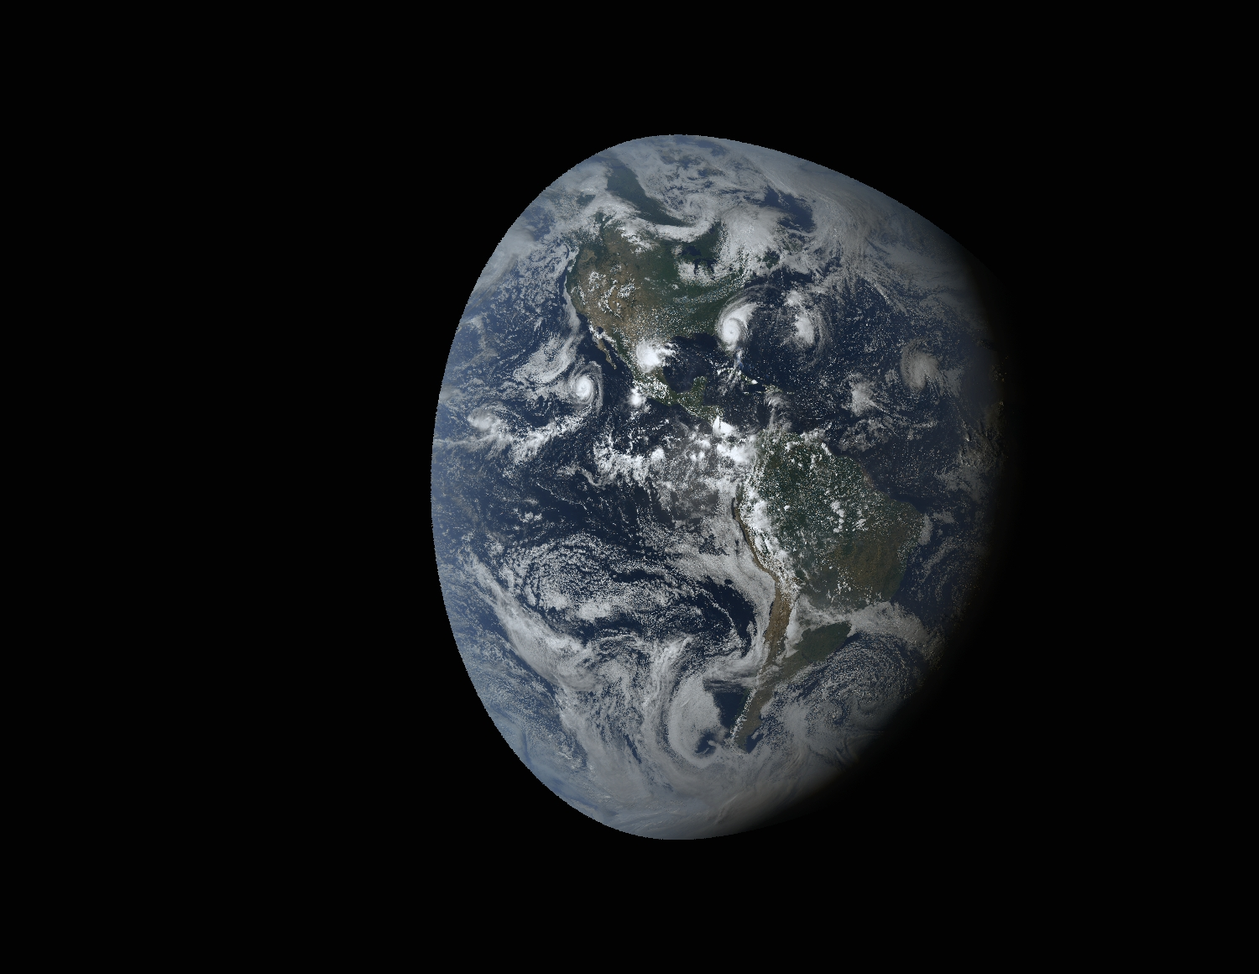

Slide 4
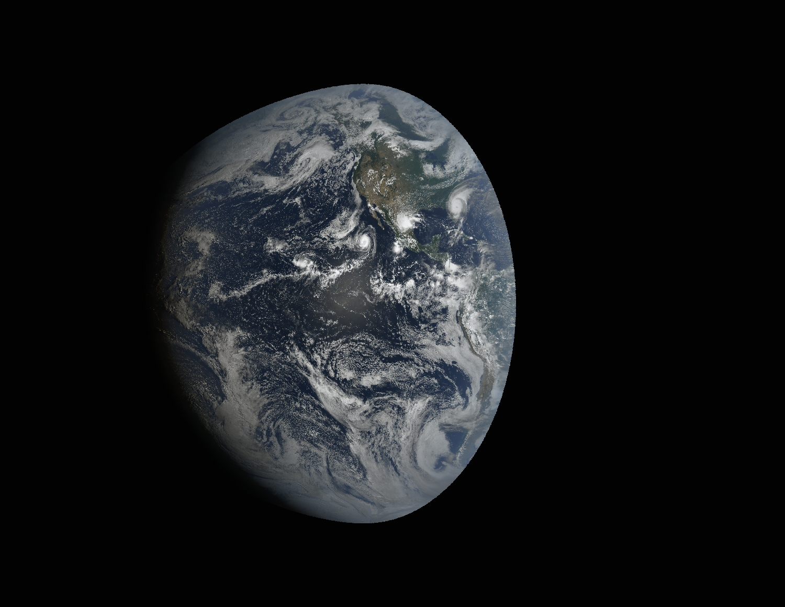

Slide 5
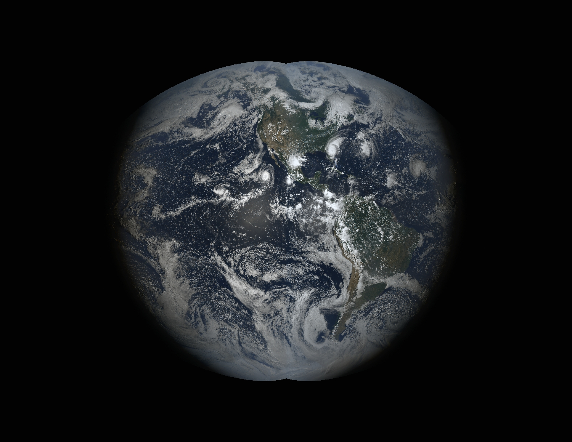

Slide 6
Forward/Backward Scattering

Slide 7
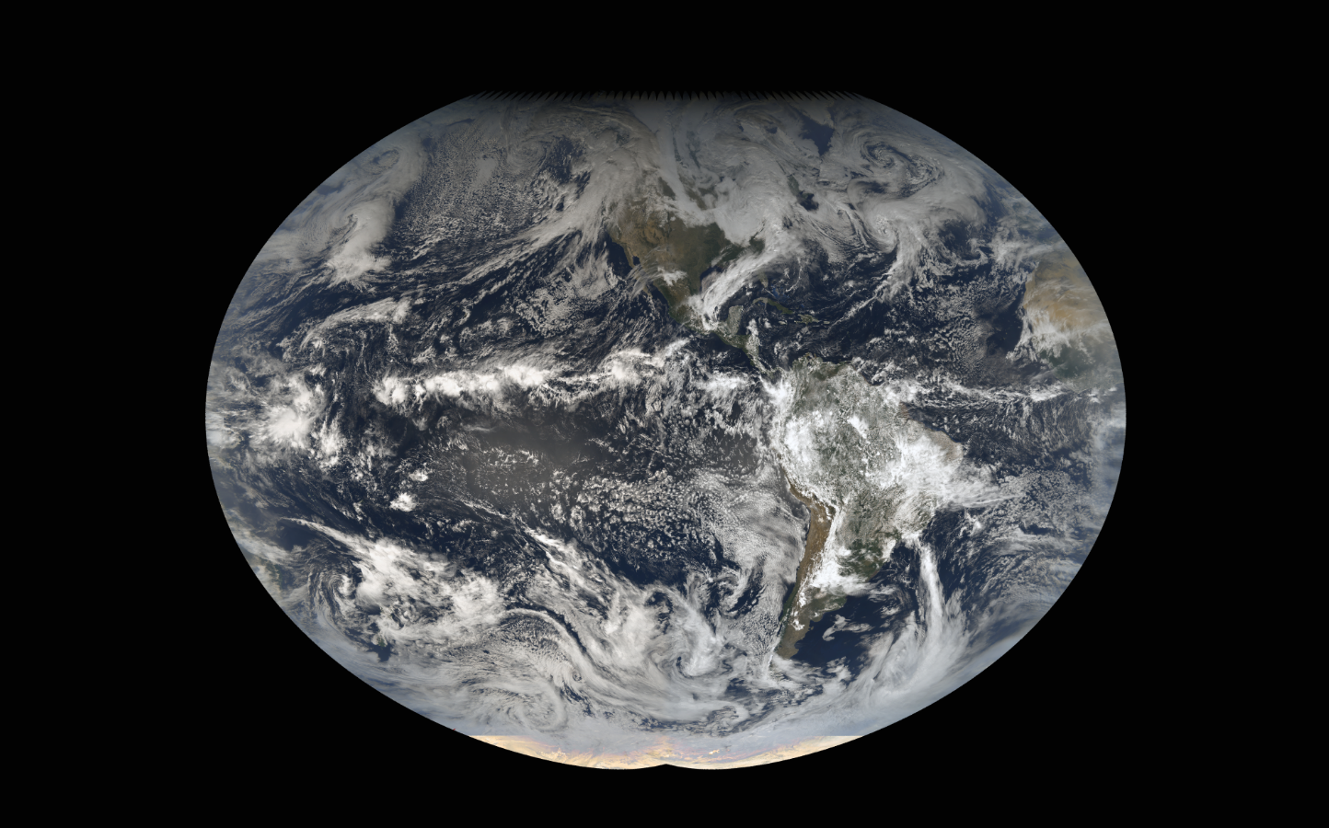
First attempt at Local Noon

Slide 8
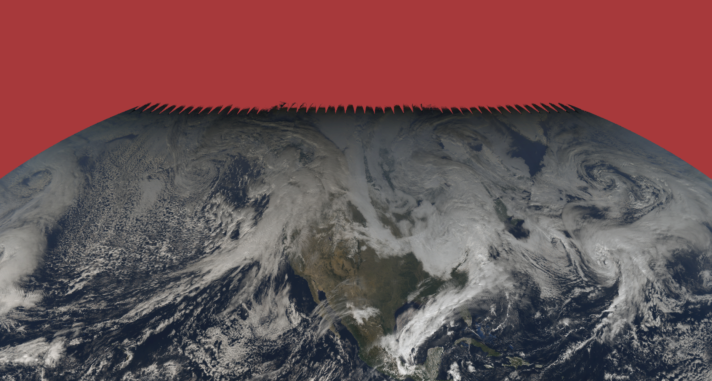

Slide 9
Local Noon Probe

Slide 10
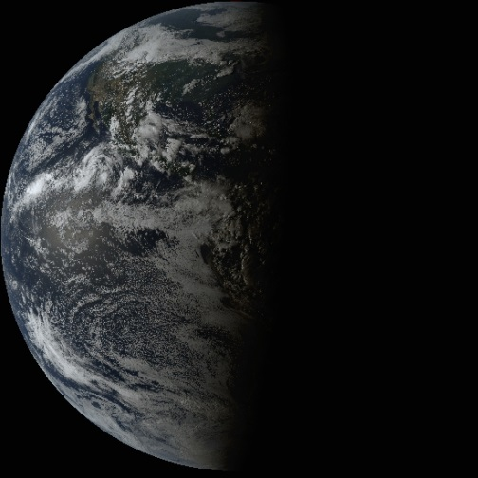
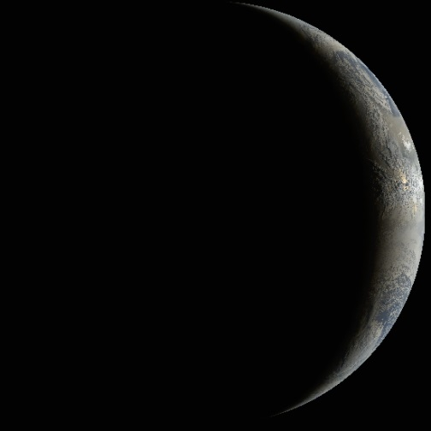
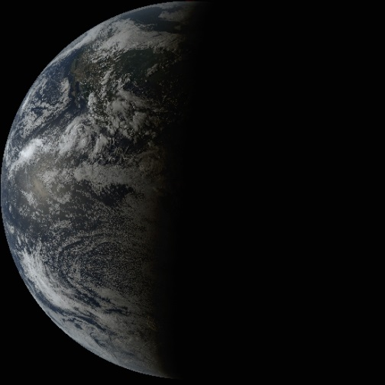
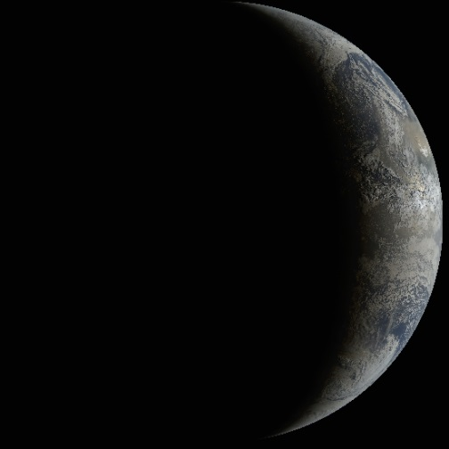
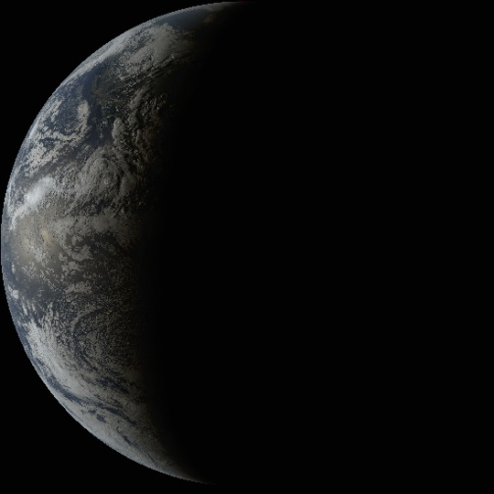
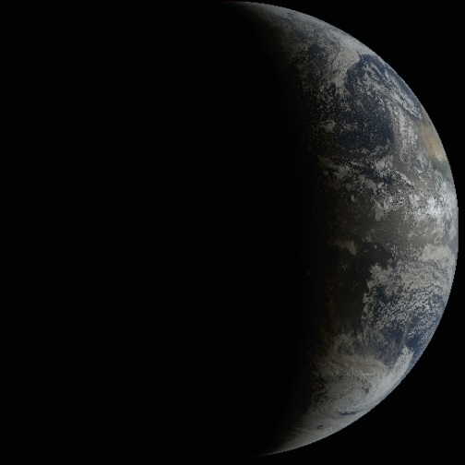
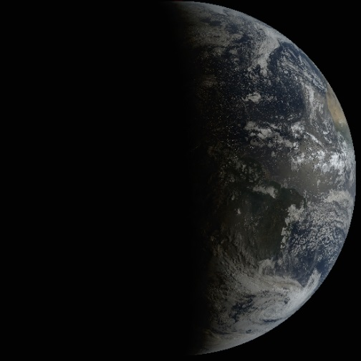
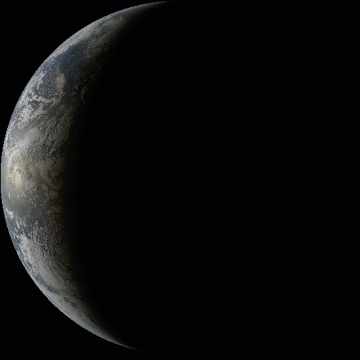
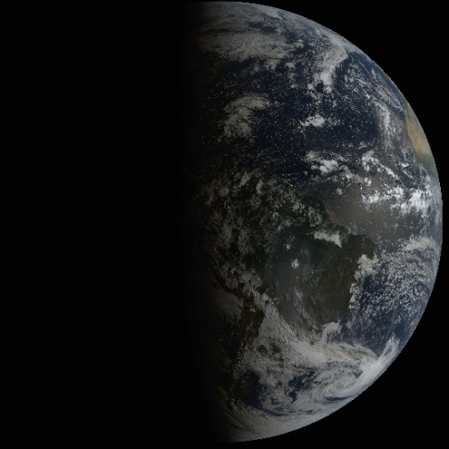
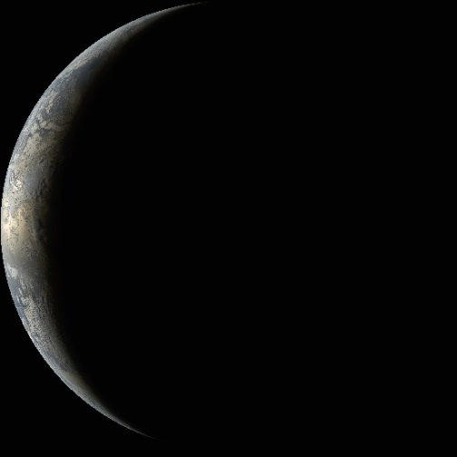
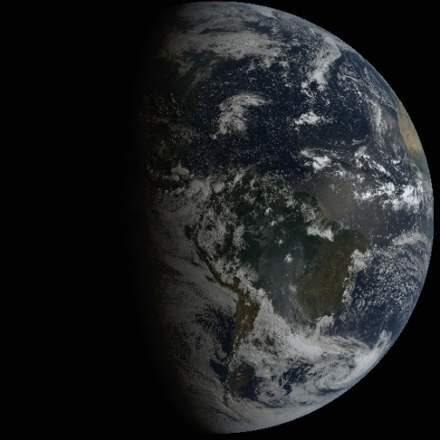
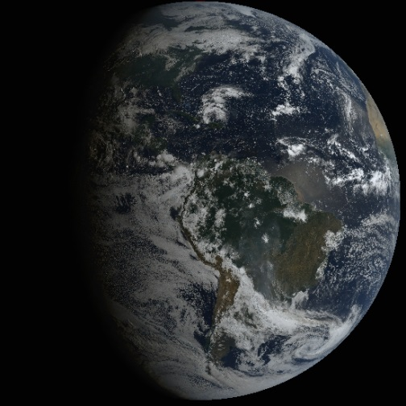
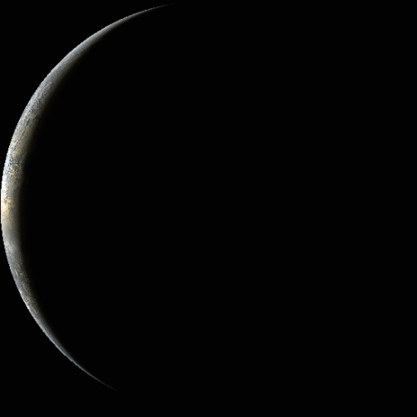
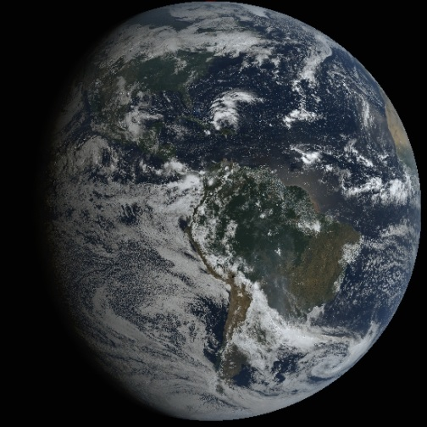
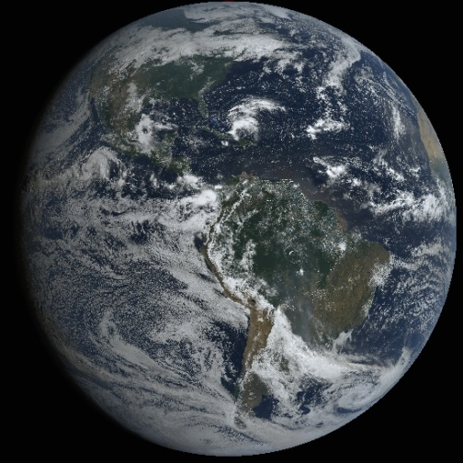
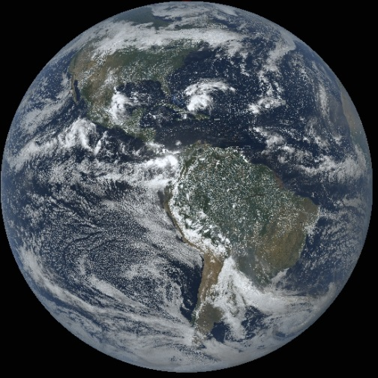
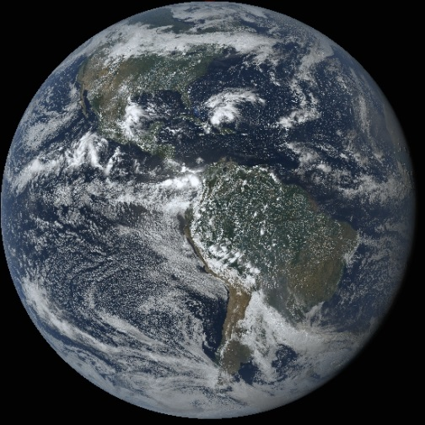
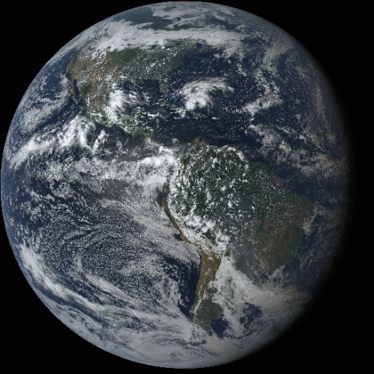
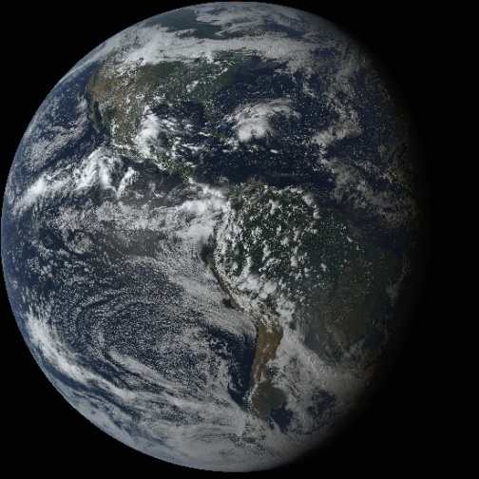
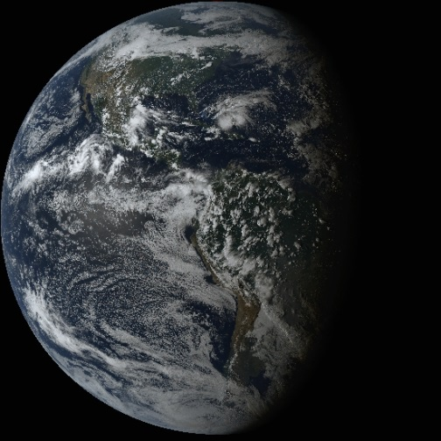
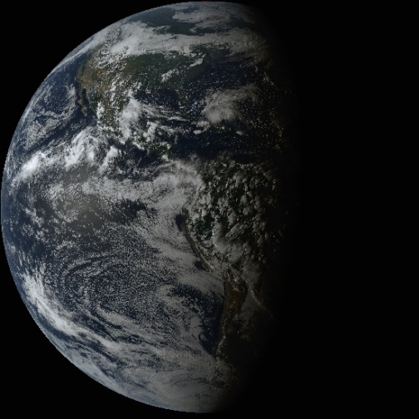

Slide 11
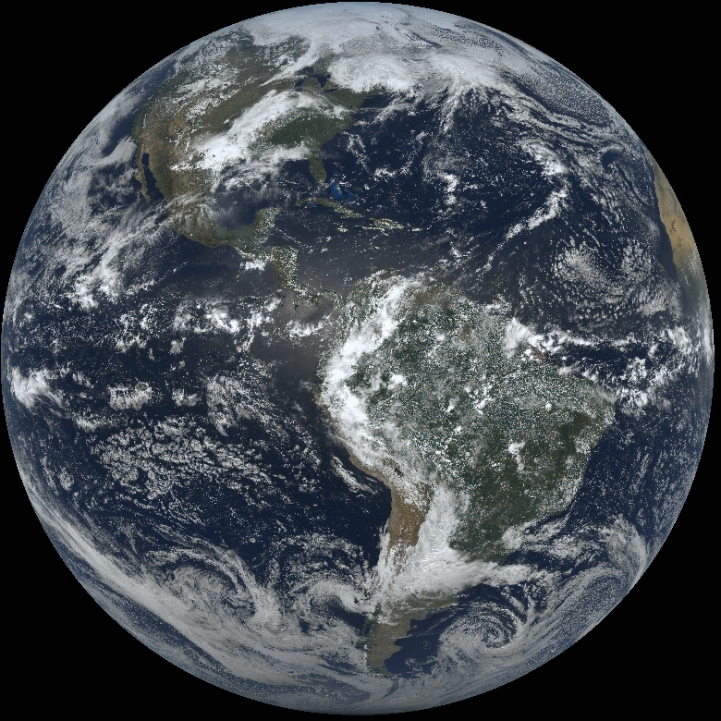
Local Noon Stretched RGB

Slide 12
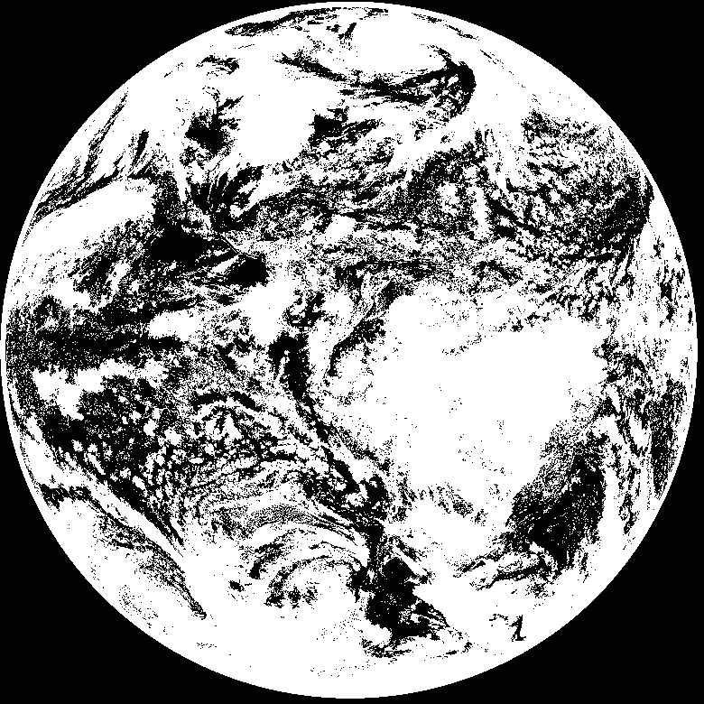
Local Noon CSPP-GEO AIT Cloud Mask

Slide 13
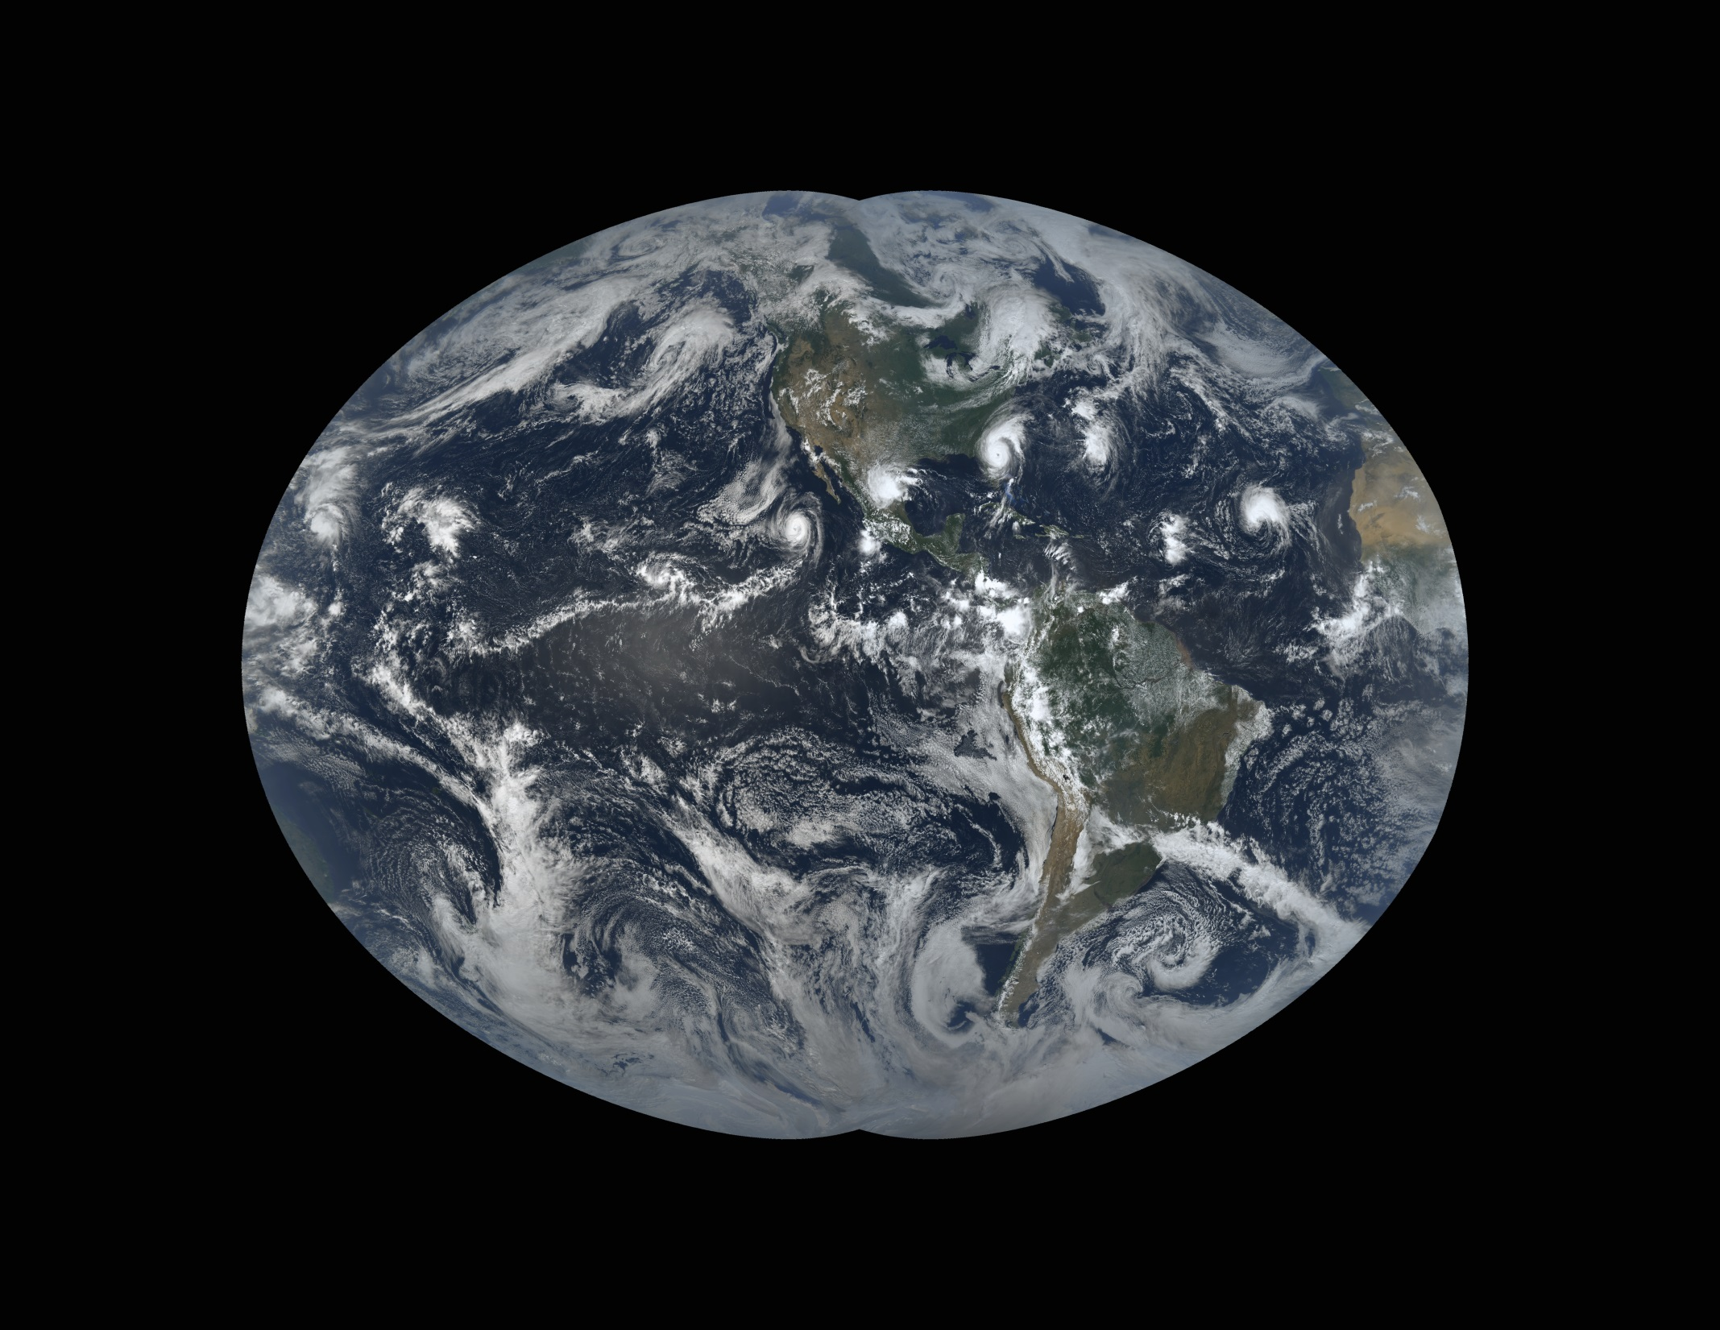

Slide 14
How
Stretched GOES-16 RGB images
Use amqpfind to listen for RabbitMQ messages from SDS
Starts McIDAS code (python)
Copy graphics to web
Copies AREA file to SDS
End of the day – create composite for RGB and cloud mask
amqpfind – utility to listen to RabbitMQ messages from SDS
https://www.ssec.wisc.edu/datacenter/amqpfind/

Slide 15
Local Noon RGB with Cloud Mask

Slide 17
Days Old
0-1
2-4
5-8
9-16
17-32
>32
Pixel age

Slide 18
Days Old
0-1
2-4
5-8
9-16
17-32
>32
Pixel age – Land mask

Slide 19
