Slide 1
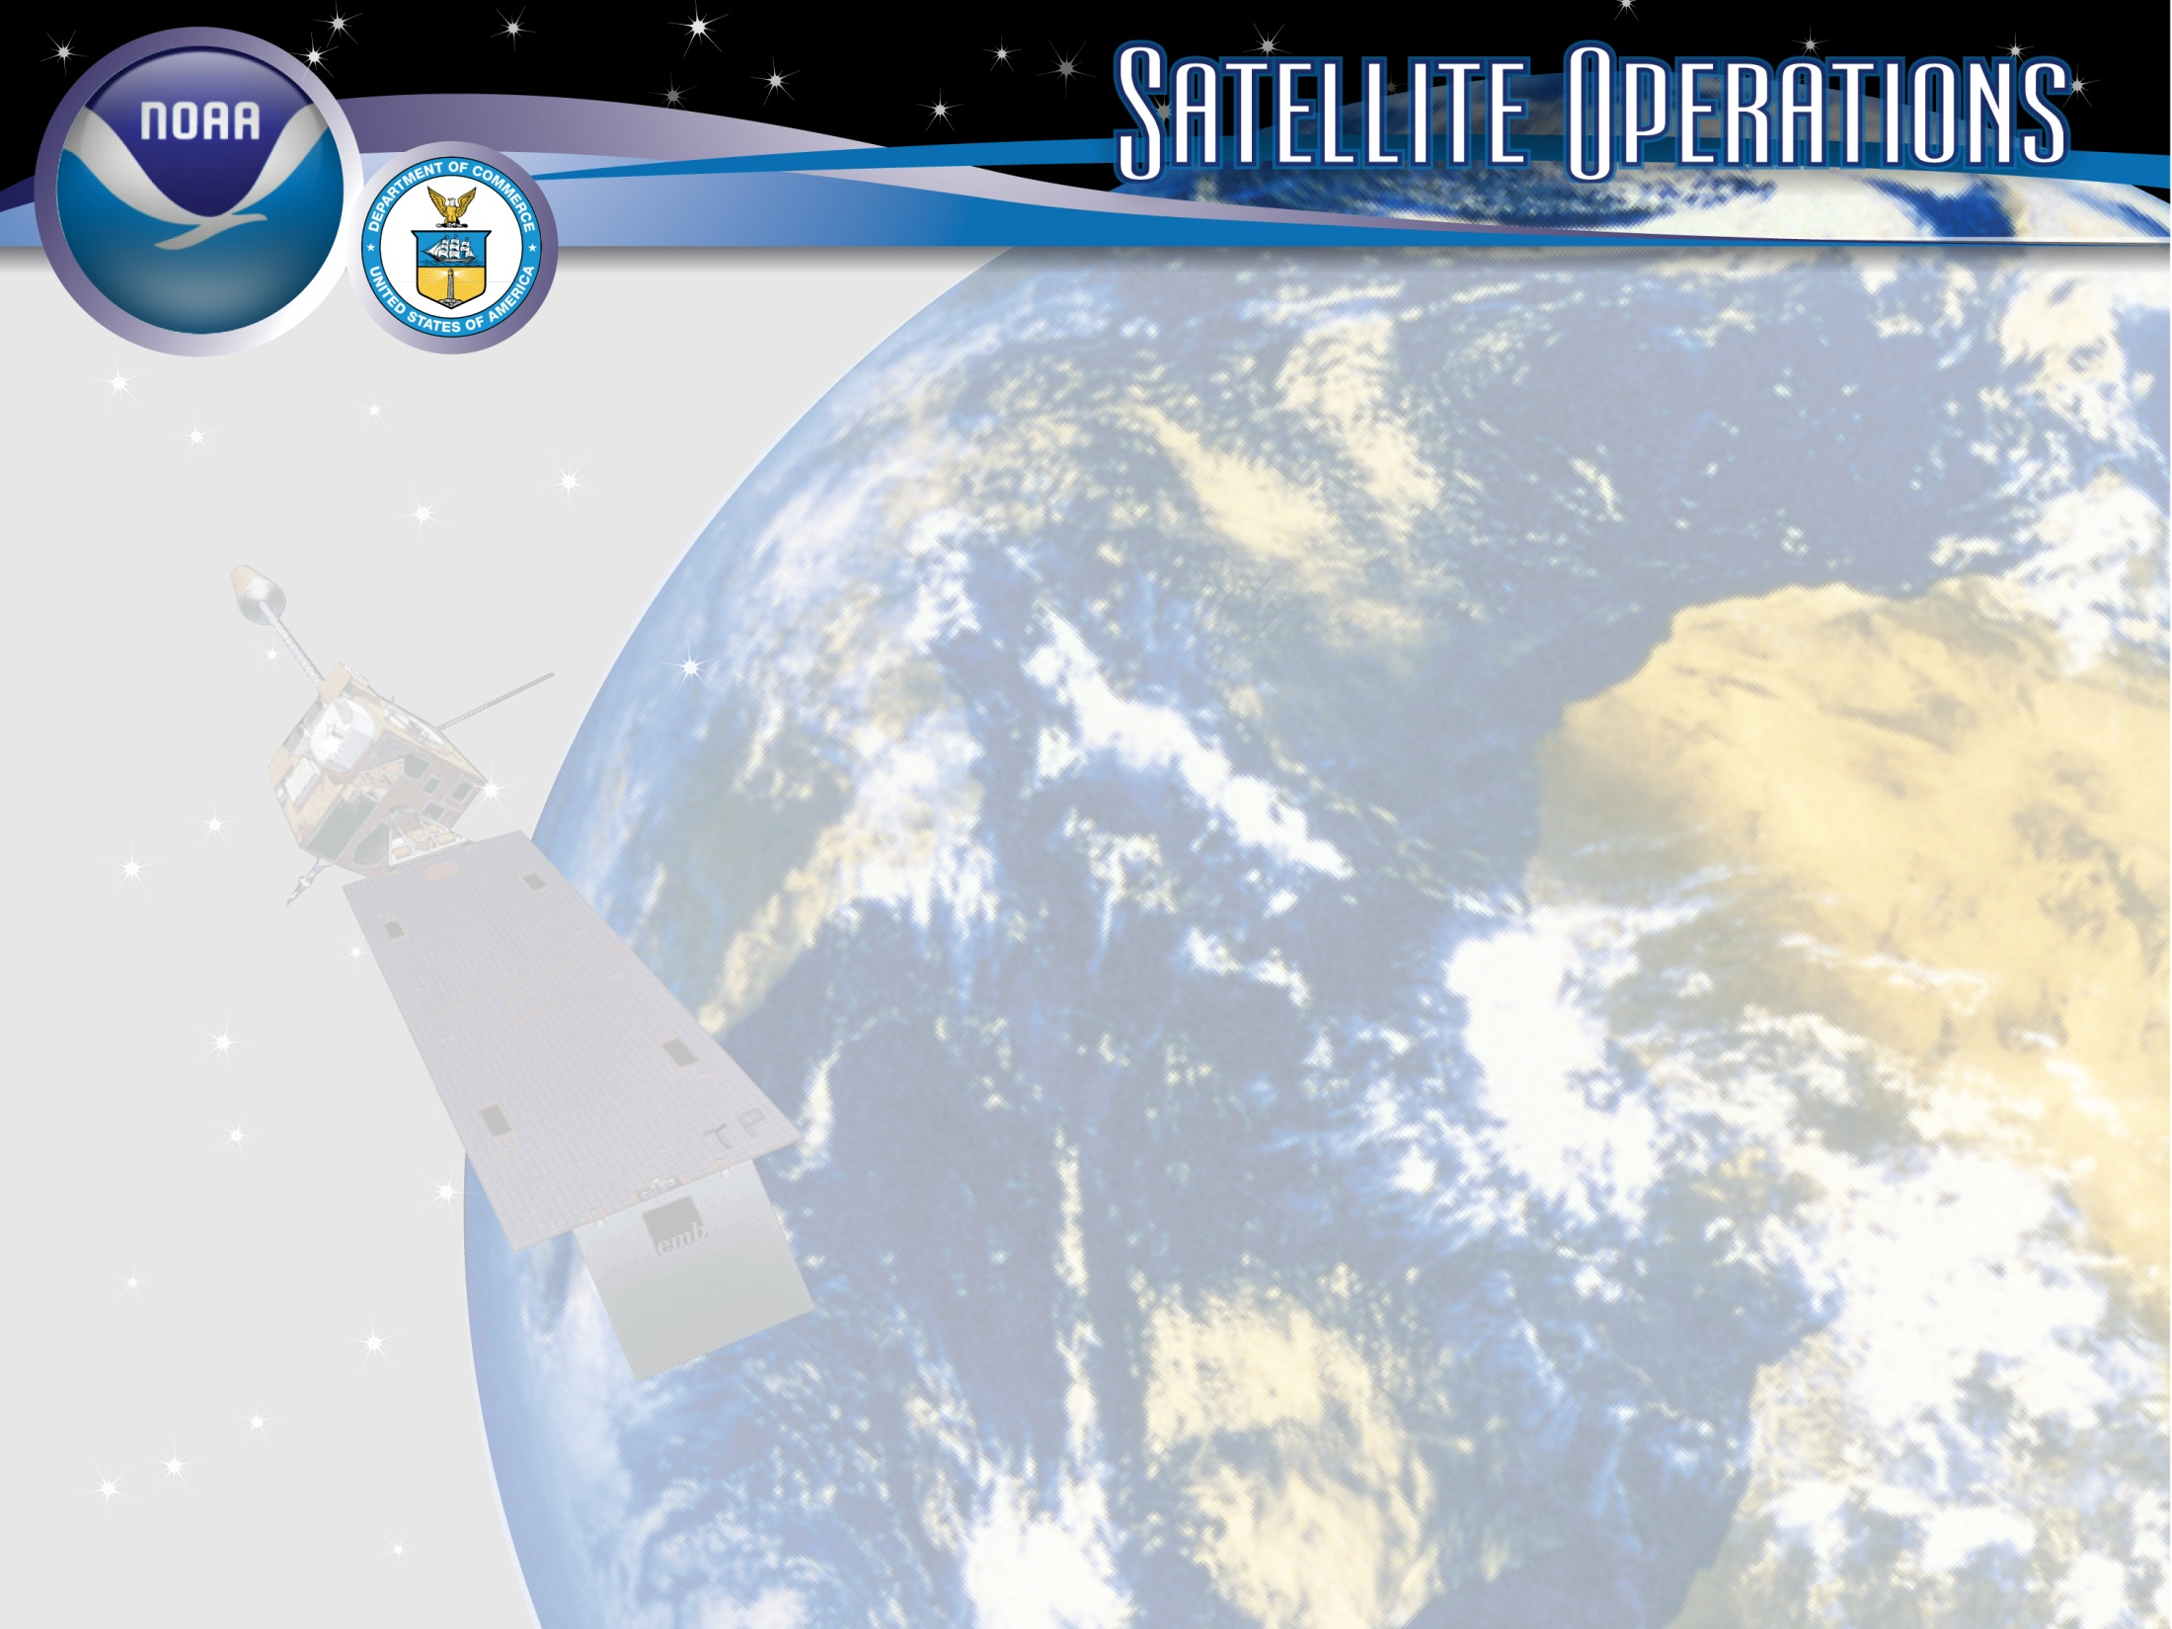
Status of NOAA Satellite Operations & McIDAS at ESPC
Monday, September 25, 2023
Clay Davenport
Notes:
Images
Satellite Image - GOES-13/14/15 (GOES-N/O/P)
Derived and Interpretive Products Image - Infrared Imagery with overlay of Heavy Precipitation (Rain & Snow) Interpretive Analysis from SAB (Satellite Analysis Branch)
Antennas at OSPO Wallops CDA (Command and Data Acquisition Station), symbolic of Direct Broadcast Services.
Title Slide Background and Banner were designed by TeddyPavlis@gmail.com

Slide 2
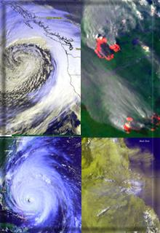
Presentation Outline
Overview of the Office of Satellite and Product Operations (OSPO)
Status of Satellite Operations
Status of McIDAS at ESPC
Q&A

Slide 3
The NESDIS Office of Satellite and Product Operations (OSPO) owns or operates the Nation’s 17 environmental satellites
NOAA owns and operates ten satellites, which include:
Four geostationary (GOES-14, -16, -17 and -18)
Five polar-orbiting (NOAA-15, -18, -19, -20, and -21)
One deep space satellite (DSCOVR)
NOAA operates but does not own, seven satellites, which include:
Suomi NPP (NOAA/NASA)
Jason-3 (CNES owns)
Three Defense Meteorological Satellite Program (DMSP) satellites (F-16, F-17, F-19)
EWS-G1 and –G2 (Air Force owns, formerly GOES-13 and -15)
Notes:
The NESDIS Office of Satellite and Product Operations (OSPO) currently commands and controls nations 17 environmental satellites (listed are various types).

Slide 4
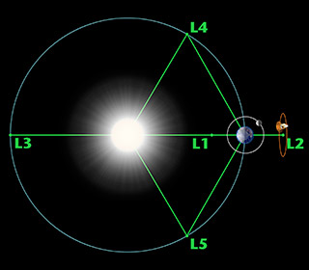
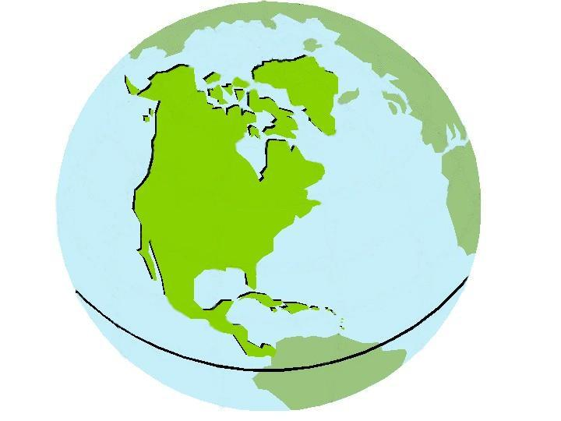
Three Observation Vantage Points
Polar-orbiting Operational Environmental Satellites
Geostationary Operational Environmental Satellites
Deep Space
at Lagrange 1 Point
22,300 Miles
540 Miles
Each satellite covers the Earth
twice per day
Pole-to-pole orbit is 101 minutes and views each location at the same time of day; capability for ½ orbit dumps with JPSS-1
Global coverage every 12 hours with one satellite
EUMETSAT - mid-morning orbit
NOAA - early afternoon orbit
Continuous monitoring
of the Americas
Coverage over the same geographic location
Constant monitoring for nowcast purposes and for forecast applications (NWP, etc.)
Continuous monitoring
of the Sun
Uninterrupted view of the sun
Information is used for solar winds monitoring for Space Weather warnings
Notes:
The satellites provide three observational vantage points for coverage of Earth.
Polar-orbiting satellites orbit the globe twice per day (pole to pole) for morning and afternoon coverage.
Geostationary satellites provide coverage over the same geographic location for constant nowcast monitoring.
Deep Space satellite (DSCOVR) provides an uninterrupted view of the sun.

Slide 5
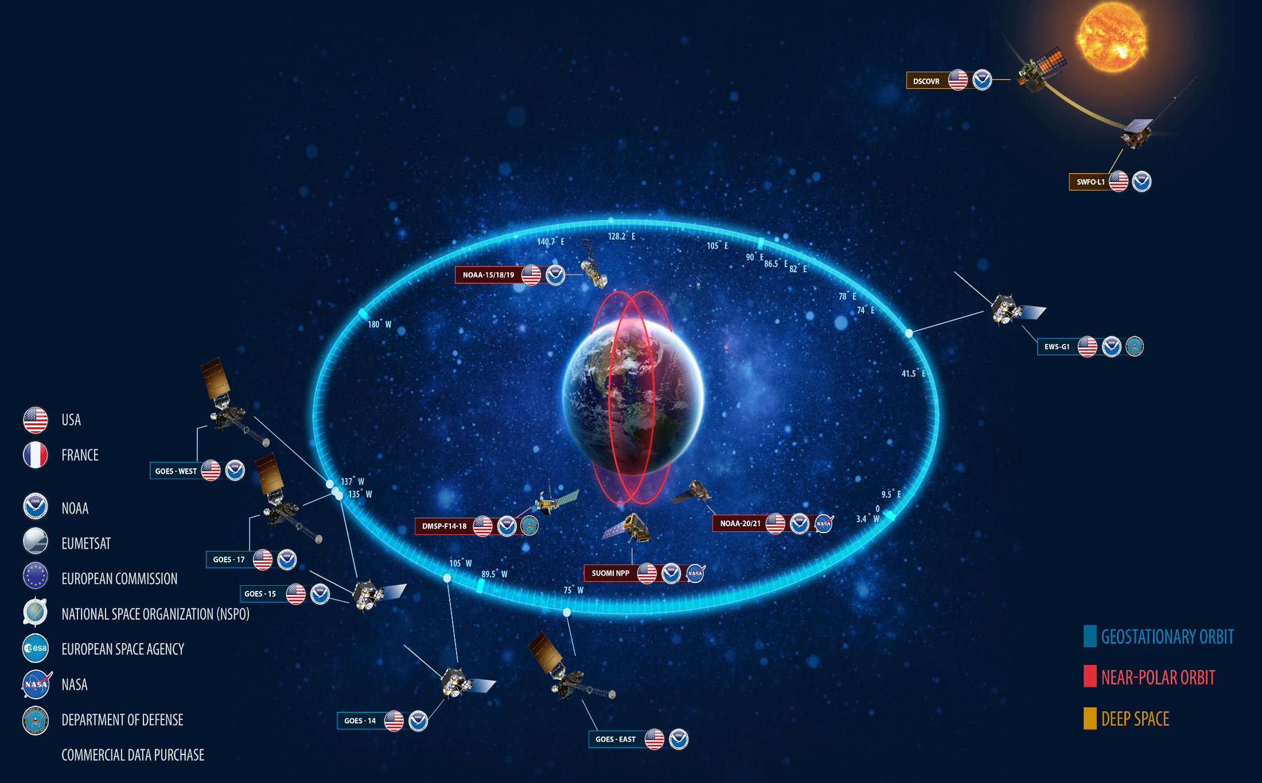
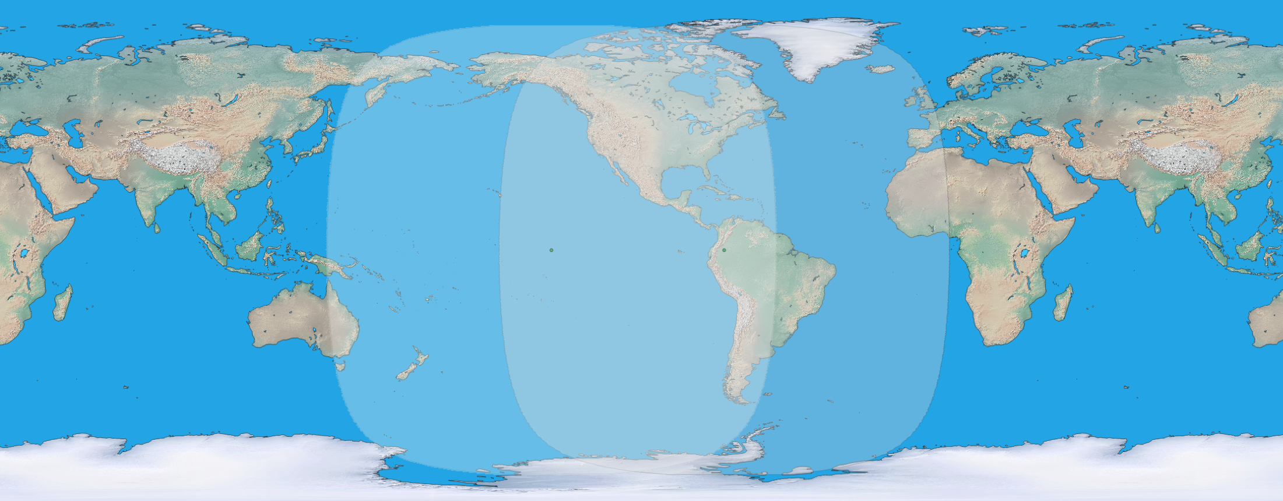
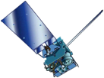
NOAA Constellation
GOES-West
GOES-15
135° West
GOES-East
GOES-13
75° West
GOES-West
Standby
GOES-East
Primary source of data for short term forecasting, especially of severe weather such as tropical storms
Continuity of Operations since 1974
Notes:
GOES- East: G-16 75.2W
GOES-West: G-18 137.2W
GOES-14 standby 108W
GOES-17 Standby 107W
GOES-15 to EWS-G2 at 61E

Slide 6
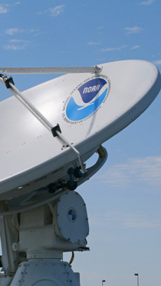
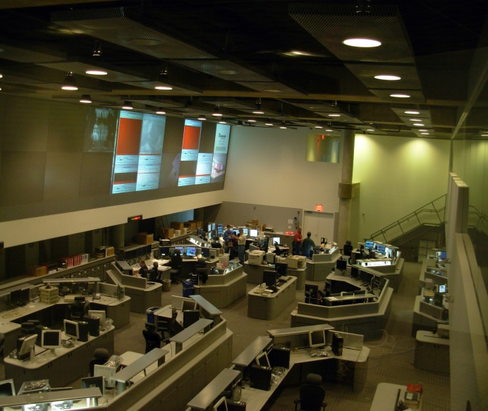
OSPO’s Key Roles
Ground System Command & Control, Ingest, Generation, and Distribution
Pre-Launch and Post-Launch Testing
Operational Testing, Validation, and Verification
User Readiness for Broadcast Services and Product Delivery
Long-Term Continuity of Products and Services
Notes:
OSPO manages and directs the operation of the central ground facilities which ingest, process, and distribute environmental satellite data and derived products to domestic and foreign users.
Responsible for:
Ground System Command and Control,
Pre-Launch and Post-Launch Testing,
Operational Testing, Validation, and Verification
User Readiness for Broadcast Services and Product Delivery
Long-Term Continuity of Products and Services

Slide 7
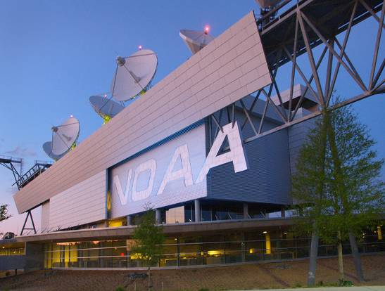
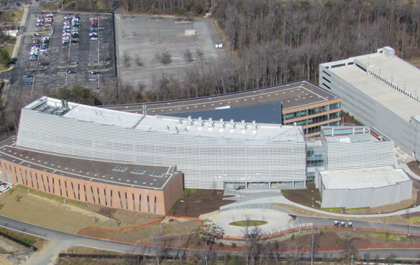
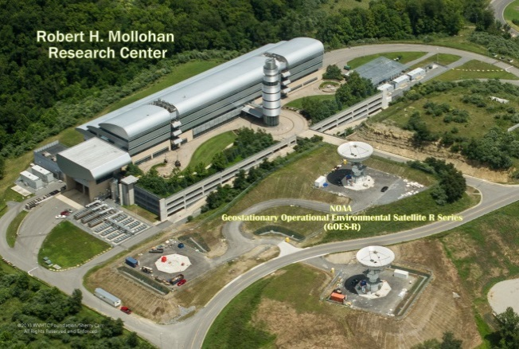
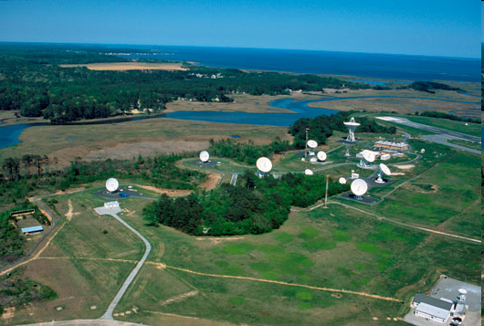
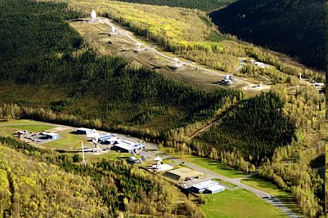
OSPO Operational Facilities
Over 500 staff supporting or operating the satellites, receptors, and processing systems
Suitland, MD
College Park, MD
Fairmont, WV*
Wallops, VA
Fairbanks, AK
* GOES-R and JPSS (New) Backup Facility
Notes:
OSPO has locations at four major facilities housing over 500 people.
NOAA Satellite Operations Facility (NSOF) in Suitland, Maryland
Mission Operations Division (MOD)
NOAA Center for Weather & Climate Prediction (NCWCP) in College Park, Maryland.
Satellite Product and Services Division (SPSD)
OSPO has Command and Data Acquisition Stations in Fairbanks, Alaska and Wallops, Virginia.

Slide 8
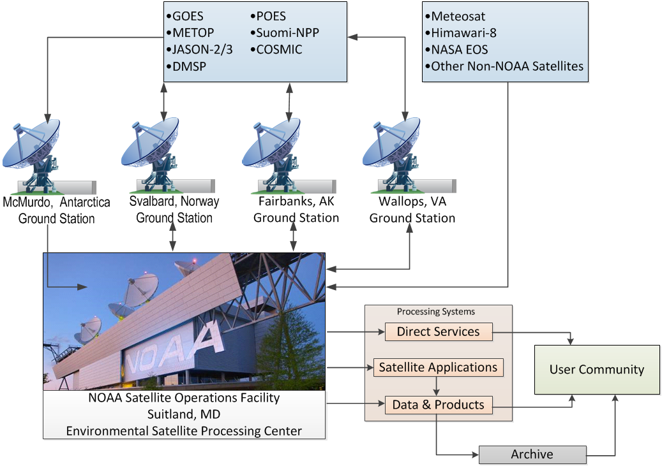
Nominal Satellite Data Flow
GOES NOP (14 + 15)
GOES-R (16 +17)
METOP
Jason- 2/3
DMSP
POES
NPP/NOAA-20
COSMIC
Meteosat
Himawari-8
NASA EOS
Other Non-NOAA Satellites
Notes:
Here’s a depiction of the nominal satellite data flow as data from the satellites is ingested and processed by ESPC.
Processing systems provide the data to the user community and archive (NCEI).

Slide 9
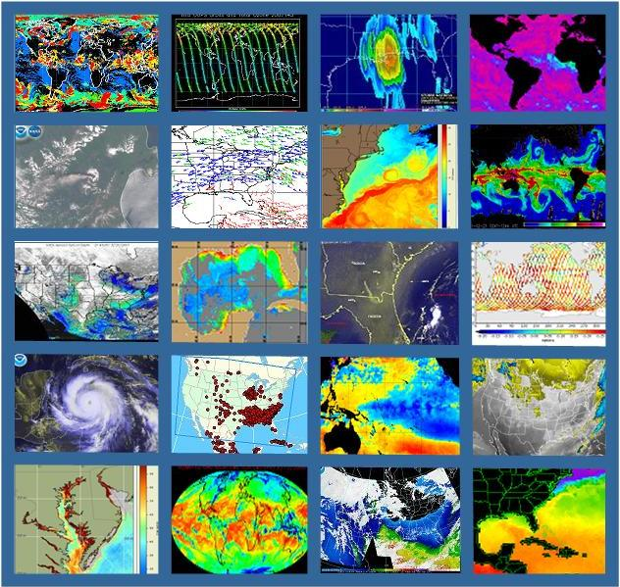
OSPO’s Satellite Products and Services Division
Provides 24x7 interpretive analyses of satellite data
Atmospheric temp/moisture
Hurricane intensity & position
Volcanic Ash
Fire and Smoke
Oil Spills
Manages automated environmental products
Collaborates with partners to support transition of research products into operations
Notes:
OSPO’s Satellite Products and Services Division leads production, adaptive maintenance, and monitoring activities for a variety of derived and interpretive environmental products.
Satellite Analysis Branch (SAB) provides operational 24X7 interpretive analyses of satellite data.
Satellite Products Branch (SPB) collaborates with STAR - Satellite Products and Services Review Board (SPSRB) to effectively manage the product life cycle process from product development, transition into operations, enhancements, and retirement.

Slide 10
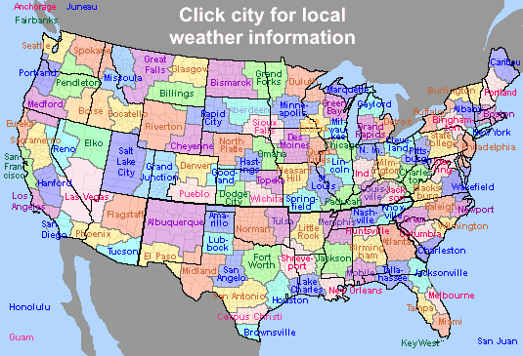
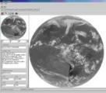
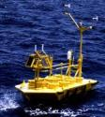
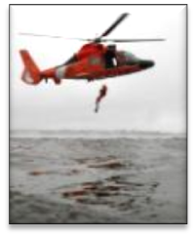
Direct Service Operations
Emergency Managers Weather Information Network (EMWIN):
NOAA satellites relay critical information to users across the country.
GOES Rebroadcast (GRB):
The GRB provides the primary GOES-16 and GOES-17 relay of full resolution, calibrated, near-real-time direct broadcast Level 1b data from each instrument and Level 2 data from the Geostationary Lightning Mapper (GLM). https://www.noaasis.noaa.gov/GOES/GRB/grb.html
Data Collection:
NOAA satellites are used to collect and relay scientific data from around the globe.
http://www.noaasis.noaa.gov/DCS/ http://www.noaasis.noaa.gov/ARGOS/
Search and Rescue Satellite Aid Tracking (SARSAT):
NOAA satellites are used to relay distress alerts from aviators, mariners and
land-based users (http://www.sarsat.noaa.gov/
Geonetcast Americas:
Data from NOAA for diverse societal benefits - agriculture, energy, health, climate,
weather, disaster mitigation, biodiversity, water resources, and ecosystems.
http://www.geonetcastamericas.noaa.gov/index.html
Notes:
OSPO partners with NWS to provide data and products through the Emergency Managers’ Weather Information Network (EMWIN).
OSPO also manages GOES Data Collection Services (*more than 21,000 active Argos platforms collecting data for over 1,900 distinct projects in 100+ countries).
Though the assistance of OPSO’s Search and Rescue Satellite Aid Tracking (SARSAT) program – (*250 individuals were rescued in calendar year of 2015 alone).
Since 1982, there have been a total of 7,740 SARSAT saves in the US, and more than 39,000 worldwide (as of December 31st, 2015)

Slide 11
GEO Status

Slide 12
Geostationary Operational Environmental Satellite (GOES-NOP) Performance Status – August 2023
Payload Instrument | EWS-G1 (GOES-IO) Launch: May 06 Activation: Apr 10 | GOES-14 (Storage) Launch: Jun 09 Activation: | EWS-G2 (Storage) Launch: Mar 10 Activation: Dec 11
Imager | G | B | B
Sounder | R | B | Y/B
Energetic Particle Sensor (EPS) | B | B | Y/B
Magnetometers | G | G | G
High Energy Proton and Alpha Detector (HEPAD) | B | B | B
X-Ray Sensor (XRS) | B | B | B
Solar X-Ray Imager (SXI) | B | B | B
Spacecraft Subsystems
Telemetry, Command & Control | G | G | G
Attitude and Orbit Control | G | G | G
Fuel for Inclination Control | G | G | G
Propulsion | G | G | G
Mechanisms | G | G | G
Electrical Power | G | G | G
Thermal Control | G | G | G
Communications Payloads | G | B | B
Key
Operational
Functional (Off)
Operational with limitations
Non-operational
Spacecraft Issue but No User Impact
G
B
Y
R
S/C
Notes:
1
(1) GOES-13 XRS capacitor short
Action
Performed tests on GOES-14 & 15 sensors to ensure failures will not be repeated
Using GOES-15 spacecraft to receive solar x-ray data
Impact
GOES-13 XRS X-ray measurements can potentially invert unexpectedly
Nominal XRS data since July 2013
No user impacts
(2) GOES-13 SXI detector damage due to flare, abnormal flare protection in level 5
Action
Modified flight software to implement safing of SXI to prevent permanent damage
To modify flare detection algorithm
Impact
User impacts, 9 rows currently affected out of 512 total
User impacts, flare protection stays in level 5
(3) GOES-15 Sounder roll blanket raised above cooler
Action
User has been notified
Yaw flip at Equinox to keep Sun angle below cooler plane
Impacts
Data outage and degraded products during each yaw flip maneuver and 28 hours of INR recovery period
(4) GOES-13 Sounder filter wheel stalls
Action
User has been notified
Power cycled filter wheel windings
Impacts
Sounder IR data are not usable
GOES-15 INR performance using single Star Tracker #3 is degraded during high solar activity
(5) GOES-15 MAGPD/MAGED reached thermal high limit
Action
User has been notified
Turn off MAGPD and MAGED around winter solstice

Slide 13
Geostationary Operational Environmental Satellite (GOES-RSTU) Performance Status – August 2023
Payload Instrument | GOES-16 (EAST) Launch: Nov ‘16 Activation: Dec ‘17 | GOES-17 (BACKUP) Launch: Mar ‘18 Activation: Mar ‘19 | GOES-18 (WEST) Launch: Mar ‘21 Activation: Jan ‘23
Advanced Baseline Imager (ABI) | G | Y | G
Space Environment I-Situ Suite (SEISS) | G | G | G
Solar Ultraviolet Imager (SUVI) | G | G | G
EUV and X-ray Irradiance Sensors (EXIS) | G | G | G
Magnetometer | Y | G | G
Geostationary Lightning Mapper (GLM) | G | G | G
Spacecraft Subsystems
Command Data & Handling (CD&H) | G | G | G
Guidance Navigation Control (GNC) | G | G | G
Electrical Power Subsystem (EPS) | G | G | G
Propulsion | Y | G | G
Mechanisms | G | G | G
Electrical Power | G | G | G
Thermal Control | G | G | G
Communications Payloads | G | G | G
Key
Operational
Operational with limitations
Non-operational
G
Y
R
Notes:
1
GOES-16 Mag performance impacted by thermoelectric effect, temp compensation error and Arc Jet Thruster firing
Actions
Work underway on Mag FSW change
Work underway on ground algorithm corrections based on orbital trend
(2) GOES-16 Repressurization Anomaly Recovery and 2nd Even 5lbf REA Flush Complete
S/C is fully operational under careful selection of thrusters used during Momentum Adjusts (MAs), North-South Station Keeping (NSSK) Manuevers, and East-West Station Keeping (EWSK) Maneuvers
Low Thrust Rocket engine assemblies (LTR) #21 and 32 removed from service
Arcjet 15 (AJ#15) removed from service until after additional testing planned for Dec 2021
NSSKs alternate using the AJ14/16 and AJ13/16 pairs
AJ15 performance increasing following thruster pulsing on 9/7/22 and 12/7/22, additional pulsing and calibrations to occur in Jan ‘23
(3) GOES-17 ABI loop heat pipes anomaly
Actions
Semi-annual Yaw-flip required
Cryocooler operations changes
Focal plane module operations changes
Algorithm turning to minimize impact of IR channel loss
Performance degraded after two ABI safing events in July 2021
FPM thermal setpoint increased from 81K to 84K on 10/8
FPM thermal setpoint will be set to 87K during hottest parts of year (see slide 8)
Mode 3 “Cooling Timeline” used during hottest parts of year pre and post eclipse season (see slide 8)

Slide 14
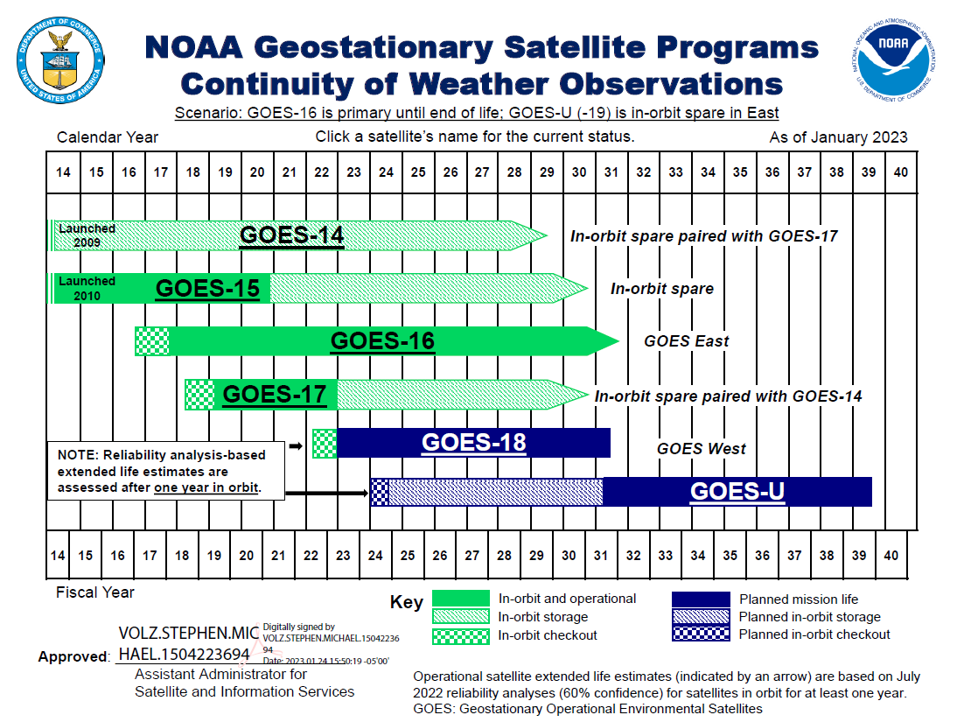
GOES Flyout Schedule
Transferred to Air Force June 2023
http://www.nesdis.noaa.gov/FlyoutSchedules.html http://www.goes-r.gov
Notes:
Here is the Flyout Schedule showing the continuity of the GOES Mission.
GOES-R is the next generation of GOES satellites that will provide a major improvement in quality, quantity, and timeliness of data collected.

Slide 15
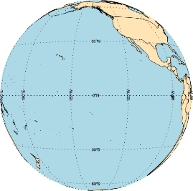
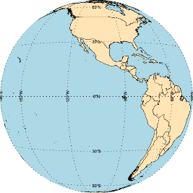
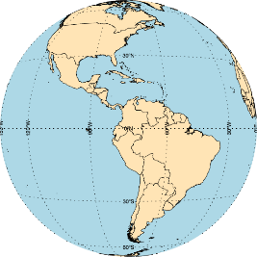
GOES Constellation
GOES-West
GOES-18
137.0° West
Storage
GOES-14
108° West
Storage
GOES-17
104.7° West
GOES-East
GOES-16
75.2° West
Changes are indicated in blue
GOES-15 has been transferred over to U.S. Space Force and is drifting to new location over Indian Ocean
GOES-17 & GOES-14 are now in Storage/Standby, and are ready to provide backup capabilities in the effect of a GOES-East or GOES-West anomaly
M. Seybold, D. Pogorzala

Slide 16
GOES- R Series Data Access
Acronym | System Name
GRB | GOES Rebroadcast
HRIT/ EMWIN | High Rate Information Transmission/ Emergency Managers Weather Information Network
PDA | Product Distribution and Access
CLASS | Comprehensive Large Array-data Stewardship System
GNC-A | GEONETCast Americas
Websites | Websites on the Internet
NODD | NOAA Open Data Dissemination
SBN/NOAAPort | NWS Satellite Broadcast Network

Slide 17
GOES-18 L1b Science Product Validation Status
Ver: 11/29/22 E. Kline

Slide 18
GOES-18 L2+ Science Product Validation Status
L2+ Products | Beta | Prov | Full |  | L2+ Products | Beta | Prov | Full
Cloud and Moisture Imagery (CMI) and Sectorized CMI (KPP) | 5/11/2022 | 7/28/2022 | FY23 |  | Fire/Hot Spot Characterization | 5/11/2022 | 10/12/2022 | FY23
Aerosol Detection (Smoke & Dust) | 5/11/2022 | 11/9/2022 |  |  | Ice Age & Thickness ^{E} | 5/11/2022 | 12/29/2022
Aerosol Optical Depth | 5/11/2022 | 11/9/2022 |  |  | Ice Concentration & Extent ^{E} | 5/11/2022 | 12/29/2022
Clear Sky Mask ^{E} | 5/11/2022 | 9/28/2022 |  |  | Ice Motion | N/A | FY24Q1
Cloud Cover Layers ^{E} | 5/11/2022 | 5/16/2023 |  |  | Land Surface Albedo ^{E} | 5/11/2022 | 11/9/2022
Cloud Optical Depth ^{E} | 5/11/2022 | 11/21/2022 |  |  | Land Surface Reflectance ^{E} | 5/11/2022 | 11/9/2022
Cloud Particle Size Distribution ^{E} | 5/11/2022 | 11/21/2022 |  |  | Land Surface Temperature ^{E} | 5/11/2022 | 11/9/2022
Cloud Top Height ^{E} | 5/11/2022 | 9/28/2022 |  |  | Legacy Vertical Moisture Profile | 5/11/2022 | 10/12/2022
Cloud Top Phase* ^{E} | 5/11/2022 | 9/28/2022 |  |  | Legacy Vertical Temperature Profile | 5/11/2022 | 10/12/2022
Cloud Top Pressure ^{E} | 5/11/2022 | 9/28/2022 |  |  | Rainfall Rate/QPE | 5/11/2022 | 11/9/2022
Cloud Top Temperature ^{E} | 5/11/2022 | 9/28/2022 |  |  | Reflected S/W Radiation: TOA | 5/11/2022 | 11/9/2022
Derived Motion Winds | 5/11/2022 | 9/28/2022 |  |  | Sea Surface Temperature | 5/11/2022 | 11/21/2022
Derived Stability Indices | 5/11/2022 | 9/12/2022 |  |  | Snow Cover ^{E} | N/A | 12/9/2022
Downward S/W Radiation: Surface | 5/11/2022 | 11/9/2022 |  |  | Total Precipitable Water | 5/11/2022 | 10/12/2022
Ver: 6/8/23 E. Kline
* Previously discovered issue that caused an over-categorization of water clouds as ice clouds in the GOES-18 Cloud Top Phase product has been resolved as of 5/31/23

Slide 19
Documentation of Product Status
A comprehensive listing of data quality assessments for GOES-16/17/18 ABI L2 products:
https://www.noaasis.noaa.gov/GOES/product_quality.html
Notes:
Beta: Data are preliminary and non-operational; undergoing testing and initial calibration and validation. Products are made available to users to gain familiarity with data formats and parameters in accordance with the GOES-R Product User Guide (PUG). Beta products have been minimally validated and may still contain significant errors. They are not optimized for operational use.
Provisional: Data are ready for operations and use in cal/val activities. Performance has been tested and documented over a subset of conditions, locations, and periods. Validation is still ongoing, not all anomalies are known but all known are documented and available to the user community.
Full: Product is operational. All known anomalies are documented and shared with the user community. Performance has been tested and documented over a wide range of conditions. Users are engaged and feedback is assessed

Slide 20
POES Status

Slide 21
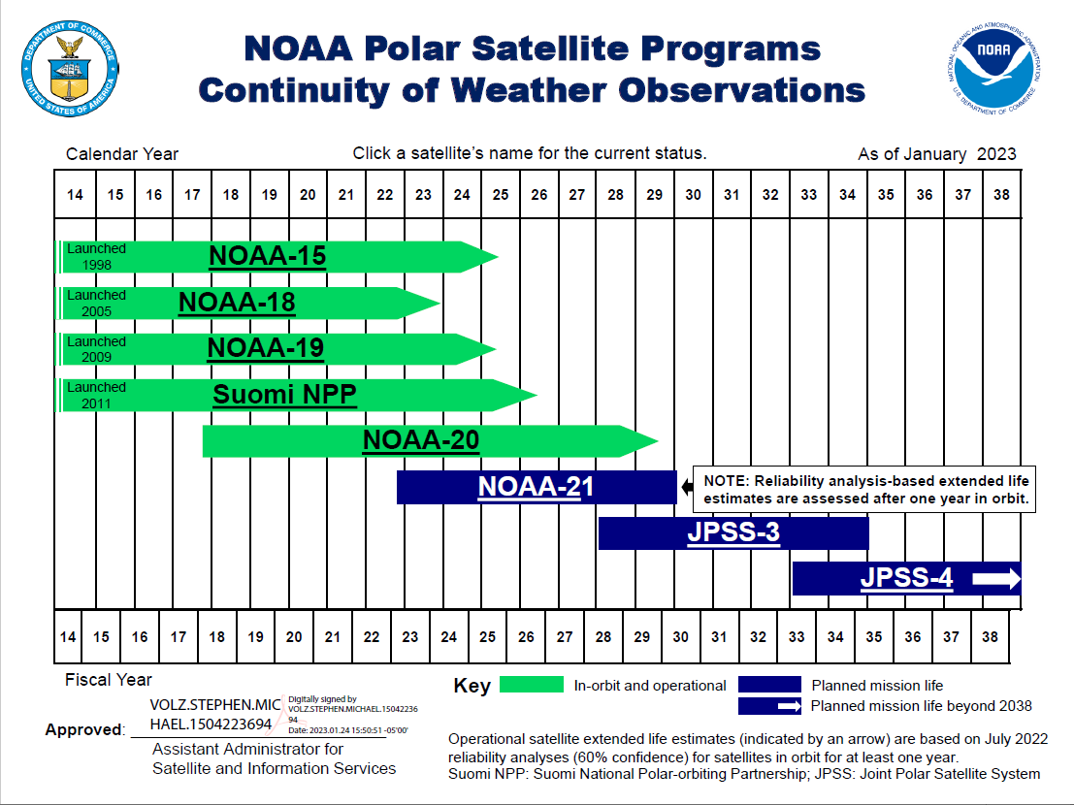
LEO Flyout Schedule
http://www.nesdis.noaa.gov/FlyoutSchedules.html http://www.jpss.noaa.gov
Notes:
Here is a depiction of the Low Earth Orbit Flyout Schedule.
S-NPP is a risk reduction mission for JPSS-1 and provides data continuity for NASA EOS Missions.
Highest priority is to launch the follow-on polar satellite Joint Polar Satellite System (JPSS-1/NOAA-20) with launch expected Mid-March 2017 while JPSS-2 launch readiness is planned for 4th quarter FY 2021
The JPSS will succeed NOAA's POES satellites and ground systems by leveraging investments made in NOAA POES, NASA's Earth Observing System (EOS), and the SNPP to maintain continuity of global, operational, space-based observations.

Slide 22
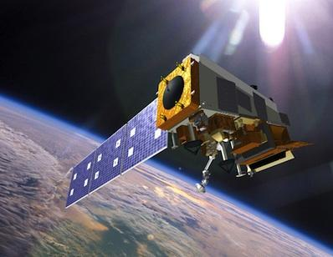
Overall Mission Status | S-NPP
Spacecraft | S-NPP
Launch Date | Oct 28, 2011
Mission Category | LTAN 1325 (PM) (Secondary/Ops) +/- 10 mins (Secondary PM)
Payload Instruments | Status
ATMS | G
CERES | G
CrIS | Y
OMPS – Nadir | G
OMPS – Limb | G
VIIRS | G
Spacecraft Subsystem | Status
TLM, Command & Control | G
ADCS | G
EPS | G
Thermal Control | G
Communications | G
CDP | G
SCC | G
GPS | G
1553 | G
1394 | G
Operational (or capable of)
Operational with limitations (or in standby)
Operational with degraded performance
Not functional
Functional but turned off
No status reported
Additional Notes:
All instruments operating normally CrIS operating on side-1 electronics, Long-Wave recovered and at validated level of maturity (operational) as of July 13, 2020 but CrIS Mid-Wave digital signal processor is inop on side-1. Extensive monitoring of the S-NPP ATMS scan drive motor current loads and temperatures is ongoing, ATMS scan drive reversal occurs 2Xs per orbit Spacecraft and sub-systems are power positive and operating nominally Middle solar panel inop, power positive on 2/3s of the solar array

Slide 23
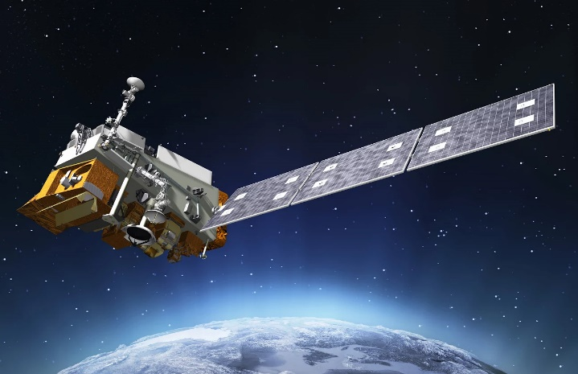
Overall Mission Status | NOAA-20
Spacecraft | NOAA-20/JPSS-1
Launch Date | Nov 18, 2017
Mission Category | LTAN 1325 (PM) +/- 10 mins (Primary PM)
Payload Instruments | Status
ATMS | G
CERES | G
CrIS | G
OMPS – Nadir | G
OMPS – Limb | G
VIIRS | G
Spacecraft Subsystem | Status
TLM, Command & Control | G
ADCS | G
EPS | G
Thermal Control | G
Communications | G
CDP | G
SCC | G
GPS | G
1553 | G
SpaceWire | G
Operational (or capable of)
Operational with limitations (or in standby)
Operational with degraded performance
Not functional
Functional but turned off
No status reported
Additional Notes:
All instruments operating nominally and are meeting/exceeding their established performance specifications.

Slide 24
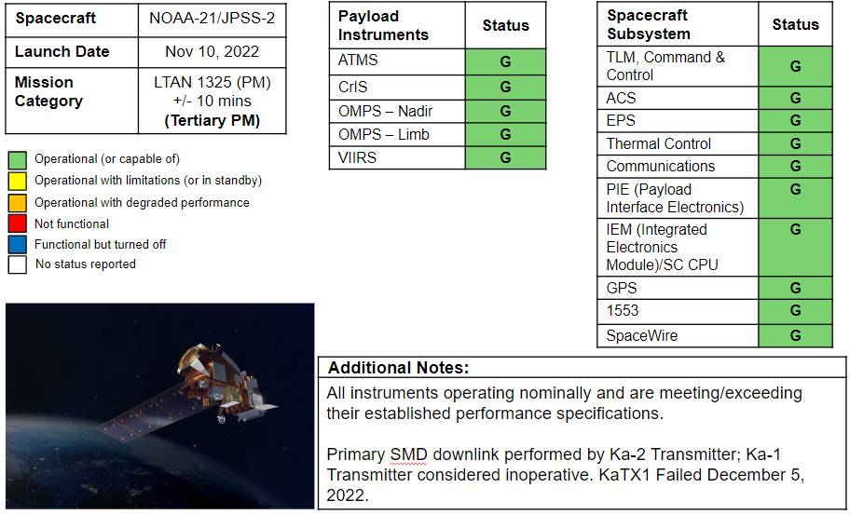
Overall Mission Status | NOAA-21

Slide 25
Notional NOAA-21 Schedule
Operational Orbit Location
(Launch to ~L+14 Months)
Operational Orbit Location
(~L+14 Months to Post Primary Designation)

Slide 26
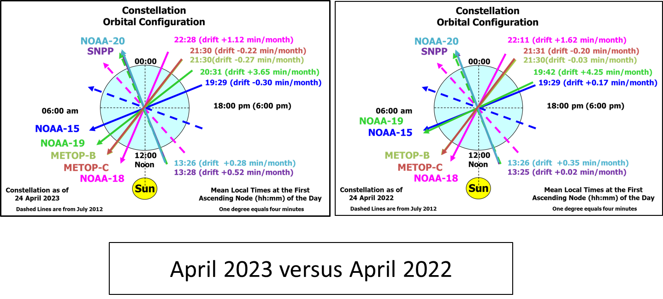
O'clock diagram IJPS OWG/FtF Meeting updates
April of 2023 compared to April of 2022
Notes:
Updated to October 2021 F2F biannually Meeting
Updated twice a year Fall and Spring, The LTANs do not change that much month to month

Slide 27
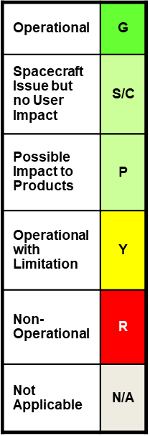
Polar Operational Environmental Satellite (POES) Operational Status Aug 24, 2023
Spacecraft Subsystems | METOP-B | METOP-C | NOAA-19 | NOAA-18 | NOAA-15
Launch Date | Sept 2012 | Nov 2018 | Feb 2009 | May 2005 | May 1998
Operational Date | April 2013 | April 2019 | Jun 2009 | Aug 2005 | Dec 1998
Mission Data Category | Primary (AM) | Operational (AM) | Prime Services Mission (PM) | Secondary (PM) | Secondary (AM)
Payload Instruments
AVHRR | G | G | G | G | Y
HIRS | R | N/A | Y | Y | Y
AMSU-A1 | P | G | G | P | Y
AMSU-A2 | G | G | G | G | G
AMSU-B | N/A | N/A | N/A | N/A | R
MHS | G | G | Y | R | N/A
SEM | G | G | G | G | G
SBUV | N/A | N/A | S/C | R | N/A
Spacecraft Subsystems
Telemetry, Command & Control | G | G | G | G | G
ADACS | G | G | S/C | Y | Y
EPS | G | G | G | G | G
Thermal Control | G | G | G | G | Y
Communications | G | G | G | G | Y
APT/LRPT | R | R | G | G | G
DCS | N/A | N/A | N/A | G | G
ADCS | Y | G | G | N/A | N/A
SAR | Y | N/A | G | G | Y
Notes:
Note Metop HIRS went from green to red for both operations and performance due to the stalled filter wheel in the month of May 2020 and back to yellow September 2022.
EUMESAT implemented an automated power toggling of the Metop-B HIRS on Sep 3, 2020. It consists of 10 toggles with 2 second intervals. This will execute on 13/14 orbits per day just after the SVL pass ends, until the anomaly is recovered. 116 weeks and counting.
HIRS filter wheel breaks free after 116 power cycles 9/29/2022, L1b products below or near spec
New: Metop-B HIRS went from green to red for both operations and performance due to the stalled filter wheel. The instrument ceased producing useful data after 18:45 UTC on Friday 17th March 2023. ARB meeting held on 20th March to determine appropriate recovery actions for the stalled Filter Wheel Motor (FW).
The HIRS Filter Wheel on Metop-B remains stalled after manual power cycle week of 20 March 2023 .
Further recovery attempts will continue in an automated manner when the new Mission Planning schedule comes into effect on Sunday 26 March 2023.
EARS dissemination will be stopped in the future.
The UNS message will be updated if the FW remains stalled next week 27 March 2023.
• Metop-A removed, decommissioned 30 November 2021
No color change March 2022
No color Change February 2022
No color change September 2020
Note Metop HIRS went from green to red for both operations and performance due to the stalled filter wheel in the month of June.
EUMESAT implemented an automated power toggling of the Metop-B HIRS on Sep 3, 2020. It consists of 10 toggles with 2 second intervals. This will execute on 13/14 orbits per day just after the SVL pass ends, until the anomaly is recovered.
• All other stoplight colors remained the same
No color change in April 2018
No color change in May 2016

Slide 28
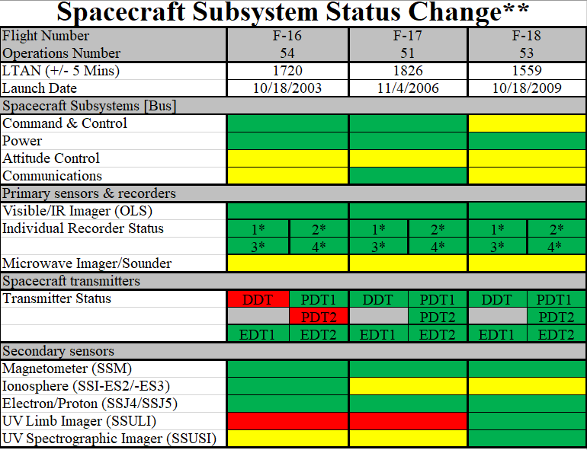
Defense Meteorological Satellite Program (DMSP)
Performance
(August 2023)
Slide Provided
By USSF 19th
OL-A
Slide Provided
By USSF 19th
OL-A
 | Fully Mission Capable
 | Capable
 | Not Mission Capable

Slide 29
POES Extended Life Mission
In 2022, NOAA selected a team led by Parsons Corporation (NYSE: PSN) to provide engineering services, information technology functionality, and flight operations support to assume on-orbit operations for the Polar Operational Environmental Satellites (POES) NOAA-15, NOAA-18, and NOAA-19.
Transfer of operations for NOAA-18 took place in September 2023; NOAA-15 and -19 will follow soon
Parsons will perform C3 functions via a Cloud Ground Station as a Service environment with subsidiary KSatLite for the remainder of the POES Extended Mission (through at least FY25)
Data will remain accessible to NOAA and NCEP models, with reduced reliability criteria

Slide 30
Meteosat and Himawari

Slide 31
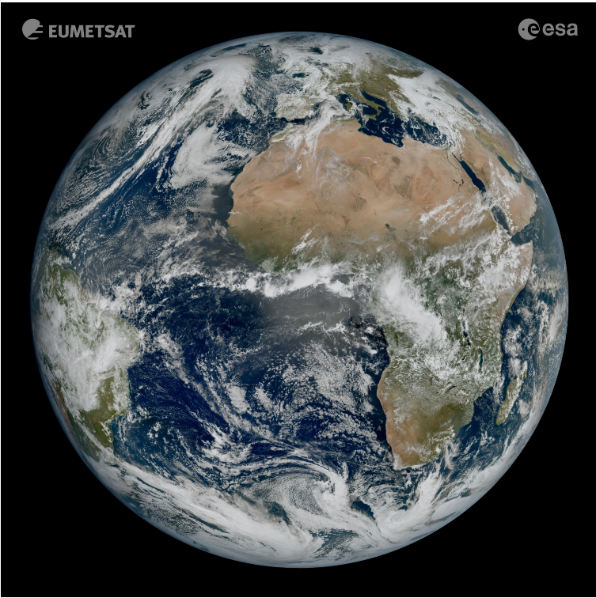
Current Meteosat Constellation
Meteosat Program Updates
SATELLITE | LIFETIME | POSITION | SERVICES
Meteosat-11 | 15/07/2015 – Fuel lifetime is until 2033 | 9.5°E | Rapid Scan Service. Real-time Imagery.
Meteosat-10 | 05/07/2012– Fuel lifetime is until 2030 | 0° | 0º SEVIRI Image Data. Real-time Imagery.
Meteosat-9 | 28/08/2002 – Fuel lifetime is until 2022 | 45.5° E | Primary IODC service started 6/1/22.
MTG-I1 | Launched 12/13/2022 | 0° | Will replace Meteosat-10 at 0º around February 2024.
Primary Imaging Operations
First image of the full Earth disc from Meteosat Third Generation – Imager 1 (MTG-I1). The image was captured at 11:50 UTC on 18 March 2023 by the Flexible Combined Imager (FCI) on MTG-I1.

Slide 32
Meteosat Configuration Plans
The relocation of Meteosat-10 to 0° and Meteosat-11 to 9.5°E occurred March 21, 2023.
After the swap, Meteosat-11 will began support of Rapid Scanning Service (RSS) at 9.5°E. Meteosat-10 began support of Full Disc Scan Service (FDSS) at 0°.
Products and subscriptions were toggled to use the MET-10 imagery.
MTG-I1 launched December 13, 2022 from French Guiana.
MTG-I1 will be assigned to Full Disk Scan Service (FDSS) when starting Prime operations at 0° ~ February 2024.
There will be a 6-12 month overlap between MET-10 and MTG-I1 at this location prior to MTG-I1 becoming the primary operational satellite at this location/for this service.
First images were captured in March 2023 and released May 4, 2023
NOAA’s data policy should be largely the same between MSG and MTG

Slide 33
Himawari-8/9/10 Constellation Plans
Himawari-9 is operational at 140.7E.
Himawari-8 was placed in standby mode on December 13, 2022. It remains at or near 140.7E.
Lingering Level-2 H-9 products are partially operational.
L2 Cloud and Wind products went operational in the NCCF on June 13, 2023 and are available for subscription in the PDA.
L2 Rainrate and SST products are scheduled to be worked late summer through early fall. It is likely that products will not be operational until late Fall 2023.
Work is progressing on Himawari-10 with the contractor selections completed and announced. It is still slated to launch in 2028 and take over operations from H-9 in 2029.

Slide 34
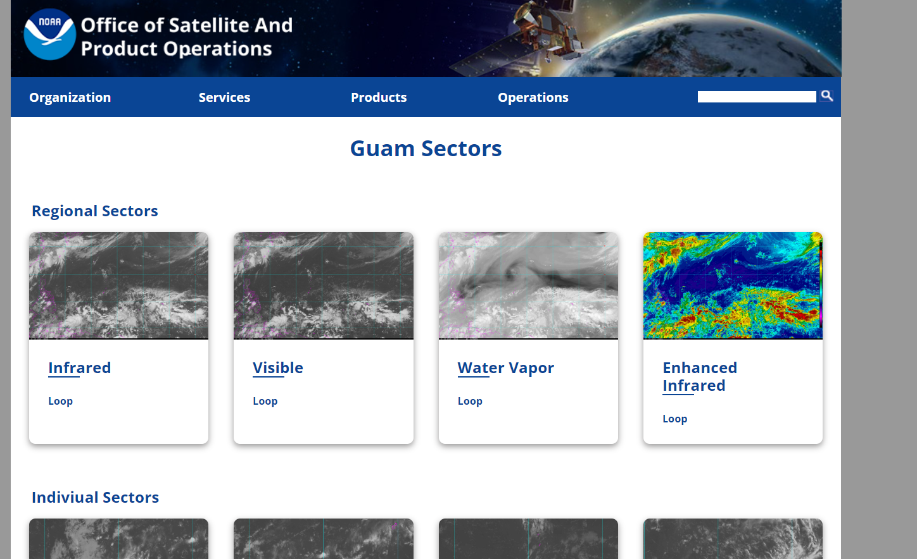
Revamped OSPO Imagery Webpage for Himawari
The OSPO Imagery webpage has been revamped. It is now organized by satellite type (Geostationary, Polar, etc.)
Within each imagery type, imagery is organized by satellite mission for easy access.
Southern Hemisphere and Guam/Pacific Island sectors remain the same, just cleanly organized and migrated to the new OSPO page (off of the goes.noaa.gov domain)
The original goes.noaa.gov page with the sectors will remain active for a few months as users transition - a warning banner will direct users to the new location.

Slide 35
McIDAS at ESPC

Slide 36
NOAA Usage of McIDAS to Decline 1. Cloud Migration
NESDIS is currently in a multi-year project to migrate almost all production from in-house hardware to the AWS (Amazon) cloud
Many (most?) existing apps being rewritten as Enterprise Algorithms
Directly ingesting satellite data
Notes:
McIDAS was a primary means for converting satellite data into manipulable

Slide 37
Arctic Composite Imagery
Notes:
One of a few products whose cloud version will continue to be built with McIDAS in a docker image

Slide 38
Precipitation Products Updates
Enterprise Satellite Rainfall Rate Estimates
Operation status:
1.Enterprise Satellite Rainfall Rate Estimates (RR) will be installed on NCCF on 09/2023.
EN RR is the new version of GHE.
EN RR will be only generating global netcdf products.
No CONUS GRIB2 file will be generated from EN RR!!!!!
2. Legacy GHE products will be retired 30 days 6-12 months after EN RR is transitioned into operation on NCCF. (Part of cooperative agreement with WMO)

Slide 39
GHE Validation

Slide 40
NOAA Usage of McIDAS to Decline 2. SAB Tropical Desk Divestiture
NOAA is seeking NWS approval to terminate the SAB tropical program. NWS HQ will approve when NWS or its international counterparts, or a combination, are performing the functions currently done by the SAB tropical program.
Progress has been slow and no NWS HQ approved plan currently exists.
SAB has been a key user of McIDAS products, but has also been affected by the cloud migration and are leaning into AWIPS
Notes:
McIDAS was a primary means for converting satellite data into manipulable

Slide 41
looprgb.sh script for SAB

Slide 42
RGBs in SAB
Background script continuously builds/saves RGB components for fast loading
17 RGBs being made full-time in FDSK
Volcano: PAVA, PAVB, ASH, SO2
Weather: DTMP, NTMP, AIRMAS, SEVST, DNMP
Imagery: TRUE, NATCOL, SNOW
Air quality: SMOKE, DUST
Fire: DayFire7, DLCFIRE, FireT
8 in CONUS
PAVA, ASH, SMOKE, TRUE, DTMP, NTMP, DNMP, FireT

Slide 43
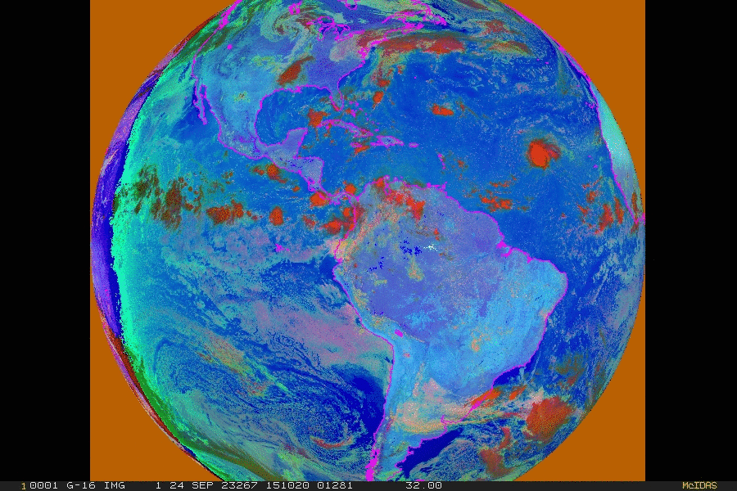
Combined Day/Night MicroPhysics

Slide 44
3-hour 89GHz Composite 20 orbits, 10 satellites!
Notes:
NOAA-19, F-17 and -18, Metop-B and C, SNPP, NOAA-20 and 21, GCOM, GPM

Slide 45
NOAA/STAR GLM Overlay, log scaled

Slide 46
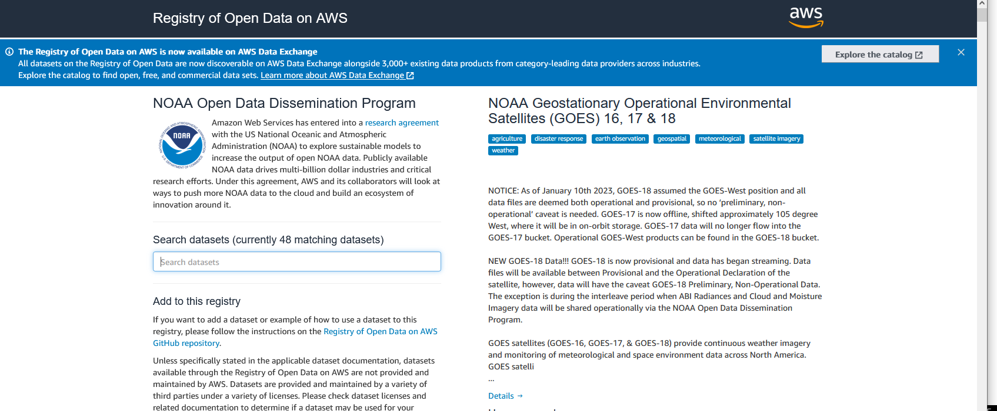
NOAA Open Data Dissemination
Formerly Big Data, AWS Open Source Directory for many NOAA products

Slide 47
ESPC Notifications, Status, and Contacts
Information | Web Link/Email Address
ESPC Messages | http://www.ospo.noaa.gov/Operations/messages.html
24/7 Help Desk | ESPCOperations@noaa.gov
User Services | SPSD.UserServices@noaa.gov
Data Access | NESDIS.Data.Access@noaa.gov
Webmaster | SSDWebmaster@noaa.gov
Facebook | https://www.facebook.com/NOAASatellites/
Twitter | www.twitter.com/noaasatellites
Satellite Ops Status | https://www.ospo.noaa.gov/Operations/satellite_operations.html
Press releases | https://www.nesdis.noaa.gov/press
NOAA Open Data | https://registry.opendata.aws/collab/noaa/
Web | www.ospo.noaa.gov
Thank you!
Notes:
Please reference the OSPO contact information listed for a variety of resources.

Slide 48
Thank you!
Questions?

