Slide 1
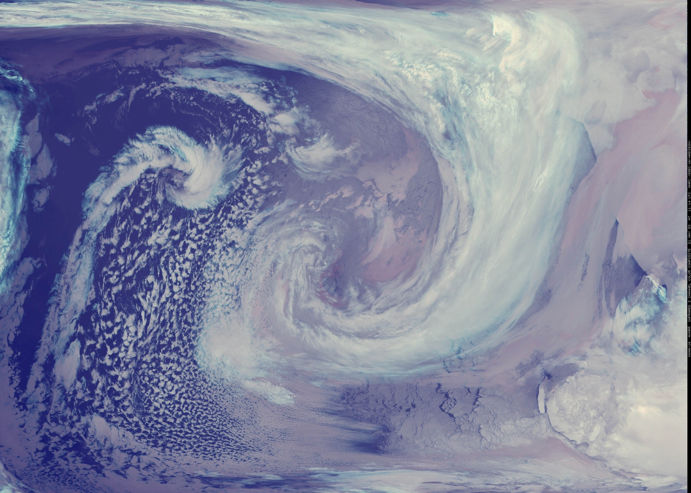






Two Cases of McIDAS:
The AMRDC & MATC!
Matthew Lazzara, PhD
AMRDC, UW-Madison
Physical Sciences, MATC

Slide 2
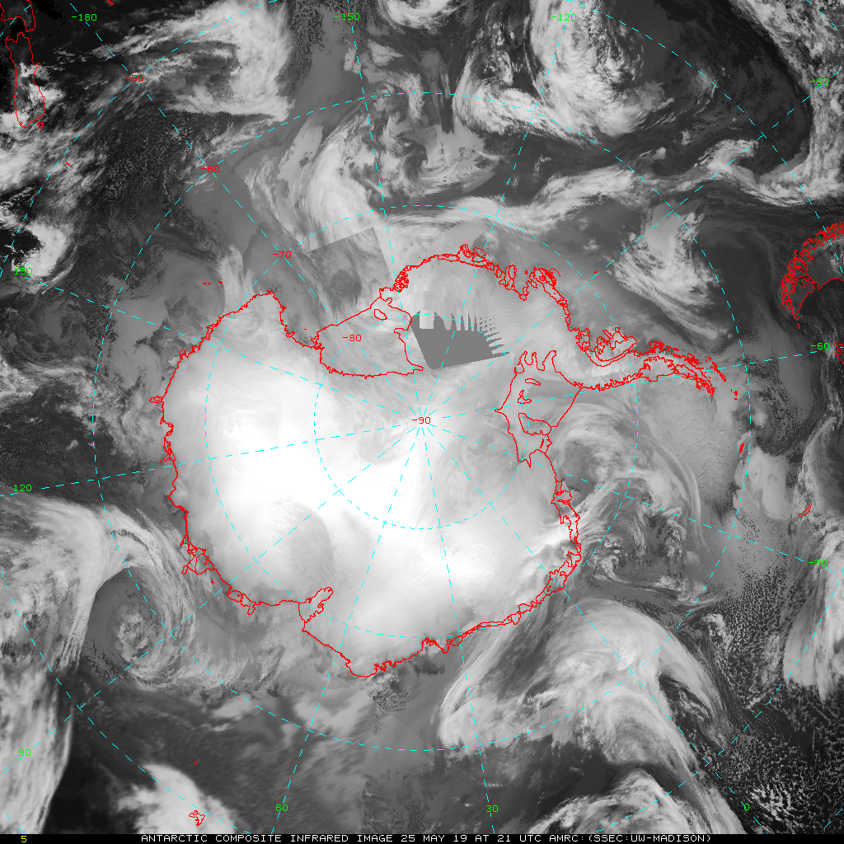
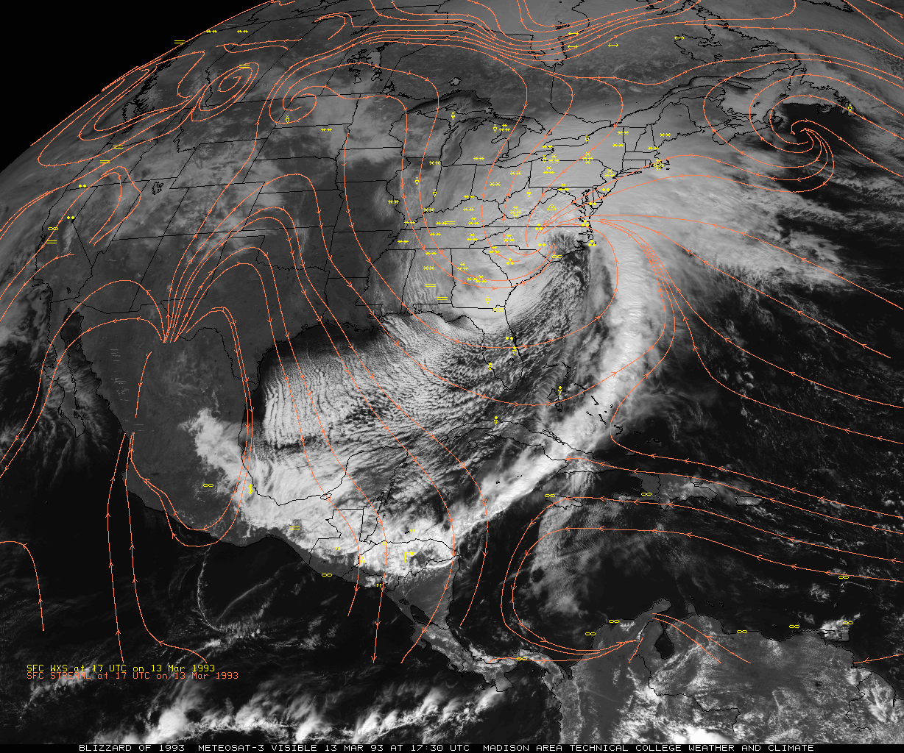
Outline
The AMRC…
Madison College

Slide 3
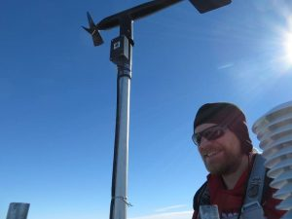














The Team!!

Slide 4
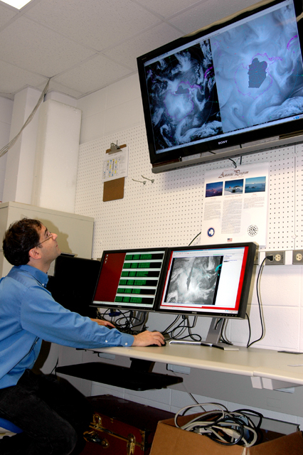

Slide 5


Slide 6
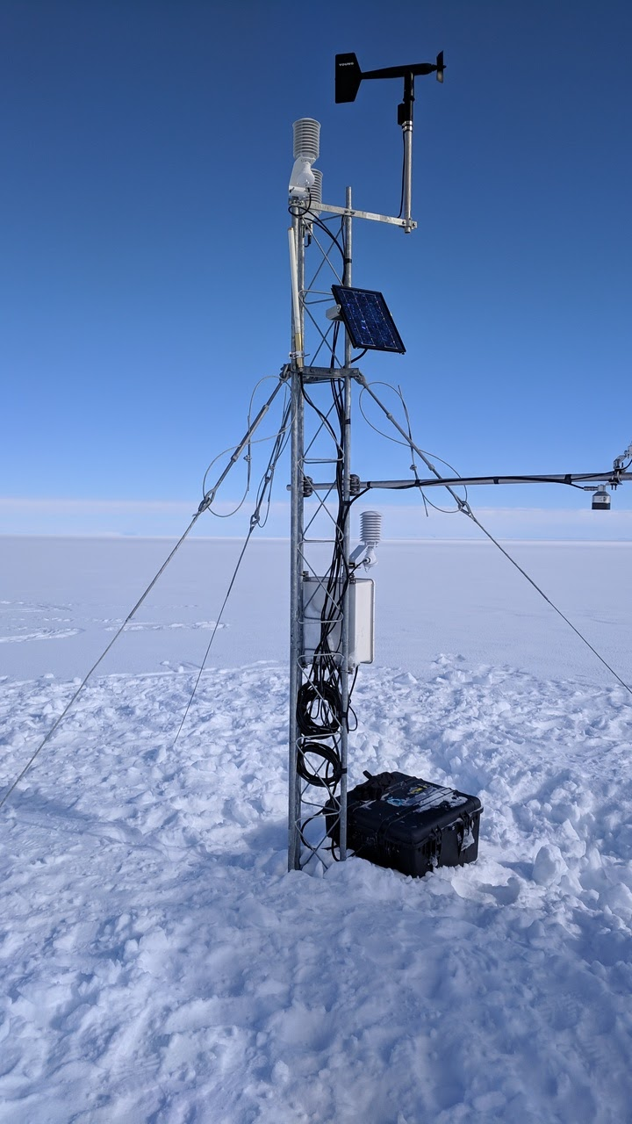
The AMRC…er…AMRDC
The Antarctic Meteorological Research Center
  ”Marriage” between the McIDAS Project and Automatic Weather Station project
  Established in 1992 – at a MUG meeting!!
  Centered around satellite composite work, real-time weather displays, and data archival for Antarctica
    Satellite data ingest was also sort of included…
Today we are called the Antarctic Meteorological Research and Data Center or AMRDC
  Check out our commands/servers in XRD and servers in McIDAS-X! ☺
  AWSMG, NOAA Level 1b ADDE server, etc.
Marilyn AWS 2019

Slide 7
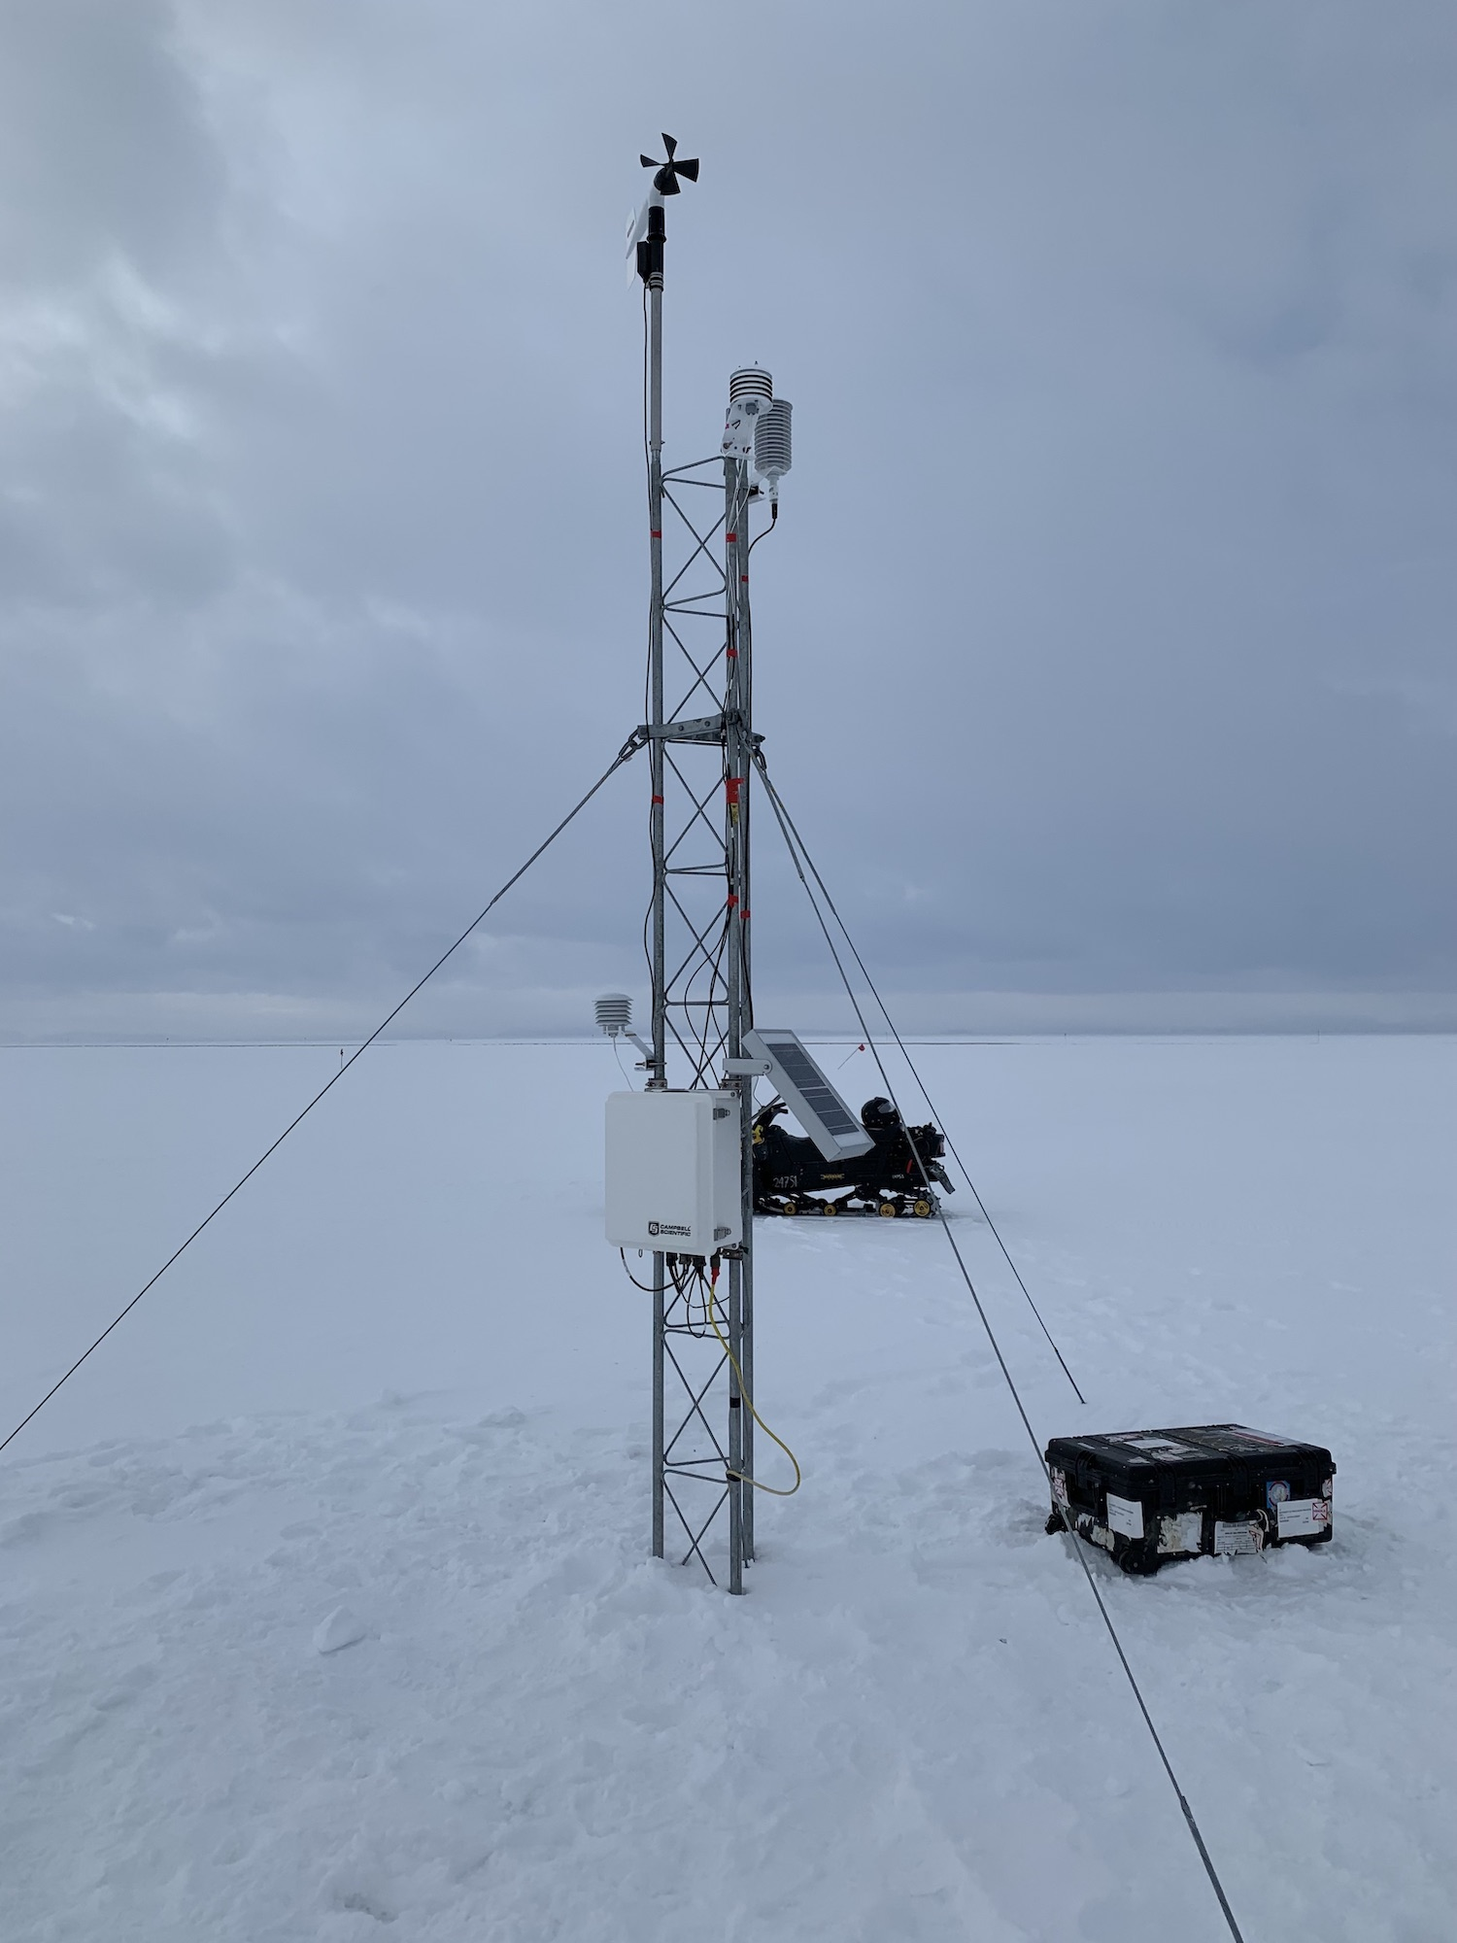
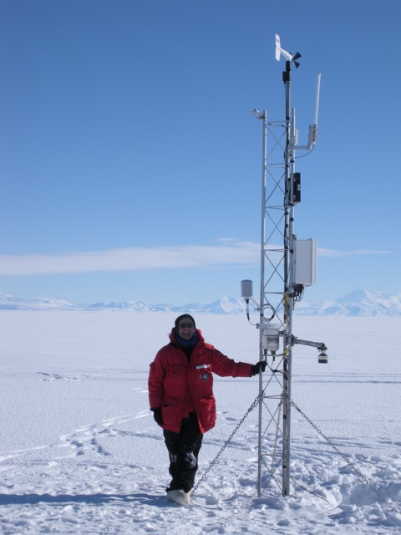
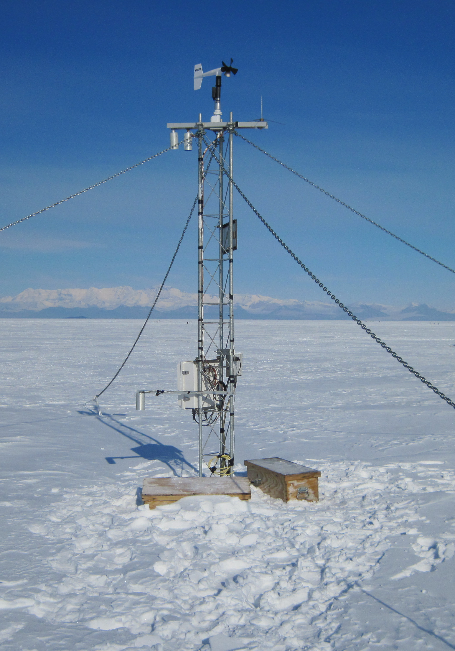
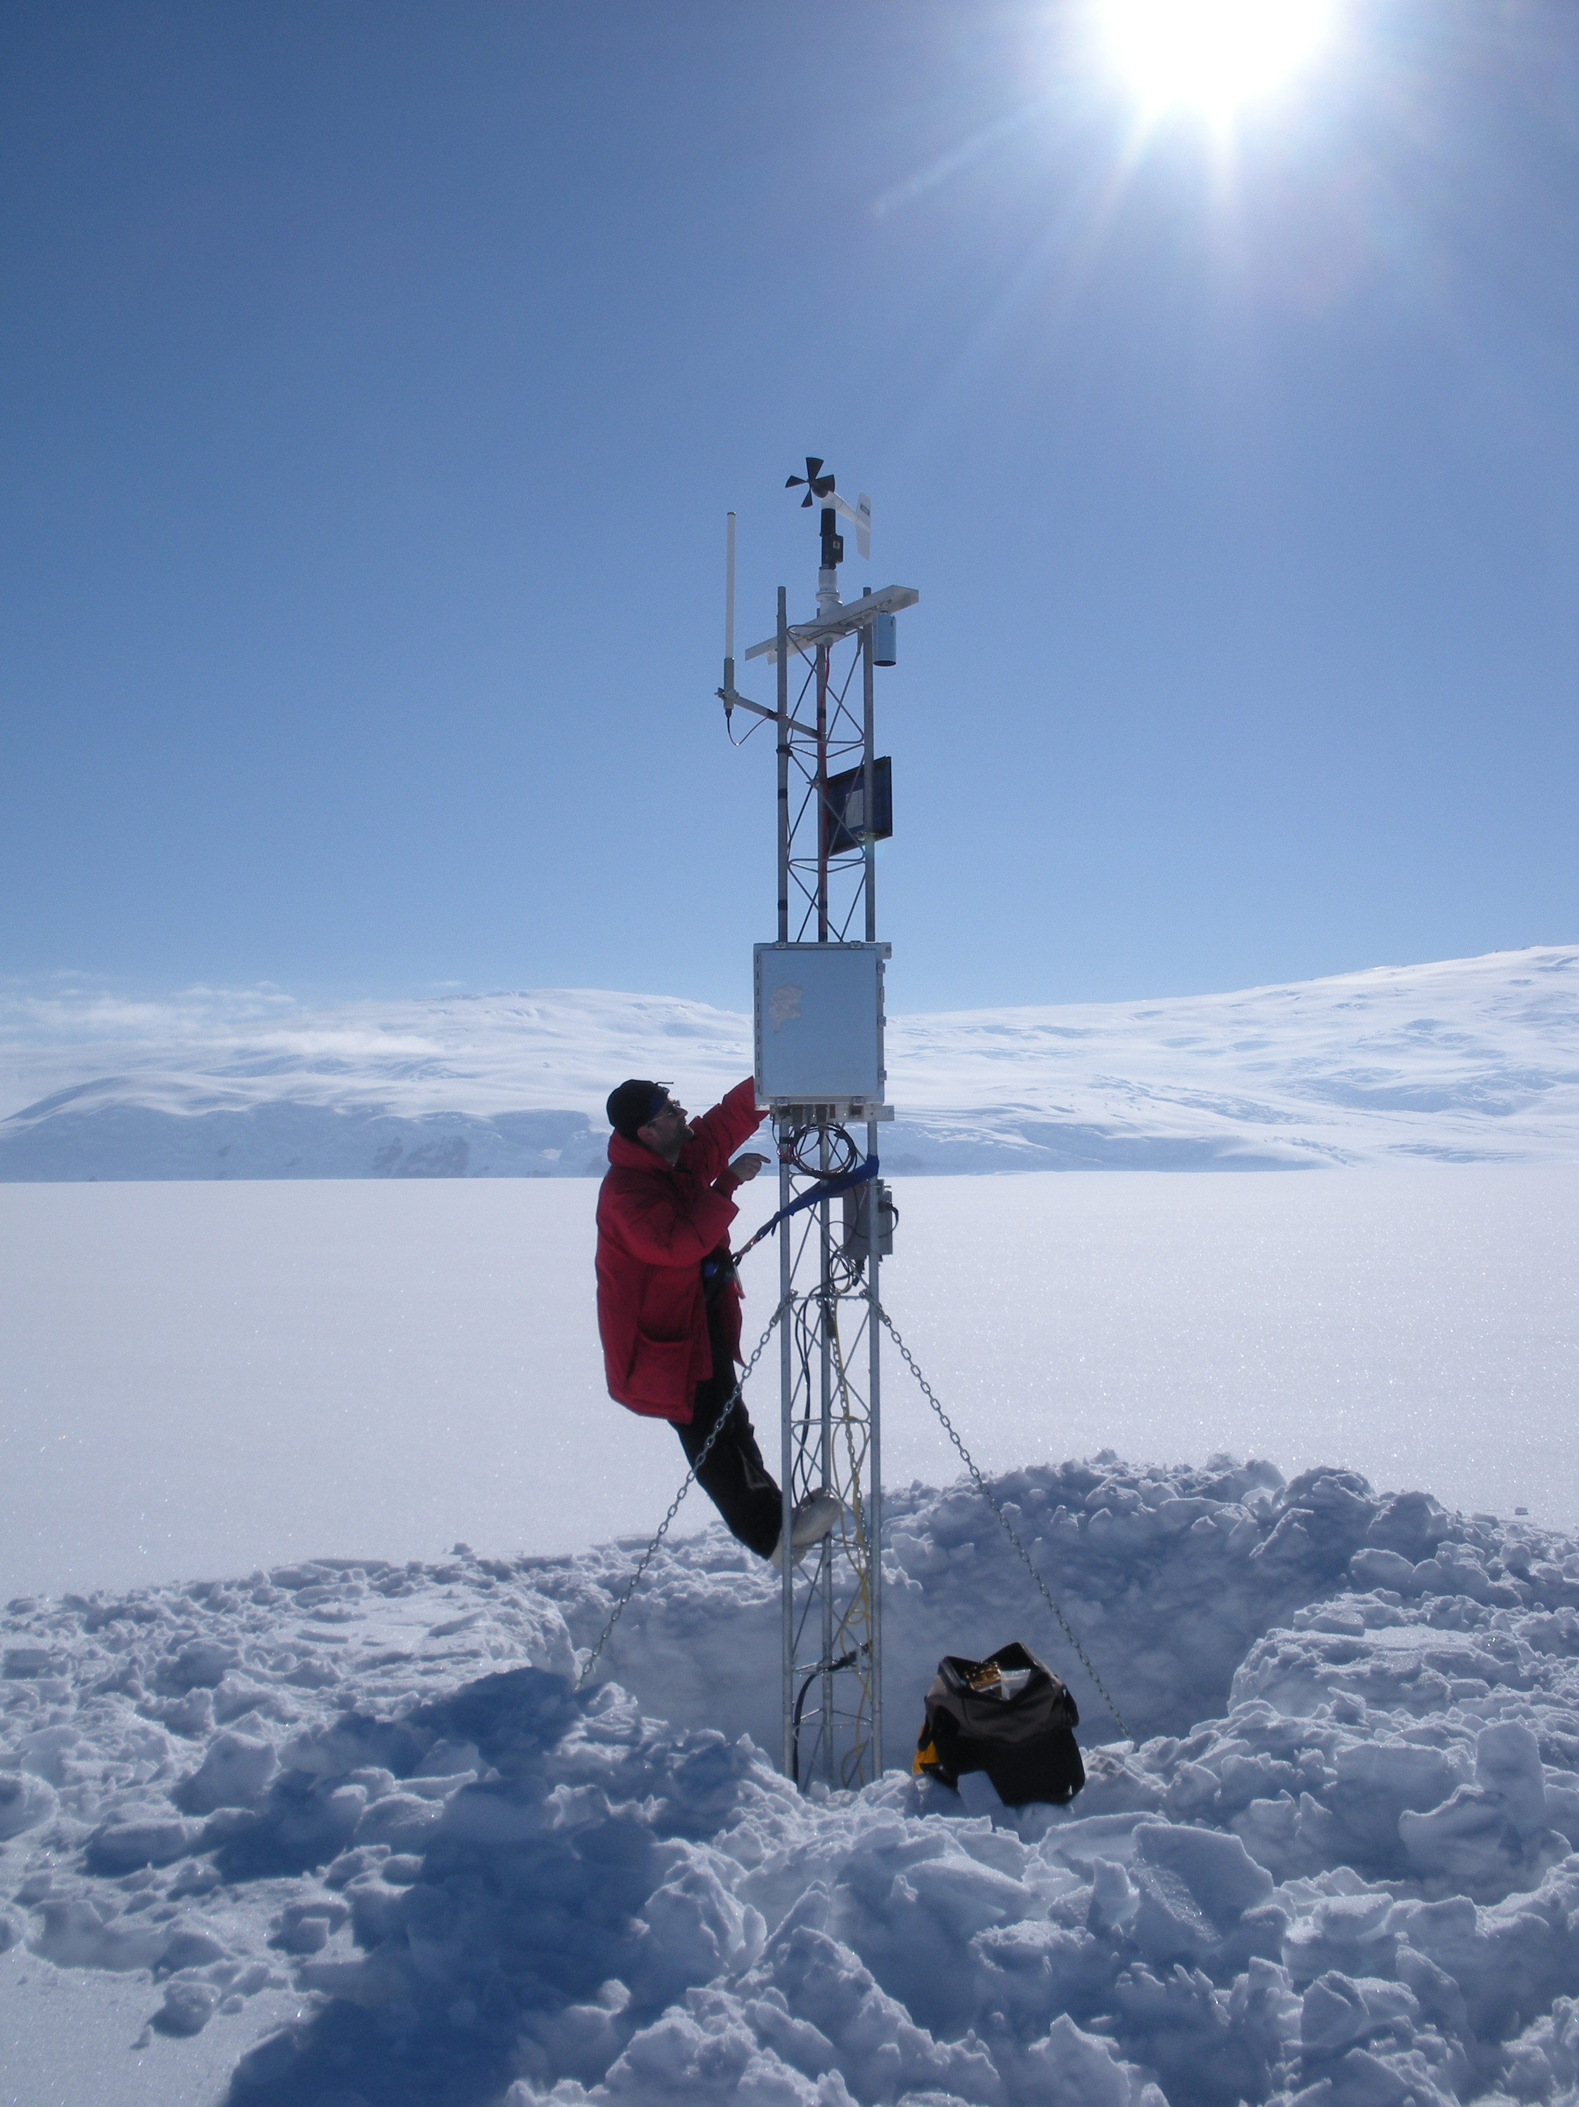
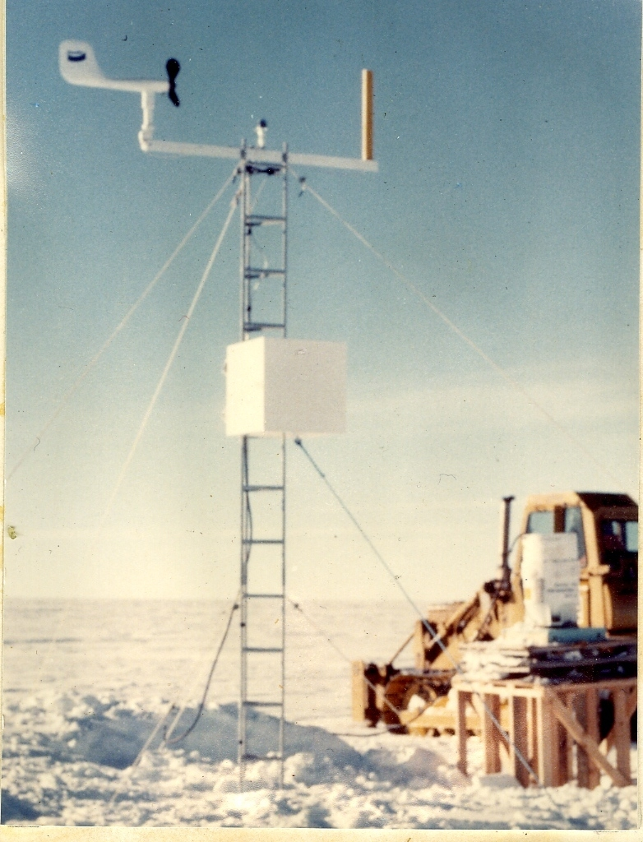
43 Years of Antarctic Meteorological Sentinel Service
2010/2020
Antarctic Automatic Weather Stations (AWS)
2000s
1990s
1980s
Late-1970s/1980s
Madison PCWS
Wisconsin CR1000
Wisconsin CR10X
Wisconsin 2B
Stanford/Wisconsin 1A
All photos from the UW AWS Program

Slide 8
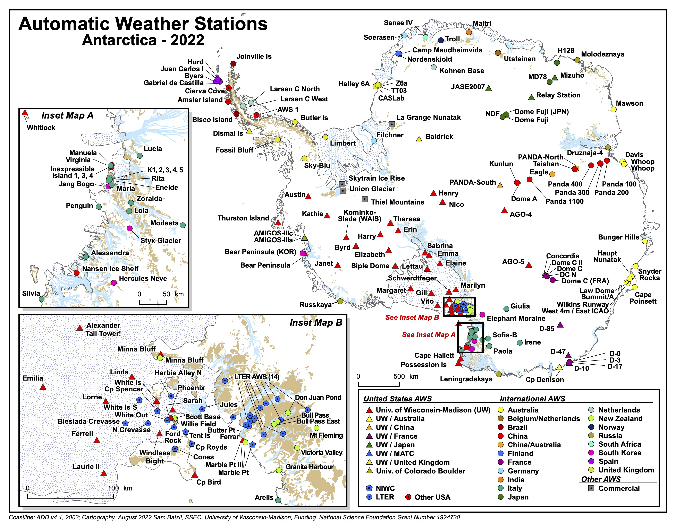

Slide 10
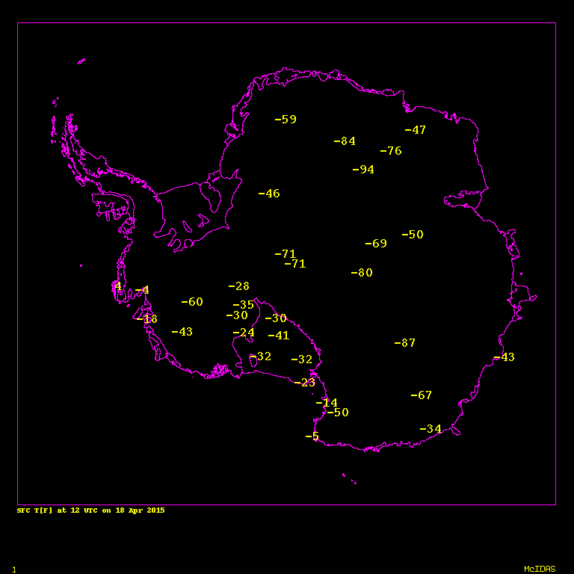
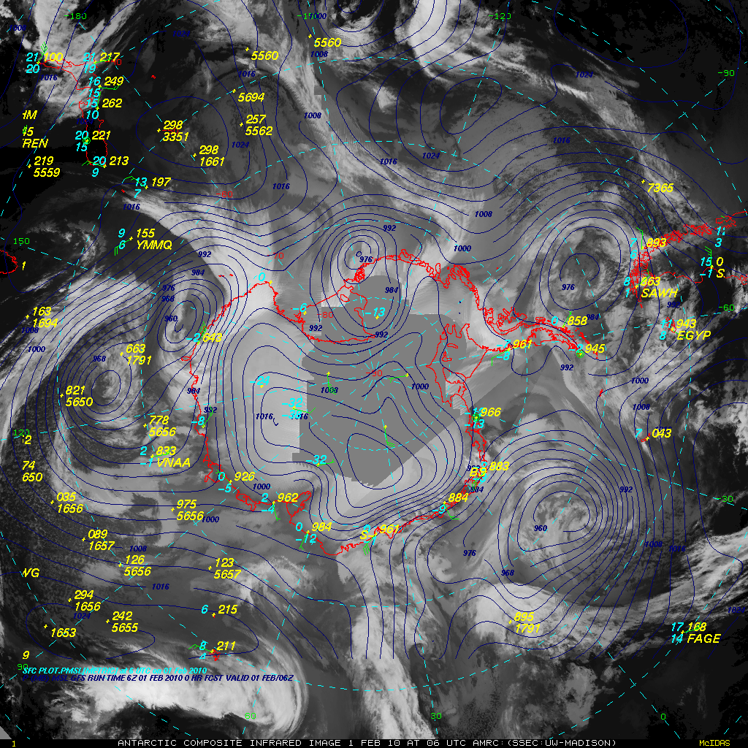

Slide 11
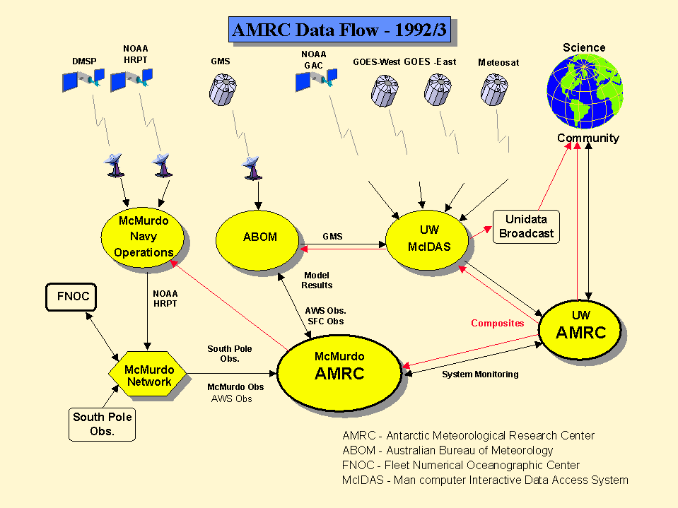

Slide 12
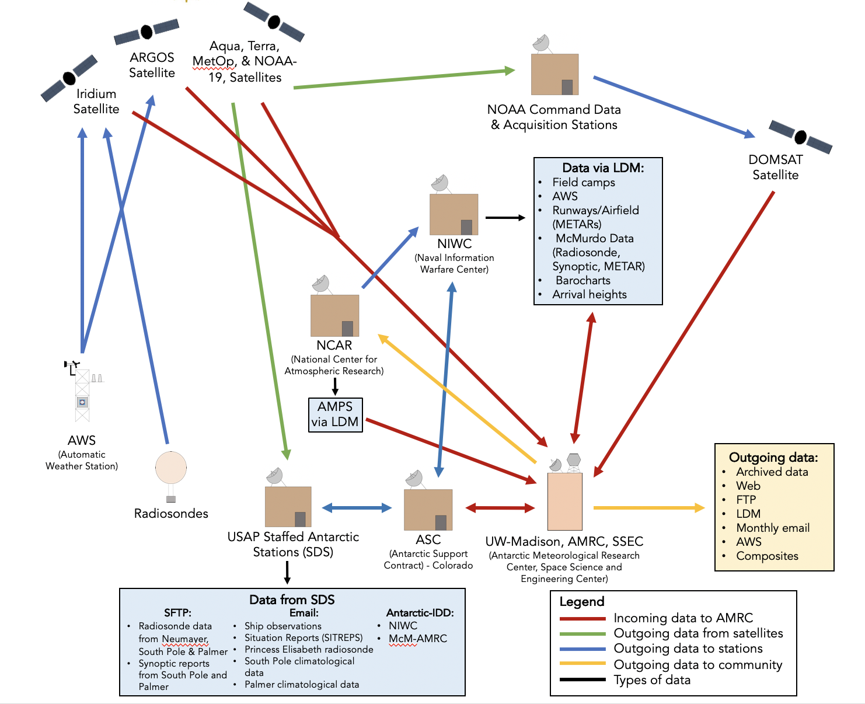
AMRC
“Data Center”

Slide 13
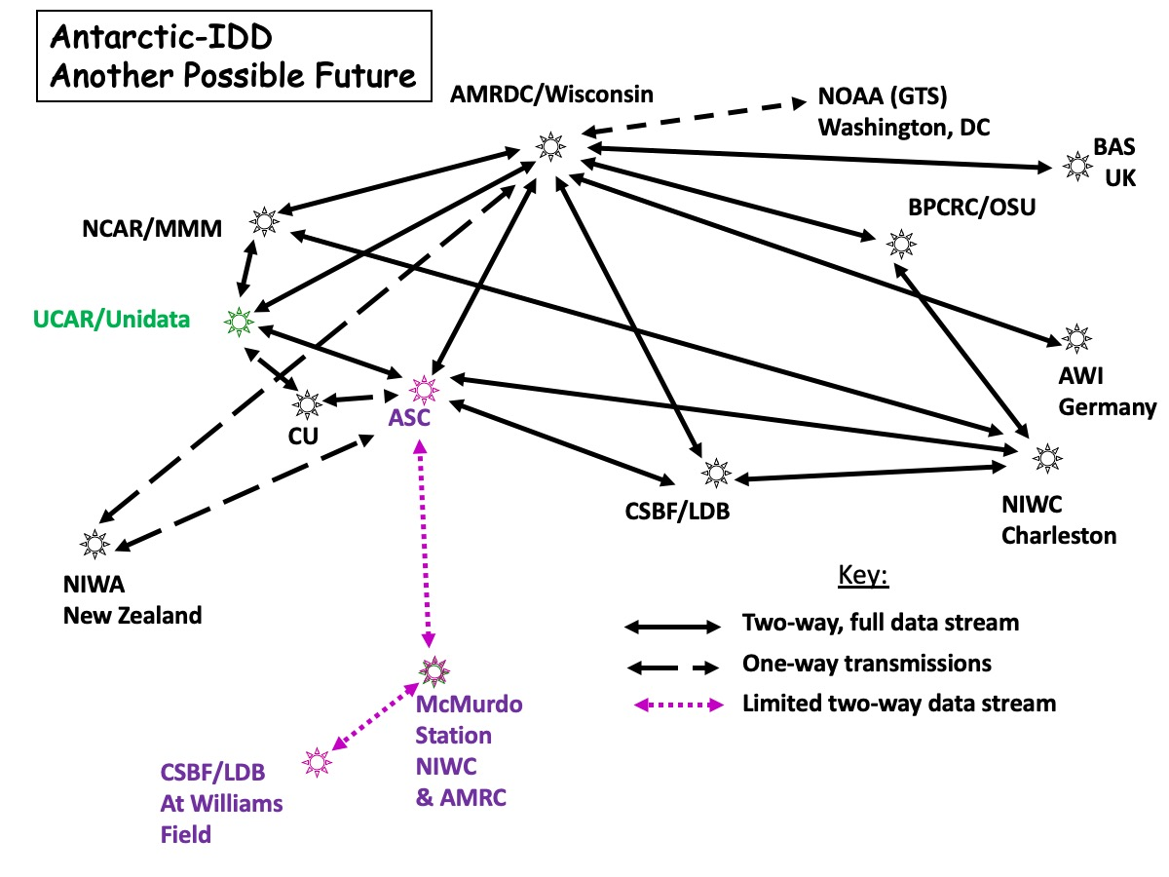

Meteorological Data Servers and Services
McIDAS ADDE
  AMRDC mcw.ssec.wisc.edu
  AMRC amrc.ssec.wisc.edu
  ARCHIVE amrc.ssec.wisc.edu
  ROSS ross.ssec.wisc.edu
LDM – Antarctic-IDD
THREDDS – TBA
  https://amrdcdata.ssec.wisc.edu/thredds/catalog/catalog.html
Data Repository
  https://amrdcdata.ssec.wisc.edu/

Slide 14

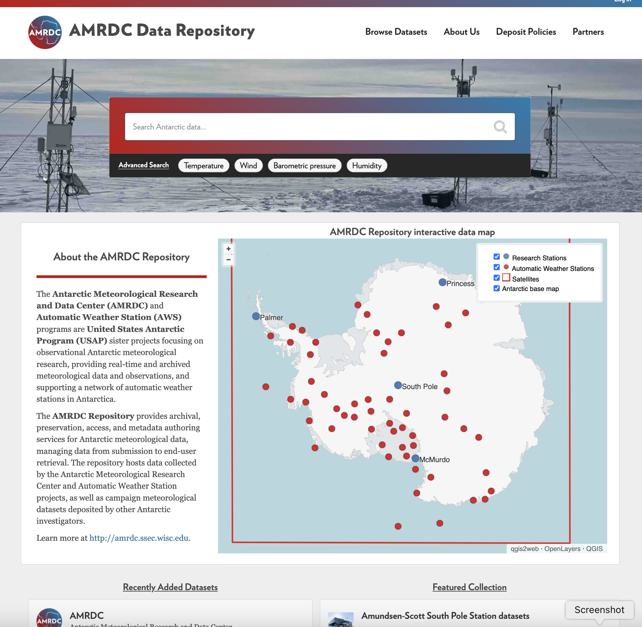
AMRDC
Repository
https://amrdcdata.ssec.wisc.edu
Based on CKAN
  Open Source
  (Comprehensive Knowledge Archive Network)
Easy access
Search/Advanced Search
Clickable Map
Keywords
Digital Object Identifiers (DOI)
Follows ‘FAIR’ conventions
  Findable, Accessible, Interoperable, and Reusable
Now available!
  Please make use of it!!
  Feedback welcome!
  Data being added all the time

Slide 15
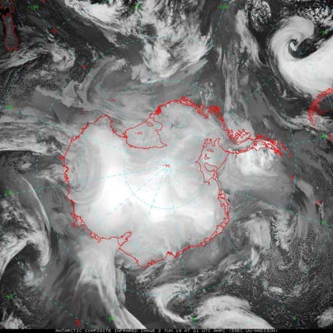
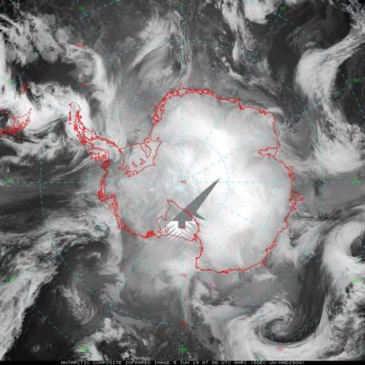
Antarctic Satellite Composite Imagery
This project *formal* operational support for these composites after 30+ years of generation!!
Improve by including more satellites into the composite
Providing a “standard grid-north-up” product
Continue to make hourly composites available in 5 spectral channels.

Slide 16
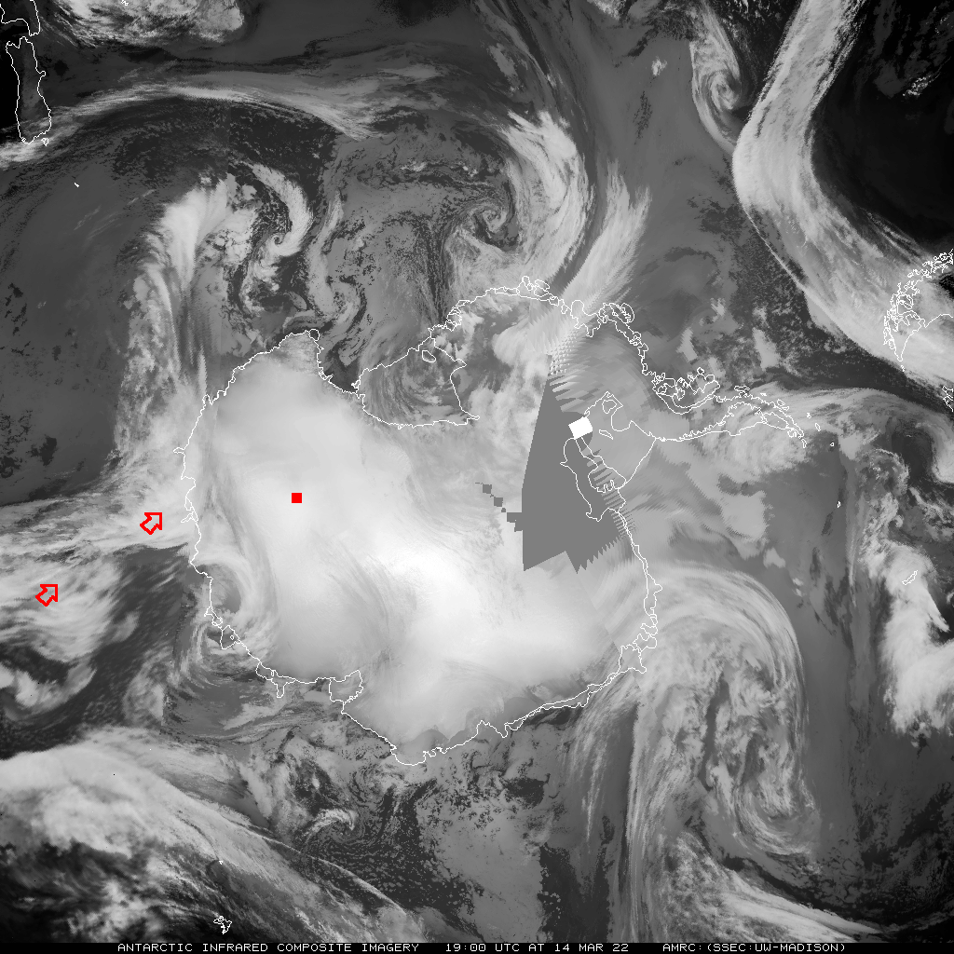
14 March
19 UTC
D-10
D-47
Dome C II
AGO-4

Slide 17
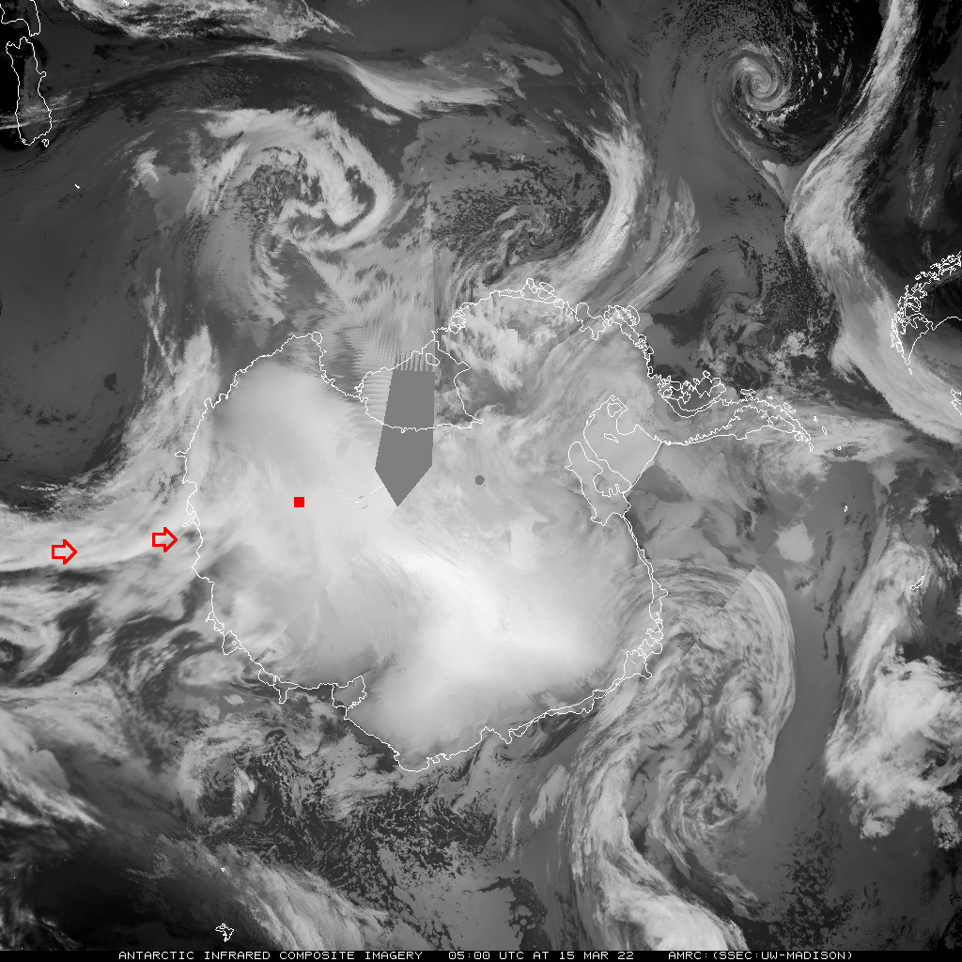
15 March
05 UTC

Slide 18
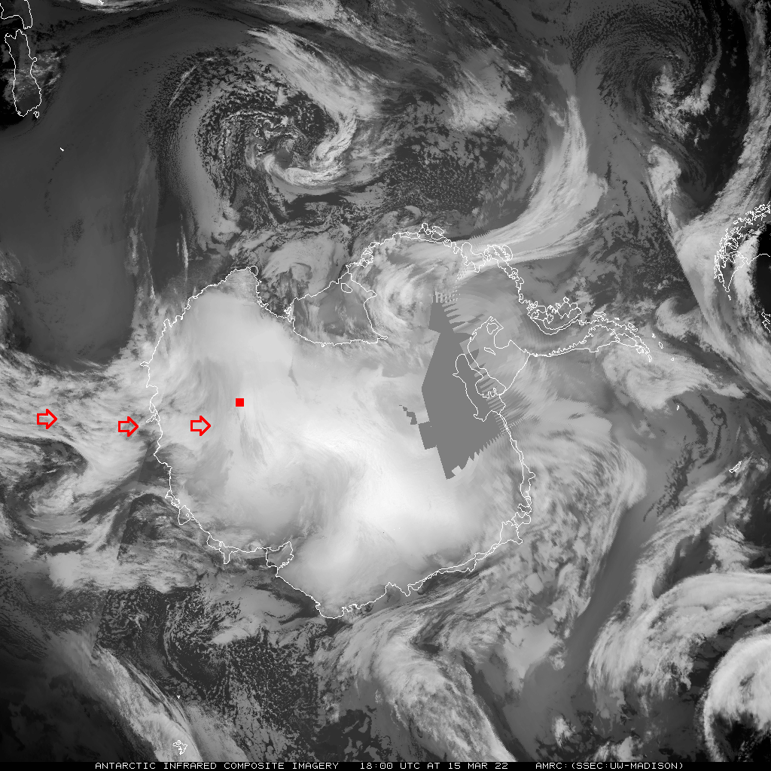
15 March
18 UTC

Slide 19
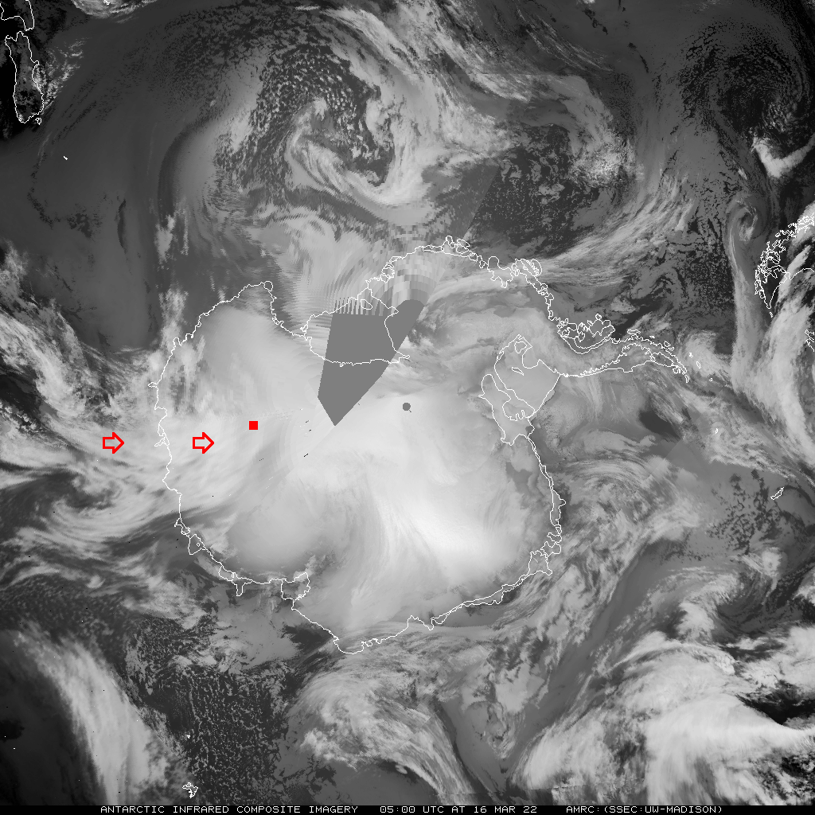
16 March
05 UTC

Slide 20
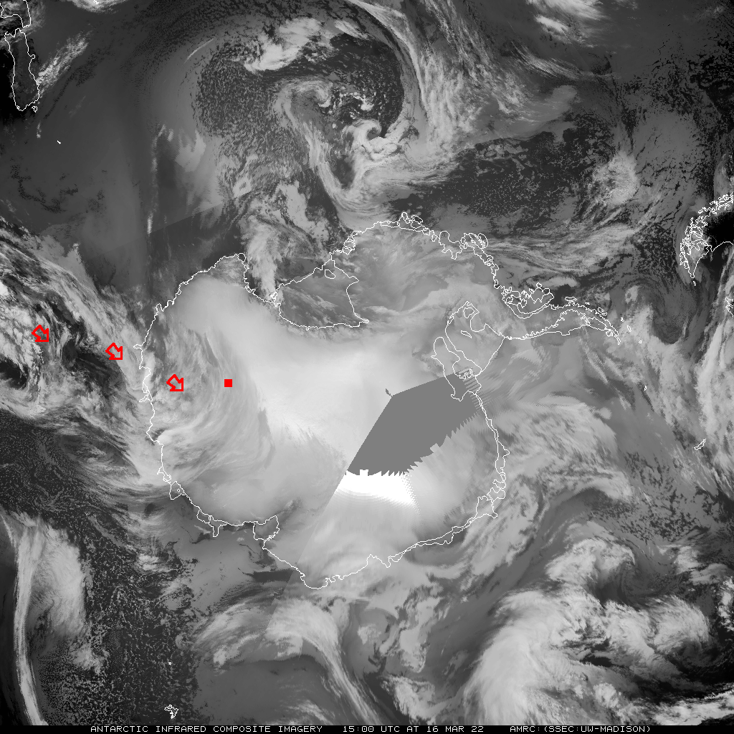
16 March
15 UTC

Slide 21
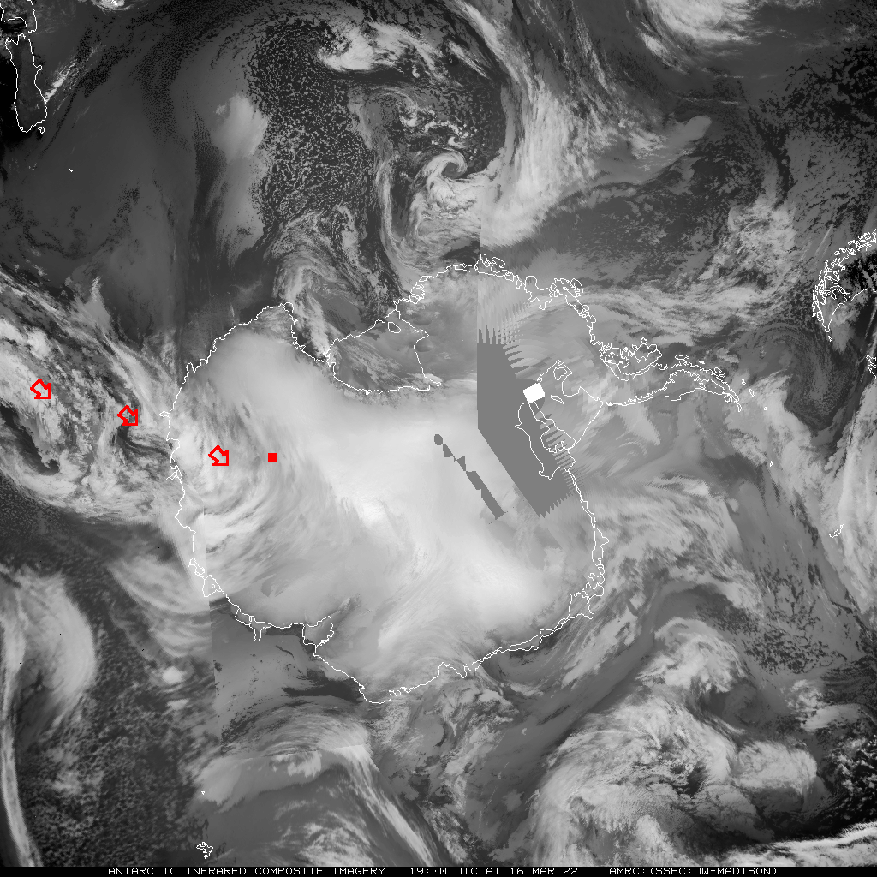
16 March
19 UTC

Slide 22
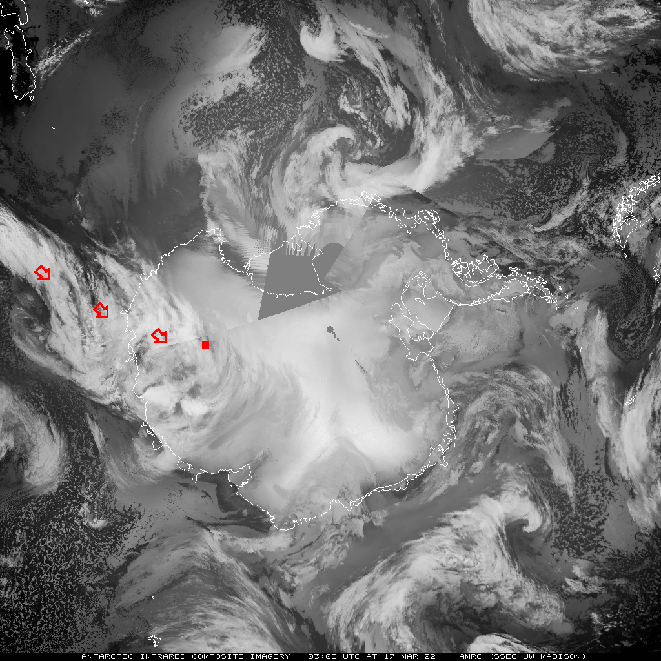
17 March
03 UTC

Slide 23
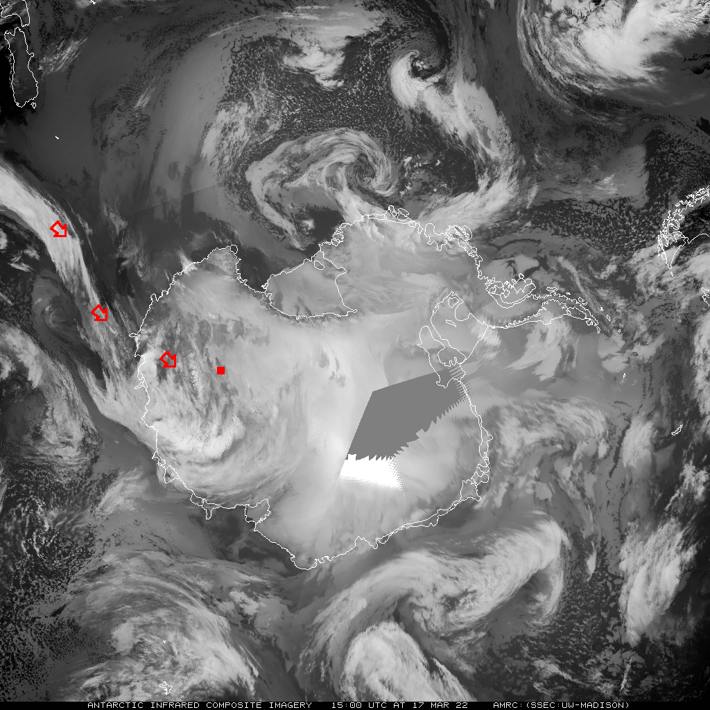
17 March
15 UTC

Slide 24
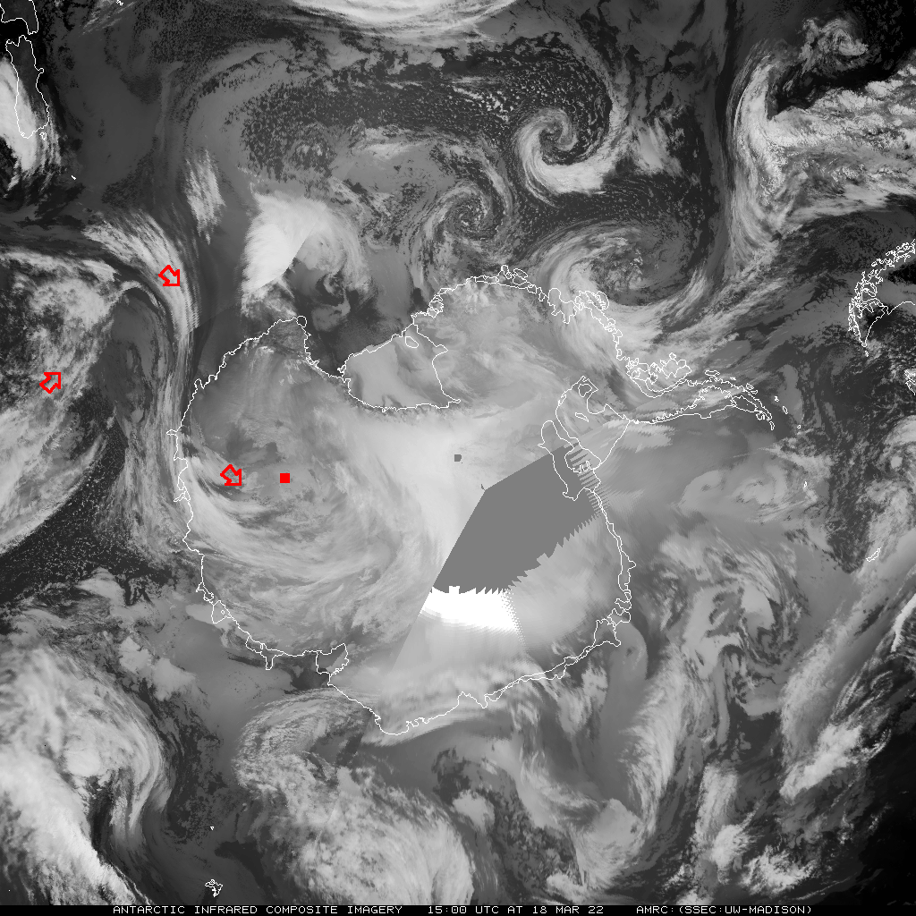
18 March
15 UTC

Slide 25
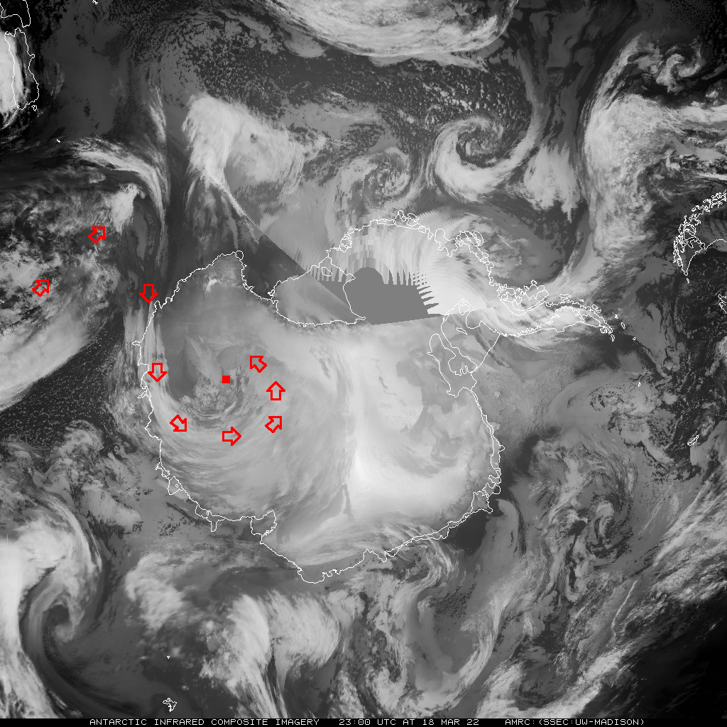
18 March
23 UTC

Slide 26
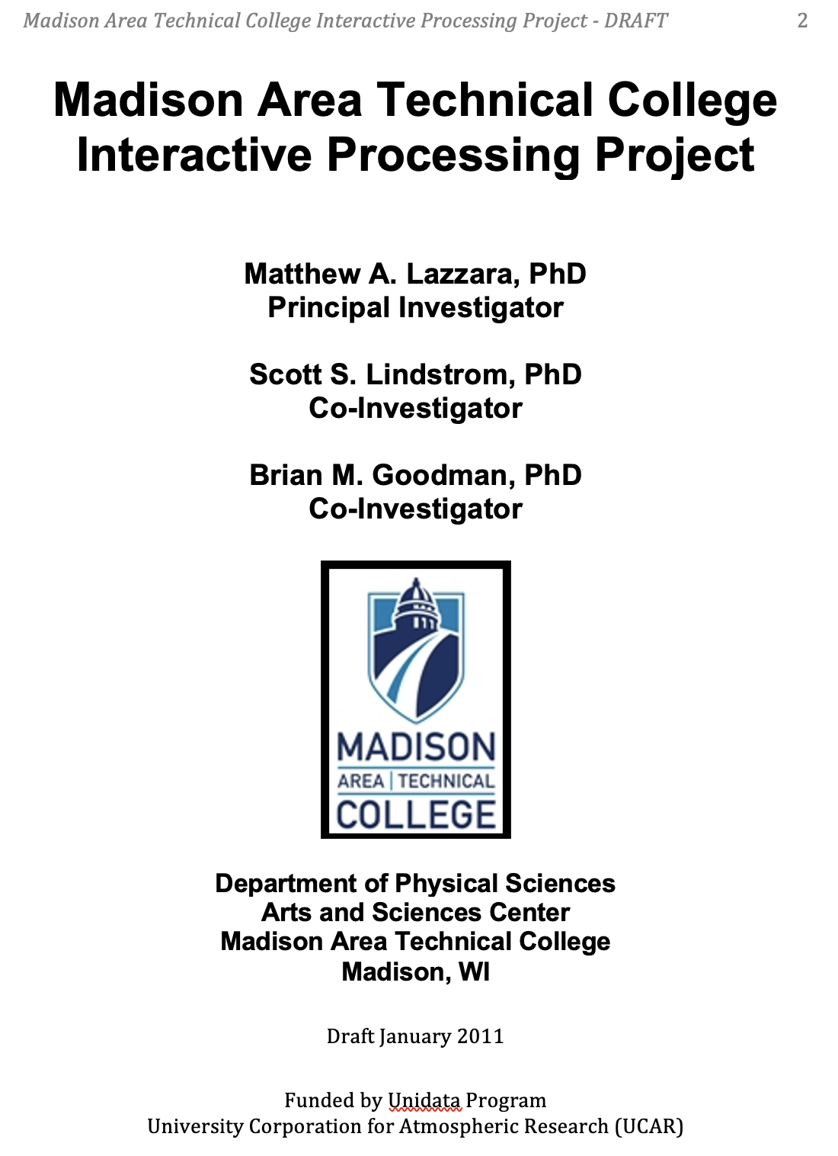
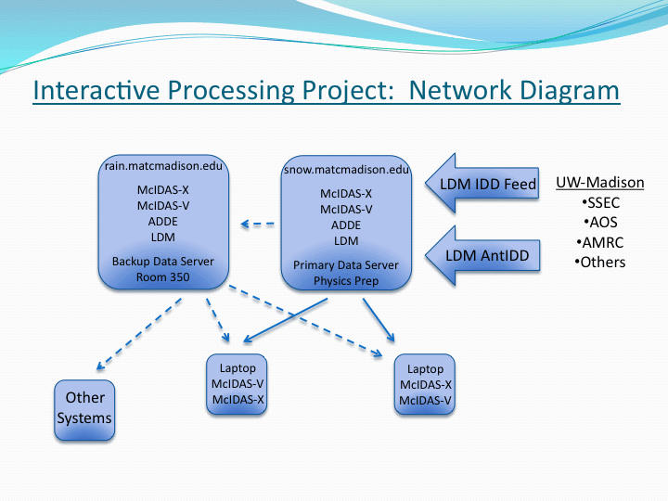
Madison College
An unusual Unidata site
Unidata Equipment Award 2010
McIDAS-X: Classroom and Lab use - Macs

Slide 27

MATC McIDAS Usage
Educational
  Course support:
    Weather and Climate
    Weather and Climate Lab
    Climate and Climate Change (less so)
    Aviation Weather (coming spring 2024!)
    Independent study
    Honors meteorology
  Other applications:
    Astronomy observing support
    Hall weather display/monitor
    Research activities

Slide 28
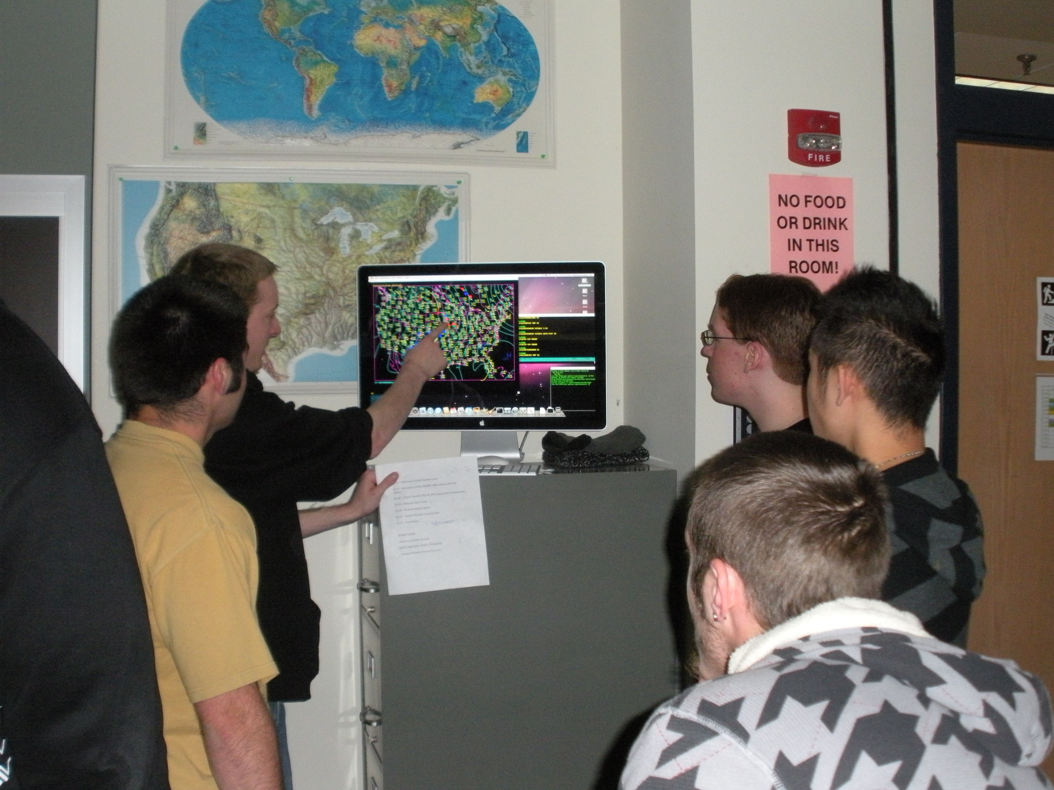
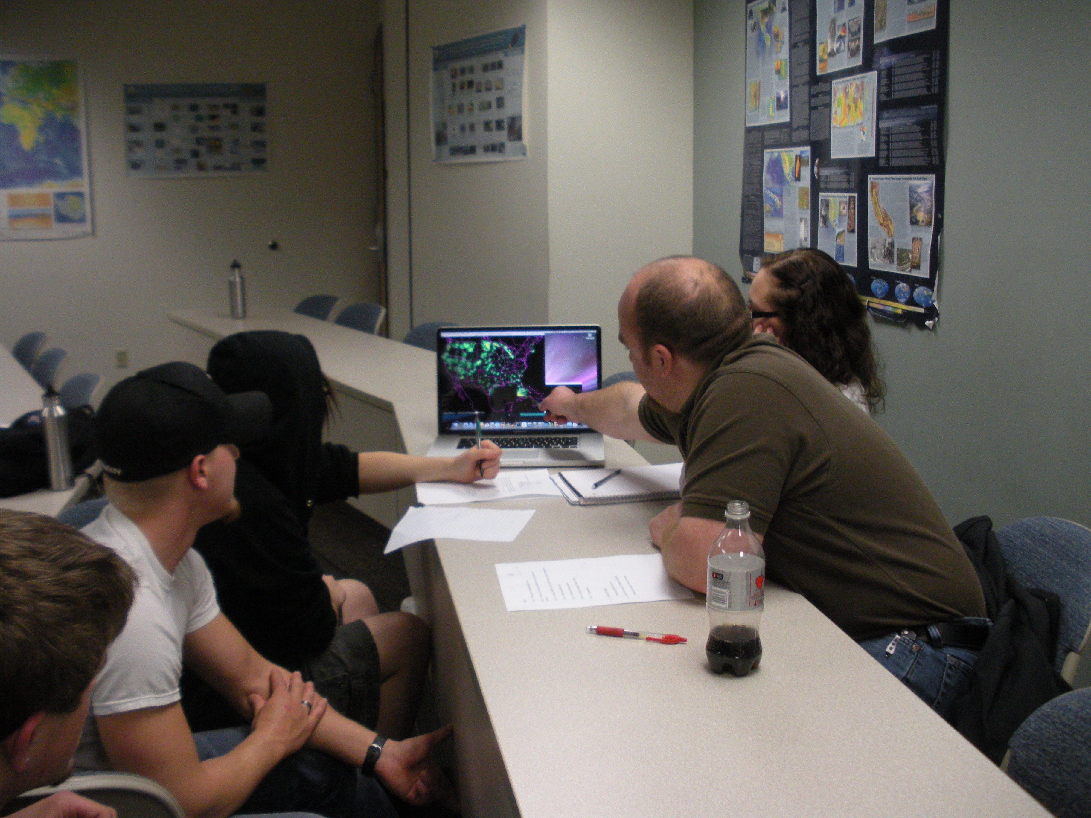
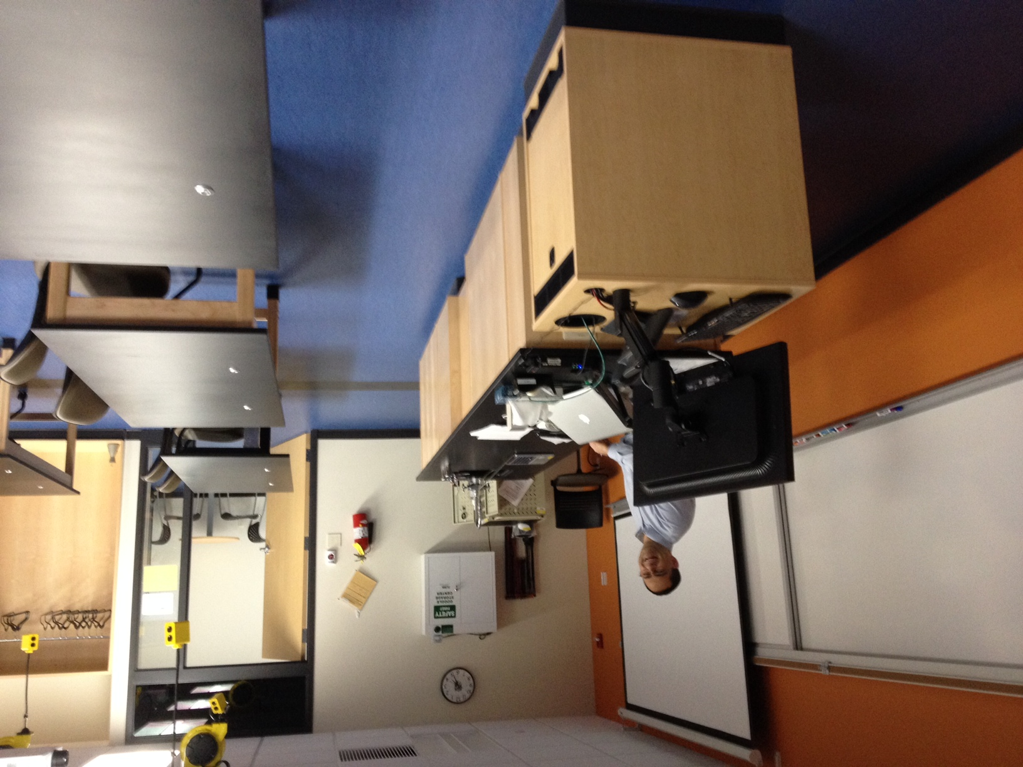
Educational Experiences with Data!
…its more than just pretty pictures!

Slide 29
Comments on
McIDAS-X on MacOS at MATC…
We are a Mac shop (for our department)
Always on the bleeding edge of new versions of MacOS
Routine hardware “refresh” for systems
  (on the order of 3 to 4 years or less)
Currently on Mac’s with M2 chips system
No utility ‘mcidas’ account due to MATC security rules
  Installed in /User/Shared/mcidas
JAMF management environment at MATC for Mac systems
  “Push” or deploy software ( or using a ”self-service” system)

Slide 30
How’d we do it that? (the Reader’s Digest version)
JAMF - Install of CMAKE, Xquartz
Script to trick softwareupdate to update and install Command Line Tools
Homebrew—
  Script found to install as root (and bypass issues with that)
  Older version for i386 – works for Arm Architecture
  Install in incorrect directories issues?
    use the arch -x86_64 (Thanks Dave Paker!) command to force brew to install the dependencies as i386 and not care about the arm part
    arch -x86_64 brew install gcc@11
All of this has been placed into a PKG
  Use of preinstall and postinstall script
A few steps not mentioned here – including dealing with dependencies…
Built mcidas in /User/Shared (make and install) and then build is zip’ed

Slide 31

How’d we do it that?
(the Reader’s Digest version – Part II)
Bottomline – it actually seems to work!
  Just need the PKG, internet and an account named administrator
  Only tested with Apple Silicon Macs
Be careful trying this at home!
(Apply all standard warnings and disclaimers here)
…and let me know if you have questions
(I can route them to the folks who did the work)

Slide 32
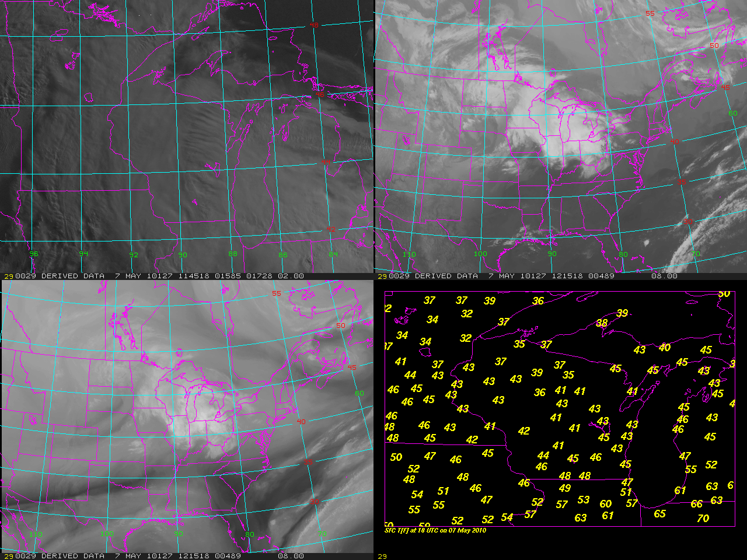
Two Cases of McIDAS
AMRDC
MATC

Slide 33
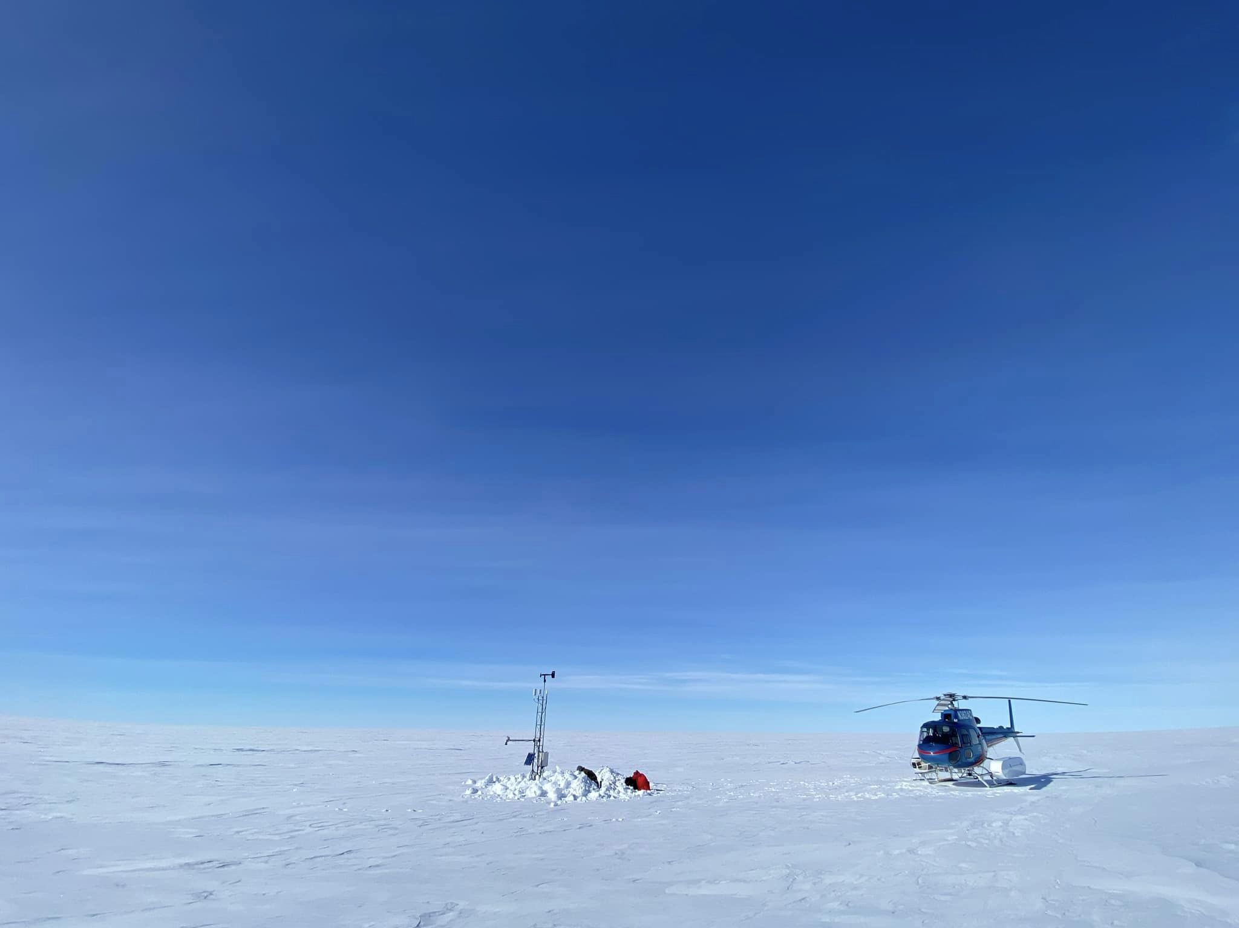
Thank you!! Questions?
Thanks to MUG and fellow MUG members over the years!
Thanks to Rick Kohrs and SSEC Satellite Data Services
Thanks to the MUG Help Desk
Thanks to Unidata
Thanks to MATC (Physical Sciences) and SSEC (AMRDC)!
Thank you to the MUG membership!
Thanks to NSF: Grants 1924730, 1951720, 1951603, and 2301362
Lorne AWS Courtesy of Taylor Norton

