Slide 1
NUCAPS and VIIRS Capabilities in McIDAS-V
William Straka, Tommy Jasmin, Bob Carp
¹ CIMSS/SSEC

Slide 2
Outline:
Introduction
What is NUCAPS
NUCAPS Capabilities
VIIRS Capabilities

Slide 3
Introduction: A walk through history
McIDAS-v has evolved over the years to help support the JPSS and LEO programs
This started from just being able to read the original (IDPS) algorithms as well as Level 1B (SDR) products from VIIRS and ATMS.
Currently additions have been made to read in other instruments (OMPS, TROPOMI) as well as new algorithms, including those that have replaced the IDPS algorithms.
Other improvements have included Improved dateline functionality, including selecting data over the dateline, new RGBs, local servers for VIIRS SDR (M, I, DNB) and imagery EDR (M, I) displaying data at full resolution by default without the user having to subset a region prior to creating the display.
Most recently the ability to display NUCAPS gridded data from local data sources and THREDDs servers have been implemented in the latest version of McIDAS-V

Slide 4
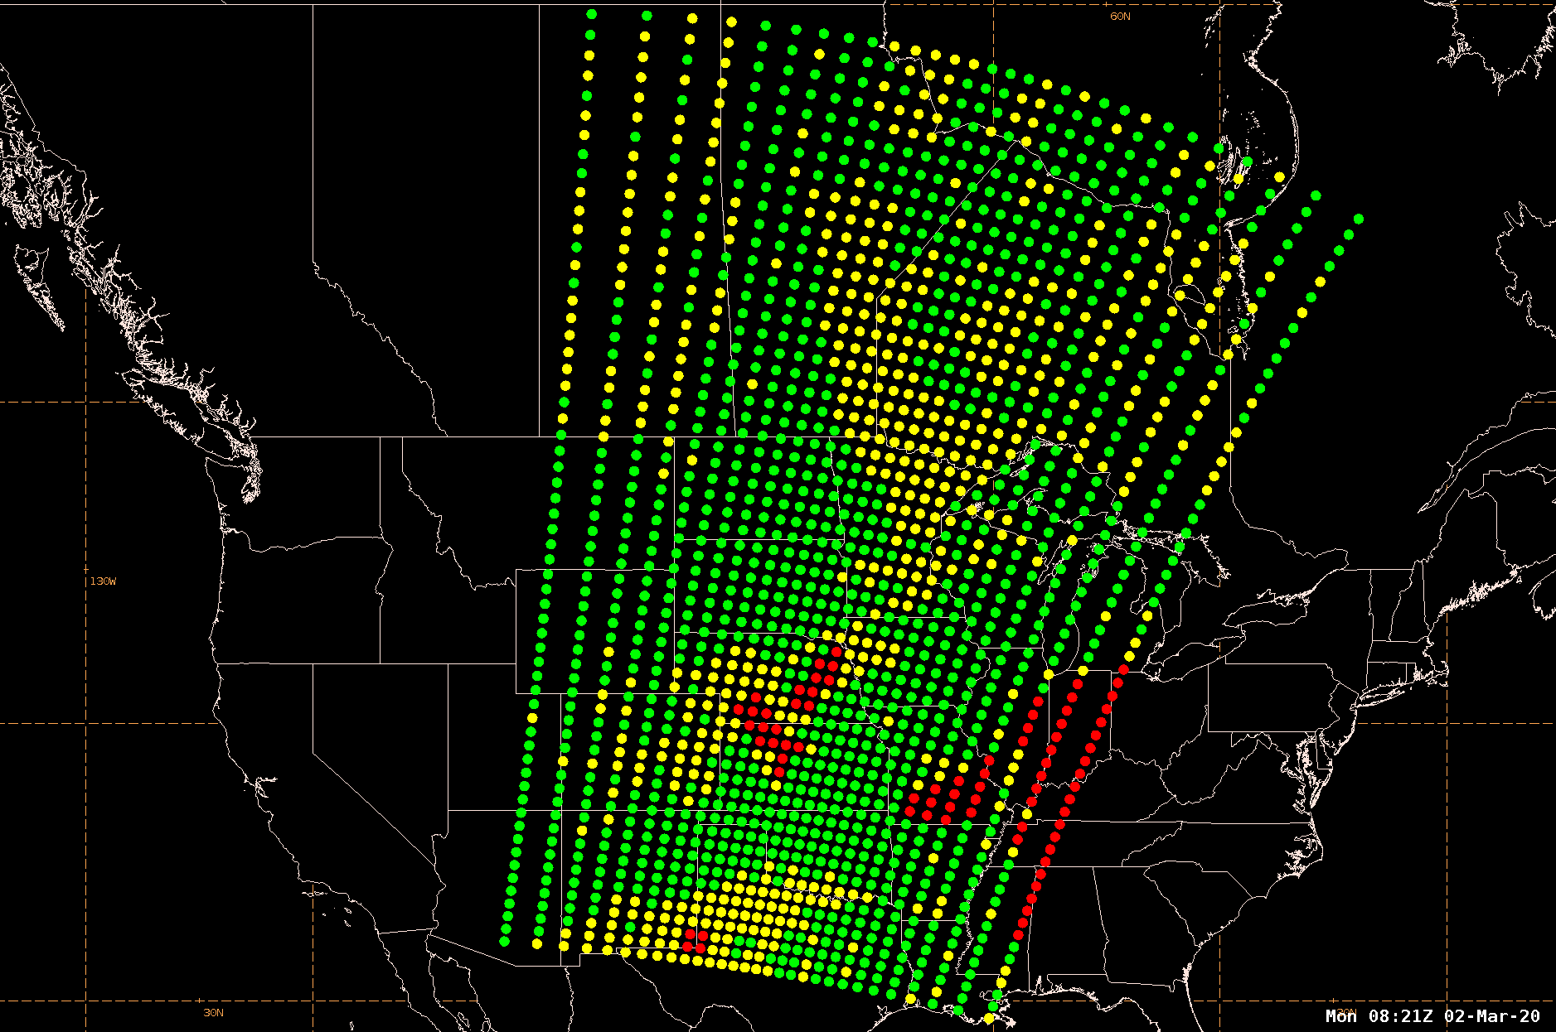
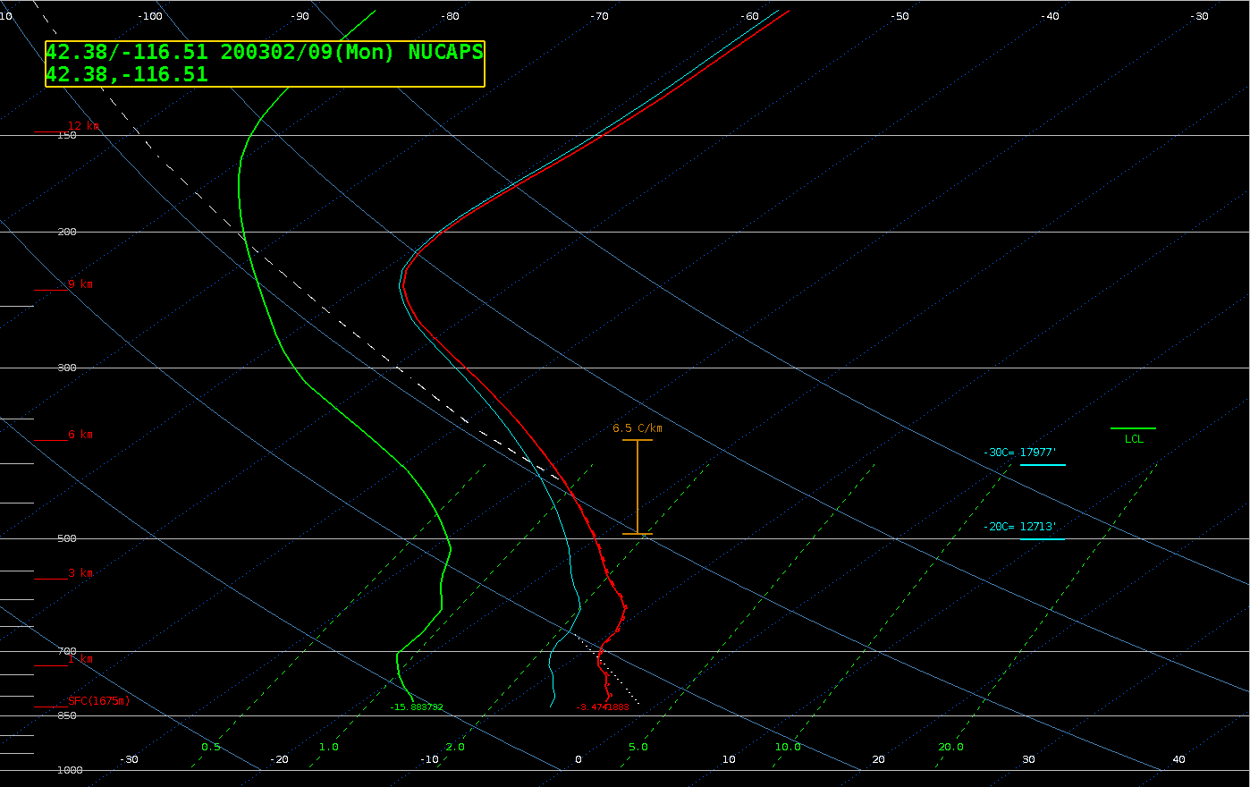
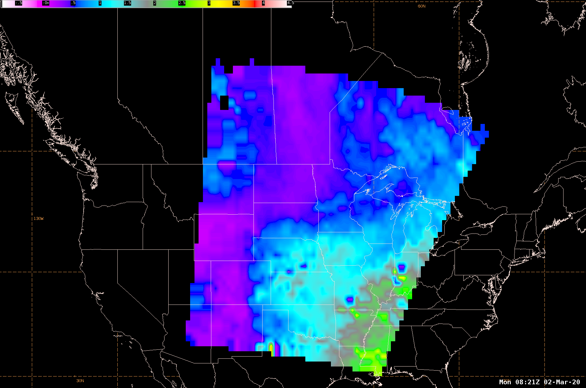
NUCAPS
NUCAPS Locations
NUCAPS
Skew-T
Gridded
NUCAPS

Slide 5
NUCAPS Summary
Section prepared by Emily Berndt and Rebekah Esmaili
NUCAPS vertical soundings are used to assess the presence of moist or dry layers, especially between radiosonde observations.
NUCAPS plan view fields (i.e. Gridded NUCAPS) are used to assess the context of warm, dry conditions favorable for increased wildfire risk.
NUCAPS excels at identifying spatial gradients for the analysis of features such as a Low-Level Thermal Trough.
Derived fields from NUCAPS such as the Haines Index and Total Precipitable Water add value to the verification of model forecasts.
NUCAPS trace gases, especially CO, can be used to monitor thick smoke at 500 mb and above both day/night
NUCAPS soundings provide environmental context for radiosondes.

Slide 6
NUCAPS In McIDAS-V
McIDAS-V has the ability to load gridded NUCAPS netCDF files that are downloaded locally or remotely through the THREDDS server.
Parameter defaults have been set for all of the variables included in the data. This allows the data to be displayed with the expected enhancement and enhancement range.
Several new enhancements have been added for gridded NUCAPS data that can be found under Satellite > NUCAPS when setting the enhancement in McIDAS-V
Derived dewpoint fields are available in the Field Selector that are created from the Temperature and Relative Humidity variables included in the data.
Individual images can be displayed, or loops can be created by aggregating the individual files together leveraging the time dimension included in the data.
Also displayable in RealEarth

Slide 7
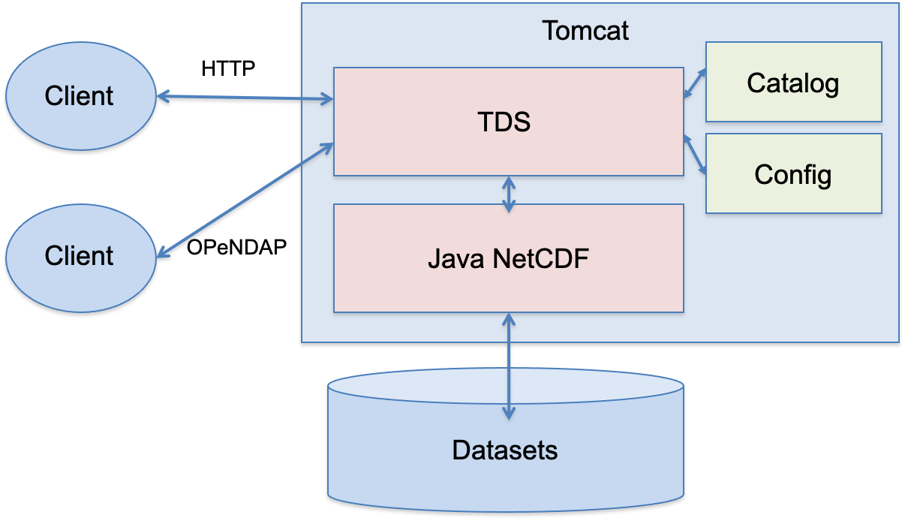
THREDDS Features and Architecture
THREDDS: Thematic Real-time Environmental Distributed Data Service
TDS: THREDDS Data Server
Developed at Unidata
Clients: IDL, MATLAB,
McIDAS-V, IDV, etc.
Datasets: Grid, Radial, Swath,
Point, Trajectory

Slide 8
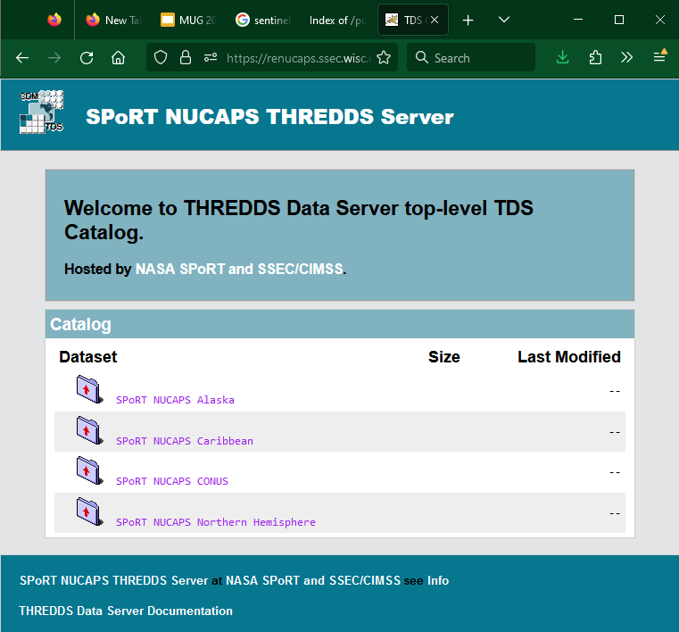
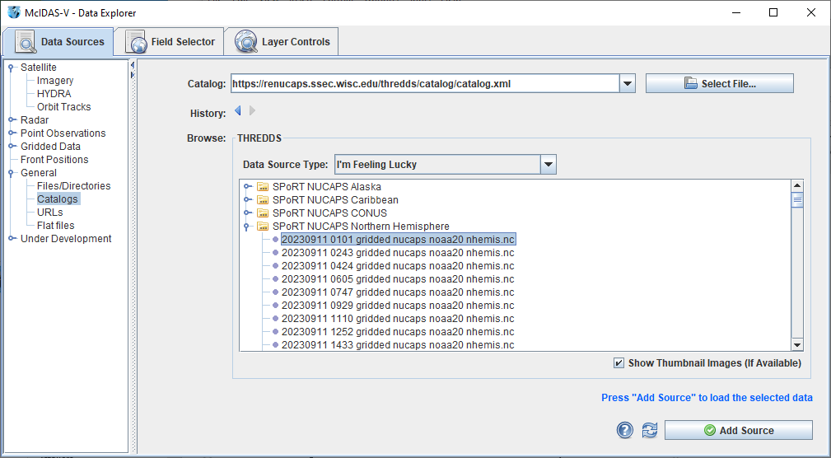
Remote Data via THREDDS Servers

Slide 9
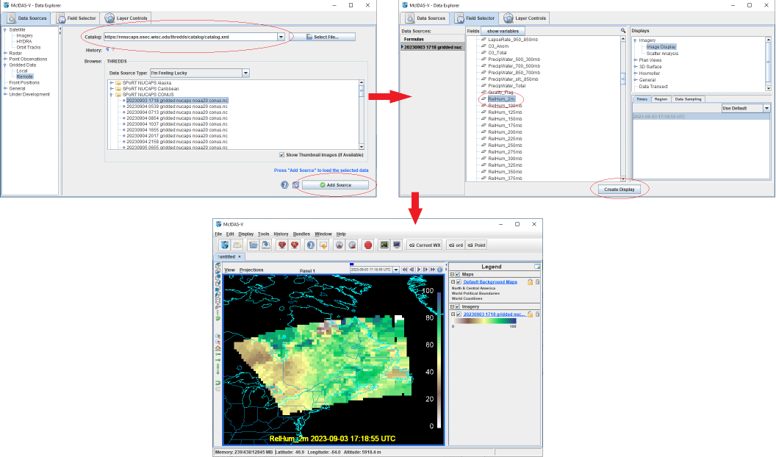
NUCAPS In McIDAS-V
General workflow from loading to displaying gridded NUCAPS data:

Slide 10
NUCAPS In McIDAS-V
Animation of all Relative Humidity levels included in gridded NUCAPS data

Slide 11
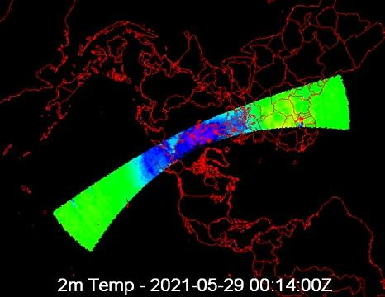
NUCAPS In McIDAS-V
Animation of 2m Temperature over Northern Hemisphere domain for a full day

Slide 12
Thank you!

