Slide 1
McIDAS-X & Python
The Powers that Drive the COD-NEXLAB Satellite Imagery
McIDAS Users’ Group 2023
Mike Zuranski – Unidata
09-26-2023

Slide 2
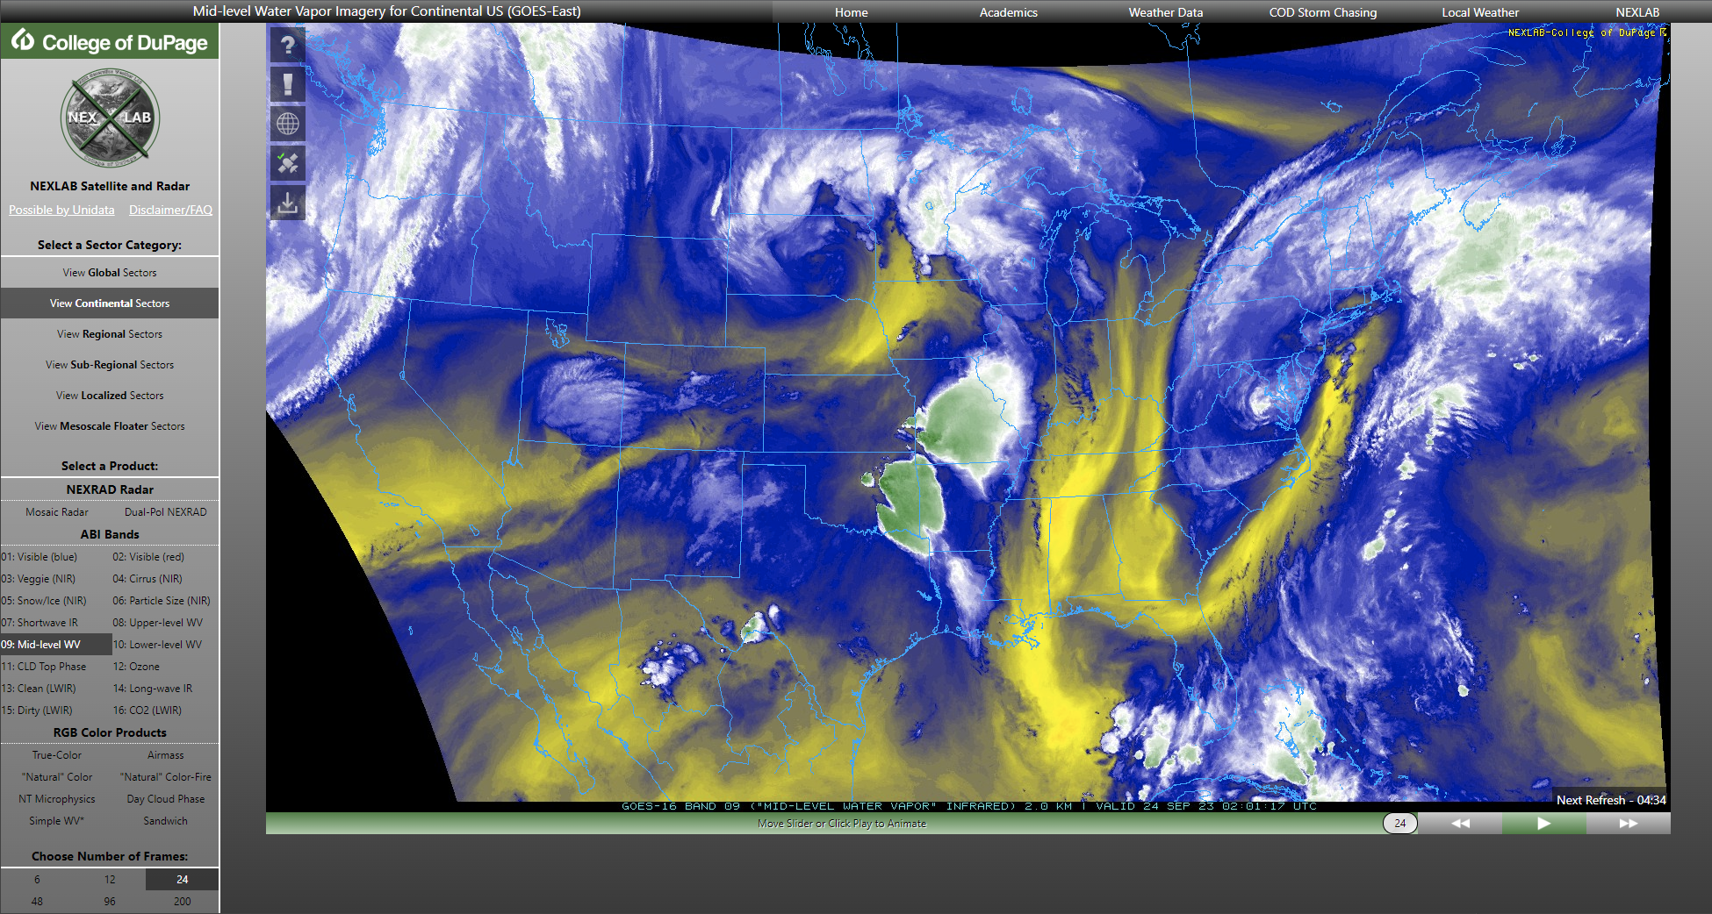
College of DuPage - NEXLAB
ABI Bands, RGB Products, GLM, Derived Products, Data & Mapping Overlays
Notes:
How many of you are familiar with this page

Slide 3
College of DuPage – NEXLAB Meteorology Faculty and Staff
Paul Sirvatka Professor of Meteorology | Ron Stenz Associate Professor of Meteorology | Gilbert Sebenste Support Analyst & Product Developer | Evan Anderson Web Developer & Lab Manager

Slide 4
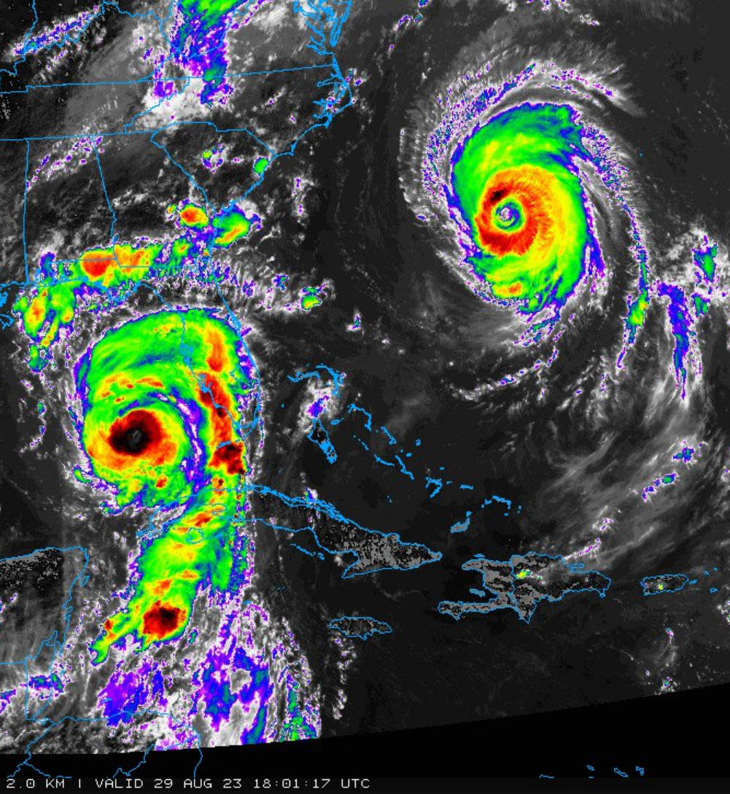
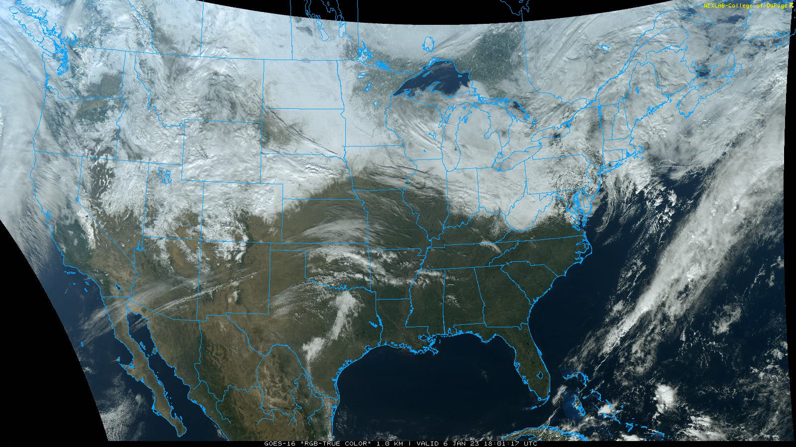
College of DuPage - NEXLAB
Normal Day:
12-15 Million Hits
20-25 Thousand Unique Visitors
750 GB – 1 TB of Data Out
Busiest Day (so far) 8-29-2023:
40 Million Hits
57 Thousand Unique Visitors
3 TB of Data Out

Slide 5
The College of DuPage – NEXLAB Satellite Imagery Processing
A Behind-the-Scenes Look at How COD’s Satellite Imagery is Made
Notes:
What I’d like to do is give you a brief overview of how everything works. I won’t be showing much code, you wouldn’t want to see it anyway. I more want to show you some of the tricks I’ve used.

Slide 6
Overview
16 ABI Bands, 8 RGB products, 10 L2 Derived products, 4 GLM products
Nearly all this data comes from NOAAPort/SBN
Exceptions:
Gridded GLM (Unidata LDM feed)
Select GRB imagery (Unidata ADDE)
Almost everything is initiated by LDM

Slide 7
Overview General Processing Workflow
LDM
goes-restitch.py
Manager Scripts
Runner Scripts
LDM
To
IA-State
Archive
goes-info.py
Centralization
Of information
And functions
map_gen.py
Map overlay generation

Slide 8
Automation Local Data Manager (LDM)
Nearly all data arrives via the LDM
ABI tiles are stitched together using goes-restitch.py
ABI and L2 data are saved to disk
Their paths are passed to the manager scripts
GLM data is saved to disk for use later, no actions taken

Slide 9
Automation Manager Scripts
manager.py, manager_derived.py and manager_remote.py
These take the file name/path from goes-restitch.py
Invokes the “runners” and enforces timeouts
Invocation details and timeouts determined by product and scene
Any runner script still running at the timeout is culled to prevent runaway processing
Notes:
Timeouts are important!

Slide 10
Automation Runner Scripts
sat_runner.py, sat_runner_meso.py, rgb_runner.py, sandwhich_runner.py, derived_runner.py
These are the product generation scripts
This is where McIDAS is invoked
Includes handling for scenes, bands, products, projections, etc.
Utilizes multiprocessing where possible
Not generally possible for Full-Disk – many unique projections

Slide 11
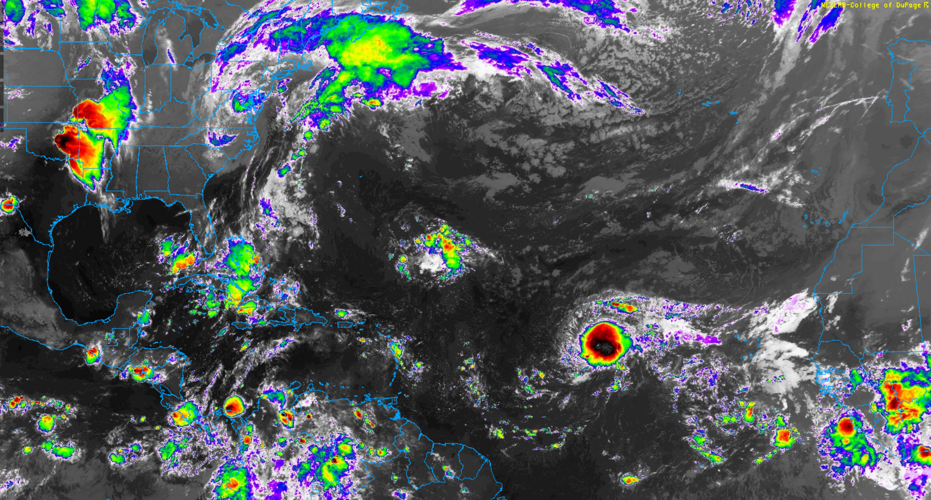
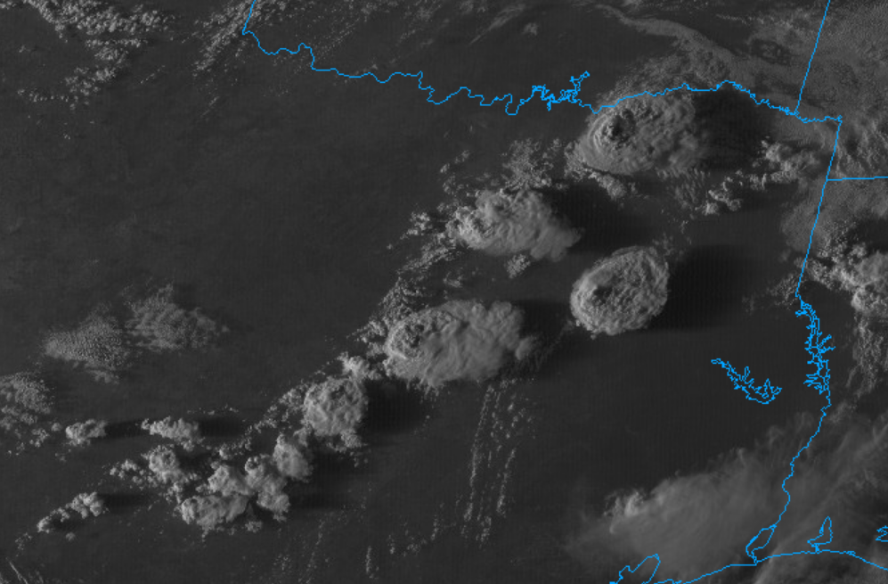
Automation ABI Imagery
Reproject if necessary
For Each sector and scale, make the base image
If CONUS or Mesoscale, make GLM imagery
If Mesoscale, handle 30-second imagery and new location mapping
If Full-Disk, make background images
Send images to IA-State for archival
CONUS | Mesoscale | Full-Disk | Remote
One projection GLM data 5-minute Standard | No reprojection GLM data Possible 30-sec Mode | Many projections No GLM data* Possible 5-min Mode | One projection GLM Data Check each min for new data
Notes:
This just illustrates some of the difference between the data that needs to be handled. MESO has its own script

Slide 12
Automation ABI Imagery – Remote Cropping
We needed imagery over Canada, but SBN Full-Disk is too coarse
Full-Disk GRB data is large!
Solution: Take a cropping of GRB imagery remotely with IMGREMAP
I download only what I need
Faster to work with too

Slide 13
Automation ABI Imagery – Remote Cropping
IMGREMAP RTGOESR/FDC02 GOESDATA.9902 PRO=LAMB 2 26 95 SSIZE=2000 10500 SIZE=3600 9400 LAT=50.2 82.5

Slide 14
Automation GLM Products
All GLM products are made as part of the ABI processing
Each GLM product is initiated by an ABI band
GLM products are overlays – Must make them transparent
EU Tables:
FED: L2-COD
TOE and MFA: Derived from AWIPS color tables
Different EU tables for reprojected imagery
Accuracy not guaranteed
Logarithmic scaling required to do make these products the right way

Slide 15
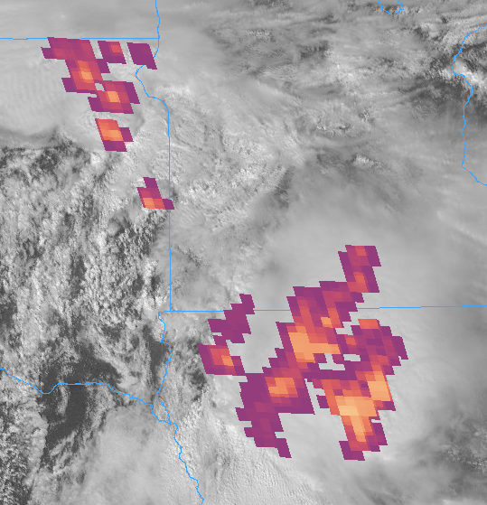
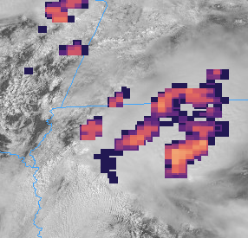
Automation GLM Products
Reprojected CONUS
Mesoscale
Notes:
This is why I asked about EU tables yesterday

Slide 16
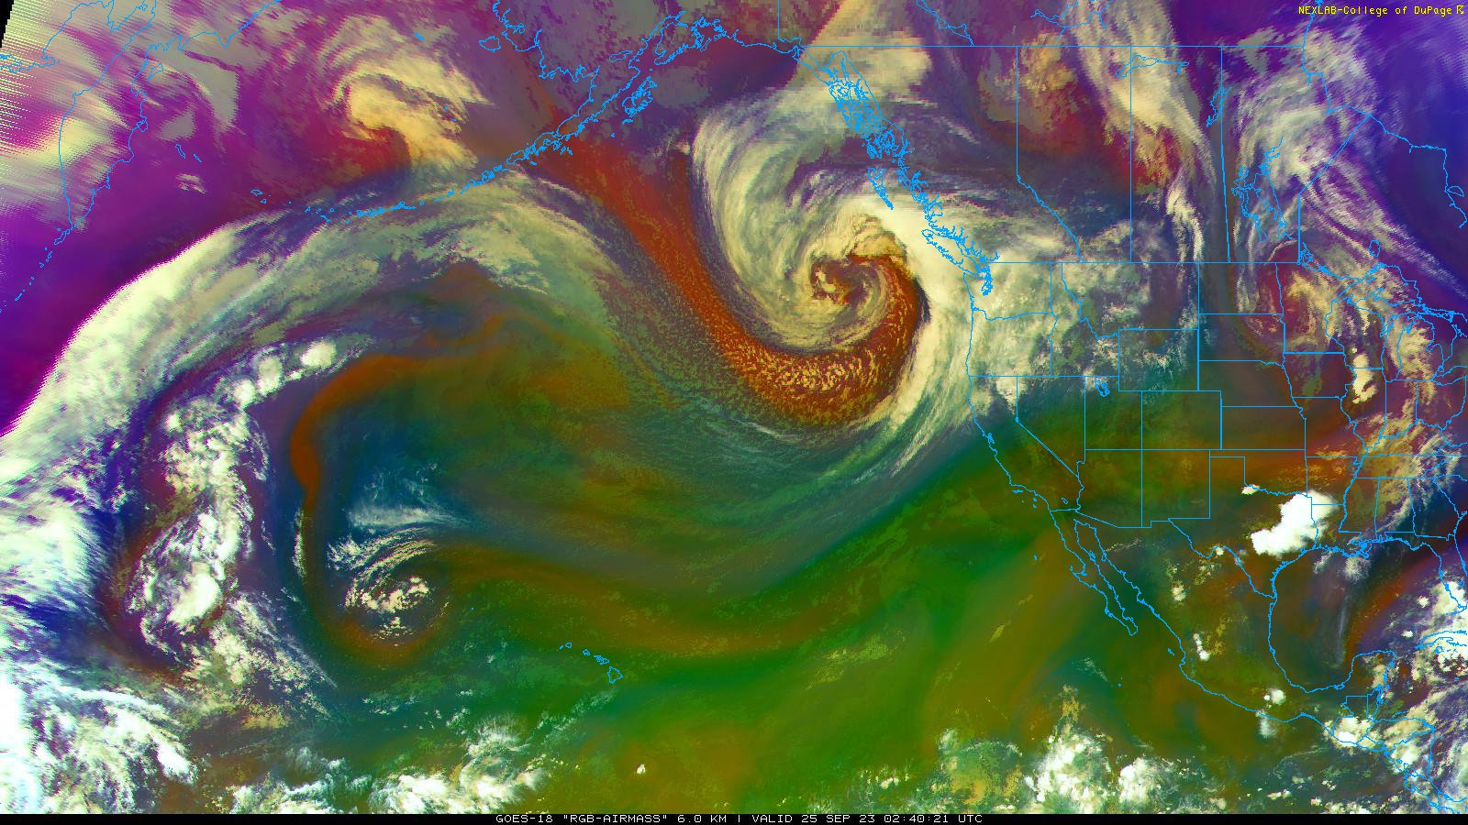
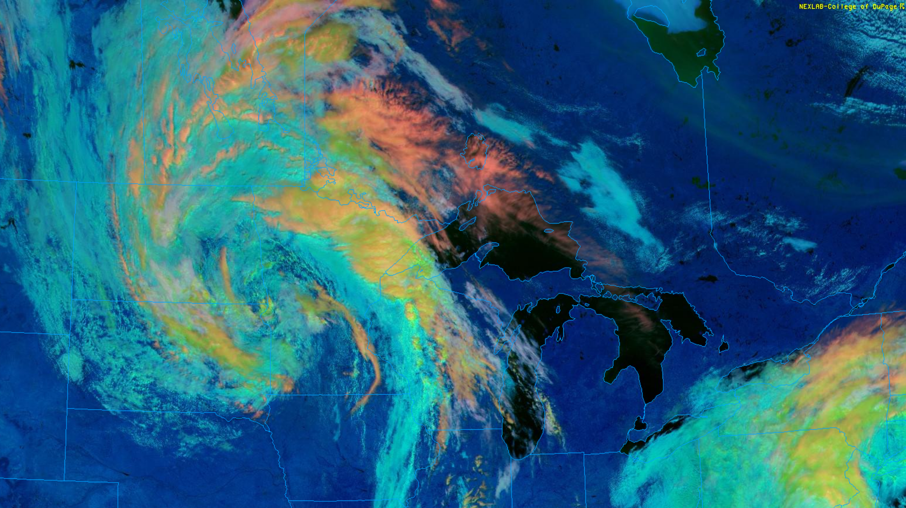
Automation RGB Imagery
Very similar structure and workflow as ABI imagery
A single band will initiate a product
E.g. Band-8 will start making Airmass imagery
The rgb_runner will wait until all required bands are available
Separate timeout for waiting on the other bands
Mesoscale handling included in rgb_runner
RGB recipes are stored in the rgb_runner as part of its code
Different recipes for reprojected imagery
Notes:
Thank you for the GAMMA parameter!

Slide 17
Iowa State Archive Daryl Herzmann
Began archiving in 2018
All ABI and RGB products (except local sectors)
Images are inserted into LDM after they are made
Example URL: https://mtarchive.geol.iastate.edu/2023/09/26/cod/sat/
There will be a front-end… Someday™

Slide 18
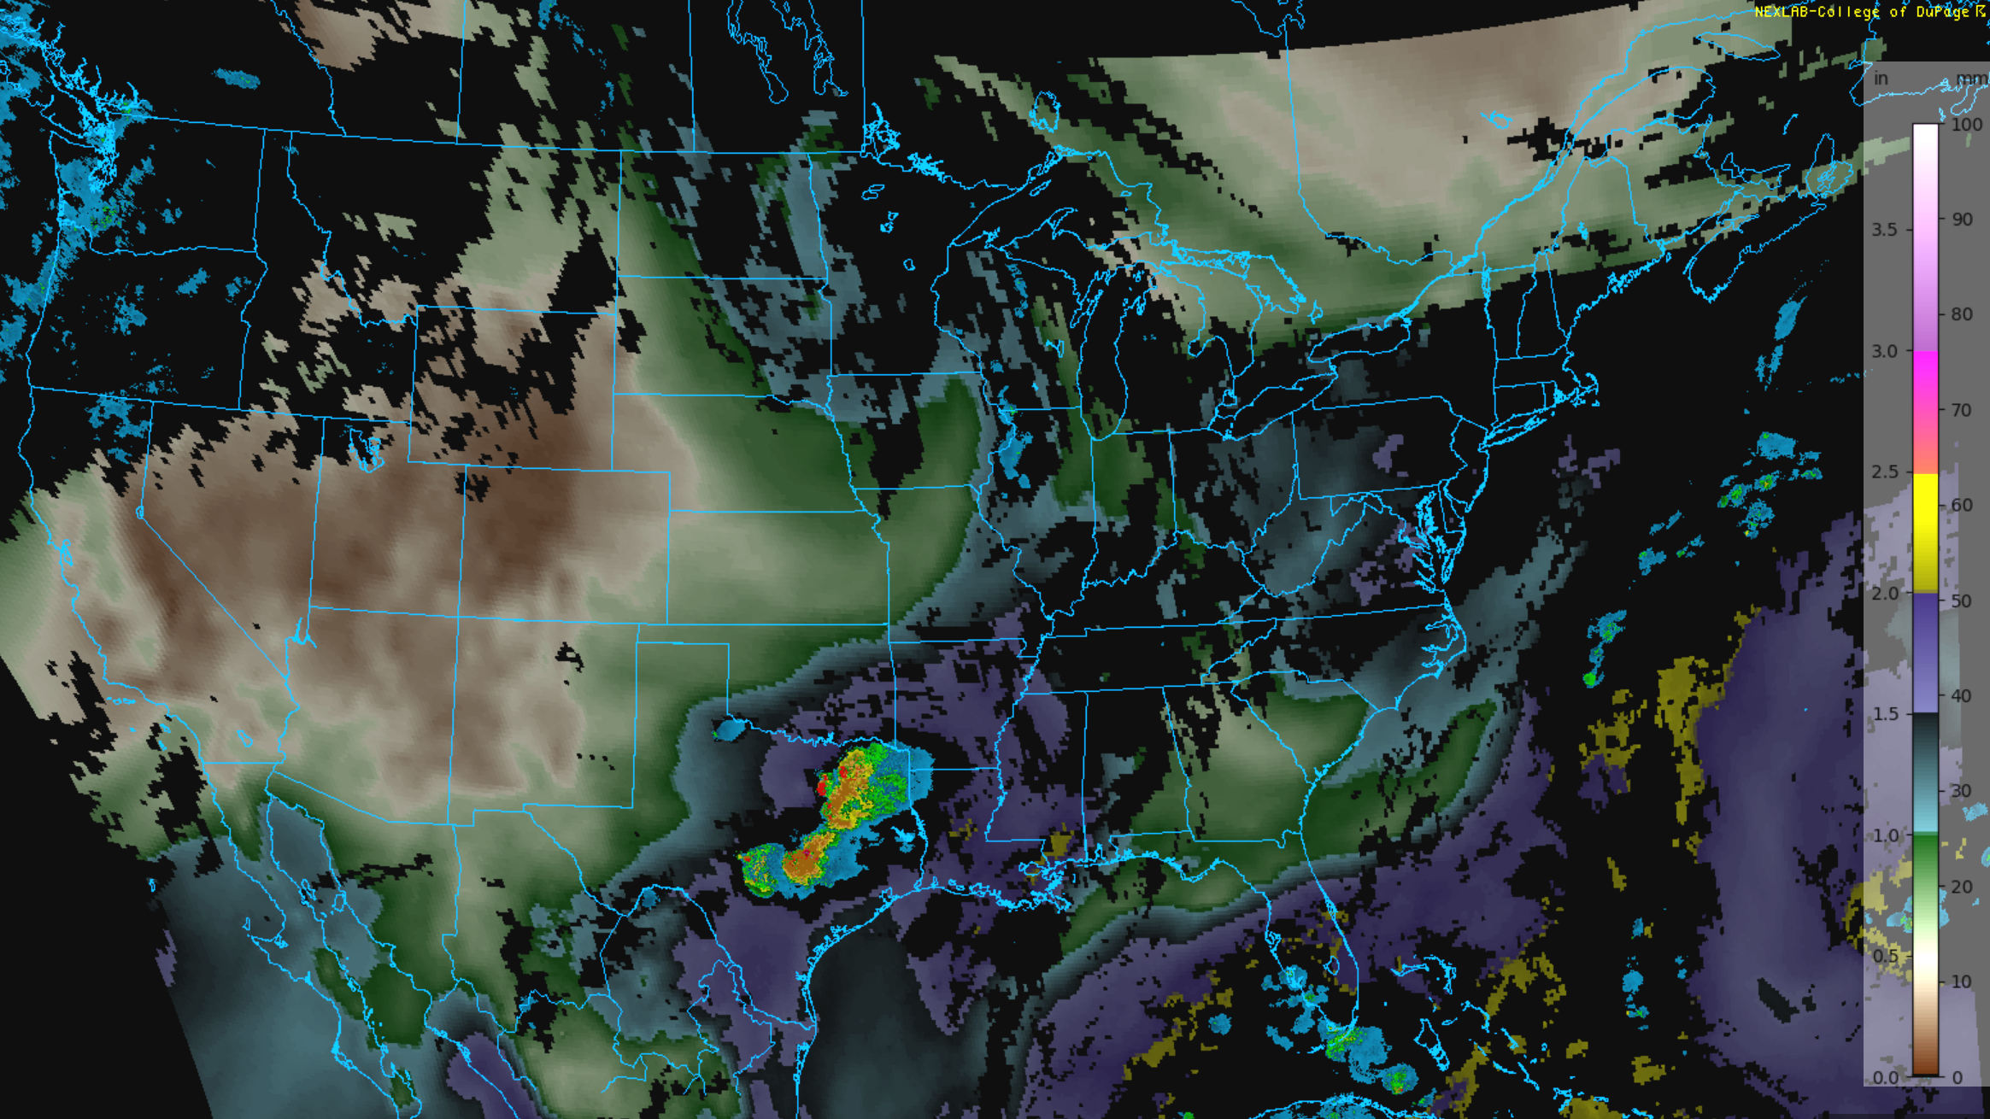
Automation Level-2 Derived Products
Very similar structure and workflow as ABI imagery
Some additional logic for specific products/domains
E.g. SSTs, do we need that in the Midwest?
These are all overlays – Must make them transparent
These are not sent to IA-State for archival

Slide 19
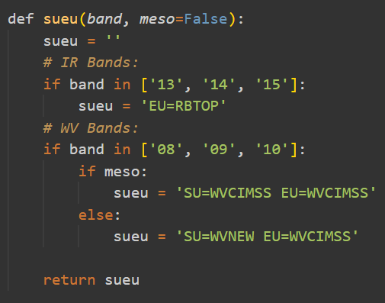
Automation Centralization – goes_info.py
This is home for things referenced in multiple locations
Sector information, projections, frame labels
Common functions
Examples of common functions
insert_into_ldm()
sueu()
AREA file mapping logic
Non-operational message overlays
Notes:
Have two AREA helper functions

Slide 20
Automation Map Generation – map_gen.py
This is the only script where maps are made
This is also where map sets are defined
Maps used vary depending on scale and location
Most maps are pre-made once, mesoscale when moved to a new location
Maps include roads, lakes & rivers, counties, CWAs, Lat/Lon, ARTCC boundaries
CWA and ARTCC were made from GEMPAK maps
Notes:
Air Route Traffic Control Centers

Slide 21
Optimizations, Tips and Tricks
I wanna go fast! - Ricky Bobby
Notes:
This data is a fire hose, and we need to stay ahead of it

Slide 22
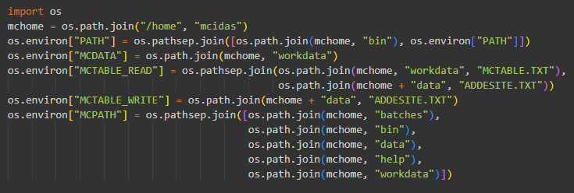
Setting the McIDAS Environment in Python
Set McIDAS environmental variables in the top level of the script…
They will be used across the board from that point on.

Slide 23
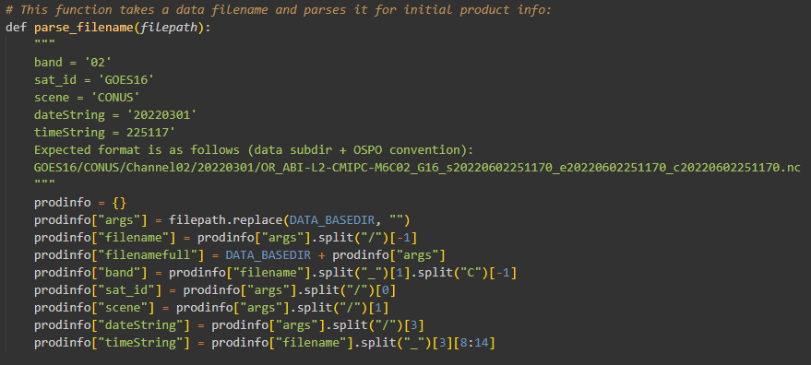
String Formatting It’s used everywhere!
Parsing data file path/name so I don’t have to crack open the data

Slide 24
String Formatting It’s used everywhere!
Poll the remote ADDE server to check for new data
Notes:
This would be an interesting case for MQ

Slide 25
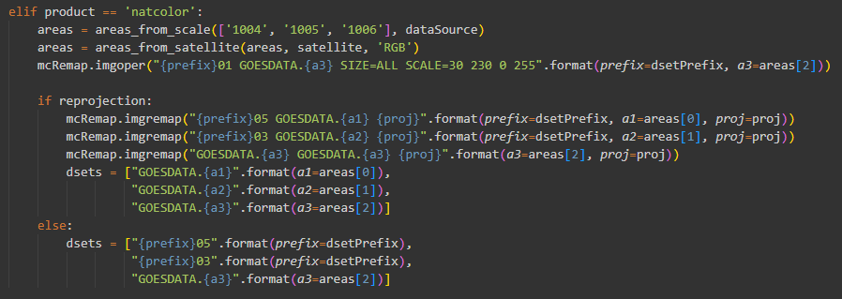
String Formatting It’s used everywhere!
Dynamically create McIDAS commands

Slide 26
Put key directories in a RAMDisk
Python’s tempfile module uses /tmp
This default can be changed
Goes-restitch.py uses tempfile
McIDAS reads/writes AREA files in ~/workdata
This too can be changed
Putting both of these into RAMDisk significantly reduces I/O overhead
All these things can be lost, and that’s okay

Slide 27
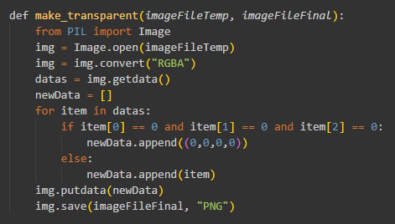
Transparent Images with Python Using Pillow (PIL)

Slide 28
Image File Sizes
Base imagery saved with QUA = 90
Background imagery with QUA = 70
Archive imagery with QUA = 85 (Pillow)
Thumbnails for mesoscale selection
These gave about a 40% reduction in file sizes
Web cache settings were also critical
Notes:
Story about crashing server

Slide 29
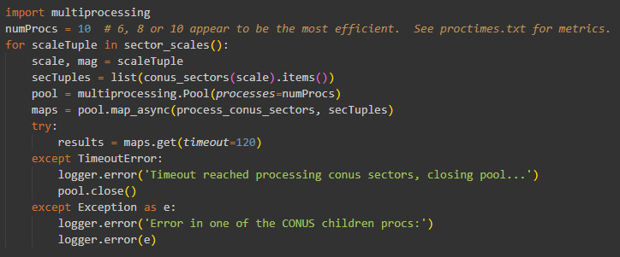
Multiprocessing

Slide 30
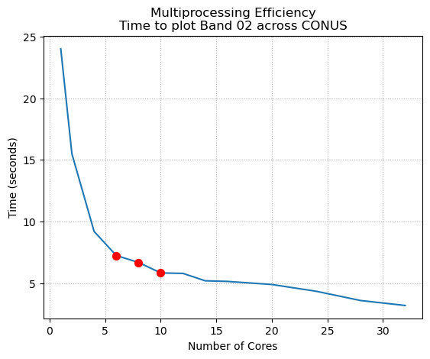
Multiprocessing
Number of Cores | Time (seconds)
1 | 24
2 | 15.5
4 | 9.2
6 | 7.2
8 | 6.7
10 | 5.83
12 | 5.8
14 | 5.2
16 | 5.15
20 | 4.9
24 | 4.35
28 | 3.6
32 | 3.2

Slide 31
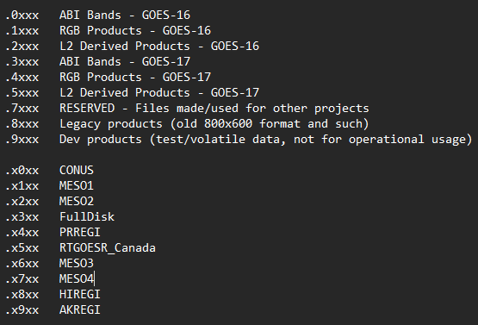
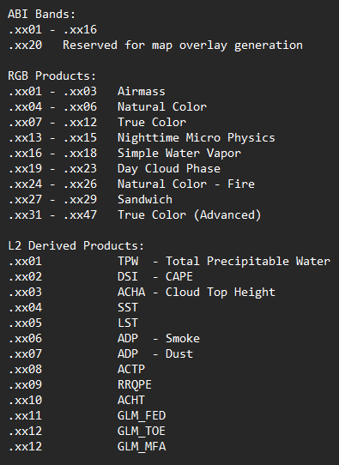
Strategic Use of AREA Files
Now you know why I have those helper functions!

Slide 32
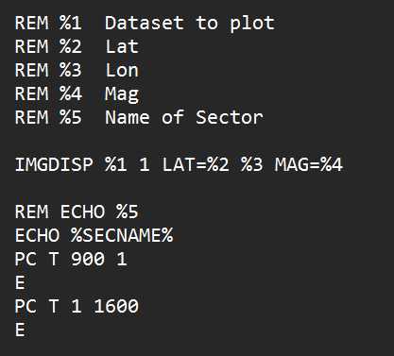
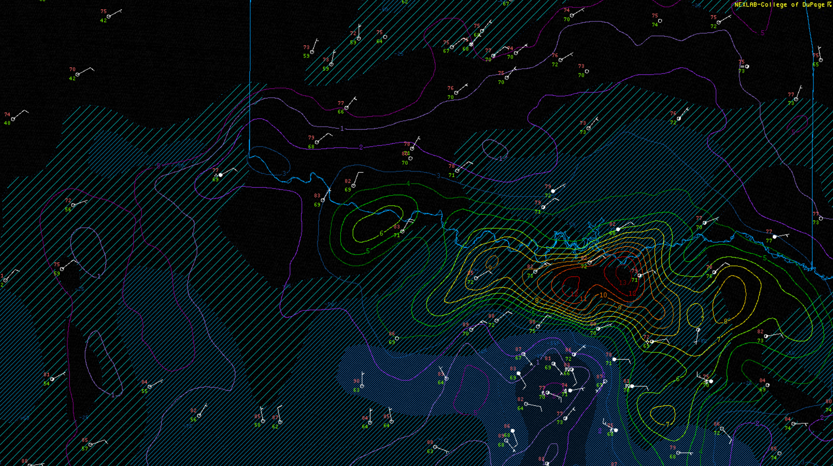
Matching Domains between McIDAS and GEMPAK
Convert center point & mag into lower-left and upper-right

Slide 33
Some Observations, Hindsights And Final Thoughts

Slide 34
McIDAS Python Wrapper
Works great, near-zero issues!
It made all that automation possible
Greatly simplifies the automation
Easily capture STDOUT from McIDAS invocations
Which can then be acted upon

Slide 35
McIDAS Python Wrapper Some Ideas
Return the imagery made as an object
Return data values, coordinates and other information
Return metadata (e.g. IMGLIST output)
Returns as Xarray or Pandas dataframes
Jupyter Notebook integration
Tools for working with color bars, EU and SU tables

Slide 36
RGB Recipes Are a Pain And I did it to myself
Adding or modifying these recipes is cumbersome
Extracting the actual McIDAS commands is very cumbersome
What I would consider doing differently:
Use .BAT files to store recipes
Script option to print recipes in McIDAS format

Slide 37
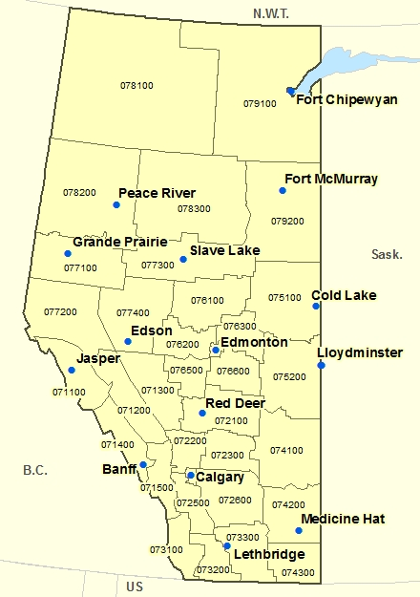
McIDAS Map Files
Somewhat common feedback: “Your maps are out of date.”
Plenty of GIS data that could be useful as maps
Forecast, Fire, Marine zones
Canadian Forecast Regions
International boundaries
I’m making a shapefile -> map file utility
Automatically updates to latest AWIPS Basemap and TIGER road shapefiles
Convert your own
Reduction with Mapshaper

Slide 38
Final Thoughts
McIDAS is the only way to batch process as much imagery as COD does
Python made the automation approachable
While I could have used .BAT files, the wrapper made things much easier
Additional Python integrations would make McIDAS much more accessible
And more in-line with current teachings

Slide 39
Thank You!
SSEC, for McIDAS and the ongoing partnership with Unidata
Unidata, for letting COD be a guinea pig & beta tester
COD, for letting me brag about the operation I’m no longer a part of
Daryl Herzmann, for archiving an insane amount of imagery (and many other things)

Slide 40
Questions?

