Slide 1
RealEarth
MUG Meeting - Sep 2023
David Parker

Slide 2
RealEarth
Overview
RealEarth
Conceived as a way for scientists at SSEC to easily visualize the output of their work
Built on open-source GIS tools to enable visualization of mixed-resolution geolocated raster and vector data (images and shapes)

Slide 3
RealEarth
Overview
RealEarth
Conceived as a way for scientists at SSEC to easily visualize the output of their work
Built on open-source GIS tools to enable visualization of mixed-resolution geolocated raster and vector data (images and shapes)
Allows easy colocation of products in time and space
Supports pan/zoom and animation
Default viewer is flat Leaflet slippy map, Cesium globe view is optional, etc.
API endpoints for easy access

Slide 4
RealEarth
re1
Head Nodes
haproxy: realearth.ssec.wisc.edu
frontend
(primary 1)
database
(primary)
Redundant HAProxy backends
Expandable
Interchangeable
https://realearth.ssec.wisc.edu
re2
haproxy: realearth.ssec.wisc.edu
frontend
(primary 2)
database
(backup)

Slide 5
RealEarth
karben4
Data Nodes
fantasy
(node 1)
brewery
(production)
luck
(node 2)
15 hosts
24-48 cores
64-128gb memory
Many TBs disk
22 Identical VMs serving RealEarth products
Provisioned as necessary
Nine product generation VMs
lakelouie
warped
(node 1)
brewery
(production)
mephisto
(node 2)
… many more…
capital
skal
(node 1)
brewery
(production)
mutiny
(node 2)

Slide 6
RealEarth
karben4
Data Nodes
fantasy
(node 1)
brewery
(production)
luck
(node 2)
15 hosts
24-48 cores
64-128gb memory
Many TBs disk
22 Identical VMs serving RealEarth products
Provisioned as necessary
Nine product generation VMs
lakelouie
warped
(node 1)
brewery
(production)
mephisto
(node 2)
… many more…
capital
skal
(node 1)
brewery
(production)
mutiny
(node 2)

Slide 7
RealEarth
karben4
Federation
fantasy
(node 1)
brewery
(production)
luck
(node 2)
User requests - Session round-robin
lakelouie
API calls
warped
(node 1)
brewery
(production)
HAProxy
mephisto
(node 2)
realearth.ssec.wisc.edu
re1: frontend
(primary 1)
re2: frontend
(primary 2)
… many more…
SSL, sessions, cache, etc
capital
skal
(node 1)
brewery
(production)
mutiny
(node 2)
Grafana stats

Slide 8
RealEarth
{
"id": "globalir",
"dataid": "globalir",
"duplicate": false,
"reingest": false,
"name": "Global Infrared",
"description": "This product is a global composite of imagery from multiple satellites. It is completed every hour (at about 35-minutes after the hour UTC) by the SSEC Data Center with the best available imagery. While it shows the most current imagery, shifting occurs along composite seams.",
"owner": "",
"url": "",
"categories": [
"Global"
],
"order": 0,
"orderclause": "",
"opacity": 100,
"type": "raster",
"displaytype": "tile",
"projection": "epsg:4326",
"marker": "",
"probe": "value",
"units": "C",
"maxzoom": 7,
"seedpolicy": 6,
"seedlatbound": 85,
"static": false,
"released": true,
"status": 0,
"optimizeflag": 0,
"fetch": false,
"centerproperty": null,
"declutter": true,
"cluster": true,
"declutterexempt": null,
"outputtype": "png24",
"resample": "nearest",
"processing": "",
"scalemin": "0",
"scalemax": "0",
"minutes": "90",
"timewindow": "0",
"showlegend": true,
"merge": "none",
"mergeproducts": "",
"times": [],
"notifyvalues": [],
"hasparts": false,
"largetiles": true,
"vmid": "e1131cfda86d389c99420e42766ecdc2"
},
Products
>1,100 products
26 collections
139 categories
Product List
Admin Overview

Slide 9
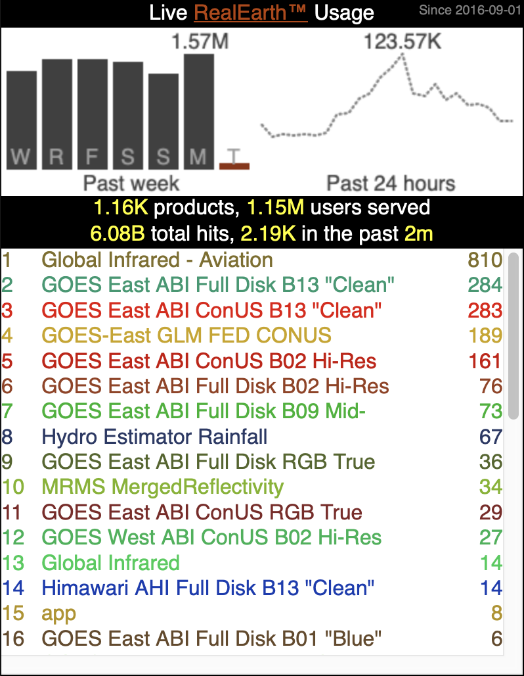
RealEarth
Usage
>6 billion hits
~1.15m unique IPs
Live Usage
Admin Activity

Slide 10
Product Creation
Breweries - Polling
Cron entries trigger McIDAS-X processing
Legacy VM dating from 2009
Russ Dengel wrote a LOT of code—including custom FORTRAN McX commands—to create product imagery from SDS holdings

Slide 11
Product Creation
Breweries - Polling
Cron entries trigger McIDAS-X processing
Legacy VM dating from 2009
Russ Dengel wrote a LOT of code—including custom FORTRAN McX commands—to create product imagery from SDS holdings
The spirit of PAW lives on!

Slide 12
Product Creation
Breweries - RabbitMQ
AMQPFind listens for new data messages
Himawari, ABI, VIIRS
Trigger processing on message reception
Pass to Python script to parse payload dictionary
Launch McX mcenv session to fetch and process data

Slide 13
Product Creation
Breweries - RabbitMQ
AMQPFind listens for new data messages
Himawari, ABI, VIIRS
Trigger processing on message reception
Queueing with separate process thread
Don’t miss messages
Avoid saturating resources

Slide 14
Product Creation
Breweries - McIDAS-X
Running on every single RealEarth VM in the federation
Integral part of product generation for 100s of products
Can accept AREAs as input
GeoTIFF writer creates rasters that are ingested directly
CSV vector data converted to GeoJSON for ingest

Slide 15
Product Creation
Breweries - Scrape & Fetch
PHP and Python classes to manage remote data mirroring
FTP
HTTP(S) w/auth
Local directory
Custom processing using GDAL, Python, and shell scripts

Slide 16
Product Creation
External Sources
External users can create and manage products
520 external users registered as product managers
Can upload using a shell script or web form
Happy to help anyone set up a user account

Slide 17
Data Ingest
Raster Imagery
GeoTIFF format (also COG)
Overviews added for all zoom levels
Tiles are optionally pre-seeded for better performance
Multi-band, multi-byte
Enhancements can be added to 1-byte data

Slide 18
Data Ingest
Raster Imagery
GeoTIFF format (also COG)
Overviews added for all zoom levels
Tiles are optionally pre-seeded for better performance
Multi-band, multi-byte
Enhancements can be added to 1-byte data
Band combinations
Calibrated data values

Slide 19
Data Ingest
Raster Imagery
GeoTIFF format (also COG)
Overviews added for all zoom levels
Tiles are optionally pre-seeded for better performance
Multi-band, multi-byte
Enhancements can be added to 1-byte data
Transparency masking
Variable opacity
Honor NODATA

Slide 20
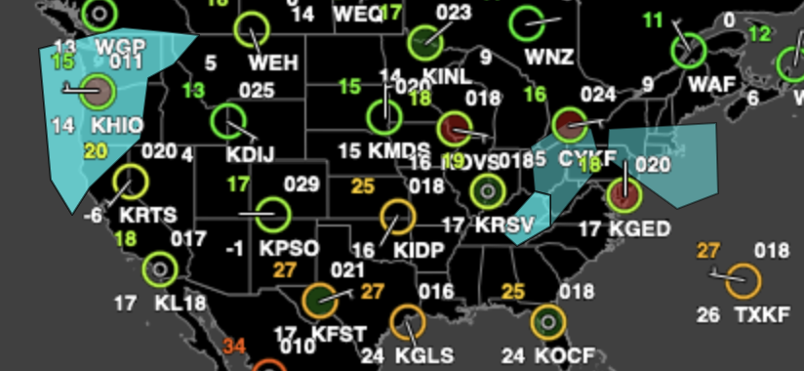
Data Ingest
Vector Imagery
GeoJSON format
Can be viewed as shape objects (point, line, polygon) or rendered into tiles (raster)
Points can be rendered using Canvas drawing techniques

Slide 21
Data Ingest
Time Steps
Each time step is unique
Data for each time step can be split and uploaded as a "part" and merged geospatially on the fly
Time steps can be aggregated through time into a single display
"Time" dimension was a novel idea for GIS in 2009

Slide 22
Data Ingest
mapserver
https://mapserver.org/
OGR-compliant web mapping server
Speaks WMS/WMTS/WFS, etc. to GIS clients
mapscript API for fine-grain control
GDAL tools used for data translation and mapping

Slide 23
Data Ingest
mapserver
https://mapserver.org/
OGR-compliant web mapping server
Speaks WMS/WMTS/WFS, etc. to GIS clients
mapscript API for fine-grain control *
GDAL tools used for data translation and mapping
Each time step is a Layer
Time steps are transient
Allows aggregate sources
Dynamic band combinations
key feature

Slide 24
Data Volume
Incoming
Tens of 1,000s of time steps per hour
GOES-16 alone accounts for ~4,300 individual time steps per hour
Each product defines a data cylinder based on # of time steps or absolute time range
Some keep months of 1-min data

Slide 25
Data Volume
Outgoing
Steady 1.5 - 2 million requests served each day
Spikes to 3+ million during severe weather events
Embedded and used around the world
Hobby websites
State agencies in the Americas and Asia

Slide 26
Project Support
Distinct uses at SSEC
Non-federated instances of RealEarth
Separate authentication and access

Slide 27
Project Support
Distinct uses at SSEC
Non-federated instances of RealEarth
Separate authentication and access
Boeing
Global flood monitoring
Cloud product development
GEONETCast (GNC-A)
ProbSevere LightningCast
MyRadar
Fire detection

Slide 28
Wildfires
Case Study
Integrate GIS data with satellite observations

Slide 29
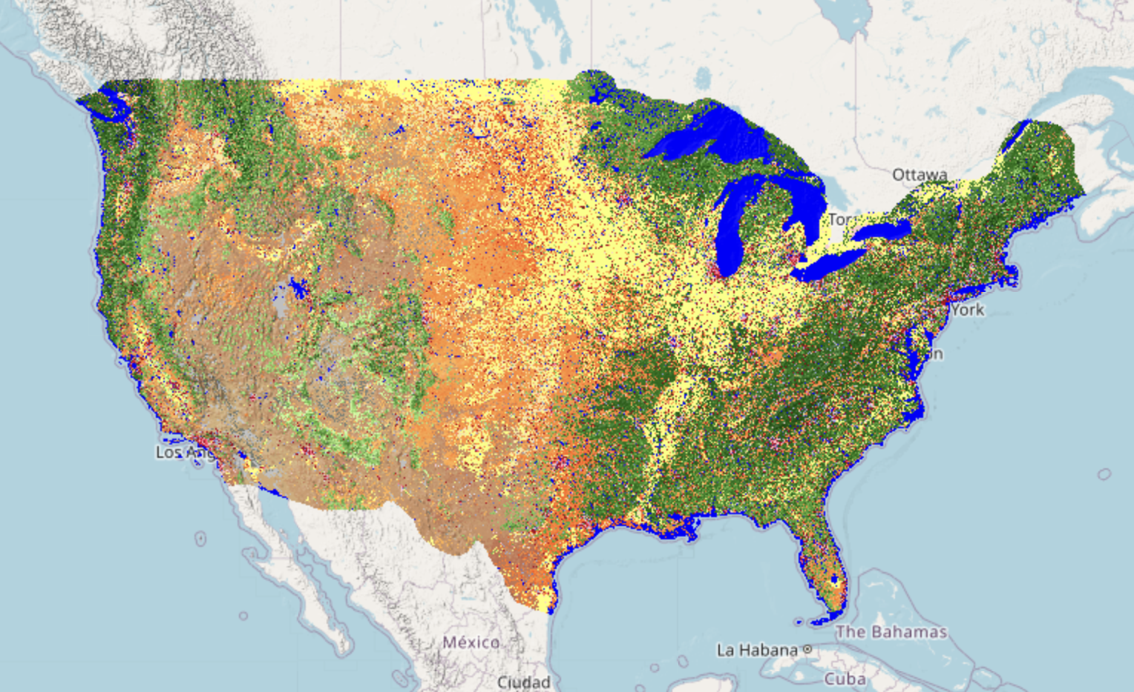
Wildfires
Case Study
LANDFIRE
Integrate GIS data with satellite observations
Land cover and fuel type

Slide 30
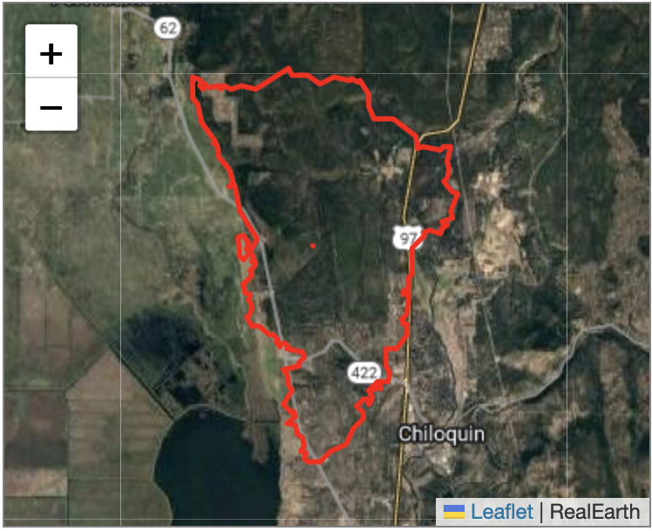
Wildfires
Case Study
Integrate GIS data with satellite observations
Land cover and fuel type
Fire perimeters
NIFC

Slide 31
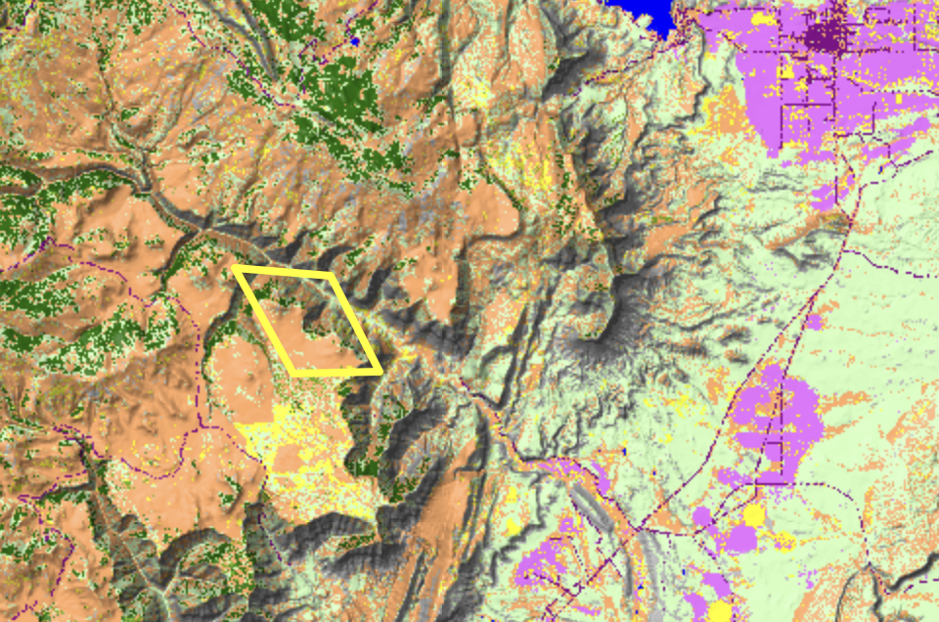
Wildfires
Case Study
NGFS
Integrate GIS data with satellite observations
Land cover and fuel type
Fire perimeters
Fire detection pixels
Histogram of land cover and fuel types

Slide 32
Wildfires
Case Study
Integrate GIS data with satellite observations
Land cover and fuel type
Fire perimeters
Fire detection pixels
Histogram of land cover and fuel types
Solar farm identification

Slide 33
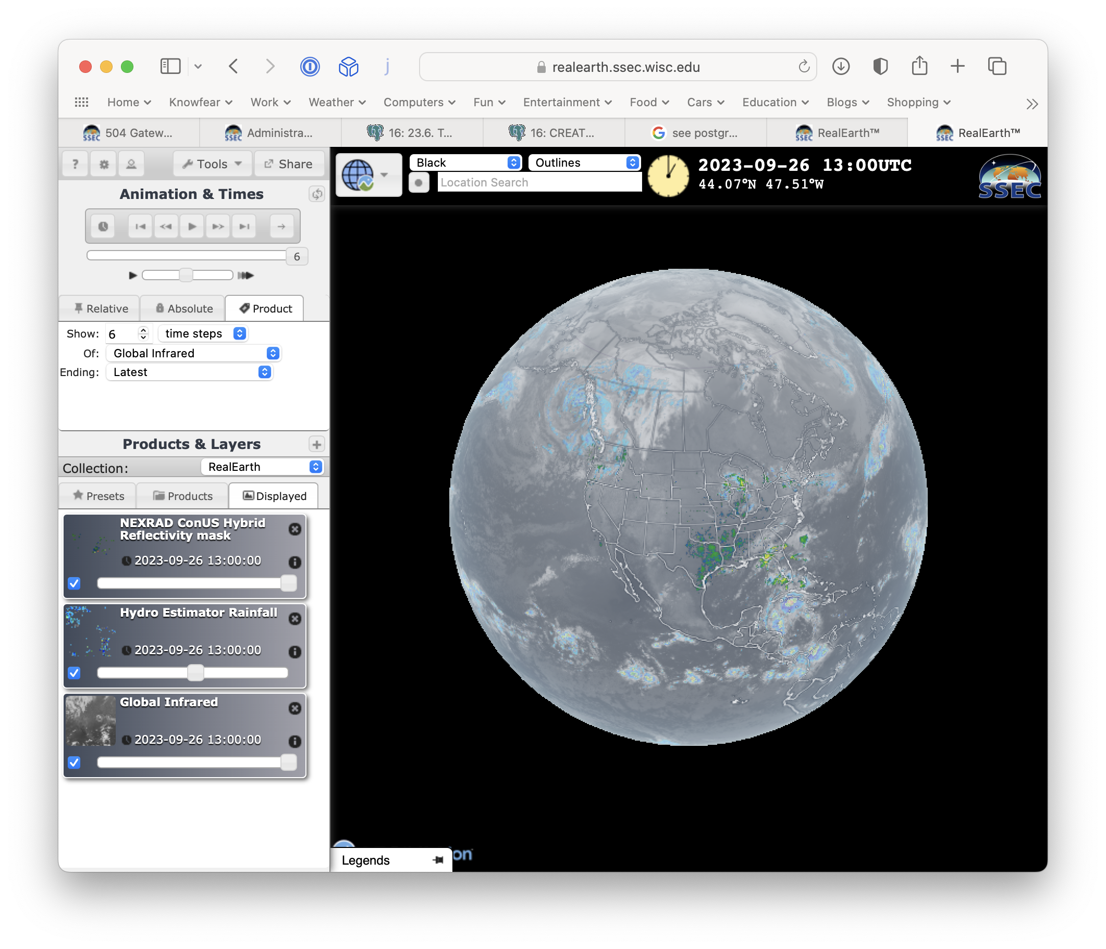
RealEarth
Live Demo
Basic
Globe
Basemaps, Labels, Other controls (share, draw, etc.)
Station models
Probe & Feature tracking
Parts / Time aggregation

