Slide 1
Welcome to the 2023 McIDAS User Group Meeting
September 25– 28th 2023 Madison, Wisconsin

Slide 2
While you are here ...

Slide 3
Capitol

Slide 4
Brats!

Slide 5
Babcock ice cream – yummmm!
Available in the Union

Slide 6
WI Beer

Slide 7
Try ‘em fried too!!

Slide 8
Fromagination
(on the square across from the Capitol)

Slide 9
Picnic Point (1 hour walk along lakeshore)

Slide 10
Visit the Capitol

Slide 11
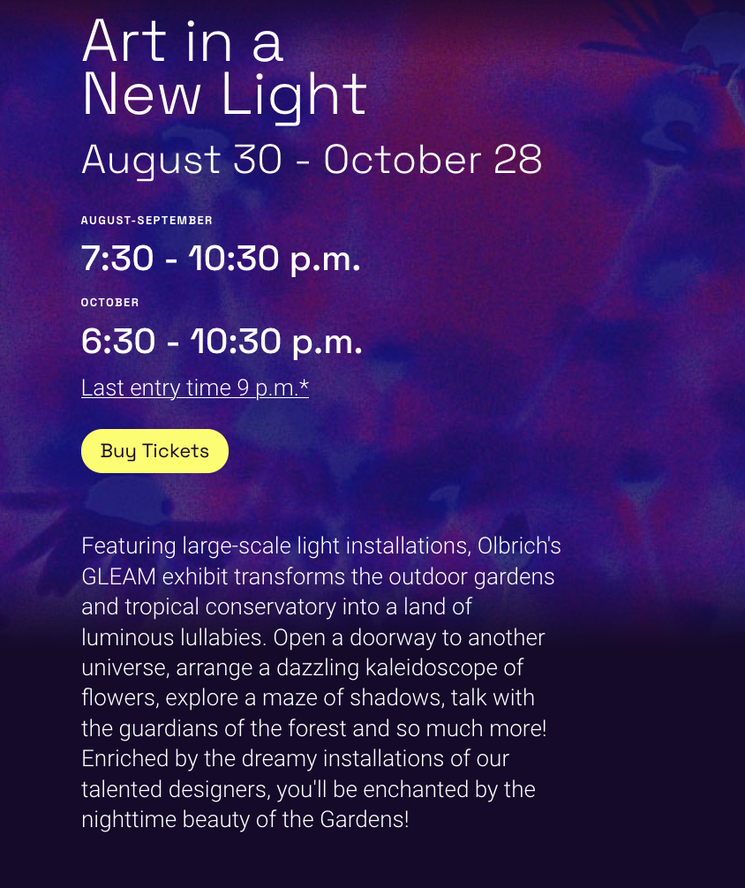
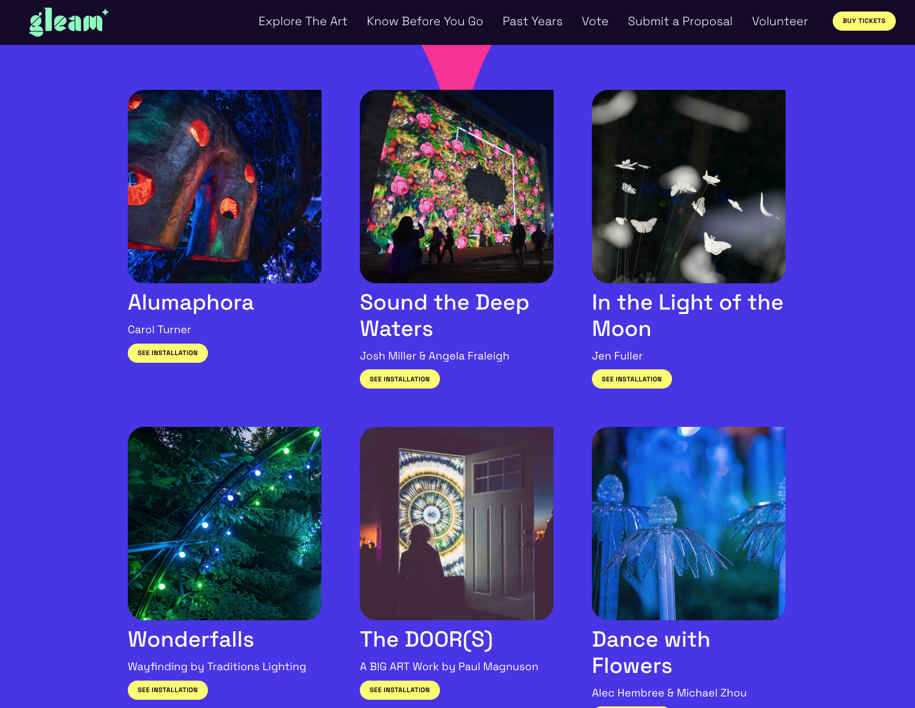
Consider Going to GLEAM at the Olbrich Gardens
https://www.olbrichgleam.org/

Slide 12
Staying longer?
Saturday Farmer’s Market
AOSS

Slide 13
Come back and visit again…

Slide 15
Go forth and enjoy!

