Slide 1
McIDAS –XCD Status Update
2023 McIDAS Users’ Group Meeting

Slide 2
McIDAS-XCD Team
Kevin Baggett, Kaba Bah, Jonathan Beavers, Dan Forrest, Jay Heinzelman, Dave Parker, Jerrold Robaidek, Becky Schaffer, Clayton Suplinski

Slide 3
McIDAS-XCD
McIDAS X
Conventional Data
Decoder
McIDAS-XCD files, decodes and indexes the NOAAPORT data stream into formats that can be served by McIDAS-X ADDE servers.
Output formats include McIDAS MD files, Text files, McIDAS GRID files, GRIB
Version 1 and 2 files, NEXRAD files, and BUFR files.

Slide 4
Recent Updates to McIDAS-XCD
Latest version is 2022.1- 3 annual releases since the last MUG Meeting
Many station additions/updates to STNDB.CORE and accompanying MD files
Additions/updates to RTGRIDS datasets with increased volume of GRIB data coming across NOAAPORT/CONDUIT data feeds
Added an optional LDM CONDUIT feed monitor
Added support for the display of GRIB variables such as Potential Vorticity (PV), Soil Temperature (STEM), Sigma Levels (SIGM) and Entire Atmosphere (EATM) categories that had up to the point of the fixes were displaying as “duplicate” grids

Slide 5
Replace -XCD?
McIDAS –XCD has been reliably providing data to McIDAS-X users for many years but has its issues behind the scenes:
Installation is difficult
Upgrades are difficult
System is overly complex, large learning curve for operators, and very large learning curve for new programmer
System was written for a mainframe then ported to UNIX
A powerful system is needed to run -XCD, otherwise data can be lost
A data format change can mean bad data, and a fix can be difficult to implement, and is only effective for future data

Slide 6
Goals
Replace 4 parts of -XCD filing and decoding:
GRIB
NEXRAD
Text
POINT/MD serving
Utilize LDM direct filing
Reduce or eliminate compiled code
Remove legacy mainframe complexity
Utilize simple open-source database, SQLite
Match or exceed current filing and serving performance on existing hardware

Slide 7
McIDAS-XCD Beta: Packaging and Installation
Existing servers and decoders (compiled code) have been migrated into McIDAS-X 2022.1
McIDAS-XCD Beta GRIB and text software have been packaged as Podman containers and tested on multiple Linux RHEL 8 multiprocessor machines
We utilize Unidata LDM that is packaged as a Docker container
Podman/Docker has the goal of simplifying the installation, running, and upgrading of the rep McIDAS–XCD Beta components for the benefit of system administrators.

Slide 8
McIDAS-XCD Beta: Requirements
Linux (RHEL 8)
Podman (most recent version)
Unidata LDM or LDM Docker container
The following LDM-specific files for McIDAS–XCD Beta are supplied with the package
pqact.conf
ldmd.conf
registry.xml
Except for a few instances, the above files can be changed to what the –XCD site needs

Slide 9
-XCD Replacement System
-XCD/site-specific config files
start_xcd
Future
Unidata LDM
xcdtext
xcdgrib
xcdbufr
Raw NEXRAD (WSR & TDWR) files
Raw .XCD text files
Raw .grib1/.grib2 files
SQLite daily
text databases
SQLite GRIB databases separated by
date, model, and GRIB version
SQLite BUFR databases separated by date and BUFR version
ptdb* servers
obtgserv
nexr* servers
wtxgserv
gribdb* servers
bufrdb* servers

Slide 10
McIDAS-XCD Beta: GRIB Data
RTGRIDS dataset
LDM files GRIB messages to a temporary directory
A Python daemon watches for GRIB data, extracts information and files metadata into a SQLite database
SQLite databases are separated by version, model and date
Volume of GRIB data has increased greatly to 650 GB/day (with CONDUIT feed)over the last few years

Slide 11
McIDAS-XCD Beta: NEXRAD Data
RADAR, WSR and TDWR datasets
LDM directly files NEXRAD files (WSR and TDWR) into a directory structure similar to the existing -XCD Decoder
Data served by the existing NEXRAD server

Slide 12
McIDAS-XCD Beta: Text Data
RTWXTEXT dataset
LDM files text data directly to disk as a daily .XCD file
A bash daemon script watches for new data and extracts metadata for insertion into a daily SQLite database
Text servers (wxtgserv and obtgserv) query the daily SQLite databases to find data and return information to the client
Commands: WXTLIST, WWLIST, WWDISP, *RPT

Slide 13
McIDAS-XCD Beta: Point Data
RTPTSRC dataset
Uses certain text data identified by WMO headers filed in the daily SQLite text database (e.g. SA and SP for SFCHOURLY)
No MD files are created, but structure created on the fly when serving via ADDE
At the start of each UTC day, the replacement –XCD creates a station table in the daily database based on the current version of STNDB.CORE
Commands: PTLIST, PTDISP and PTCOPY
Retrieve metadata from the SQLite database, then extract data from the daily *.XCD files created by LDM

Slide 14
Point Data Improvements
McIDAS–XCD Beta captures more surface hourly data than existing –XCD
Existing –XCD: Hourly & 2 Specials
Replacement –XCD: Hourly & All Specials

Slide 15
Point Data Issues
Number of hourly records of PTCOPY for SFCHOURLY data has been increased and can be a variable number up to 60 readings per hour (every minute)
Usually, shouldn’t be more than 2 or 3 specials per hour
Certain searches in McIDAS–XCD Beta take longer than in McIDAS–XCD 2022.1
SFCLIST CO=US DAY=21/MAY/2018 TIME=0 23 SEL=‘T[F] 60 90’ takes about 2-3 seconds in –XCD 2022.1 due to MD file storage of a temperature data. This is in contrast to 20+ seconds using McIDAS-X servers for McIDAS–XCD Beta as the servers have to calculate the temperature data on the fly from the raw text data

Slide 16
BUFR Data (Binary Universal FoRmat)
Filed directly using LDM
Using the ecCodes Python API from ECMWF, we have been able to set up a prototype BUFR Version 3 and 4 SQLite database system similar to the GRIB system with aspects of text data
We have been able to serve BUFR data from this prototype using the PTLIST/PTDISP commands
Not delivered with the McIDAS-XCD Beta package but this will be a focus of future releases

Slide 17
Local Data
A couple -XCD sites have local (non-NOAAport) feeds of data
We have contacted those sites in the past
So far, no core -XCD decoder dependencies are known i.e. sites have written their own decoders
If there is local data that do depend on -XCD libraries, sites will be able to continue to use -XCD libraries, or may link to McIDAS-X libraries as needed. Contact Jerry Robaidek or Becky Schaffer if you have concerns.

Slide 18
McIDAS-XCD Beta Monitoring
Command line
ldmadmin watch from within the xcdldm container
Graphical
HTML based
Does not require apache to be installed
Need to open a port to the McIDAS-XCD Beta Machine in order to display

Slide 19
McIDAS-XCD Beta Monitoring

Slide 20
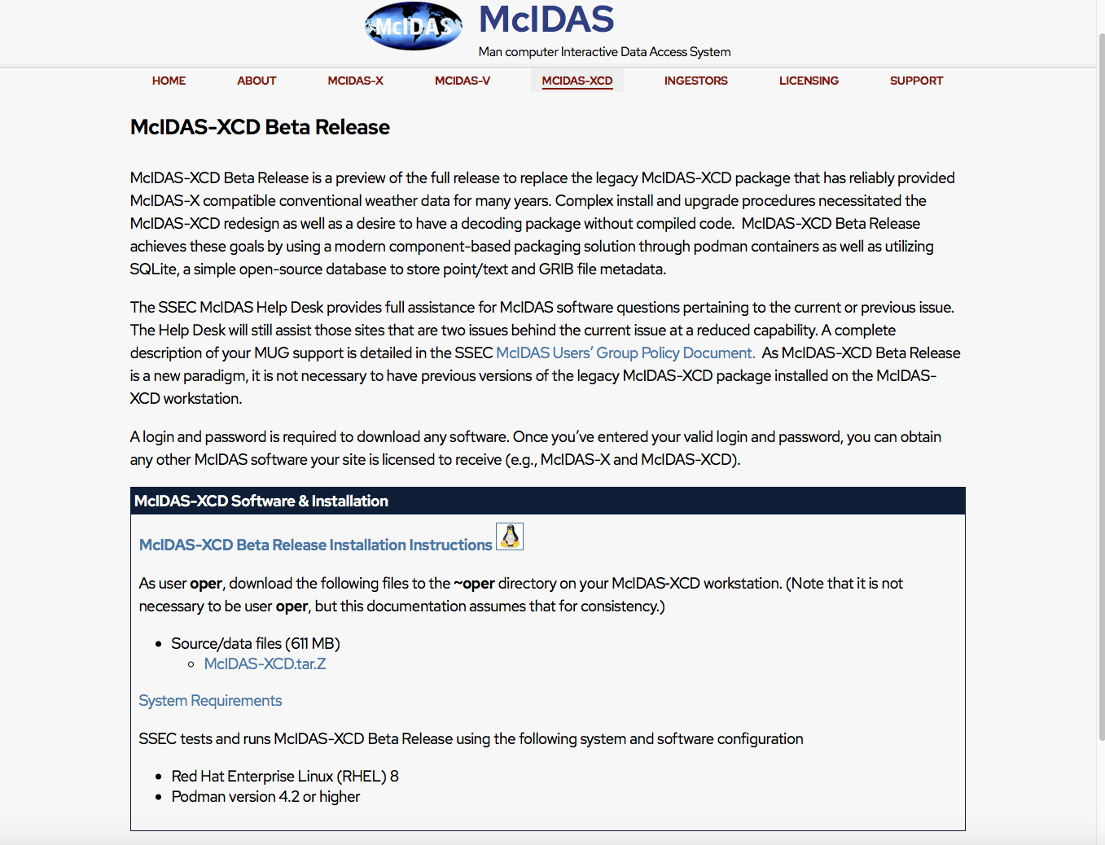
McIDAS-XCD Beta Release Webpage
https://www.ssec.wisc.edu/mcidas/software/xcd/xcd-beta/

Slide 21
McIDAS-XCD Beta Meeting
-XCD member sites can meet with our team tomorrow at this location from 9:15 to 9:45 am
Sample download and installation process of McIDAS–XCD Beta and the related McIDAS-X servers
Bring any questions you may have

