Slide 1
Developing ADDE Servers in Python
McIDAS Users’ Group Meeting
September 25-28, 2023
Tommy Jasmin, SSEC

Slide 2
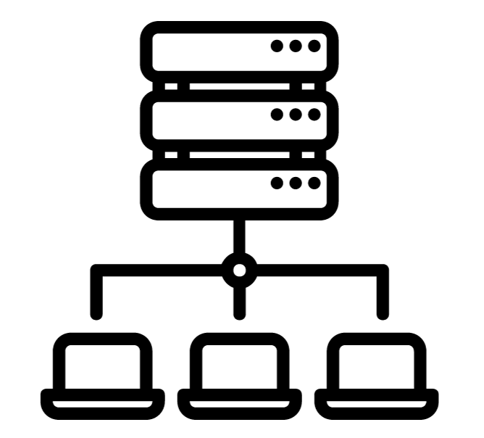
Abstract Data Distribution Environment
Efficient access to large datasets, stored in a variety of file formats, delivered in a common format
Standard Client/Server Paradigm
Some Clients: IDL, McIDAS, Matlab, IDV
Servers can be Local, or Remote over TCP/IP

Slide 3
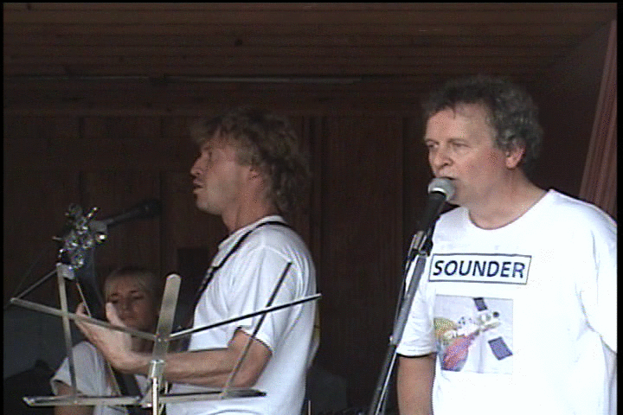
ADDE Down Through the Ages
Port Number | Protocol
21 | FTP
22 | SSH
80 | HTTP
112 | ADDE
443 | HTTPS
Notes:
Netscape Communications created HTTPS in 1994 for its Netscape Navigator web browser.

Slide 4
Under the Hood, an Elegant Simplicity?
A Specialized URL is Sent from Client to Server
adde://server.domain/request?key1=value1&key2=value2…keyN=valueN
Each Key/Value Pair Further Defines and Refines the Request
Similar to a Dynamic Web Page Request, e.g.:
https://mcidas.ssec.wisc.edu/inquiry-v/?inquiry=2499
Example of a Real Request:
adde://easta/imagedata?group=ABI&descr=FD&pos=0&band=2&mag=-8

Slide 5
PyADDE Motivation
Then: Old guys writing servers in Fortran and C.
Now: Young kids writing code quickly in Python
We want to provide a modern, modular, and extensible development framework for current and future developers.
We want to leverage very powerful, strongly supported Python libraries (like Satpy) to abstract away much of the heavy lifting.
Question: Is ADDE still relevant?

Slide 6
Accomplishments
Developed a prototype, verified client/server communication needs
Developed a server which is a functional equivalent of an existing server (GOES-R ABI)*
Began refactoring, with an API in mind
Addressed bugs and discrepancies with core
Developed new servers for new datasets (GK-2A AMI, MTG FCI, still in progress)
Still to do:
Another round of refactoring
Speed them up
Make some pudding

Slide 7
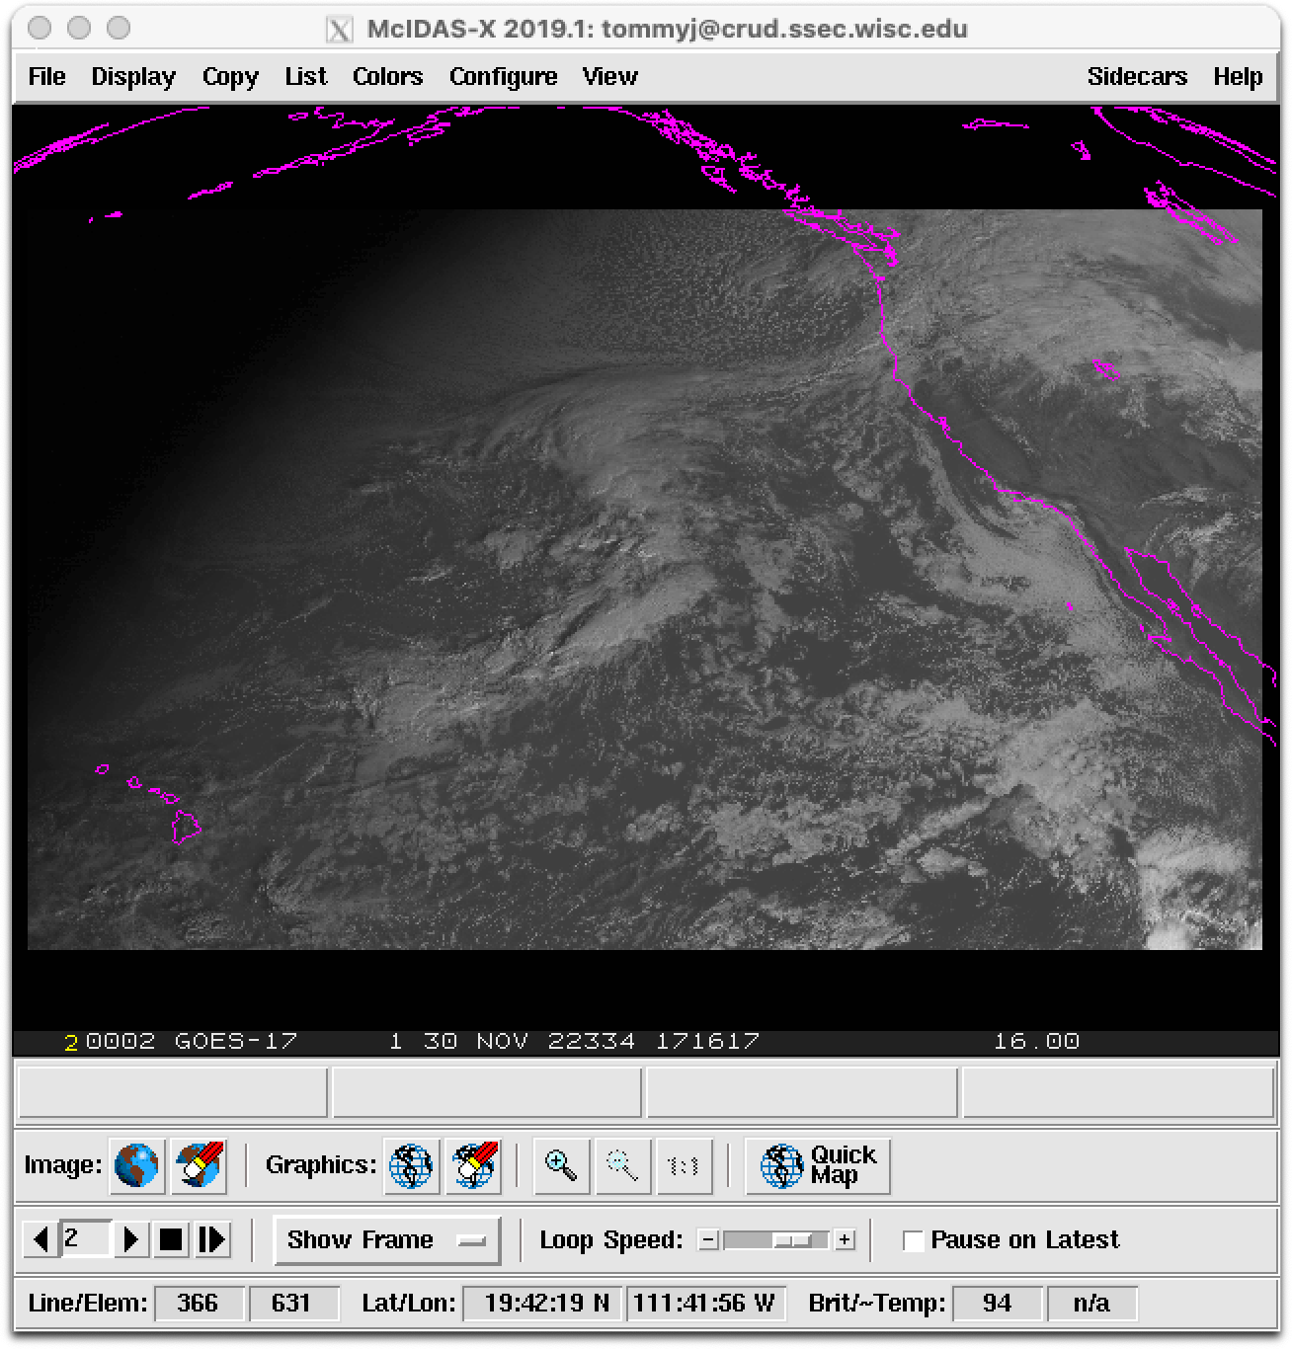
Why Start with an Existing Server?
FORTRAN and C
Python
L: IMGDISP ABDB17/CONUS.208 LAT=30 137 BAND=1 DAY=22334 MAG=-8
R: IMGDISP ABIP17/CONUS.208 LAT=30 137 BAND=1 DAY=22334 MAG=-8
Notes:
This gave us confidence we could use Satpy as a backend, that geolocation was accurate, etc.

Slide 8
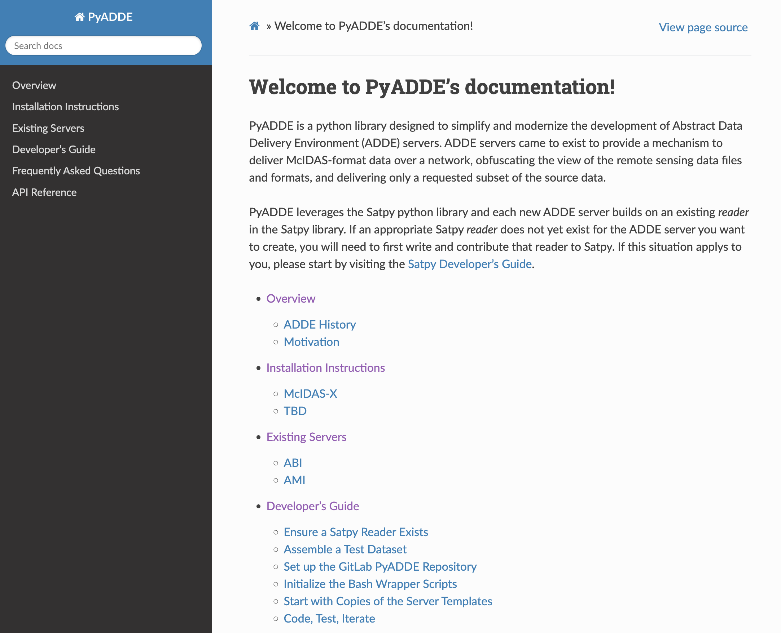
Online Documentation
Sphinx Python Documentation Generator
https://www.sphinx-doc.org/en/master/

Slide 9
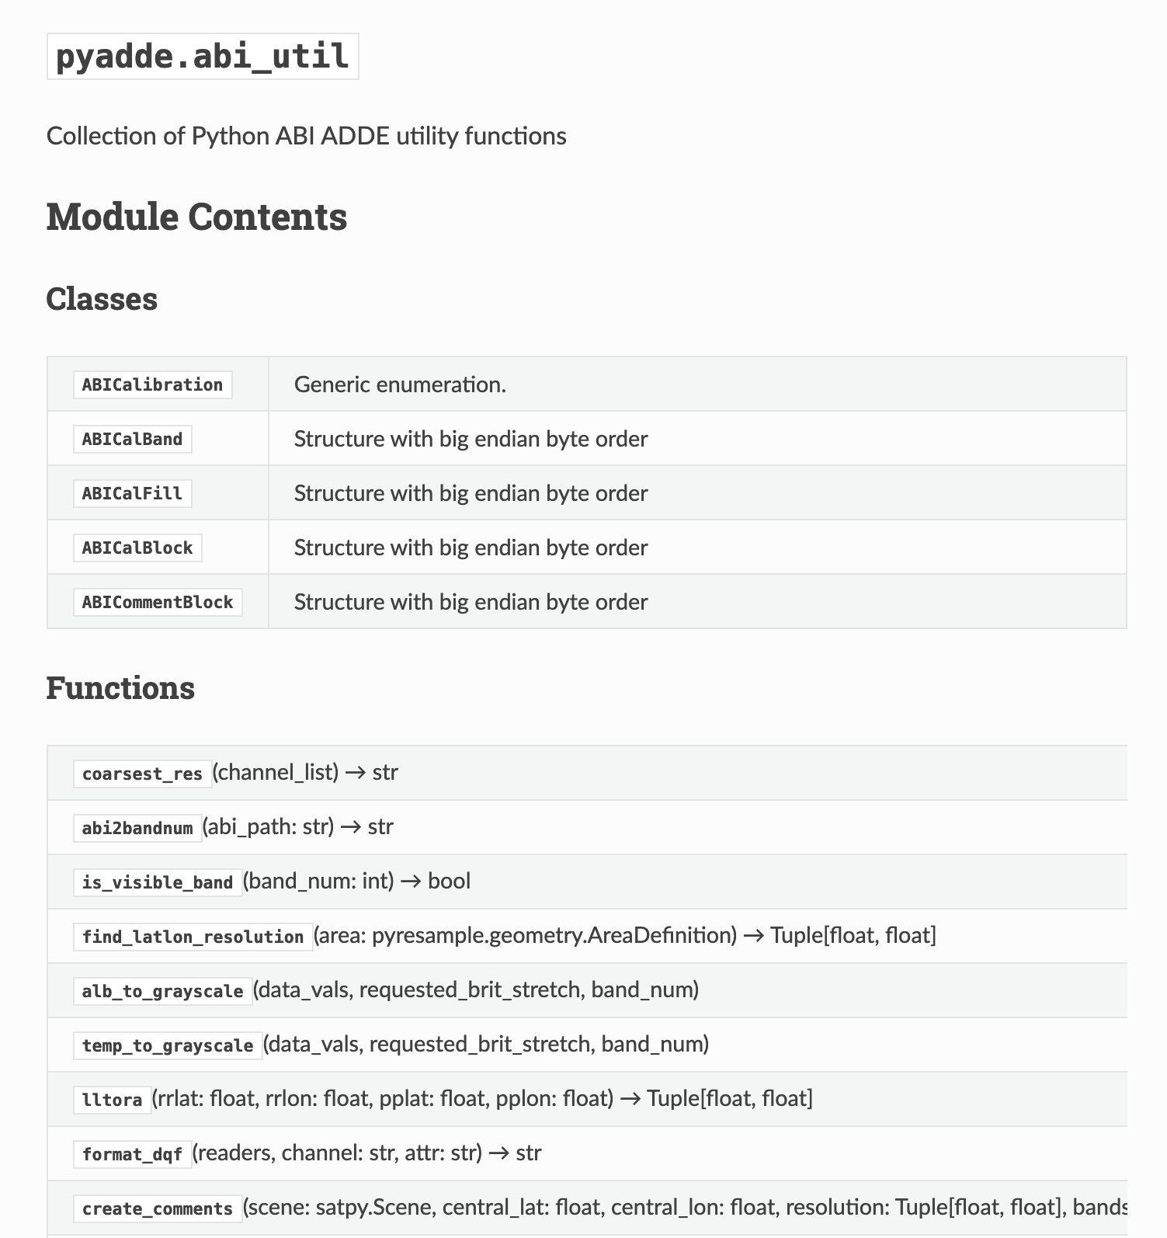
Auto-Generated Developer’s API

Slide 10
Until Next Time!

