Slide 1
McIDAS-X Software Development and Demonstration
Dave Santek and Jay Heinzelman
25 September 2023

Slide 2
Overview
McIDAS-X 2020.1, 2021.1, 2022.1
Software development and plans for 2023 and beyond…

Slide 3
Plans from last MUG meeting
September 2019
Investigate replacement environment for McIDAS-X for Windows 10:
  Windows Subsystem for Linux (WSL)
  Linux Virtual Machine
Support for VIIRS EDR data
Support Python ADDE servers
Promote from -XRD: GLMIMG

Slide 4
GOES Satellites
GOES-R Series ABI
Support GOES-17 fusion imagery
Calculate actual data resolution
Support for Level 2 CMIP
Corrected 1x1 pixel shift with upper left corner is off image
New Level 2 products: Aerosol detection of smoke and dust. Level 3 Vlab GLM
Notes:
16907 (G17), 16830 (res), 17013 (CMIP), 17234 (1x1), 17346 (smoke, vlab)

Slide 5
GOES Satellites
GOES-R Series ABI with Database
Database support for archive datasets
Servers are capable for use with database with GOES-18 and -19
Fixed error when database is used with a DAY range
Notes:
17104 (archive database), 17214 (database), 17159 (DAY)

Slide 6
Polar Satellites
VIIRS
Fixes to shortwave IR (band 18; M13) data interrogation (IMGPROBE)
Improve data output precision for NREF and REF (visible, near IR, SW IR)
Ability for server to read both SDR and EDR data files
Notes:
16993 (M13), 19969 (NREF), 16684 (EDR)

Slide 7
Other Geostationary Satellites
Meteosat
Added more precision in output of radiance
New server for Meteosat Third Generation (MTG) Flexible Combined Imager (FCI). Python-based.
  Added navigation and calibration modules
Notes:
17002 (RAD), 16842 (MTG)

Slide 8
Other Geostationary Satellites
Himawari, pre-GOES-R
Himawari
  Updates for high-resolution band 7
  EUMETCast version of HimawariCast support
Electro-optical Infrared Weather System Geostationary (EWS-G1)
  Updates needed for GOES-13 to EWS-G1
  EWS-G2 (formerly GOES-15) coming soon
Notes:
17360 (WARI), 17356 (WARC), 17085 (EWS-G1), 16180 (GEO)

Slide 9
Imagery
IMGCONV
  BNOR (blue channel normalization)
    With Rayleigh scattering correction
  IDT option to specify limb darkening
IMGPROBE
  NORM: histogram normalization
  Increase BOX limit size to 30M pixels
Notes:
16989 (IMGCONV), 17147 (NORM), 15613 (BOX)

Slide 10
Imagery
IMGOPER
  GAMMA keyword added for RGB images
NEXR servers updated for super-resolution WSR products
Improve RGBDISP performance
Notes:
16598 (GAMMA), 17262 (NEXR), 16192 (RGBDISP)

Slide 11
Display
DIST updated to handle small distances
(< 1km)
BAR
  Improvements to graphics, line width
  BORDER keyword
  Can handle up to 256 breakpoints from SU (stretch) table
Notes:
16918 (DIST), 17201 (BAR), 17143 (BORDER), 17153 (SU)

Slide 12
Display
CM
  Updated to correctly circulate graphics levels on all supported platforms
CUR
  STAT option added to interactively output latitude/longitude/pixel value
Notes:
16890 (CM), 16884 (CUR)

Slide 13
Grid
Grid server updated to handle larger grids (e.g., SST)
Update to current and access to new models: LMP, NAM, NWPS, URMA, WRFE, MRMS
Antarctica:
  Add WRF parameters
  Improve display over poles
Notes:
16937 (SST), 17205 (new models), 17052 (Antarctica)

Slide 14
Grid
Updates to handle GRDIMG navigation and subsecting correctly for high-resolution grids
GFS
  New specification for potential vorticity levels
  Add support for soil temperature
Grid servers and GRD* commands
  Handle decimal levels
  Work with sigma levels (SIGM)
Notes:
17022 (GRDIMG), 16818 (PVU), 16187/16067 (soil temp), 17245 (decimal and sigma levels)

Slide 15
McIDAS-XCD
Routine updates to STNDB.CORE with new and corrected METAR, TAF, and NAMMOS stations
Needed updates for zone and county maps with current NWS shapefiles for the WW* commands
Notes:
16903,16902,17054, 17053, 17252, 17251

Slide 16
McIDAS-XRD
GRAYLABEL: Label grayscale with brightness temperatures or albedo
  IMGDISP with GRAY=YES
RGB.MCB and RGB-VIIRS.MCB
DAYNITE: Combines visible and IR images at terminator
NOAA standard enhancement tables
NOAA STAR enhancement tables
Notes:
16862 (graylabel), 17212 (NOAA ENH), 16598 (RGB.MCB), 17390 (DAYNITE), 17368 (NOAA STAR enh), 17350 (RGB, RGB-VIIRS

Slide 17
Miscellaneous
ADDE servers honor the ADDETIMEOUT environment variable; overrides the 600 second default
REDIRECT command accepts 72 characters for directory path
Improve cut and paste behavior in McIDAS-X text window
DATALOC, DSINFO: MATCH= and CASEMATCH= keywords added to list datasets that match conditions
Notes:
17180 (timeout), 17134 (REDIRECT), 17075 (DATALOC, DSINFO), 17270 (cut&paste)

Slide 18
Plans for 2023 and beyond
IMGPROBE, IMGPARM: Add VIIRS scanline time
GRDIMG: Include scaling for more precision with IMGPROBE
Update VIIRS RGB recipes (Dust, cloud phase, sea spray, etc.)
Notes:
17446 (scanline), 17442 (VIIRS RGB), 17402 (sea spray), 17308 (scaling)

Slide 19
Plans for 2023 and beyond
DSSERVE: Solve race condition when multiple DSSERVE commands are running
IMGOPER, IMGREMAP: Occasional data-dependent issue with latitude/longitude navigation by pixel
Notes:
17271 (DSSERVE), 17249 (IMGOPER), 16637 (netCDF)

Slide 20
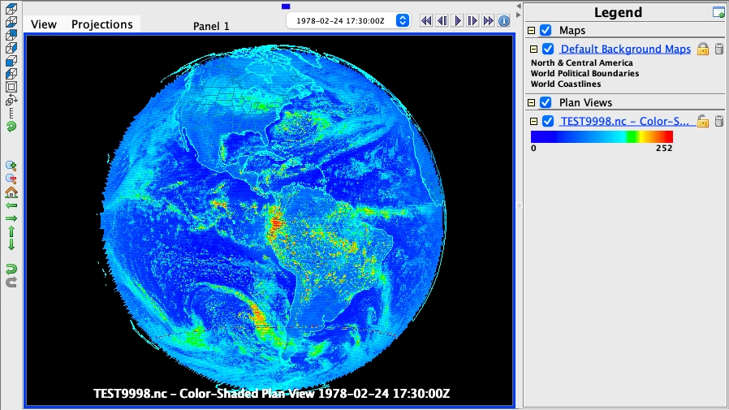
Plans for 2023 and beyond
ADDE netCDF write server: Off-Earth pixels are set to missing; displays correctly in McIDAS-V
Notes:
17271 (DSSERVE), 17249 (IMGOPER), 16637 (netCDF)

Slide 21
Plans for 2023 and beyond
McIDAS-XRD
IMGEU: When used with COMBINE, paneled frames can display images with a seemingly different enhancement for each panel
SUVI enhancement tables
Adding ABI day/night rocket plume RGB recipes
Notes:
17463 (IMGEU), 17483 (SUVI), 17419 (rocket)

Slide 22
New investigation
Python ADDE client
Functionally the same as IMGCOPY, the Python code:
  Constructs the ADDE request based on user-input specifications (server, ADDE dataset, subsecting, band, etc.)
  Sends request to server
  Returned data written to McIDAS Area

Slide 23
New investigation
Python ADDE client
Original Python code written by Ioan Ferencik in 2019:
  pyadde library is a Python 3 implementation of McIDAS ADDE client binary protocol
  pyarea library is a Python port of McIDAS Area Java reader/writer from the edu.wisc.ssec.mcidas Java package

Slide 24
New investigation
Python ADDE client
Sophia Reiner (current undergrad) has developed/prototyped additional functionality within the Python environment:
  User input/Default output display
  Navigation
  Reprojecting
  Output netCDF file

Slide 25
Python ADDE client
User input
Command line interface to input specifications for retrieving data via ADDE:
./fetchfile.py host=archive.ssec.wisc.edu group=AGOES02 descriptor=A-VIS file=AREA9998 unit=BRIT nlines=700 nelems=700 lmag=-22 emag=-22 stime=17.5 etime=17.5 position=0 band=1 day=1978055 netcdf=ncdf9998.nc
Notes:
17463 (IMGEU), 17483 (SUVI), 17419 (rocket)

Slide 26
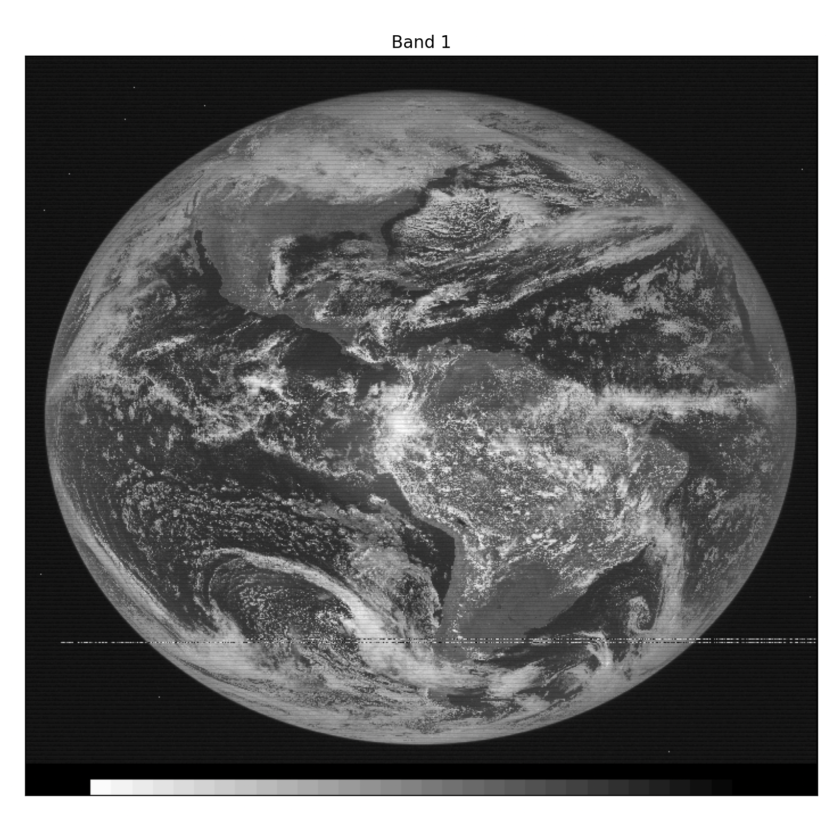
Python ADDE client
Default output display
Any data retrieved can be displayed
Navigation information not needed for default display
Calibration not needed (server converts units)
Notes:
17

Slide 27
Python ADDE client
Navigation
To geolocate the data and reproject, navigation is needed:
  ADDE server provides McIDAS navigation parameters
  Used f2py to convert the McIDAS-X nvxgoes.dlm Fortran navigation module to a Python-callable library
  nvxgoes.dlm is for GOES-1 to -7 satellites (1970s to 1990s)
Notes:
17463 (IMGEU), 17483 (SUVI), 17419 (rocket)

Slide 28
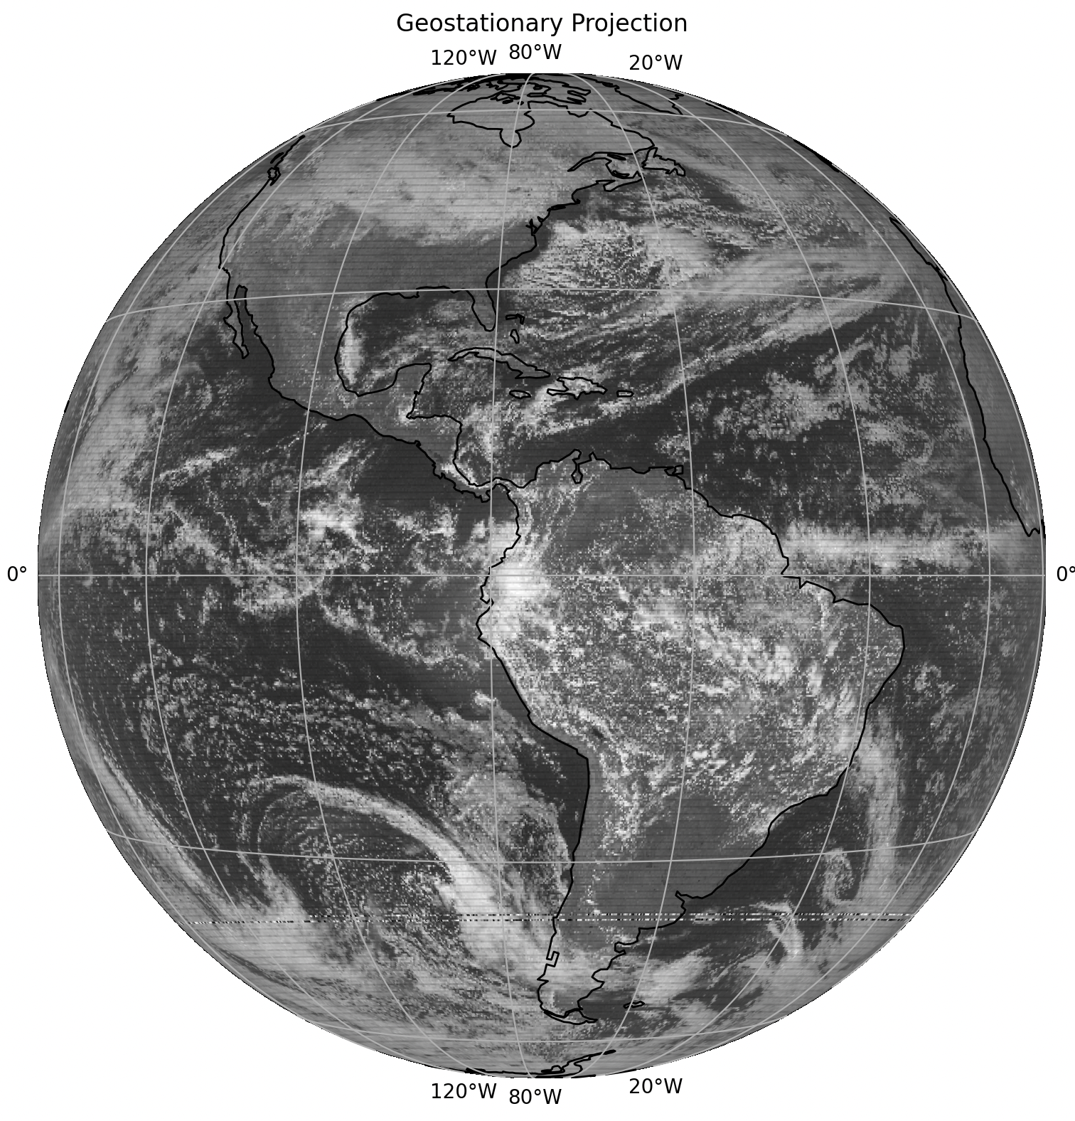
Python ADDE client
Navigation
Original image
Reprojected to nominal geostationary view
Notes:
17463 (IMGEU), 17483 (SUVI), 17419 (rocket)

Slide 29
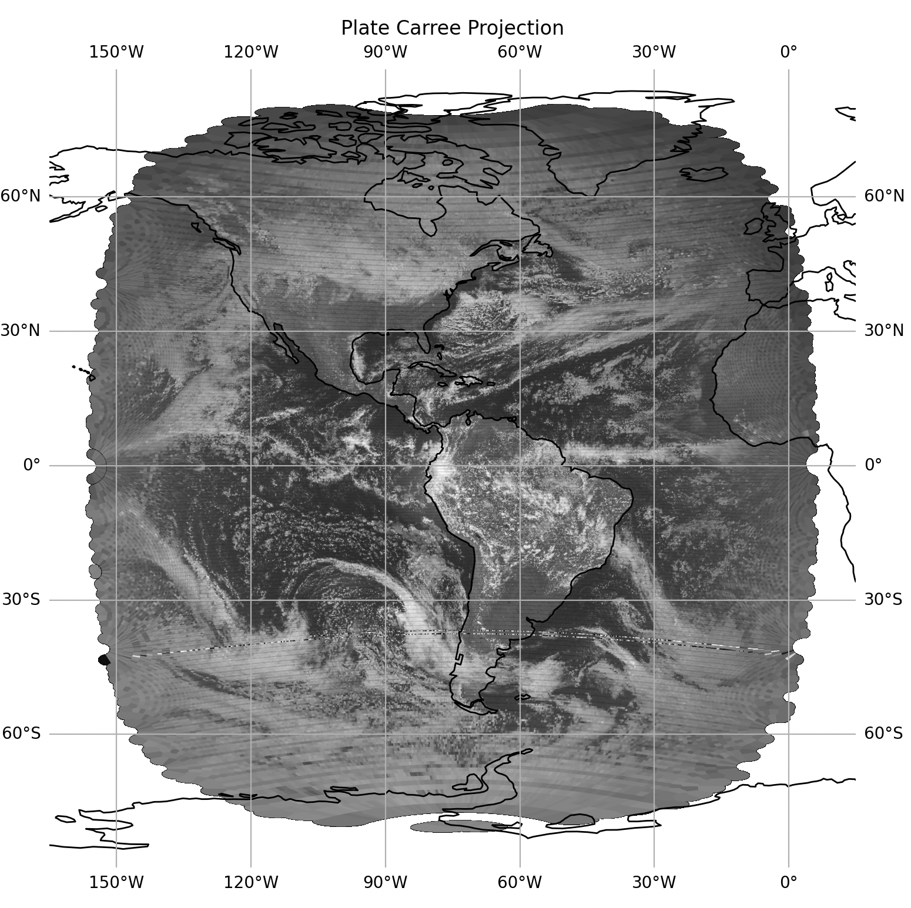
Python ADDE client
Reprojection
Nominal geostationary view
Latitude/Longitude projection
Notes:
17463 (IMGEU), 17483 (SUVI), 17419 (rocket)

Slide 30
Python ADDE client
netCDF file output
Write out geostationary projected image to netCDF file Displayable in McIDAS-V
Notes:
17463 (IMGEU), 17483 (SUVI), 17419 (rocket)

Slide 31
Any questions for
Jay or Dave
on McIDAS-X Demo?
Any technical questions about Python ADDE client:
Sophia should be at icebreaker
Notes:
17463 (IMGEU), 17483 (SUVI), 17419 (rocket)

