Slide 1
MUG Status Update Becky Schaffer – McIDAS Program Manager beckys@ssec.wisc.edu
2025 McIDAS Users' Group Meeting
21 May 2025
https://www.ssec.wisc.edu/mcidas

Slide 2
MUG Status Update
MUG Personnel
What’s New in 2025
Who uses McIDAS-X and McIDAS-V?
McIDAS User Support
How long will McIDAS-X be supported?

Slide 3
MUG Personnel Current MUG Staff
Kevin Baggett: -XCD programming
Jon Beavers: -V & pyADDE programming
Bob Carp: Help Desk & testing -V documentation & programming
Jay Heinzelman: Help Desk & testing
-X documentation & programming
Dave Parker: Systems programming

Slide 4
MUG Personnel Programmers
McIDAS-X
SSEC:
Tommy Jasmin
Rick Kohrs
Tim Olander
Dave Santek
Dave Stettner
McIDAS-V
SSEC:
Ansh Aggarwal
Tommy Jasmin
Tom Rink
Unidata:
Julien Chastang
Yuan Ho

Slide 5
MUG Personnel Unidata Collaboration
Working Together on VisAD, IDV, McIDAS-V and McIDAS-X
Monthly –V / IDV Teleconferences
MUG Testers helping to test new functionality in IDV
Code exchanges between McIDAS-V and IDV
McIDAS-X programming

Slide 6
MUG Personnel Unidata Collaboration
Unidata currently provides McIDAS-X & XCD free of charge to educational institutions
Why that’s important:
Future meteorologists learning McIDAS-X before entering the “real” world is important for the future of McIDAS
Current websites like College of DuPage and Embry-Riddle are important online sources of satellite imagery and they use McIDAS-X for the majority of their imagery

Slide 7
What’s New in 2025? McIDAS-X OS Support
Vendor | Operating System
Apple | macOS 13 (2024.1 only) | gcc / gfortran 13.1 compilers
 | macOS 14 & 15 | Podman container with Rocky Linux 9 - new in 2024.1
 | ** will support Podman containers on macOS 16 when fully supported at SSEC

Slide 8
What’s New in 2025? McIDAS-X OS Support
Reasons for transition from native OS (Darwin) to a containerized Linux kernel (Rocky Linux 9).
Xcode does not use GNU compilers
gfortran is not available in Xcode
Reliance on “homebrew” for compilers and support libraries
macOS Gatekeeper is becoming more restrictive about running non-signed binaries. Difficult to manage signing because:
McIDAS-X is composed of many small standalone binaries that communicate via shared memory
User-generated binaries must also be signed

Slide 9
What’s New in 2025? McIDAS-X OS Support
Vendor | Operating System | Compilers Supported
Microsoft | Windows 11 with WSL (Windows Subsystem for Linux) | gcc / gfortran 11.4
 | Ubuntu 22.04.5 LTS
 | ** Windows 10 will reach EOL support from Microsoft October 14, 2025, and no longer be supported by MUG in the next release.

Slide 10
What’s New in 2025? McIDAS-X OS Support
Vendor | Operating System | Compilers Supported
Red Hat | Red Hat Enterprise Linux (RHEL) | gcc / gfortran
 | RHEL 9.5 - new in 2023.1 | 11.5
 | RHEL 8.1 | 8.5

Slide 11
Who uses McIDAS-X? Current MUG Members
NOAA CLASS ESPC NCEP CENTRAL OPERATIONS NWS - PACIFIC REGION STAR NOAA – CI CIMSS/SSEC CIRA EDUCATION UNIDATA | NASA COLUMBIA SCIENTIFIC BALLOON FACILITY JOHNSON SPACE CENTER LANGLEY RESEARCH CENTER GOVERNMENT / MILITARY CAPE CANAVERAL SFS NTSB PATRICK AFB CDD | PRIVATE ACCUWEATHER BOEING ENSCO REDTOWN SERVICES – KWAJALEIN ATOLL INTERNATIONAL AUSTRALIA – BoM MEXICO – AIR FORCE MEXICO – HIDROMET SPAIN – AEMet

Slide 12
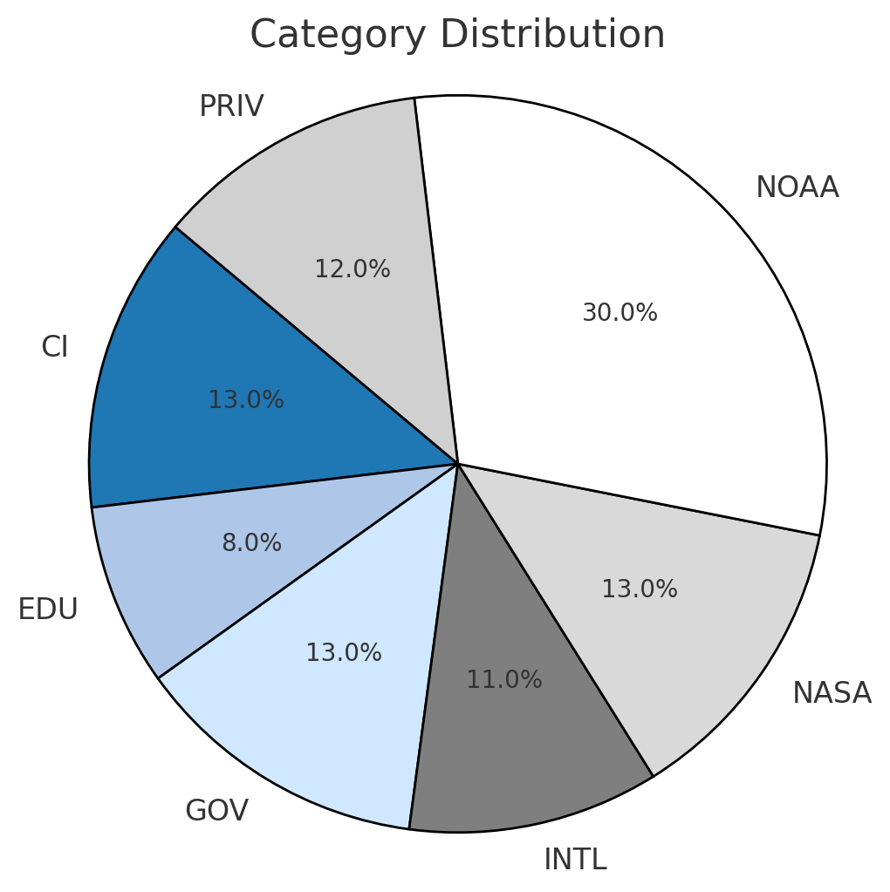
Who funds McIDAS-X? Current MUG Members
McIDAS support and maintenance is funded 100% by MUG Membership Fees
Additional funding pays for special projects:
SSEC Funds – ABI python servers & database work
NOAA / AMRDC – MTG & MetOp-SG python servers
CIRA – VIIRS development

Slide 13
Who uses McIDAS-V?
McIDAS-V is now used in…
research projects & publications
satellite blogs
satellite meteorology classes
visualization of EUMETCast and GEONETCast
international training courses: EUMETSAT, CIRA
private industry Funded mostly by MUG with special projects funded by CIRA & EUMETSAT

Slide 14
Who uses McIDAS-V? From the Usage Statistics
1.2 MILLION Uses in 2024 !
18 MILLION Total Uses ! - each time a script is run or McIDAS-V is started
1450 Members of the McIDAS-V Forums !
Users of McIDAS-V are encouraged to answer forum questions of other users and share their knowledge & expertise.

Slide 15
McIDAS Support User Support Requests
With so many new non-paying users, how do we prioritize our support?
McIDAS-X, –XCD and SDI questions from MUG members to the McIDAS Help Desk
McIDAS-V questions from MUG members to the Help Desk and Support Forums
McIDAS-V questions from non-MUG users to the Support Forums
ALL bug reports are put into the McIDAS Inquiry System
 | 2024
McIDAS-X Inquiries | 106
McIDAS-V Inquiries | 59
McIDAS-V Forum Posts | 38

Slide 16
McIDAS Support How long will –X be supported?
SSEC plans to support McIDAS-X through the current GOES-R Satellite Series, which is currently listed as 2039 NO END DATE IN SIGHT!!!
MUG members will continue to receive priority support for –X and –V
Continue to release –X as needed for bugs, updates, improvements, and new OS & data/satellite changes (1-2 times per year)
No plans for support fee structure changes

Slide 17
McIDAS Support How long will –X be supported?
Important Programming & User Issues
ADDE written in Fortran and C – Python!
Larger datasets mean larger images, maps, and grids – improvements have been made
-X tcl / tk GUI more fragile with each OS upgrade
Display Quality Issues with fonts and labels
Always looking for new funding sources for special projects
NOAA / AMRDC – MetOp-SG python servers
??? – GEOXO python servers

Slide 18
McIDAS Support Looking for more user input!
Especially with the availability of free GOES ABI viewers …
We’ve had 3 large sites tell us that they’ve done studies to look for options other than McIDAS
Their findings: McIDAS is the best!
Gave us a punch list on things to improve, sometimes with funding, sometimes with no funding
If you’re looking for options, let us know. We can help!

Slide 19
McIDAS Support Looking for more user input!
Use McIDAS-V Support Forums or contact the McIDAS Help Desk
Fill out the MUG Meeting Survey to be sent later this week
Suggestions for improving McIDAS or the MUG Meeting?
What data types do you need to read/write with McIDAS?
On what platform(s) do you currently run McIDAS?
Do you use the McIDAS-X GUI?
Add your comments at the end of the survey!
If you have specific development needs, contact me or the Help Desk about helping to fund site-specific development.

Slide 20
In Summary…
McIDAS Users’ Group is still going strong!
MUG Membership staying steady for large sites using -X, -XCD and SDI -- still our #1 Priority
McIDAS-X will be fully supported, updated & maintained at least through the GOES-R Series (2039)
McIDAS-V usage still growing and user forums have been a success
We’re always looking for new funding sources, large or small

Slide 21
In Summary…
We need input from you
to make all of McIDAS better
for everyone!
THANK YOU!!!

