Slide 1
McIDAS –XCD Status Update
2025 McIDAS Users’ Group Meeting

Slide 2
McIDAS-XCD Team
Kevin Baggett, Jonathan Beavers, Dan Forrest, Jay Heinzelman, Dave Parker, Jerrold Robaidek, Becky Schaffer, Clayton Suplinski

Slide 3
McIDAS-XCD
McIDAS X
Conventional Data
Decoder
McIDAS-XCD files, decodes and indexes the NOAAPORT data stream into formats that can be served by McIDAS-X ADDE servers.
Output formats include McIDAS MD files, Text files, McIDAS GRID files, GRIB
Version 1 and 2 files, NEXRAD files, and BUFR files.

Slide 4
Recent Updates to McIDAS-XCD
Latest version is 2024.1
2 annual releases since the last MUG Meeting
Updates to code so that it compiles with gfortran 10+
Additions/updates to RTGRIDS datasets
Improvements to add more levels to RTPTSRC UPPERMAND and UPPERSIG products
Added new definitions of RADAR/WSR datasets to handle super resolution NEXRAD Level 3 products with improved dataset naming with input from the McIDAS-X Team

Slide 5
McIDAS-XCD 2024.2
McIDAS –XCD has been reliably providing data to McIDAS-X users for many years
The last release of the legacy system will be McIDAS-XCD 2024.2 in the coming months with some minor changes from the 2024.1 release from December.
The replacement will be the previous McIDAS-XCD Beta, first released in 2023.
McIDAS-XCD 2025.1, released later this year, and beyond will be the new system

Slide 6
Goals of McIDAS-XCD 2025.1
Replace 4 parts of -XCD filing and decoding:
GRIB
NEXRAD
Text
POINT/MD serving
Utilize LDM direct filing
Reduce or eliminate compiled code
Remove legacy mainframe complexity
Utilize simple open-source database, SQLite
Match or exceed current filing and serving performance on existing hardware

Slide 7
McIDAS-XCD 2025.1: Packaging and Installation
Existing servers and decoders (compiled code) have been migrated into McIDAS-X since 2022.1
McIDAS-XCD 2025.1 GRIB and text software have been packaged as Podman containers and tested on multiple Linux RHEL 8/9 multiprocessor/multithreaded machines
We utilize Unidata LDM that is packaged as a Docker container
Podman/Docker has the goal of simplifying the installation, running, and upgrading of the McIDAS–XCD 2025.1 components for the benefit of system administrators.

Slide 8
McIDAS-XCD 2025.1 Requirements
Linux (RHEL 8 or 9)
Podman (most recent version, currently 5.0 with RHEL 9)
Unidata LDM or LDM Docker container
The following LDM-specific files for McIDAS–XCD Beta are supplied with the package
pqact.conf
ldmd.conf
registry.xml
Except for a few instances, the above files can be changed to what the McIDAS–XCD site needs

Slide 9
McIDAS-XCD 2025.1 System
-XCD/site-specific config files
start_xcd
Future
Unidata LDM
xcdtext
xcdgrib
xcdbufr
Raw NEXRAD (WSR & TDWR) files
Raw .XCD text files
Raw .grib1/.grib2 files
SQLite daily
text databases
SQLite GRIB databases separated by
date, model, and GRIB version
SQLite BUFR databases separated by date and BUFR version
ptdb* servers
obtgserv
wtxgserv
nexr* servers
wtxgserv
gribdb* servers
bufrdb* servers

Slide 10
McIDAS-XCD 2025.1: GRIB Data
RTGRIDS dataset
LDM files GRIB messages to a temporary directory
A Python daemon watches for GRIB data, extracts information and files metadata into SQLite databases
SQLite databases are separated by version, model and date
Volume of GRIB data has increased greatly over the last few years especially with CONDUIT feed additions

Slide 11
McIDAS-XCD 2025.1: NEXRAD Data
RADAR, WSR and TDWR datasets
LDM directly files NEXRAD files (WSR and TDWR) into a directory structure similar to the existing -XCD Decoder
Data served by the existing NEXRAD server

Slide 12
McIDAS-XCD 2025.1: Text Data
RTWXTEXT dataset
LDM files text data directly to disk as a daily .XCD file
A bash daemon script watches for new data and extracts metadata for insertion into a daily SQLite database
Text servers (wxtgserv and obtgserv) query the daily SQLite databases to find data and return information to the client
Commands: WXTLIST, WWLIST, WWDISP, *RPT

Slide 13
McIDAS-XCD 2025.1: Point Data
RTPTSRC dataset
Uses certain text data identified by WMO headers filed in the daily SQLite text database (e.g. SA and SP for SFCHOURLY)
No MD files are created, but structure created on the fly when serving via ADDE
At the start of each UTC day, the replacement –XCD creates a station table in the daily database based on the current version of STNDB.CORE
Commands: PTLIST, PTDISP and PTCOPY
Retrieve metadata from the SQLite database, then extract data from the daily *.XCD files created by LDM

Slide 14
Point Data Improvements
McIDAS–XCD 2025.1 captures more surface hourly data than existing –XCD
Existing –XCD: Hourly & 2 Specials
McIDAS–XCD 2025.1: Hourly & All Specials

Slide 15
Point Data Issues
Number of hourly records of PTCOPY for SFCHOURLY data has been increased and can be a variable number up to 3600 readings per hour (every second)
Usually not more than 2 or 3 specials per hour
Certain searches in McIDAS–XCD 2025.1 are known to take longer than in McIDAS–XCD 2024.1
SFCLIST CO=US DAY=19/May/2026 TIME=0 23 SEL=‘T[F] 60 90’ takes about 2-3 seconds from McIDAS-X servers for McIDAS–XCD 2024.1 due to MD file storage of temperature data. This compares to about a minute using McIDAS-X servers for McIDAS–XCD 2025.1 as the servers have to calculate the temperature data on the fly from the raw text data

Slide 16
BUFR Data (Binary Universal FoRmat)
Filed directly using LDM
Using the ecCodes Python API from ECMWF, we have been able to set up a prototype BUFR Version 3 and 4 SQLite database system similar to the GRIB system with aspects of text data
We have been able to serve BUFR data from this prototype using the PTLIST/PTDISP commands
Not delivered with the McIDAS-XCD 2025.1 package but this will be a focus of future releases

Slide 17
Local Data
A couple -XCD sites have local (non-NOAAport) feeds of data
We have been notified of a couple core –XCD code dependencies and have migrated those code modules to a library used for McIDAS-XCD servers in McIDAS-X
Sites will continue to be able to use the legacy -XCD libraries, or may link to McIDAS-X libraries as needed. Contact Jerry Robaidek or Becky Schaffer if you have concerns.

Slide 18
McIDAS-XCD 2025.1 Monitoring
Command line
ldmadmin watch from within the xcdldm container
Graphical
HTML based
Does not require apache to be installed
Need to open a port to the McIDAS-XCD 2025.1 machine to display

Slide 19
McIDAS-XCD 2025.1 Point/Text Monitoring

Slide 20
McIDAS-XCD 2025.1 Testing
We will be running through the McIDAS-XCD 2025.1 installation process one more time with a new machine in the coming weeks
Dell Poweredge 360, 16 GB RAM, 8 core/16 thread 3.2 GHz processors, 16 TB hard drive
RHEL 9 with Podman Version 5.0

Slide 21
McIDAS-XCD Issues for Discussion
NWS has accelerated AWIPS migration to the cloud timetable to September 2026 from September 2028
NOAAPORT/SBN distribution commitment until that date but won’t commit beyond that

Slide 22
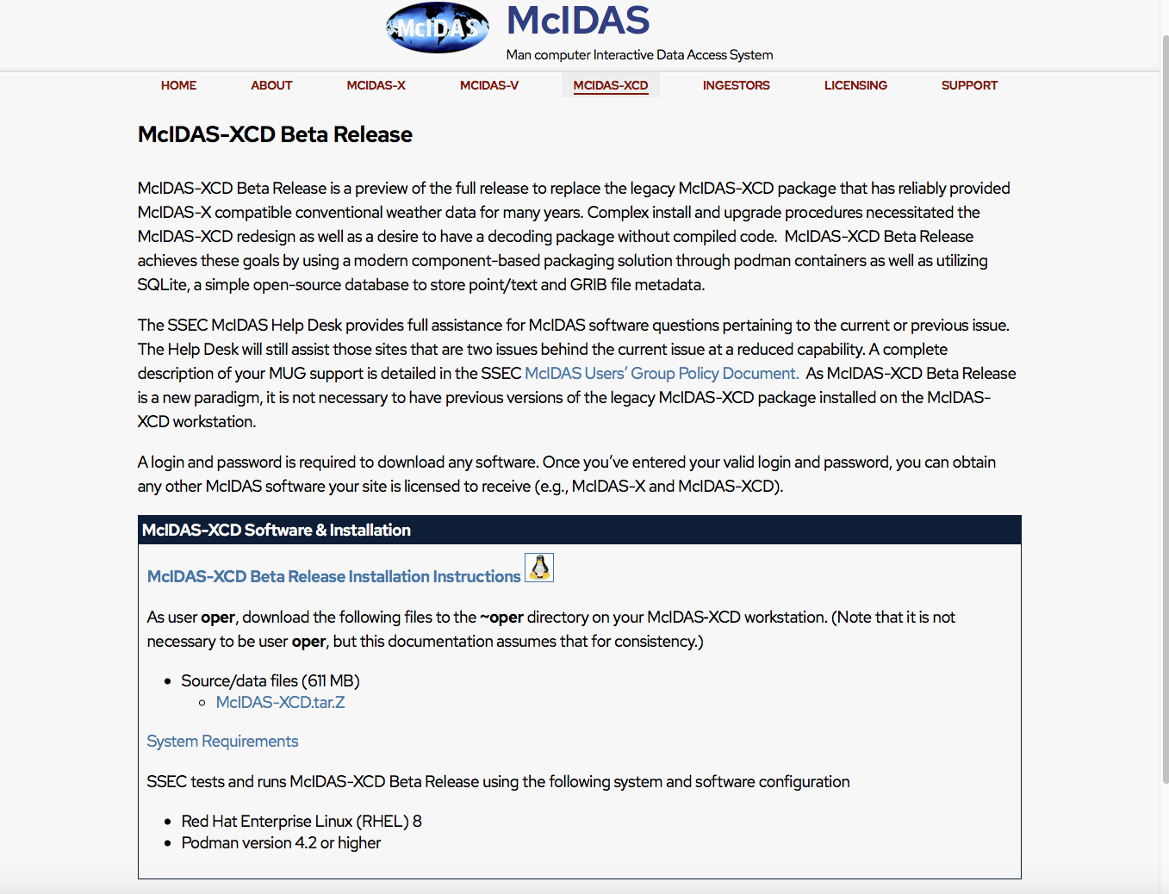
McIDAS-XCD 2025.1 Webpage
https://www.ssec.wisc.edu/mcidas/software/xcd/xcd-beta/

