Slide 1
McIDAS-V Demo
Bob Carp
2025 McIDAS Users’ Group Meeting

Slide 2
Outline
McIDAS-V introduction
Kanlaon Volcano – VIIRS RGB, GEMS, TEMPO, HYDRA2
Cyclone Zelia – VIIRS Rayleigh Correction, MIRS, Sandwich RGB, HYDRA2
3D Gridded display over Hurricane Milton
Additional enhancements and new functionality in McIDAS-V
How to download the 2.0beta1 nightly build

Slide 3
Introduction
McIDAS-V is composed primarily of two windows, the Main Display window and the Data Explorer window.
Main Display window – Where most displays appear
Data Explorer window – What and how to display.
Data Sources tab – Select the type of data
Field Selector tab – Select the variable and display type
Layer Controls tab – Modify the display

Slide 4
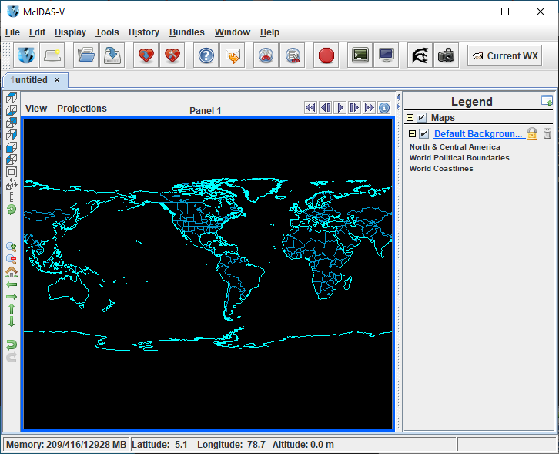
Main Display Window

Slide 5
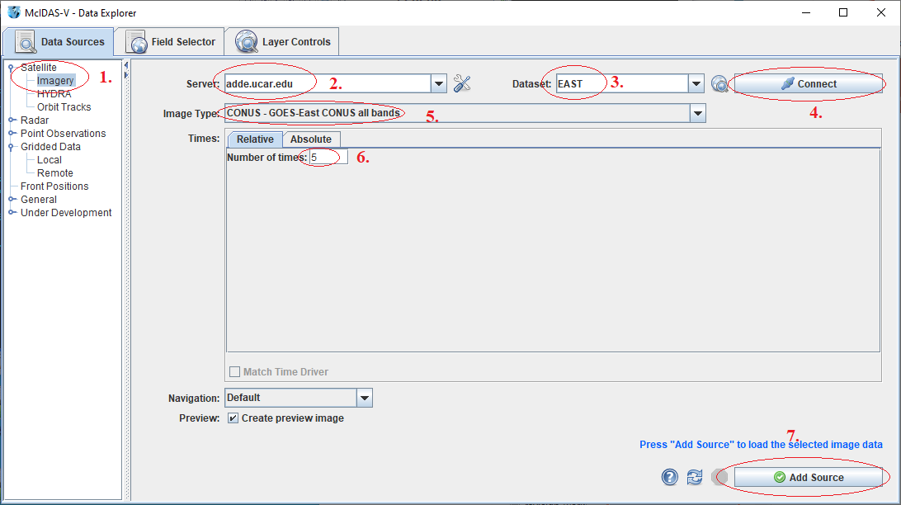
Data Explorer Window Data Sources Tab

Slide 6
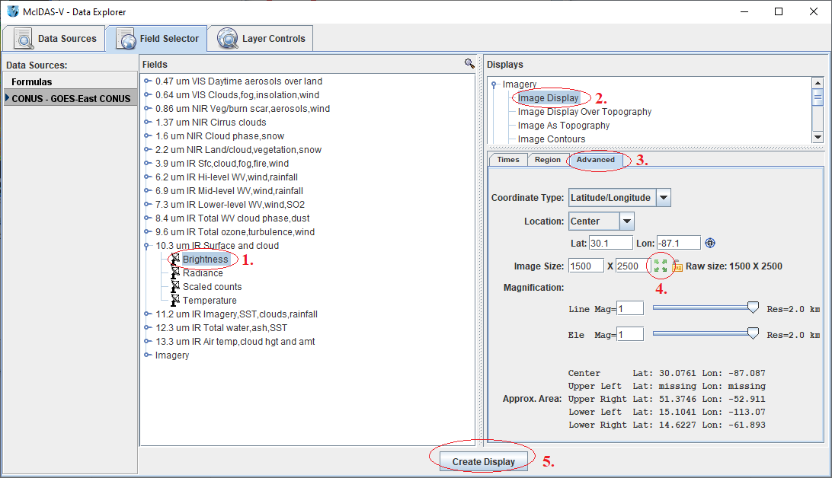
Data Explorer Window Field Selector Tab

Slide 7
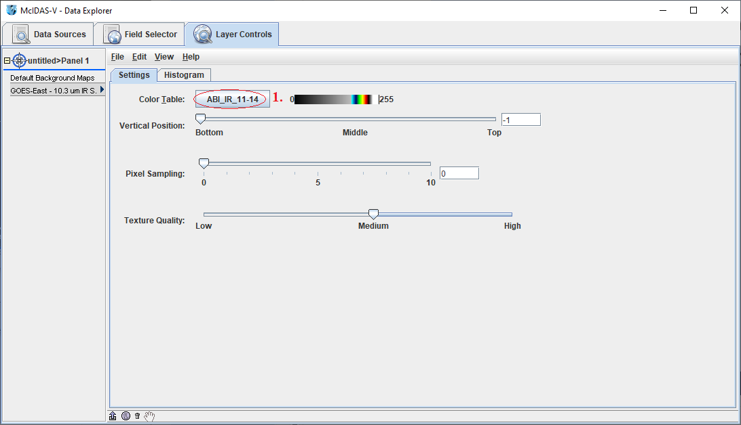
Data Sources Window Layer Controls Tab

Slide 8
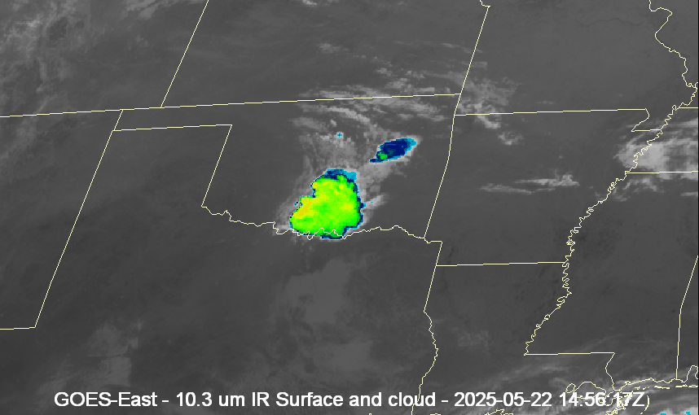
Display

Slide 9
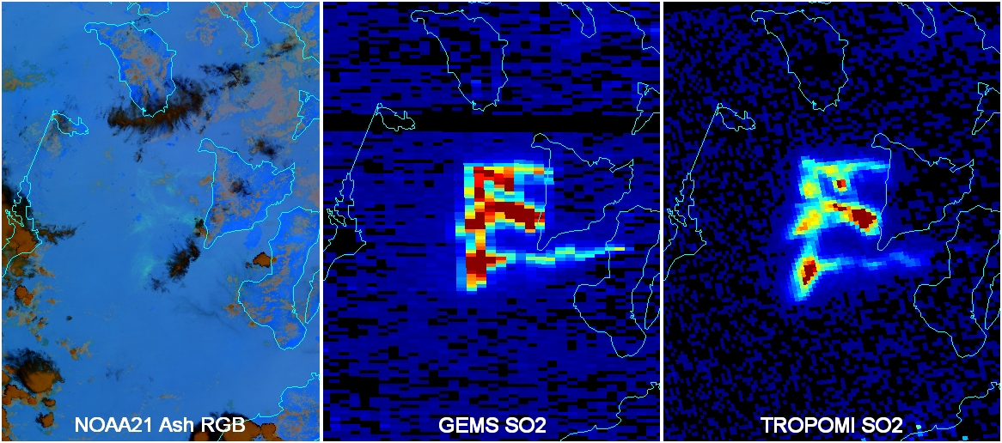
Example 1: Kanlaon Volcano Steps to Create to Follow

Slide 10
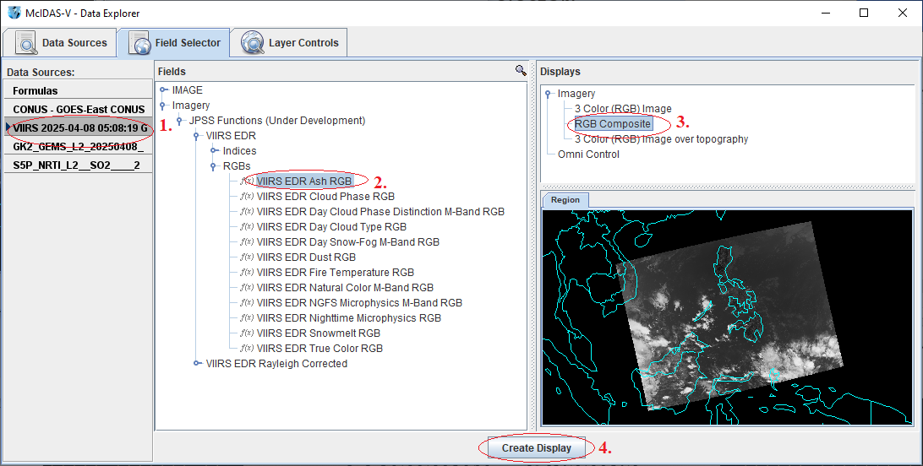
Panel 1 – Ash RGB
Load VIIRS data containing M14, M15, and M16 through the JPSS Chooser. In the Field Selector:

Slide 11
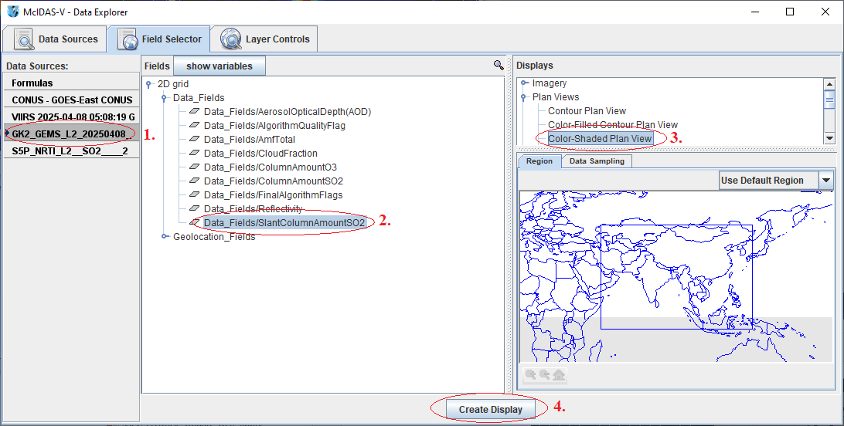
Panel 2 – GEMS SO2
Load GEMS data through the General>Files/ Dir chooser as a gridded data source. Field Selector:

Slide 12
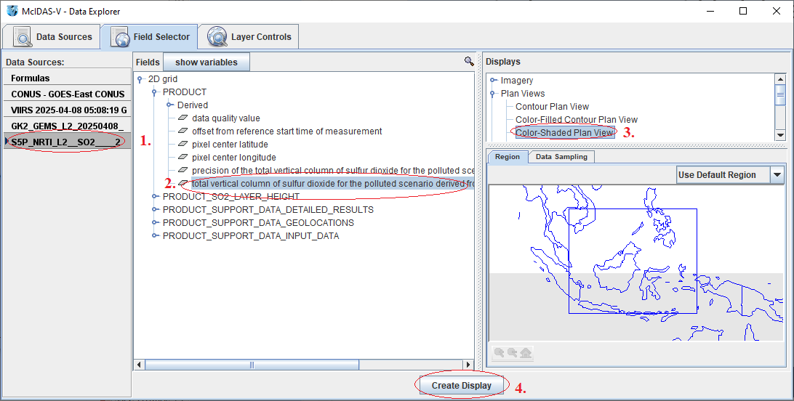
Panel 3 – TROPOMI SO2
Load TROPOMI data through the General>Files/ Dir chooser as a gridded data source. Field Selector:

Slide 13
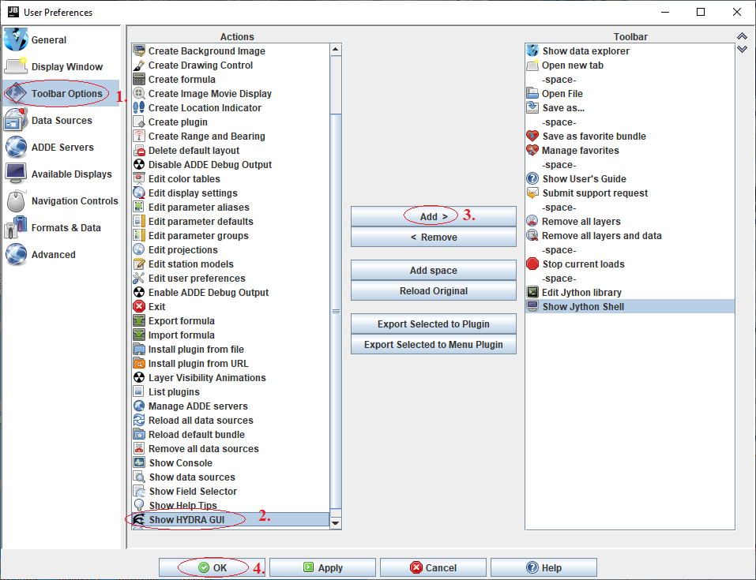
Add HYDRA2 Button to Main Display
From the Main Display window, select Edit > Preferences. Add HYDRA2 button to toolbar:

Slide 14
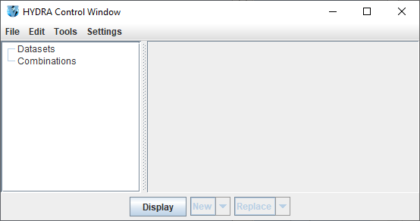
Start HYDRA2
From the Main Display window, click the HYDRA2 button.

Slide 15
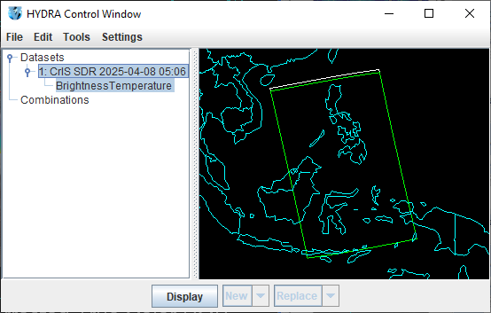
Load CrIS Data in HYDRA2
Start HYDRA2. In the HYDRA Control Window, select File>Files. Select file. Click Display

Slide 16
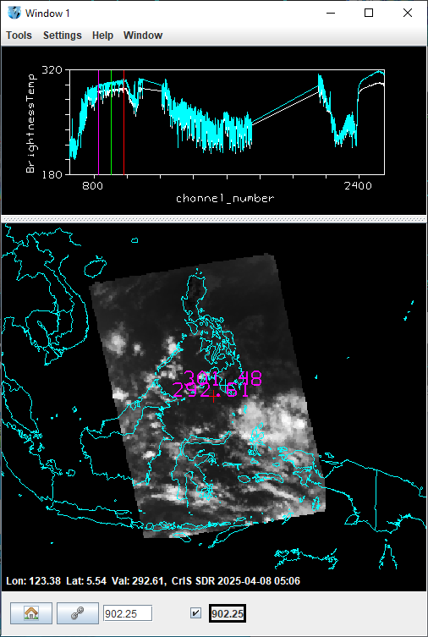
Subtract 2 Channels to Show SO2
In the HYDRA display window, choose Tools>Four Channel Combine. Enter 1345.0-1325.0 and click Create. Channel 1345 is SO2 sensitive, 1325 is not. Both channels are similarly sensitive to water vapor.

Slide 17
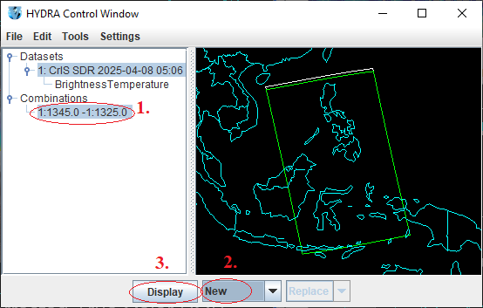
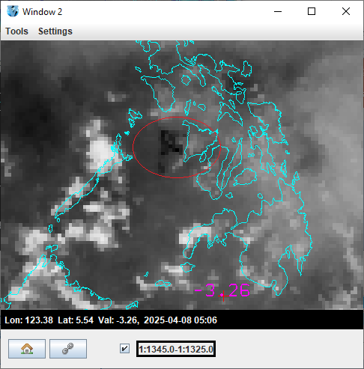
Display Channel Subtracted Data
In the HYDRA Control Window, display the Combination in a new window. The dark area circled represents likely SO2 detection.

Slide 18
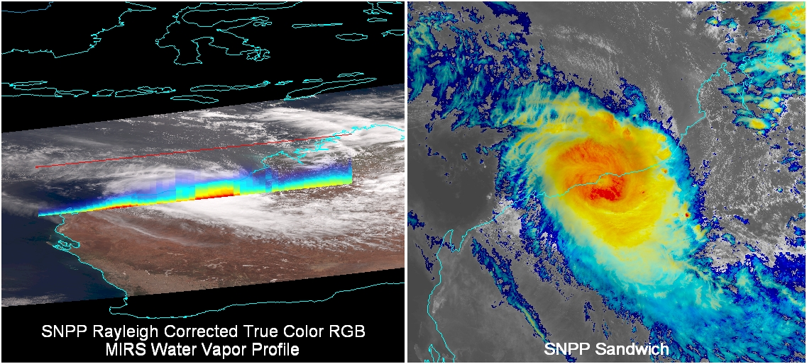
Example 2: Tropical Cyclone Zelia Steps to Create to Follow

Slide 19
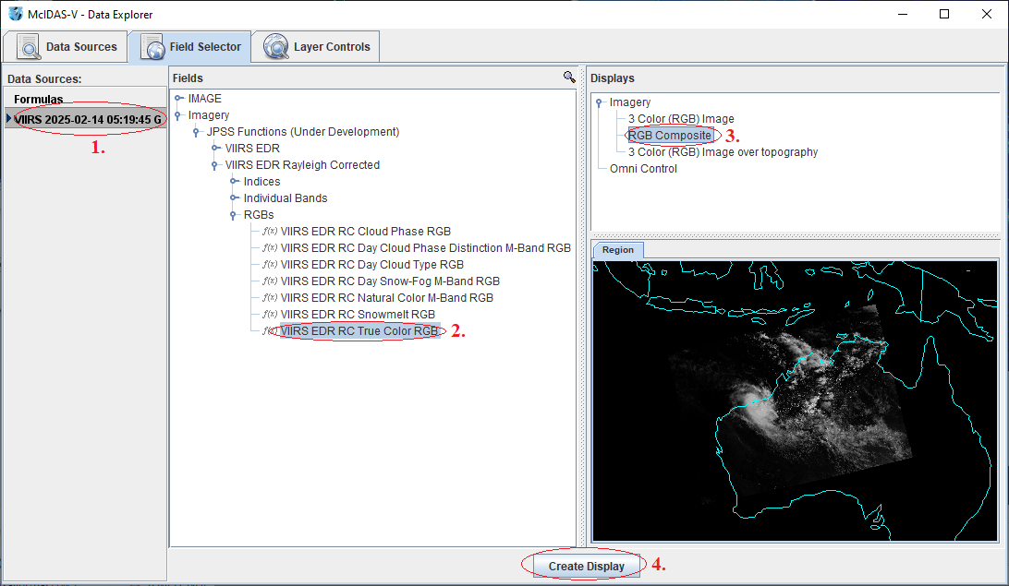
Panel 1 – Rayleigh-Corrected RGB
Load VIIRS data containing M3, M4, M5, and M15 through the JPSS Chooser. In the Field Selector:

Slide 20
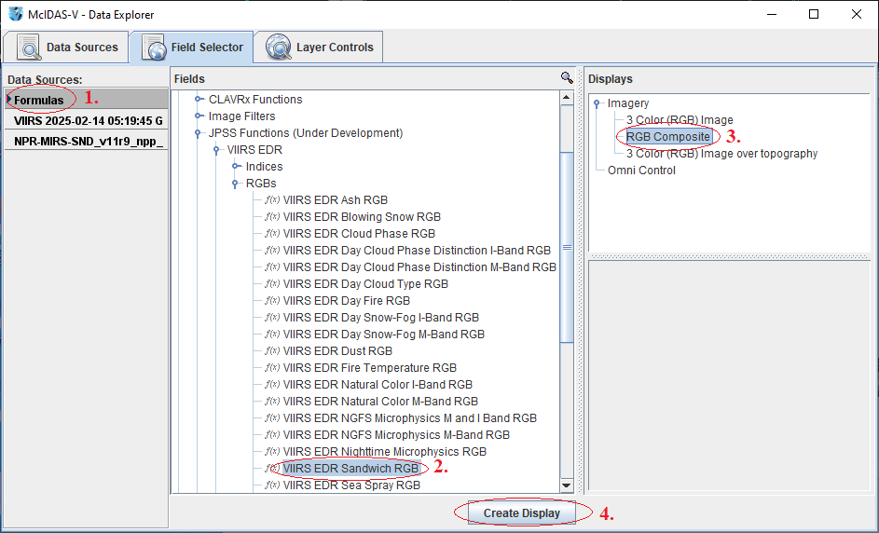
Panel 1 – Water Vapor Profile
Use the same VIIRS file from the RGB. In the Field Selector (min/max=180/270; VIS=M4Rad; IR=M15T):

Slide 21
Panel 2 – GEMS SO2
Load GEMS data through the General>Files/ Dir chooser as a gridded data source. Field Selector:

Slide 22
Start HYDRA2
From the Main Display window, click the HYDRA2 button.

Slide 23
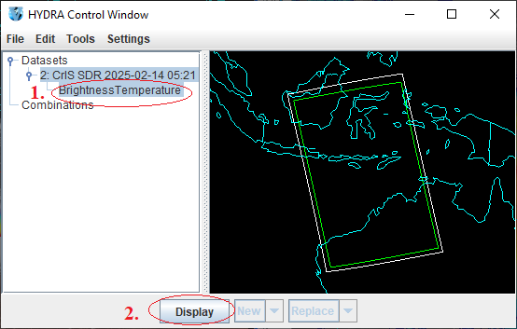
Load CrIS Data in HYDRA2
Start HYDRA2. In the HYDRA Control Window, select File>Files. Select file. Click Display

Slide 24
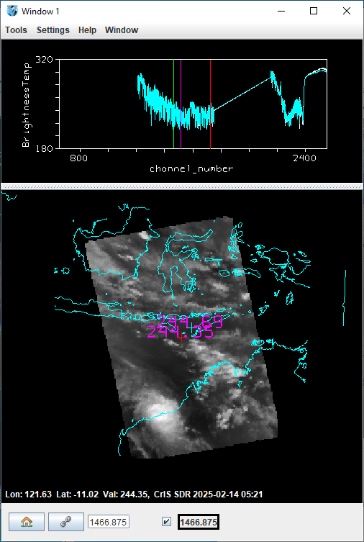
Convolve CrIS Bands
In the HYDRA display window, choose Tools>Convolve. Enter a range of 1517.5 to 1726.875 and click Create. This range can be used to simulate ABI upper-level water vapor band 8.

Slide 25
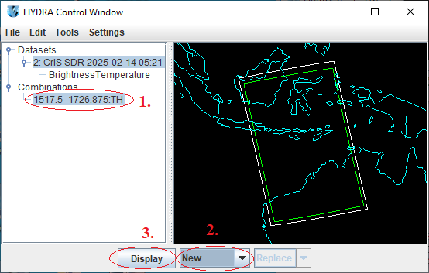
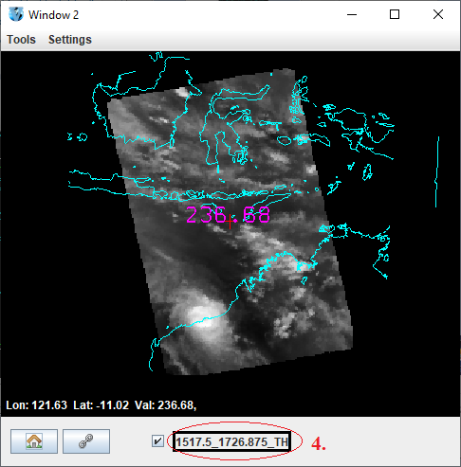
Display Convolved CrIS Data
In the HYDRA Control Window, display the Combination in a new window. After inverting the enhancement, this looks like ABI band 8.

Slide 26
Other New HYDRA2 Functionality
In the MultiSpectral display, probes can be added over the highest and lowest pixel locations.
The Transect Display is now possible than VIIRS data.
Multi-variate transect displays are now possible.
Scatter Analysis displays can be colored by density.
Note – The goal is to have HYDRA2 replace the existing HYDRA in McIDAS-V.

Slide 27
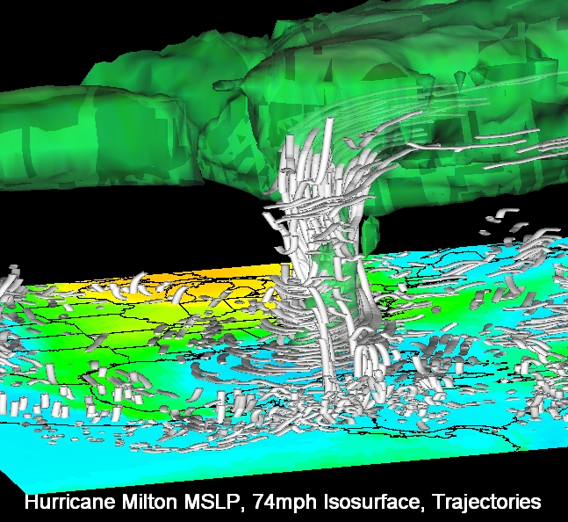
Example 3: Hurricane Milton GFS Data Steps to Create to Follow

Slide 28
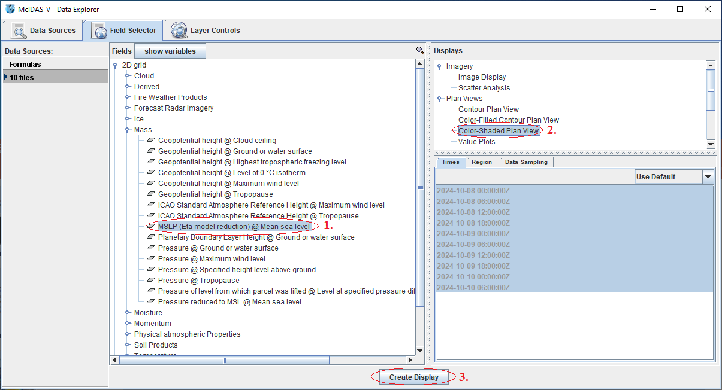
Layer 1 – MSLP
Add forecast model data through the Gen>Files/Dir or Gridded>Remote chooser. In the Field Selector:

Slide 29
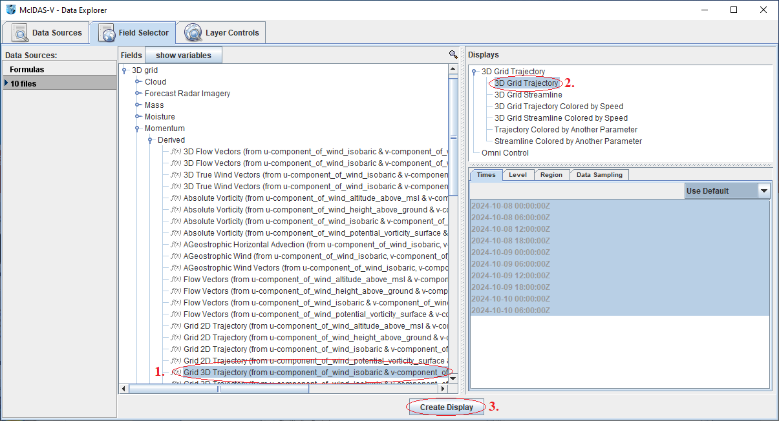
Layer 2 – 3D Grid Trajectory
Display Grid 3D Trajectory data. In the Field Selector:

Slide 30
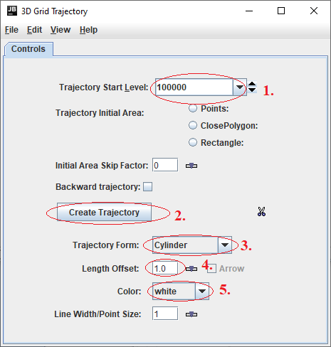
Layer 2 – 3D Grid Trajectory
Change some of the display characteristics. In the Layer Controls:

Slide 31
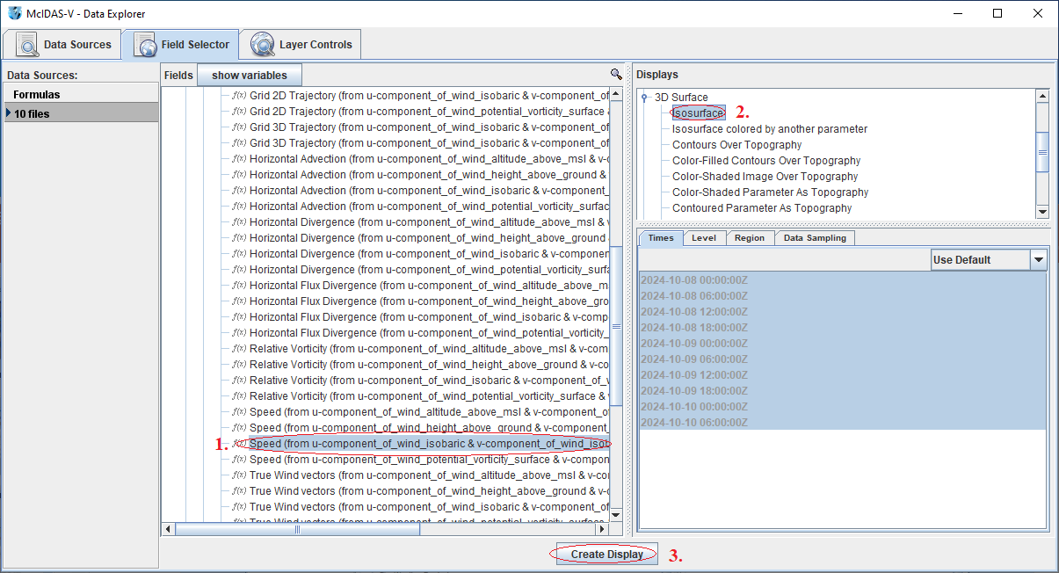
Layer 3 – Wind Speed Isosurface
Display an isosurface of 3D wind speed data. In the Field Selector:

Slide 32
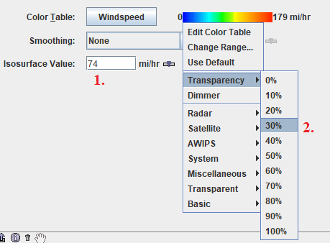
Layer 3 – Wind Speed Isosurface
Change some of the display characteristics. In the Layer Controls Select Edit>Change Display Unit to set the unit to mi/hr.

Slide 33
Additional New Functionality in McIDAS-V
More RGB and channel combos for different instruments, including the NGFS RGB for VIIRS/ABI.
ProbSevere data can be displayed via local and remote data.
Layer label updates to make things more consistent and descriptive across data types.
New enhancements.
Ability to specify lat/lon corners of wireframe box.
Faster movie capturing.

Slide 34
Additional New Functionality in McIDAS-V (Continued)
Updated and improved location labels.
Polling notifications – When new data is available a popup window will appear letting the user know.
Globe rotation is smoother, especially at low speeds.
In scripting, ADDE Imagery can now be centered over a station instead of a lat/lon or line/element point.
Many other bug fixes and enhancements.

Slide 35
Nightly Build
Much of the new functionality is currently in the 2.0beta1 nightly build. This is automatically created every day with all of the previous day’s programming changes, and therefore not everything has been fully tested. To download the nightly, go to: https://www.ssec.wisc.edu/mcidas/software/v/unstable/
The username and password are both: mcv

