Slide 1
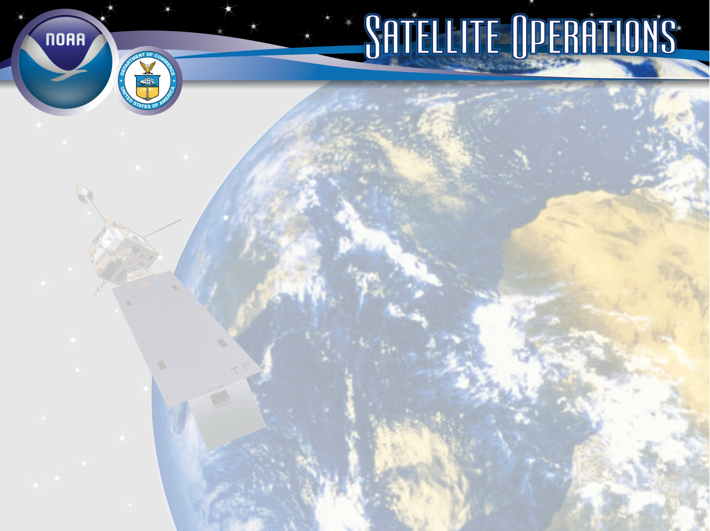
Status of NOAA Satellite Operations & McIDAS at ESPC
Wednesday, May 21, 2025
Clay Davenport
ERT, Inc.
Notes:
Images
Satellite Image - GOES-13/14/15 (GOES-N/O/P)
Derived and Interpretive Products Image - Infrared Imagery with overlay of Heavy Precipitation (Rain & Snow) Interpretive Analysis from SAB (Satellite Analysis Branch)
Antennas at OSPO Wallops CDA (Command and Data Acquisition Station), symbolic of Direct Broadcast Services.
Title Slide Background and Banner were designed by TeddyPavlis@gmail.com

Slide 2
Introduction (Jason, Joe, Josh)
Jason Taylor
Work: (301) 683-3248
Work Cell: (301) 467-6775
Jason.Taylor@noaa.gov
SPB Branch Deputy
Joseph Fiore
Phone: (703) 328-0746
Joseph.Fiore@noaa.gov
Enterprise User Services Coordinator
Josh Jankot
User Engagement Lead
Work: (301) 683-3242
Josh.Jankot@noaa.gov
SPSD.Userservices@noaa.gov

Slide 3
Introduction (Steve, Jessica)
Steve Superczynski
GOES-R User Services Coordinator
Work: (301) 683-0611
Stephen.Superczynski@noaa.gov
Jessica Shallcross
International User Service Coordinator
Phone: (724) 549-1921
jessica.levine@noaa.gov
International User Services Coordinator
SPSD.Userservices@noaa.gov

Slide 4
Meeting Agenda
Introduction
Part 1: Satellite Status/Product Updates
Part 2: McIDAS Updates

Slide 5
GOES-R Update

Slide 6
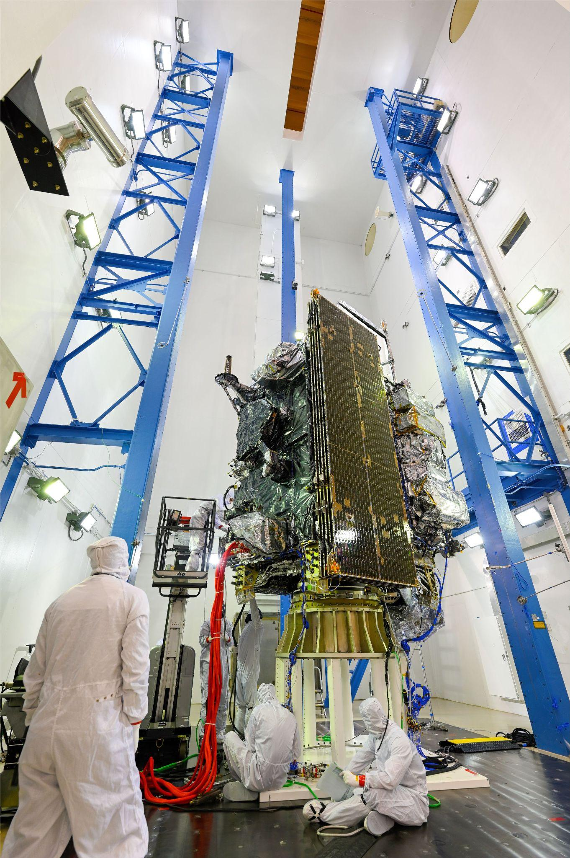
GOES-18 and GOES-19 Status
GOES-18
GOES-18 is Operational GOES-West satellite as of January 4, 2023
GOES-19
GOES-19 is Operational GOES-East satellite as of April 7, 2025
GOES-U acoustics testing at Lockheed Martin Space facility in Littleton, CO
6

Slide 7
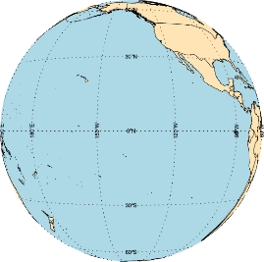
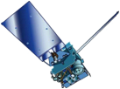
GOES Constellation
GOES-West
GOES-18
137.0° West
Storage
GOES-14
108.4° West
Storage
GOES-17
104.4° West
Storage
GOES-16
95.8° West
GOES-East
GOES-19
75.2° West
GOES-14 will be transferred to U.S. Space Force and will move to Australia this summer
GOES-15 has been transferred to U.S. Space Force and is located over the Indian Ocean (61.6° E)
GOES-16 & GOES-17 are now in Storage/Standby, and are ready to provide backup capabilities in the effect of a GOES-East or GOES-West anomaly
M. Seybold, D. Pogorzala

Slide 8
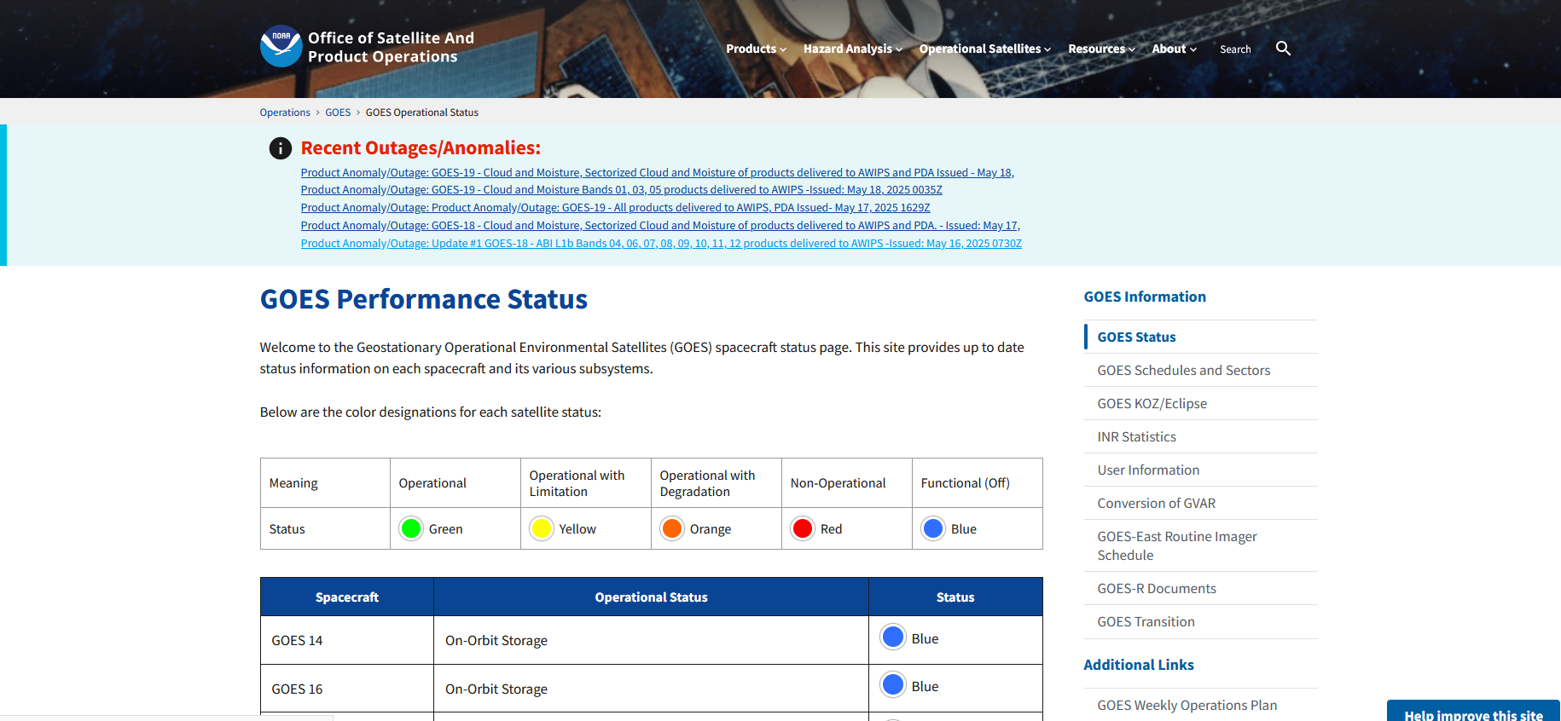
GOES Status
https://www.ospo.noaa.gov/operations/goes/status.html

Slide 9
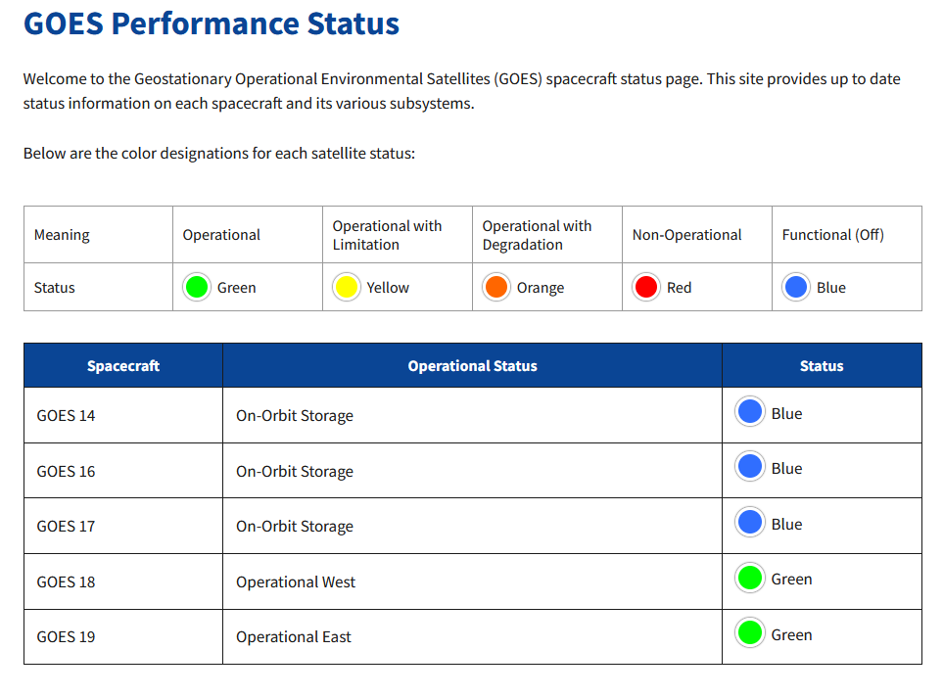
GOES Status

Slide 10
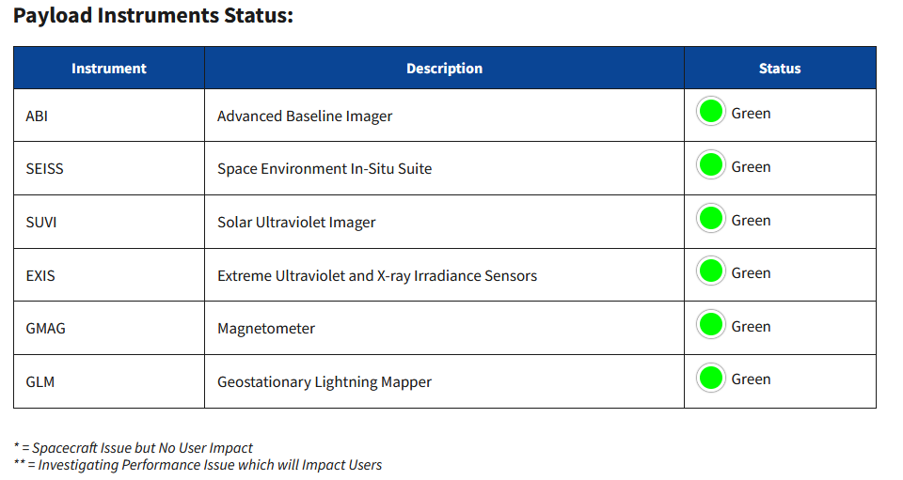
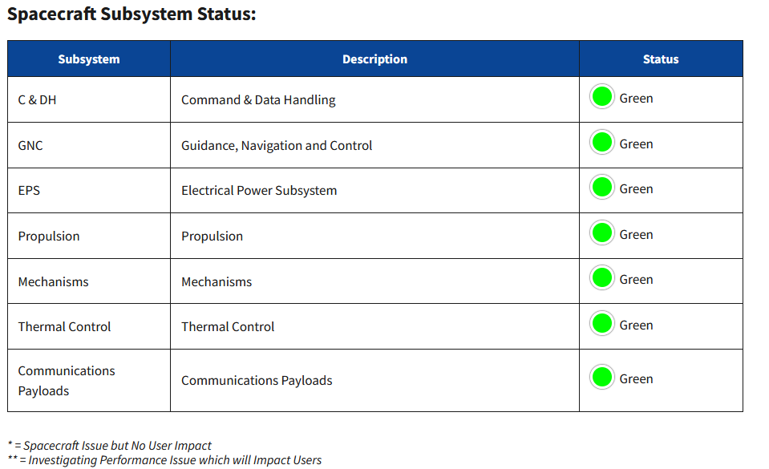
GOES-18 Status

Slide 11
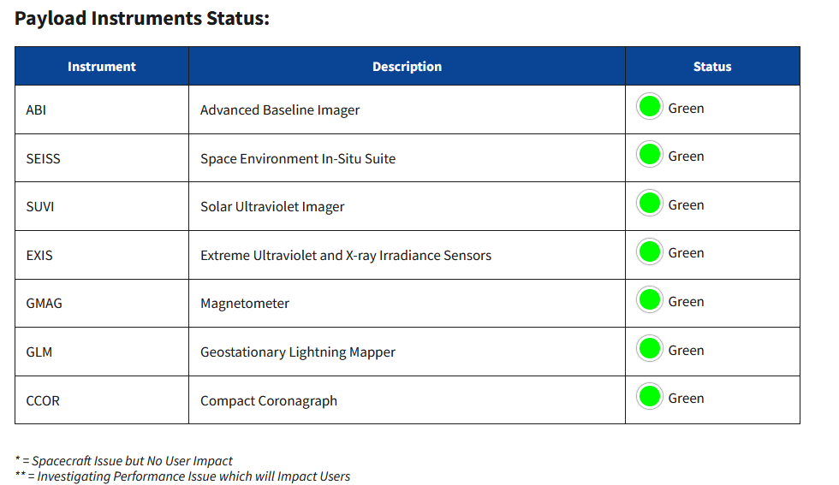
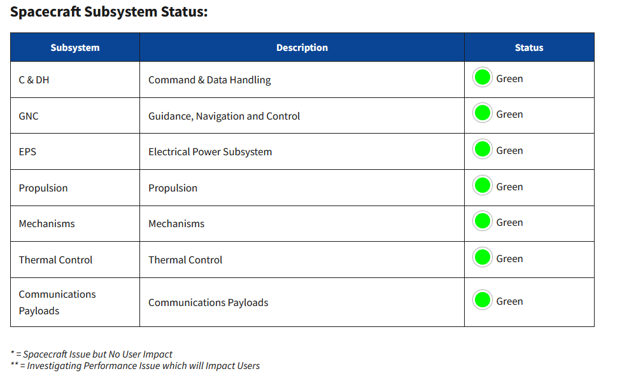
GOES-19 Status

Slide 12
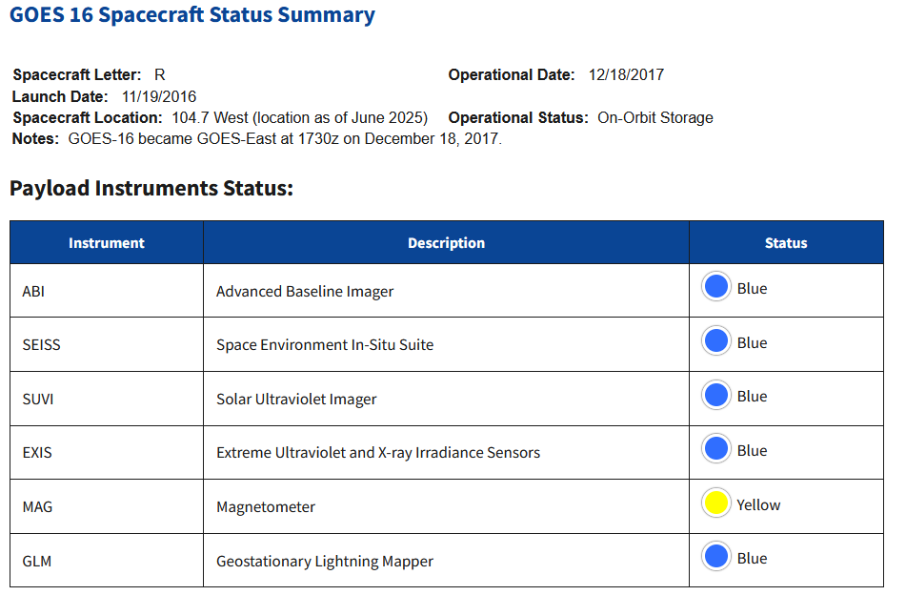
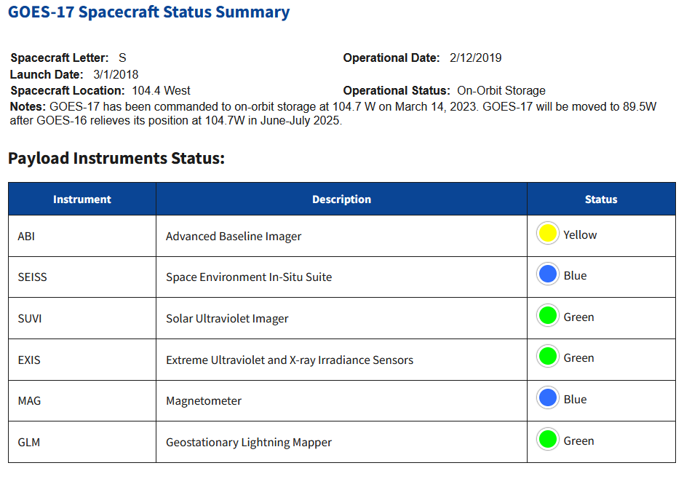
GOES-16 and -17 Status

Slide 13
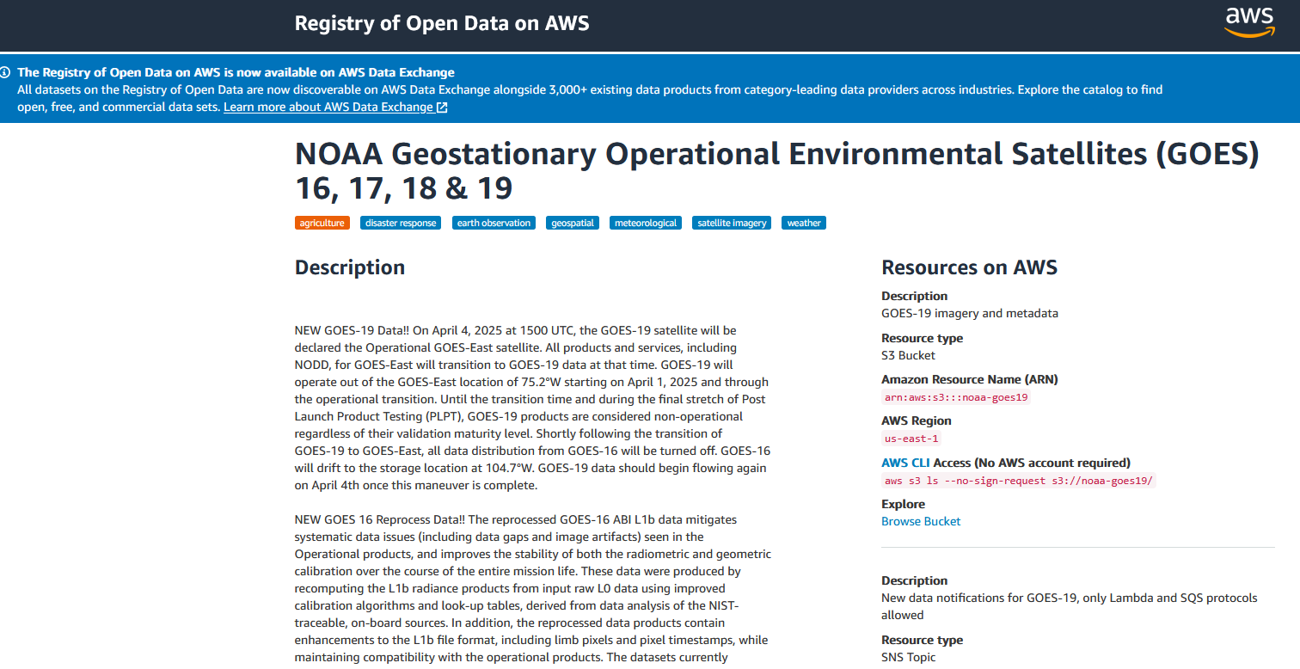
Public Access to GOES Data in AWS
https://registry.opendata.aws/noaa-goes/

Slide 14
NOAA-15, NOAA-18, NOAA-19 (POES)
Operational Status

Slide 15
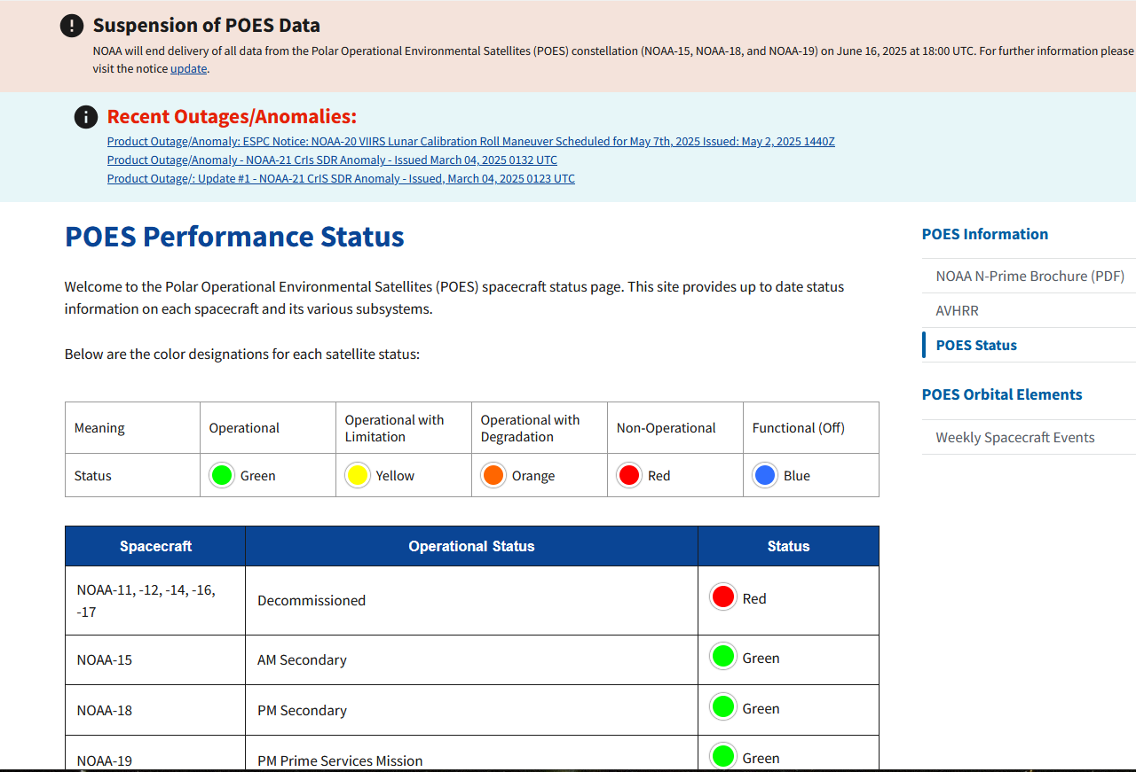
NOAA-15, NOAA-18, NOAA-19 (POES) Status
https://www.ospo.noaa.gov/operations/poes/status.html

Slide 16
Suspension of POES Data
NOAA will end delivery of all data from the Polar Operational Environmental Satellites (POES) constellation (NOAA-15, NOAA-18, and NOAA-19) on June 16, 2025 at 18:00 UTC. For further information please visit the notice update.

Slide 17
Update #2: This is the 30 day reminder for Suspension of POES data to Users after June 16, 2025.
Update #1: Correction to subject line. Issued date is April 25, 2025
Topic: Suspension of POES data to Users after June 16, 2025
Date/Time Issued: May 16, 2025 1430 UTC
Product(s) or Data Impacted: All POES data products
Date/Time of Initial Impact: June 16, 2025 18:00 UTC
Date/Time of Expected End: NA
Length of Outage: See Details.
Details/Specifics of Change: NOAA will end delivery of all data from the POES constellation (NOAA-15, NOAA-18, and NOAA-19) on June 16, 2025 at 18:00 UTC.
AMSU-A1/A2/B - data will no longer be available after Jun 16, 2025 after 1800 UTC
APT/LRPT - service will be left enabled, but do not use this service for operational use
HRPT - service will be left enabled for diagnostic flight use only (no operational use)
AVHRR - data will no longer be available after Jun 16, 2025 after 1800 UTC
DCS/ADCS (Argos) - service will be left enabled as best effort only
HIRS - data will no longer be available after Jun 16, 2025 after 1800 UTC
SARR (SARSAT) - service will be left enabled as best effort only
SEM - data will no longer be available after Jun 16, 2025 after 1800 UTC
MHS - data will no longer be available after Jun 16, 2025 after 1800 UTC
SBUV - data will no longer be available after Jun 16, 2025 after 1800 UTC
In the interim, all users should make plans to discontinue use of POES data from NOAA-15, NOAA-18 and NOAA-19 as these data and services will no longer be made available after Jun 16, 2025 1800 UTC.
Further updates regarding POES will be provided as the June 16, 2025 date approaches.

Slide 18
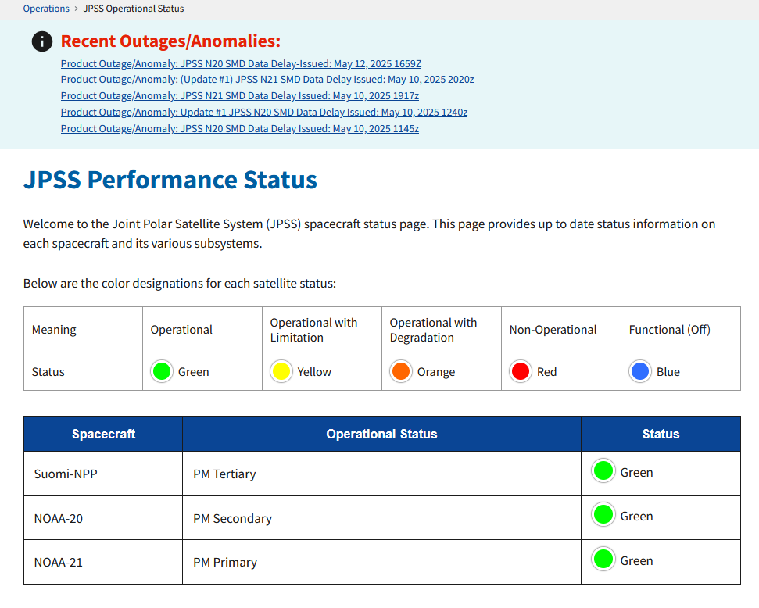
SNPP, NOAA-20, NOAA-21
Operational Status
https://www.ospo.noaa.gov/operations/jpss/status.html

Slide 19
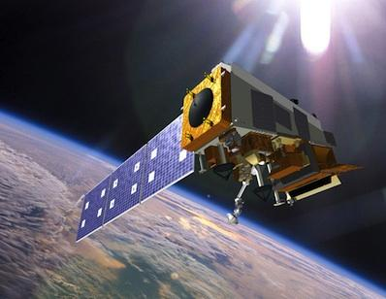
Overall Mission Status | S-NPP
Spacecraft | S-NPP
Launch Date | Oct 28, 2011
Mission Category | LTAN 1325 (PM) (Secondary/Ops) +/- 10 mins (Secondary PM)
Payload Instruments | Status
ATMS | G
CERES | G
CrIS | O
OMPS – Nadir | G
OMPS – Limb | G
VIIRS | G
Spacecraft Subsystem | Status
TLM, Command & Control | G
ADCS | G
EPS | G
Thermal Control | G
Communications | G
CDP | G
SCC | G
GPS | Y
1553 | G
1394 | G
Operational (or capable of)
Operational with limitations (or in standby)
Operational with degraded performance
Not functional
Functional but turned off
No status reported
Additional Notes:
All instruments except CrIS are operating normally CrIS operating on side-1 electronics, Long-Wave recovered and at validated level of maturity (operational) as of July 13, 2020 but CrIS Mid-Wave digital signal processor is inop on side-1. ATMS was in safe-hold mode from 11/19-2024 - 1/28/2025 before being restored.

Slide 20
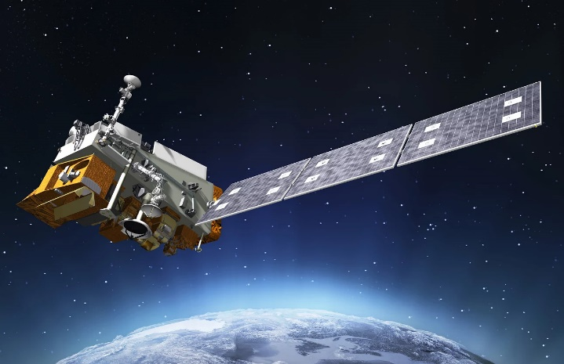
Overall Mission Status | NOAA-20
Spacecraft | NOAA-20/JPSS-1
Launch Date | Nov 18, 2017
Mission Category | LTAN 1325 (PM) +/- 10 mins (Primary PM)
Payload Instruments | Status
ATMS | G
CERES | G
CrIS | G
OMPS – Nadir | G
OMPS – Limb | G
VIIRS | G
Spacecraft Subsystem | Status
TLM, Command & Control | G
ADCS | G
EPS | G
Thermal Control | G
Communications | G
CDP | G
SCC | G
GPS | G
1553 | G
SpaceWire | G
Operational (or capable of)
Operational with limitations (or in standby)
Operational with degraded performance
Not functional
Functional but turned off
No status reported
Additional Notes:
All instruments operating nominally and are meeting/exceeding their established performance specifications.

Slide 21
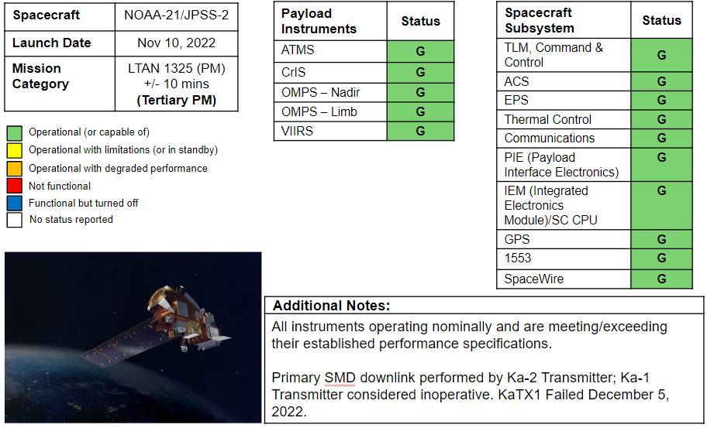
Overall Mission Status | NOAA-21

Slide 22
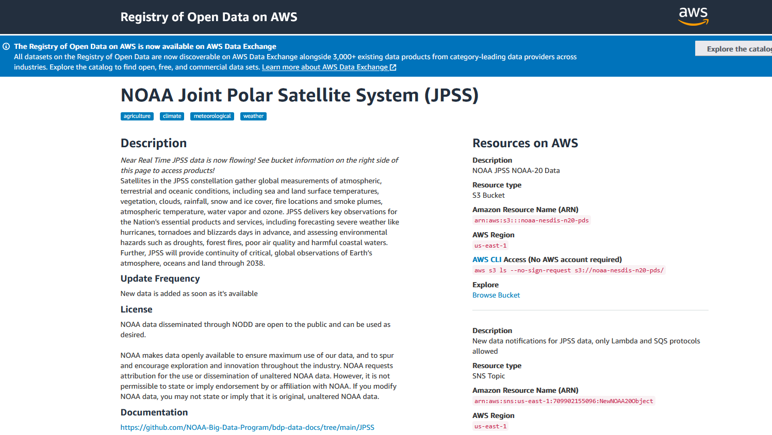
Public Access to JPSS Data in AWS
https://registry.opendata.aws/noaa-jpss/

Slide 23
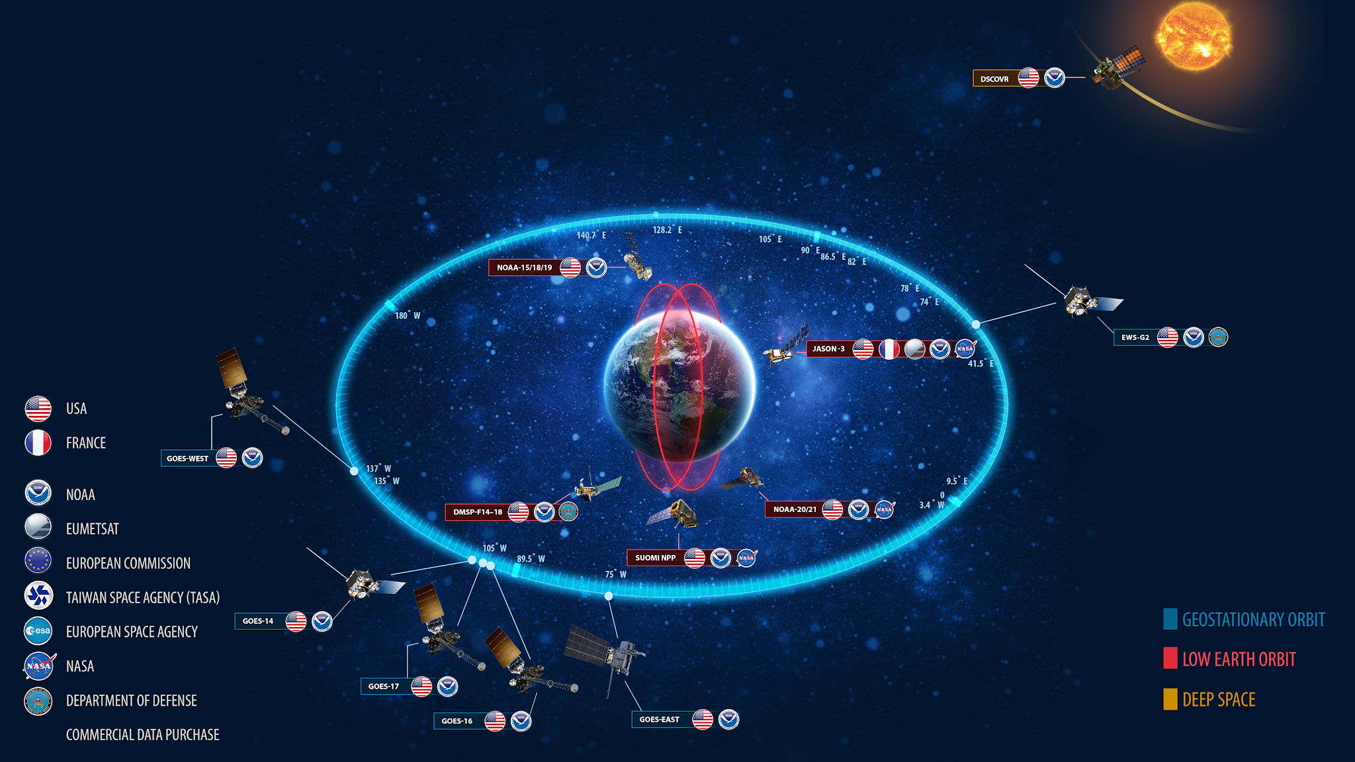
NOAA Observes the Earth

Slide 24
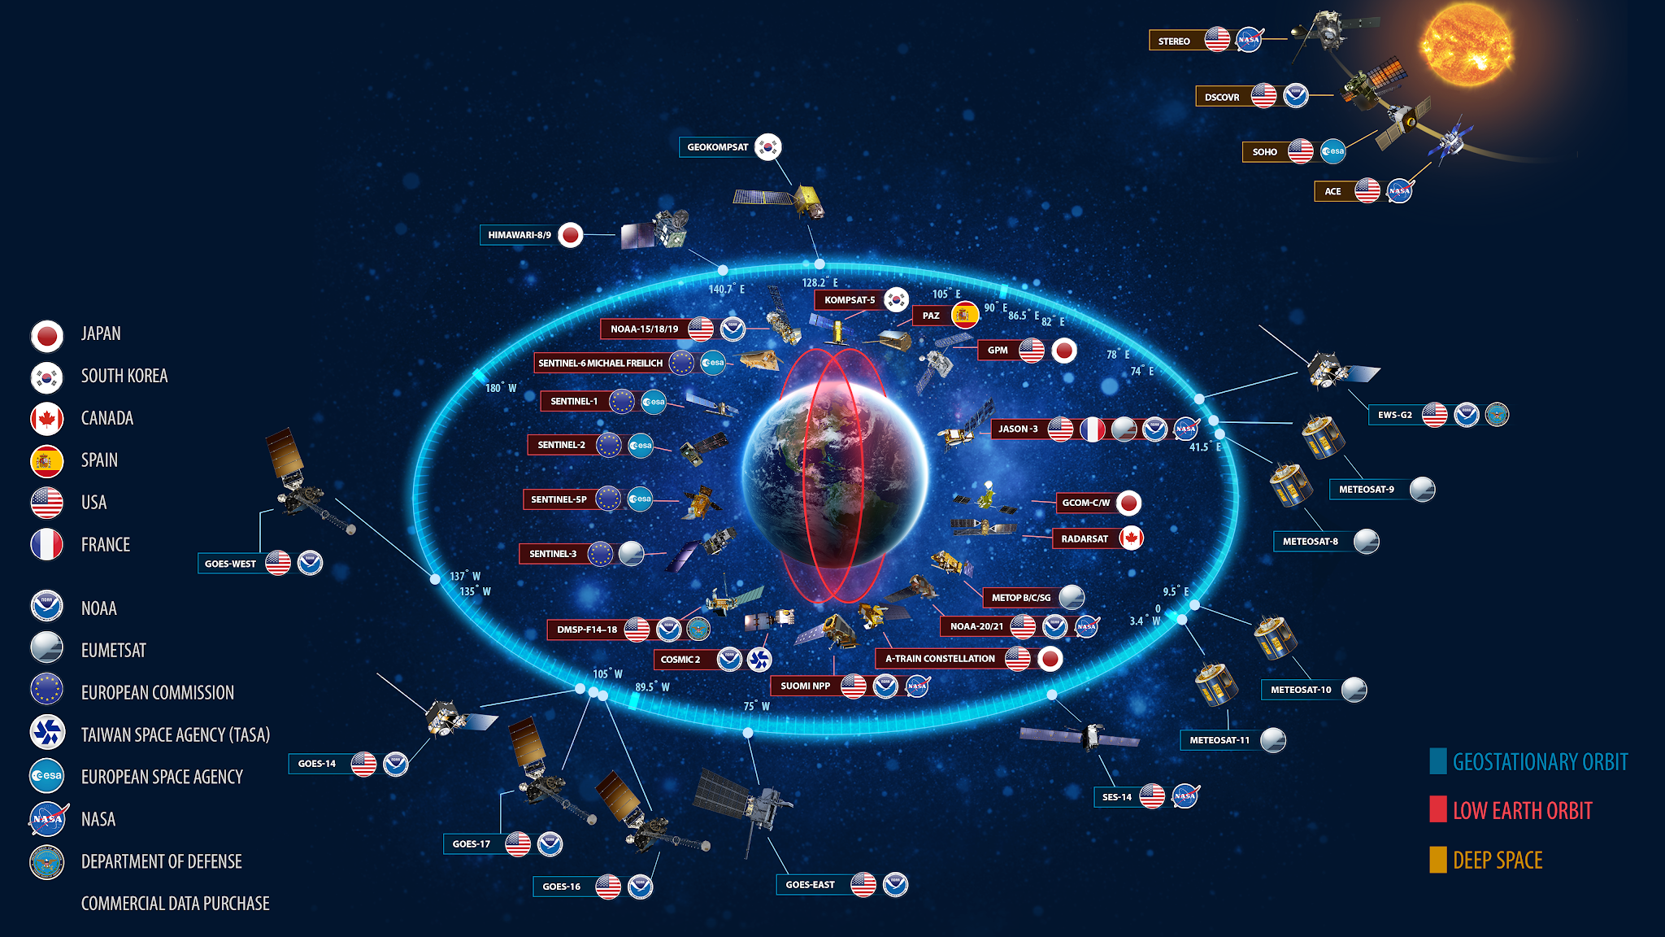
NOAA Partners to Observe the Earth

Slide 25
Himawari and Meteosat Satellite Program Updates
NOAA National Environmental Satellite, Data, and Information Service

Slide 26
Himawari-8/9/10 Constellation Plans
Himawari-9 is operational at 140.7E.
Himawari-8 was placed in standby mode on December 13, 2022. It remains at or near 140.7E.
Lingering Level-2 H-9 products are partially operational.
L2 Cloud and Wind products went operational in the NCCF on June 13, 2023 and are available for subscription in the PDA.
Work is progressing on Himawari-10 with the contractor selections completed and announced. It is still slated to launch in 2028 and take over operations from H-9 in 2029.

Slide 27
NOAA’s Himawari-8/9 Data Access Options
PDA (operational distribution and subscription)
H8 L1B data and H8 L2 products in netCDF and netCDF4 if an anomaly occurs with H-9
H9 L1B data and H9 L2 products* in netCDF and netCDF4 currently available
NOAA Open Data Dissemination - NODD (part of the Big Data Program, non-operational distribution, general public access)
H8 L1B data (HSD format) and H8 L2 (netCDF4 format) products until 12/13/22
https://noaa-himawari8.s3.amazonaws.com/index.html
H9 L1B data (HSD format) and H9 L2 (netCDF4 format) products starting 12/13/22
https://noaa-himawari9.s3.amazonaws.com/index.html
GEODIST Servers
McIDAS Products
Imagery, Arctic Composite, GHE, TCFP, ADT, SST, GMGSI, eTRaP
Customized sectors (GIF files) supporting WFO Guam operations at OSPO web page
https://www.ospo.noaa.gov/products/imagery/himwari.html

Slide 28
NOAA’s Himawari-8/9 Operational Products: PDA and BDP Distribution
Products | Type | Number files | Refresh Rate | Files Size/Day
Cloud Moisture Imagery | Tiles | 1408 files/10min | 10 minutes | 117GB
Clouds: Clear Sky Mask Cloud Top Height Cloud Top Phase | FD | 142 files/Day for each Clouds Products | 10 minutes | 120GB
Derive Motion Winds: Visible Cloud Winds (ch-3) SW Infrared Winds (ch-7) Cloud Top Water Vapor Winds (ch-8) Clear Sky Water Vapor Winds (chl-8) Clear Sky Water Vapor Winds (ch-9) Clear Sky Water Vapor Winds (ch-10) LW Infrared Winds (ch-14) | FD | 142 files/Day for each Winds Product (except for ch-3 and ch-7) | 10 minutes | 20GB
Sea Surface Temperature: L2C, L3C and Legacy 2C | FD | 24 files/Day for each SST products | 60 minutes | 11GB
Rainfall Rate | FD | 142 files/Day | 10 minutes | 9GB

Slide 29
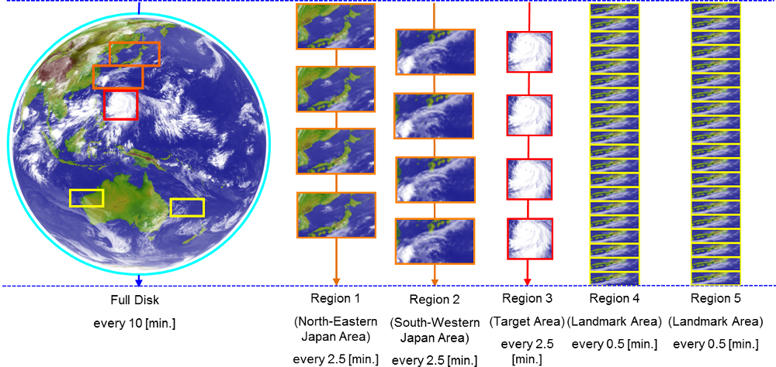
Himawari Scanning Sectors including Floating 2.5 min Target Area (Region 3)
*Only Full Disk and Target Area/Region 3 scans is processed at NOAA/NESDIS*

Slide 30
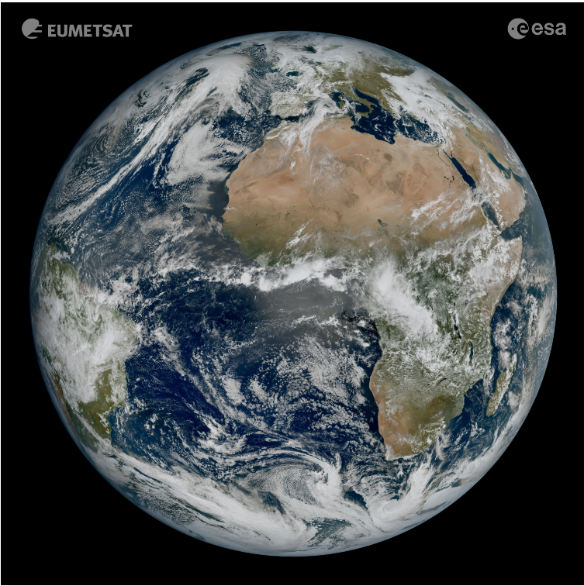
Current Meteosat Constellation
Meteosat Program Updates
SATELLITE | LIFETIME | POSITION | SERVICES
Meteosat-11 | 15/07/2015 – Fuel lifetime is until 2033 | 9.5°E | Rapid Scan Service. Real-time Imagery.
Meteosat-10 | 05/07/2012– Fuel lifetime is until 2030 | 0° | 0º SEVIRI Image Data. Real-time Imagery.
Meteosat-9 | 28/08/2002 – Fuel lifetime is until 2022 | 45.5° E | Primary IODC service started 6/1/22.
MTG-I1 | Launched 12/13/2022 | 0° | Will replace Meteosat-10 at 0º around December 2024.
Primary Imaging Operations
First image of the full Earth disc from Meteosat Third Generation – Imager 1 (MTG-I1). The image was captured at 11:50 UTC on 18 March 2023 by the Flexible Combined Imager (FCI) on MTG-I1.

Slide 31
Meteosat Configuration Plans
MTG-I1 launched December 13, 2022 from French Guiana.
MTG-I1 will be assigned to Full Disk Scan Service (FDSS) when starting Prime operations at 0° ~ December 2024.
There will be a ~12 month overlap between MET-10 and MTG-I1 at this location
NOAA’s data policy should be largely the same between MSG and MTG

Slide 32
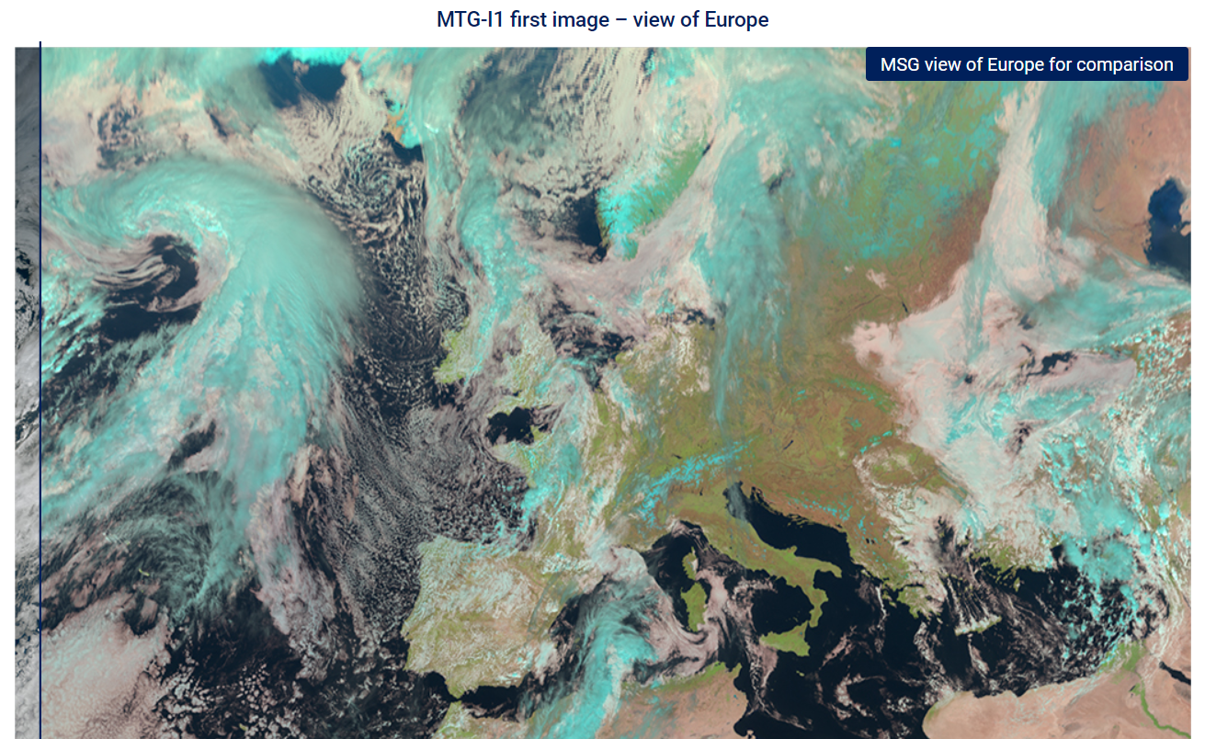
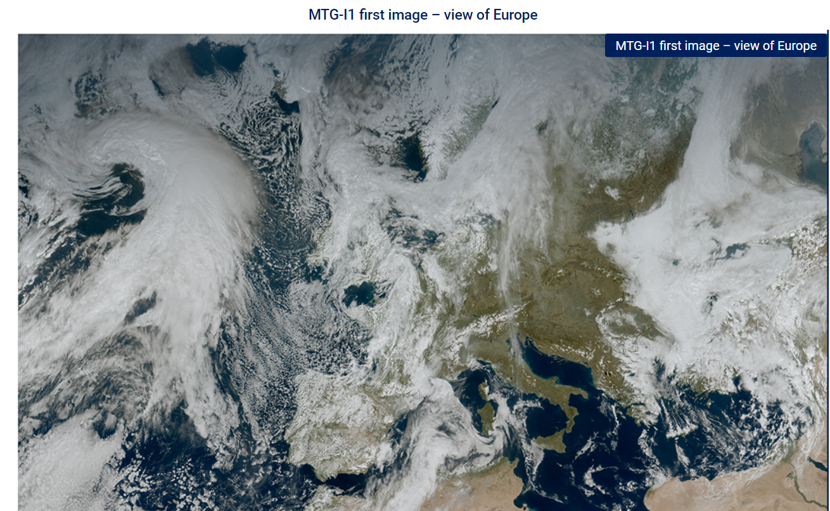
Meteosat Third Generation (MTG) Satellites
Meteosat-12 (aka MTG-I1) (imager mission)
Launched December 13, 2022
Declared operational on December 4, 2024, as Meteosat-12
16 spectral band imager (Flexible Combined Imager - FCI) and Lightning Imager (LI)
Temporal and spatial resolutions similar to GOES-R series
FCI - 10 minute FD scans and 2.5 minute scans over Europe
LI – 84% FD coverage every 10 minutes and 100% European coverage every 2.5 minutes
MTG-S1 (sounder mission)
Projected launch date July 2025
fully operational by end of 2025
First operational sounding satellite in geostationary orbit
InfraRed Sounder (IRS)
Two Spectral bands: MWIR (4.44–6.25 µm) and LWIR (8.26–14.70 µm)
Spatial resolution of 4 km x 4 km at nadir
Notes:
MSG (Meteosat 2nd Gen) currently operational vs the first images from MTG (3rd Gen) over the same area for comparison

Slide 33
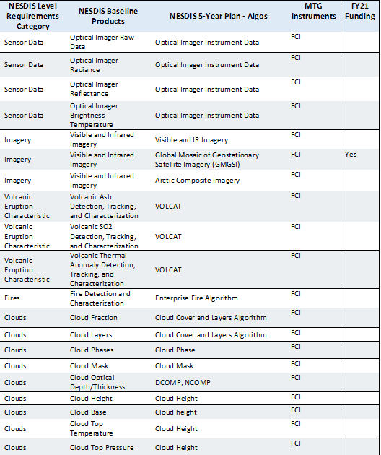
Planned MTG Products
Notes:
working in mtgi1 into blended prodcuts - jordan gerth

Slide 34
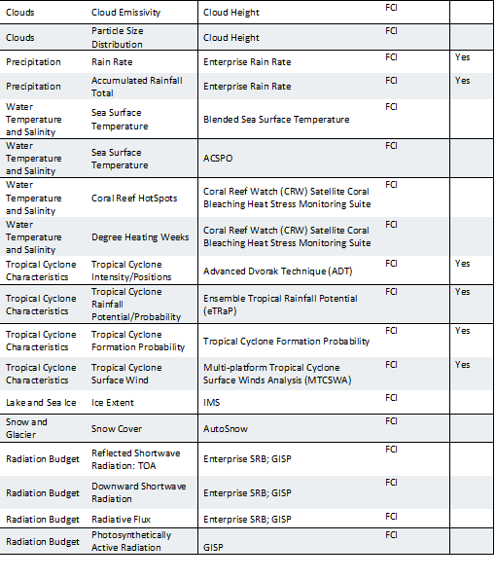
Planned MTG Products (cont.)

Slide 35
McIDAS at NOAA

Slide 36
NOAA/OSPO Usage of McIDAS Continues to Decline
1. Cloud Migration
NESDIS is nearing the end of a multi-year project to migrate almost all production from in-house hardware to the AWS (Amazon) cloud
Most existing apps have been rewritten as Enterprise Algorithms
Directly ingesting satellite data
About 85% of programs scheduled to move have been completed; rest should finish by end of year

Slide 37
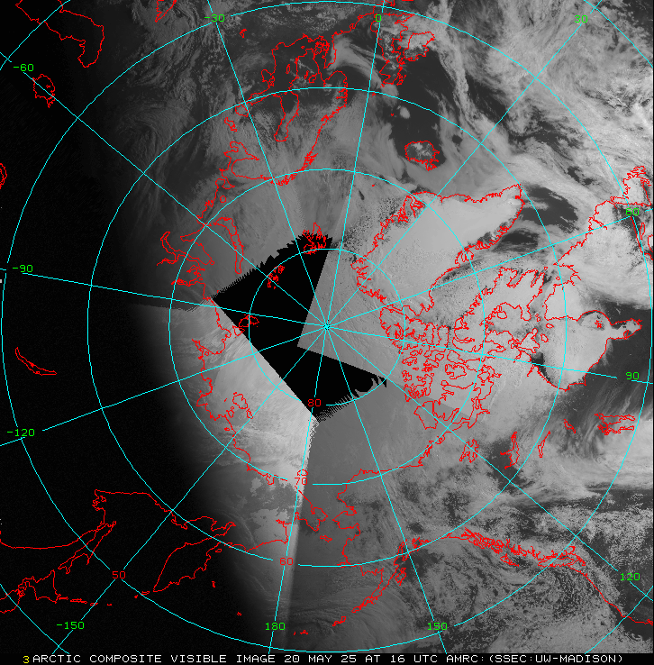
Arctic Composite

Slide 38
Precipitation Products Updates
Enterprise Satellite Rainfall Rate Estimates
Operation status:
1.Enterprise Satellite Rainfall Rate Estimates (RR) became operational in NCCF in early 2024
EN RR is the new version of GHE.
EN RR will be only generating global netcdf products.
No CONUS GRIB2 file will be generated from EN RR!!!!!
2. Legacy GHE products were expected to retire 30 days after EN RR transitioned into operation on NCCF. However:
GHE was part of a global flash flood guidance program coordinated with the WMO
Was a primary input for ETRAP, which will not transition to NCCF until summer 2025
3. The legacy GHE will probably end by Labor Day 2025.

Slide 39
SAB Usage to Continue
Plans to divest the Tropical Desk have stalled
The tropical and volcano desks remain strong McIDAS users
All SAB McIDAS products did receive updates for GOES-19
Plans in place for MTG data (no delivery as yet)

Slide 40
RGBs in SAB
Background script continuously builds/saves RGB components for fast loading
17 RGBs being made full-time in FDSK
Volcano: PAVA, PAVB, ASH, SO2
Weather: DTMP, NTMP, AIRMAS, SEVST, DNMP
Imagery: TRUE, NATCOL, SNOW
Air quality: SMOKE, DUST
Fire: DayFire7, DLCFIRE, FireT
8 in CONUS
PAVA, ASH, SMOKE, TRUE, DTMP, NTMP, DNMP, FireT

Slide 41
looprgb.sh script for SAB

Slide 42
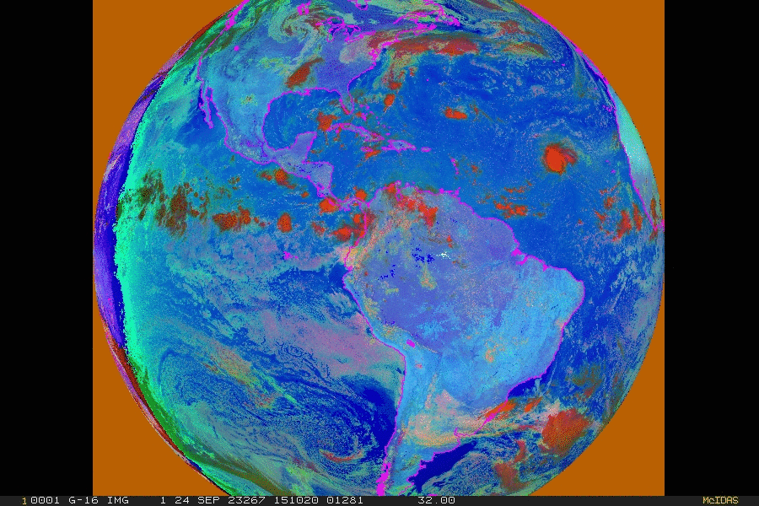
Combined Day/Night MicroPhysics

Slide 43
OSPO External ADDE Servers
Geodist1 - GHE data
Geodist4 - Polar (Metop) data
Geodist6 - MSG data (at PM and IO)
Geodist7 - Himawari data
FOS - NOAAPort/XCD Data
NOAA does plan to decommission these servers.
Cannot promise, but should remain available through 2026

Slide 44
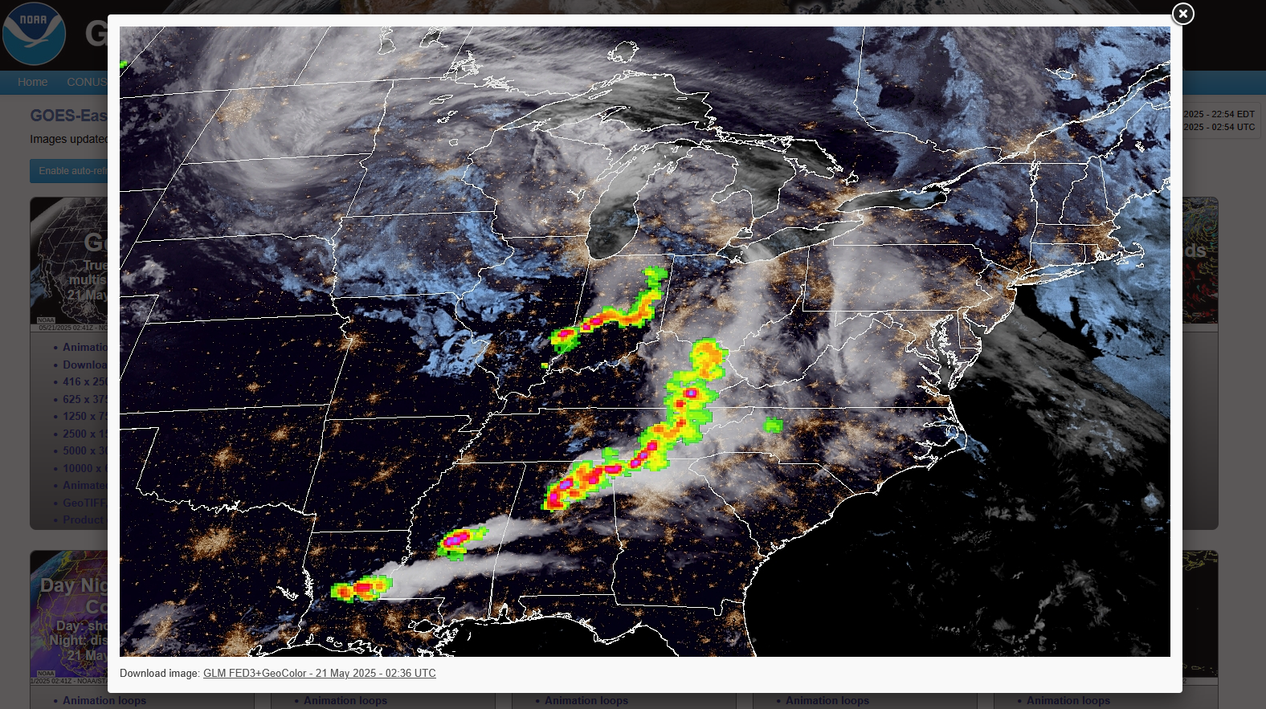
NOAA/STAR GOES Viewer
https://www.star.nesdis.noaa.gov/GOES/index.php

Slide 45
NOAA/STAR GLM Overlay, log scaled

Slide 46
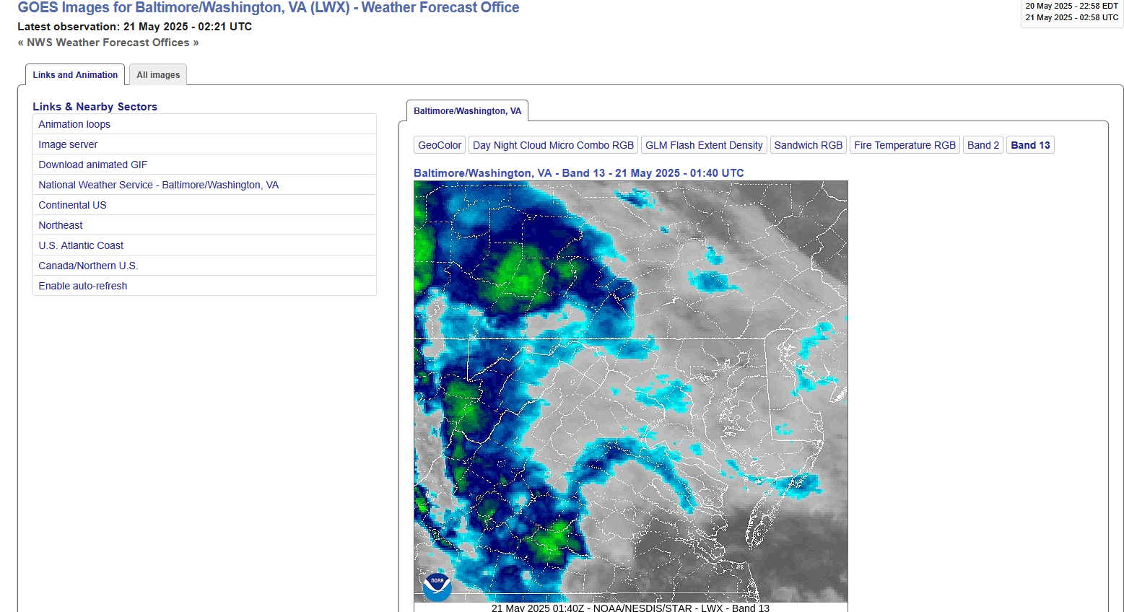
NOAA/STAR Individual Weather Forecast Offices

Slide 47
ESPC Notifications, Status, and Contacts
Information | Web Link/Email Address
ESPC Messages | http://www.ospo.noaa.gov/Operations/messages.html
24/7 Help Desk | ESPCOperations@noaa.gov
User Services | SPSD.UserServices@noaa.gov
Data Access | NESDIS.Data.Access@noaa.gov
Webmaster | SSDWebmaster@noaa.gov
Facebook | https://www.facebook.com/NOAASatellites/
Twitter | www.twitter.com/noaasatellites
Satellite Ops Status | http://www.ospo.noaa.gov/Operations/daily-news.html
Press releases | https://www.nesdis.noaa.gov/press
Web | www.ospo.noaa.gov
Thank you!
Notes:
Please reference the OSPO contact information listed for a variety of resources.

Slide 48
Questions?

Slide 49
Outstanding Issues, Comments & Open Floor

