Slide 1
McIDAS Program Status
David Santek
2025 McIDAS Users’ Group Meeting
21 May 2025

Slide 2
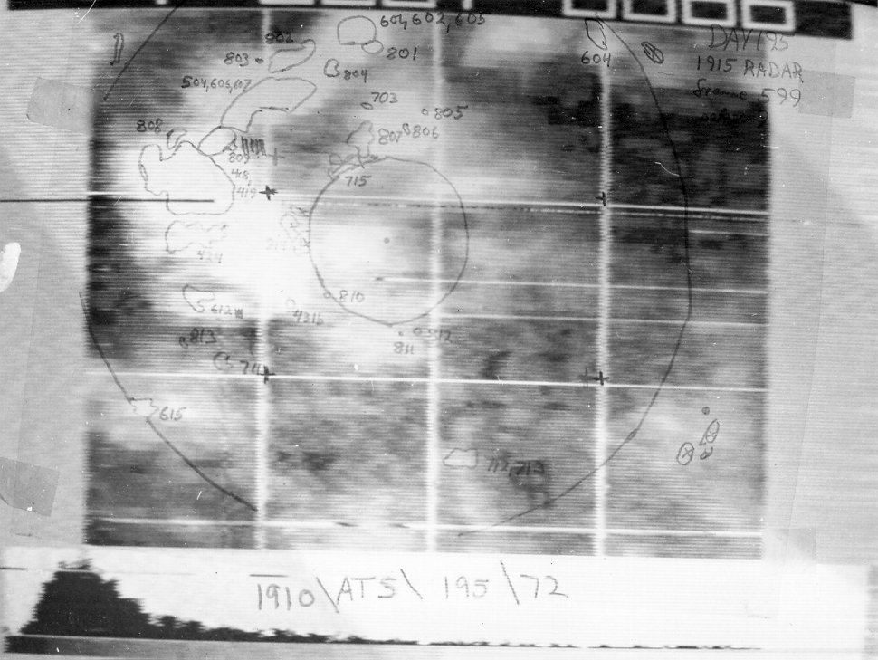
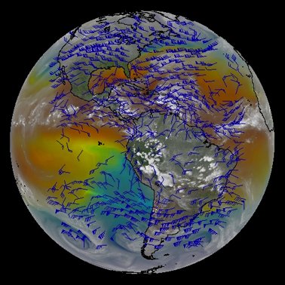
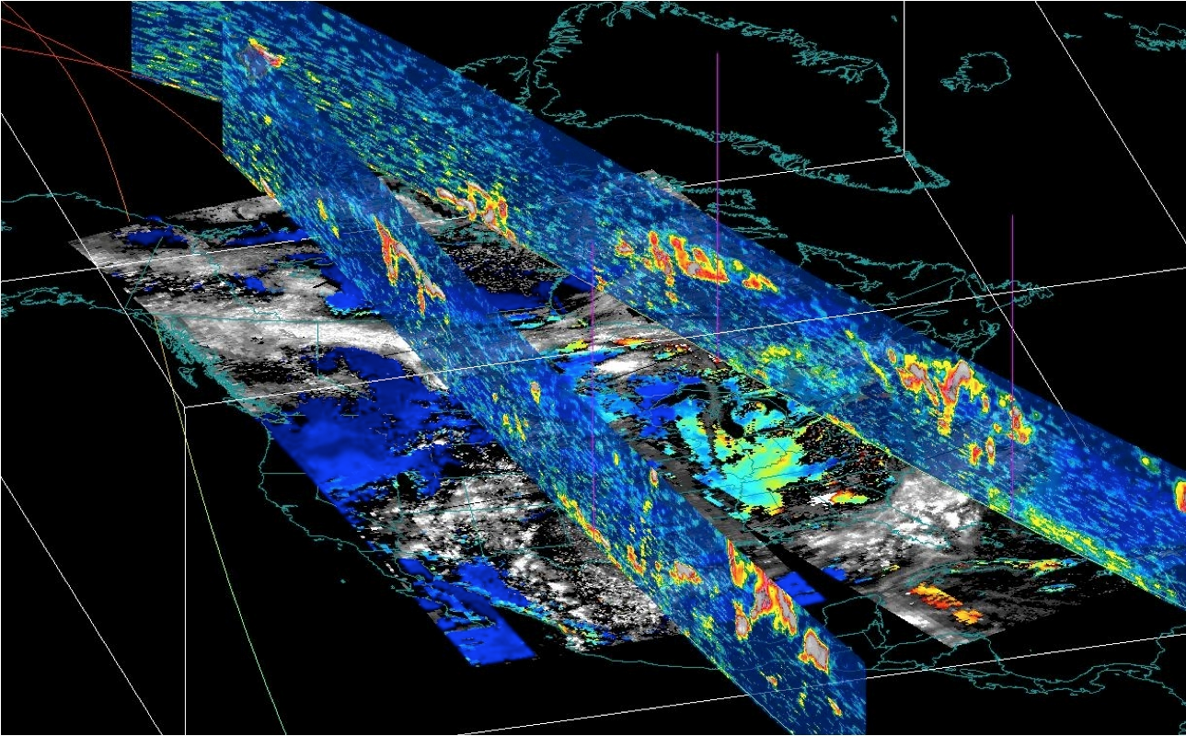
McIDAS Status
McIDAS-X
McIDAS-XCD
McIDAS-XRD
McIDAS-V
SSEC Data Ingestor (SDI)

Slide 3
McIDAS-X Current
Periodic updates (1-2 times per year)
Improvements to display
More channel combination tools (RGB)
Product enhancements
Capability with newest and future satellites:
ADDE server for MTG Flexible Combined Imager (FCI) and Lightning Imager (LI)
ADDE server for Metop-SG METimage

Slide 4
ADDE Servers
Implementing Python-based ADDE servers
Easier for others to write servers
Servers based on Satpy, which has readers for many different types of satellite data
Compatible with McIDAS-X and –V

Slide 5
McIDAS-X Future
MUG responsible for general improvements, bug fixes, maintenance (updates for current and new satellites), and OS and external library updates
Considering current Korean satellite GEO-KOMPSAT-2
Planning Metop-SG (Second Generation) METimage server, which is the replacement for the current Metop AVHRR series
Unique enhancements continue to be funded outside the MUG and code contributed by internal projects and external sites
McIDAS-X is expected to be supported into the 2030s for the GOES-R series satellites. No sunset date in sight.
Beginning to look into the next series (2030s to 2050s): Geostationary Extended Observations (GeoXO)

Slide 6
McIDAS-XCD Conventional Data
Ingest conventional weather data from NOAAPORT
Stay tuned for Kevin’s talk on the status of McIDAS-XCD

Slide 7
McIDAS-XRD Research and Development
A collection of R&D code that is not formally tested by McIDAS User Services:
Over 100 McIDAS commands
Over 15 ADDE servers
Testing is limited to ensuring code builds on supported platforms
Occasionally promote to core
Status: Current support level continues
Future: Coincides with McIDAS-X future

Slide 8
SDI SSEC Data Ingestor
SDI (SSEC Desktop Ingestor) 1997 - 2005
SDI-104 (SSEC Data Ingestor) 2005 – ?
SDI-GRB Appliance 2016 - ?
Status: SDI-GRB fully supported; SDI-104 limited support
Future:
SDI-104: Limited support while GOES GVAR satellites are operational or backup
SDI-GRB Appliance: throughout the GOES-R era

Slide 9
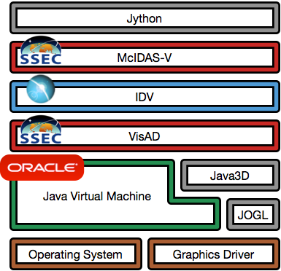
McIDAS-V Status
Major components by Unidata, SSEC, OpenJDK, open source community
Additional components include file format libraries, math libraries, packaging and build utilities; all open source
OS vendors Linux,Windows, Mac
Hardware drivers from manufacturers
OpenJDK
Notes:
who maintains VisAD?primarily Rink, Whittaker, Don Murray
https://github.com/visad/visad/graphs/contributors

Slide 10
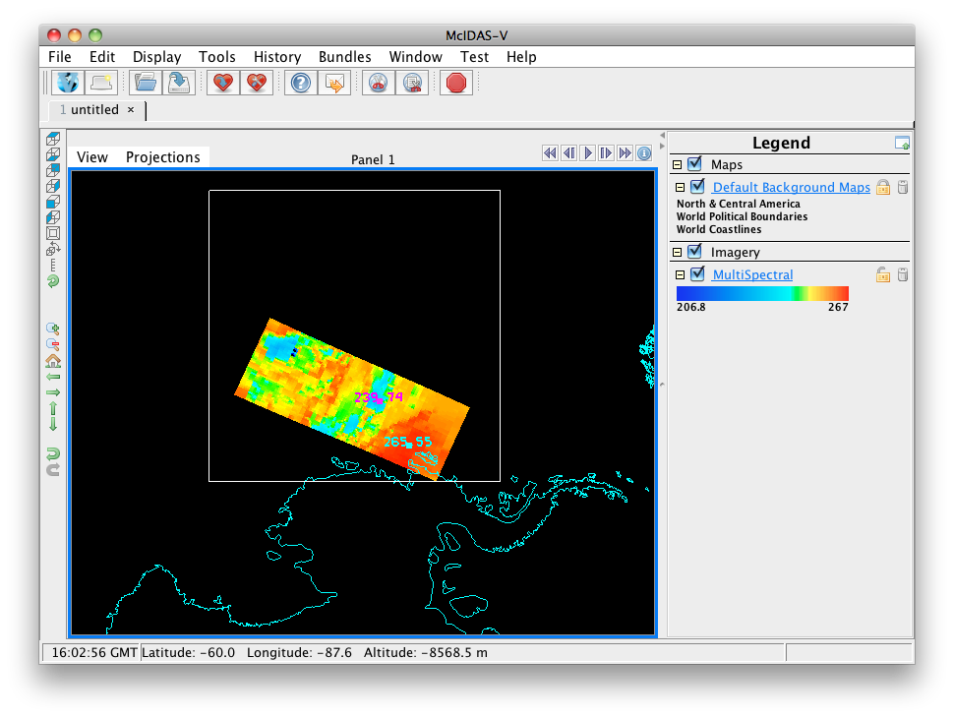
McIDAS-V Funding
MUG
CIMSS grant from VIIRS Imagery Team through 2025
On the watch for other proposal opportunities (e.g., NASA)

Slide 11
McIDAS-V MUG Support
User-level Infrastructure: User interface, scripting
Bug fixes: Prioritize, coordinate internally and with Unidata
Testing
Documentation: Includes maintaining tutorials
Help Desk: Includes maintaining forums

Slide 12
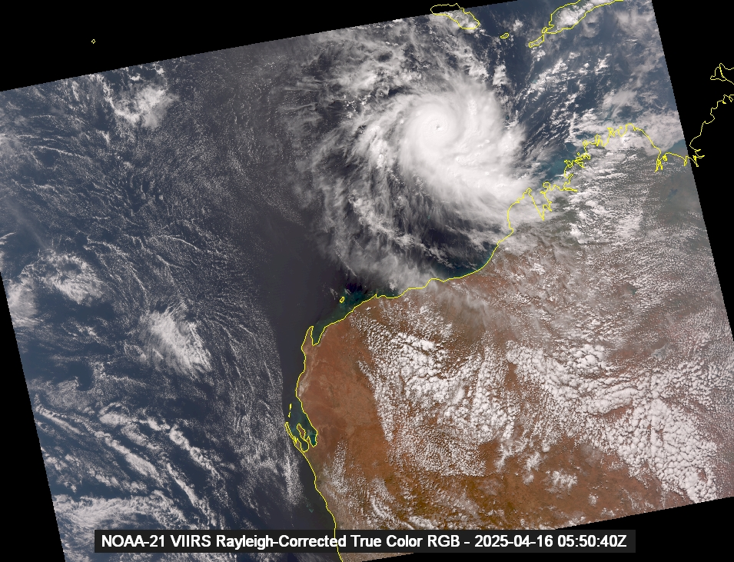
McIDAS-V CIMSS Grants
Rayleigh corrected VIIRS true color images

Slide 13
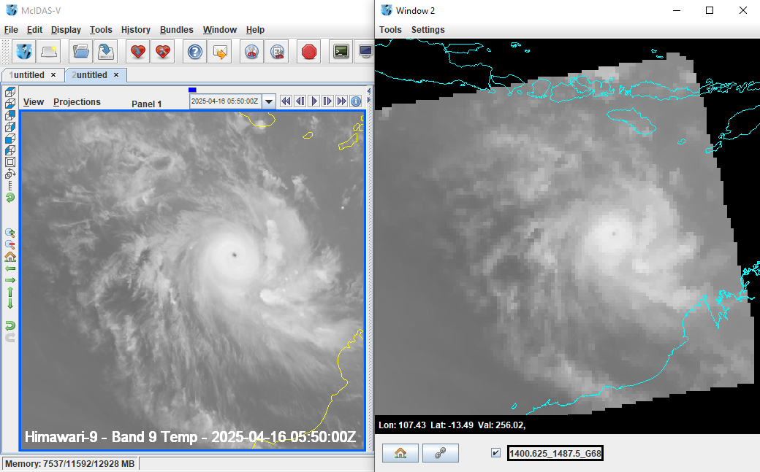
McIDAS-V CIMSS Grants
CrIS visualization and channel combinations to create simulated imager bands
Left: Himawari AHI band 9 (6.9 µm water vapor band) brightness temperature
Right: Convolved CrIS channels simulating AHI band 9

Slide 14
McIDAS-V Priorities
Fix Critical and Quick bugs (MUG, Unidata)
Incorporate enhancements from CIMSS projects, especially those that are not possible in McIDAS-X (CIMSS, MUG)
Ensure new data sources are usable (MUG, CIMSS)
Geo and Leo missions
Test with new data in standard formats (netCDF, HDF, BUFR, GRIB)
Maintain compatibility with Unidata’s IDV (Unidata, MUG)

Slide 15
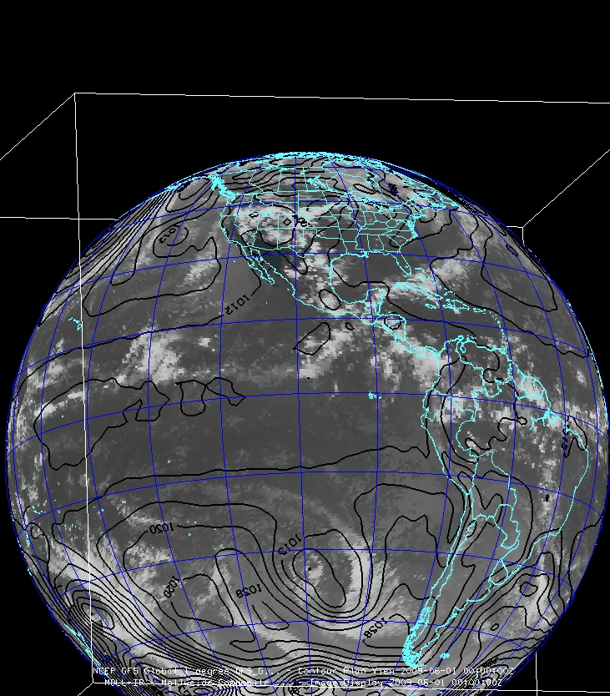
McIDAS-V Future
Continue to engage new researchers:
Workshops and training
Classroom
Appeal to researchers:
Input/output data formats
Scripting
More data fusion
Distributed as a signed application
Compliance with ever-changing OS security standards

