Slide 1
McIDAS-X Software Demonstration and Development Plans for 2025 and beyond
Dave Santek and Jay Heinzelman
21 May 2025

Slide 2
McIDAS-X Demo: 2023.1 & 2024.1 & New Testing
MTG python ADDE server (Meteosat-12)
VIIRS server scan line times; IMGPARM support
NOAAPort American Samoa sectors (support in ABI server)
New grid model examples: ETSS PETS SPC RRFS
CUR STAT option
XRD: Many new RGB formulas, support for MTG
XRD: SUVI enhancement files
In testing: MTG lightning server (MTGLDISP & MTGLLIST)

Slide 3
McIDAS-X Demo: F-Key entries created with TE command
KEYF1 := DSSERVE LIST JMTG
KEYF2 := IMGLIST JMTG/MTG-FD.58 FORM=ALL
KEYF3 := IMGLIST JMTG/MTG-HR.58 FORM=ALL
KEYF4 := IMGDISP DEMO/MTGFD.1 1 MAG=-8 BAND=3 SF=YES;MAP;PC C;D
KEYF5 := IMGDISP DEMO/MTGFD.1 2 MAG=-8 BAND=14 SF=YES;MAP;PC C;D
KEYF6 := IMGDISP DEMO/MTGHR.1 3 REP=6 LAT=28 17 BAND=3 REF='MAP GRA=(GRA) IMA=(IMA)'
KEYF7 := IMGDISP DEMO/B14.1 9 REP=2 LAT=0 0 REF='MAP X X LALO GRA=(GRA) IMA=(IMA);
EU REST STAR-ABI_B11-14'
KEYF8 := IMGDISP TESTSET/SVM.3 11 SF=YES LAT=39 75 BAND=18;MAP
KEYF9 := IMGLIST NPGWEST/ASR FORM=ALL;IMGDISP NPGWEST/ASR 12 MAG=-2 BAND=13 SF=YES REF='MAP X X LALO GRA=(GRA) IMA=(IMA)'
KEYF10 := GRDLIST RTGRIDS/PETS-USLCDRS TIME=12 DAY=#Y FHOUR=12 PARAM=ETCW FORM=ALL; GRDDISP RTGRIDS/PETS-USLCDRS TIME=12 DAY=#Y PARAM=ETCW GRA=13 FHOUR=12
KEYF11 := GRDLIST RTGRIDS/SPC-USLCAWI4 TIME=12 DAY=#Y FHOUR=24 PARAM=PRSV FORM=ALL; GRDDISP RTGRIDS/SPC-USLCAWI4 TIME=12 DAY=2025139 PARAM=PRSV GRA=14 FHOUR=24
KEYF12 := RGB LIST

Slide 4
McIDAS-X Demo: F-Key entries created with TE command
KEYSF1 := RGB MAKE ABI DAYROCKET DEMO/PLUME.1 15 X 'LAT=28:52:36 79:43:48 MAG=4'
KEYSF2 := RGB MAKE FCI DIFFWV DEMO/MTGFD.1 16 X 'MAG=-8’
KEYSF3 := RGB MAKE FCI CLOUDPHASE DEMO/MTGFD.1 17 X 'MAG=-8'
KEYSF4 := RGB MAKE FCI CLOUDPHASEDIST DEMO/MTGFD.1 18 X 'LAT=36 10'
KEYSF5 := RGB MAKE ABI NGFS DEMO/NGFS.1 19 X 'LAT=28:25:46 81:54:52 MAG=3'
KEYSF6 := IMGDISP G19SUVI/FE171-BASE 20 MAG=-2 EU=SUVI-FE171
KEYSF7 := IMGDISP DEMO/MTGHR.2 21 SF=YES BAND=3 MAG=-3 LAT=0 0;MAP
KEYSF8 := MTGLDISP TIME=IMA DATASET=TESTSET/MTGL-AFA.ALL
KEYSF9 := PTLIST TESTSET/MTG3-LGR.ALL;PTLIST TESTSET/MTG3-AF.ALL;
PTLIST TESTSET/MTG3-AFA.ALL;PTLIST TESTSET/MTG3-AFR.ALL
KEYSF10 := MTGLLIST TIME=17 NUM=10
KEYSF11 := MTGLDISP TIME=IMA DATASET=TESTSET/MTGL-AFR.ALL SEL='ENGY 50 50000' COL=3

Slide 5
Plans for 2025 and beyond
Model grids in Mercator projection
Model grids in Gaussian Latitude/Longitude projection
Display VIIRS Near Constant Contrast (NCC) product

Slide 6
Plans for 2025 and beyond
CLASS will provide raw files from the early GOES satellites (SMS, GOES-1 to -7)
Upcoming Metop-SG METimage data
SUVI visualization

Slide 7
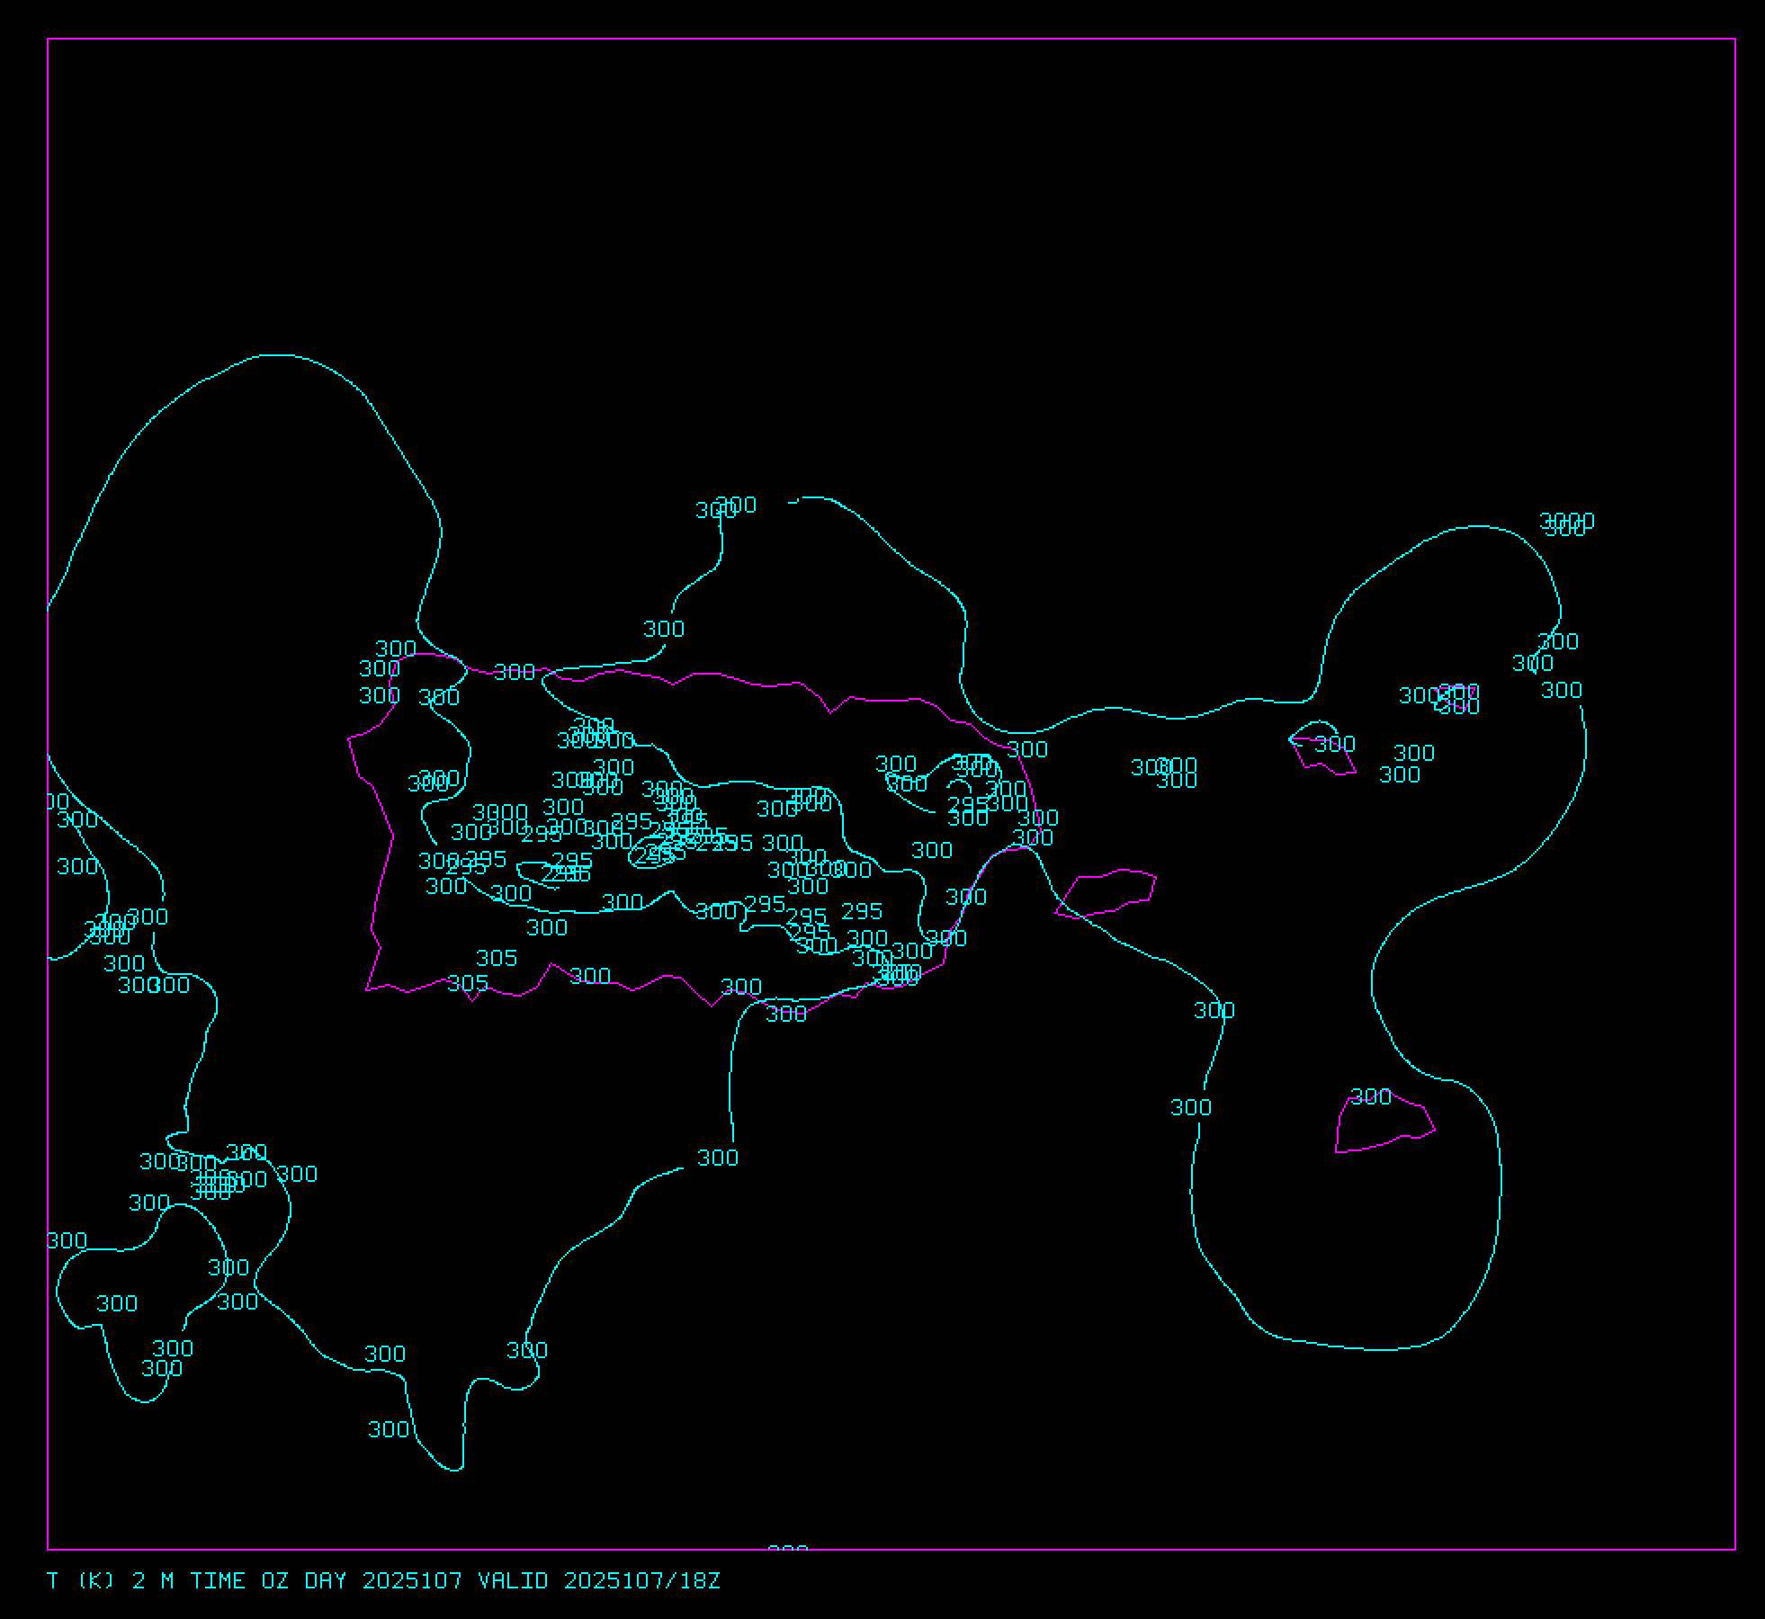
Model Grids in
Mercator Projection
Historically, McIDAS-X supported grids only in rectangular lat/lon, polar stereographic, and Lambert conformal
True Mercator grids will now be supported

Slide 8
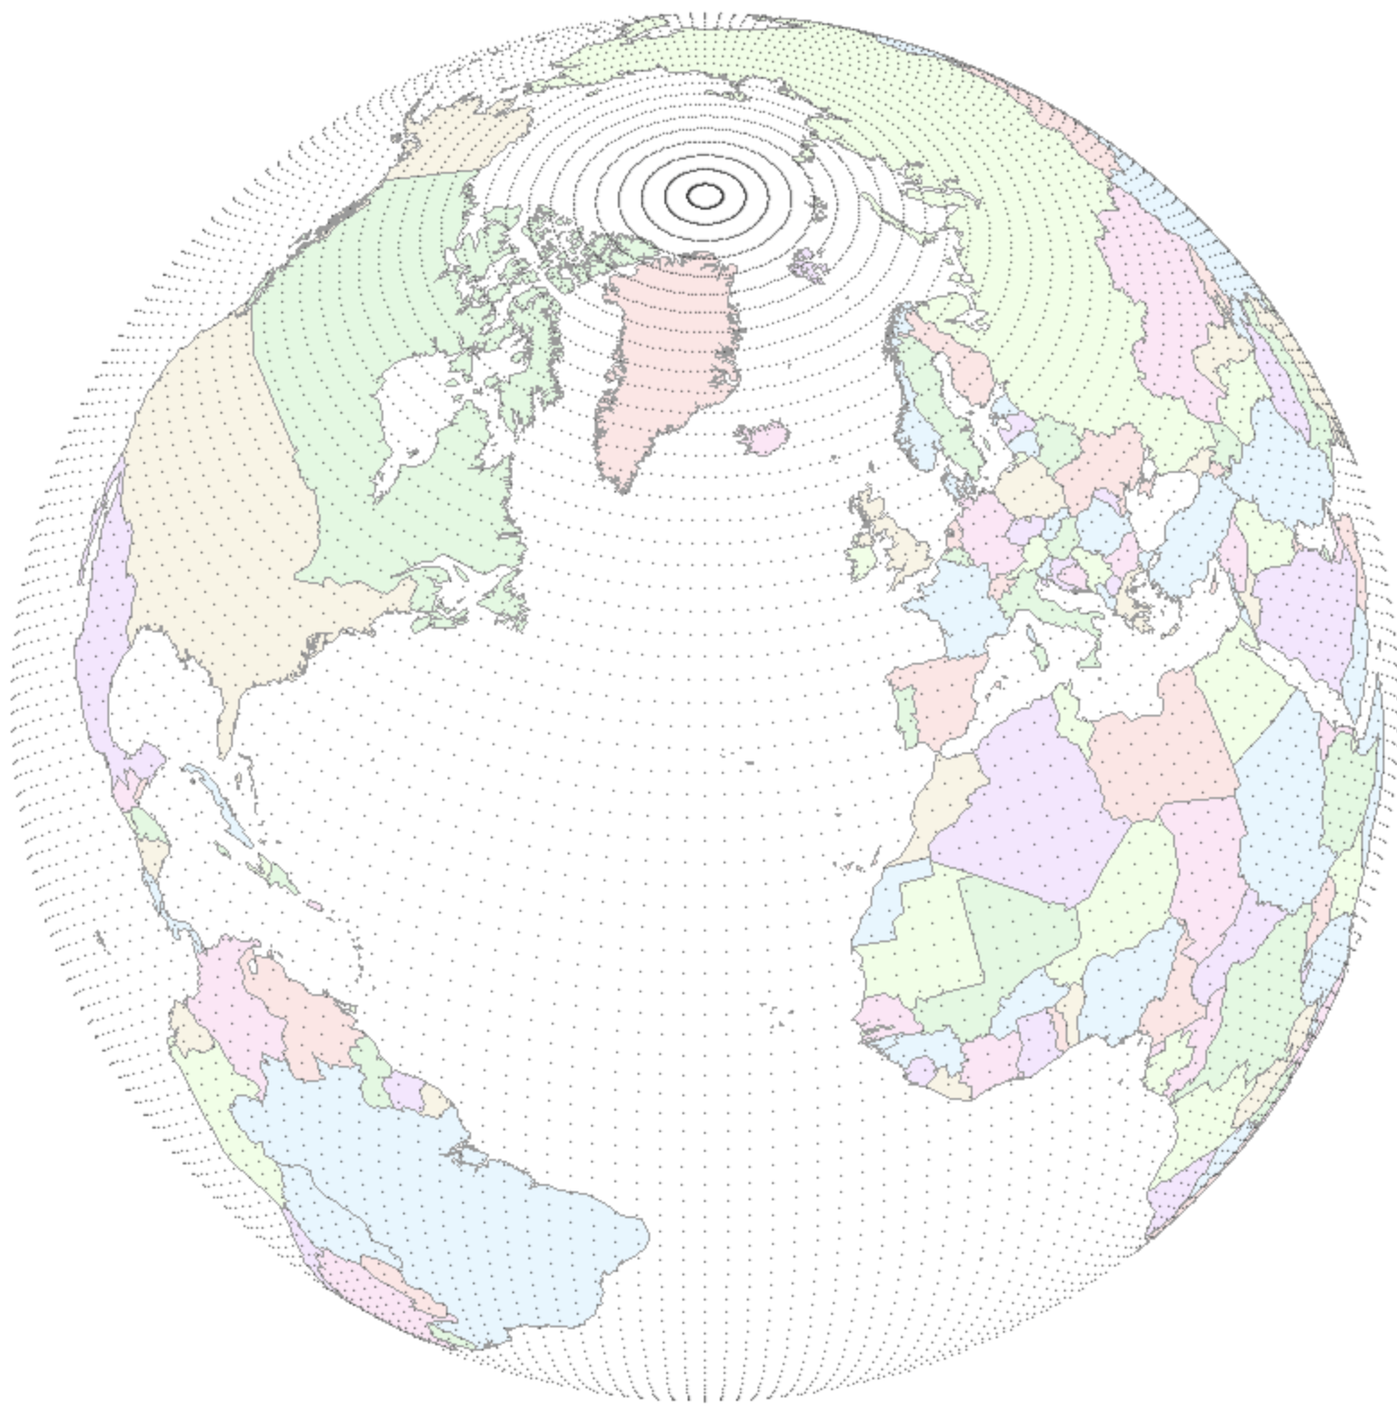
Model Grids in
Gaussian Latitude/Longitude
NOAAPORT also broadcasts many grids in Gaussian Latitude/Longitude projection
This will require a new navigation module in McIDAS-X
Projection according to ChatGPT

Slide 9
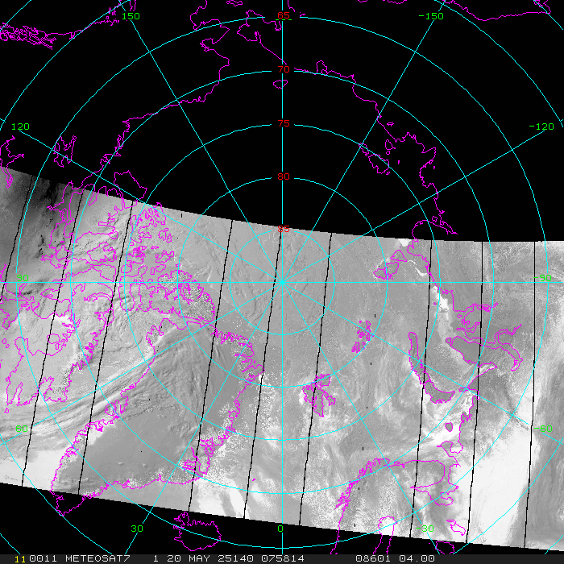
VIIRS NCC Product
VIIRS Near Constant Contrast (NCC) derived from the Day/Night Band
Regardless of the lighting (sunlit, moonlit, no light) the image has the same contrast

Slide 10
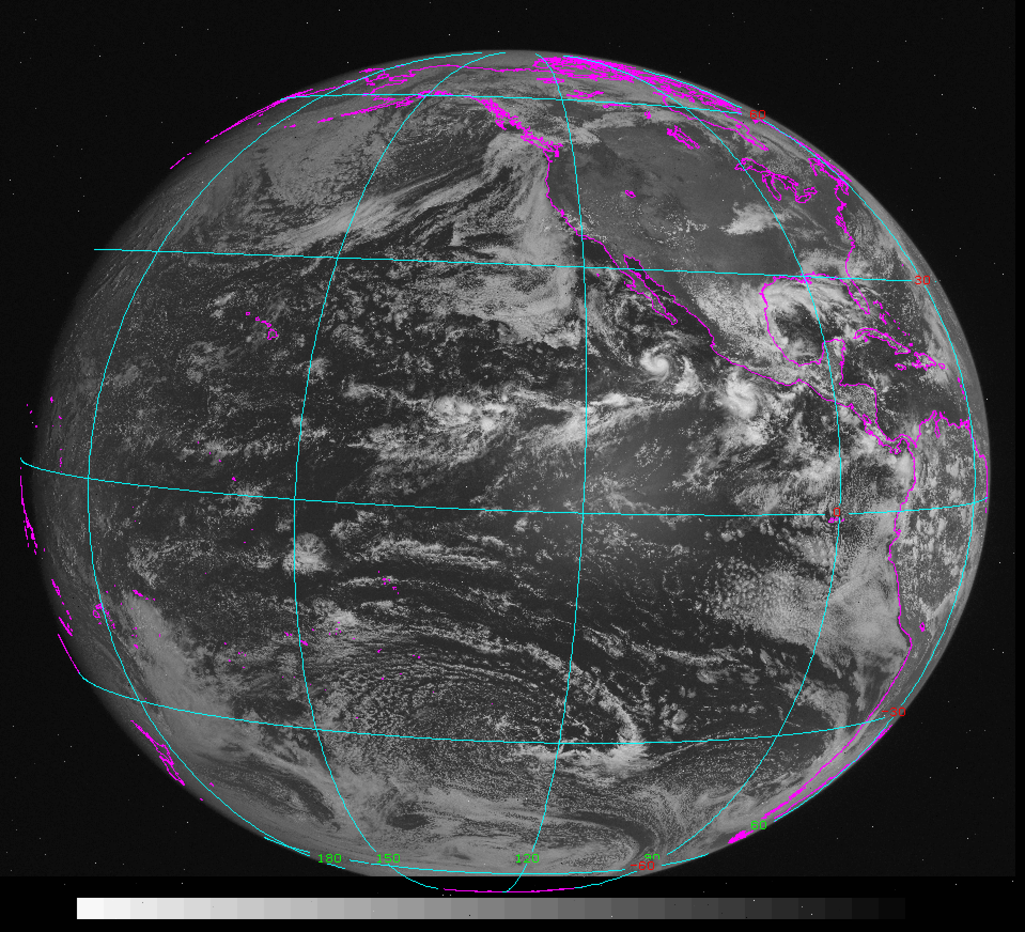
Early GOES Images
from NOAA/CLASS
ADDE servers available for Mode A, AA, and AAA raw format files
Example GOES-1 visible image from 17 Sep 1984

Slide 11
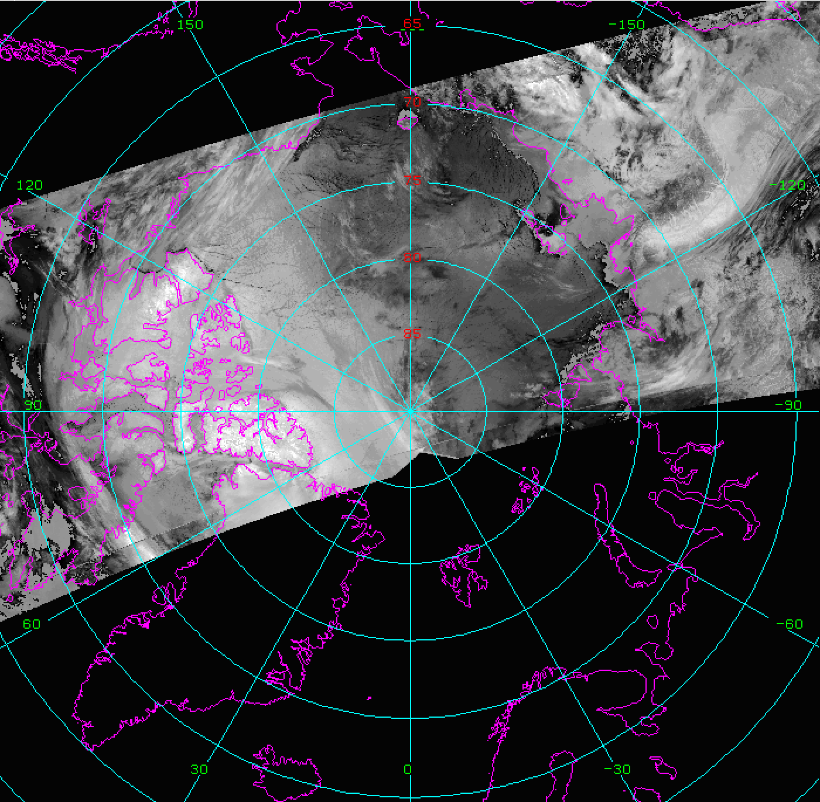
Metop-SG METimage
Metop-SG-A1 launch expected in August 2025
Replacement for Metop AVHRR
New instrument METimage, which is similar to MODIS
Planning on an ADDE server

Slide 12
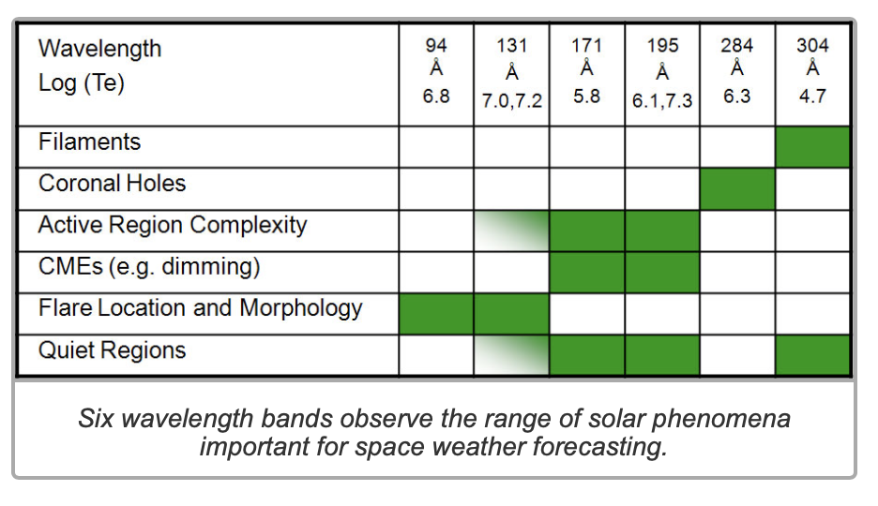
SUVI visualization
Solar UV Imager (SUVI)

Slide 13
Python ADDE client
Functionally the same as IMGCOPY, the Python code:
Constructs the ADDE request based on user-input specifications (server, ADDE dataset, subsecting, band, etc.)
Sends request to server
Returned data stored in a Python image object for further operations or written to McIDAS Area

Slide 14
Python ADDE client
Original Python code written by Ioan Ferencik in 2019:
pyadde library is a Python 3 implementation of McIDAS ADDE client binary protocol
pyarea library is a Python port of McIDAS Area Java reader/writer from the edu.wisc.ssec.mcidas Java package

Slide 15
Python ADDE client
Sophia Reiner (undergrad) has developed/prototyped additional functionality within the Python environment:
User input/Default output display
Navigation
Reprojecting
Output netCDF file

Slide 16
Python ADDE client
User input
Command line interface to input specifications for retrieving data via ADDE:
./fetchfile.py host=archive.ssec.wisc.edu group=AGOES02 descriptor=A-VIS file=AREA9998 unit=BRIT nlines=700 nelems=700 lmag=-22 emag=-22 stime=17.5 etime=17.5 position=0 band=1 day=1978055 netcdf=ncdf9998.nc
Notes:
17463 (IMGEU), 17483 (SUVI), 17419 (rocket)

Slide 17
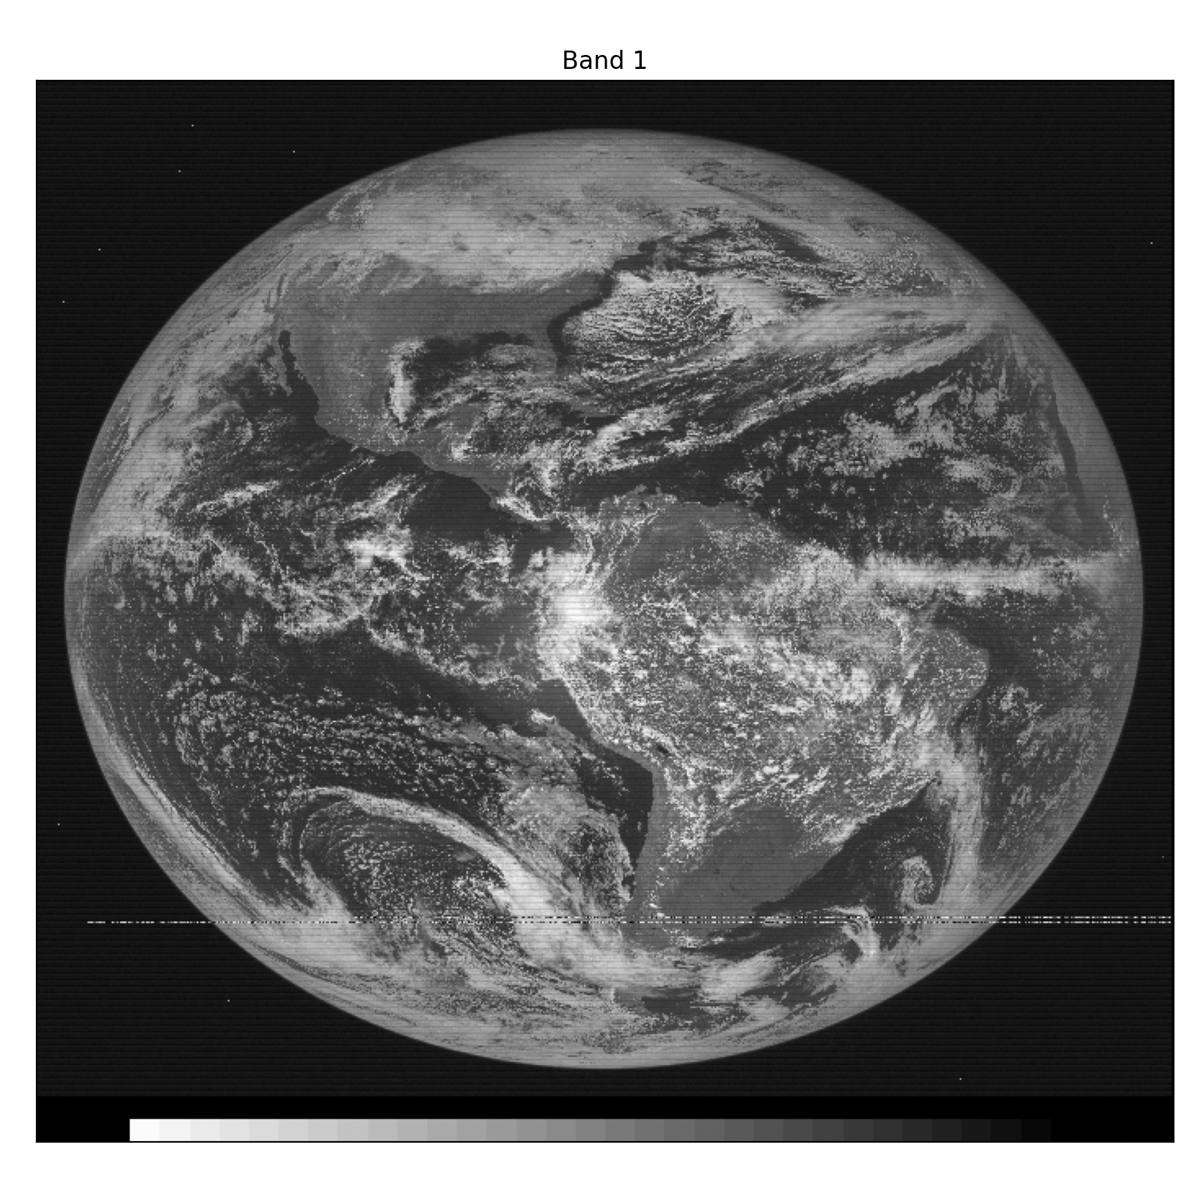
Python ADDE client
Default output display
Any data retrieved can be displayed
Navigation information not needed for default display
Calibration not needed (server converts units)
Notes:
17

Slide 18
Python ADDE client
Navigation
To geolocate the data and reproject, navigation is needed:
ADDE server provides McIDAS navigation parameters
Used f2py to convert the McIDAS-X nvxgoes.dlm Fortran navigation module to a Python-callable library
nvxgoes.dlm is for GOES-1 to -7 satellites (1970s to 1990s)
Notes:
17463 (IMGEU), 17483 (SUVI), 17419 (rocket)

Slide 19
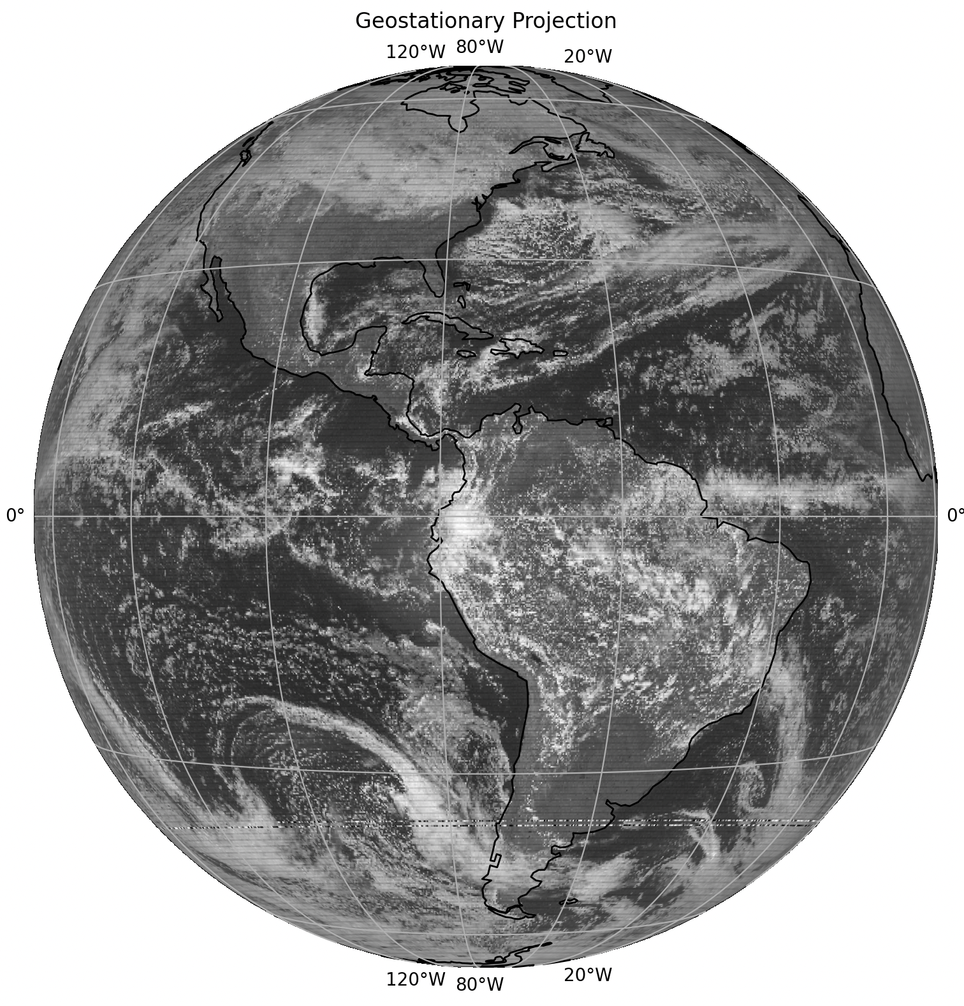
Python ADDE client
Navigation
Original image
Reprojected to nominal geostationary view
Notes:
17463 (IMGEU), 17483 (SUVI), 17419 (rocket)

Slide 20
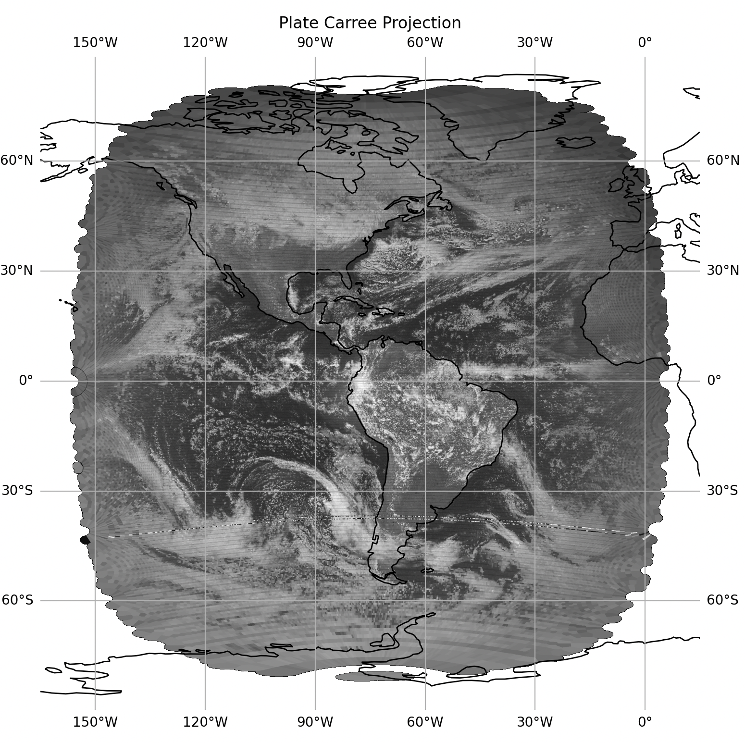
Python ADDE client
Reprojection
Nominal geostationary view
Latitude/Longitude projection
Notes:
17463 (IMGEU), 17483 (SUVI), 17419 (rocket)

Slide 21
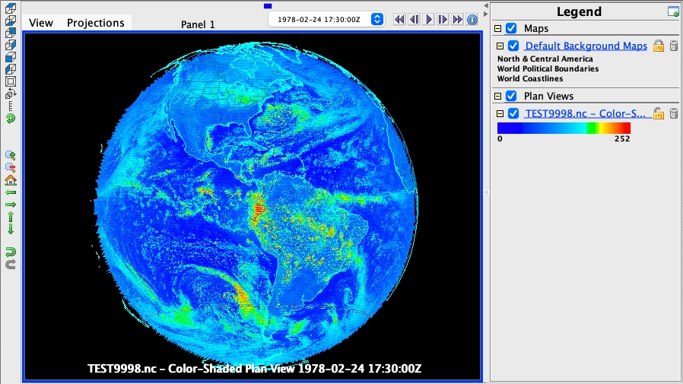
Python ADDE client
netCDF file output
Write out geostationary projected image to netCDF file Displayable in McIDAS-V
Notes:
17463 (IMGEU), 17483 (SUVI), 17419 (rocket)

Slide 22
Questions?
Notes:
17463 (IMGEU), 17483 (SUVI), 17419 (rocket)

