Slide 1




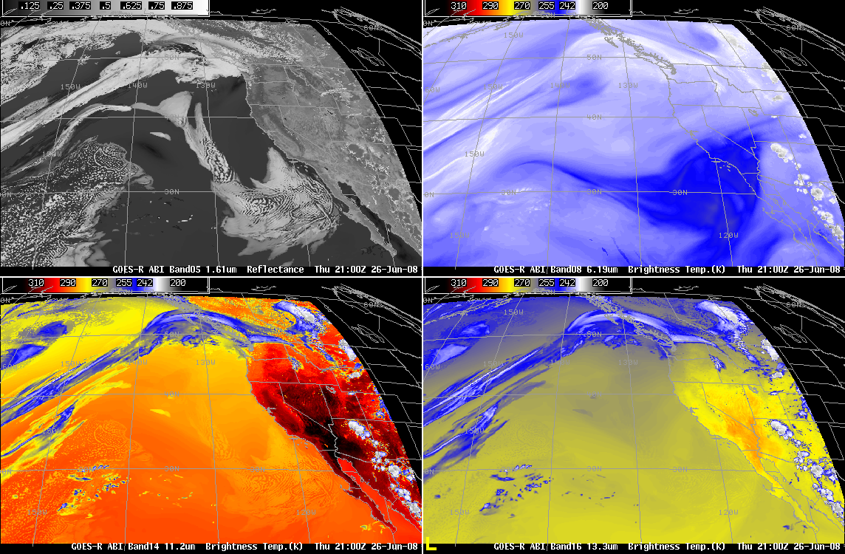
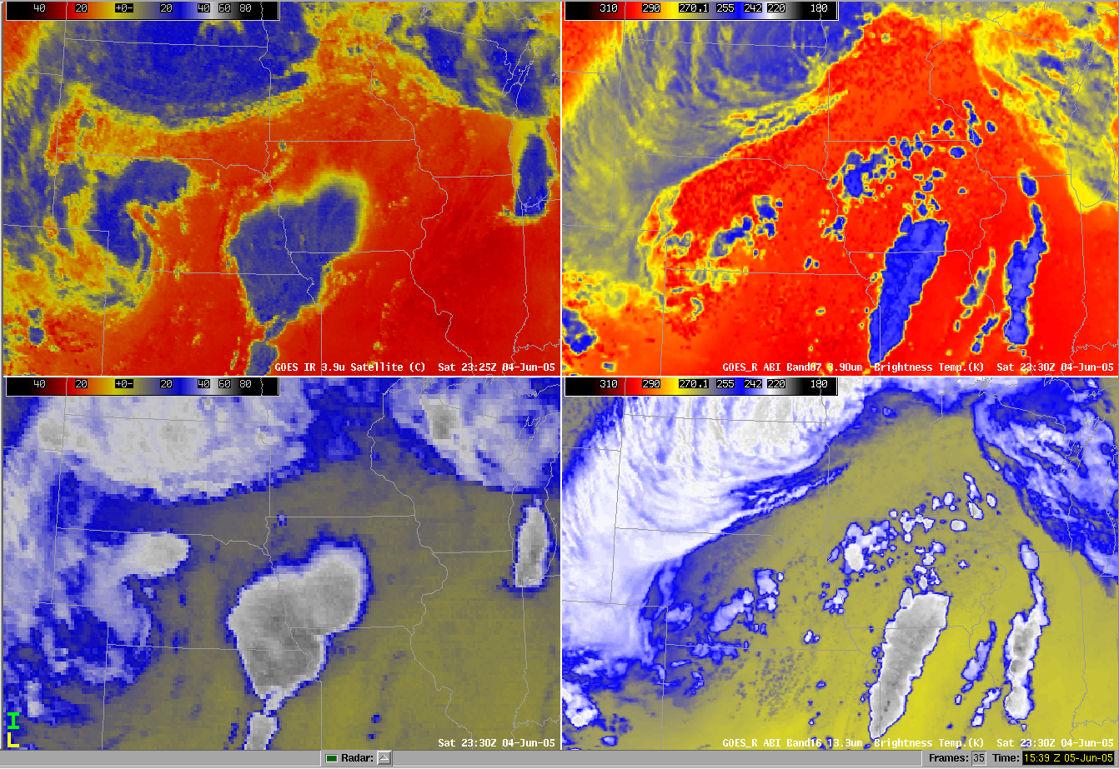
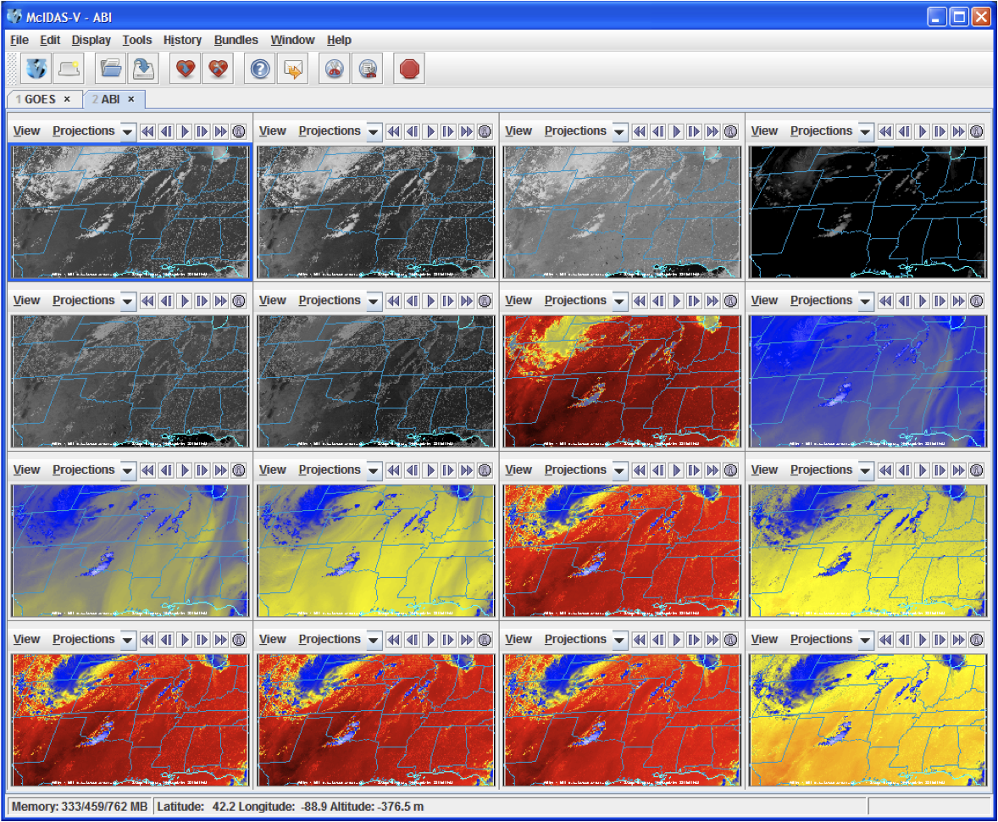
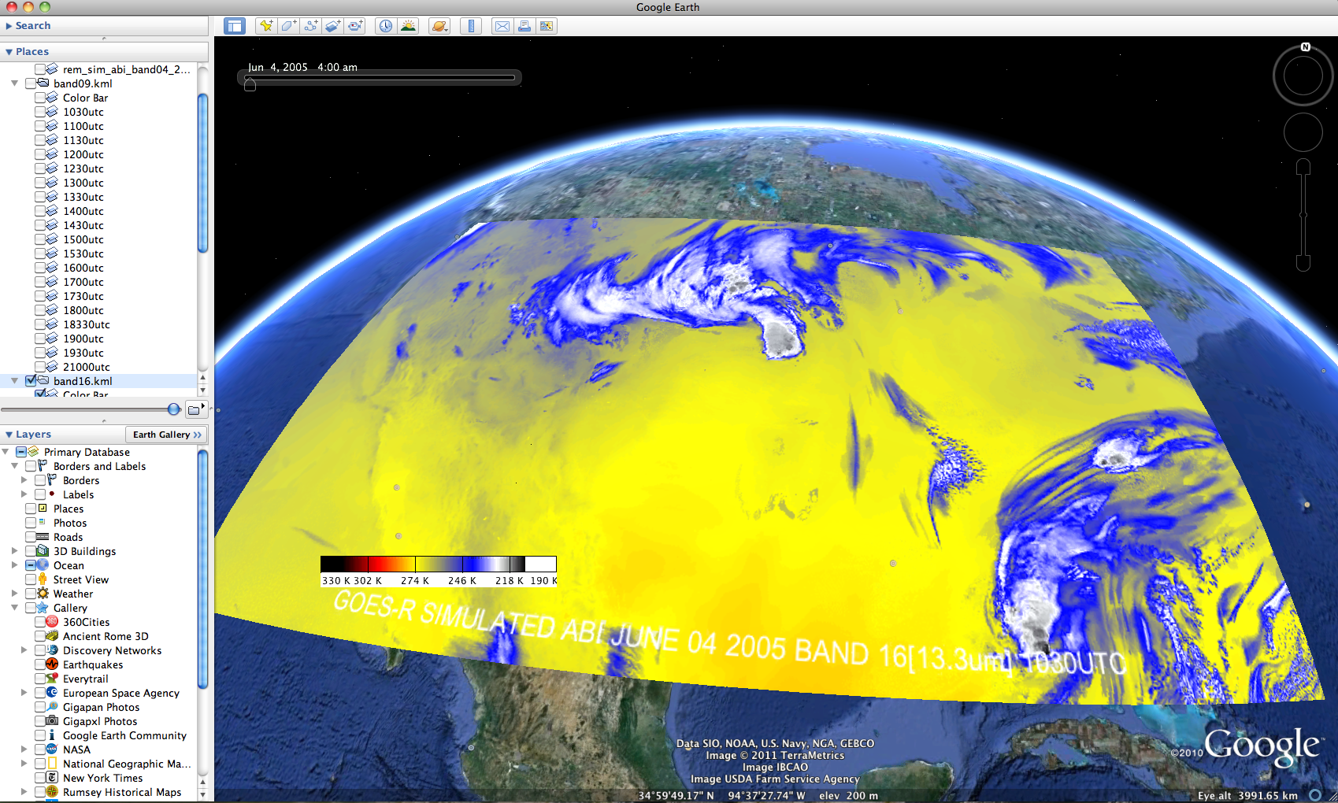
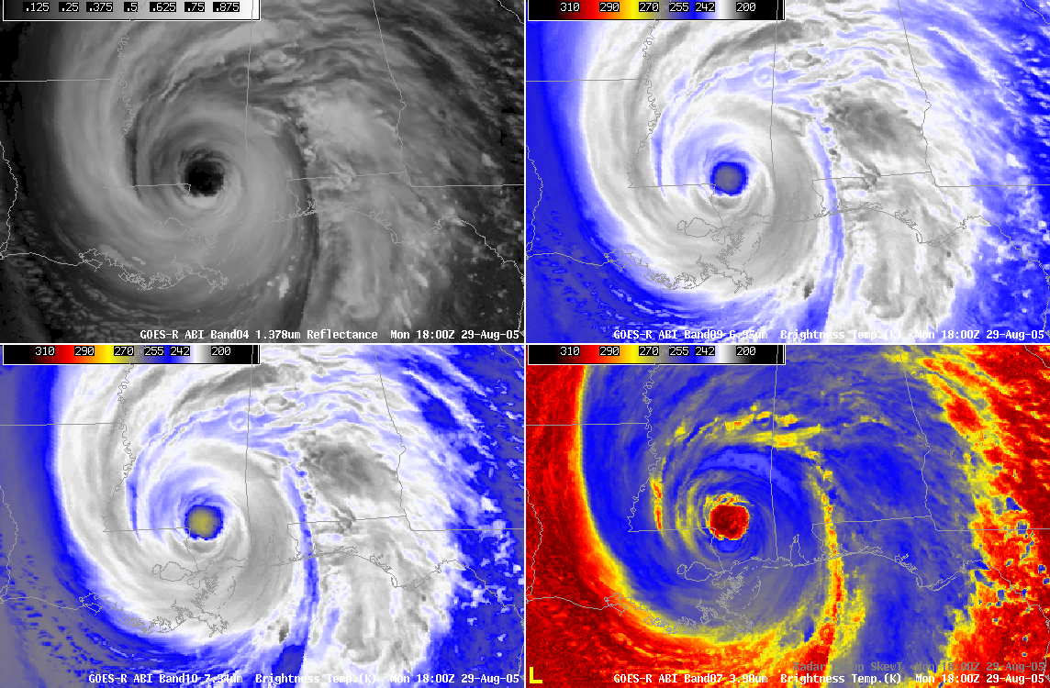
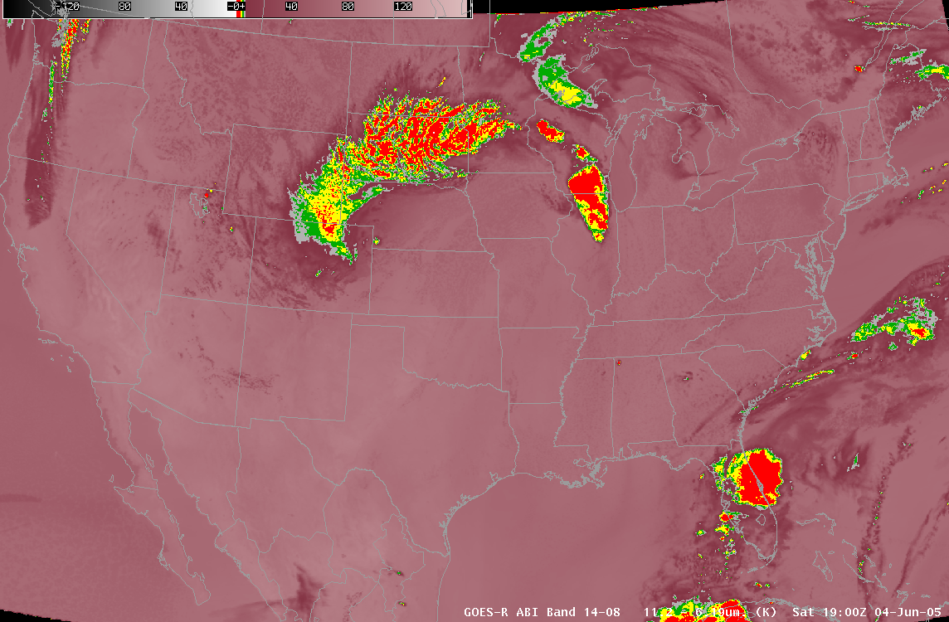
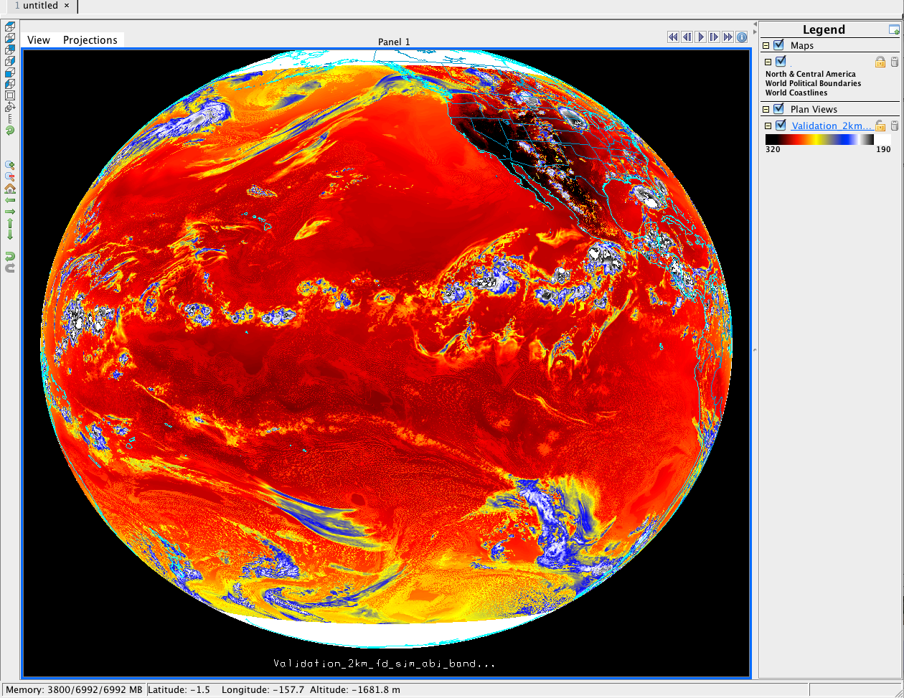
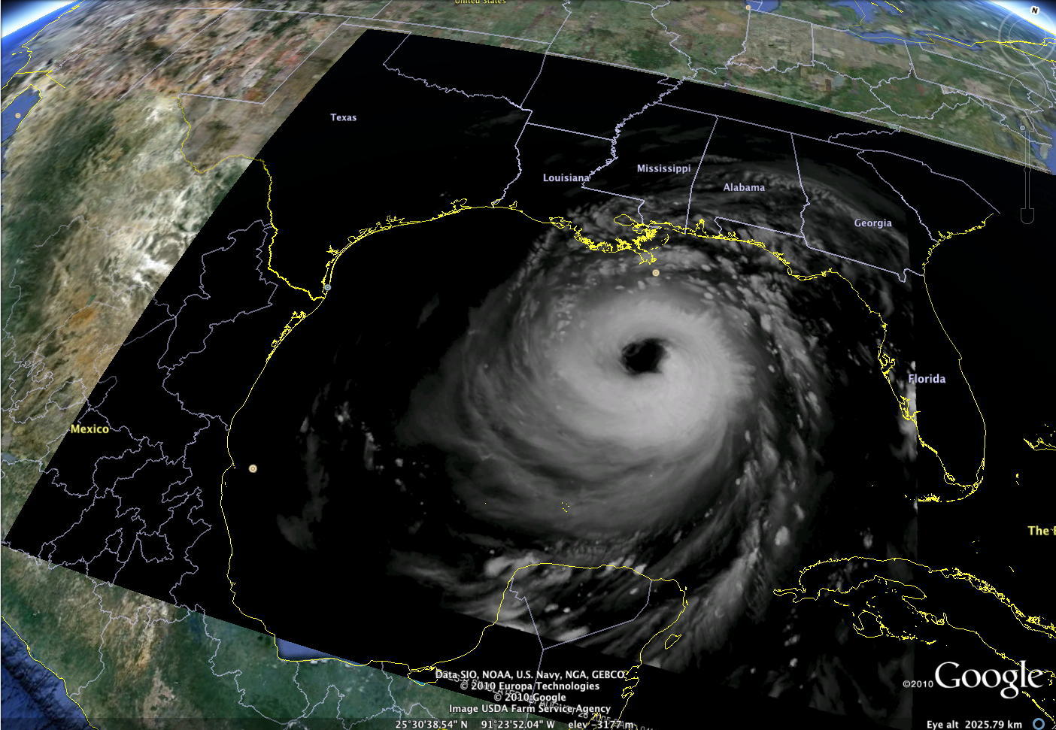
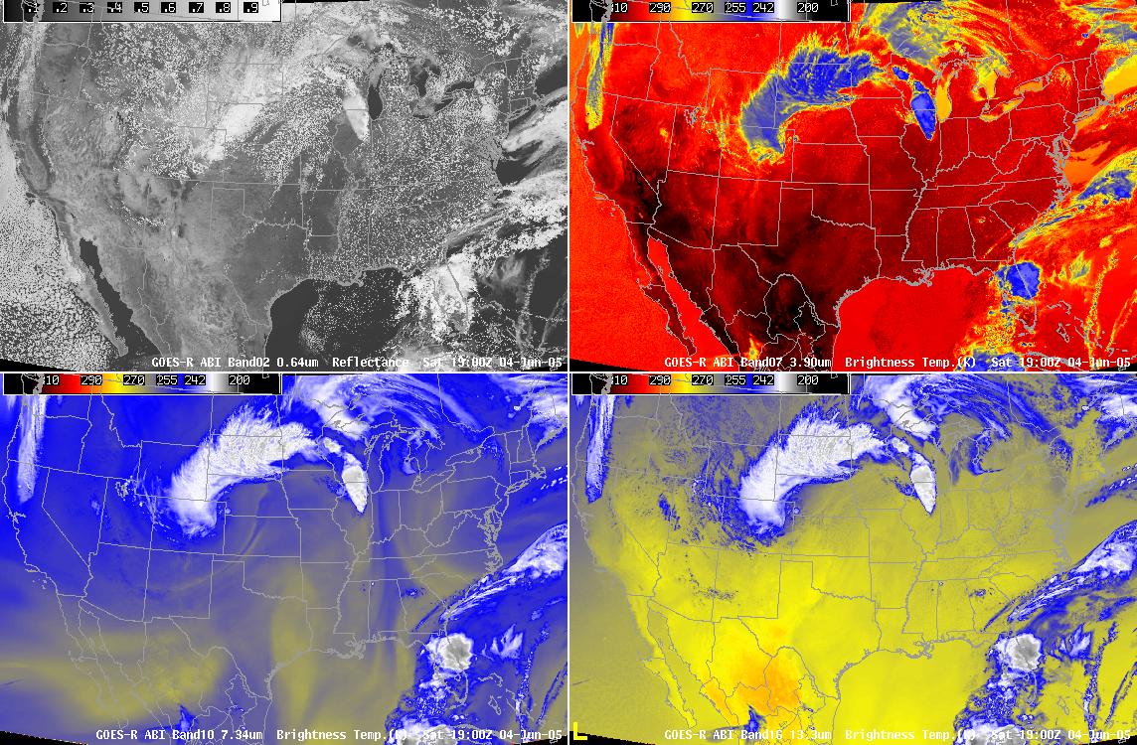
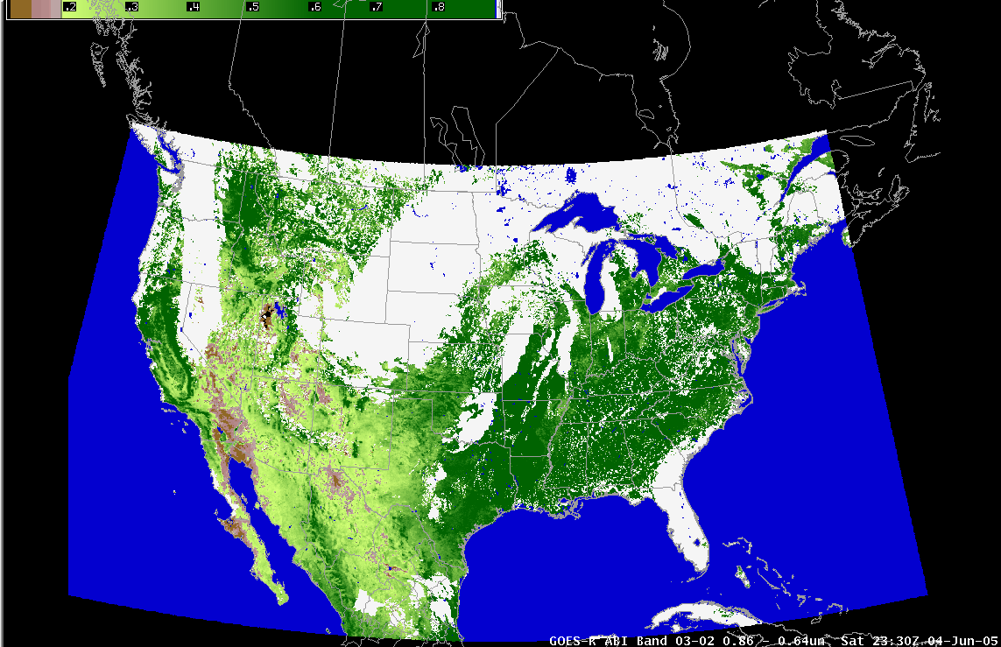
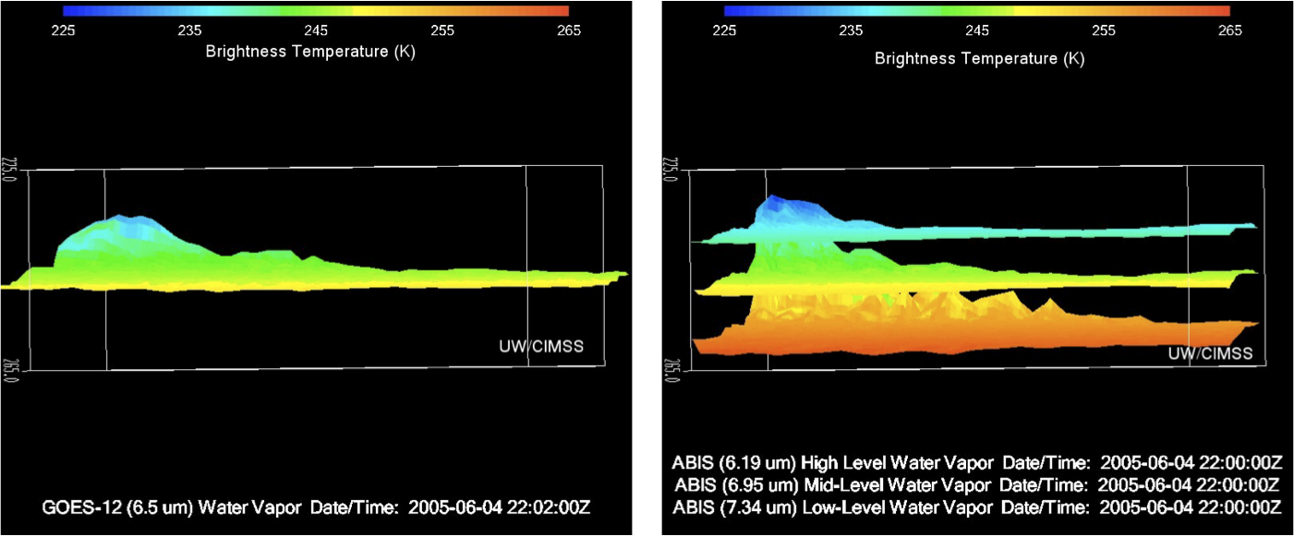
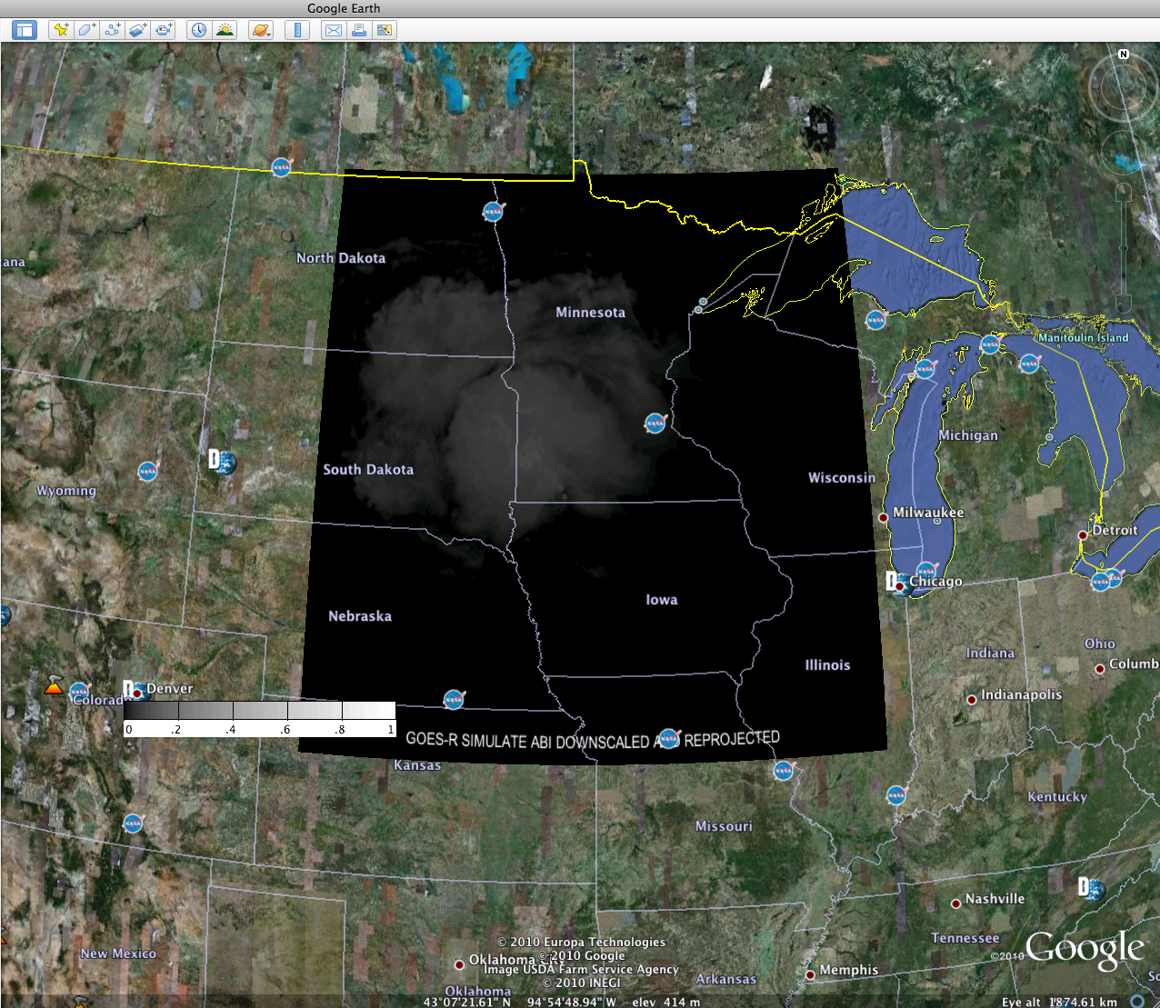
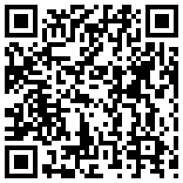
Preparation for use of the GOES-R Advanced Baseline Imager (ABI)
James Gurka², Kaba Bah¹, Tim Schmit², Tom Achtor¹,Justin Sieglaff¹, Jordan Gerth¹, Marcia Cronce³ , Joleen Feltz¹, Gary Wade², Jason Otkin¹
¹Cooperative Institute for Meteorological Satellite Studies, University of Wisconsin - Madison, WI
²NOAA/NESDIS Center for Satellite Applications and Research - Madison, WI, ³NWS Milwaukee/Sullivan- WI
The capabilities of the Advanced Baseline Imager (ABI) that will be on board the GOES-R satellite are being demonstrated by using AWIPS, McIDAS-V and Google earth to visualize and analyze simulated GOES-R ABI data. These simulated images were created by the GOES-R Algorithm Working Group (AWG) who used super computers to run high resolution numerical models, which were then input into the Cooperative Institute for Meteorological Satellite Studies (CIMSS) advanced radiative transfer models
Visualizing and analyzing different simulated GOES-R ABI cases in AWIPSI
Visualizing and Analyzing different simulated GOES-R ABI cases in McIDAS-V and Google earth
West Projection simulation of the ABI showing the pacific projection at 137° for band05, band08, band14 and band16 (1.61,6.19,11.2 and 13.3um) for June 25th 2008 at 21:00UTC
McIDAS-V
Google Earth
Comparing GOES-12 to simulated GOES-R spatial resolution for band 7 (3.90um) and band 16 (13.3um).
CONUS simulation of the 16 ABI bands displayed
In McIDAS-V for the June-05-2005 storm outbreak.
Band 16 (13.3um) (Long wave IR band) for June 05th 2005 at 10:30UTC, re projected in the Fix Grid Format and displayed in Google earth.
Hurricane Katrina simulation of the ABI approaching the shore on August-29-2005.
Band difference simulated ABI band 14-08 (11.2 - 6.19um) showing high/Upper tropospheric clouds for June 04 2005 at 19:00UTC.
Full disk simulation of ABI band14 (11.2um) and displayed in McIDAS-V for the June-26-2008 storm outbreak at 21:00UTC.
Band 04 (1.38um) (Daytime Cirrus band) for August 28th 2005
at 21:00UTC, Showing hurricane Katrina approaching Louisiana.
06-04-2006 22:00Z
CONUS simulations of the ABI showing band02, band07, band10 and band16 (0.64, 3.90, 7.34, 13.30um) for June 04th 2005 at 19:00UTC re projected into the Fix Grid Format.
NDVI computed using reflectance's from simulated ABI band 03 (0.865um) and band 02 (0.64um).
ABI water vapor bands highlighting the added layer information by plotting brightness temperature.
ABI band01(0.64um) (Daytime “blue” band) for June 04th 2005 at 10:00UTC, re projected and displayed in Google earth.
08-28-2005 19:45Z
All the above shown images were created by using McIDAS-V, AWIPS and Google earth.
For more information visit the websites below.
GOES-R ABI: http://cimss.ssec.wisc.edu/goes_r/proving-ground.html
McIDAS-V : http://www.ssec.wisc.edu/mcidas
AWIPS : Advanced Weather Interactive Processing system
MIDAS-V: Man Computer Interactive Data Access System
E-mail: kbah@ssec.wisc.edu
Poster QR code

