Slide 1

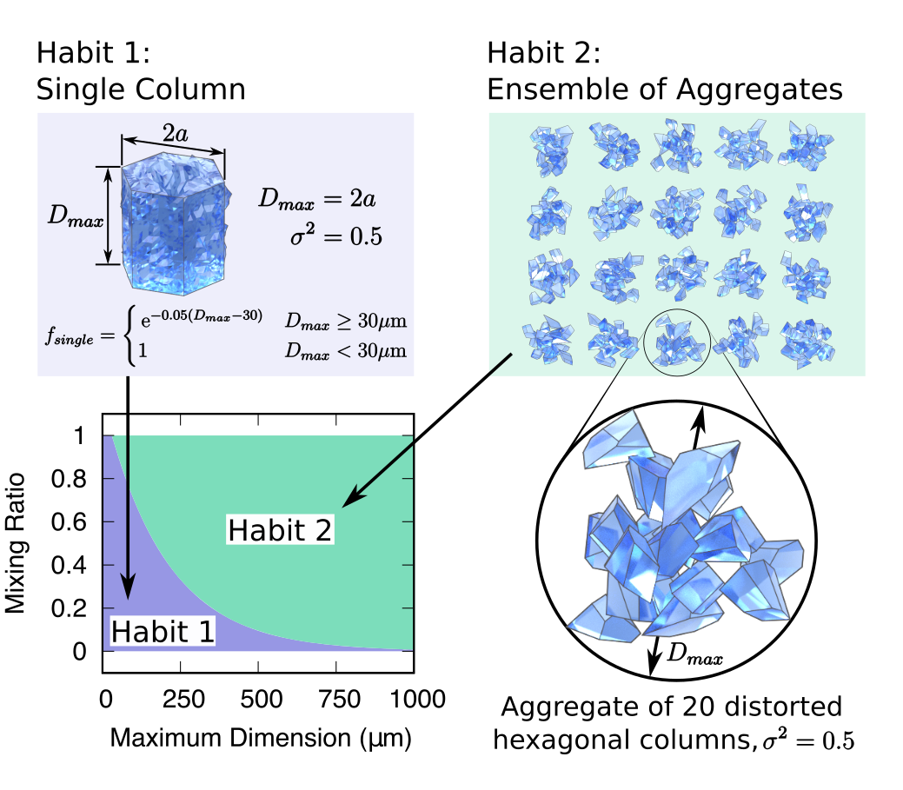
Consistency of Ice Cloud Models in Forward Retrieval and Radiative Forcing Assessment
PI: Ping Yang, Texas A&M University
Non-funded collaborator: Norman Loeb, NASA Langley Research Center
Consistency hypothesis: radiative fluxes derived using a consistent ice particle model assumption throughout provide a more robust reference for climate model evaluation compared to existing ice cloud property retrievals (Loeb et al. 2017). In other words, the same ice model must be consistently used in forward remote sensing implementations and downstream radiative transfer computations.
Objectives
Validate the consistency hypothesis by using the MODIS, AIRS, and CALIPSO cloud property products, CERES flux products, and state-of-the-science light scattering and radiative transfer modeling capabilities in conjunction with the ice cloud models used by the respective science teams.
Quantify the global scale uncertainties/errors caused by using inconsistent ice cloud models
Develop parameterization schemes for ice cloud bulk radiative properties that are consistent with the ice models used in NASA’s cloud property retrieval products
Schematic diagram showing two ice crystal habits and their mixing ratios of the Two-Habit Model. Habit 1 is a roughened single column with aspect ratio 2a/D_{max} =1, and Habit 2 is an ensemble of 20 randomly generated aggregates. Individual aggregate shape consists of 20 randomly distorted hexagonal columns. The mixing ratio of Habits 1 and 2 add up to one. Adapted from Loeb et al. (2018).

Slide 2
Consistency of Ice Cloud Models in Forward Retrieval and Radiative Forcing Assessment
PI: Ping Yang, Texas A&M University
Non-funded collaborator: Norman Loeb, NASA Langley Research Center
Status:
Review literature
Collocate Data
Implement ice cloud models into radiative transfer models
Needed Products:
MODIS, AIRS, and CALIPSO cloud property products, and CERES flux products
Known Issues:
N/A.
Recent Publications:
  Loeb, N. G., P. Yang, F. G. Rose, G. Hong, S. Sun-Mack, P. Minnis, S. Kato, S.-H Ham, W. L. Smith Jr., S. Hioki, and G. Tang, 2018: Impact of ice microphysics on satellite cloud retrievals and broadband flux radiative transfer model calculations. J. Climate, 31, 1851-1864.
Develop optimal ice cloud optical property models in support of MODIS/VIIRS cloud retrievals
Develop consistent ice cloud radiative property parameterizations for downstream radiative forcing assessment involving ice clouds based on MIDOS/VIIRS retrieval products

