Slide 1
Academic Staff and Limited Employee Manager Self Service (MSS) Payroll

Slide 2
Instructions on Leave Reporting:
Leave for full-time Academic Staff and Limited employees shall be charged in increments of 4 and 8 hours.
Absences of less than 2 hours should not be reported.
Absences of between 2 hours and 6 hours shall be charged as 4 hours.
Absences of more than 6 hours shall be charged as 8 hours.
Notes:
Absences need to be entered by employees by the 5th of every month. Absences need to be approved by the supervisor by the 10th of every month.

Slide 3
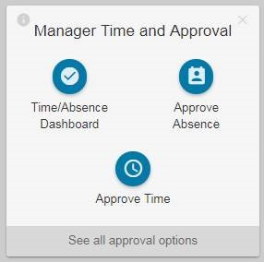
How to Approve Absence Request:
1. Log onto the My UW Portal at https://my.wisc.edu
2. Under Manger Time and Approval, Select “Time/Absence Dashboard”

Slide 4
Selection Criteria
3. Opens to the “Selection Criteria” page
4. Criteria may include:
Empl ID
Last Name, First Name
Department
Select Refresh
Notes:
NOTE: If you do not know your department’s UDDS or employee’s Empl IDs, please contact me and I will send them to you.

Slide 5
Approve Absence Request
5. Click the check box next to the employee’s name and select approve.
To review the employee’s absence balances, click on the employee’s name.
6. Once the request has been approved, the entry will be removed automatically from the list.
NOTE: this indicates that the absence request exceeds the employee’s available balance. This does not prevent the approval from processing.
Notes:
If you see this symbol, you will need to communicate with the employee to select another leave type.
Do not use the Push Back button. If there is an issue with an absence request, please reach out to the employee to resolve.

Slide 6
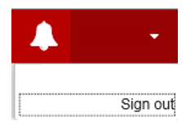
Signing Out
After using My UW System Portal, Sign Out using the link in the upper right and close the browser if you are using a public computer to ensure that your personal data is kept private.
Notes:
Take aways:
Employees should NOT use date ranges when entering absences
We have asked your employees to notify you if they change an absence after you approve them on the 10th of the month; you will need to re-approve the revised absences
Absences need to be reported in 4 or 8 hours increments (exceptions: p/t and FMLA employees)
Legal holidays will preload
‘No leave taken’ needs to be entered if the employee hasn’t taken any leave OR the only leave for the month were the legal holidays

