Slide 1





NOAA VIIRS / ABI Flood Product Quick Guide for United States Stakeholders
Updated April 22, 2019

Slide 2
Quick Guide Overview
The intention of this quick guide is to give a brief overview of the VIIRS and ABI Flood Mapping products for emergency response stakeholders and how to access and use them.
This is not a technical document. Users who wish to have the specific scientific information, such as which bands are used, can refer to the last slide at the end of this presentation or contact the developers (information listed on slide 10).
A set of useful links to access the products is also provided.

Slide 3
Flood Products Overview
Both the VIIRS and ABI flood products provide flood areal extent and can be used for situational awareness.
The joint VIIRS/ABI flood product, whenever it is available, is always highly recommended for use because it is with both the most complete flood extent and the finer 375-m spatial resolution.
Under clear-sky conditions in both VIIRS and ABI images, VIIRS flood product is recommended for use because of its more accurate floodwater details.
The ABI flood maps filter out clouds using a multiple composition process. This means that it may be able to provide flood extent in regions which are cloudy during the two daytime VIIRS overpasses. In this case, the ABI flood map could take the role of providing a very coarse flood detection map.

Slide 4
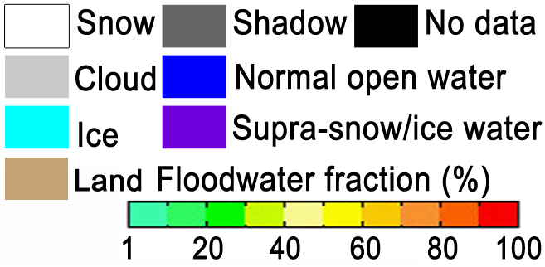
Lists of VIIRS/ABI Flood Products
Products | Spatial resolution | Availability | Time Data acquired | Production | Description
Suomi-NPP/NOAA-20 VIIRS flood product | 375m | 2-3 daytime passes for each satellite cover entire CONUS | ~1700 (East CONUS) - ~2130 UTC (West CONUS) | Routinely produced | Daytime-only flood extent in water fractions (open water percentage in a satellite pixel)
GOES-16/ABI flood product | 1-km (at nadir) | Every hour | Daytime hours only | Routinely produced
Joint VIIRS/ABI flood product | 375m | Once per day | ̶ | Upon request

Slide 5
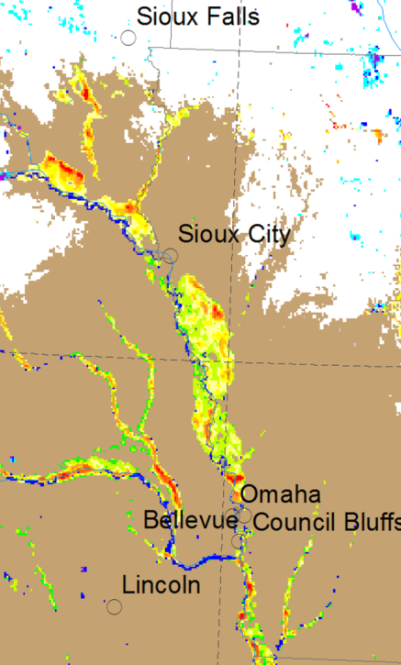
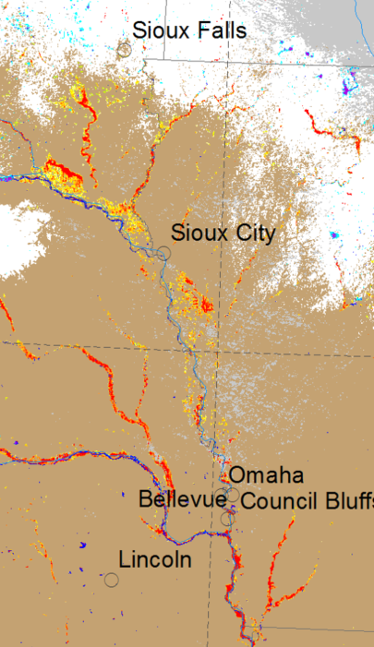
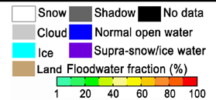
Example from 15 March 2019
VIIRS:
Advantages: VIIRS imagery is with constant spatial resolution at ~375m and provides finer and more accurate details of the flood extent than the 1-km ABI flood product. In addition, the VIIRS has been validated (Li et. al 2017)
Disadvantage: Images are available twice a day, and can be easily affected by clouds and cloud shadows.
ABI:
Advantages: ABI flood product is composited from 5-minute flood maps. Thus, it captures the maximal clear-sky coverage during daytime and can provide flood extent more completely with a better time manner.
Disadvantage: The spatial resolution is coarse and in mid latitudes, the actual spatial resolution is about ~1.3-~1.5km over CONUS, which provides flood extent with vague boundaries. The ABI product has also not been completely validated
ABI Flood product from GOES-16
VIIRS Flood product from SNPP/NOAA-20

Slide 6
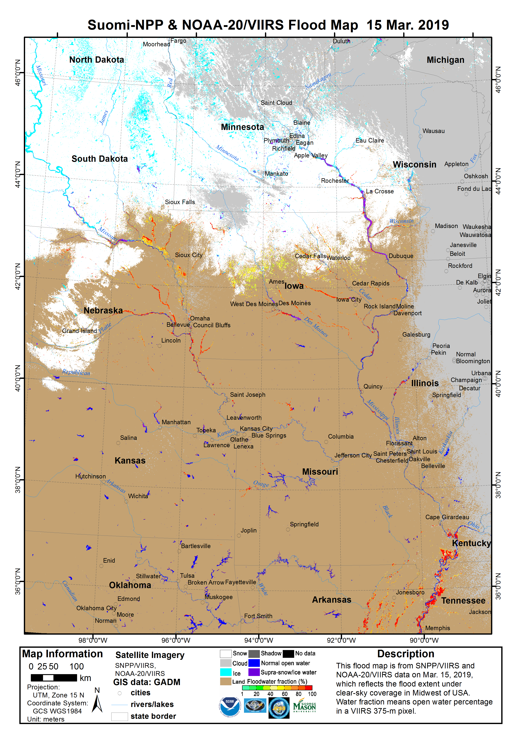
VIIRS Flood Product
The VIIRS 375-m Flood Product, is a near real-time product derived from daytime VIIRS imagery from S-NPP and NOAA-20.
The VIIRS Flood Map reflects the current flood status at the time of the overpass along with additional information on the weather and land conditions.
S-NPP and NOAA-20 are low earth orbiting satellites, which means only two daytime observations can be derived per day over a given Region of Interest (ROI) with a ~50 min interval.
Observations are taken ~2-3pm local solar time. Utilizing Direct Broadcast (where available, such as CONUS, AK and HI) means that the latency of the product is less than 1 hour after the pass is complete.

Slide 7
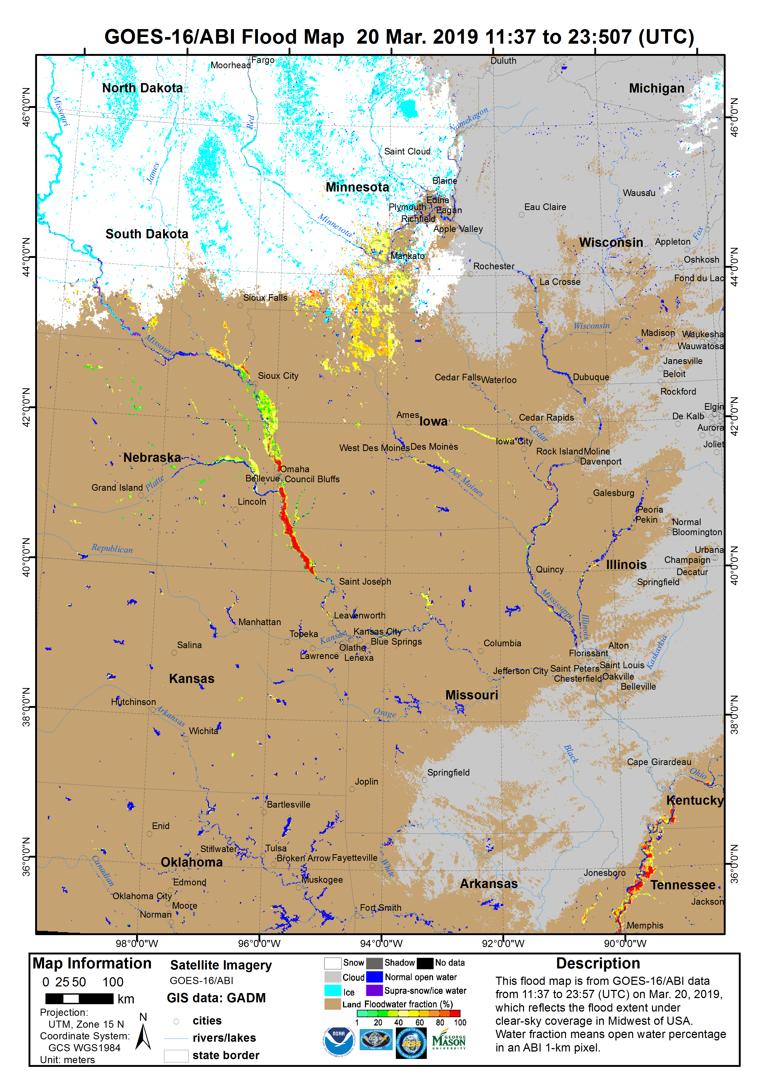
ABI Flood Product
The ABI Flood Product is a rolling composited result based on the 5-minute ABI flood maps with hourly updates. Each hourly-updated flood map shows the average flood water fractions from the first 5-minute flood map to the latest one.
At the end of a day, the ABI Flood Map is a daily flood composite, and shows the flood extent under the daily maximal clear-sky coverage (example shown right).
Data from ABI is acquired using the GOES Rebroadcast (GRB) downlink, which provides short latency in aquiring the ABI data.
IMPORTANT NOTE - The ABI Flood product is still experimental and has not been completely validated.

Slide 8
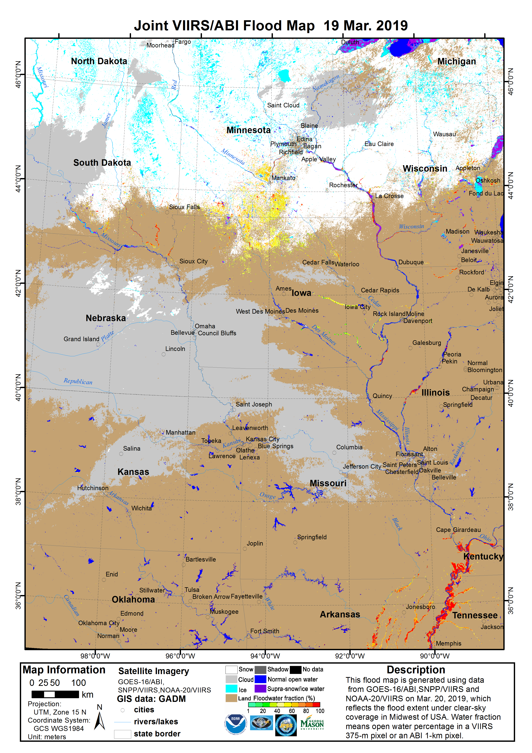
Joint VIIRS/ABI Flood Product
The joint VIIRS/ABI Flood Product blends the daily flood detection results from VIIRS and ABI. It is based on the VIIRS 375-m flood maps, and uses the 1-km ABI clear-sky detection results to fill the gaps of clouds and cloud shadows in the VIIRS maps.
Thus, it shows the flood extent under the maximal clear-sky coverage derived by the satellites during daytime, and keeps the finer VIIRS 375-m spatial resolution.
The product is not yet routinely produced, and is available only after all the VIIRS and ABI flood products become available.
IMPORTANT NOTE - The current Joint VIIRS/ABI Flood product is an experimental product using overlapping process. The ABI flood water fractions have not been fully fused with the VIIRS results.

Slide 9
Example of how the products can be used during the day
The ABI flood maps are available from the early morning to the late afternoon, and thus are recommended for use during the periods when VIIRS flood products are unavailable.
Once the high resolution (375 m) flood product from VIIRS become available (3-4pm local solar time over a given region, assuming DB availability). Assessments can be revised using finer and more accurate details of the flood extent, depending on cloud cover over ROI at time of S-NPP and NOAA-20 passes.
If available, the Joint ABI/VIIRS Flood product is highly recommended for an initial evening assessment, since it provides the most complete and highest spatial resolution flood map. If the joint product is not available, then the VIIRS or ABI composite flood products can be used for an initial evening assessment, depending on cloud conditions.
Remember that the all of the flood products are produced during daytime only, thus the products will not be updated overnight

Slide 10
Accessability and Contact information
SSEC RealEarth
  ABI Hourly composites: http://realearth.ssec.wisc.edu/?products=River-Flood-ABI-hourly
  ABI Daily composites: http://realearth.ssec.wisc.edu/?products=River-Flood-ABI
  VIIRS real-time flood maps: http://realearth.ssec.wisc.edu/?products=RIVER-FLDall-US
  Specific NWS River Forecast Center Regional VIIRS products are available as well
  Also available on RealEarth App (available for Android and Apple)
NRT feed for KML, geoTIF and PNGs available at ftp://floodlight.ssec.wisc.edu/realtime/
The flood products via Web Mapping Service (via Real Earth) are available
Note that these products are not supported 24/7 but do have a high reliability of uptime.
Any questions can be referred to William Straka (wstraka@ssec.wisc.edu), Bill Sjoberg (bill.sjoberg@noaa.gov) and Mitch Goldberg (mitch.goldberg@noaa.gov)
Any technical and scientific issues can be referred to Jay Hoffman (jay.hoffman@ssec.wisc.edu), Sanmei Li (slia@gmu.edu) and Donglian Sun (dsun@gmu.edu)

Slide 11
Subsample of cases where flood product has been used by stakeholders
Support for flooding after tropical cyclones
  Hurricane Harvey, Irma, Maria and Nate (2017)
  Hurricane Florence and Michael (2018)
Flooding in Midwest (2018 and 2019)
International Charter (highlights)
  Venezuela, Vietnam and others (2017)
  Vietnam, India, Philippines and others (2018)
NRT distribution and usage by NWS River Forecast Centers

Slide 12
References
Sanmei Li, DonglianSun, Mitchell Goldberg, Bill Sjoberg, David Santek, Jay P. Hoffman, Mike DeWeese, Pedro Restrepo, Scott Lindsey, Eric Holloway (2017). Automatic near real-time flood detection using Suomi-NPP/VIIRS data, Remote Sensing of Environment, 204 (2018) 672–689
Sanmei Li, Donglian Sun, Mitchell Goldberg & Bill Sjoberg (2015). Object-based automatic terrain shadow removal from SNPP/VIIRS flood maps, International Journal of Remote Sensing, Vol. 36, No. 21, 5504–5522
Sanmei Li, Donglian Sun, Mitchell Goldberg & Antony Stefanidis (2013). Derivation of 30-m-resolution Water Maps from TERRA/MODIS and SRTM. Remote Sensing of Environment 134 (2013) 417–430
Sanmei Li, Donglian Sun, Yunyue Yu, Ivan Csiszar, Antony Stefanidis, & Mitch D. Goldberg (2012). A New Shortwave Infrared (SWIR) Method for Quantitative Water Fraction Derivation and Evaluation with EOS/MODIS and Landsat/TM data. IEEE Transactions on Geoscience and Remote Sensing, Vol. 51, Issue 3
Sanmei Li, Donglian Sun & Yunyue Yu (2013). Automatic cloud-shadow removal fromflood/standing water maps using MSG/SEVIRI imagery, International Journal of Remote Sensing, 34:15, 5487-5502
Donglian Sun, Yunyue Yu, Rui Zhang, Sanmei Li, and Mitchel D. Goldberg (2012). Towards Operational Automatic Flood Detection Using EOS/MODIS data. Photogrammetric Engineering & Remote Sensing, 78 (6)

