Slide 1

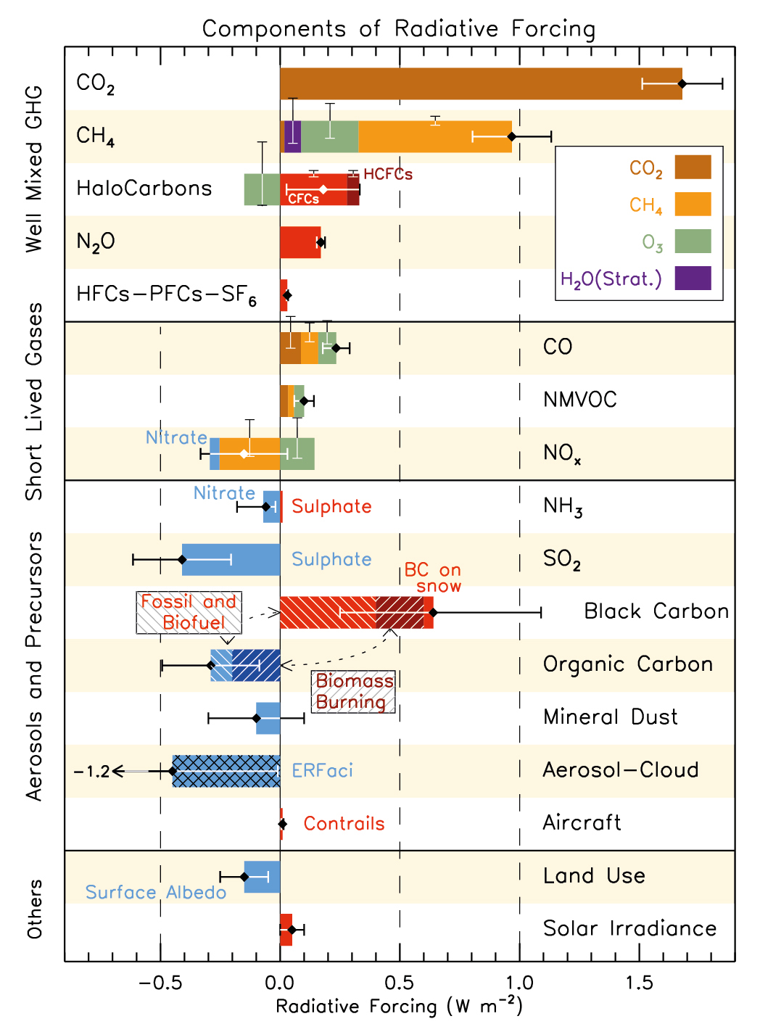
Understanding Variability and Net Radiative Effect of Mineral Dust in Recent Decades by Using Terra, Aqua, and Suomi NPP
Hongbin Yu, Zhibo Zhang, Tianle Yuan, Robert Levy
Objectives
To improve the observational understanding of dust variability and net radiative effect on climate in recent decades with dust observations from satellites.
How has dust been changing in recent decades with seasonal distinction and on a regional basis?
What are major factors that have been driving the recent regional dust changes?
Does dust exert a net cooling or warming effect on the energy balance of the Earth-atmosphere system?
IPCC AR5
Dust varies greatly, due to the sporadic nature of dust events, large variability of transport/removal processes, and tight coupling with other components of the climate system.
Dust radiative effect is highly uncertain, even for the sign (cooling or warming?).

Slide 2

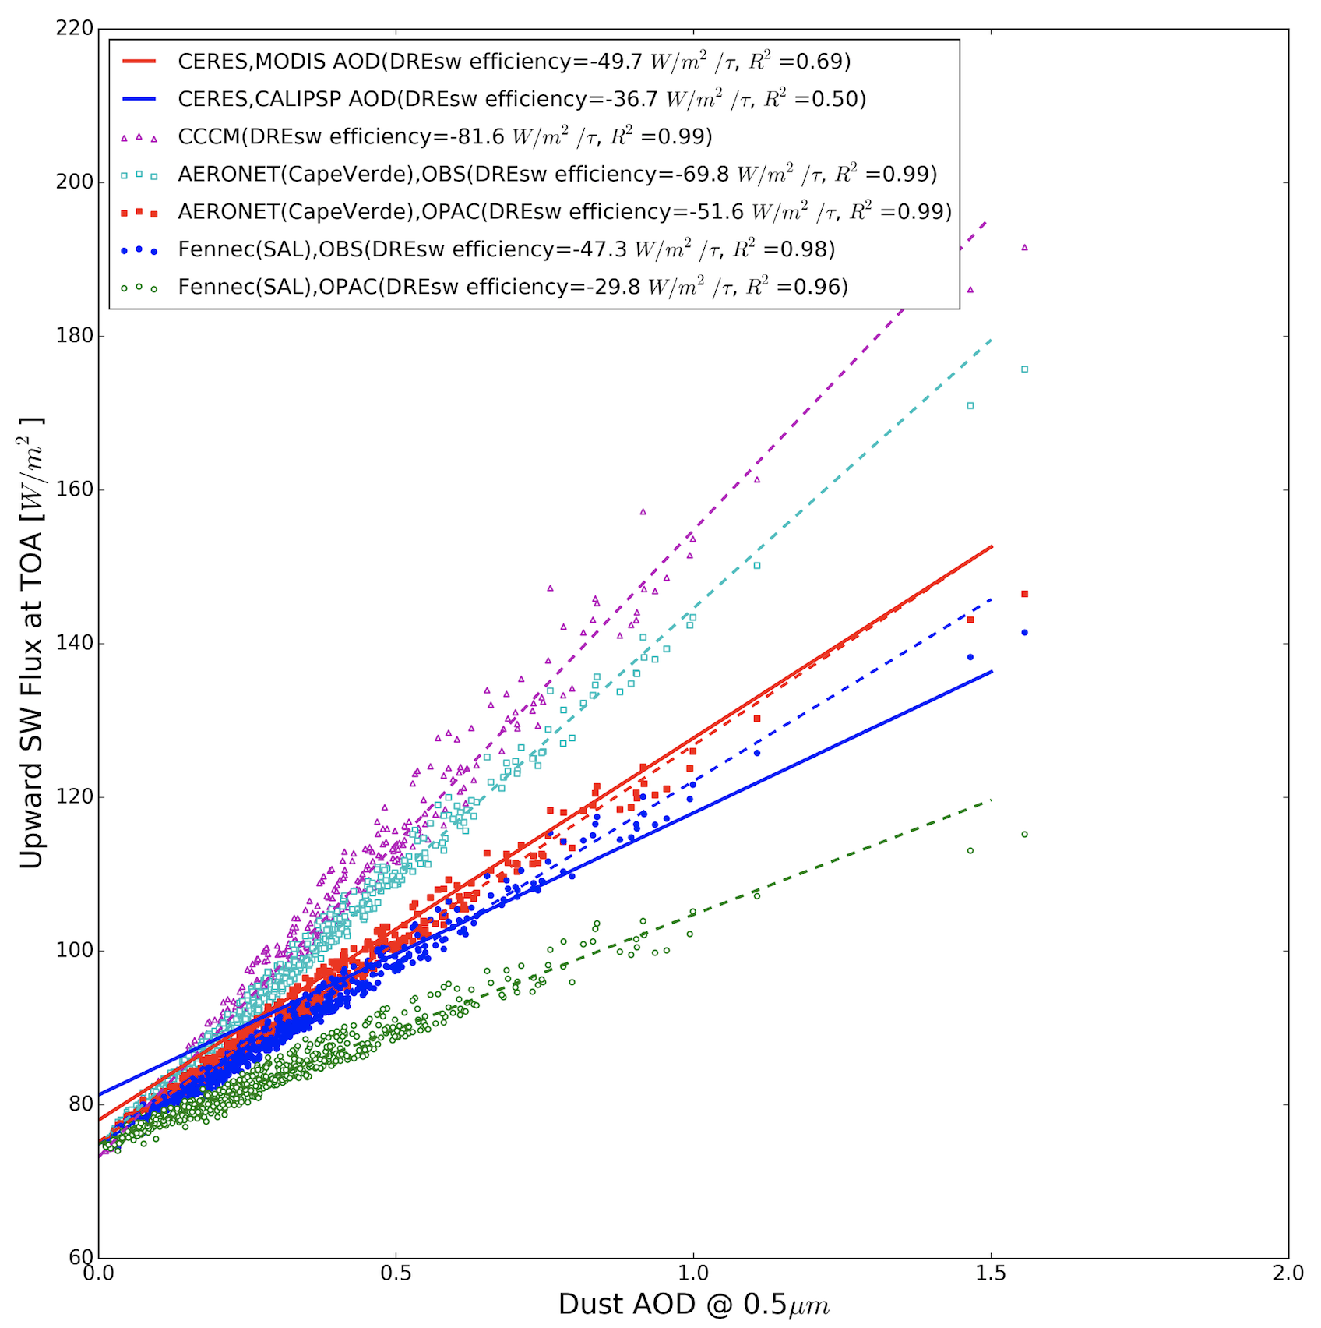
Understanding Variability and Net Radiative Effect of Mineral Dust in Recent Decades by Using Terra, Aqua, and Suomi NPP
Hongbin Yu, Zhibo Zhang, Tianle Yuan, Robert Levy
Status:
Derived dust optical depth (DOD) from MODIS, MISR, CALIOP, IASI over 2000-2017
Analyzed African dust interannual variability with seasonal distinction and major factors
Acquired observation-based estimate of dust net radiative effect over North Atlantic Ocean (i.e., MODIS, CALIOP, CERES, in situ)
Needed Products:
VIIRS DT, DB aerosol products
Known Issues:
MODIS-Terra and MODIS-Aqua offset
Potential bias in MODIS land surface temperature/emissivity retrievals over desert region caused by dust?
Recent Publications:
Song, Q., et al., Net radiative effects of dust in the tropical North Atlantic based on integrated satellite observations and in situ measurements, Atmos. Chem. Phys., 18, 11303-11322, 2018.
Remote sensing observations show a consistent interannual variability of African dust, with largest variability in spring.
Dust variability is controlled by surface wind, although it correlates negatively with prior-year Sahel rainfall anomaly (SPI).
H. Yu et al. poster
Instantaneous SW and LW dust direct radiative effects (DRE) are derived from A-Train
Satellite-based SW and LW DREs are used to constrain dust properties.
Over the ocean, diurnally averaged SW and LW DRE at TOA is -10W/m² and +3W/m², respectively.
Song et al. 2018 (ACP)
Z. Zhang talk

