Slide 1
Academic Staff and Limited Employee Self Service (ESS) Payroll

Slide 2

Instructions on Leave Reporting:
Leave for full-time Academic Staff and Limited employees shall be charged in increments of 4 and 8 hours.
Absences of less than 2 hours should not be reported.
Absences of between 2 hours and 6 hours shall be charged as 4 hours.
Absences of more than 6 hours shall be charged as 8 hours.
Exception: Leave for part-time staff and employee’s with approved FMLA should enter absences as actual hours used.
Notes:
Note: Absences need to be entered by employees by the 5th of every month. Supervisors will approve absences by the 10th of every month.

Slide 3
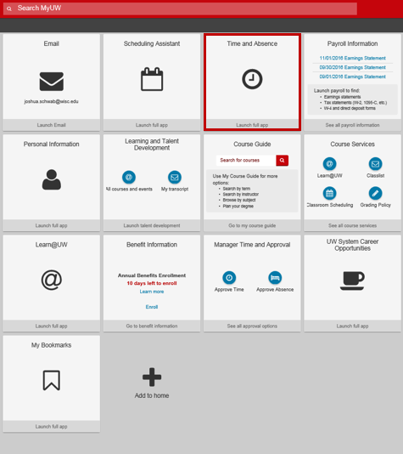
How to Record Leave Used:
Log onto the My UW Portal at https://my.wisc.edu
Select “Time and Absence”

Slide 4
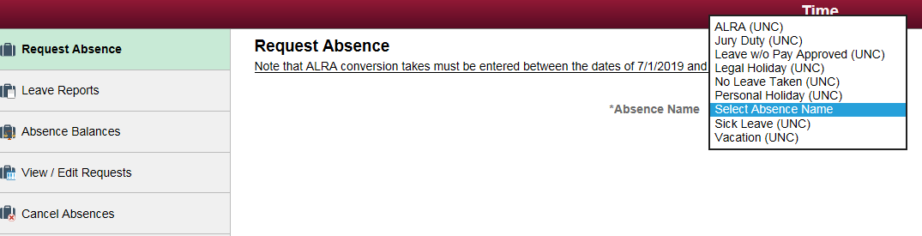
Request Absence
Note: No entry is required for legal holiday. It will automatically load.
Notes:
LIMITATION: Only one type of absence can be entered on a single request. If you have several types of absences to submit for the same absence (e.g., personal holiday, sick leave, vacation), you will need to submit a request for each type of absence.

Slide 5
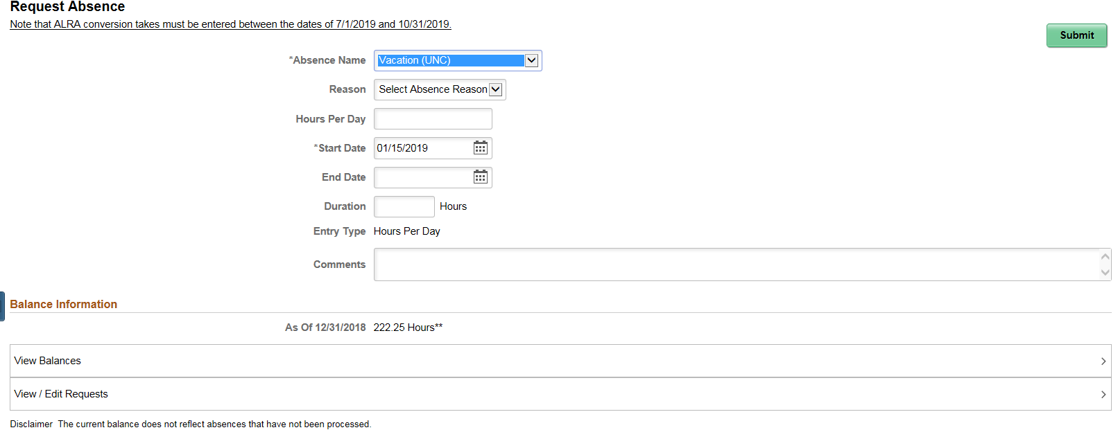

View Leave Balances
Notes:
Note: leave balances are also available in the UW Portal

Slide 6
Entering an Absence Request
Note: The start date and end date should be the same. Do not use a date range.

Slide 7
How to Record No Leave Taken:
Notes:
Select No Leave Taken in the Absence Name

Slide 8
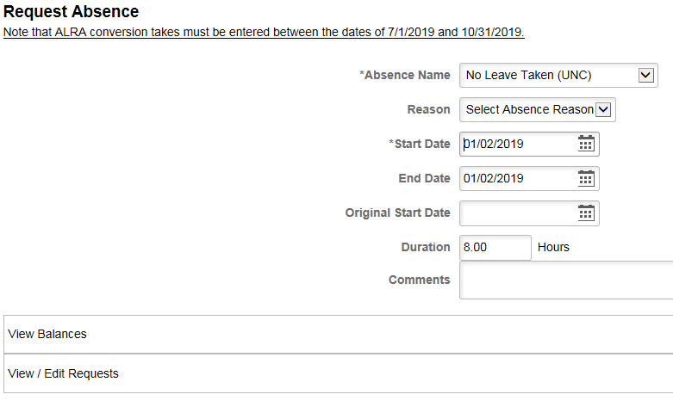

Entering No Leave Taken
Note: The start date and end date should be the same. Do not use a date range.
NOTE: The No Leave Taken entry should be made for a single day within the month. It is recommended to use the first day of the month, unless that day is a legal holiday.

Slide 9
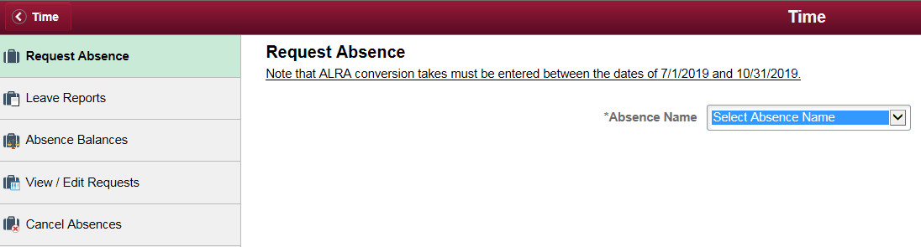
Edit/Cancel Absence Request
Notes:
Note: if you edit or cancel a request after the 9th of the month notify your supervisor to review and review your updated absences

Slide 10
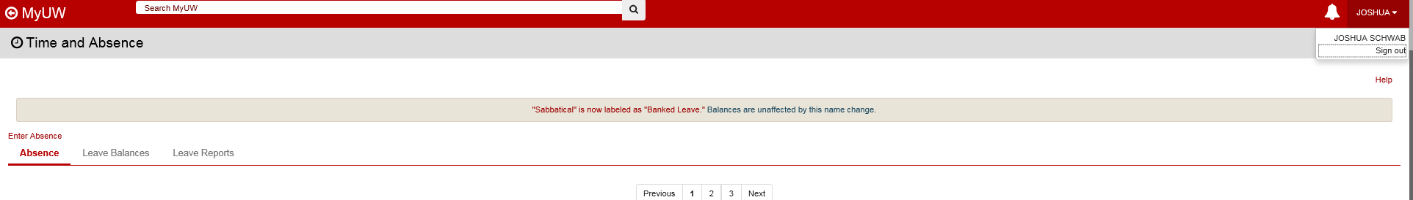
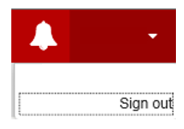
Signing out
After using My UW System Portal, Sign Out using the link in the upper right and close the browser if you are using a public computer to ensure that your personal data is kept private.
Notes:
Take aways:
Employee will always have one missing leave report
Do NOT use date ranges when entering absences
Notify your supervisor if you change your absences after they approve them on the 10th of the month
Absences need to be reported in 4 or 8 hours increments (exceptions: p/t and FMLA employees)
Legal holidays will preload
‘No leave taken’ needs to be entered if the employee hasn’t taken any leave OR the only leave for the month were the legal holidays

