Slide 1
The Current and Future Global Flood Inundation Mapping Systems from Multiple-Source Satellite Imagery
William Straka - Presenter

Slide 2
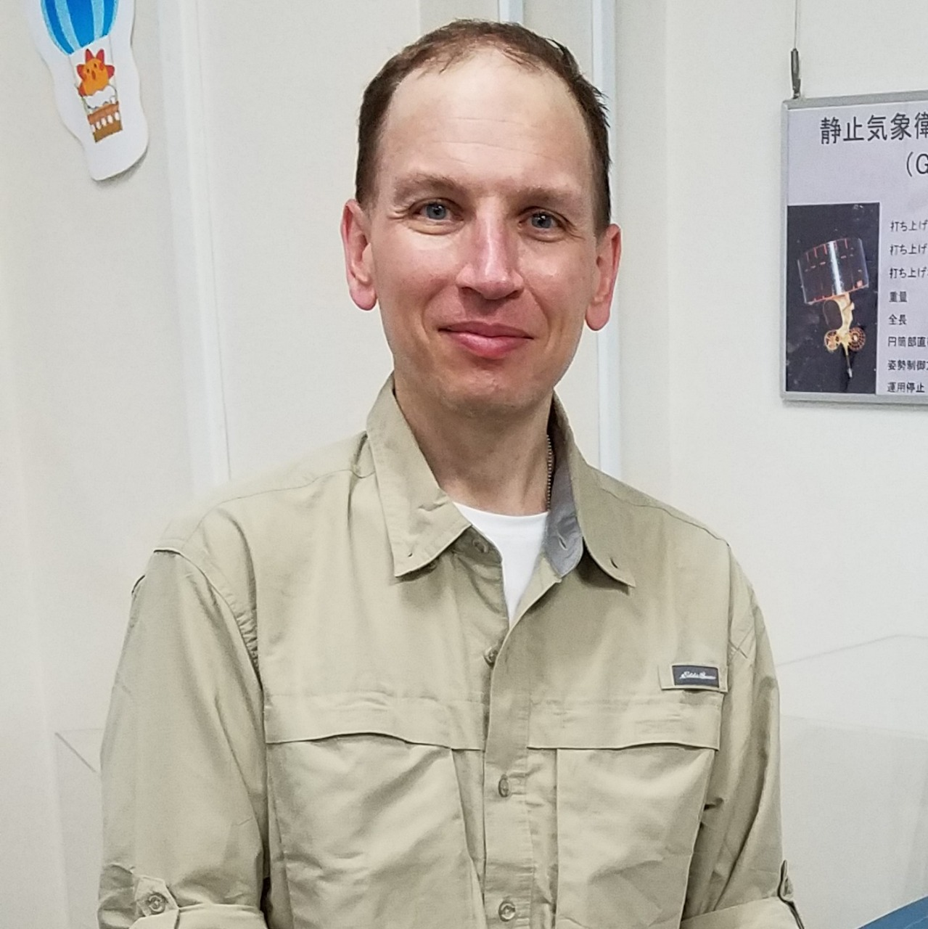
Acknowledgements: Sanmei Li (GMU), Mitch Goldberg (CCNY/CESSRST, former NOAA NESDIS Chief Scientist), Sean Helfrich (NOAA/NESDIS) and the stakeholders who provide invaluable feedback as well as many others!
Presenter BIO:
William Straka is a researcher with the Cooperative Institute for Meteorological Satellite Studies (CIMSS), where he has been working for over 18 years. He currently works as a liaison, including assisting in training, to the US National Weather Service as well as US and international emergency response stakeholders such as BMKG on the NOAA Flood Products.
William Straka III
wstraka@ssec.wisc.edu
william.straka@noaa.gov
Notes:
What you do know about satellite-derived flood products"; "How many flood products do you know, could you mention them", or "Do you have experience with it?"; "What is the actual output of VIR products?" etc... (we can do this with Slido or even as simple as asking the participants to type the answer in the chat column). After gaining their answer, slide 1 to 3 can be explained.

Slide 3
Optical and SAR Flood products
With help from Sean Helfrich (NESDIS), Sanmei Li (GMU), Vincent Decker (NRCan), Mitchell Goldberg (CCNY, Former NESDIS Cheif Scientist, Qingyuan Zhang (UMD), Qing Yang (UW- Milwaukee), and Xinyi Shen (UW- Milwaukee)

Slide 4
SATELLITE INFORMATION USED FOR DSS
Optical imagery (RGBs)
Good for qualitative, high resolution, analysis
Limited to daytime and cloud free conditions
Good to observed “downstream” impacts from storms.
Ex - “Lake Oslo” breeze
Flood Extent product
Good for quantitative extent impacts
Optical
Limited to daytime and cloud free conditions.
Lower resolution (1 km for ABI, 375 m for VIIRS flood products, 30 m for downscaled VIIRS)
SAR
High spatial (5-10 m resolution)
Limited repeat cycle, even with higher refresh from RCM
Limited swaths and availability

Slide 5
OPTICAL FLOOD PRODUCTS
Optical sensors can use information from visible, near infrared , and short-wave infrared (SWIR) channels, along with a series of test for cloud detection, shadow detection, snow/ice detection and combining them with water reference maps to discriminate permanent water bodies
One can combine data from various sensors, such as ABI and VIIRS, to create a daily, cloud cleared, flood product. Or one can utilize digital elevation models and other higher resolution datasets to create flood depth maps at higher spatial resolution (30 m)
This is different that RGB composites in that it gives a quantitative measurement of how much of a pixel is flooded. This can provide stakeholders a method to exploit other datasets (ex. Cropland, population) to determine impacts from a flood event
The disadvantage of optical flood products is that they are limited to cloud free and daytime conditions only. However, they have the advantages of providing excellent data availability with large spatial coverage, and low cost.
Currently, the NOAA VIIRS flood extent product is produced operationally and the geostationary products are being transitioned to operations.
The primary inputs are the visible (VIS), near infrared (NIR), and short-wave infrared (SWIR) channels and also use a DEM to help downscale the data and provide more accurate flood mapping.

Slide 6
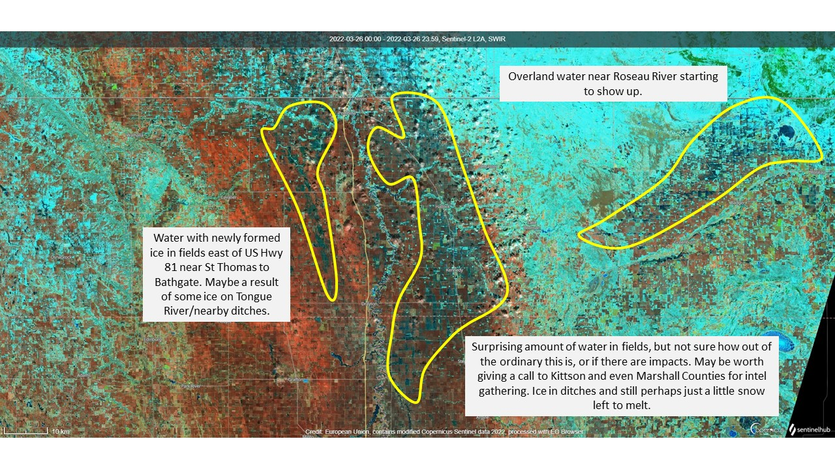
Sentinel-2 RGB Example

Slide 7
NOAA Optical Flood Products Overview
The VIIRS, ABI and AHI flood products provide flood areal extent and can be used for situational awareness.
On a daily basis, the joint VIIRS/ABI or VIIRS/AHI flood product provides the best coverage in regions covered by ABI or AHI.
Under clear-sky conditions in the VIIRS and ABI/AHI images, the VIIRS flood product is recommended for use because of its more accurate floodwater details.
The ABI and AHI flood maps filter out clouds using a multiple composition process. This means that they may be able to provide flood extent in regions which are cloudy during the two daytime VIIRS overpasses. In this case, the ABI and AHI flood maps may be used for flood mapping with spatial resolution at about 1 km instead of 375 meters.

Slide 8
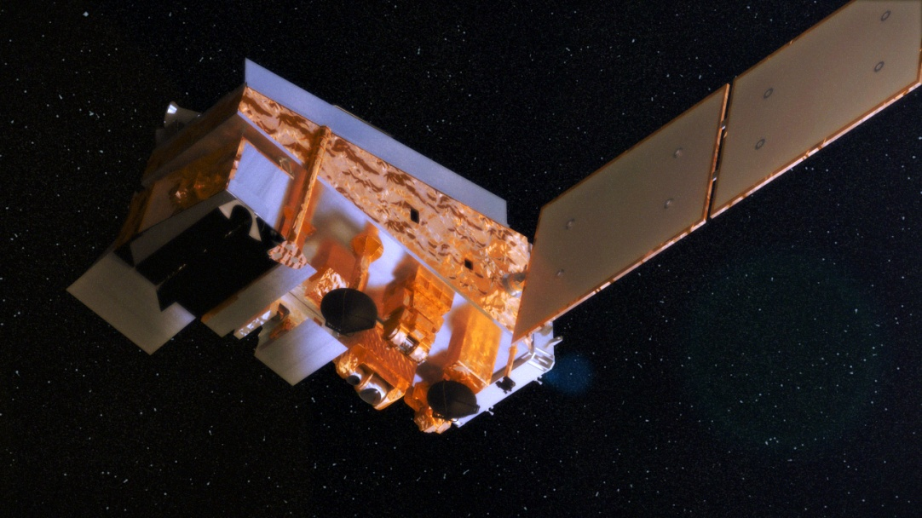
VIIRS
Visible/Infrared Imaging Radiometer Suite (VIIRS)
Flies on the National Polar-orbiting Partnership (NPP) and the Joint Polar Satellite System (JPSS) satellites
Combines aspects of legacy AVHRR, MODIS, and DMSP OLS imagers
VIIRS is on both Suomi NPP, NOAA-20, NOAA-21
2 day/night time passes over a given location per day.
Suomi-NPP
CERES
CrIS
ATMS
OMPS
Credit: NASA
* MODIS = Moderate-resolution Imaging Radiometer
* AVHRR = Advanced Very High Resolution Radiometer
* DMSP/OLS = Defense Meteorological Satellite Program, Operational Linescan System

Slide 9
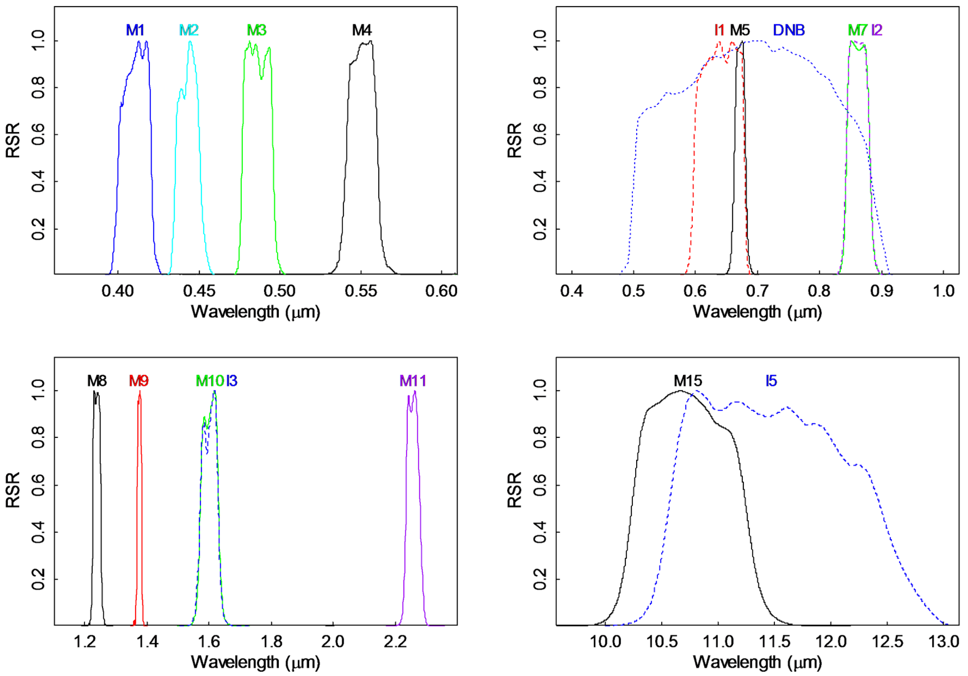
The 22 Spectral Bands of VIIRS
VIIRS Band | Central Wavelength (μm) | Band Explanation | Spatial Resolution (m) @ nadir
M1 | 0.412 | Visible/ Reflective | 750 m
M2 | 0.445
M3 | 0.488
M4 | 0.555
M5 | 0.672
M6 | 0.746 | Near IR
M7 | 0.865
M8 | 1.240 | Shortwave IR
M9 | 1.378
M10 | 1.61
M11 | 2.25
M12 | 3.7 | Medium-wave IR
M13 | 4.05
M14 | 8.55 | Longwave IR
M15 | 10.76
M16 | 12.01
DNB | 0.7 | Visible / Reflective | 750 m across full scan
I1 | 0.64 | Visible / Reflective | 375 m
I2 | 0.87 | Near IR
I3 | 1.61 | Shortwave IR
I4 | 3.74 | Medium-wave IR
I5 | 11.45 | Longwave IR
Relative Spectral Response (RSR)
Broad RSR (500-900 nm)
Advanced
Very High-
Resolution
Radiometer
(AVHRR)
Bands
1.1 km
Day/Night Band
Wang and Cao, Rem Sens. 2016, 8(1)

Slide 10
Bands used by NOAA Flood Product
VIIRS Band | Central Wavelength (μm) | Band Explanation | Spatial Resolution (m) @ nadir
M1 | 0.412 | Visible/ Reflective | 750 m
M2 | 0.445
M3 | 0.488
M4 | 0.555
M5 | 0.672
M6 | 0.746 | Near IR
M7 | 0.865
M8 | 1.240 | Shortwave IR
M9 | 1.378
M10 | 1.61
M11 | 2.25
M12 | 3.7 | Medium-wave IR
M13 | 4.05
M14 | 8.55 | Longwave IR
M15 | 10.76
M16 | 12.01
DNB | 0.7 | Visible / Reflective | 750 m across full scan
I1 | 0.64 | Visible / Reflective | 375 m
I2 | 0.87 | Near IR
I3 | 1.61 | Shortwave IR
I4 | 3.74 | Medium-wave IR
I5 | 11.45 | Longwave IR
Channels used by the NOAA VIIRS Flood Product

Slide 11
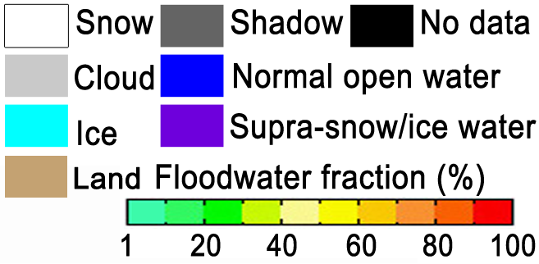
List of VIIRS/ABI Flood Products
Products | Spatial resolution | Availability | Coverage | Production latency | Description
Suomi-NPP, NOAA-20, NOAA-21 VIIRS near real-time flood product* | 375m | 2-3 daytime passes for each satellite | Global land between 80°S and 80°N | Available 3 hours after pass¹ | Daytime-only flood extent in water fractions (open water percentage in a satellite pixel)
Suomi-NPP, NOAA-20, NOAA-21 VIIRS daily composited flood product* | 375m | Once per day | Global land between 60°S and 75°N | All tiles available by 1030Z
Suomi-NPP, NOAA-20, NOAA-21 VIIRS 5-day composited flood product* | 375m | Once per day | Global land between 60°S and 75°N | All tiles available by 1030Z
GOES-E/W(ABI) flood product * | 1-km | Every hour | Land in America (135° W ~ 17° W, 50.5°S ~ 50.5°N) | every hour
Joint VIIRS/ABI flood product⁺ | 375m~1km | Once per day | Land in America (135° W ~ 17° W, 50.5°S ~ 50.5°N) | Available at 18Z
* - Currently operational at NOAA
+ - Transitioning to operations
¹ - Latency from direct broadcast is ~10-20 minutes from satellite overpass (CONUS & AK only)

Slide 12
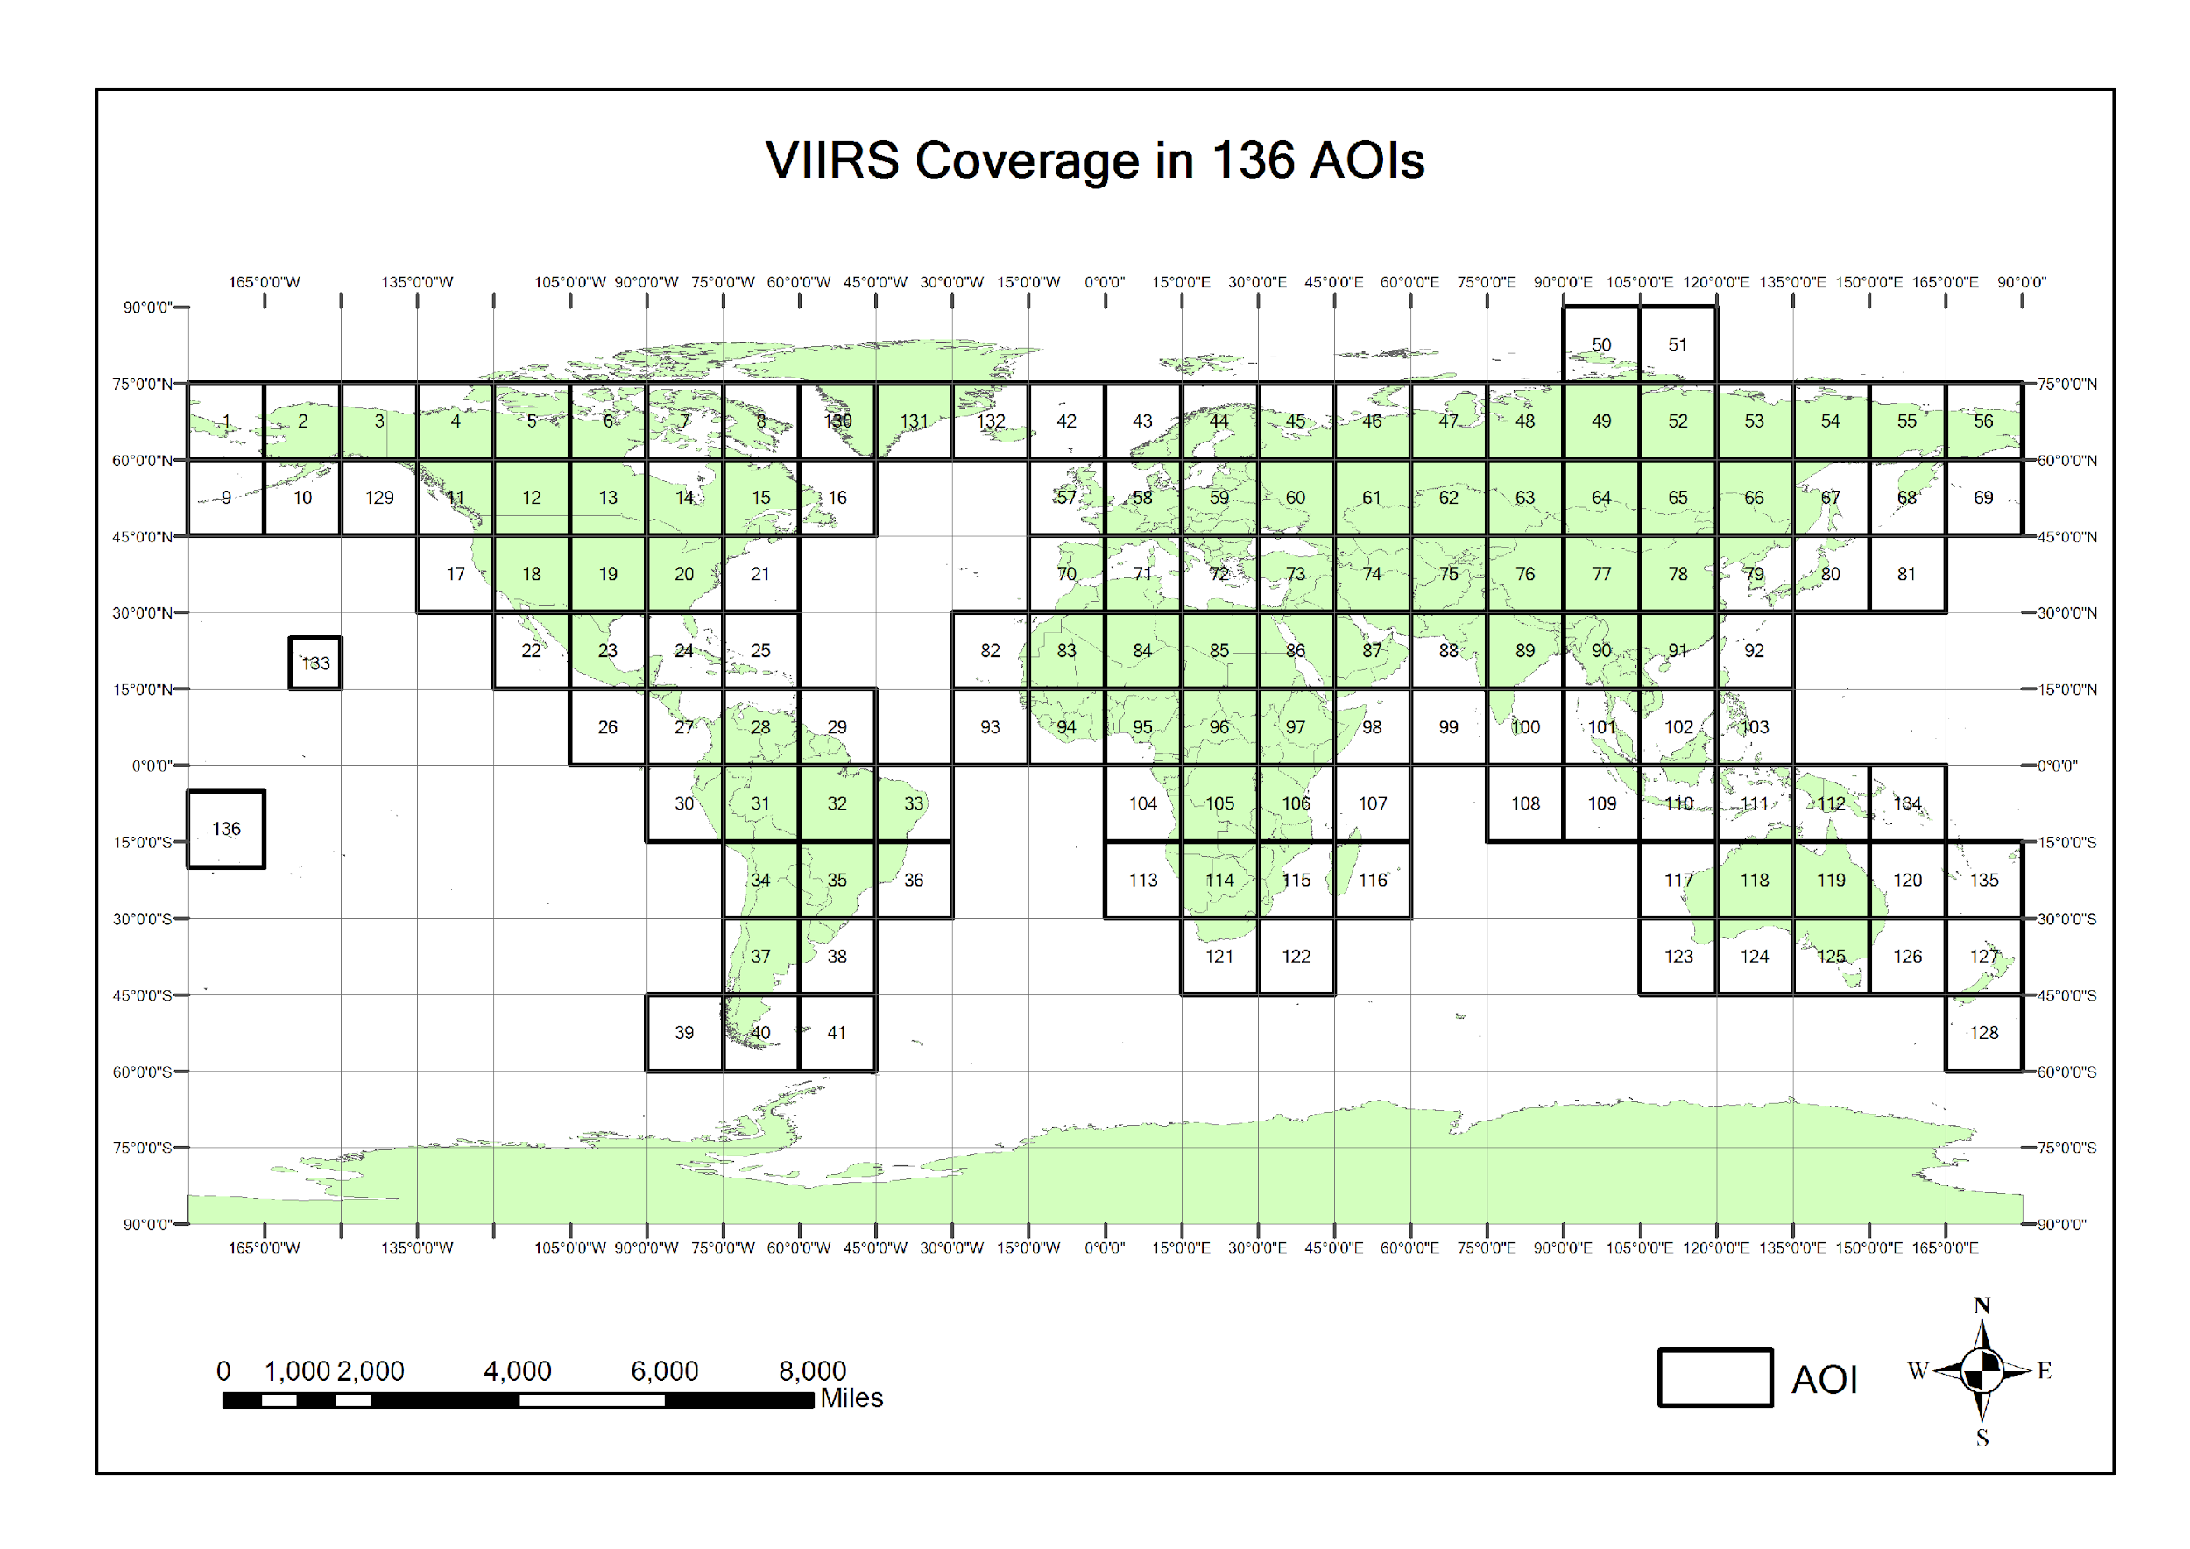
The global land is divided into 136 AOIs for the VIIRS composition process and data archive.

Slide 13
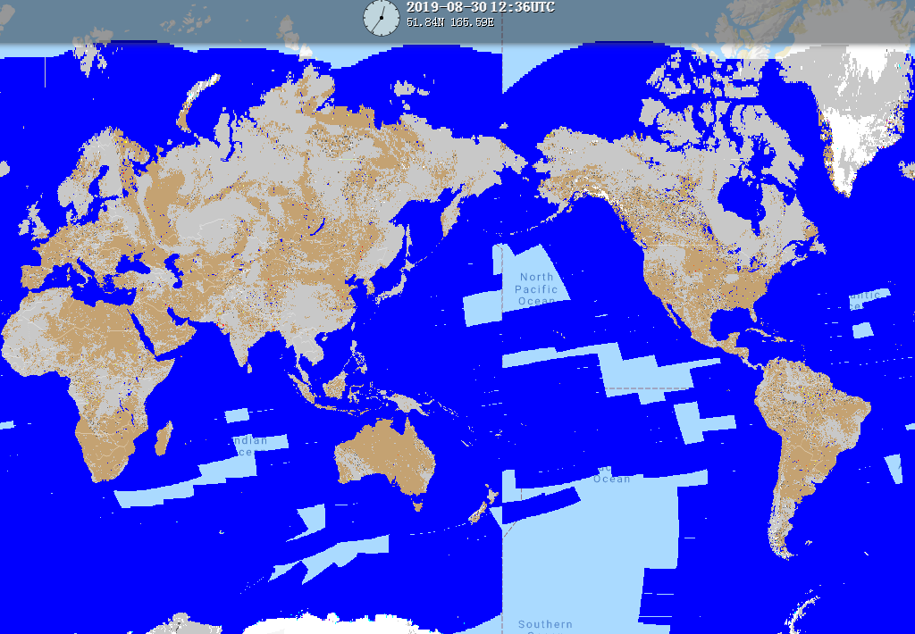
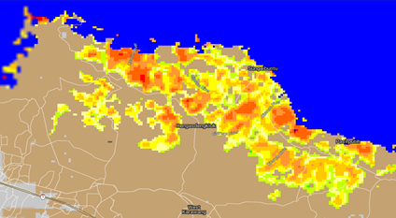
VIIRS NRT Flood Product
The VIIRS 375-m Flood Product, is a near real-time product derived from daytime VIIRS imagery from Suomi-NPP, NOAA-20 and NOAA-21.
The VIIRS Flood Map reflects the current flood status at the time of the overpass along with additional information on the weather and land conditions.
Suomi-NPP, NOAA-20 and NOAA-21 are low earth orbiting satellites, which means only two daytime observations can be derived per day over a given Region of Interest (ROI) with a ~50 min interval.
Observations are taken ~2-3pm local solar time. The latency of the product is about 3 hours after a pass is complete.

Slide 14
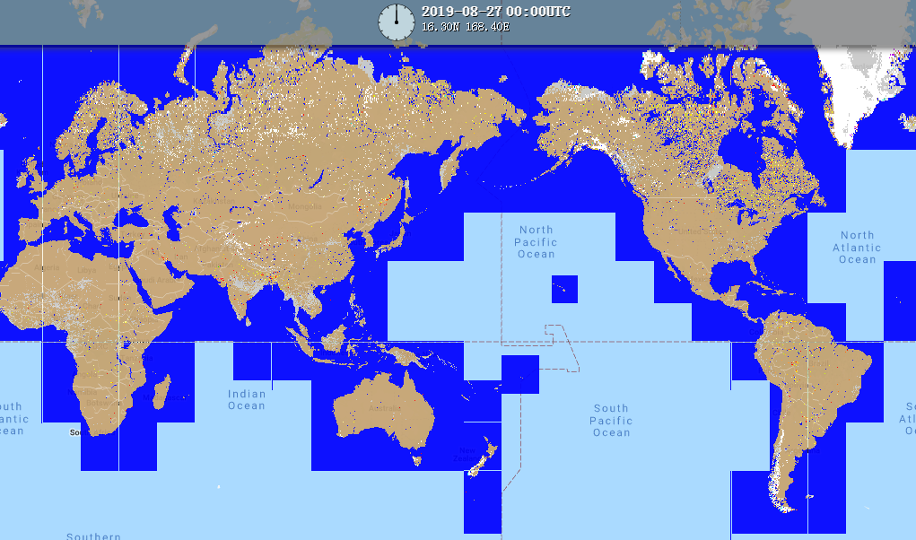
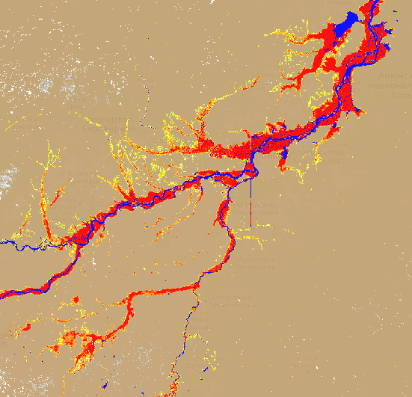
VIIRS Composited Flood Products
The VIIRS Composited Flood Products are used to filter out cloud cover through a maximal water-fraction composition process and thus derive the maximal flood extent during a flood event from the VIIRS NRT flood maps from the JPSS satellites
The routinely global VIIRS Composited Flood Products include daily composited flood product and 5-day composited flood product.
The composition process is done by dividing the global land into 136 AOIs.
VIIRS 5-day composited flood product Aug. 23-27, 2019

Slide 15
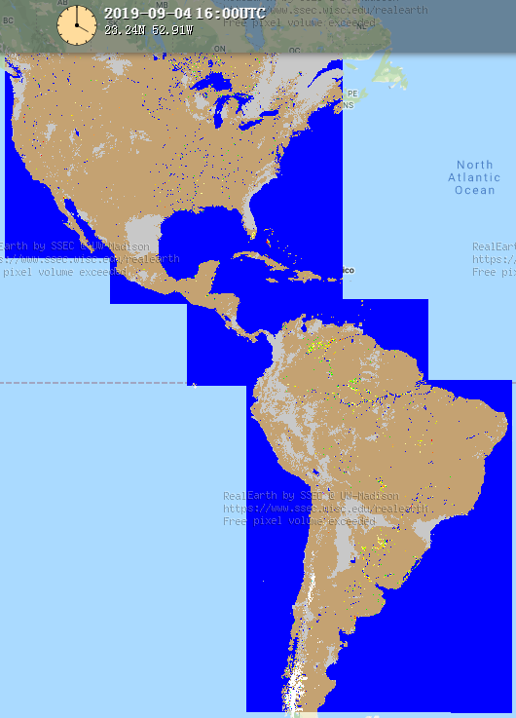
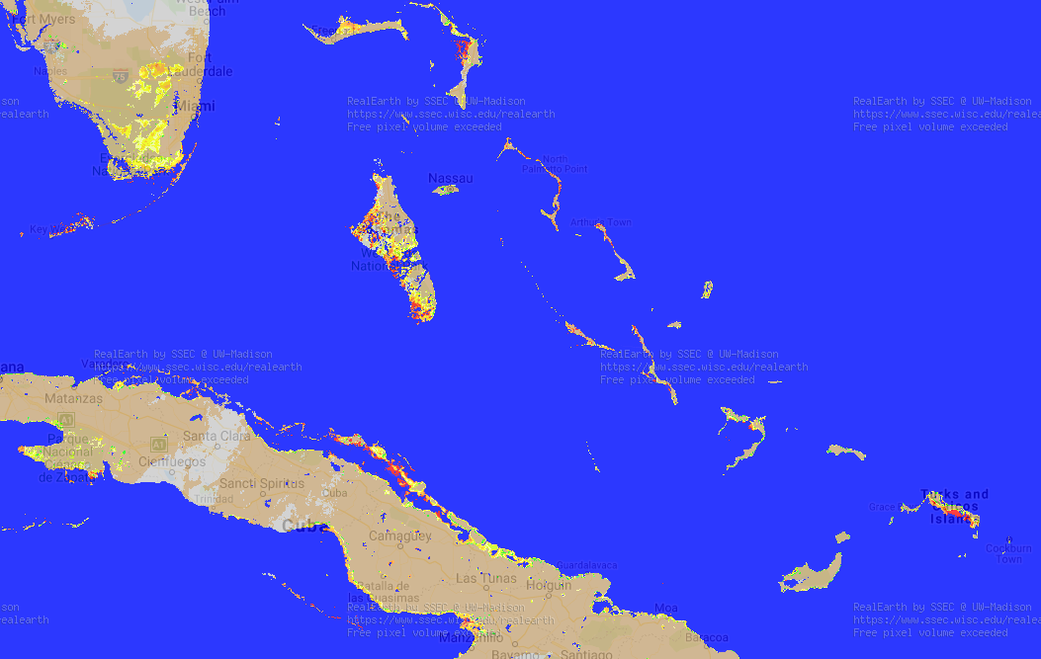
ABI Flood Products
The ABI Flood Product is a rolling composited result based on the 10-minute ABI flood maps with hourly updates. Each hourly-updated flood map shows the average flood water fractions from the first 10-minute flood map to the latest one (example shown right).
At the end of a day, the ABI Flood Map is the composited result of all the 10-minute ABI flood maps during daytime and thus shows the flood extent under the daily maximal clear-sky coverage.
Data from ABI is acquired using the GOES Rebroadcast (GRB) downlink, which provides short latency in acquiring the ABI data.

Slide 16
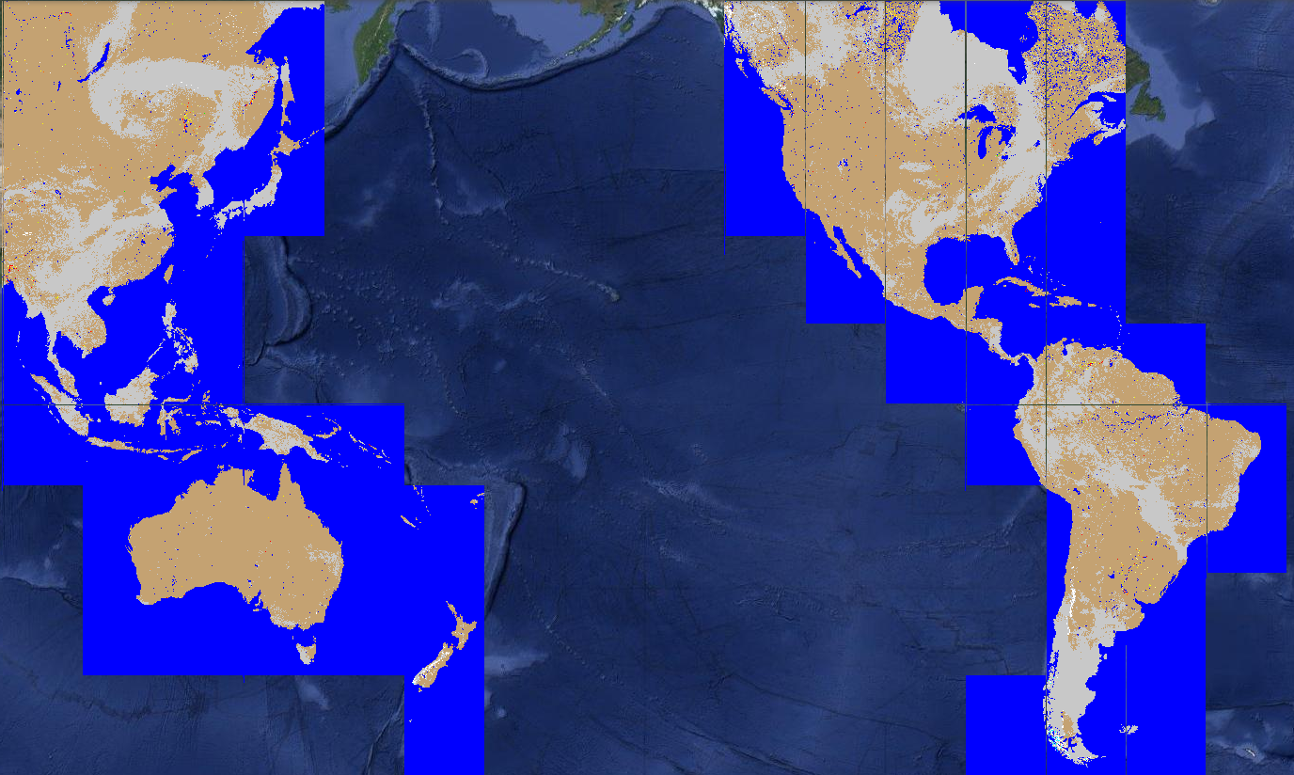
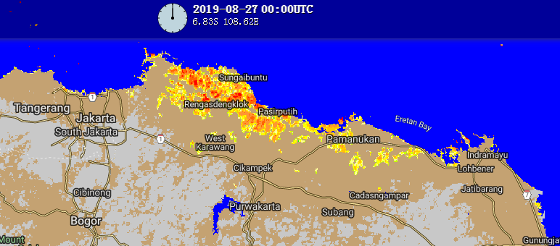
Joint VIIRS/ABI/AHI Flood Products
Aug. 27, 2019
The joint VIIRS/ABI or VIIRS/AHI Flood Products blend the daily flood detection results from VIIRS, ABI and AHI. It is based on the VIIRS 375-m daily composited flood maps, and uses the 1-km ABI or AHI daily clear-sky detection results to fill the gaps of clouds and cloud shadows in the VIIRS maps.
Thus, it shows the flood extent under the maximal clear-sky coverage derived from ABI or AHI during daytime, and keeps the more accurate floodwater details from VIIRS.

Slide 17
Example of how the optical flood products throughout the day
The ABI/AHI flood maps are available from the early morning to the late afternoon, and thus are recommended for use during the periods when VIIRS flood products are unavailable.
Once the high resolution (375 m) flood product from VIIRS become available (3-4pm local solar time over a given region, assuming DB availability), assessments can be revised using finer and more accurate details of the flood extent, depending on cloud cover over ROI at time of S-NPP and NOAA-20 passes.
When available, the Joint VIIRS/ABI or VIIRS/AHI Flood products are highly recommended for an initial evening assessment, since they provide the best coverage from ABI or AHI and the more accurate floodwater details from VIIRS.
When it is always partially cloudy during a period, the VIIRS daily or 5-day composited flood products are also recommended for use as they filter out the cloud cover through a maximal water-fraction composition process and can reflect the maximal flood extent during a day or the latest five days.
Remember that the all of the flood products are produced during daytime only, thus the products will not be updated overnight

Slide 18
SAR FLOOD PRODUCTS
Synthetic Aperture Radar (SAR) provides very high-resolution flood mapping, though at lower temporal resolution, is able to see flooding even during times of extended cloud cover or nighttime that frequently occurs during flooding and inhibits optical flood detection.
Similar to what happens in the optical flood algorithms, the transmitted radar signals on flat water surfaces are reflected back with a significantly weak signal back to the satellite.
There are multiple satellite missions (Sentinel-1, Radar Constellation Mission, JAXA’s ALOS satellites, etc). Most of these have low-repeat cycles and are often restricted datasets.
Most SAR flood products are RGB-type products, delineating flood/no-flood by different colors. However, there are several SAR flood extent products that are being produced or in development by various agencies (NR-Can, NOAA NESDIS, NOAA’s National Water Center)

Slide 19
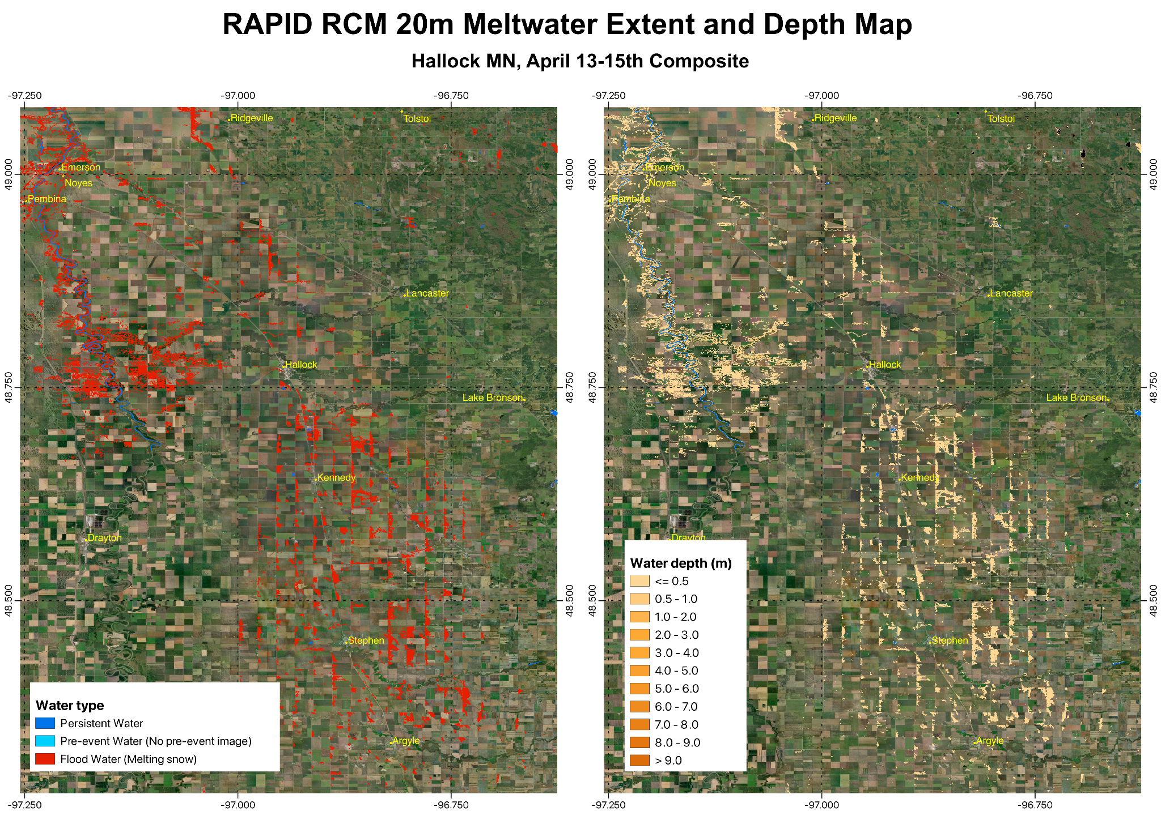
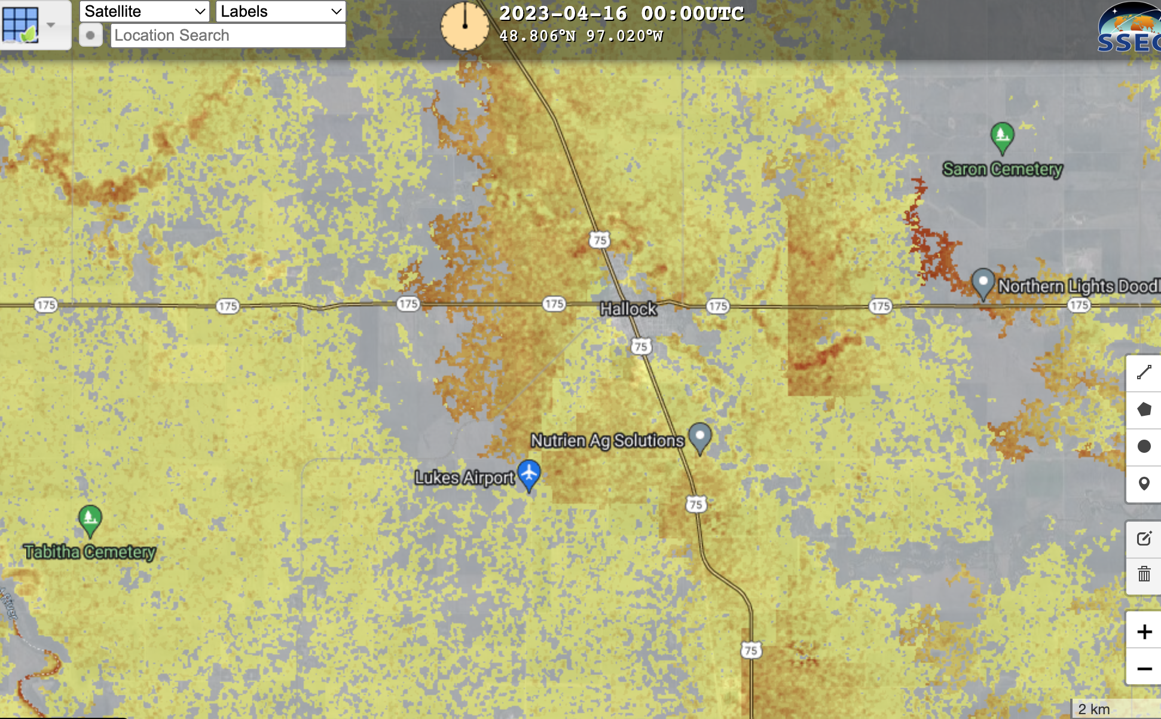
NOAA RAPID SAR algorithm vs NOAA VIIRS downscaled product from 13 April 2023
Under Development

Slide 20
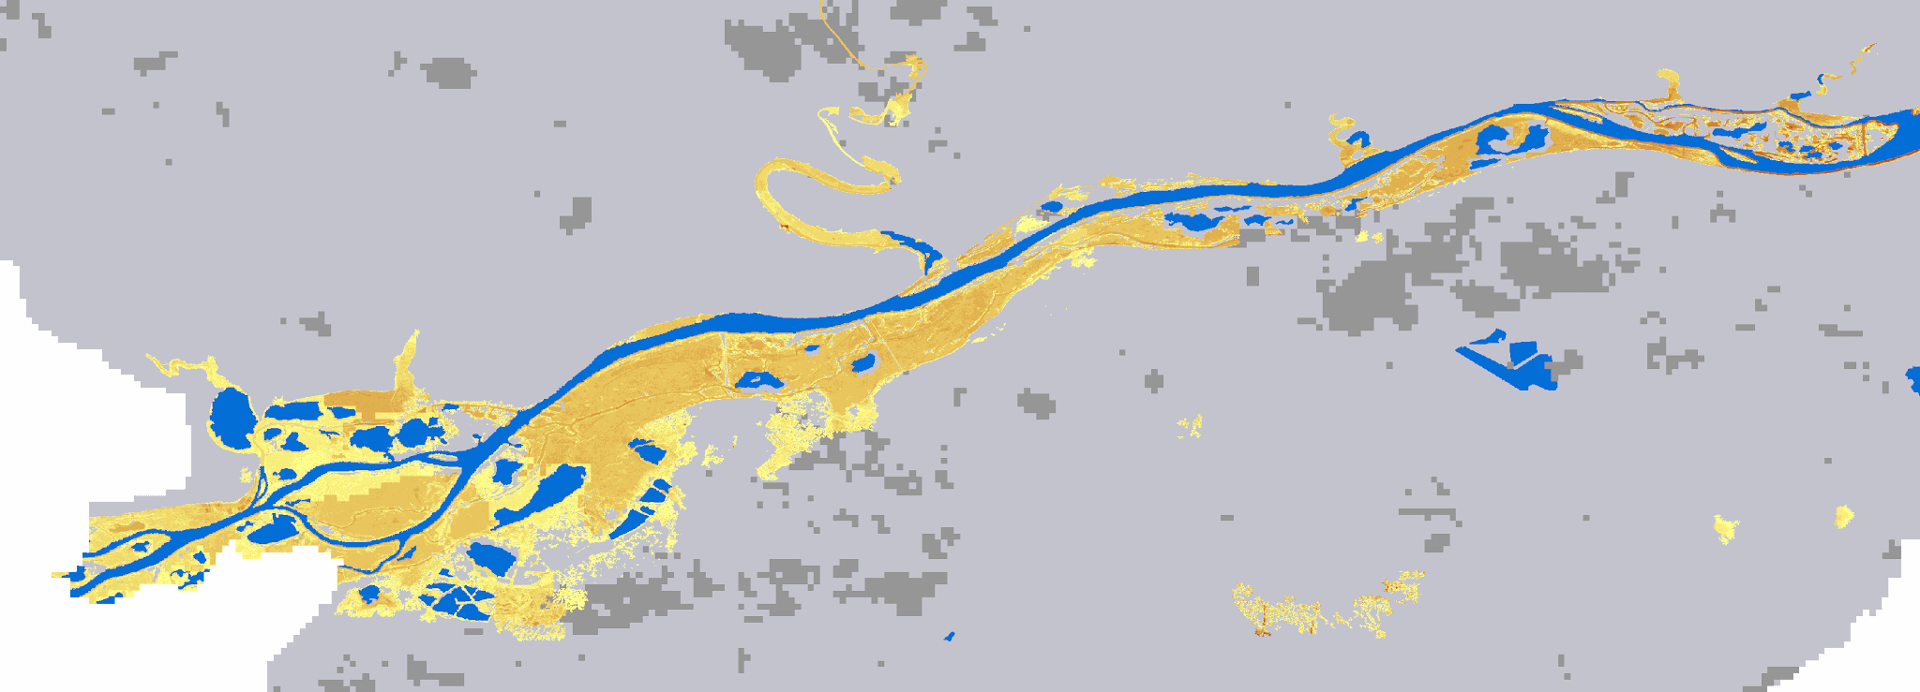
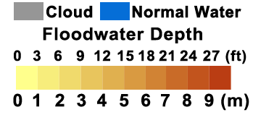
PreOperational/Developmental
Downscaled VIIRS Product: The VIIRS 375-m floodwater fraction products to 30-m 3-D flood products are currently being run routinely globally. Currently the downscaling uses the CDSM DEM, an example shown and will be tested, before transition to operations.

Slide 21
PreOperational/Developmental
SAR Flood Extent and Blended LEO/GEO/SAR Flood Product: NOAA is currently developing a SAR-based flood extent and flood depth maps utilizing multiple SAR satellites (RCM, Sentinel 1, RadarSAT 2) as well as developing a blended LEO/GEO and SAR flood mapping. This will enhance the flood project by providing the highest resolution possible flood maps as well as flooding under cloud or at night. Future efforts will explore the use of L-Band (NISAR, SAOCOM, ROSE-L, ALOS 2/4)

Slide 22
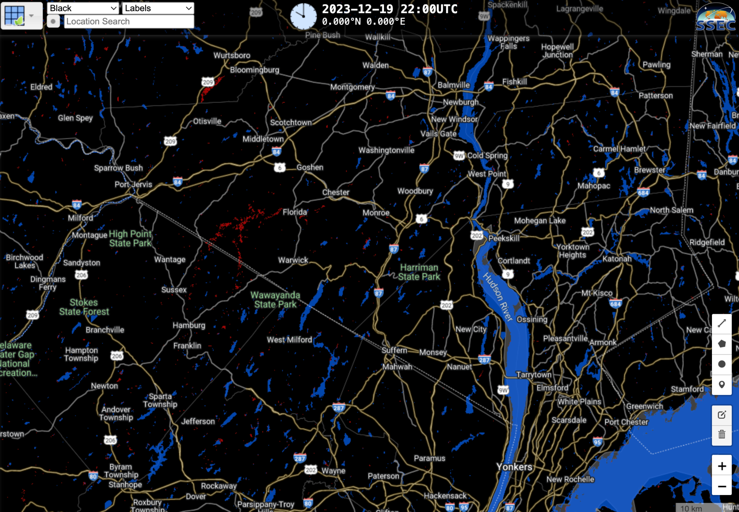
PreOperational/Developmental - NOAA SAR Flood example
https://floods.ssec.wisc.edu/?products=C-band-VV-VH-dual-pol.75,C-band-VV-VH-dual-pol-m.75&center=41.250451272341486,-74.20372009277345&zoom=10&width=1127&height=807&basemap=wb&labels=google&view=leaflet&collection=Flood%20Detection&timeproduct=C-band-VV-VH-dual-pol&timespan=-6t&animationspeed=50

Slide 23
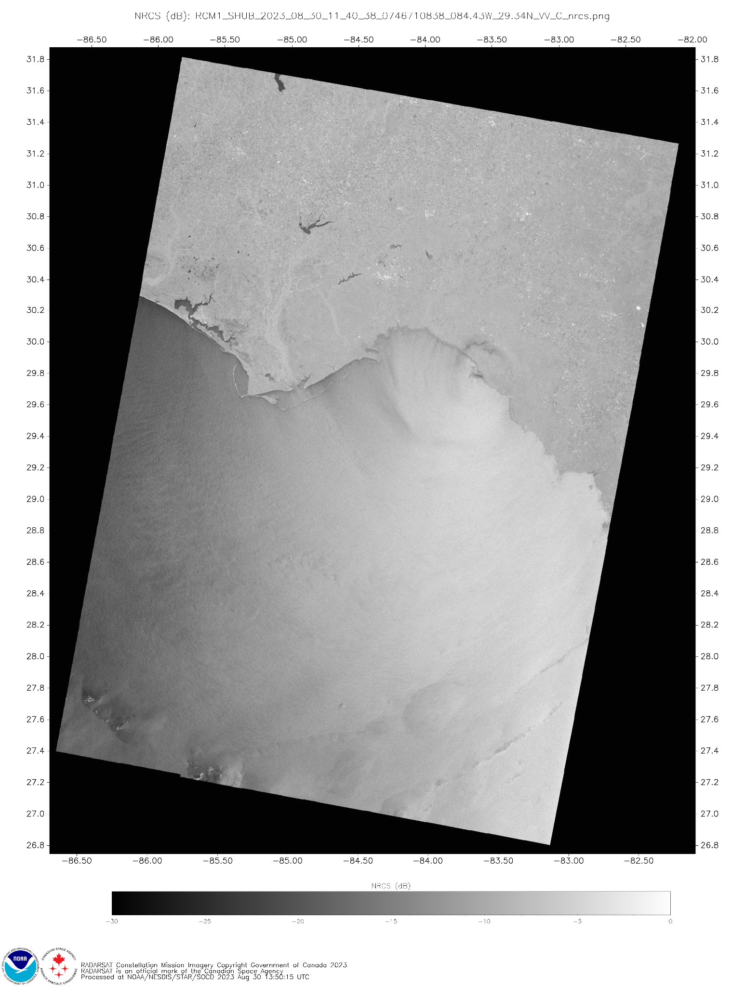
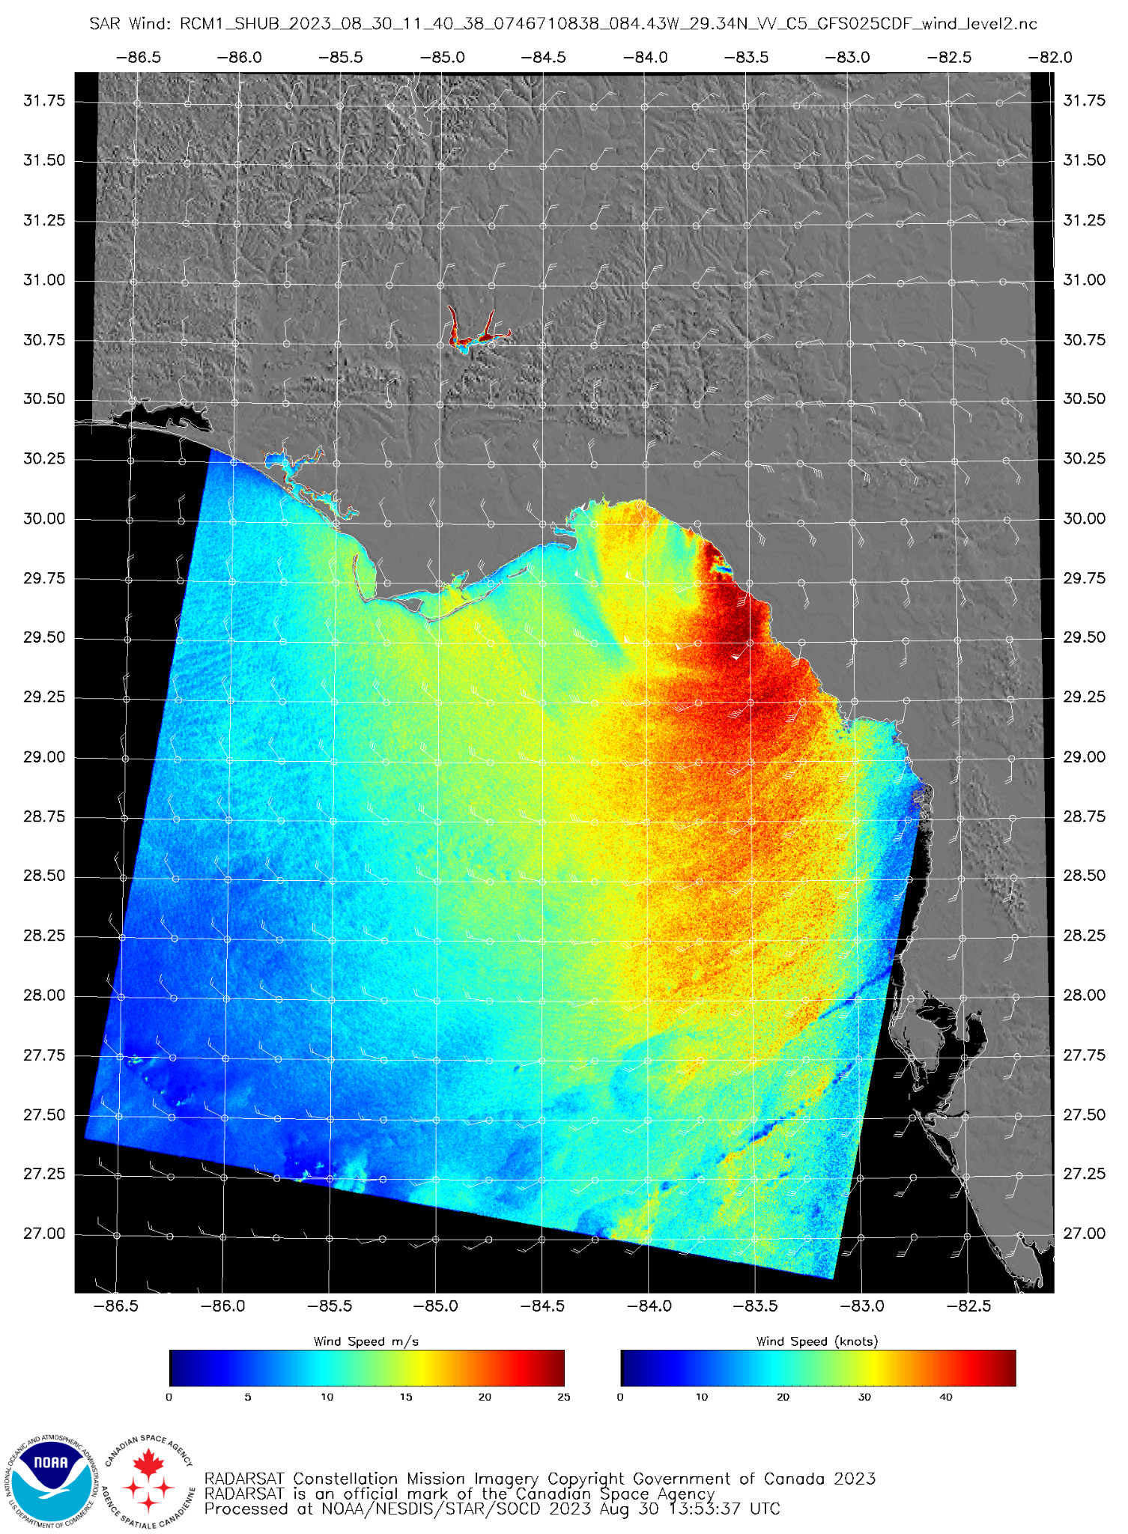
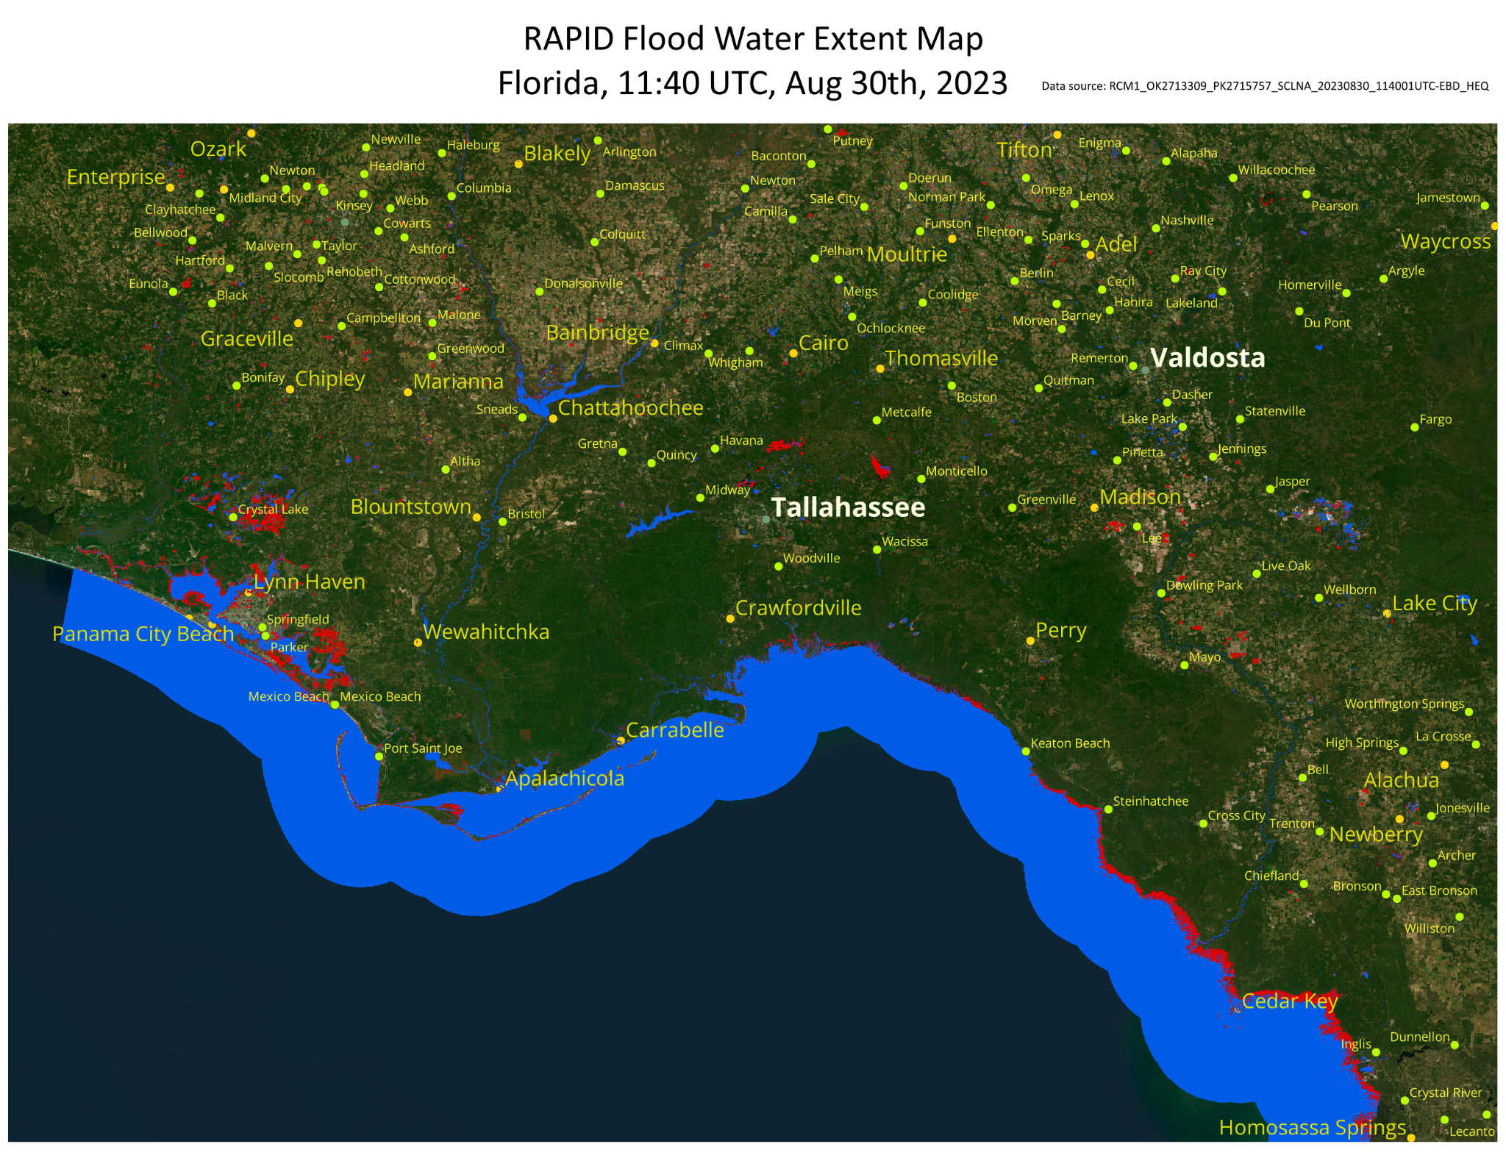
Hurricane Idalia
Under Development

Slide 24
River Ice Products
Slides from NWC and Stevens Univ

Slide 25
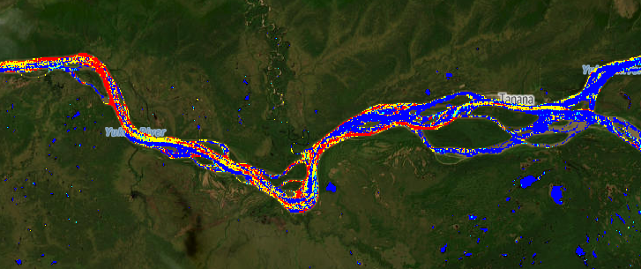
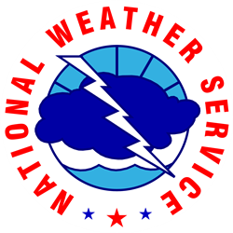
National Water Center Synthetic Aperture Radar River Ice Surveillance (SARRIS)

Slide 26
SARRIS Overview
River ice classification using Sentinel-1 Synthetic Aperture Radar
SAR provides day/night nearly all weather imaging capabilities
Relatively fast processing (9 image swath in about 1 hour)

Slide 27
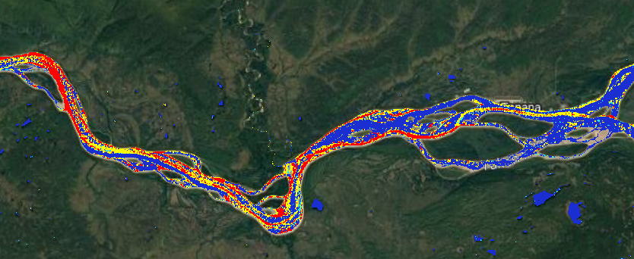
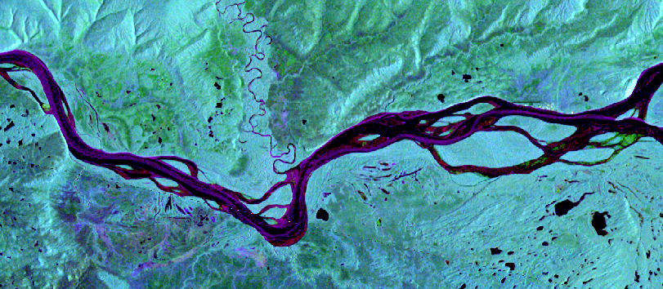
SARRIS Product
Open Water
Smooth Ice
Fractured Ice
Jumbled Ice
Sentinel-1 image acquired 2023-10-16
Multi-temporal False Color Image Red - Current VV
Blue - Current VH
Green - Reference VV

Slide 28
Other polar products which may be of interest
Slides courtesy of many people!

Slide 29
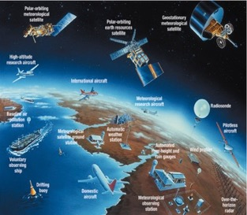
NOAA Cryosphere Operational Snow and Ice Products
NPP/JPSS VIIRS
Snow cover (binary)
Snow fraction
AMSR2 on GCOM-W1
Snow cover
Snow depth
Snow water equivalent (SWE)
Used in demonstration
Notes:
Visible Infrared Imaging Radiometer Suite (VIIRS)
Geostationary Operational Environmental Satellite-R Series (GOES-R)
The Advanced Microwave Scanning Radiometer 2 (AMSR2) onboard the GCOM-W1

Slide 30
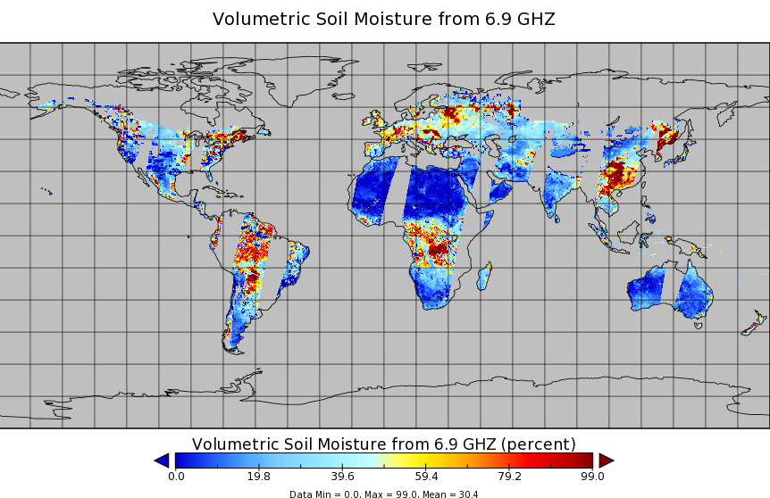
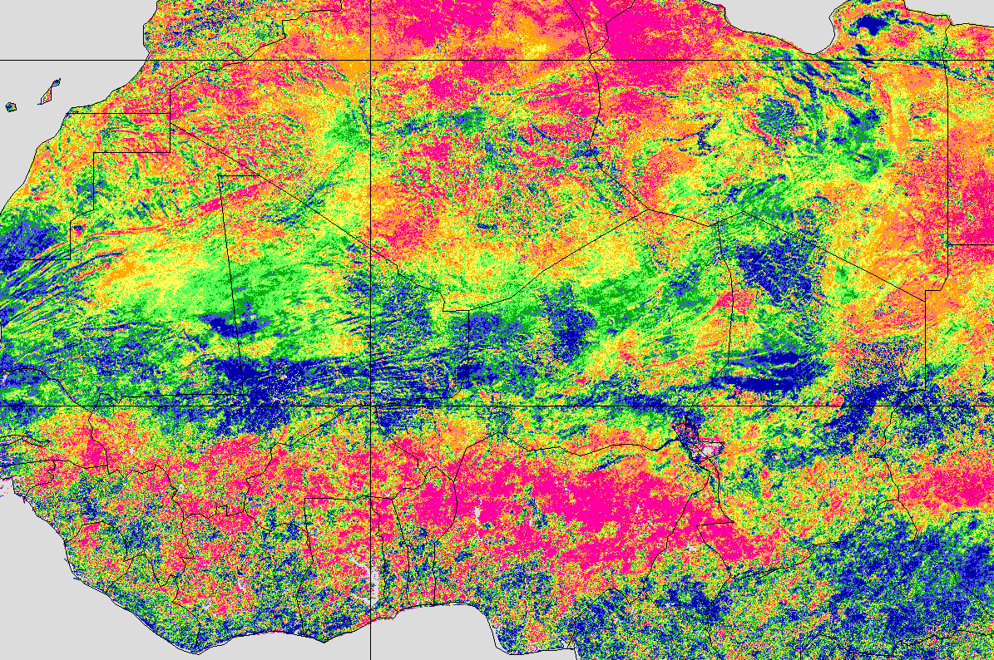
Satellite based soil moisture monitoring
Soil moisture is important in the forecasting and monitoring of drought conditions as well as helping forecast areas where wildfires are likely to occur as well as helping indicate where impending drought or flood conditions are before other indicators see the event.
There are several satellite based soil moisture products that are available from active and passive microwave instruments, scatterometers (ex. ASCAT) and imagers (ex. VIIRS) on polar orbiting satellites
These include the Soil Moisture Operational Products System (SMOPS), which is a blended product including multiple types of instruments; Soil Moisture Active Passive (SMAP); AMSR2/GCOM-W1 surface soil moisture (LPRM) L3 product and VIIRS Vegetation Health Product (VVHP, right image below)
Owing to the type of product, these are fairly coarse (4km and greater)
AMSR2/GCOM-W1 surface soil moisture product
VIIRS Vegetation Health Product

Slide 31
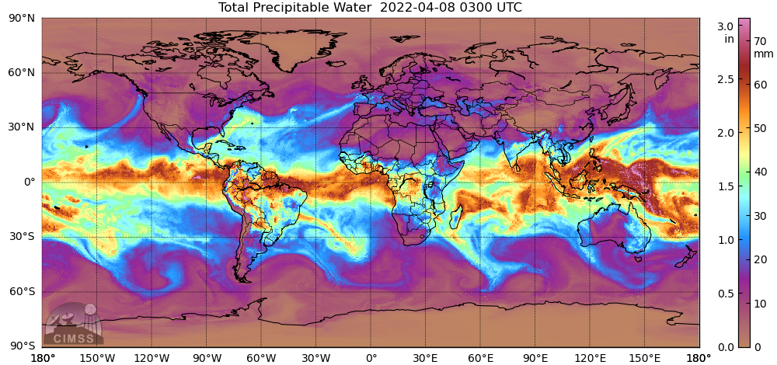
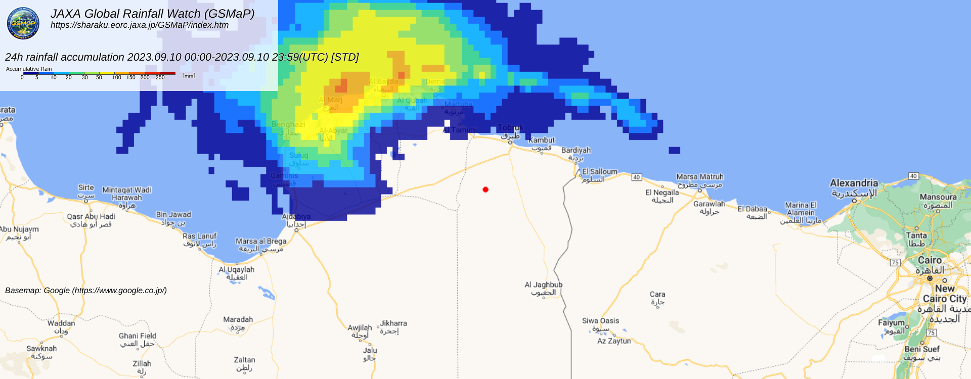
Satellite based precipitation products
There are several satellite based precipitation algorithms, which can be used to estimate rainfall amounts where there is limited or no radar coverage.
Other products are able to measure the total precipitable water, which are useful to show where atmospheric river and moisture transport are occuring
Most algorithms use microwave or infrared sensors from both geostationary and polar orbiting satellites. However, they are at very coarse resolution as compared to ground based weather radars
Some examples of these include CMORPH2 and GSMaP (precipitation) and MIMIC-TPW (moisture advection).
GsMAP
MIMIC-TPW

Slide 32
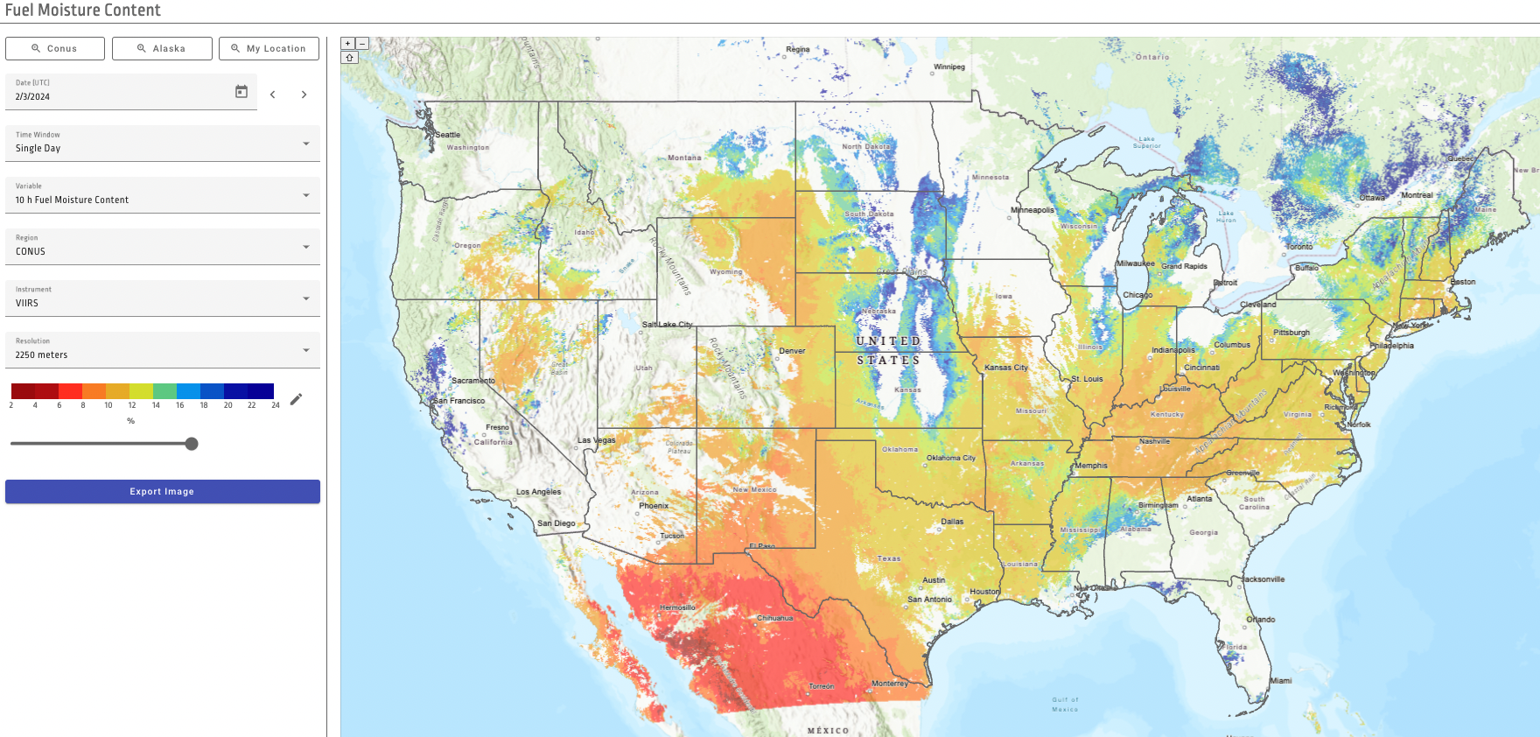
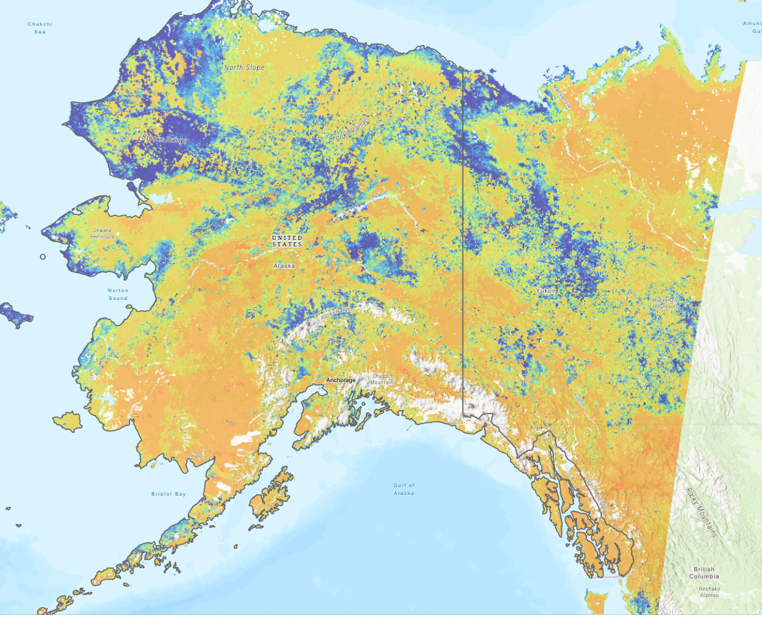
Real-time fuel moisture content (FMC) estimations at high spatio-temporal resolution based on reflectances from VIIRS and GOES-R ABI. - LEO PGRR
Started demonstration of SuomiNPP-VIIRS based retrievals on March 2023. First retrievals at 2250 m over CONUS and 3000 m over Alaska. Extended to have the target 375 m retrievals. https://ral.ucar.edu/tool/fuel-moisture-content-retrievals
Enhanced demonstration to have GOES16-ABI hourly retrievals at 2250 m (not originally planned)
Developing a visualization app (leveraging resources from other projects): https://fmc.ral.ucar.edu/
February 3 2023
30-day composite June 20 2023

Slide 33
Examples and other applications

Slide 34
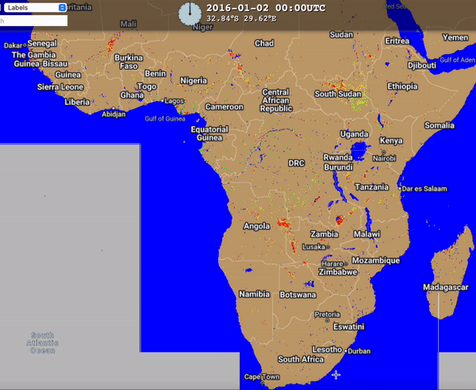
Satellites as a tool to assess flood risk
By utilizing derived flood maps, one can create a global or regional assessment of the number of days a given area is flooded for a given year (or longer time period).
This can help assess where the most flood prone regions are and help with flood mitigation/preparedness efforts
Currently NOAA has the VIIRS daily and 5-day flood maps for (2012-2020) to begin this effort, which is freely available to users for analysis.
Notes:
5 minutes activity:
title and picture appear, text hide
we ask participants:
How do you think the strength and weakness of using satellite as the tool to assess flood risk? (Mr. Faalih or Mr Rion)
raise your hand and let us know your thought.

Slide 35
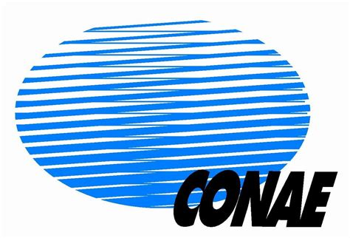
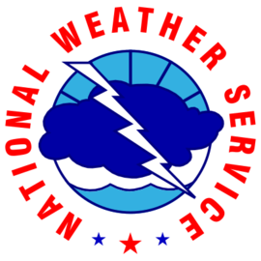
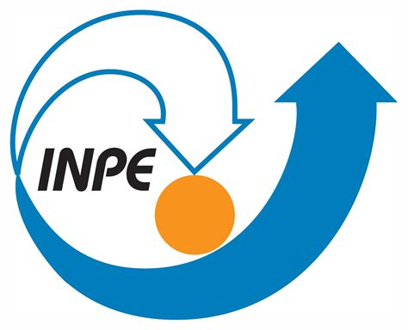
Sample of current users
And many others!

Slide 36
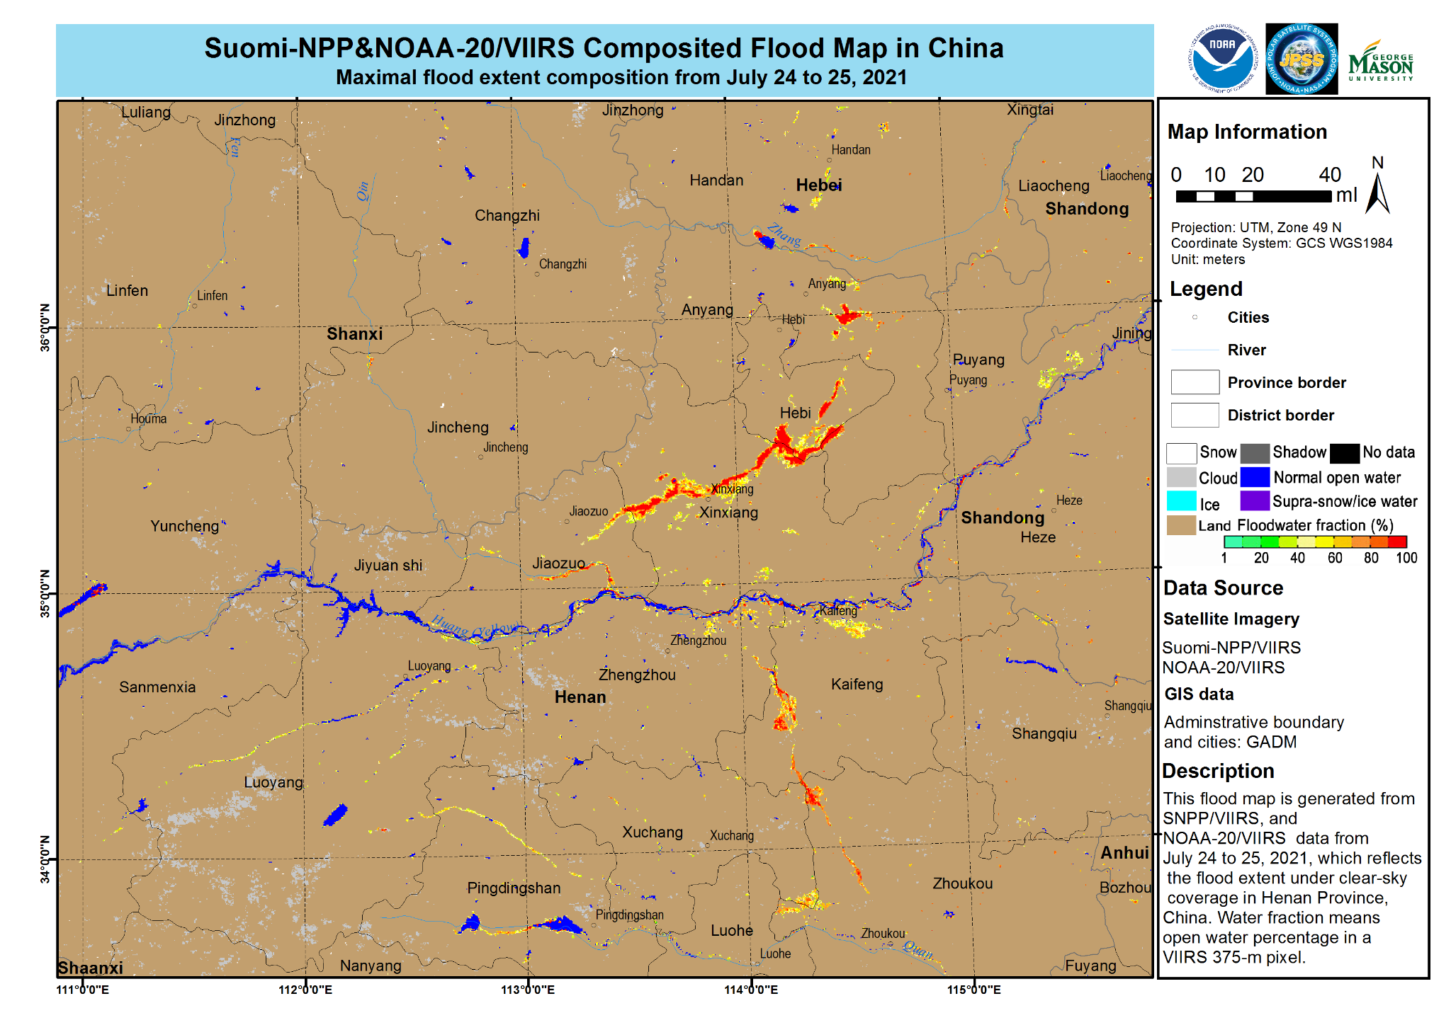
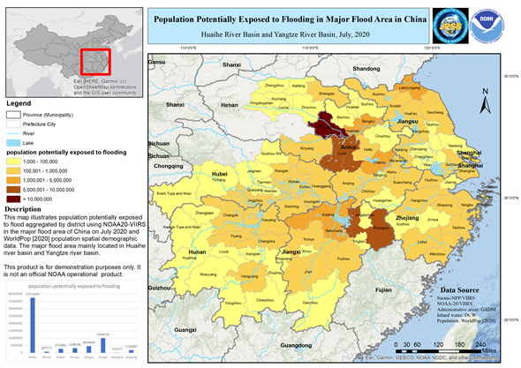
Tying satellite data and socio-economic information together
Population or other socio-economic database
ArcGIS or similar application
Li, S.; Goldberg, M.D.; Sjoberg, W.; Zhou, L.; Nandi, S.; Chowdhury, N.; Straka, W., III; Yang, T.; Sun, D. Assessment of the Catastrophic Asia Floods and Potentially Affected Population in Summer 2020 Using VIIRS Flood Products. Remote Sens. 2020, 12, 3176. https://doi.org/10.3390/rs12193176

Slide 37
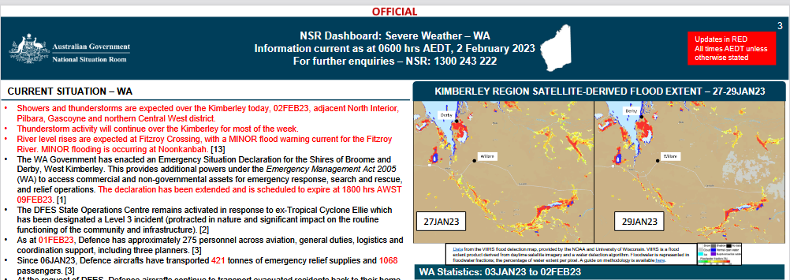
Example cases – Australia Bureau of Meteorology

Slide 38
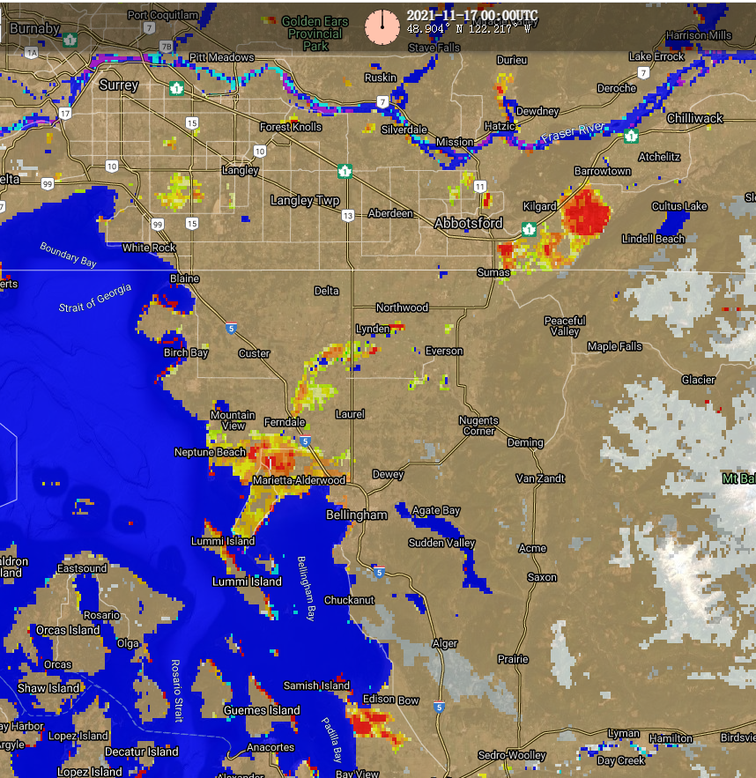
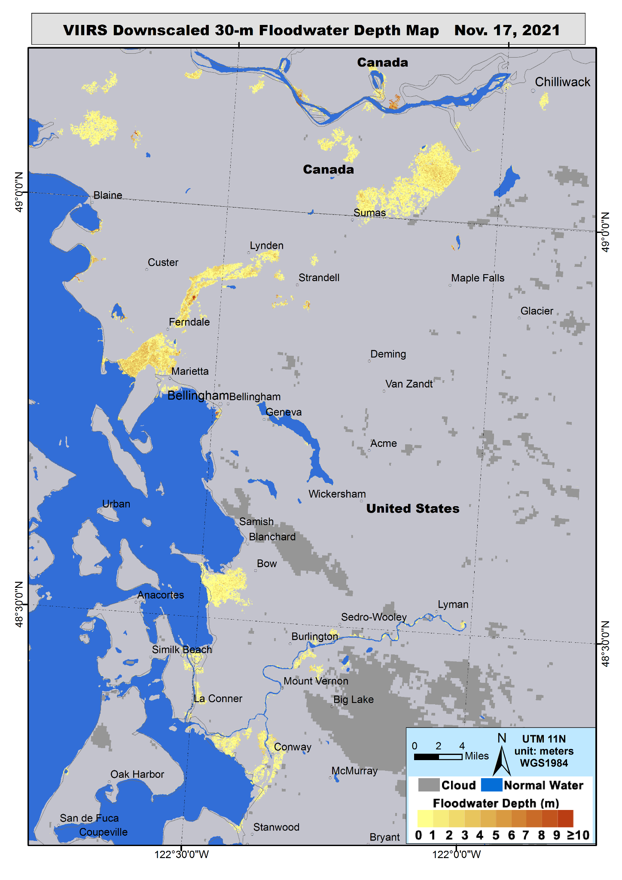
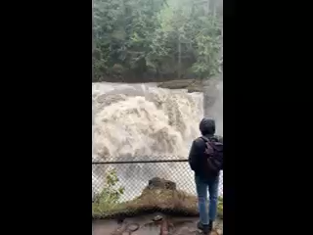
Nooksack Falls, 14 November 2021 (video credit: Olivia Ray)

Slide 39
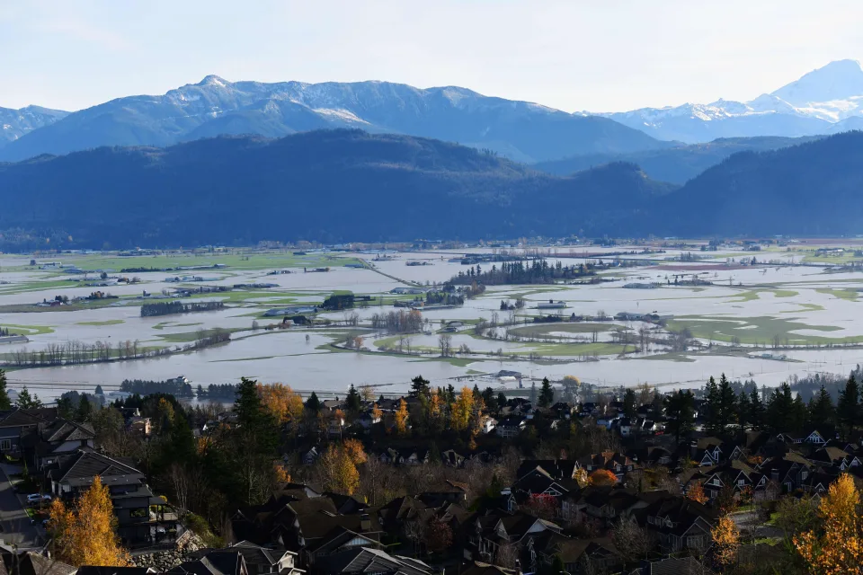
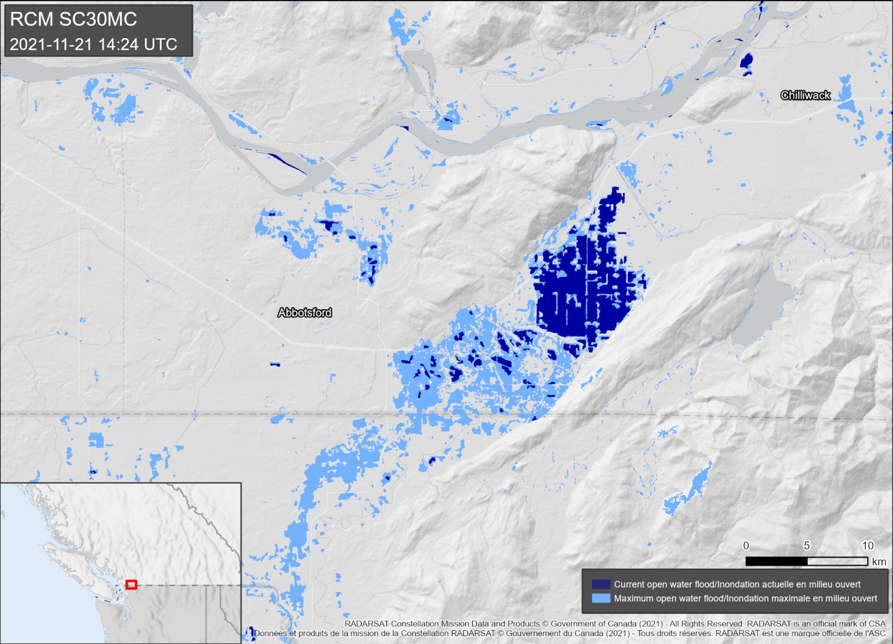
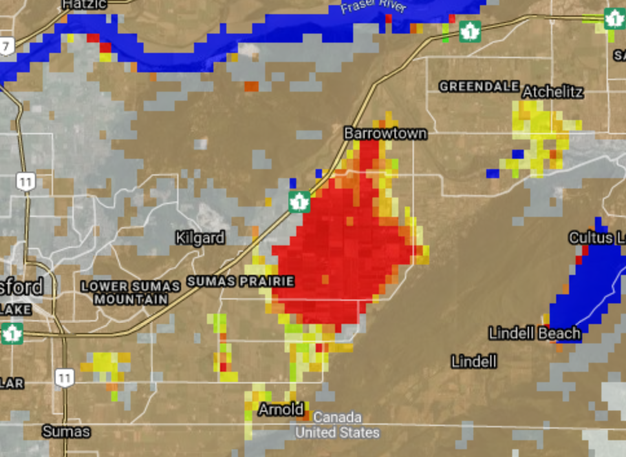
https://cimss.ssec.wisc.edu/satellite-blog/archives/43303
November 17, 2021. (Photo by Don MacKinnon / AFP via Getty Images)

Slide 40
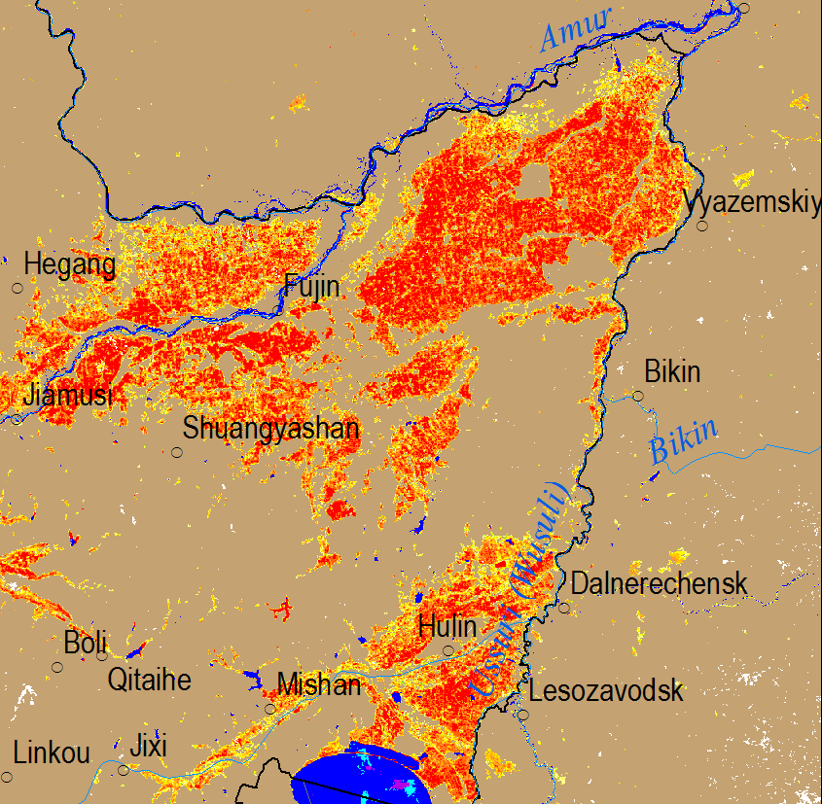
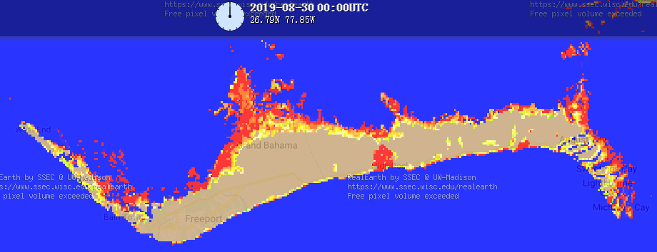
Issues to be aware of
Agricultural-related flooding: Some flooding water shown in the VIIRS flood maps may not be any hazard-related flooding, but from agriculture-related activities such as rice paddy planting and aquaculture.
Tides and Marsh lands: In some regions especially coastal areas, consistent flooding may be detected in the flood maps. These floods are mostly caused by the tides or occur over marsh lands, which do not pose any social impact.
Water reference map: The current water reference map we use for global flood mapping is from global water bodies of ESA CCI and MODIS global water mask (MOD44W Version 006). It might not reflect the new reservoirs and other hydraulic projects built after 2015, which may take some normal water as flooding water.
Solar Eclipses: For granules that are flagged as an “eclipse”, the flood product will not be produced.
The widespread flooding water in the northeast of China from May 03 to 09, 2018 was not hazard-related flooding, but the “flooded” rice paddy areas during planting season.
Flooding caused by the tides in Great Bahamas is a natural phenomenon.

Slide 41
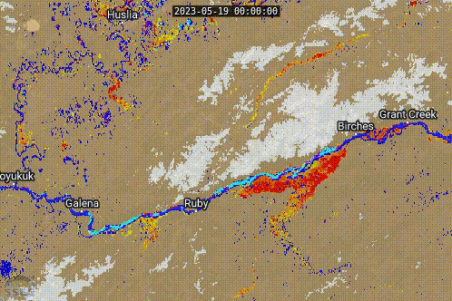
Identification of “non-hazard” flooding which might become hazardous during 2023 Alaska Breakup season
Sun, Donglian, et al. “Hazard or Non-Hazard Flood: Post Analysis for Paddy Rice, Wetland, and Other Potential Non-Hazard Flood Extraction from the VIIRS Flood Products.” ISPRS Journal of Photogrammetry and Remote Sensing, vol. 209, 2024, pp. 415–31. https://doi.org/10.1016/j.isprsjprs.2024.02.013.
Notes:
4 - 5 minutes activity
Question for participants:
can anyone tell what happen?

Slide 42
Summary
The NOAA Flood products are being used by FEMA NRCC during large scale flood events and have been used by regional offices as well (Ex. Region 9)
The NOAA LEO flood product is currently downscaled for areas between 60ºN to 60ºS, with the Arctic being available hopefully by the end of 2024
There is a SAR based river-ice only products that are available, SARRIS product from NWC, which is displayed within CIMSS RealEarth

Slide 43
Summary (cont.)
There are also several other satellite products which can be useful to help know about water and soil moisture conditions that may be useful.
Interaction with FEMA, US National Weather Service, River Forecast Centers and the National Water Center and other agencies are key in knowing what to provide the users for satellite based flood monitoring.

Slide 44
Accessibility information
Online
Online visualization page : https://www.ssec.wisc.edu/flood-map-demo/flood-products/
Links to the single flood products:
VIIRS real-time flood maps: http://floods.ssec.wisc.edu/?products=RIVER-FLDglobal
VIIRS daily composites: https://floods.ssec.wisc.edu/?products=RIVER-FLDglobal-composite1
VIIRS 5-day composites: http://floods.ssec.wisc.edu/?products=RIVER-FLDglobal-composite
ABI Daily composites: http://floods.ssec.wisc.edu/?products=RIVER-FLD-ABI
Joint VIIRS/ABI: http://floods.ssec.wisc.edu/?products=RIVER-FLD-joint-ABI
AHI Daily composites: http://floods.ssec.wisc.edu/?products=RIVER-FLD-AHI
Joint VIIRS/AHI: http://floods.ssec.wisc.edu/?products=RIVER-FLD-joint-AHI
SAR C-Band Flood products - https://floods.ssec.wisc.edu/?products=C-band-VV-VH-dual-pol.75,C-band-VV-VH-dual-pol-m.75&center=40,-90&zoom=5&width=994&height=621&basemap=satellite&labels=false&view=leaflet&collection=Flood%20Detection&timeproduct=C-band-VV-VH-dual-pol
The flood products via Web Mapping Service (via Real Earth) and FTP are available
Note that these products are not supported 24/7 but do have a high reliability of uptime.

