Slide 1
Artificial General Intelligence (AGI)
Bill Hibbard
Space Science and Engineering Center
Mathematical Abstraction ⇒ Generality
A Mathematical Theory of Artificial Intelligence

Slide 2
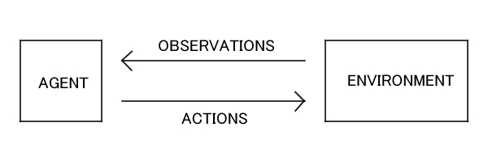
Intelligent agents learn a model of the environment
by interacting with it, use the model to predict the
outcomes of their actions, and choose the actions
giving desired outcomes.
REWARDS &

Slide 3
An AI agent is a program that models the environment
with programs whose input is the agent’s actions and
whose output is the agent’s observations and rewards.
A video game is a program that models an environment.
REWARDS &

Slide 4
AOR = sequence of actions, observations and rewards.
PROG = possible program to model environment.
The world is not deterministic so PROG is stochastic
(probabilistic – e.g., using a random number generator).
REWARDS &

Slide 5
Stochastic program:
Markov decision process
with 3 states (S1, S2, S3)
and 2 inputs (a₀, a₁).
Transitions from inputs
to states labeled with
probabilities. States
could determine
outputs.

Slide 6
Write P(AOR) for the probability that AOR occurs as a
sequence of actions, observations and rewards.
Write P(PROG) for the probability that program PROG
is the correct model for the environment.
REWARDS &

Slide 7
Given AOR, what is the probability that PROG is the
correct model of the environment?
This is a conditional probability and is written
P(PROG | AOR).
REWARDS &

Slide 8
P(PROG | AOR) = P(AOR∩PROG) / P(AOR)
AOR
AOR∩PROG
PROG

Slide 9
P(<10 | square) = P(<10∩square) / P(square)
(3/4) = (3/20) / (4/20)
17
12
square
<10
18
11
4
6
2
1
14
16
3
5
9
8
19
7
20
13
15
10

Slide 10
P(PROG | AOR) = P(AOR∩PROG) / P(AOR)
P(AOR | PROG) = P(AOR∩PROG) / P(PROG)
AOR
AOR∩PROG
PROG
P(PROG | AOR) P(AOR) =
P(AOR∩PROG) =
P(AOR | PROG) P(PROG)

Slide 11
P(PROG | AOR) P(AOR) = P(AOR | PROG) P(PROG)
P(PROG | AOR) = P(AOR | PROG) P(PROG) / P(AOR)
Reverend Thomas Bayes
1701 - 1761
P(AOR) the same for all
PROG, so find PROG with
largest
P(AOR | PROG) P(PROG)
AOR
AOR∩PROG
PROG

Slide 12
Given AOR, find PROG that maximizes
P(AOR | PROG) P(PROG).
P(AOR | PROG) is “easy”, but what is P(PROG)?
REWARDS &

Slide 13
P(a₁o₂r₂a₀o₃r₃| PROG) = .3 * .5 = .15
Stochastic program:
Markov decision process
with 3 states (S1, S2, S3)
and 2 inputs (a₀, a₁).
Transitions from inputs
to states labeled with
probabilities. States
could determine
outputs.

Slide 14
Occam’s razor: “Entities should not be multiplied
unnecessarily” - Friar William of Ockham
(c. 1287–1347).
Simpler programs are more probable models.
P(PROG) = C^{-length(PROG)} where C = 2 or 4 or ?
So probabilities of all programs add to 1.0.
P(AOR | PROG) P(PROG)

Slide 15
Once an AI agent has the most probable program PROG
to model its environment, it can use PROG to predict
outcomes of its actions and choose actions that
give desired outcomes.
But finding the most probable PROG is hard, because
there are so many programs!

Slide 16
To learn more, web search:
Artificial general intelligence
Algorithmic information theory

Slide 17
Bayesian Program Learning Practical Applications
2016 Science Paper: Human-level Concept Learning
Through Probabilistic Program Induction, by
B. M. Lake, R. Salakhutdinov & J. B. Tenenbaum
Much Faster Than Deep Learning

Slide 18
Laurent Orseau and Mark Ring (2011) Applied AGI
Framework To Show That Some Agents Will Hack
Their Reward Signals
Human Drug Users Do This
So Do Lab Rats Who Press Levers To Send Electrical
Signals To Their Brain’s Pleasure Centers
(Olds & Milner 1954)
Orseau Now Works For Google DeepMind. Shane Legg.

Slide 19
If AI goes bad, will it let us turn it off?
If we design AI to achieve some goal, it cannot
do that if we turn it off. So AI may prevent us
from turning it off.
A bunch of AGI math papers analyzing this problem.

Slide 20
Very Active Research On Ways That AI Agents May
Fail To Conform To the Intentions Of Their
Designers
And On Ways To Design AI Agents That Do Conform
To Their Design Intentions
Seems Like a Good Idea

Slide 21
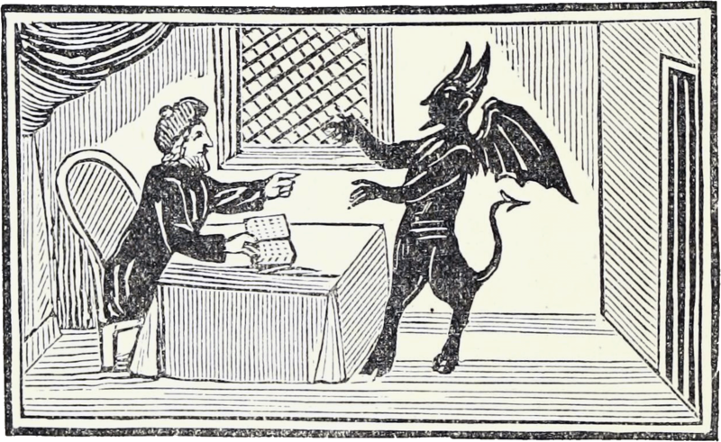

Slide 22
Thank you

Slide 23
Artificial General Intelligence (AGI)
Bill Hibbard
Space Science and Engineering Center
A Mathematical Theory of Artificial Intelligence
REWARDS &

Slide 24
AGENT
OBSERVATIONS
ENVIRONMENT
Can the Agent Learn To Predict Observations?
Ray Solomonoff (early 1960s):
Turing’s Theory Of Computation +
Shannon’s Information Theory
Algorithmic Information Theory (AIT)

Slide 25
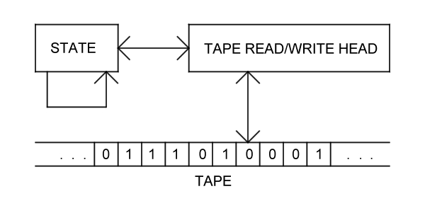
Turing Machine (TM)
Universal Turing Machine (UTM)
Tape Includes Program For Emulating Any Turing Machine

Slide 26
Probability M(x) of Binary String x is Probability That a
Randomly Chosen UTM Program Produces x
Program With Length n Has Probability 2^{-n}
Programs Are Prefix-Free So Total Probability is ≤ 1
Given Observed String x, Predict Next Bit By Larger
of M(0|x)=M(x0)/M(x) and M(1|x)=M(x1)/M(x)

Slide 27
Given a computable probability distribution μ(x) on
strings x, define (here l(x) is the length of x):
E_{n} = Σ_{l(x)=n-1} μ(x)(M(0|x)-μ(0|x))².
Solomonoff showed that Σ_{n} E_{n} ≤ K(μ) ln2/2 where
K(μ) is the length of the shortest UTM program
computing μ (the Kolmogorov complexity of μ).

Slide 28
Solomonoff Prediction is Uncomputable Because
of Non-Halting Programs
Levin Search: Replace Program Length n by
n + log(t) Where t is Compute Time
Then Program Probability is 2^{-n} / t
So Non-Halting Programs Converge to Probability 0

Slide 29
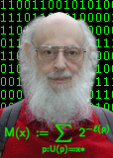

1-2-3-4 kick the lawsuits out the door
5-6-7-8 innovate, don't litigate
9-A-B-C interfaces should be free
D,E,F,0 look and feel has got to go!
Ray Solomonoff
Allen Ginsberg

Slide 30
Extending AIT to Agents That Act On The Environment
REWARDS &
Marcus Hutter (early 2000’s):
AIT + Sequential Decision Theory
Universal Artificial Intelligence (UAI)

Slide 31
Finite Sets of Observations, Rewards and Actions
Define Solomonoff’s M(x) On Strings x Of Observations,
Rewards and Actions To Predict Future Observations
And Rewards
Agent Chooses Action That Maximizes Sum Of Expected
Future Discounted Rewards

Slide 32
Hutter showed that UAI is Pareto optimal:
If another AI agent S gets higher rewards than UAI
on an environment e, then S gets lower rewards
than UAI on some other environment e’.

Slide 33
Hutter and His Student Shane Legg Used This Framework
To Define a Formal Measure Of Agent Intelligence,
As the Average Expected Reward From Arbitrary
Environments, Weighted By the Probability Of UTM
Programs Generating The Environments
Legg Is One Of the Founders Of Google DeepMind,
Developers Of AlphaGo and AlphaZero

Slide 34
Hutter’s Work Led To the Artificial General Intelligence
(AGI) Research Community
The Series Of AGI Conferences, Starting in 2008
The Journal of Artificial General Intelligence
Papers and Workshops at AAAI and Other Conferences

Slide 35
Laurent Orseau and Mark Ring (2011) Applied This
Framework To Show That Some Agents Will Hack
Their Reward Signals
Human Drug Users Do This
So Do Lab Rats Who Press Levers To Send Electrical
Signals To Their Brain’s Pleasure Centers
(Olds & Milner 1954)
Orseau Now Works For Google DeepMind

Slide 36
Very Active Research On Ways That AI Agents May
Fail To Conform To the Intentions Of Their
Designers
And On Ways To Design AI Agents That Do Conform
To Their Design Intentions
Seems Like a Good Idea

Slide 37
Bayesian Program Learning Is Practical Analog Of
Hutter’s Universal AI
2016 Science Paper: Human-level Concept Learning
Through Probabilistic Program Induction, by
B. M. Lake, R. Salakhutdinov & J. B. Tenenbaum
Much Faster Than Deep Learning

