Slide 1


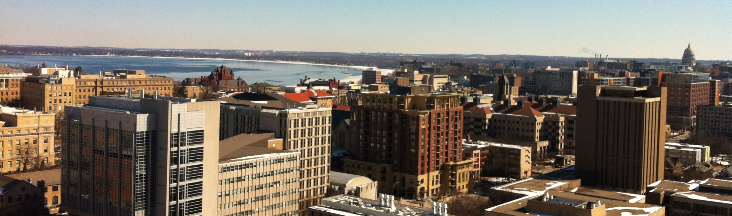
GeoXO CIMSS Passive Retrievals of 3D Optical Flows with Information Leveraged from Environmental Sounders (PROFILES)
David Santek, Jason Oktin, Tom Rink, Yubo Wang
17 November 2012
14 February 2009
March 2017
Notes:
1

Slide 2
Introduction/Motivation
The GeoXO Sounder (GXS) will provide vertical distribution of moisture, temperature, and trace gases
NOAA does not have a winds algorithm for retrieved parameters, e.g., temperature and moisture
The PROFILES project will test, develop, and demonstrate novel methods to produce 3D winds from proxy GXS data using advanced Optical Flow algorithms (e.g., WindFlow)
Explore techniques to generate uncertainty and error estimates that will be useful for future data assimilation efforts
3D Winds: The three-dimensional distribution of horizontal winds in clear sky and above cloud
This product will be complementary to the cloud drift winds from the imager (GXI)

Slide 3
NWS Benefit
The outcome of this project will complement the current cloud-tracked satellite wind products, by providing 3D wind information in data void regions of clear-sky and above clouds. Uses within NWS:
Assimilation of the 3D winds into numerical weather prediction (NWP) models
Provide a vertical distribution of wind information in clear air regions near severe weather and tropical cyclones for Nowcasting applications

Slide 4
Research Activities/Milestones
Algorithm developments and updates (Quarter 1)
  Import GXS proxy datasets into the 3D winds heritage algorithm**
  Adapt WindFlow for use with GXS proxy datasets (complete)
3D winds retrieval (Quarter 1)
  Generate AMV dataset using WINDCO with a NR or GXS proxy dataset**
  Generate AMV datasets using WindFlow with an NR and GXS proxy dataset (complete)
3D winds validation (Quarters 2 and 3)
  Produce validation statistics for each AMV dataset (WindFlow only)
  Produce comparison statistics between WINDCO and WindFlow**
**After obtaining encouraging preliminary results, we focused our efforts on developing the WindFlow dense optical flow method rather than the heritage WINDCO.

Slide 5
Research Activities/Milestones
Investigate uncertainty estimates (Quarters 3 and 4)
  Experiment with predictive uncertainty measures for WindFlow NR AMVs, where the truth field is known, and as compared to WINDCO quality metrics
  Apply methodologies to determine uncertainty estimates developed from the NR, to the GXS proxy-derived AMVs
3D winds from current satellites (Quarter 4)
  As time permits, apply WindFlow (and uncertainty estimates) to operational IR hyperspectral data (e.g., CrIS, and if available, MTG-IRS)
Reports and presentations (Quarters 3 and 4)
  Summarize overall findings and present findings at scientific meetings
    Poster at 2026 AMS Annual Meeting (CIRA, with CIMSS contributions)

Slide 6
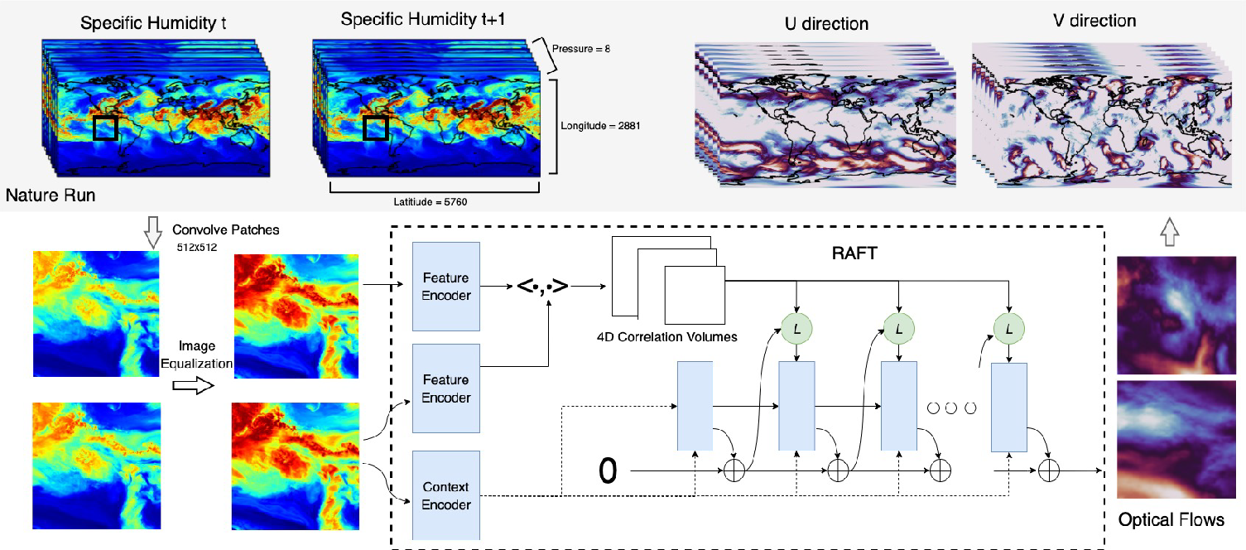
Windflow (RAFT for Winds)
Generate winds from sequences of retrieved water vapor images using WindFlow, a data-driven deep learning algorithm
Trained to output winds with two input 2D water vapor images using two years of the GEOS-5 Nature Run (G5NR) (NASA/GMAO)
Model based on the recurrent all-pairs field transforms (RAFT) architecture; inference is computationally inexpensive. Originally developed to estimate dense optical flow.
Key limitations: Retrieval method is challenging to interpret (difficult to identify why some solutions are wrong), trained on data coarser than GXS which excludes clouds, and new channels or inputs require retraining

Slide 7
Datasets
WindFlow will be applied to up to three datasets:
  GEOS-5 Nature Run: Model humidity fields simulate GXS retrieved humidity. Model winds provide ‘truth’.
  GXS Proxy Retrievals: Radiances from high resolution ECMWF XNR1K Nature Run. Retrievals generated using U-Net model (Zhenglong Li)
  MTG-IRS: If available. Currently, the best match to what is expected from GXS

Slide 8
Datasets
WindFlow will be applied to up to three datasets:
  GEOS-5 Nature Run: Model humidity fields simulate GXS retrieved humidity. Model winds provide ‘truth’.
  GXS Proxy Retrievals: Radiances from high resolution ECMWF XNR1K Nature Run. Retrievals generated using U-Net model (Zhenglong Li)
  MTG-IRS: If available. Currently, the best match to what is expected from GXS

Slide 9
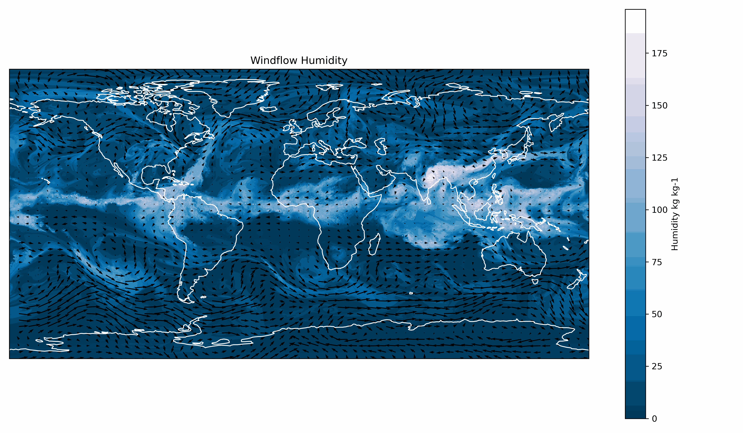
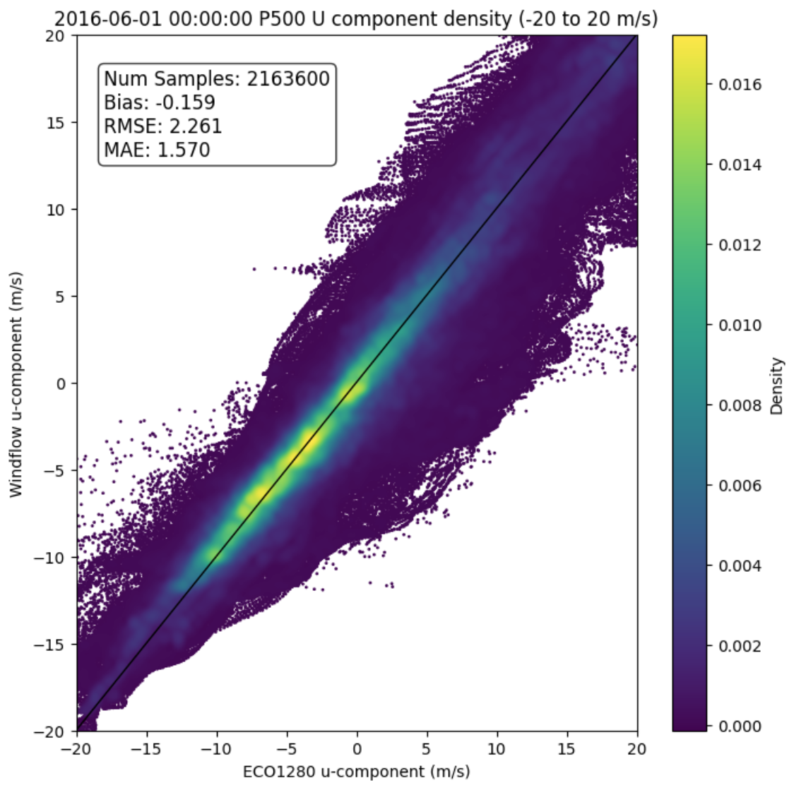
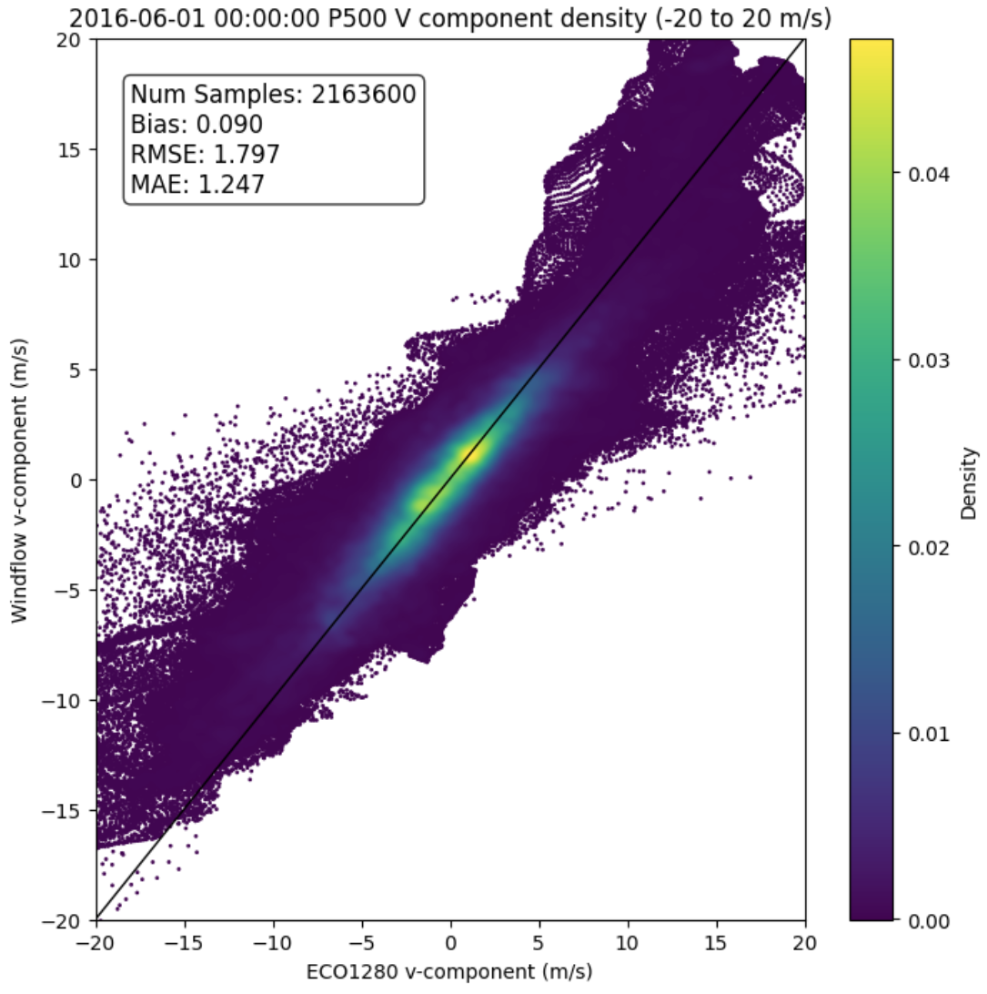
GEOS-5 Nature Run
Above: WindFlow trained with humidity fields from the GEOS-5 Nature Run (G5NR), applied to ECO1280 Nature Run grids
Right: Derived U & V winds vs truth (ECO1280 wind field). Low RMSE, however QC and error estimates needed to filter outliers.
From a different project
Applying G5NR-trained WindFlow to the ECO1280 Nature Run to show the versatility of WindFlow.

Slide 10
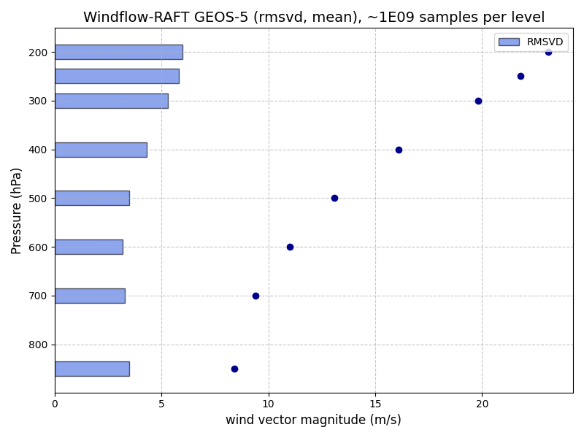
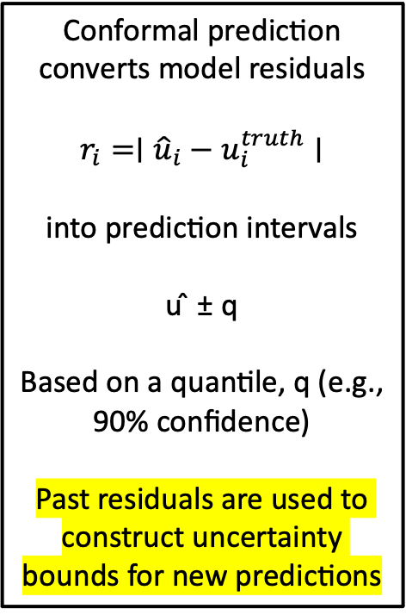
AMV Error Estimation
Conformal Prediction with G5NR
Initial and encouraging results
Conformal prediction converts model residuals
$$r_{i}=∣{\hat{u}}_{i}−u_{i}^{truth}∣$$
into prediction intervals
u ̂ ± q
Based on a quantile, q (e.g., 90% confidence)
Past residuals are used to construct uncertainty bounds for new predictions
RMSVD (bars) and mean wind speed (dots) for one billion samples at each level

Slide 11
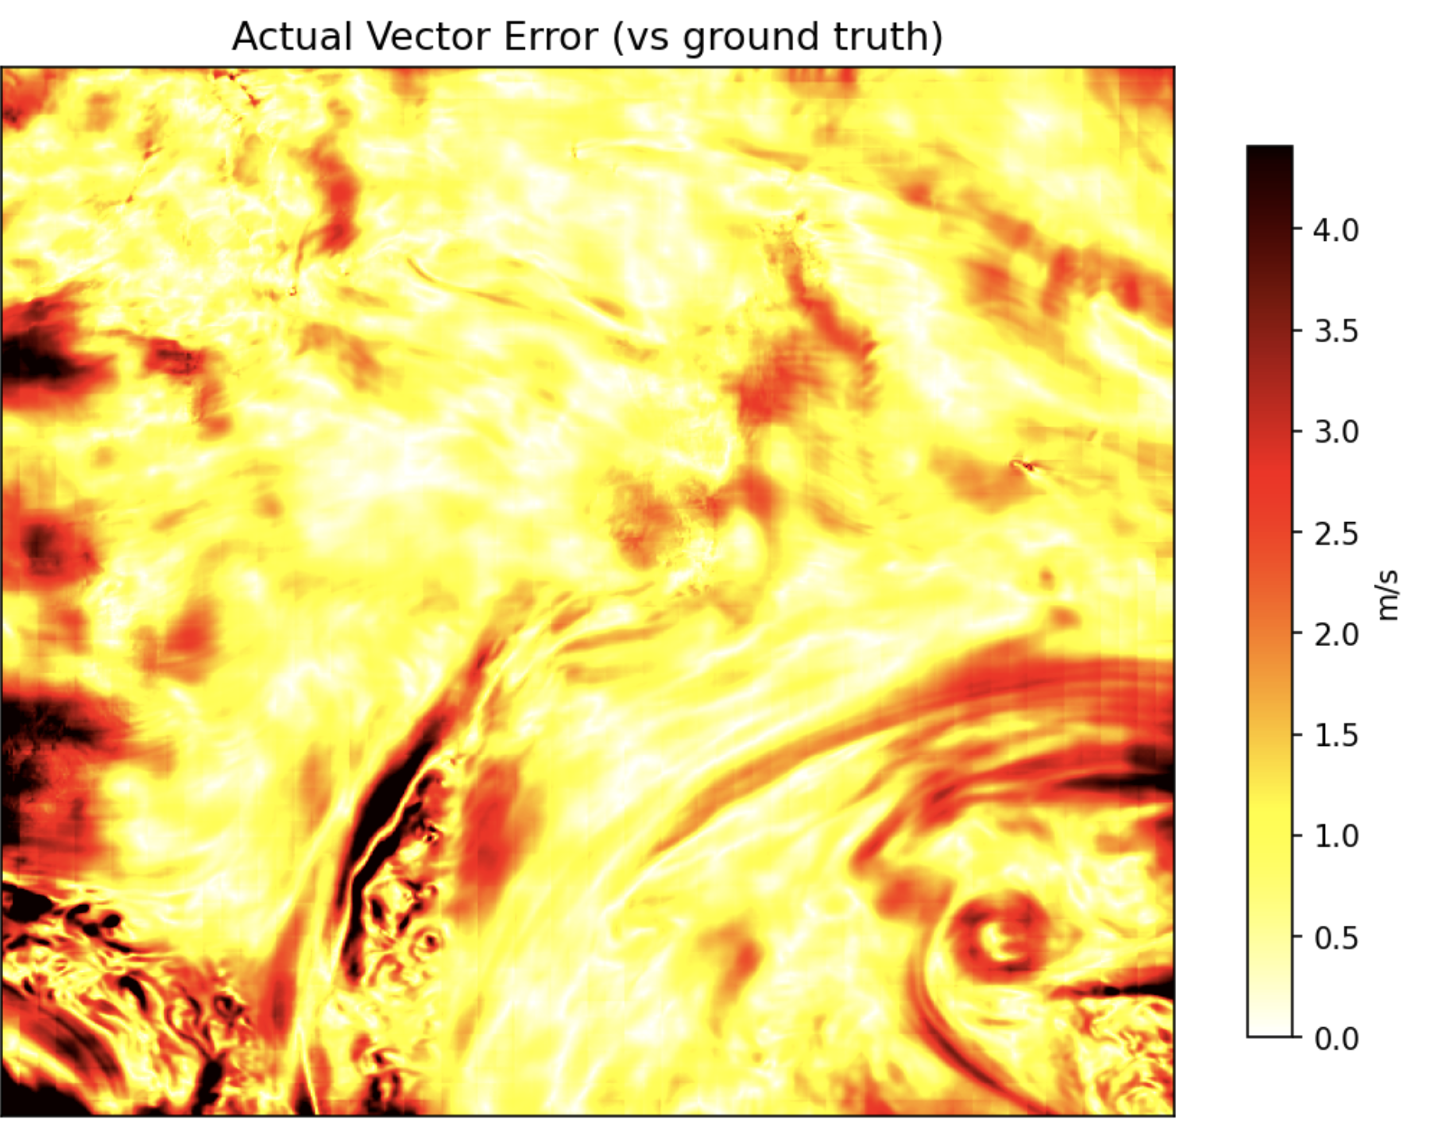
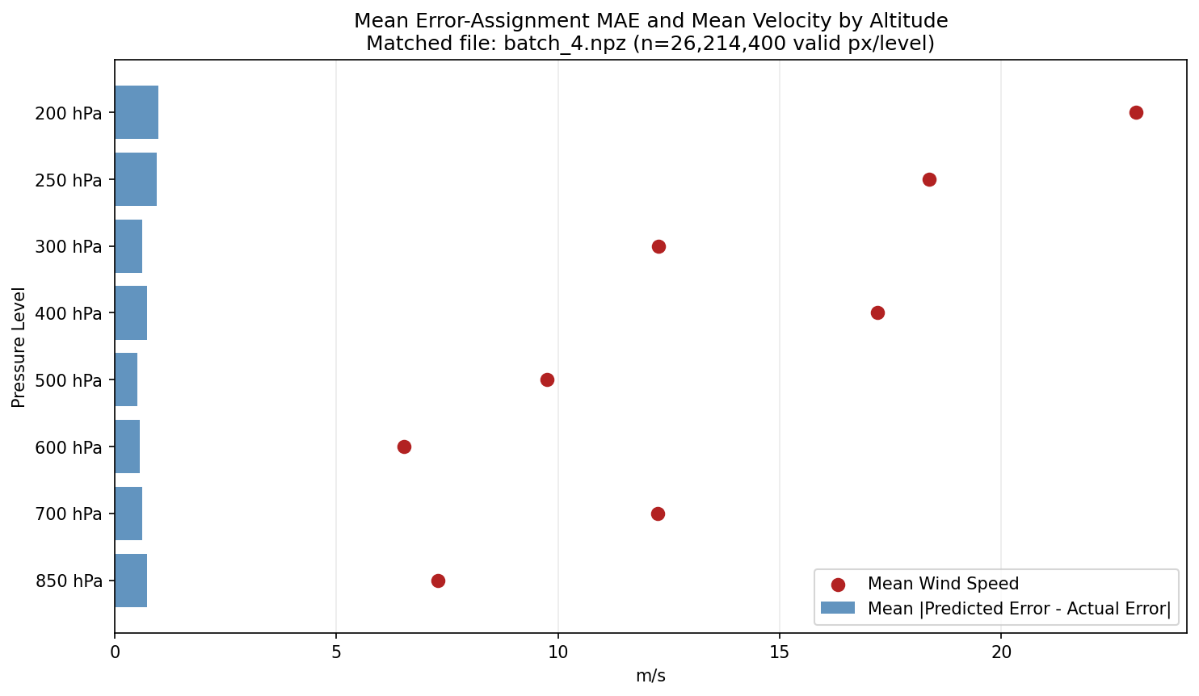
AMV Error Estimation
U-Net with G5NR
Initial and encouraging results
U-Net is a CNN used to estimate spatially varying AMV errors.
Processes 512-pixel tiles and directly predicts wind error using inputs such as u and v wind, latitude, longitude, and pressure.
Past errors are used to estimate the uncertainty of new observations
Spatial distribution of AMV errors for one tile
WindFlow AMV – G5NR wind
MAE (bars) and mean wind speed (dots) for 26 million samples at each level

Slide 12
Datasets
WindFlow will be applied to up to three datasets:
  GEOS-5 Nature Run: Model humidity fields simulate GXS retrieved humidity. Model winds provide ‘truth’.
  GXS Proxy Retrievals: Radiances from high resolution ECMWF XNR1K Nature Run. Retrievals generated using U-Net model (Zhenglong Li)
  MTG-IRS: If available. Currently, the best match to what is expected from GXS

Slide 13
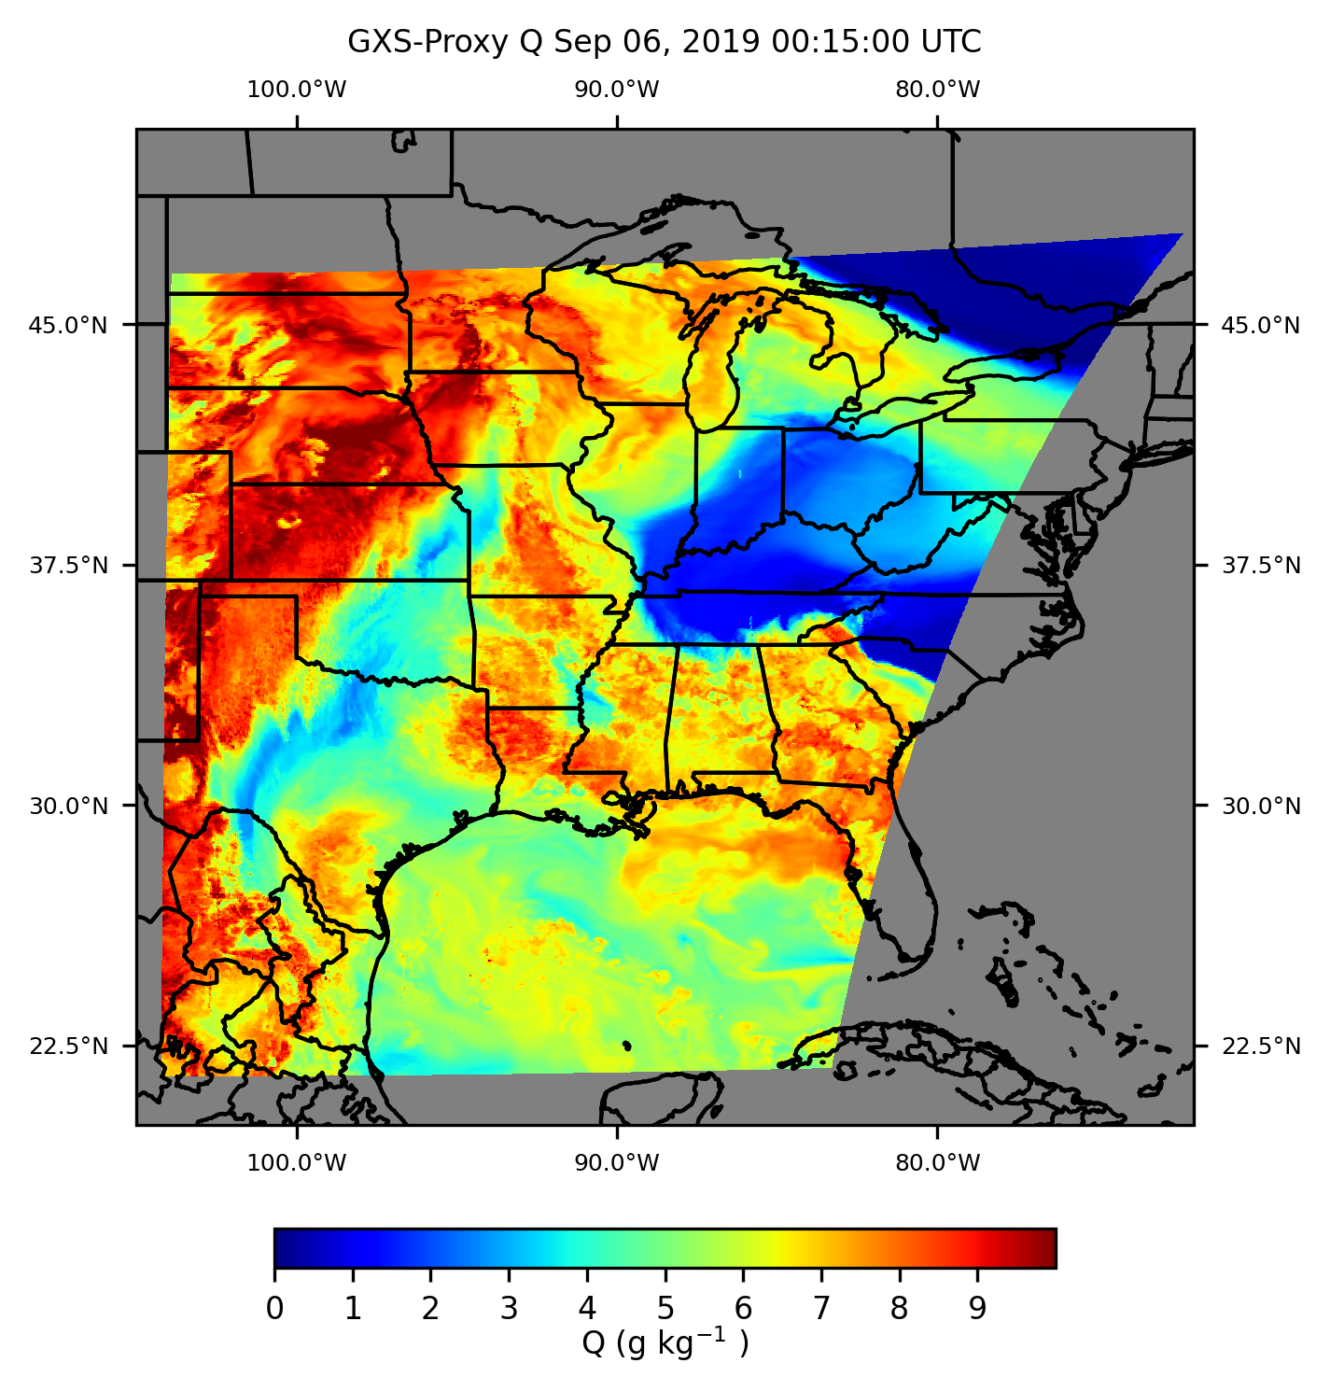
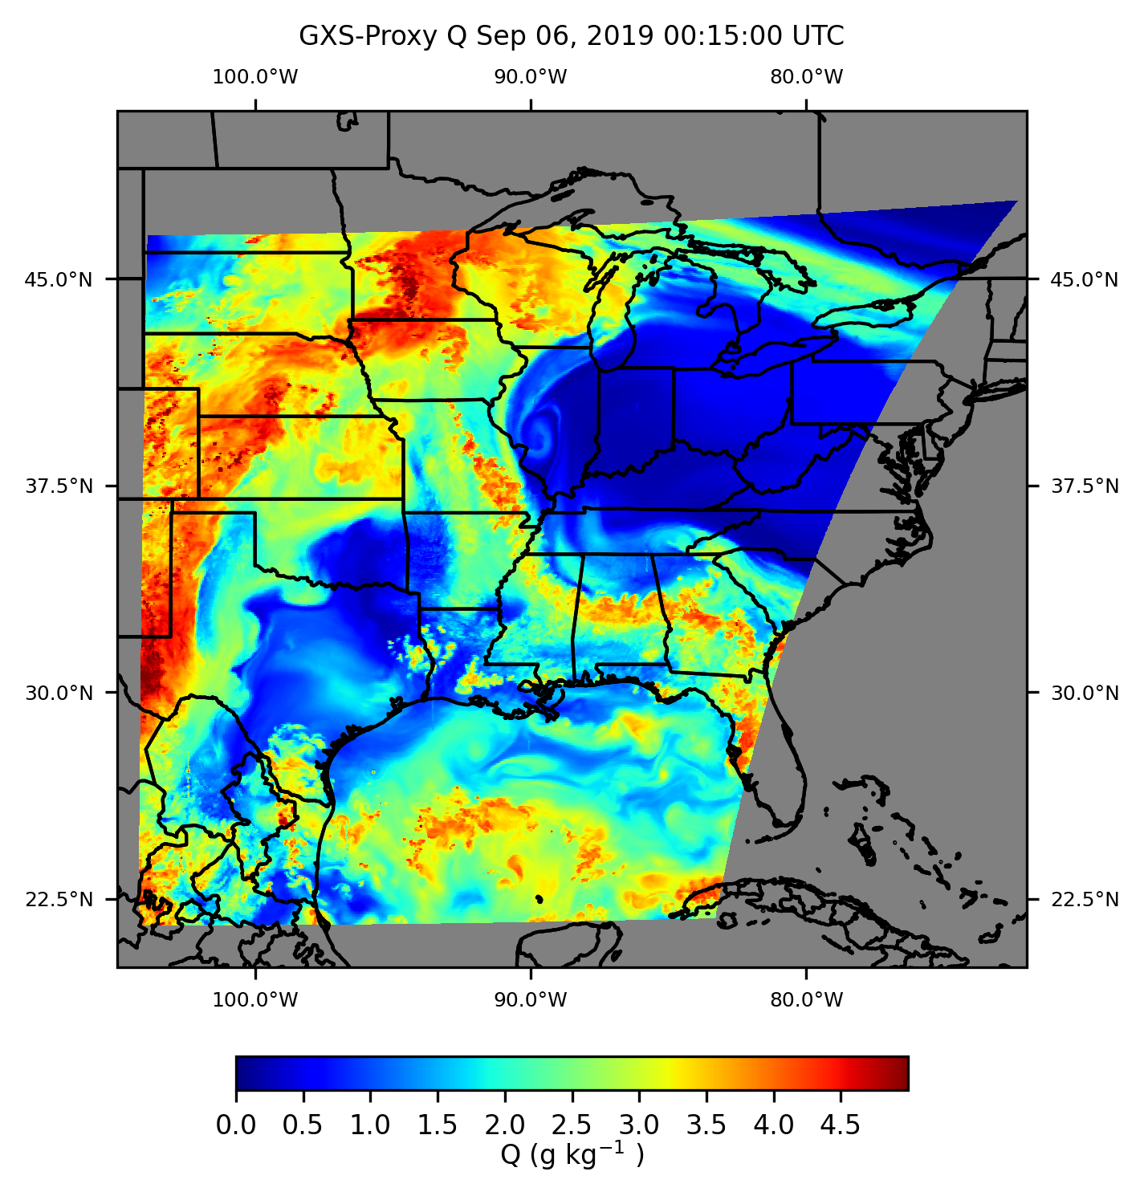
Generate AMVs
GXS Proxy Retrievals
Slide courtesy and in collaboration with Jason Apke (CIRA)
GXS proxy humidity retrievals
Low (left) and Middle (right) levels

Slide 14


Generate AMVs
GXS Proxy Retrievals
Slide courtesy and in collaboration with Jason Apke (CIRA)
GXS proxy humidity retrievals
Low (left) and Middle (right) levels

Slide 15

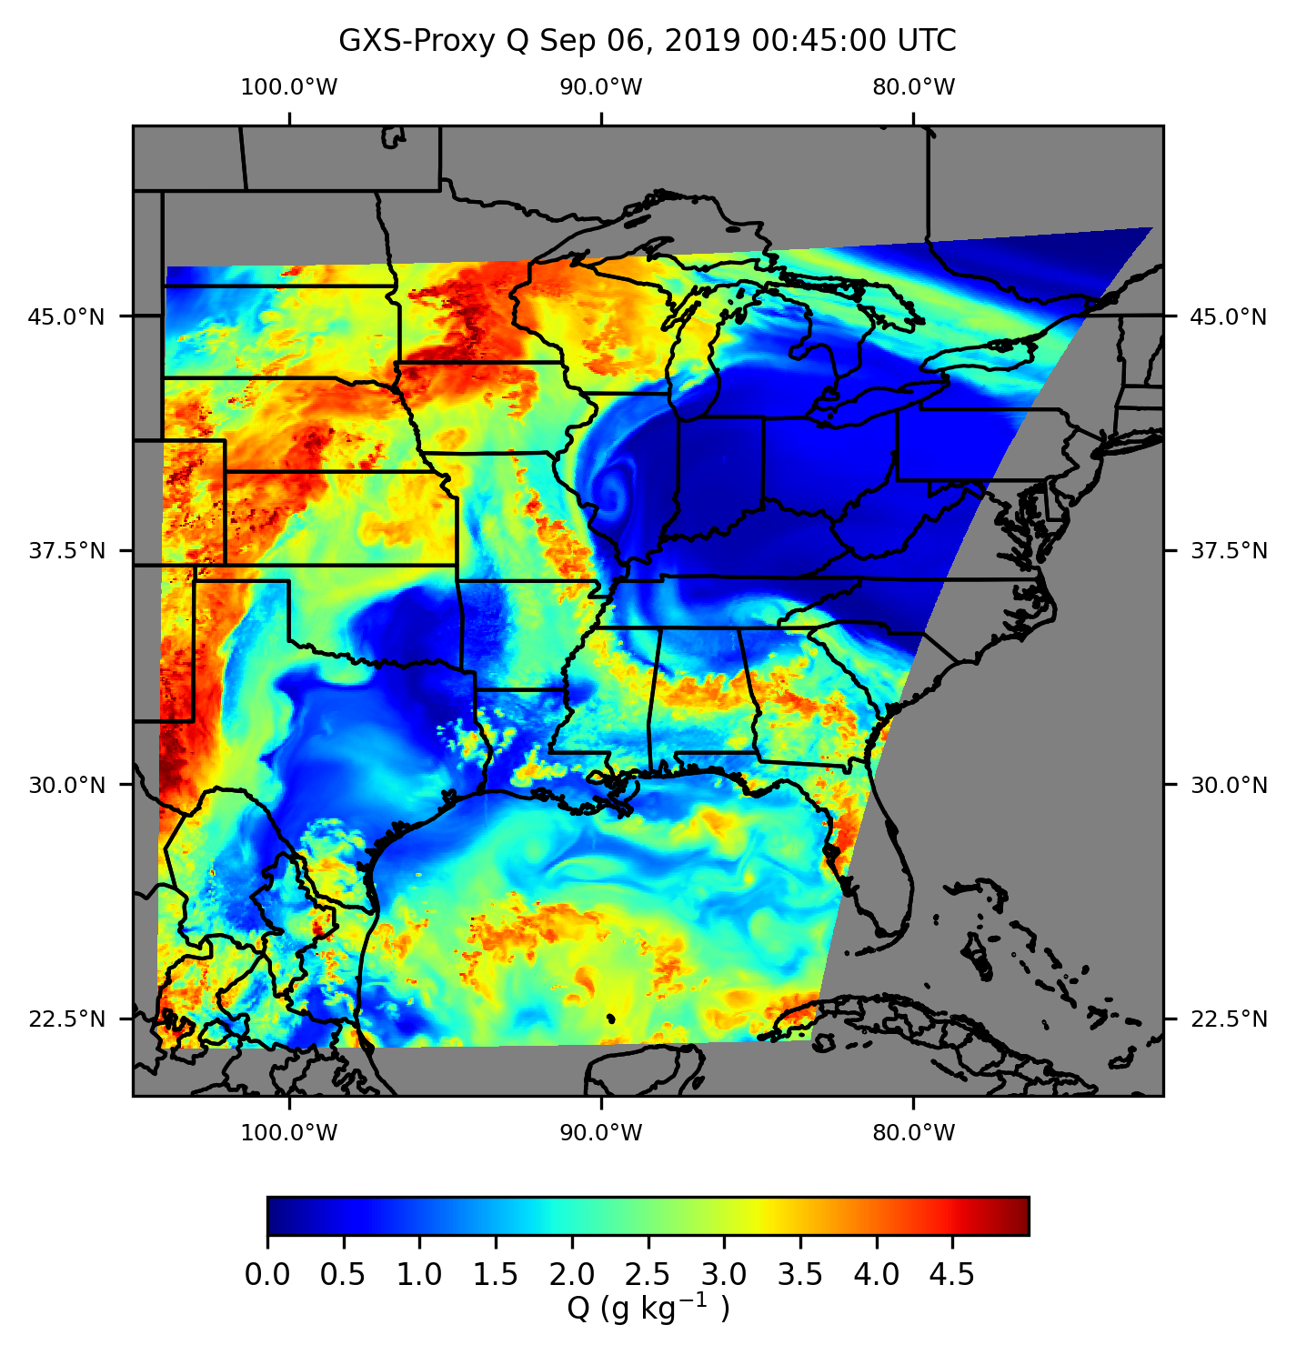
Generate AMVs
GXS Proxy Retrievals
Slide courtesy and in collaboration with Jason Apke (CIRA)
GXS proxy humidity retrievals
Low (left) and Middle (right) levels

Slide 16
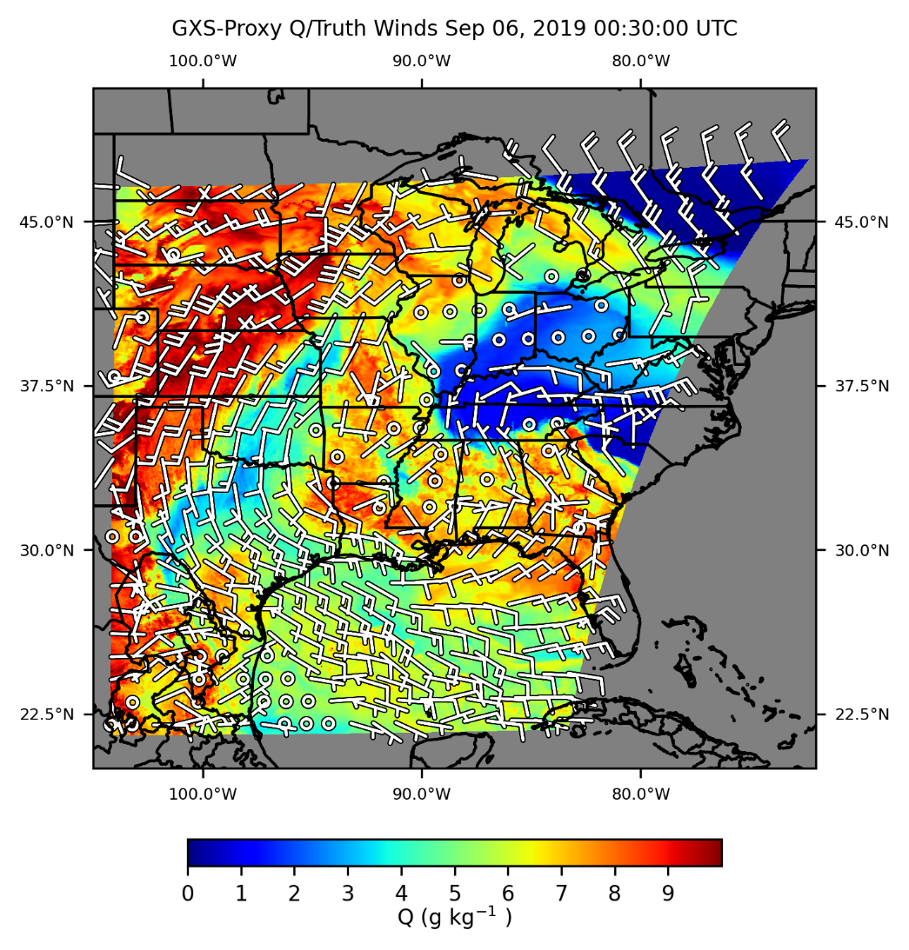
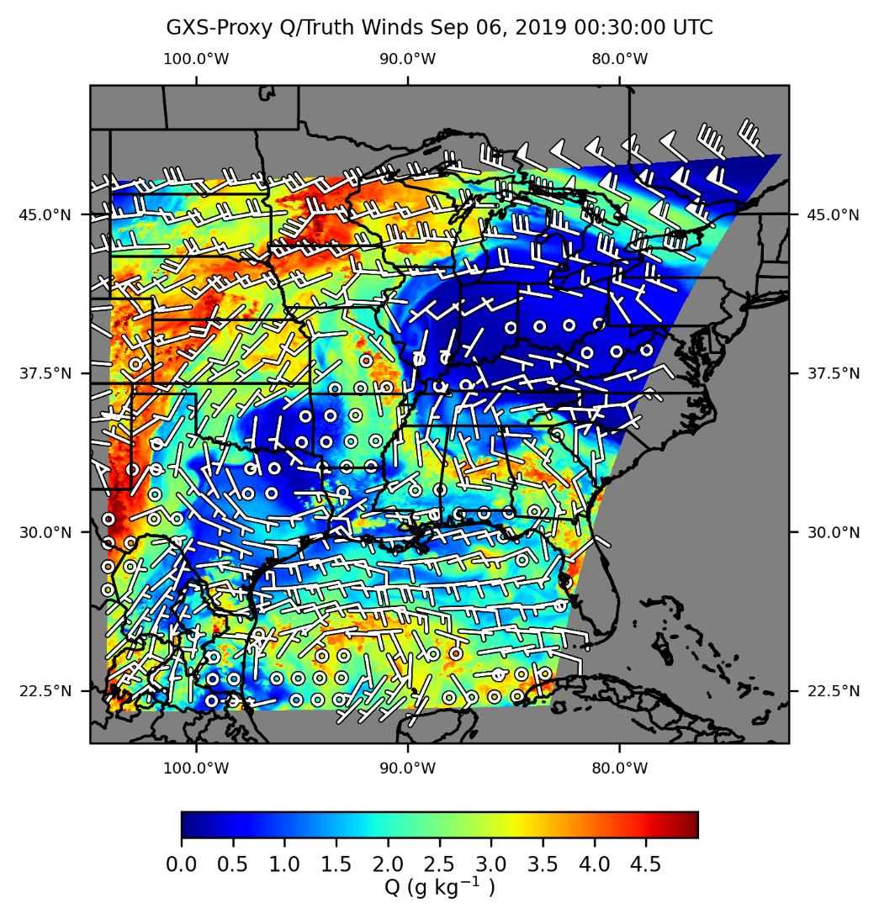
Generate AMVs
GXS Proxy Retrievals
Slide courtesy and in collaboration with Jason Apke (CIRA)
GXS proxy humidity retrievals
Low (left) and Middle (right) levels
Truth Winds

Slide 17
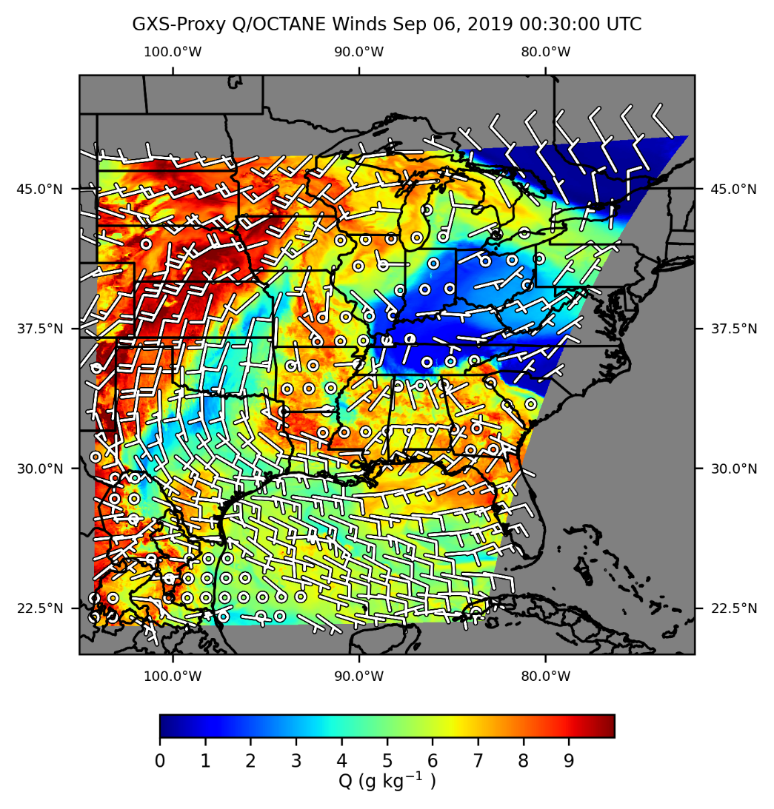
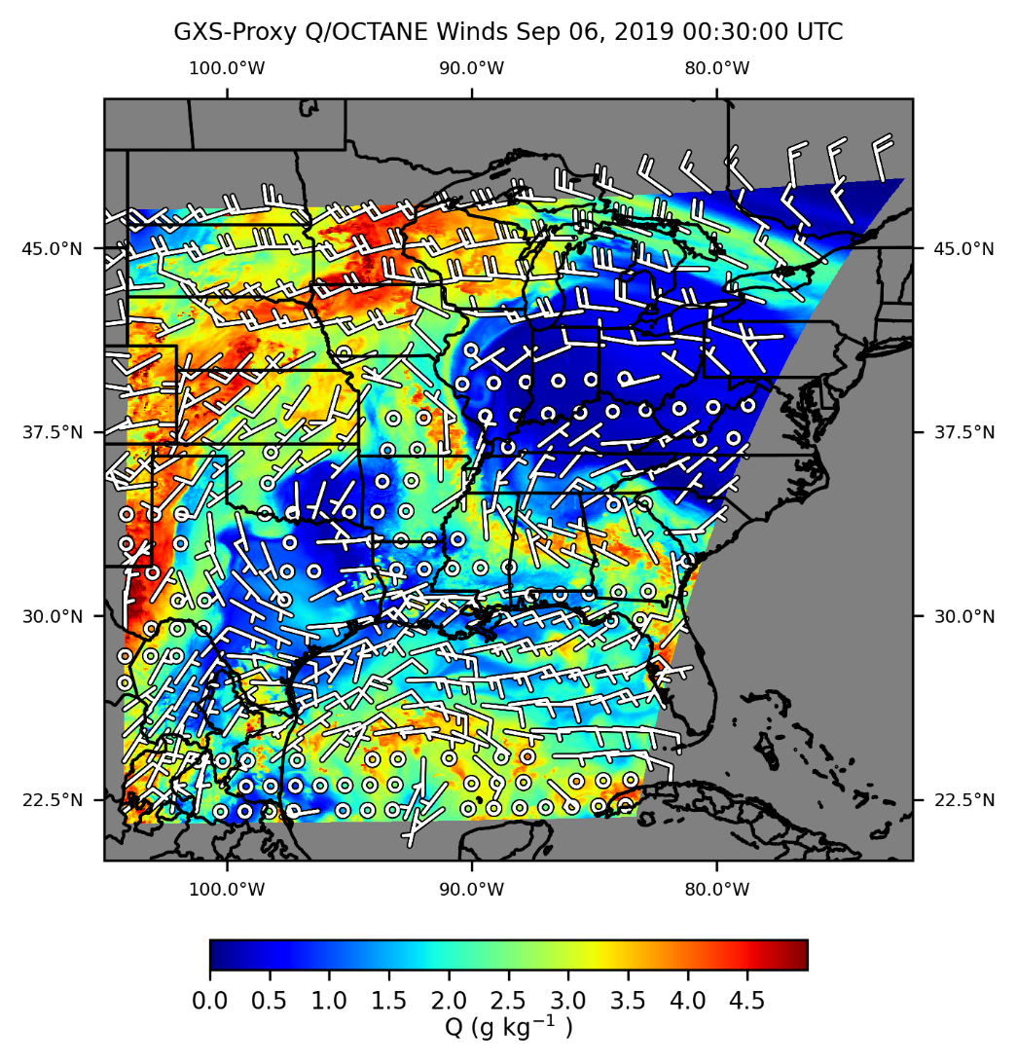
Generate AMVs
GXS Proxy Retrievals
Slide courtesy and in collaboration with Jason Apke (CIRA)
GXS proxy humidity retrievals
Low (left) and Middle (right) levels
OCTANE AMVs

Slide 18

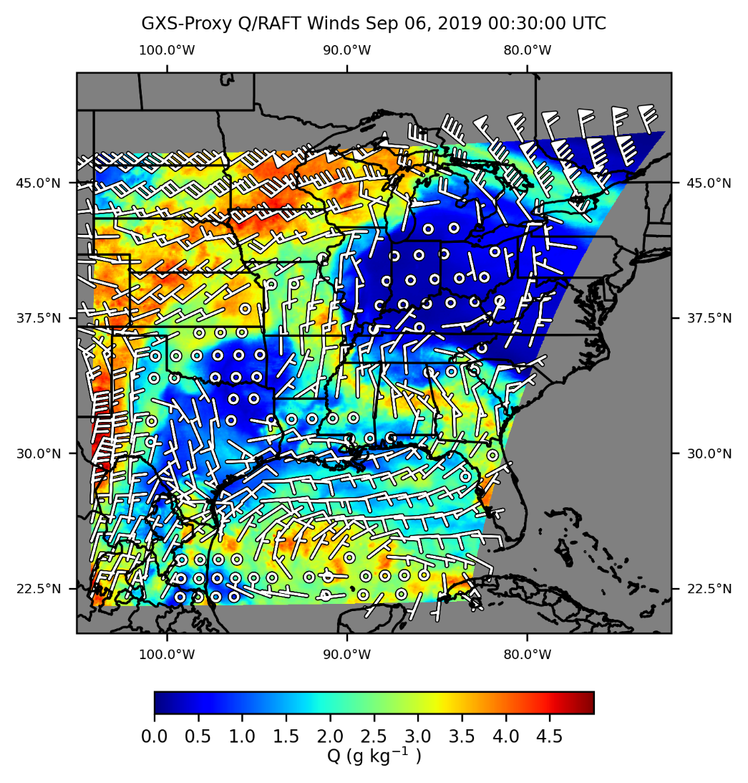
Generate AMVs
GXS Proxy Retrievals
Slide courtesy and in collaboration with Jason Apke (CIRA)
GXS proxy humidity retrievals
Low (left) and Middle (right) levels
WindFlow AMVs

Slide 19
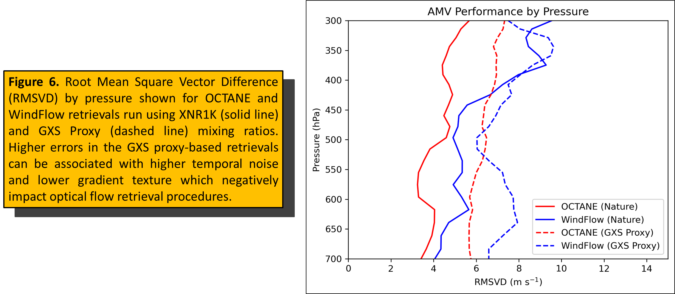
AMV Evaluation
GXS Proxy
Slide courtesy and in collaboration with Jason Apke (CIRA)
Note: No QC; only one frame!

Slide 20
Next Steps
First three milestones were completed in the first two quarters.
Next Steps: Milestones
The remaining three milestones are expected to be completed:
Investigate uncertainty estimates (Quarters 3 and 4)
  Test predictive uncertainty measures for WindFlow NR AMVs
  Apply uncertainty methodologies to the GXS proxy-derived AMVs
3D winds from current satellites (Quarter 4)
  As time permits, apply WindFlow (and uncertainty estimates) to operational IR hyperspectral data (e.g., CrIS, and if available, MTG-IRS)
Reports and presentations (Quarters 3 and 4)
Next Steps: Collaboration
Extend the CIMSS/CIRA collaboration to include the 3D winds team at EUMETSAT (Régis Borde):
Draw on EUMETSAT’s extensive experience with 3D winds to further advance uncertainty and error estimates.
When MTS-IRS data are available, coordinate 3D wind derivation and evaluation.

Slide 21
Expected Outcomes
Procedures for training, characterizing errors, and evaluating AMVs derived using GXS proxy datasets
In collaboration with CIRA and EUMETSAT, adapted versions of the above procedures for use with MTG-IRS data
In collaboration with CIRA, identify a machine-learning–based AMV retrieval system capable of deriving 3D winds and adaptable to future architectures

