Slide 1
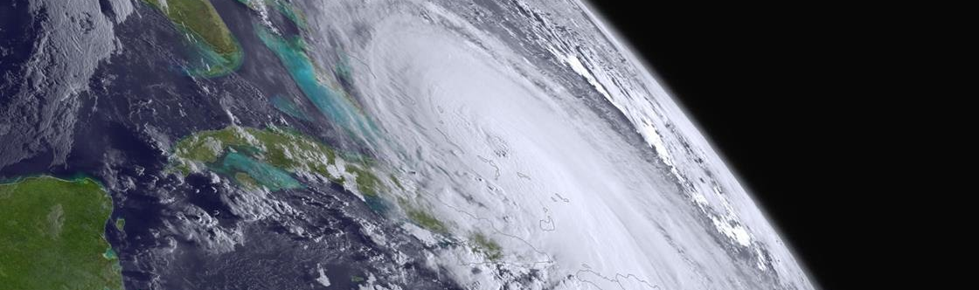
Comparison of Aeolus with AIRS AMVs in the polar regions
David Santek, Brett Hoover, Hong Zhang
21 April 2020
Updated with ESA QC 21 Jan 2021
NOAA NA15NES4320001
NASA ROSES 80NSSC18K0984
Satellite and Information Service
Internal – Not for distribution outside of OPPA

Slide 2
Two platforms: AIRS and Aeolus
Aeolus: Doppler wind lidar (DWL) instrument. Single line-of-sight instrument, which results in the Horizontal Line of Sight (HLOS) component of the wind. Two types of tracking:
  Rayleigh: Molecular (cloud free)
  Mie: Particle (aerosols and clouds)
AIRS 3D winds: Winds derived from tracking moisture features (troposphere) and ozone gradients (stratosphere) on pressure surfaces from AIRS retrieved vertical profiles of temperature, humidity, and ozone in clear-sky and above cloud.
https://www.mdpi.com/2072-4292/11/22/2597

Slide 3
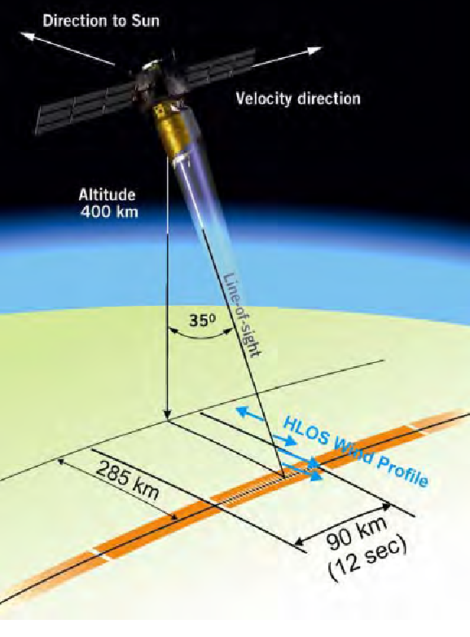
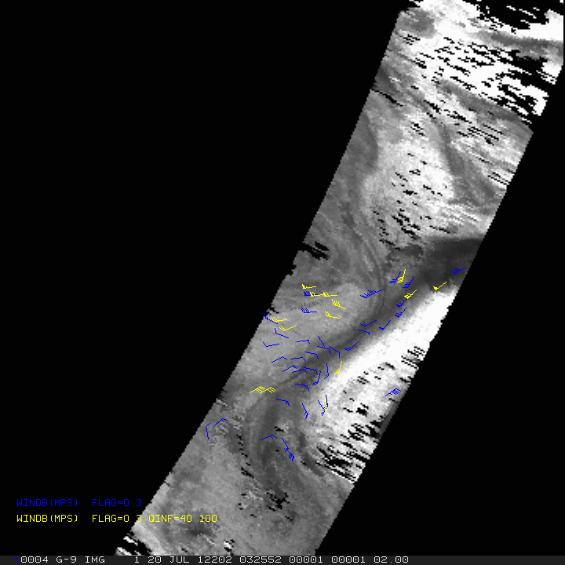
Aeolus vs AIRS
Atmospheric Motion Vectors (AMVs)
400 hPa humidity
20 July 2012: 0325, 0505, 0643 UTC
Aeolus
AIRS
45 levels: 100 to 775 hPa

Slide 4
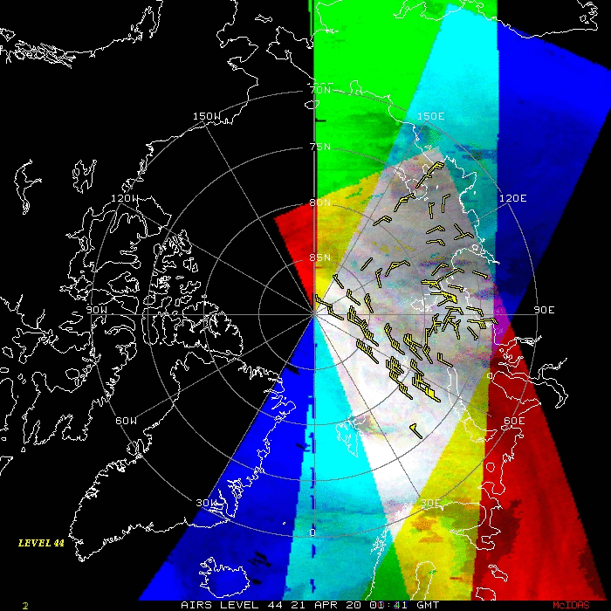
AIRS 3D winds
21 Apr 2020: 0141 UTC
45 levels: 44 (100 hPa) to 88 (775 hPa)

Slide 5
Motivation:
Why compare AIRS 3D winds to Aeolus winds?
Validation
  They both provide a vertical distribution of winds in clear sky and above cloud (Aeolous Rayleigh winds)
  Examine statistical differences between the winds: spatially and vertically
  Compare co-located winds to independent data: Rawinsonde winds, model reanalyses
Are they complementary or redundant?

Slide 6


Motivation:
Why compare AIRS 3D winds to Aeolus winds?
Decadal Survey recommends a 3D tropospheric wind mission
  Using a space-based LIDAR instrument and/or the use of hyperspectral infrared measurements.
  The combination of lidar winds and AMV winds might also provide some advantages where one is used to calibrate the other.

Slide 7
Comparison of 3D winds
Aeolus winds
Wind component perpendicular to the satellite path
Better vertical resolution
Instantaneous
AIRS 3D winds
Total wind
Better spatial coverage
Average motion over 200 minutes
To account for differences
Total wind from AIRS AMVs was adjusted to equivalent HLOS wind
(used viewing angle from co-located Aeolus winds)
For each AIRS AMV, co-located Aeolus winds were superobbed in space and time

Slide 8
Comparison overview
Comparisons of Aeolus Rayleigh and AIRS 3D winds:
    Clear sky (and above cloud)
    Polar regions
      Overlapping passes necessary for AIRS winds
    Comparisons:
      Intercomparisons
      Each to radiosonde winds
      Each to ERA5 reanalysis

Slide 9
Comparisons
Time frame:
  Aeolus Rayleigh vs AIRS 3D winds for the 2-month period August through September 2019
  Aeolus Rayleigh and AIRS 3D winds compared to RAOBs for August through September 2019
  Co-located Aeolus Rayleigh and AIRS 3D winds compared to ERA5 reanalysis for 10 days in 2019:
      5 days in August; 5 days in September
      30 km global grid
      137 levels from the surface to a height of 80km

Slide 10
Aeolus vs AIRS 3D winds
Superob (average) Aeolus winds:
Aeolus Rayleigh and AIRS 3D winds compared for a 2-month period in August through September 2019
    ESA recommended QC of Aeolus
    Exclude Aeolus winds greater than 60 ms⁻¹
    Only in the polar regions
Co-location criteria:
    Within 100 km
    +/- 90 minutes
    +/- .04 difference in log₁₀ of pressures (approx. height)
      +/- 60 hPa at 700 hPa
      +/- 20 hPa at 200 hPa
  All AIRS winds and only high-quality AIRS winds

Slide 11
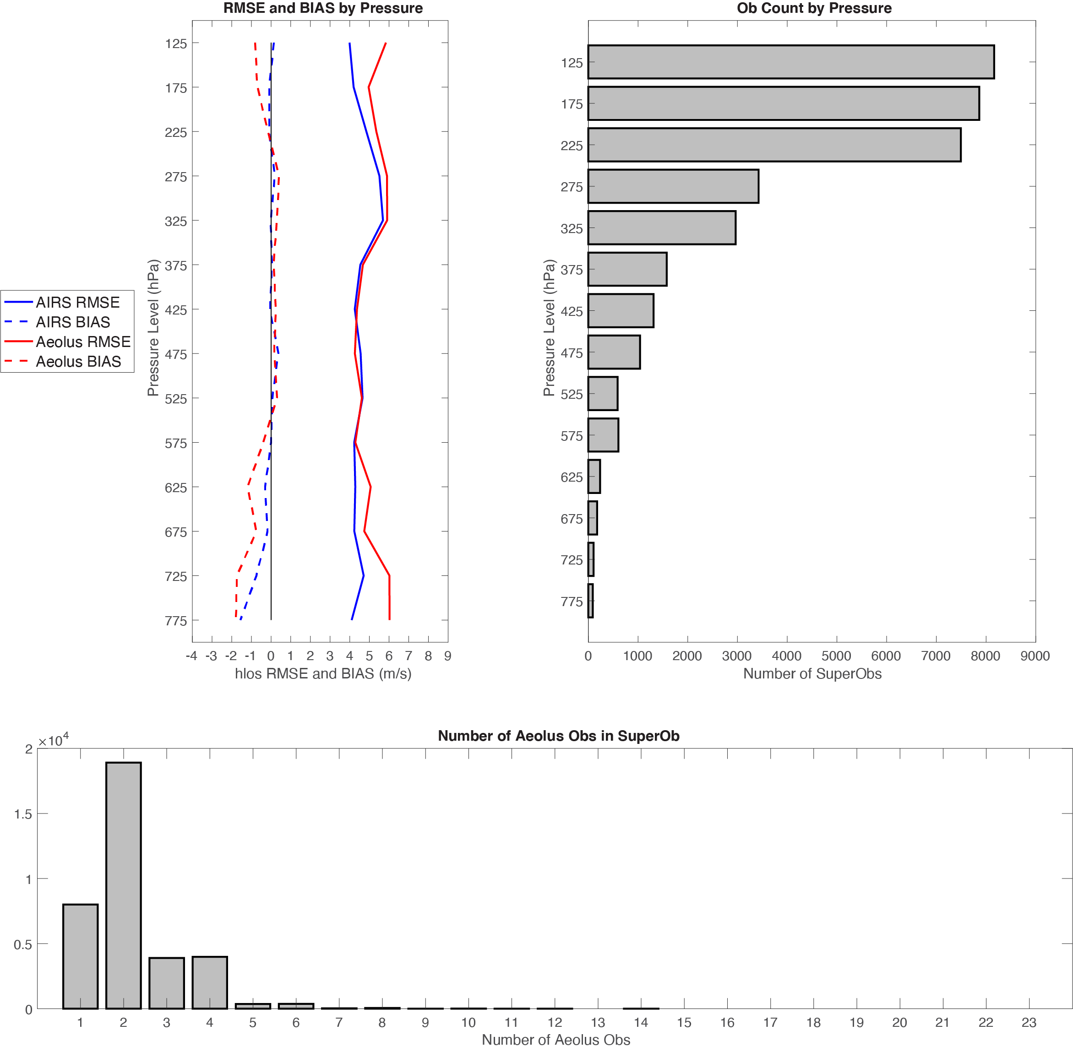
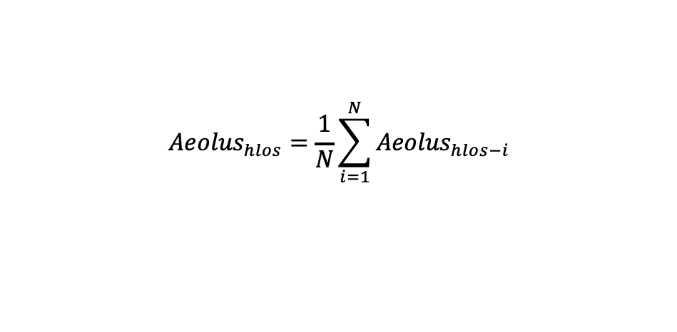
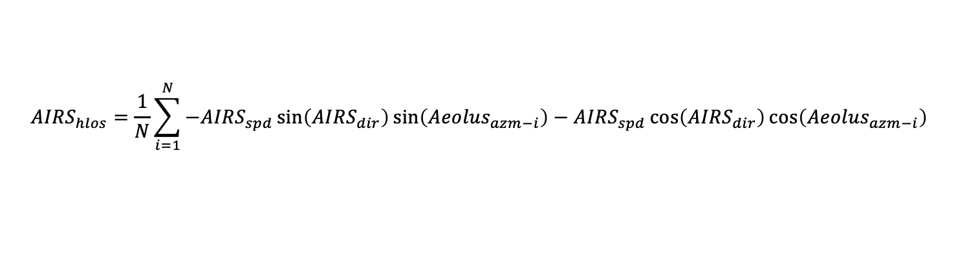
Aeolus Rayleigh vs AIRS 3D Winds
Superob process
Co-located Aeolus matches were averaged:
$${Aeolus}_{hlos}=\frac{1}{N}\sum_{i=1}^{N}{{Aeolus}_{hlos−i}}$$
Each AIRS wind was averaged (using matched Aeolus views), to result in an average HLOS-equivalent AIRS wind:
$${AIRS}_{hlos}=\frac{1}{N}\sum_{i=1}^{N}{−{AIRS}_{spd}\sin\left({AIRS}_{dir}\right)\sin\left({Aeolus}_{azm−i}\right)−{AIRS}_{spd}\cos\left({AIRS}_{dir}\right)\cos\left({Aeolus}_{azm−i}\right)}$$

Slide 12
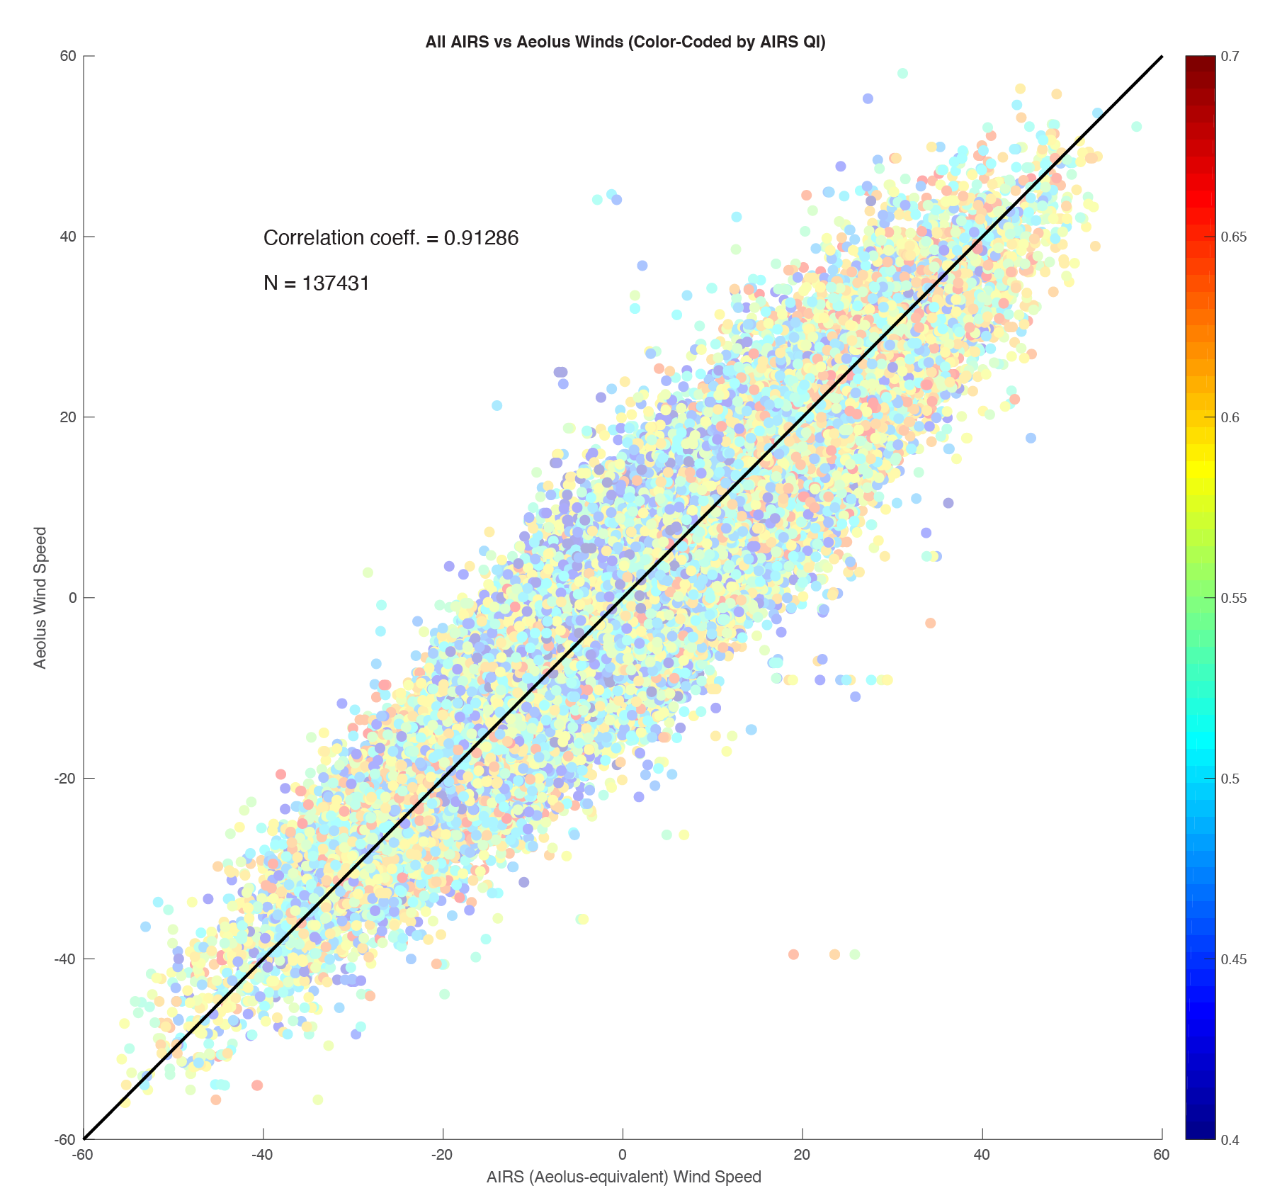
Aeolus Rayleigh vs AIRS
HLOS wind speed (stratosphere and troposphere)
August through September 2019

Slide 13
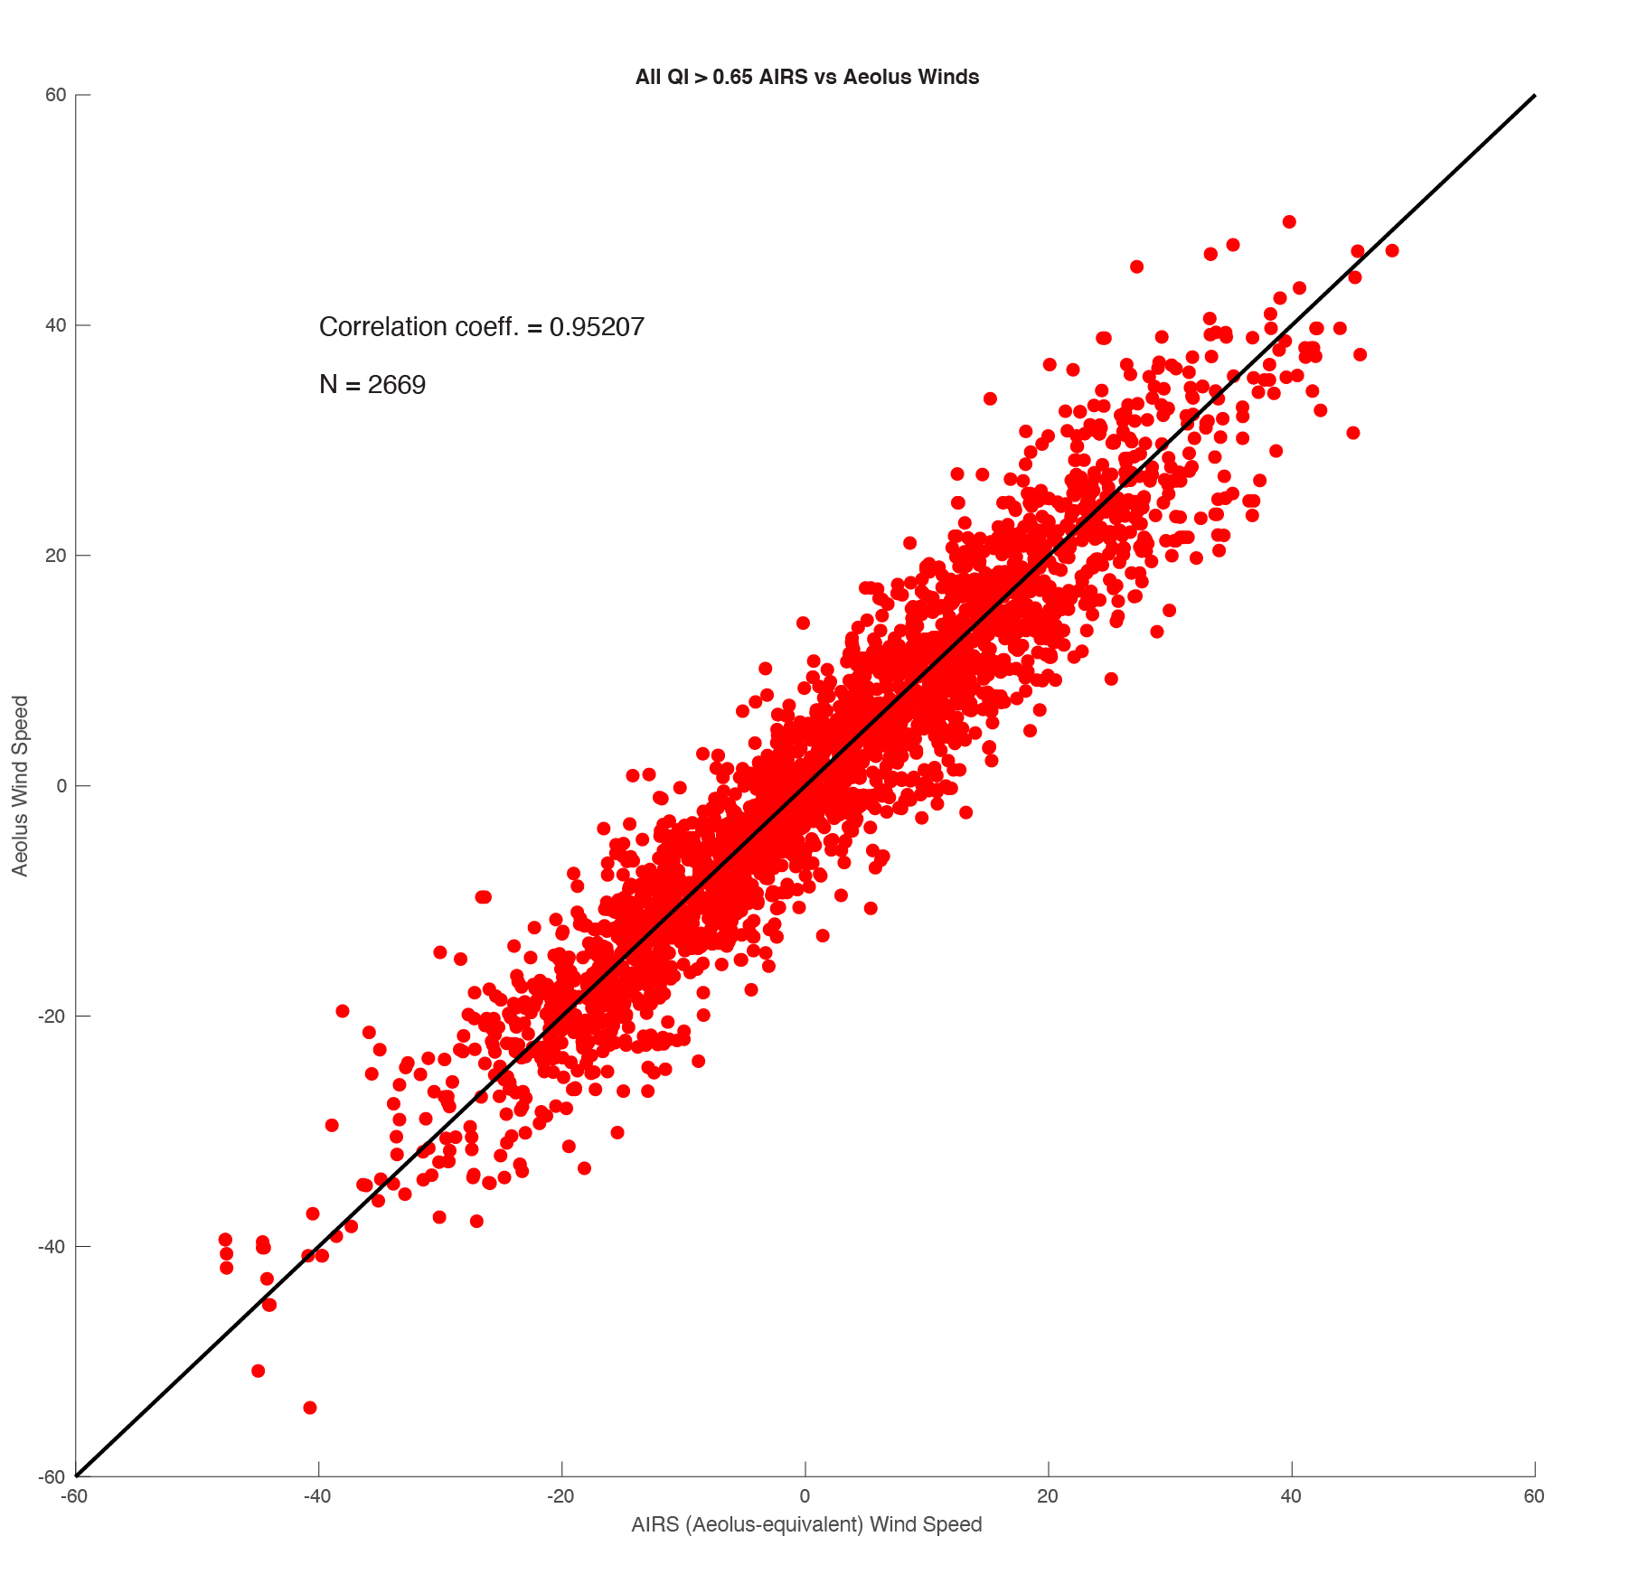
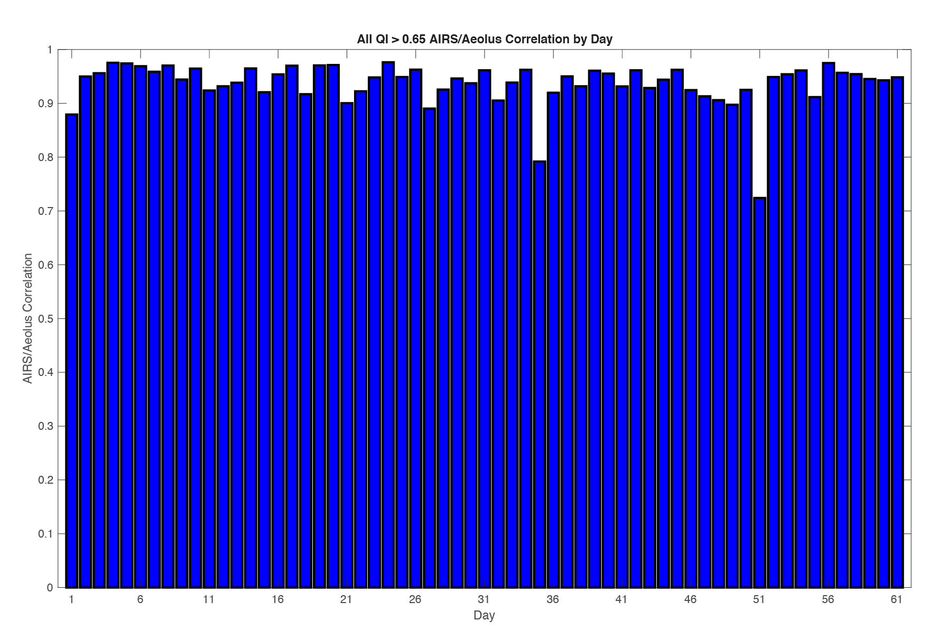
Aeolus Rayleigh vs AIRS
HLOS wind speed: Superob, AIRS QI > 0.65)
Highest quality AIRS winds are in excellent agreement with superobbed Aeolus winds
August through September 2019

Slide 14
Comparisons to RAOBs
Time frame and co-location:
Following slides show Aeolus Rayleigh and AIRS 3D winds compared to RAOBs for August through September 2019
    ESA recommended QC of Aeolus
    Exclude Aeolus winds greater than 60 ms⁻¹
    Only in the polar regions
    Aeolus and AIRS not co-located
Co-location criteria to RAOBs:
    Within 150 km
    +/- 60 minutes
    +/- .04 difference in log10 of pressures (approx. height)
      +/- 60 hPa at 700 hPa
      +/- 20 hPa at 200 hPa

Slide 15
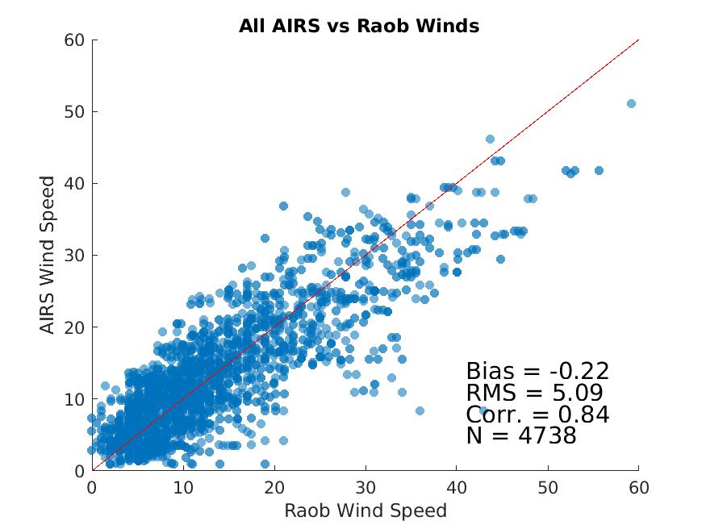
AIRS 3D winds to RAOBs
All AIRS winds (total wind)
August through September 2019

Slide 16
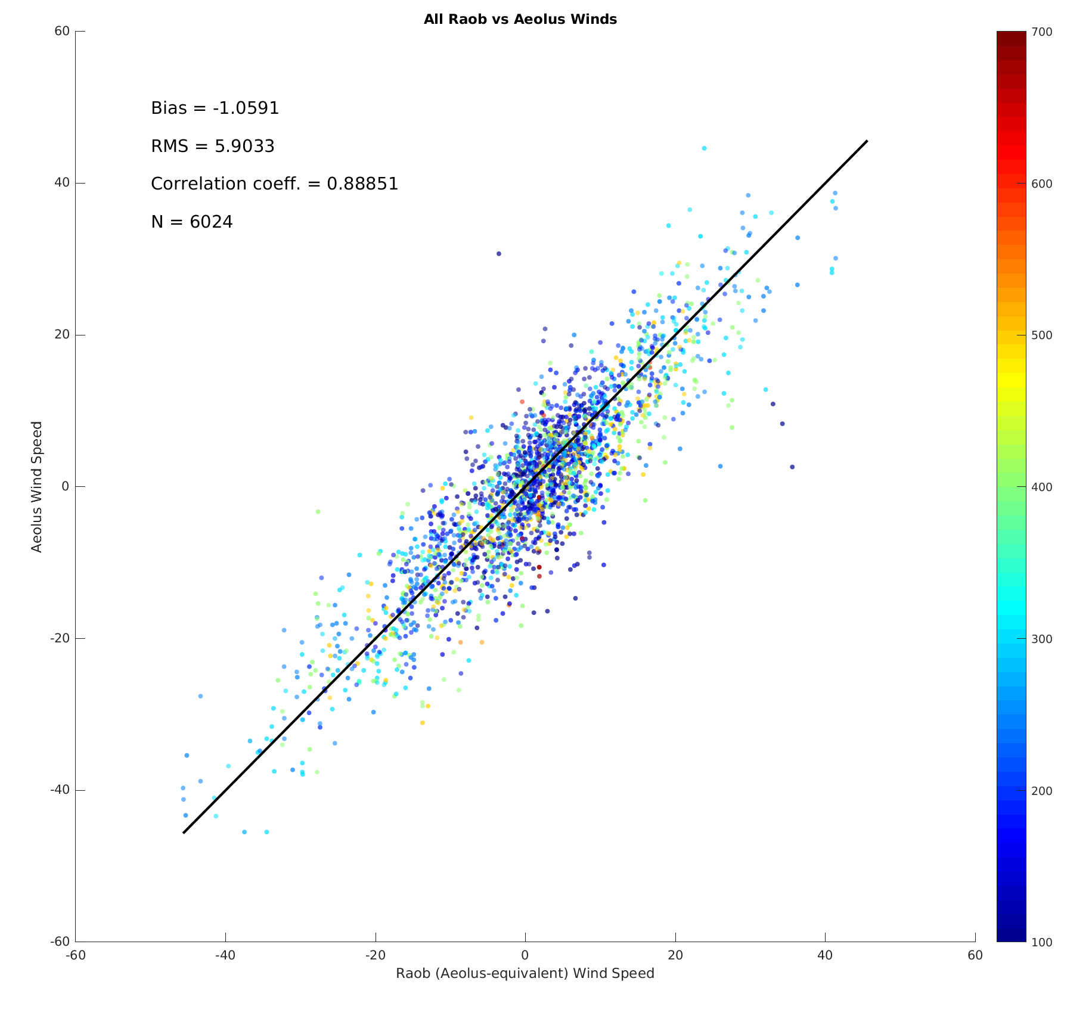
Aeolus Rayleigh vs RAOBs
All Aeolus winds (HLOS wind)
August through September 2019

Slide 17
Comparisons to ERA5
Time frame and co-location:
Co-located Aeolus Rayleigh and AIRS 3D winds compared to ERA5 for 5 days each from August and September 2019
For each hour on those dates:
    Found all AIRS AMVs matching Aeolus winds within +/- 90 min and computed the ERA5 wind at the nearest gridpoint and AIRS AMV pressure level
    Computed the HLOS value of each AIRS/ERA5 wind relative to the azimuth angle of each Aeolus wind that matches a given AIRS/ERA5 wind
    Superobbed the HLOS values for each AIRS/ERA5 wind and superobbed the Aeolus HLOS values
Results in ~35,500 AIRS/Aeolus superobs for comparison to ERA5

Slide 18
Comparisons to ERA5
 | AIRS vs ERA5 | Aeolus vs ERA5
Bias | 0.01 ms⁻¹ | -0.31 ms⁻¹
RMSE | 4.61 ms⁻¹ | 5.37 ms⁻¹
Correlation | 0.94 | 0.92
AIRS has an overall better fit; larger Aeolus bias & RMSE in lower troposphere & the stratosphere (next slide)

Slide 19
Comparisons to ERA5
Aeolus and AIRS winds very similar to ERA5 from 550 to 325 hPa
AIRS compares better to ERA5 in the lower troposphere and in the stratosphere

Slide 20
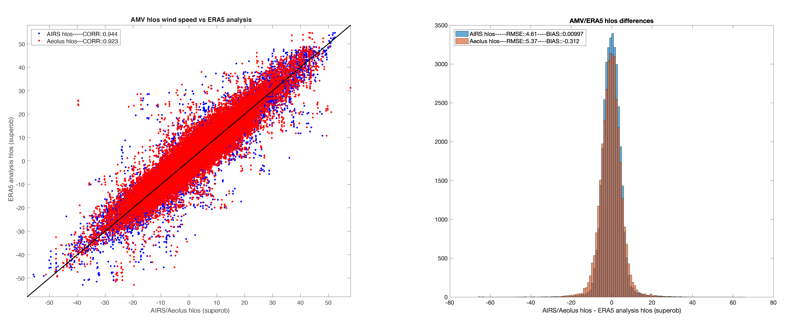
Comparisons to ERA5
Scatter plot of ERA5 vs AIRS/Aeolus
HLOS wind speed
Differences of AIRS and Aeolus to ERA5
HLOS wind speed
AIRS and Aeolus compare very similarly to ERA5

Slide 21
Summary
Since there are several inherent differences in the spatial coverage, temporal sampling, and wind measurement this high correlation indicates these two sources of 3D winds may be complementary, with similar quality.
Aeolus vs AIRS HLOS-equivalent wind speed
This helps to justify a combined mission of a DWL with a hyperspectral IR instrument:
DWL gives high-quality 3D profiles of HLOS winds along a path
Hyperspectral IR will provide potentially similar quality total wind with improved horizontal spatial coverage (reduced vertical resolution). Note: Higher resolution instrument needed on a constellation of small sats.

