Slide 1
McIDAS at the CIMSS
High School Workshop
David Santek, Bob Carp, Jay Heinzelman,
Rick Kohrs, Tommy Jasmin
Cooperative Institute for Meteorological Satellite Studies
Space Science and Engineering Center
University of Wisconsin – Madison
26 June 2024

Slide 2
Outline
Introductions
Weather analysis (early history)
McIDAS through the years
  It’s 50 years old!

Slide 3
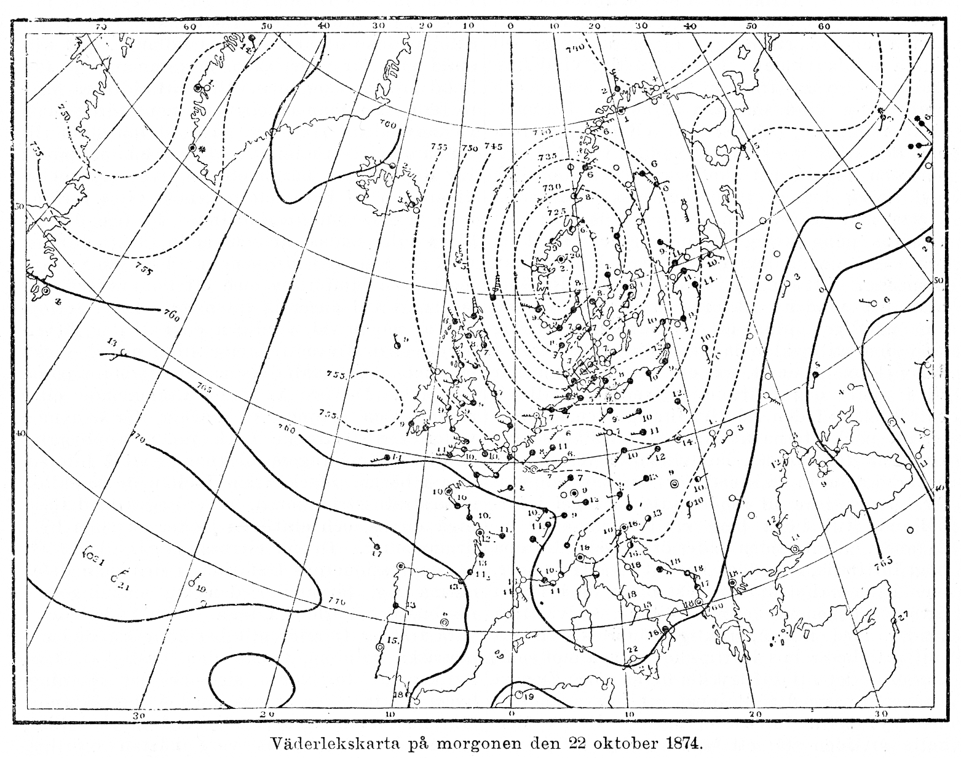
Pre-McIDAS
Meteorological Data Visualization
22 October 1874

Slide 4
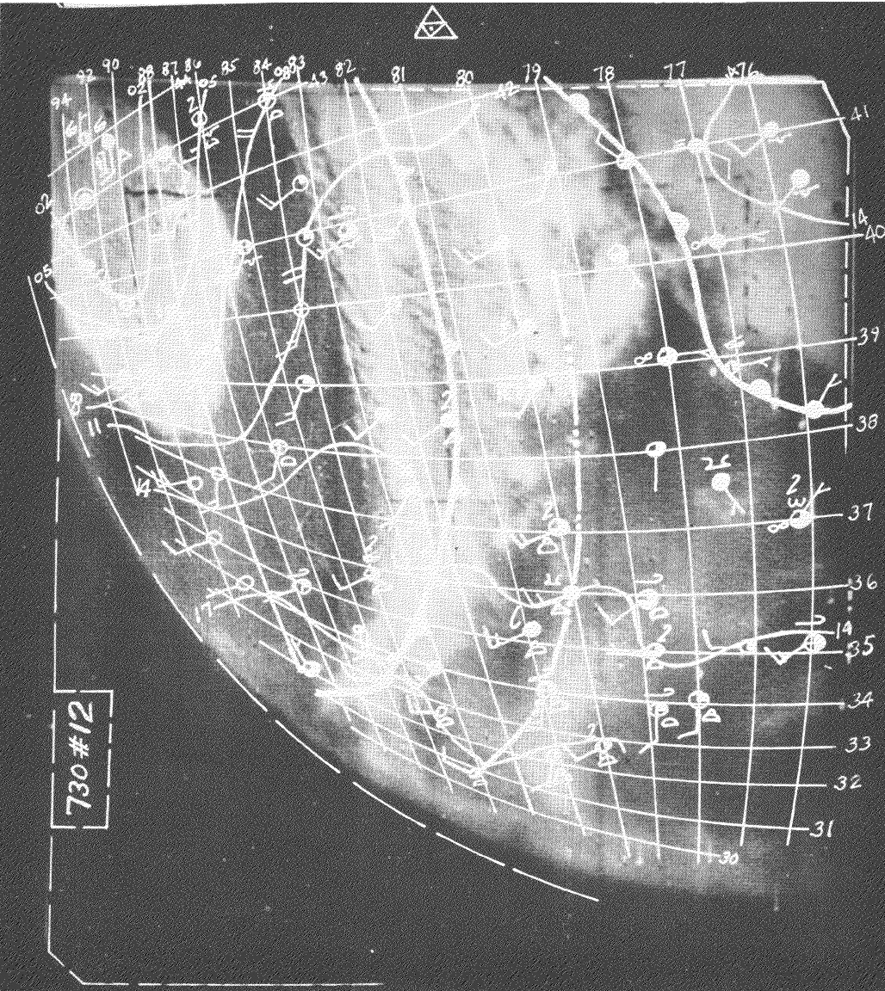
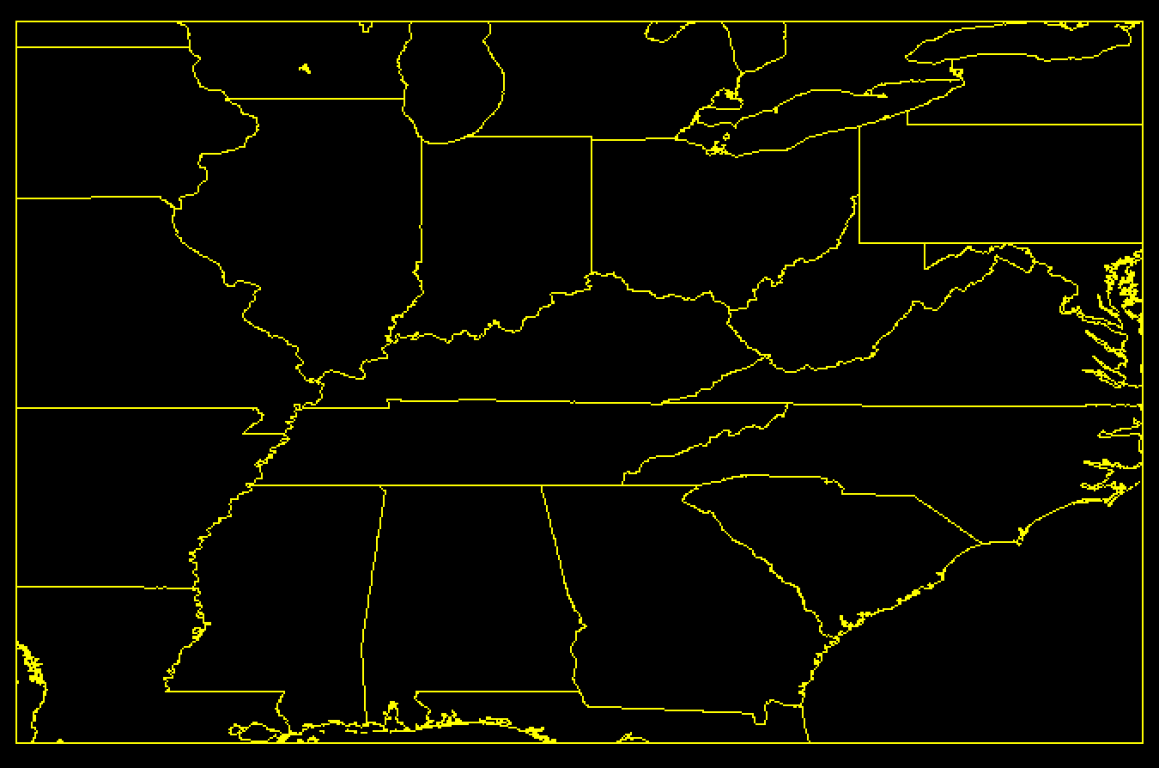
Pre-McIDAS
Satellite Data with Overlays
TIROS-1: 21 May 1960
1817 UTC
With data and latitude/longitude grid
Timchalk and Hubert MWR Nov 1961
Approximate coverage

Slide 5
McIDAS
Man computer Interactive Data Access System
1960s: Prof. Vern Suomi was striving to exploit the geostationary satellites for time-domain information
McIDAS was initially developed with the goal to mass produce cloud drift winds
For the last 50 years, McIDAS has evolved through 5 hardware/software generations as an internationally renowned system

Slide 6
Windco - McIDAS Prototype (1971-1973)
Video disk to animate satellite images based on NFL instant replay technology
Univac
1108
Line
Printer
Raytheon
440
Computer
Analog video disk
Video &
Sync
7-track
200, 556, 800 bpi
Fast Storage
Muirhead
Photofax
Cursor Generator
Signal Mixing
Card
Reader/Punch
Paper Tape
Reader
Paper tape
Punch

Slide 7
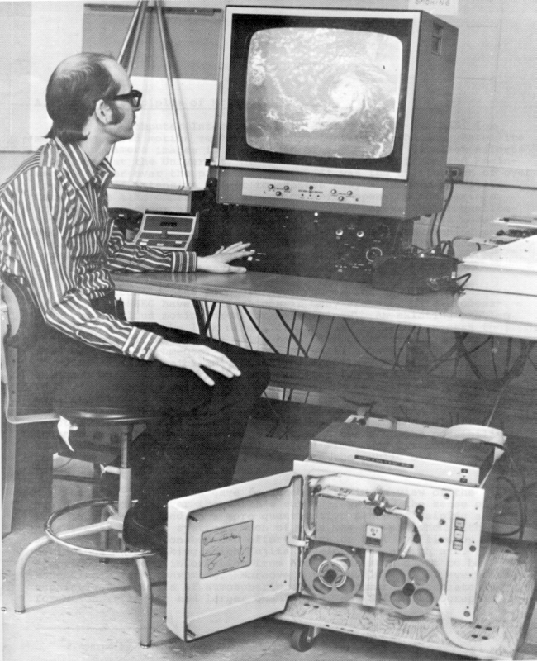
Windco - McIDAS Prototype Workstation (early 1970s)
Manually position cursor to track clouds
Location information sent to paper tape punch
Paper tape walked to computer center to calculate cloud drift wind vectors

Slide 8
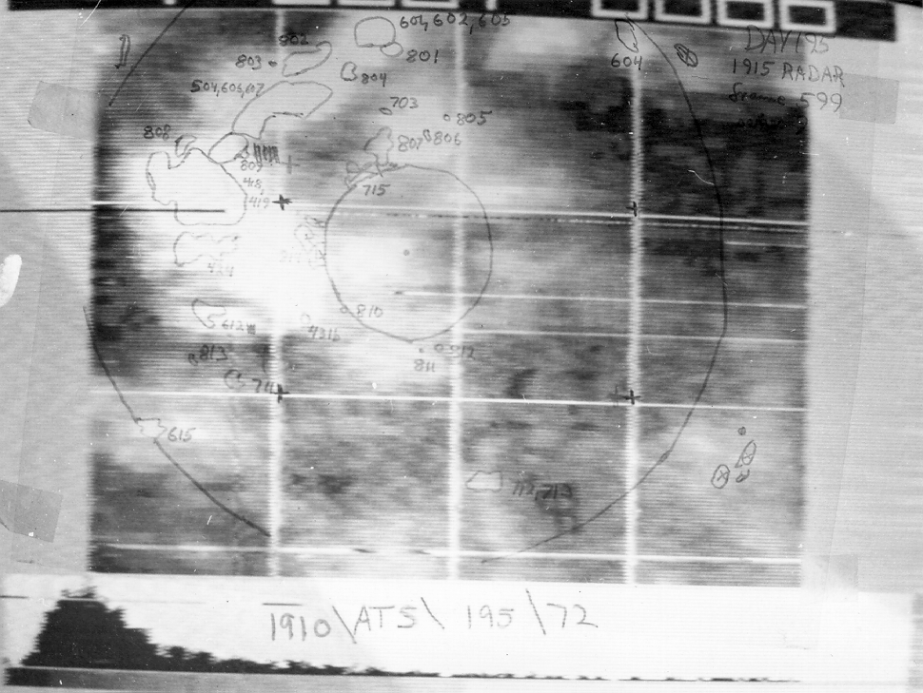
Windco - McIDAS Prototype Satellite Image with Radar ‘overlay’
Hand-drawn radar echoes
Taped on computer monitor!

Slide 9

McIDAS I
(1973 - 1978)
Modified video cassette recorder to archive satellite data on tape
SMS-1
Slant Track Recorder
Analog video disk
Video &
Sync
WBRR
(Radar)
Datacraft
(Harris)
6024/5
Computer
Fast Storage
Cursor Generator
NWS
Service
A & C
Signal Mixing
Blending Control
Enhancement
Tape Drive
Card
Reader
Line
Printer
Disk
5MB

Slide 10
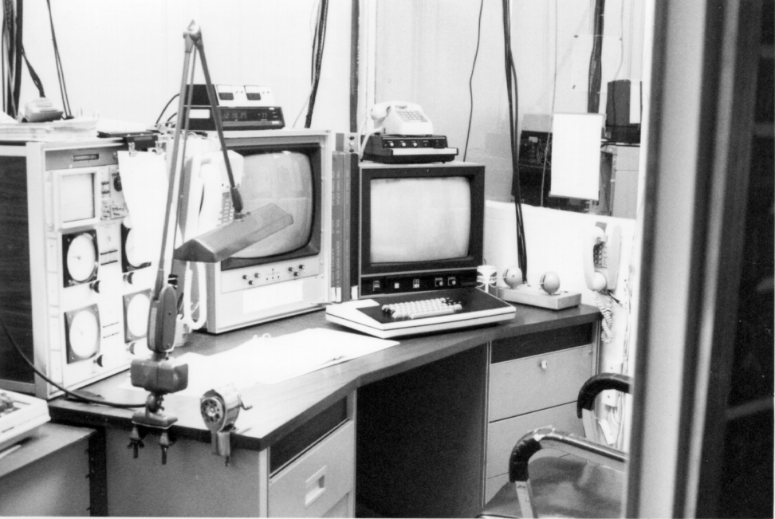
McIDAS I
Terminal (mid-1970s)
Text monitor
Image monitor
Joy stick controlled cursor

Slide 11
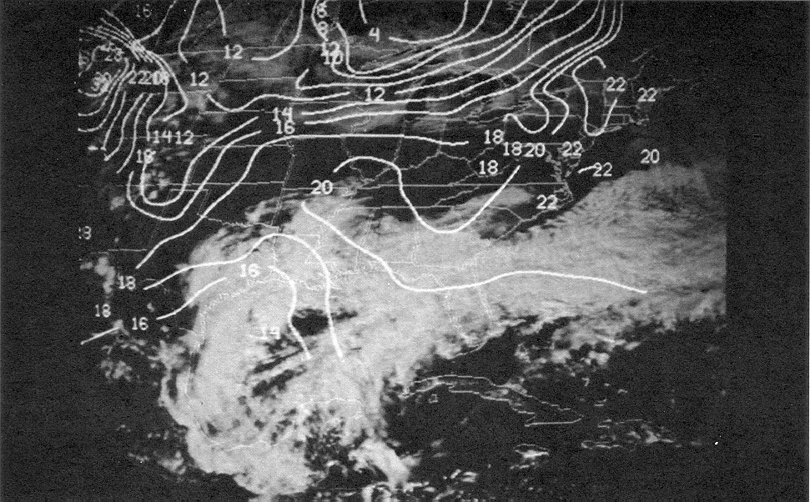
McIDAS I
Satellite Image with Temperature Overlay

Slide 12
Notable Events
12 October 1973: McIDAS was first used in a research project by Dave Martin
1977: McIDAS installed at WTVT in Tampa, FL; an active McIDAS site until 2013!

Slide 13
Spinoff
1979: ColorGraphics formed by Terry Kelly and Dick Daly
  Previously used and developed McIDAS
  Lower cost solution to McIDAS capability
  By 1982, 70% of the top 50 TV markets were using the system
1994: Eventually becomes Weather Central
2012: Now part of The Weather Company (IBM)
  Continues to provide weather data and software to media markets

Slide 14
Oldest Core Code
Circa 1974
FUNCTION RACRAE(IYRDY,IHMS,RAC)
C RACRAE PHILLI 0174 NAV: CONVERTS CELESTIAL ONG TO EARTH LON
C $ FUNCTION RACRAE(IYRDY, IHMS, RAC) (DAS)
C $ CONVERT CONVERT CELESTIAL LONGITUDE TO EARTH LONGITUDE. FN VAL IS
C $ IN REAL*4 DEGREES.
C $ IYRDY = (I) INPUT YEAR AND JULIAN DAY (YYDDD)
C $ IHMS = (I) INPUT TIME (HHMMSS)
C $ RAE = (R) INPUT CELESTIAL LONGITUDE (DEGREES)
C $$ RACRAE = NAVIGATION, CONVERT, LONGITUDE
C
C
DOUBLE PRECISION TIMDIF,RAHA,SOLSID,SHA
SHA=100.26467D0
IRAYD=74001
IRAHMS=0
SOLSID=1.00273791D0
RAHA=RAC-SHA+TIMDIF(IYRDY,IHMS,IRAYD,IRAHMS)*SOLSID/4.0D0
RAE=DMOD(RAHA,360.0D0)
IF(RAE.LT.0.0)RAE=RAE+360.0
RACRAE=RAE
RETURN
END

Slide 15
McIDAS II
(1978 - 1983)
Distributed system: Mom and Dad ingestors/servers
Rex, Abe, etc. shared computers
Local and Remote workstations
GOES-E
VAS
GOES-W
Archive
Playback
WBRR
(Radar)
In situ data
(FAA 604)
Dad
Tape Drive
Tape Drives
Mom
In situ data
(FAA 604)
High Speed
Communications
Lines
(Burn Lines)
NMC
GISS
Wallops CDA
TIROS N
NCAR
Rex
Abe
Ken
Sue
Eva
Liz
GSFC
Terminal - CPU Patch Panel
NSSFC 1
PROFS
UW-MKE
Internal workstations
NSSFC 2

Slide 16
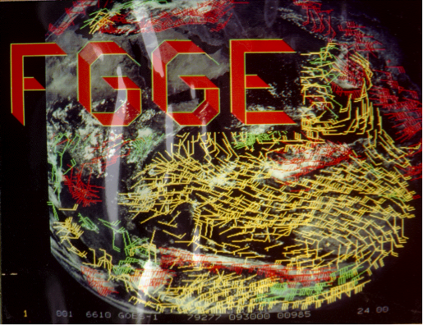
Notable Events
1978: Cloud-drift winds were manually generated from five geostationary satellites for a year as part of the First GARP Global Experiment (FGGE)

Slide 17
Notable Events
1979: Congressional delegation visited SSEC to learn about advances in severe storm forecasting in wake of tornadoes in Wichita Falls, TX
1982: McIDAS installed at NSSFC to aid in severe weather forecasting.
  Named the Centralized Storm Information System (CSIS)
  Mesoscale Discussions began in 1986, partly due to the availability of timely analyses on CSIS

Slide 18
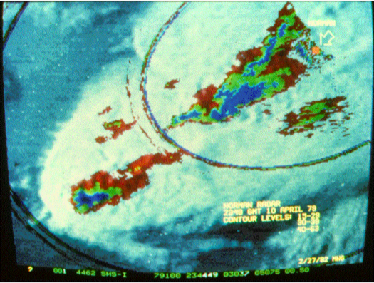
McIDAS II
Satellite and Radar Composite
Wichita Falls, Texas tornado
10 April 1979

Slide 19
McIDAS III
(1983 - 1996)
Archive
Playback
NMC
Centralized System: IBM 4381 ingestor/server
Local and Remote workstations
GOES-E
VAS
GOES-W
ABE
Remote
CPUs
In situ
data
Lightning
MSFC
Terminal
controller
IBM
4381
Computer
Radar
NMC
Programmer
terminals
(32)
Remote
comm
interface
CCFF
5.7
GB
Hughes
NSSFC
LAN
interface
MKE
NHC
SUNYA
NESDIS

Slide 20
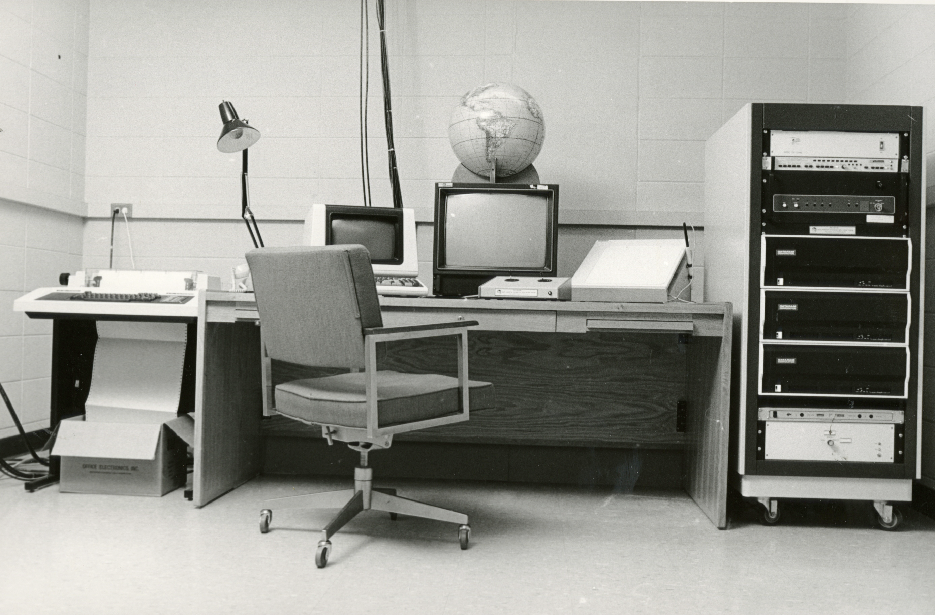
McIDAS III
Workstation (1984)
RAM for storing workstation image frames

Slide 21
Notable Events
1982: McIDAS ported to IBM mainframe; funded by then Peoples Republic of China
1982: Interactive Flash Flood Analyzer (IFFA) based on McIDAS installed at NOAA
1986: Unidata (NSF funded) provides satellite data and support to the educational community
mid-1980s: McIDAS installed at Cape Canaveral and Johnson Space Center in support of the space shuttle
1989: McIDAS Users’ Group formed

Slide 22
McIDAS-X and McIDAS-V Sites
Past and Present
NOAA –AWC, SPC, NHC, STAR, CLASS, NCO
Education – Universities via Unidata
Government – NTSB, PAFB, NASA
International – EUMETSAT, Weather Services of: Spain, Greece, Mexico, Australia
Industry – Honeywell, Weathernews, Universal Weather, Weather Central, Boeing, FedEx
And, many other sites worldwide that use McIDAS-V for research, operations, and education (including You!)

Slide 23
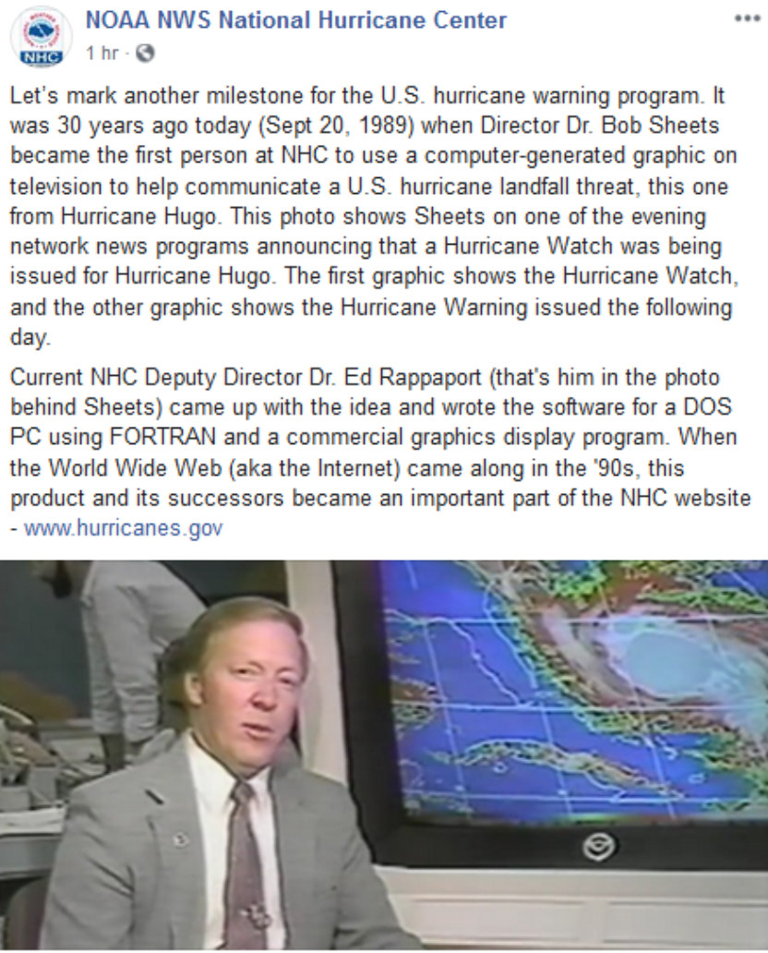
Notable Events
Late-1980s: Installed at National Hurricane Center (NHC)
Very likely a McIDAS-generated image because of color enhancement and frame annotation

Slide 24
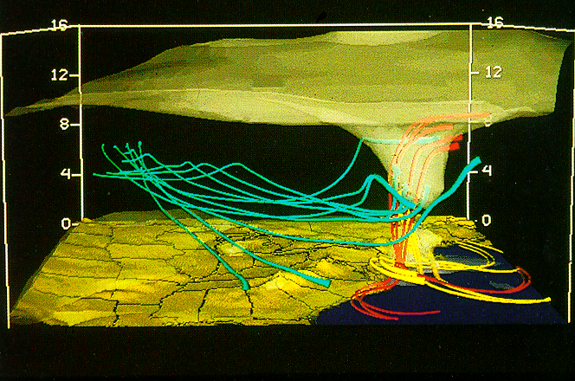
McIDAS III
Mainframe 3D Visualization
Model output of pressure surface and trajectories, over topographic map
Animation took many hours to produce
Bill Hibbard in collaboration with Louis Uccellini
Presidents’ Day Storm: 19 Feb 1979

Slide 25
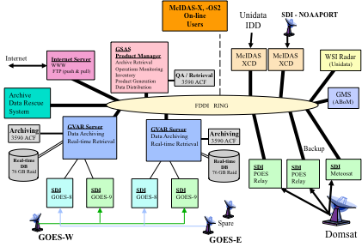
McIDAS IV
(1996 – 2000s)
Distributed System: Unix workstation ingestors/servers

Slide 26
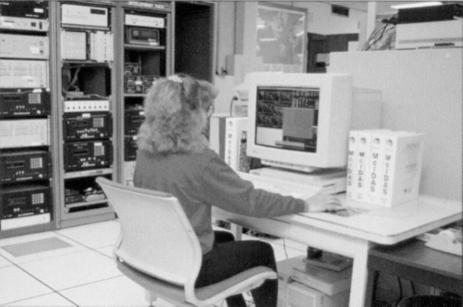
McIDAS IV
Workstation (mid-1990s)

Slide 27
Notable Events
1992: McIDAS ported from IBM mainframe to Unix-based system: McIDAS-X
1994: Provided GOES data to NWS forecast offices for 7 years prior to AWIPS deployment
mid-1990s: Developed an efficient client/server system, that is still in use today

Slide 28
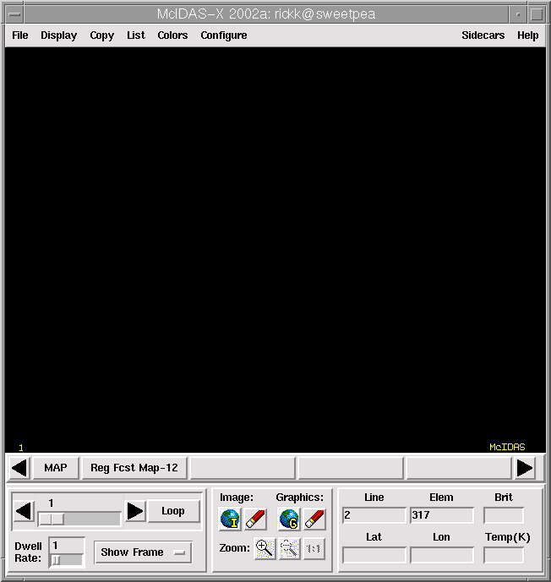
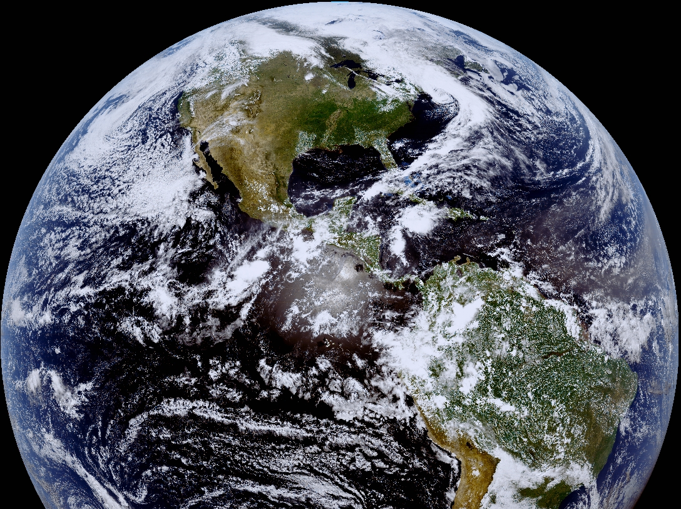
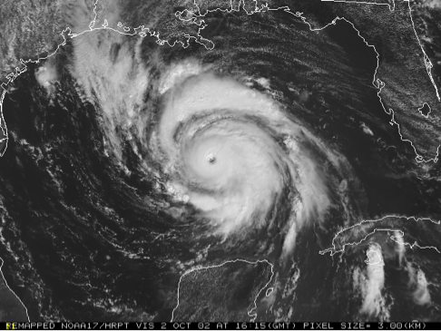
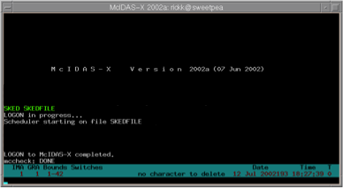
McIDAS-X
2000s
Interactive
Product generation
Extensive scripting

Slide 29
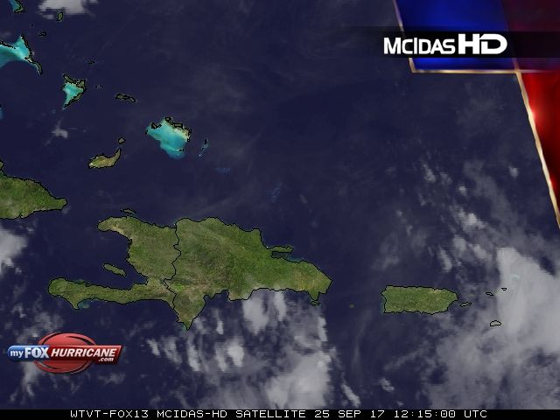
WTVT: McIDAS HD

Slide 30
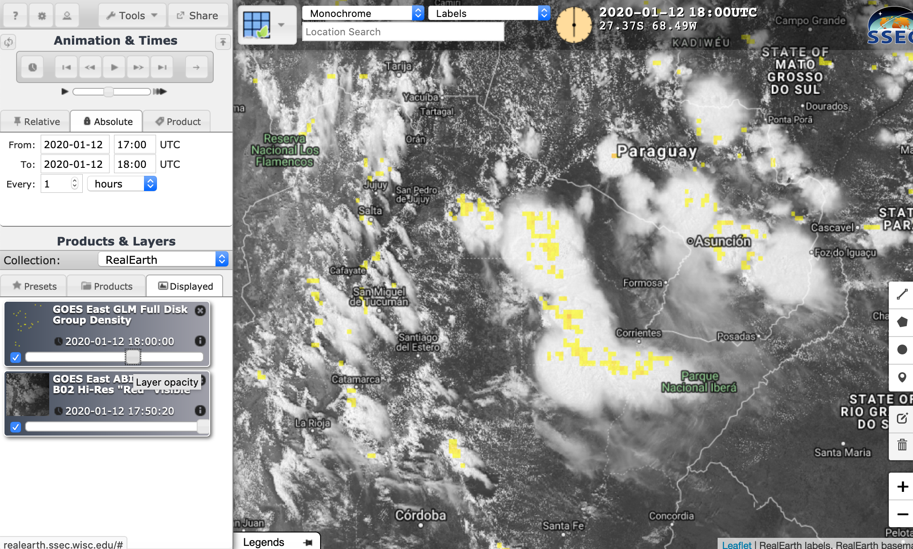
SSEC: RealEarth
realearth.ssec.wisc.edu

Slide 31
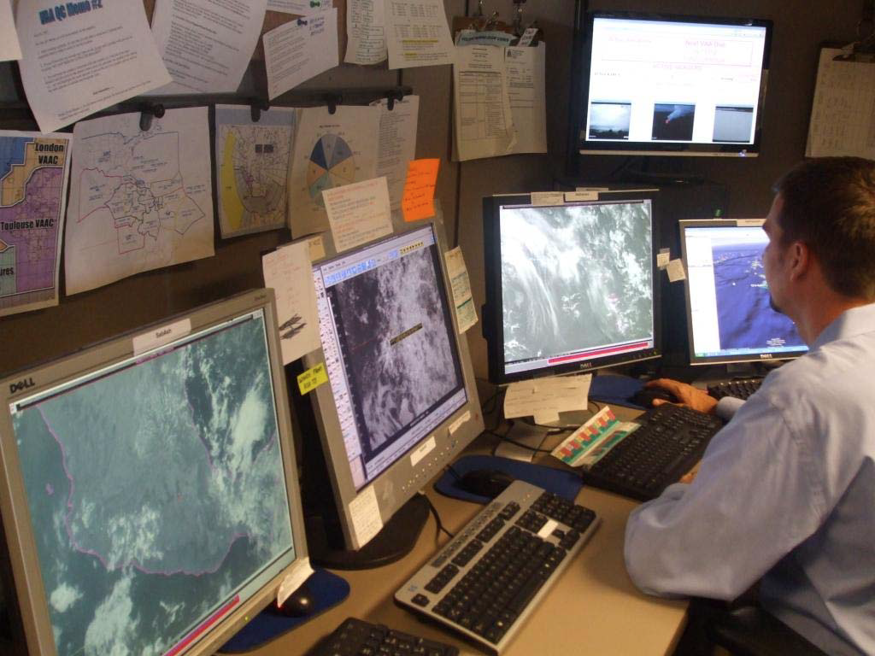
McIDAS:
NOAA
Meteorologist using data generated by McIDAS-X

Slide 32
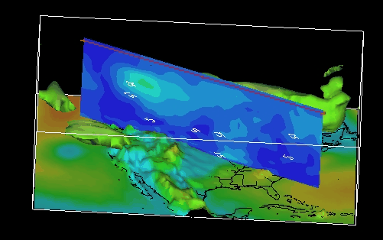
McIDAS-V
Open Source
Java-based
3D Interactivity
Demo to follow

Slide 33
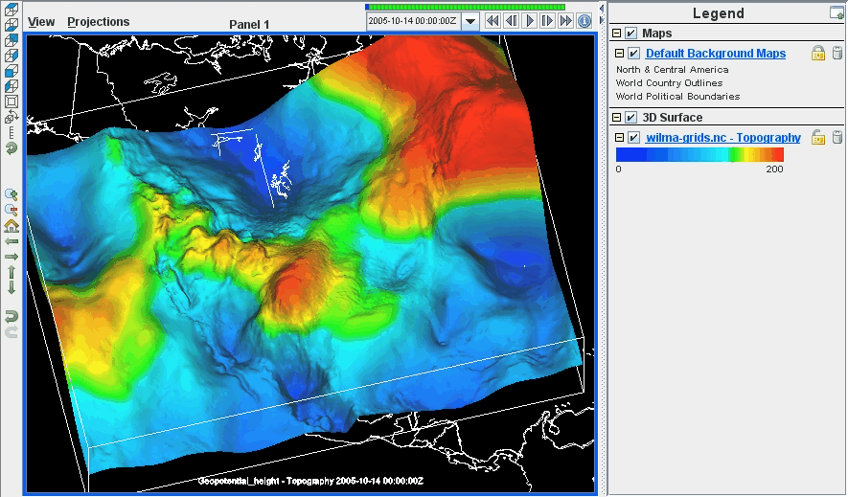
Hurricane Wilma intensity

Slide 34
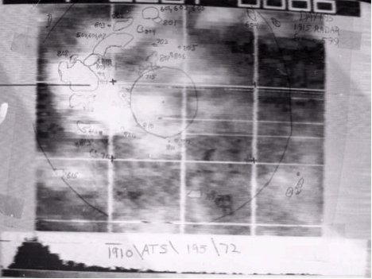
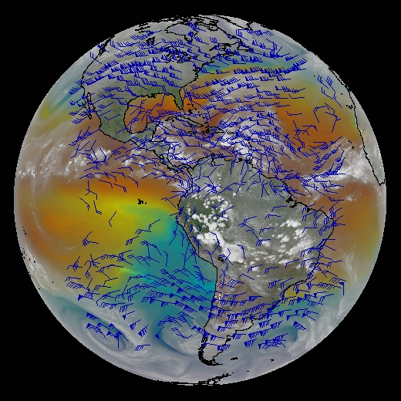
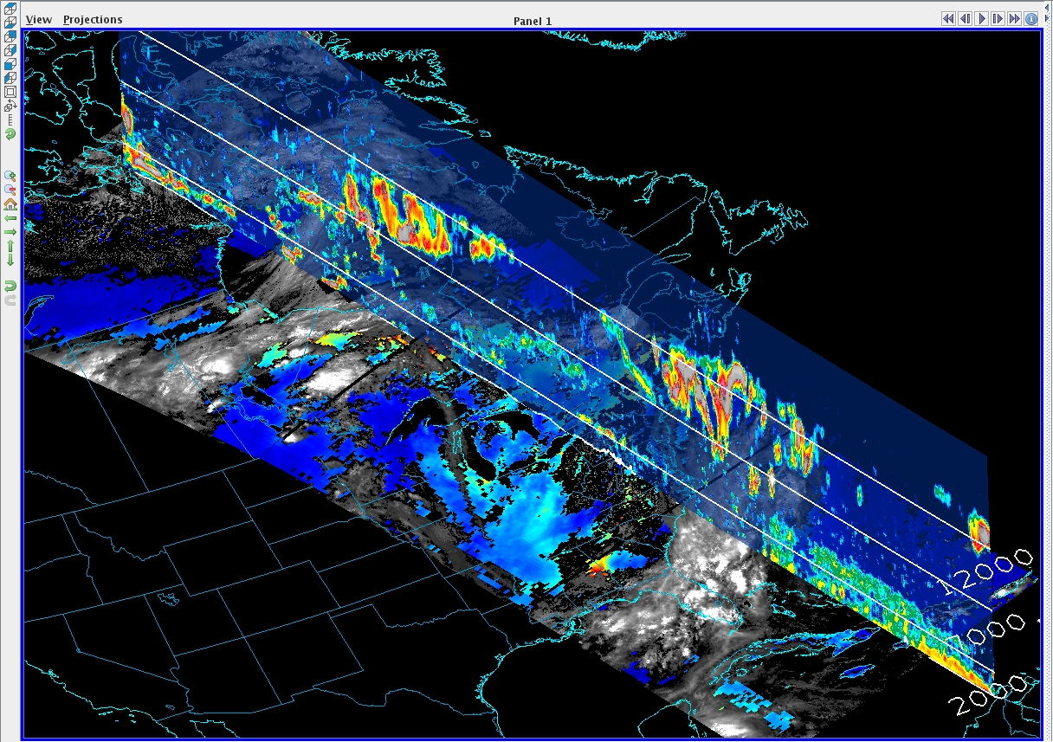
McIDAS 50th Anniversary
October 2023
McIDAS may be the oldest, continually used, and supported software package in existence anywhere.
Expected to be in use and supported a decade from now!

