Slide 1
McIDAS Program Status
David Santek
2023 McIDAS Users’ Group Meeting
25 September 2023

Slide 2
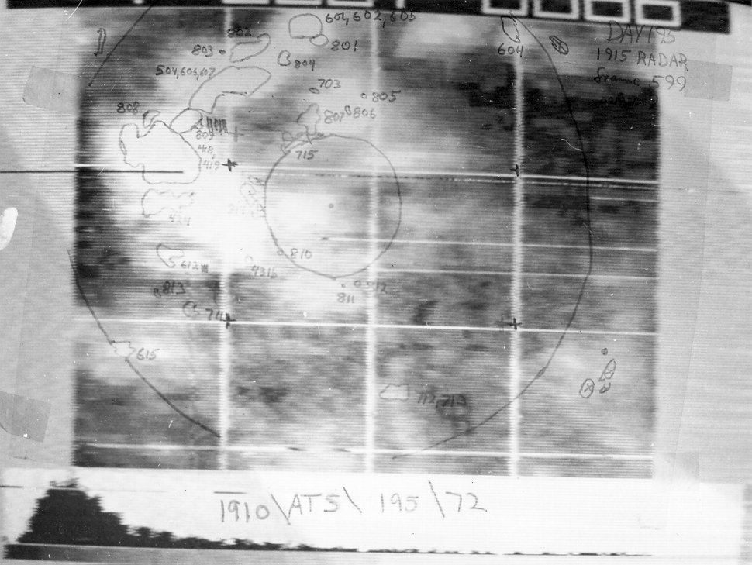
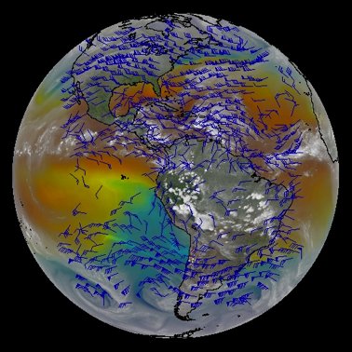
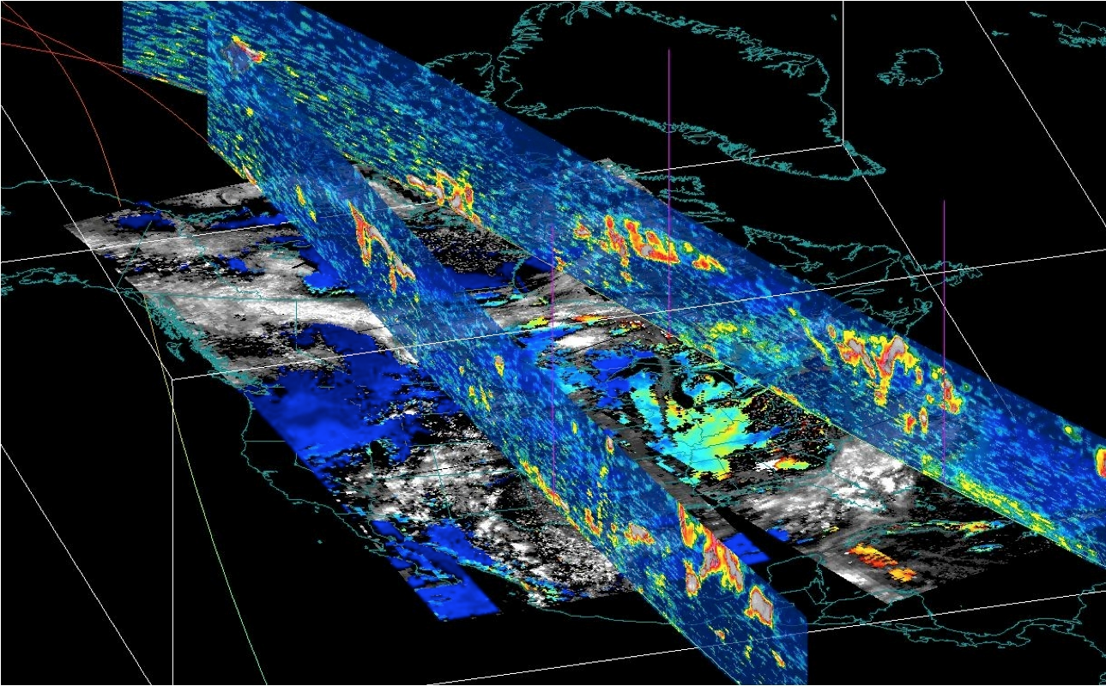
McIDAS Status
McIDAS-X
McIDAS-XCD
McIDAS-XRD
McIDAS-V
SSEC Data Ingestor (SDI)

Slide 3
McIDAS-X Current
Periodic updates (1-2 times per year)
Improvements to display
More channel combination tools (RGB)
Product enhancements
Capability with newest and future satellites:
GOES-R ABI and GLM (more metadata and product access)
S-NPP, NOAA-20, -21 VIIRS ADDE server (SDR, EDR)
Upcoming Meteosat Third Generation (MTG)

Slide 4
ADDE Servers
Implementing Python-based ADDE servers
Easier for others to write servers
First new servers based on Satpy which has readers for many different types of satellite data
Will be compatible with McIDAS-X and –V
More details tomorrow: Python ADDE Project

Slide 5
McIDAS-X Future
MUG responsible for general improvements, bug fixes, maintenance (updates for current and new satellites), and OS and external library updates
Considering current Korean satellite GEO-KOMPSAT-2
Thinking toward Metop-SG (Second Generation), which is the replacement for the current Metop series
Unique enhancements continue to be funded outside the MUG and code contributed by internal projects and external sites
McIDAS-X is expected to be supported into the 2030s for the GOES-R series satellites. No sunset date in sight.

Slide 6
McIDAS-XCD Conventional Data
Ingest conventional weather data from NOAAPORT
Current version to be supported for at least another year
Beta of new version will be available in late 2023
Currently being tested in parallel with XCD 2022.1
More information in McIDAS-XCD Status and Demonstration

Slide 7
McIDAS-XRD Research and Development
A collection of R&D code that is not formally tested by McIDAS User Services:
Over 100 McIDAS commands
Over 15 ADDE servers
Testing is limited to ensuring code builds on supported platforms
Occasionally promote to core
Status: Current support level continues
Future: Coincides with McIDAS-X future
Past: Little known fact: McIDAS-XRD has heritage back to the….

Slide 8
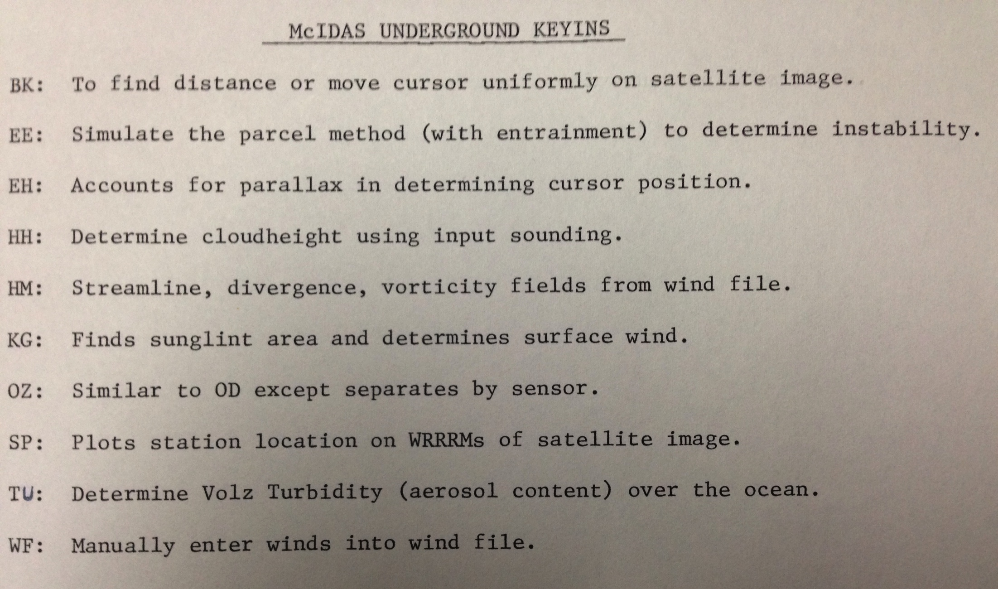
McIDAS Underground Software
(circa 1980)

Slide 9
SDI SSEC Data Ingestor
SDI (SSEC Desktop Ingestor) 1997 - 2005
SDI-104 (SSEC Data Ingestor) 2005 – ?
SDI-GRB Appliance 2016 - ?
Status: SDI-GRB fully supported; SDI-104 limited support
Future:
SDI-104: Limited support as long as GOES GVAR satellites are operational or backup
SDI-GRB Appliance: throughout the GOES-R era

Slide 10
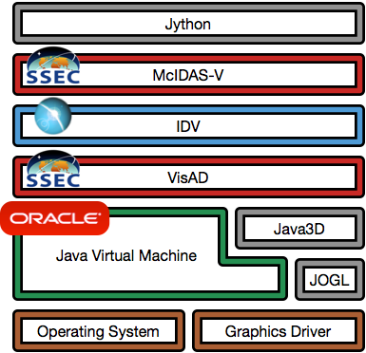
McIDAS-V Status
Major components by Unidata, SSEC, OpenJDK, open source community
Additional components include file format libraries, math libraries, packaging and build utilities; all open source
OS vendors Linux,Windows, Mac
Hardware drivers from manufacturers
OpenJDK
Notes:
who maintains VisAD?primarily Rink, Whittaker, Don Murray
https://github.com/visad/visad/graphs/contributors

Slide 11
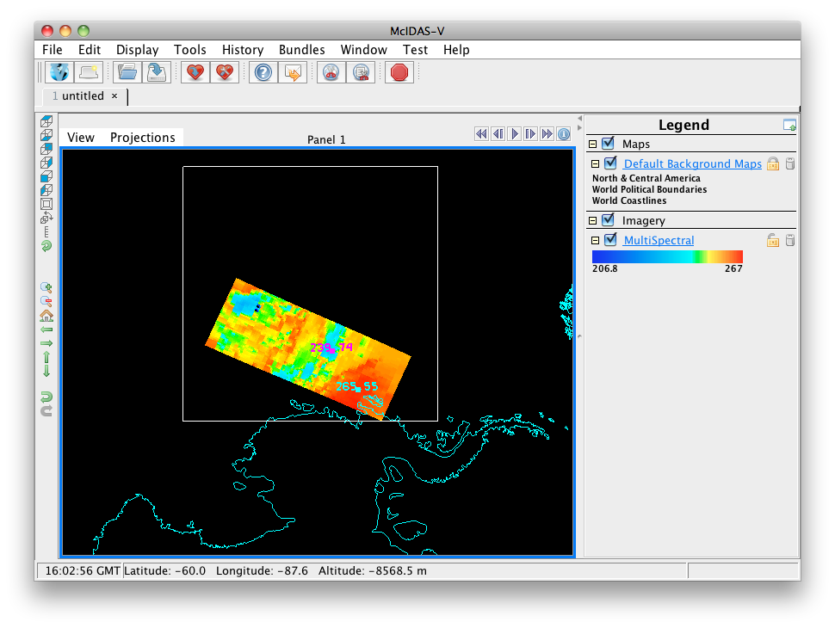
McIDAS-V Funding
MUG
CIMSS grant from VIIRS Imagery Team
On the watch for other proposal opportunities (e.g., NASA)

Slide 12
McIDAS-V MUG Support
User-level Infrastructure: User Interface, Scripting
Bug fixes: Prioritize, coordinate internally and with Unidata
Testing
Documentation: Includes maintaining tutorials
Help Desk: Includes maintaining forums

Slide 13
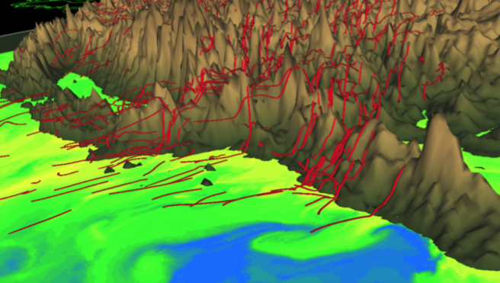
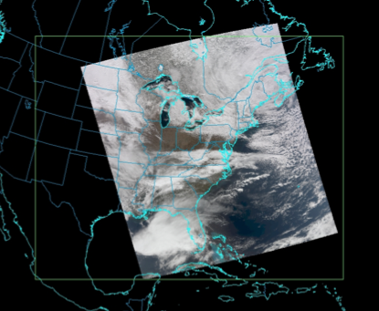
McIDAS-V CIMSS Grants
Improvements for trajectories (terrain-following)
Handle S-NPP granules that span dateline
Scripts to create VIIRS RGB images
TROPOMI sensor support

Slide 14
McIDAS-V Priorities
Fix Critical and Quick bugs (MUG, Unidata)
Incorporate enhancements from CIMSS projects, especially those that are not possible in McIDAS-X (CIMSS, MUG)
Ensure new data sources are usable (MUG, CIMSS)
Geo and Leo missions
Test with new data in standard formats (netCDF, HDF, BUFR, GRIB)
Maintain compatibility with Unidata’s IDV (Unidata, MUG)

Slide 15
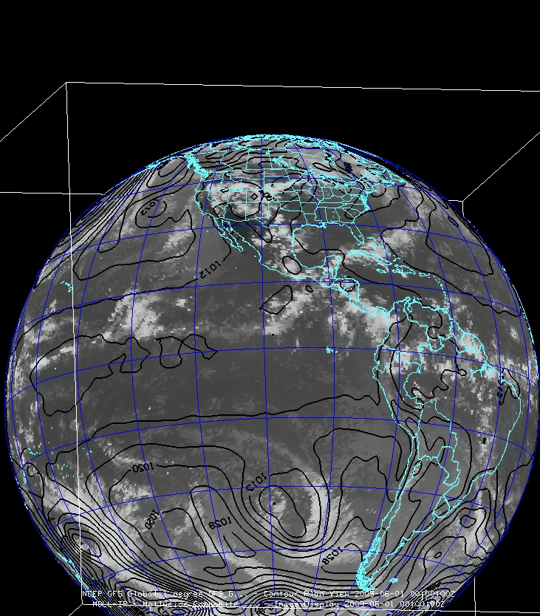
McIDAS-V Future
Continue to engage new researchers:
Workshops and training
Classroom
Appeal to researchers:
Input/output data formats
Scripting
More data fusion
Distributed as a signed application
Compliance with ever-changing OS security standards

