Slide 1
Pamela & Greg,
Here’s 2nd version of equivalent McIDAS-X generated displays. This shows the flexibility in being able to make the displays look very similar. These are one-to-one replacements from the powerpoint you sent. There are also some additional slides showing other features of the software. All spatial graphics can also be drawn over satellite, radar, etc. These examples are over a blank base map.
In the Notes I have begun to add the McIDAS-X commands used to generate, although they may not be the exact syntax nor options used for the final pictures.
Documentation for the commands:
http://www.ssec.wisc.edu/mcidas/doc/users_guide.html
Other examples are found here:
http://www.ssec.wisc.edu/data/composites.html
Dave

Slide 2
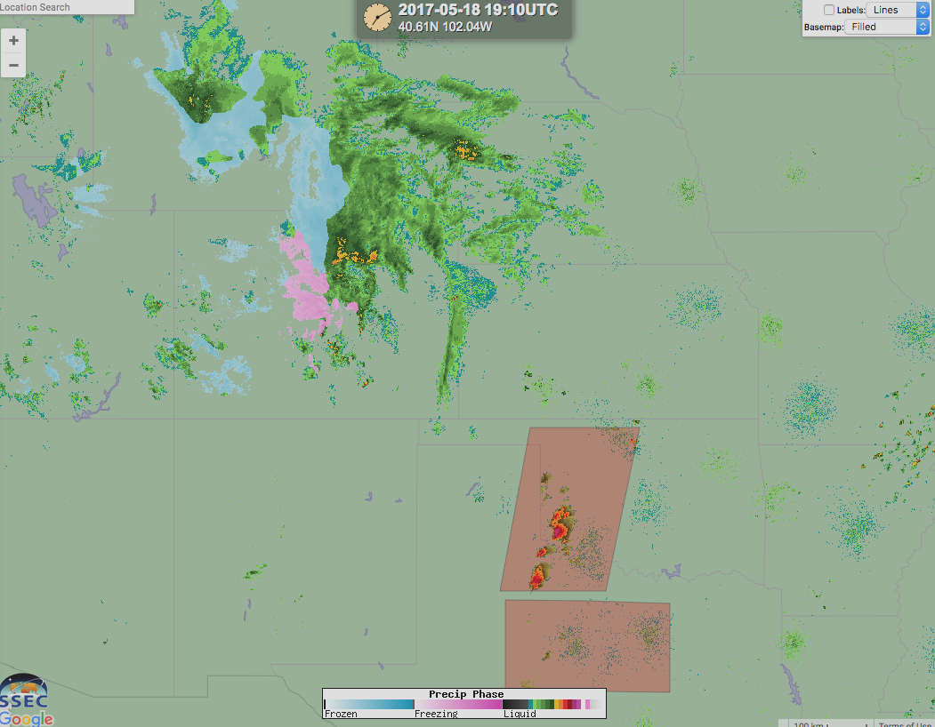
Generated by McIDAS-X; viewed in RealEarth

Slide 3
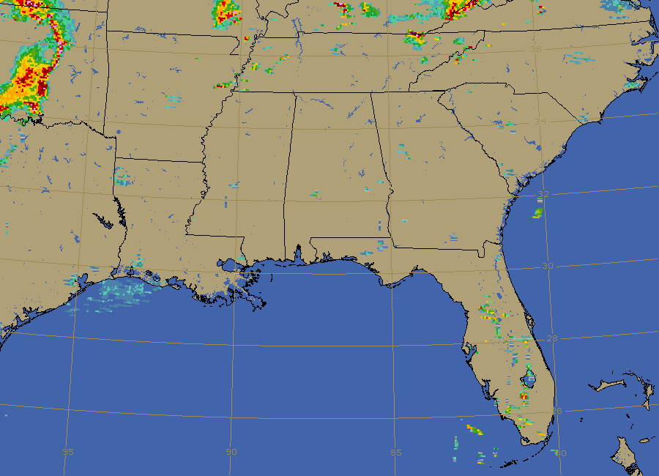
SE Regional Radar
Notes:
IMGREMAP BASEMAP/LSMASK A/A.11 SIZE=650 900 RES=2.25 PRO=TANC LATLON=31 87
IMGOPER A/A.12 A/A.14 SIZE=ALL LLMT=90
IMGDISP A/A.14
IMGFILT A/A.14 A/A.15 FILT=CLEAN SCALE=0 255 0 255 SIZE=ALL
IMGOPER A/A.11 A/A.15 A/A.16 SIZE=ALL FORM=MAX ZERO=DATA
IMGDISP A/A.16 TEXT=X X X NO
IMGDISP A/A.11 TEXT=X X X NO;EG;MAP X 1 LALO 2 LINE=1 650 ELE=1 900
EU REST WSR-BREF
EU MAKE 4 5 120 120 160 160 175 175
EU MAKE 7 8 170 170 100 100 65 65
GU MAKE 1 BLACK
GU MAKE 2 82 137 160
GU MAKE 4 82 137 160
GU MAKE 5 82 137 160

Slide 4
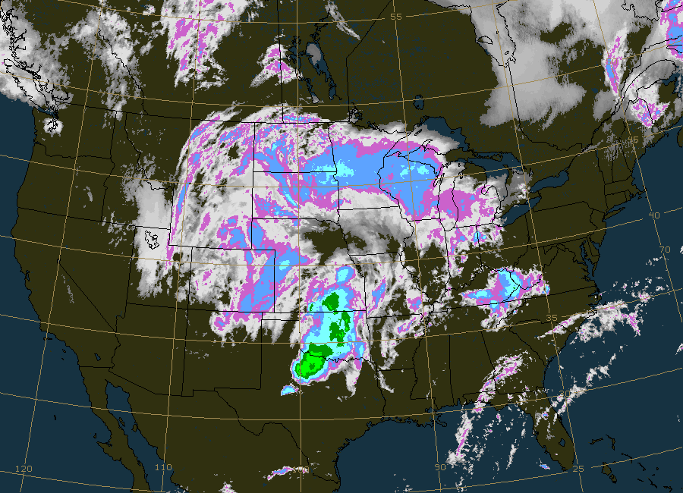

Slide 5
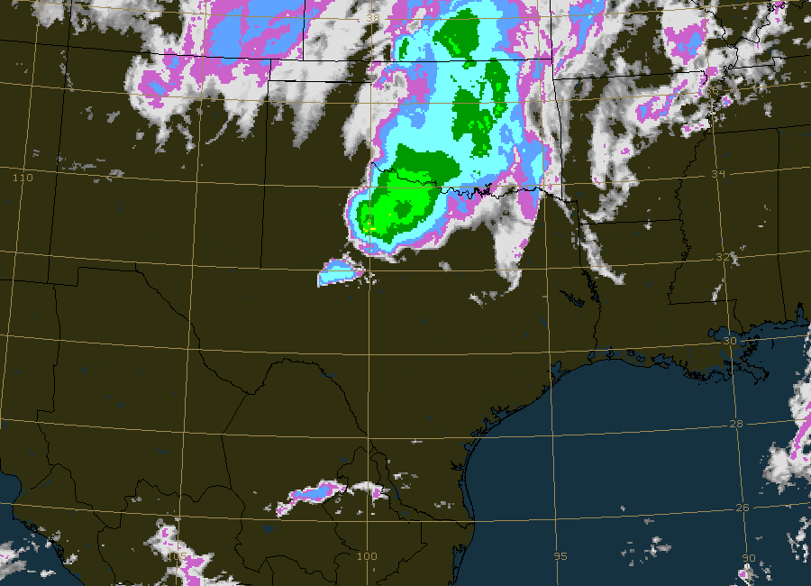
South Central Regional IR Satellite

Slide 6
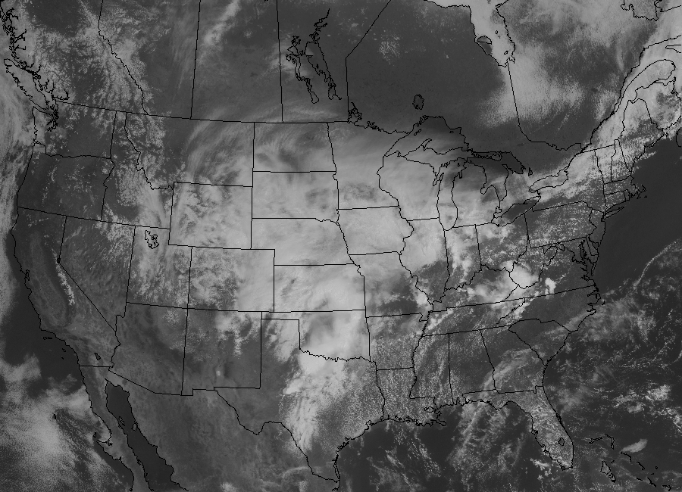

Slide 7
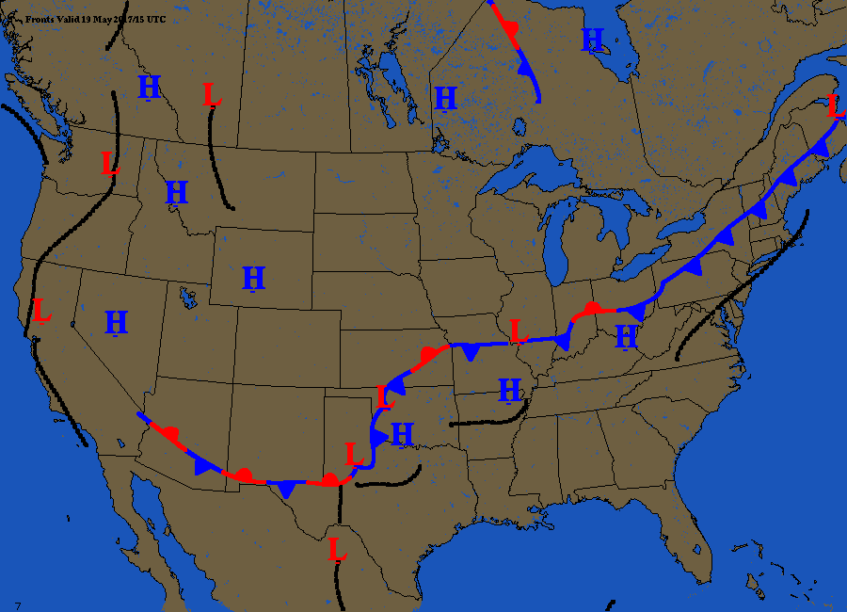
Fronts

Slide 8
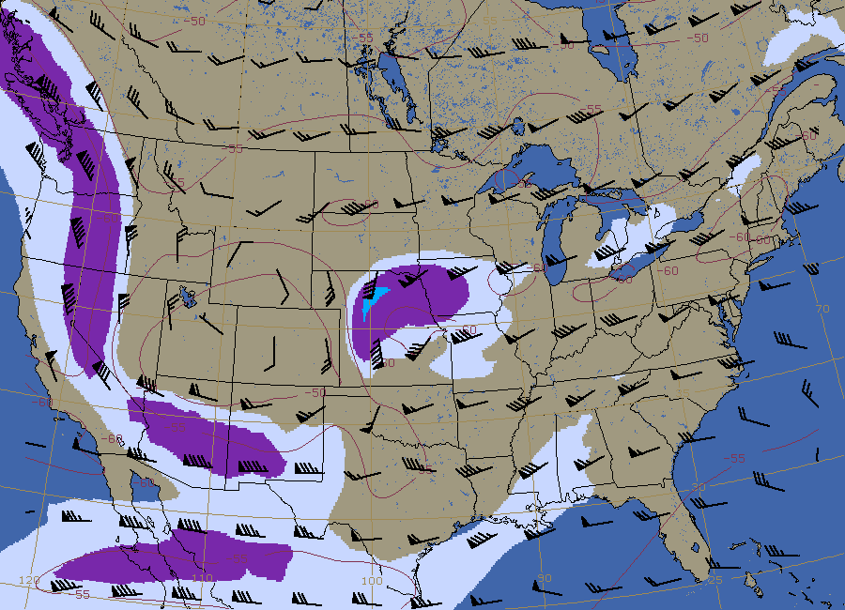
Winds Aloft – Winds from GFS. We can do any forecast time and level. This is 200 mb level.

Slide 9
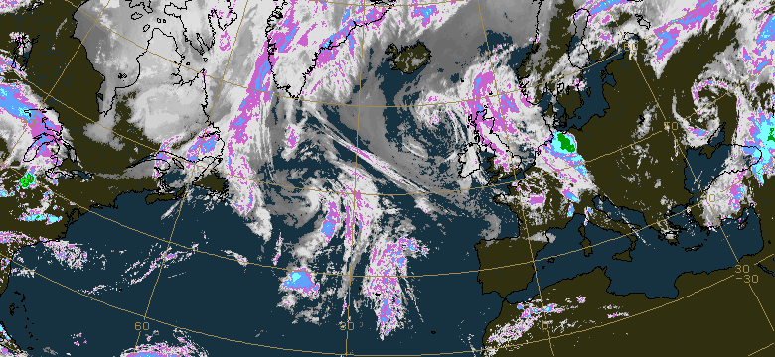
If we had the flight paths as lat/lon points, we can plot lines using the PATH command. PATH is an R&D command, not listed in online manual.

Slide 10
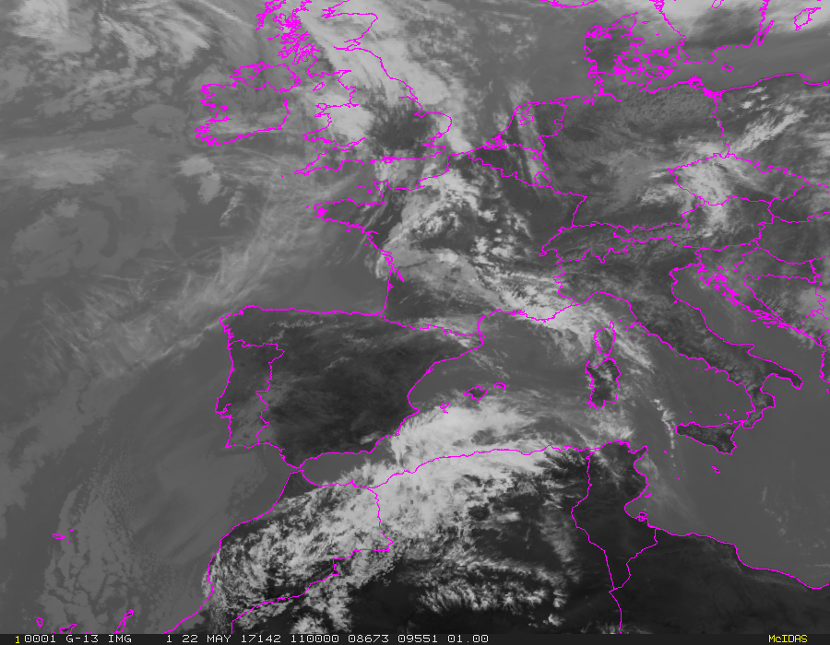
Europe sector from global composite

Slide 11
This animated GIF over Mexico…can be extracted from global composite.

Slide 12
Africa/Atlantic IR Satellite…can be extracted from composite

Slide 13
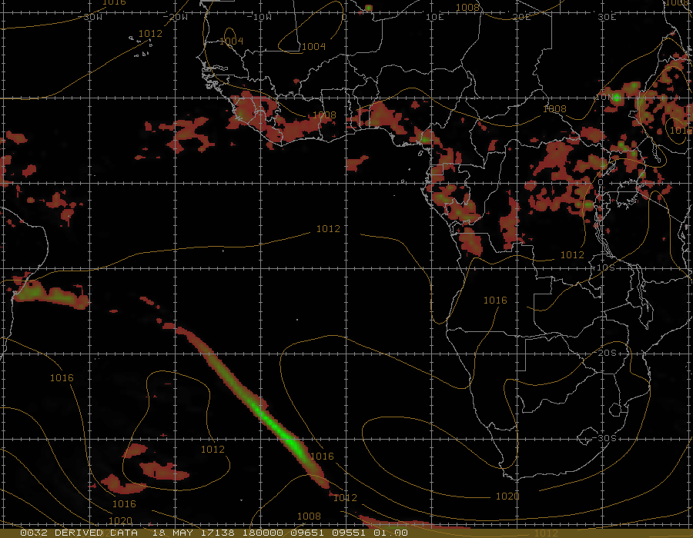
Africa/Atlantic: Source GFS
Notes:
GRDCOPY RTGRIDS/GFS-GLME0P5D G/G.1 DAY=138 TIME=0 FHOUR=18 PAR=PCP
GRDIMG G/G.1 A.1 MAG=4 4
IMGREMAP A.1 A.2 PRO=RECT LAT=-10 0 SIZE=700 900 RES=10
IMGDISP A.2
EU MAKE 10 110 BROWN GREEN
GRDCOPY RTGRIDS/GFS-GLME0P5D G/G.1 DAY=138 TIME=0 FHOUR=18 PAR=P LEV=MSL
GRDDISP G/G.1 GRID=10 UNIT=HPA COLOR=3
MAP NAME=OUTLPOLITIC
MAP LALO INT=10 LABEL=EASTPOS 2 2 YES LLMARK=YES 10 1 2
MAP LALO INT=10 LABEL=EASTPOS 2 2 YES LLMARK=YES 1 10 2
GU MAKE 2 GRAY
GRDDISP G/G.1 GRID=10 UNIT=HPA COLOR=3 NAV=C
GU MAKE 3 SIENNA

Slide 14
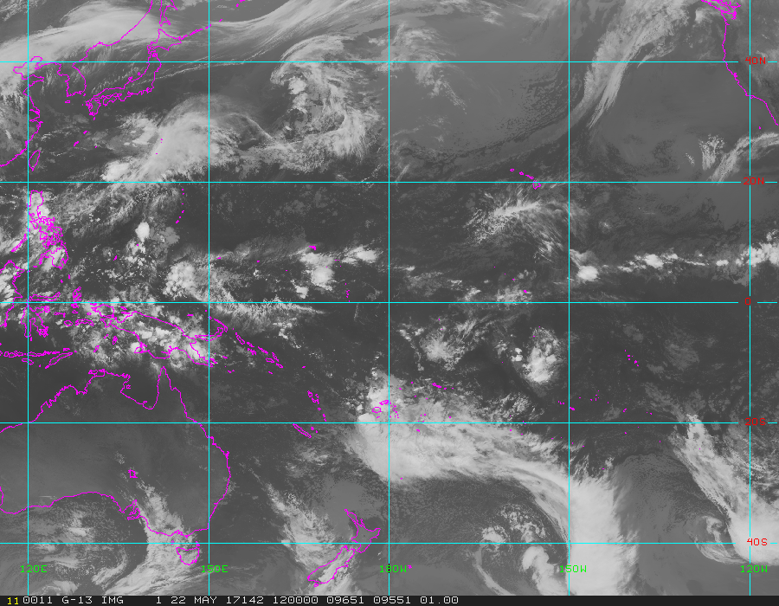
Animated loop over the pacific.

Slide 15
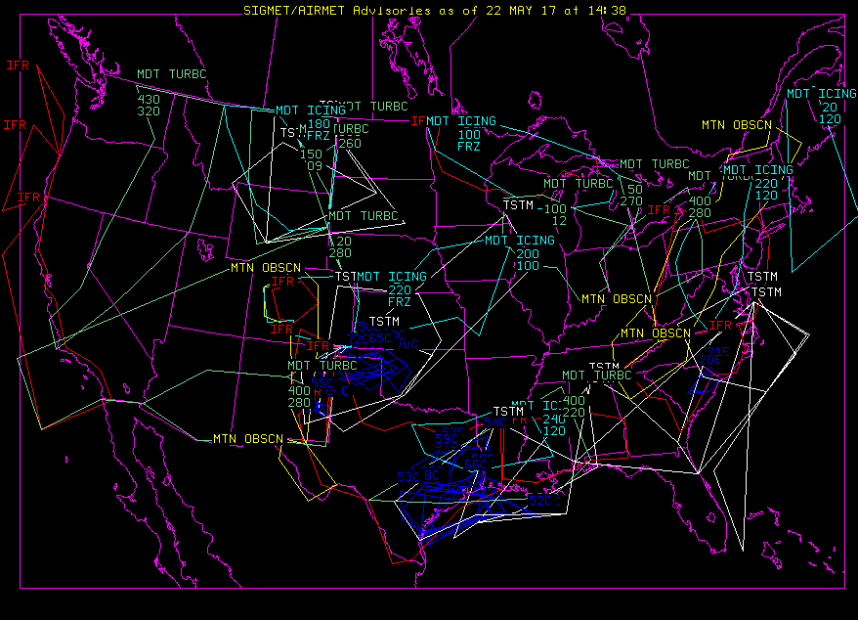
AIRMETs and SIGMETs: ADVDISP (these can be plotted individually)

Slide 16
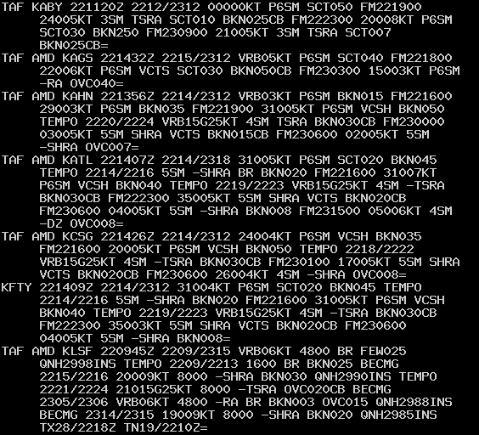
TAFRPT

Slide 17
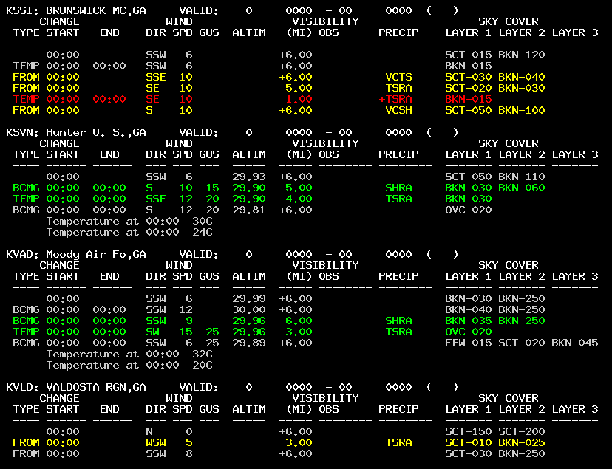
TAFLIST

Slide 18
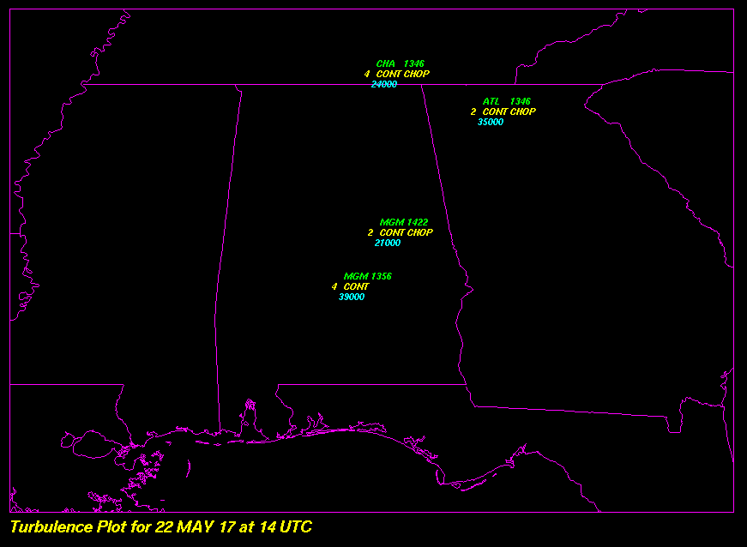
Turbulence pilot reports: PIRPPLOT TURB

Slide 19
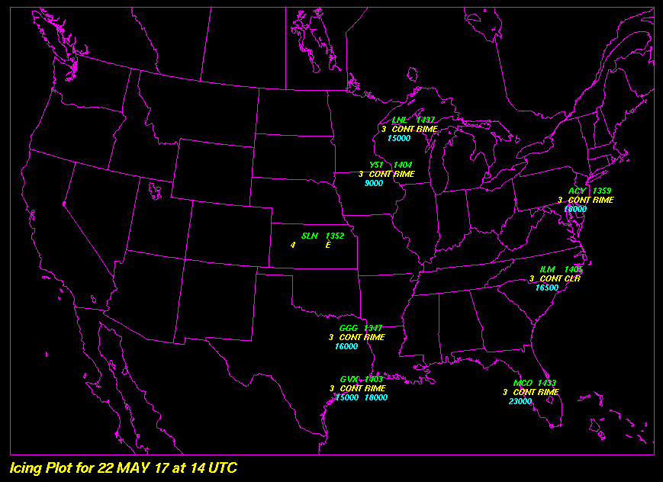
Icing pilot reports: PIRPPLOT ICE

Slide 20
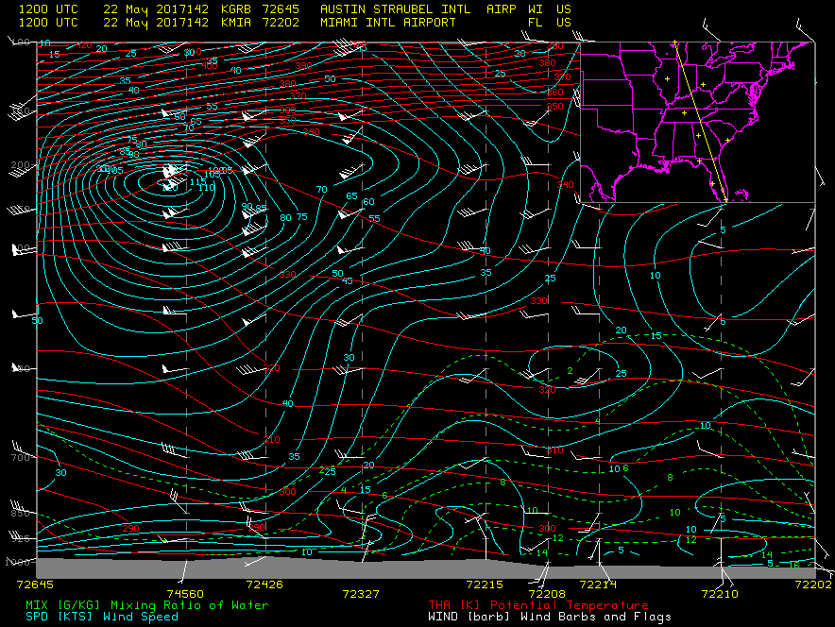
Cross section: UACROSS KGRB KMIA PAR=MIX THA SPD WINDB MAP=YES

Slide 21
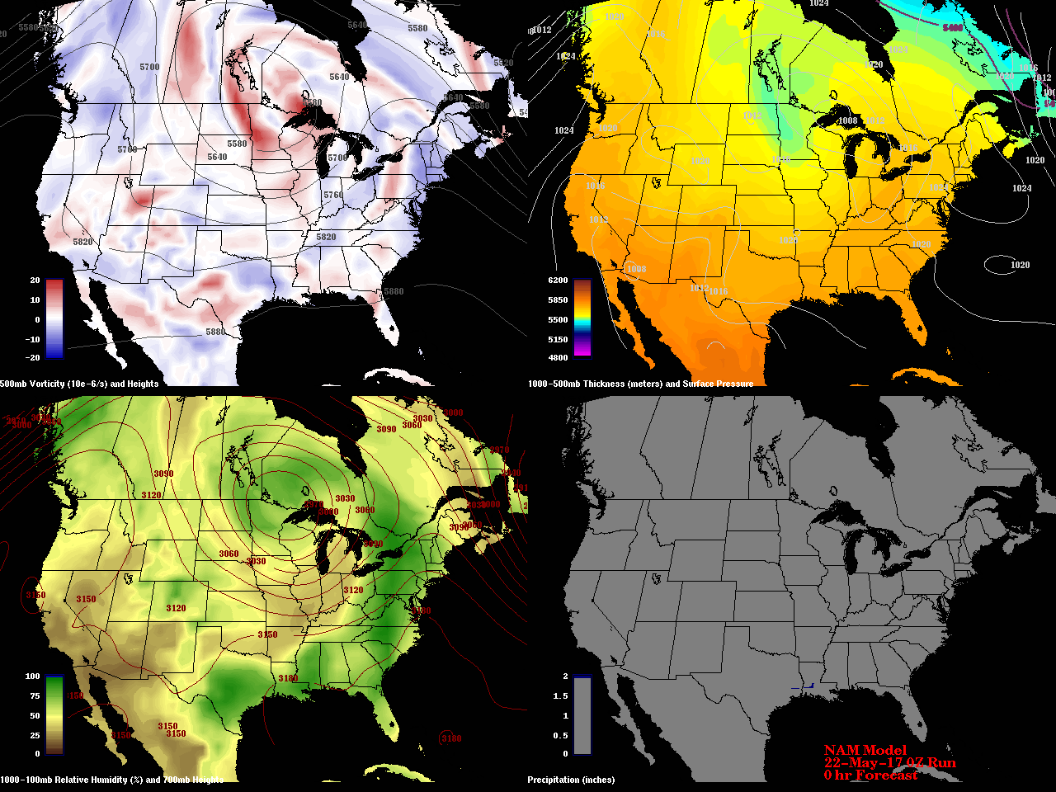
Four-panel forecast maps

Slide 22
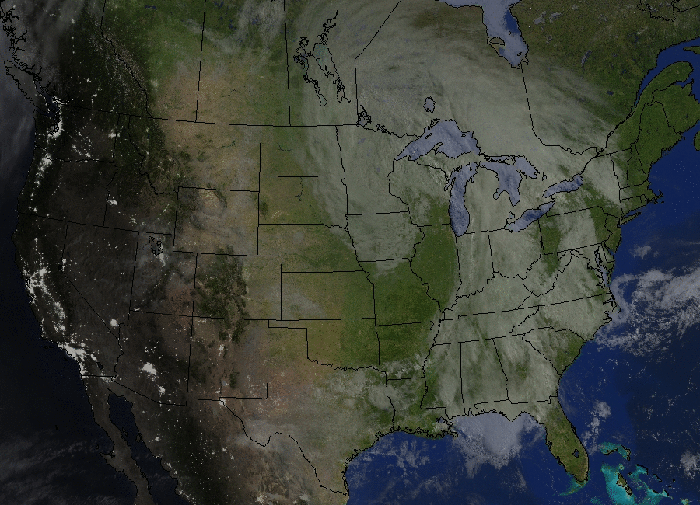
Day/night animation with city lights

Slide 23
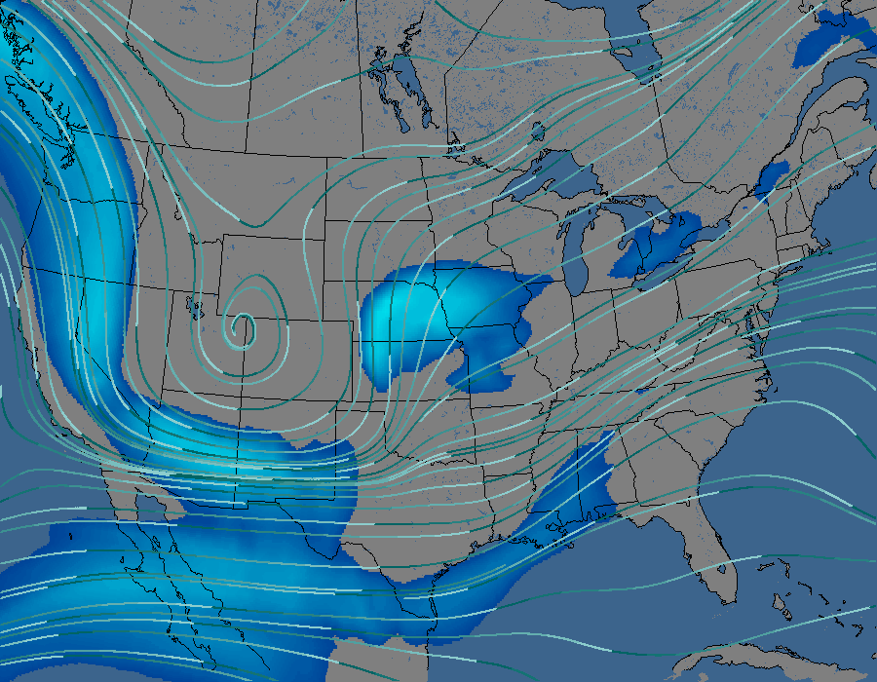
Upper-level animated streamlines

Slide 24
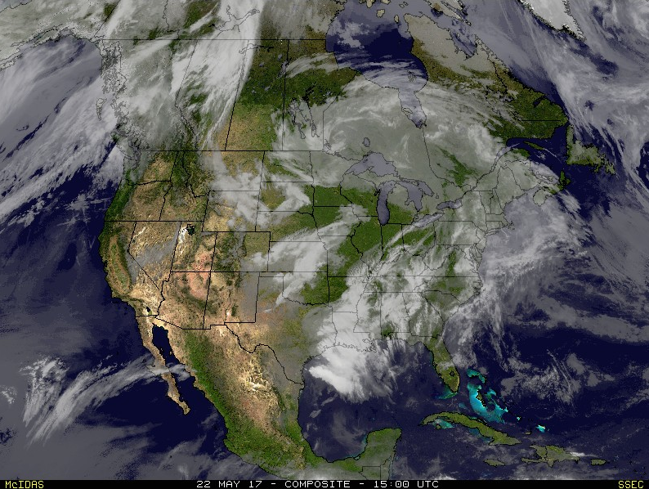
IR composite over topography

Slide 25
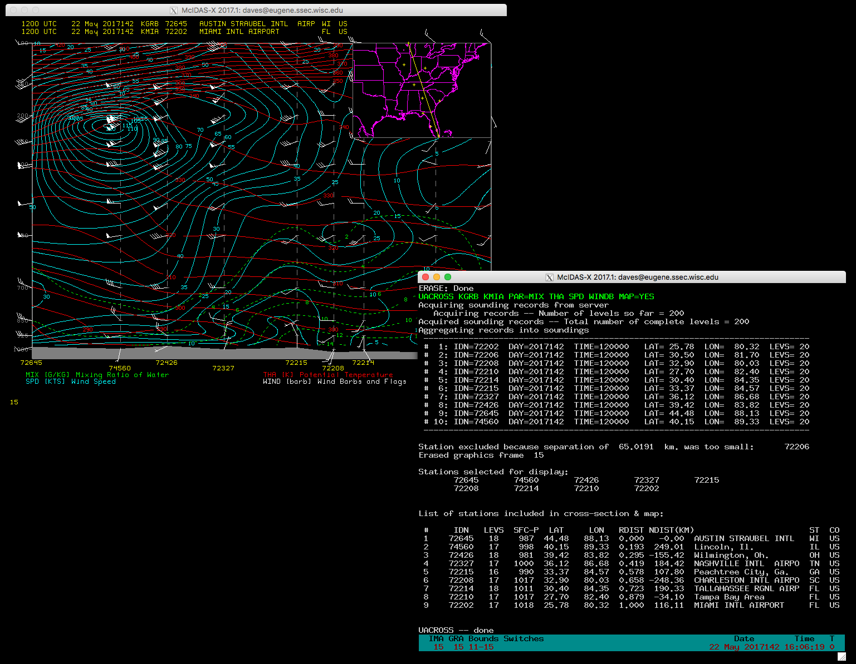
McIDAS-X interactive command line interface, with image display. Nearly all McIDAS-X commands can be scripted (Unix bash scripts) and run in background; displays can be saved GIF, JPEG, etc. Text output can be save in text files.

Slide 26
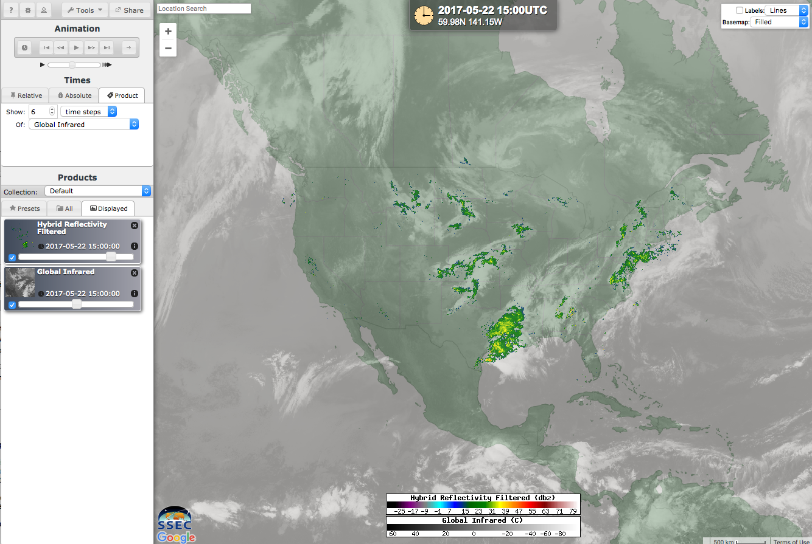
RealEarth user interface, which is very customizable, can be simplified, etc. Presets can be used to save favorites. Also, has mobile app front-end (which has notifications on product events). Not as quantitative as McIDAS-X.

Slide 27
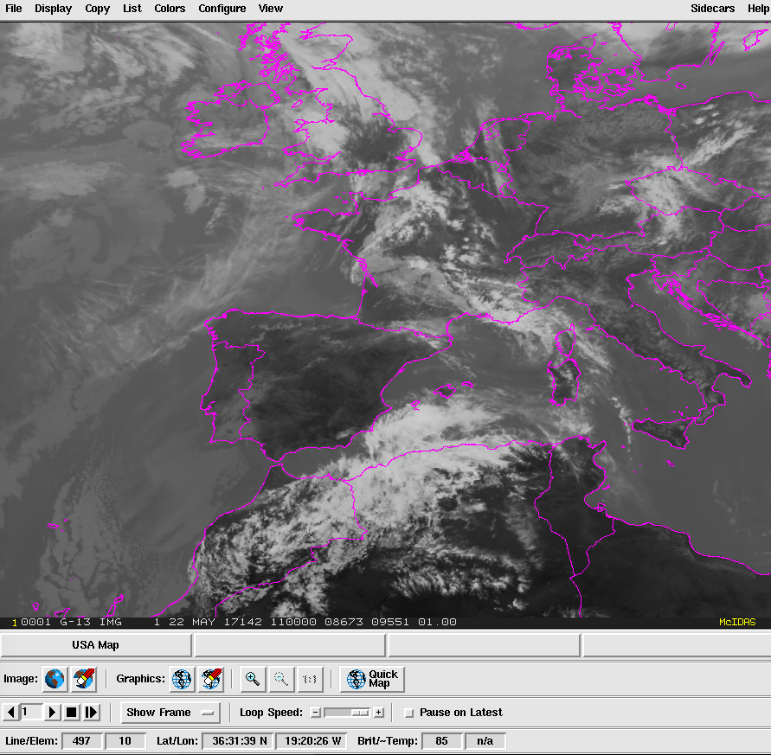
McIDAS-X GUI (uses tcl/tk) which can be tailored. Short cut buttons (circled) are user configurable.
Also, Function keys on keyboard can be configured for one-button actions.

Slide 28
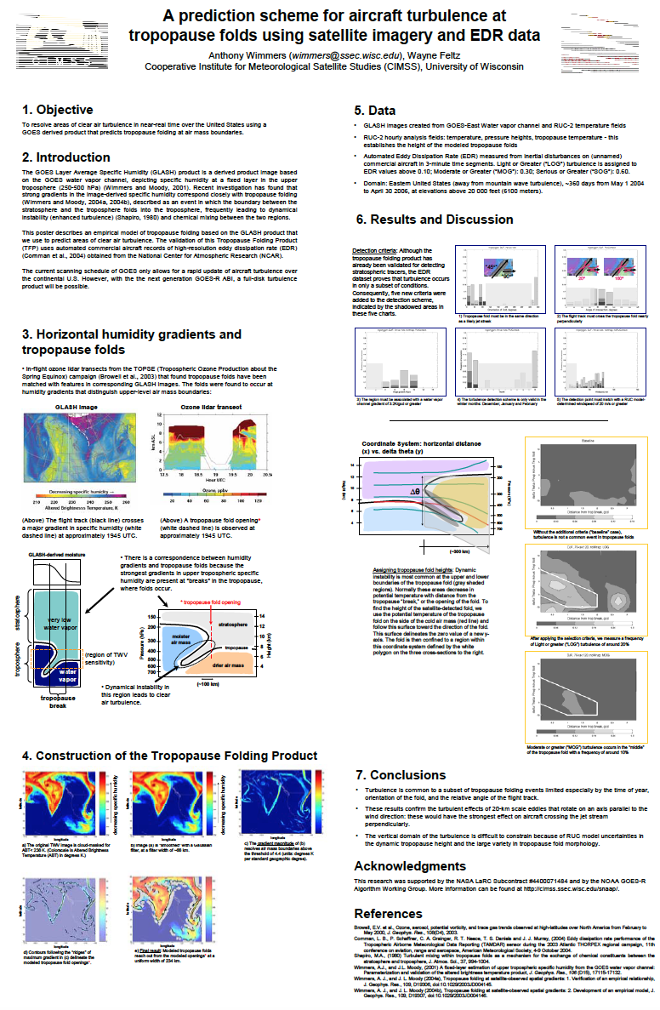
Turbulence research using satellite data (Tony Wimmers)

Slide 29
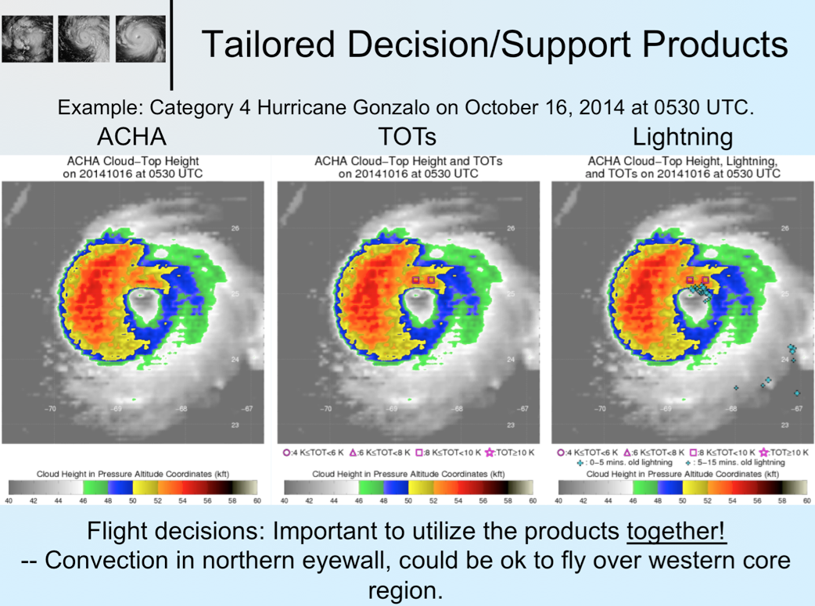
Flight rules over cloud tops using satellite and lightning data (Sarah Griffin)

