Slide 1
McIDAS Review Part 1: Directors
D. Santek, R. Schaffer, J. Robaidek, T. Achtor
11 March 2013

Slide 2
Opening Remarks
T. Achtor

Slide 3
McIDAS Program Review Introductory Remarks
McIDAS is a broad and a large Center program
Why a review?
Need for periodic management reviews of our large programs
New generation of upper management
Opportunity for feedback from a variety of SSEC’s expertise

Slide 4
McIDAS Program Review Introductory Remarks
The broad vision of McIDAS encompasses
Science and Computer Science
Engineering
User support team
SSEC Facilities
These elements are inter-dependent and combine to provide a unique data, analysis and visualization environment
The SSEC McIDAS program needs to be understood in terms of all these elements

Slide 5
McIDAS Program Review Introductory Remarks
McIDAS-V is a somewhat decentralized project
Funding challenges create prioritization difficulties
McIDAS-V development is a research effort to explore new approaches to:
Multi-dimensional visualization
New approaches to data analysis
Novel methods to support environmental satellite data exploitation
McIDAS-V development also embodies the best elements of the McIDAS-X “operational” environment
Quality control and documentation
Highest standards of software maintenance
User support and training

Slide 6
Overview
Historical overview of McIDAS-X and its future
McIDAS Users' Group (MUG)
SSEC Data Ingestor (SDI-104)
SSEC Data Center
McIDAS Advisory Committee (MAC)
McIDAS-V status and plans

Slide 7
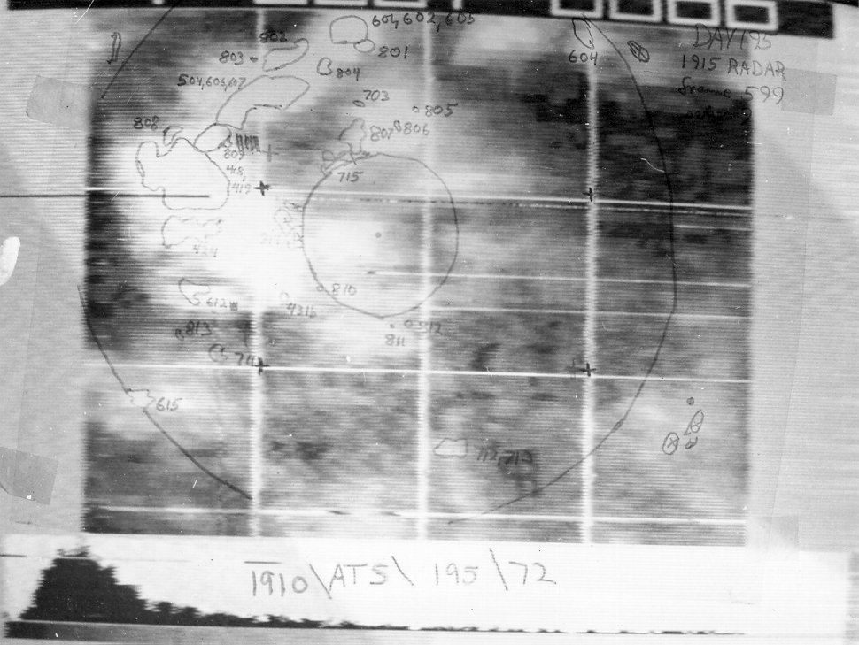
McIDAS History
1960s: Prof. Vern Suomi was striving to exploit the geostationary satellites for time domain information
McIDAS was initially developed with the goal to mass produce the cloud drift winds
For the last 40 years, McIDAS has evolved through 5 generations of hardware/software as an internationally renowned system

Slide 8
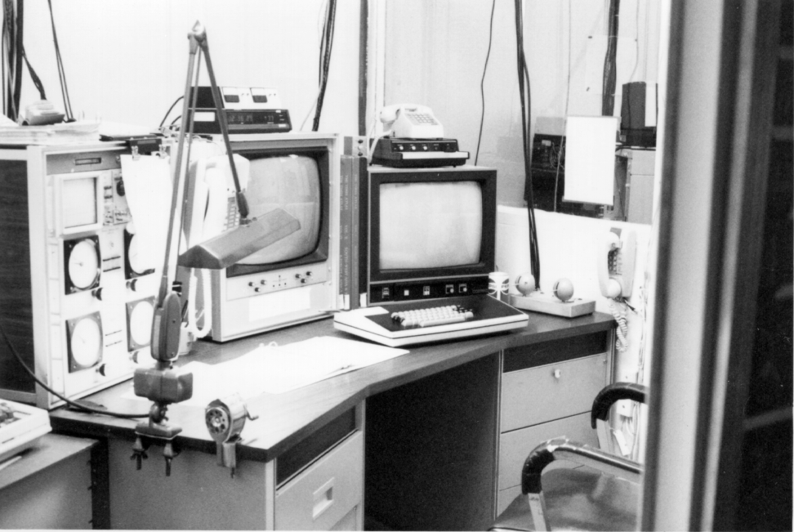
McIDAS Significant Milestones
12 October 1973: McIDAS was first used in a research project by Dave Martin
1977: McIDAS installed at WTVT in Tampa, FL; continues as an active McIDAS site today
1978: Cloud-drift winds were manually generated from five geostationary satellites for a year as part of the First GARP Global Experiment (FGGE)

Slide 9
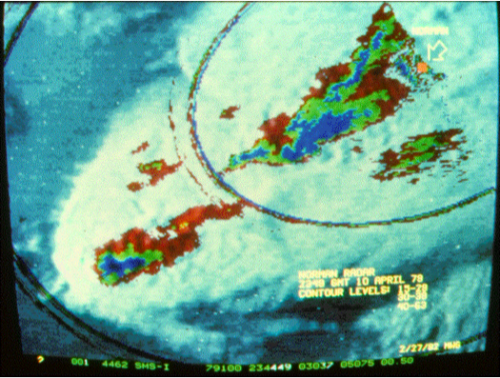
McIDAS Significant Milestones
1979: Congressional delegation visited SSEC to learn about advances in severe storm forecasting in wake of tornadoes in Wichita Falls, TX
1982: McIDAS installed at NSSFC to aid in severe weather forecasting.
Mesoscale Discussions began in 1986, partly in response to the availability of timely analyses

Slide 10
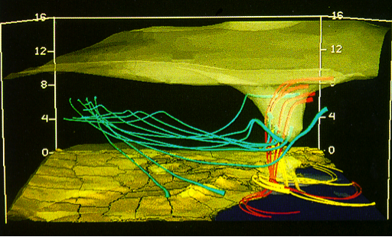
McIDAS Significant Milestones
1982: Interactive Flash Flood Analyzer (IFFA) based on McIDAS installed at NOAA
1987: McIDAS Users’ Group formed
mid-1980s: McIDAS installed at Cape Canaveral and Johnson Space Center in support of the space shuttle
late-1980s: Installed at NHC

Slide 11
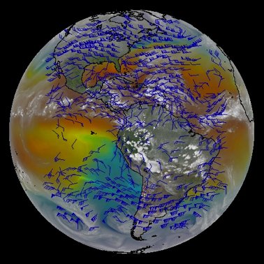
McIDAS Significant Milestones
1992: McIDAS-X, Unix-based system
mid-1990s: Abstract Data Distribution Environment (ADDE)

Slide 12
McIDAS-X Current Chapter
D. Santek

Slide 13
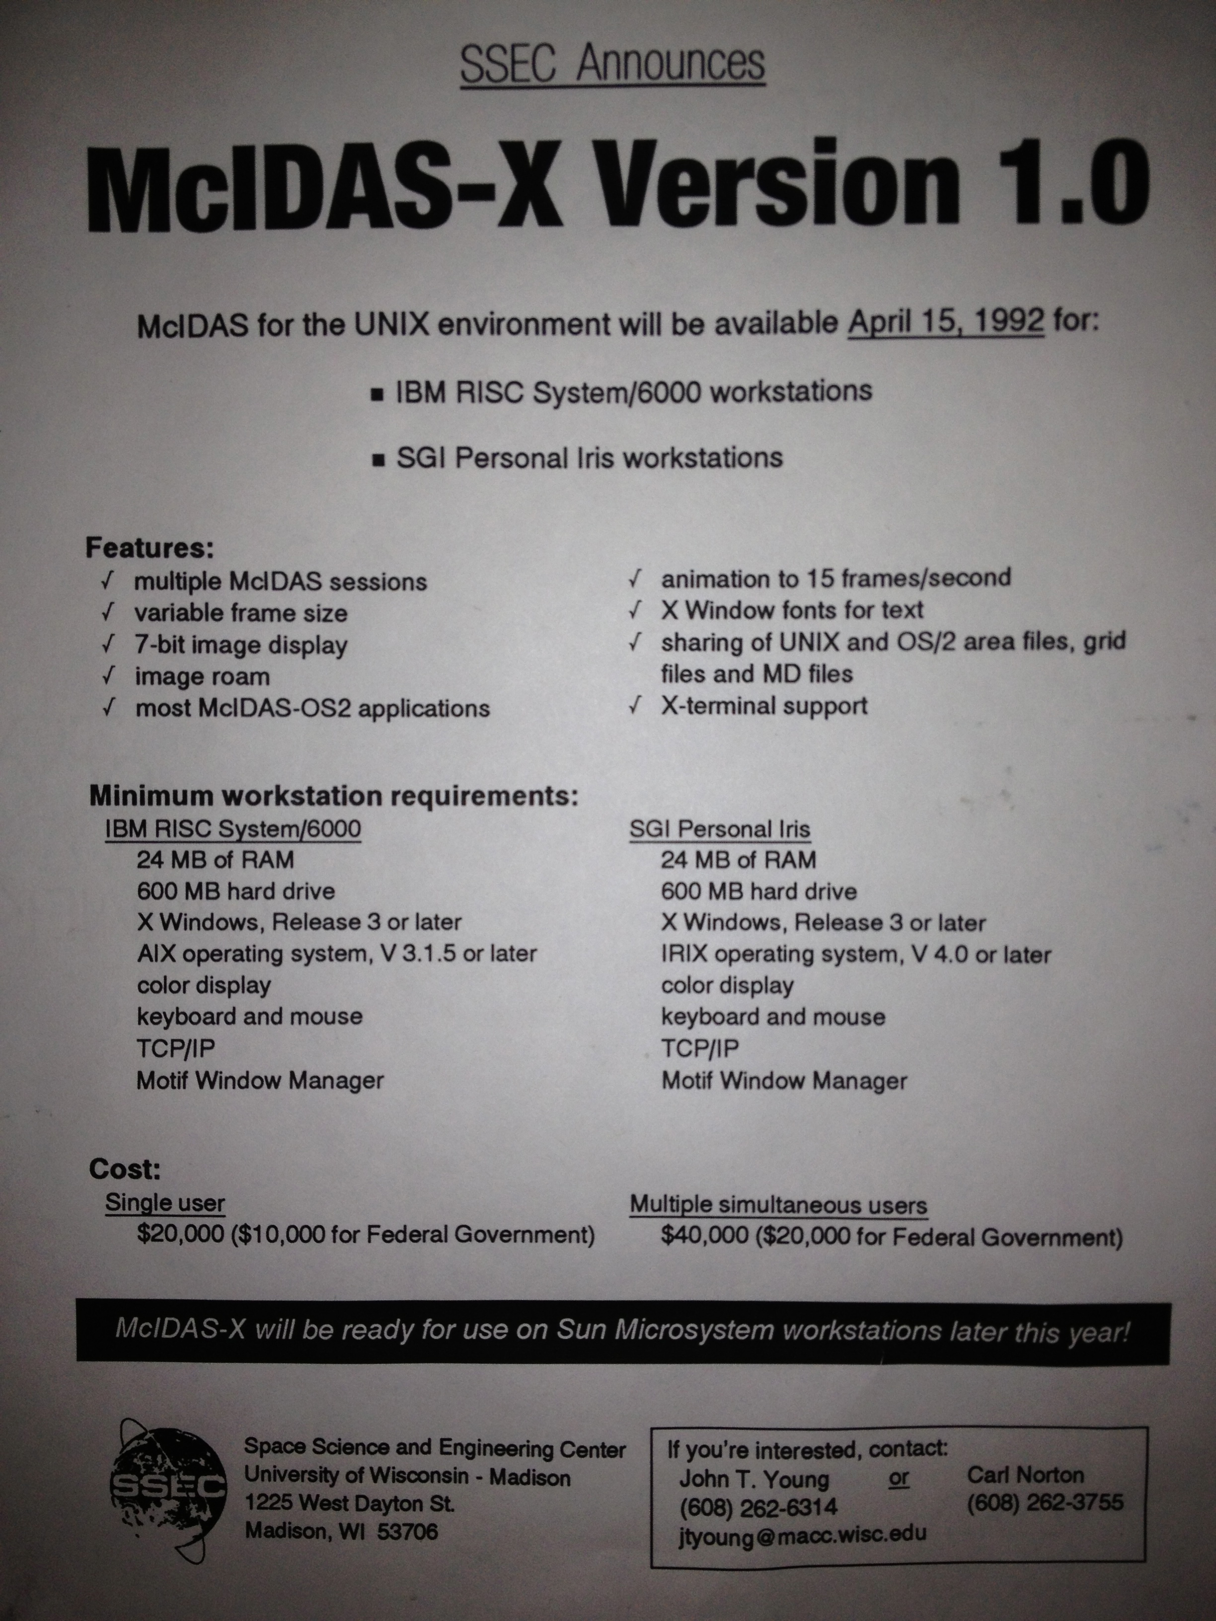
McIDAS-X Introduction
Ported code from mainframe and DOS- and OS/2-based computers to IBM AIX workstations
Released April 1992
A distributed system as opposed to previous mainframe

Slide 14
McIDAS-X Early Funding Sources
1980s: $100K for a mainframe system
1990s: $20K/$40K McIDAS-X support
2000s: $8K/$16K/$32K three-tiered support fees (2013)
PRC: Advanced McIDAS
Research
CIMSS
AMRC
NASA (WetNet, MERLIN)
Infrastructure support?

Slide 15
McIDAS-X Center Support
Port to Unix
ADDE (Abstract Data Distribution Environment)
McIDAS-X Reglue
Resulted in the longevity of McIDAS-X
Reliability, Stability
Solid infrastructure

Slide 16
McIDAS-X Current Funding
MUG fees
Proposals
New instruments: MODIS
JSC: ADDE security
Unidata: Software enhancements
Funding has been stable over the last decade

Slide 17
McIDAS-X Future
McIDAS-X is expected to be supported until about 2020 for current GOES satellites
NOAA/NESDIS has a million lines of product generation code
Enhancements continue to be funded by internal projects (e.g., VIIRS data server)
MUG bug fixes, adaptive maintenance (changes to and new satellites)

Slide 18
McIDAS User Services
R. Schaffer

Slide 19
McIDAS User Services Mission
McIDAS User Services provides support for MUG members
The McIDAS Users' Group (MUG) is a subscription-based membership group that receives maintenance and upgrades to the McIDAS software and documentation
Began in 1989 to centralize support
Currently there are 39 member sites who are users of McIDAS-X, McIDAS-XCD, McIDAS-V, SDI, and SDI-104

Slide 20
McIDAS User Services Current Sites
Operational • Research • Commercial • Education
NWS Centers: NHC, AWC, SPC, NSSL, NCDC, NCEP, SMG
NWS Offices: Pacific and Western Region
International Weather Service: Spain, Australia, Mexico
Research: CIRA, MSFC, NASA-Langley, NTSB, EUMETSAT
Education: Unidata
Commercial: Honeywell, Boeing, WTVT, VTI

Slide 21
McIDAS User Services Support
Employs 8 full-time staff: programmers, testers, help desk staff, and documentation specialists
Additional programmers contribute to bug fixes and software enhancements
Two students for testing
Maintain software, periodic updates, documentation, testing, host meetings, provide training, help desk, maintain websites and forums, demonstrations, surveys
$850K income annually from MUG fees for McIDAS-X, -XCD, SDI (none for McIDAS-V)

Slide 22
McIDAS User Services Spending
McIDAS-V 40%
McIDAS-X 35%
McIDAS-XCD 11%
MUG Meeting 5%
User Training 4%
Administration 4%
SDI 1%

Slide 23
McIDAS User Services Future
Near future:
Stable income
Stable number of MUG sites (approximately 40 sites for last 15 years)
Long term concerns:
As 2020 approaches, users of McIDAS-X may dwindle:
They may choose another package (not McIDAS-V)
They may not wish to pay for McIDAS-V support

Slide 24
SSEC Data Ingestor
(SDI)
D. Santek

Slide 25
SSEC Data Ingestor History
An ingestor is a hardware/software system for capturing satellite data in its raw form (stream of bits)
McIDAS ADDE servers run on ingestor to reformat and deliver data to McIDAS-X and –V users
The SSEC Data Ingestor (SDI) project:
July 1996: Project began
Requirements: Low cost, reliable
Small team: two software developers and engineer
October 1997: several systems sold (CCFF, VAFB, SPC)
December 1998: 46 systems deployed
January 2005: Stopped production; 123 systems built

Slide 26
SSEC Data Ingestor SDI-104
2006: Due to outdated operating system and unavailability of hardware for the SDI, the SDI-104 was developed:
Based on PCI-104 technology: “is an embedded computer standard …intended for …computing environments where applications depend on reliable data acquisition”
Currently 64 systems deployed

Slide 27
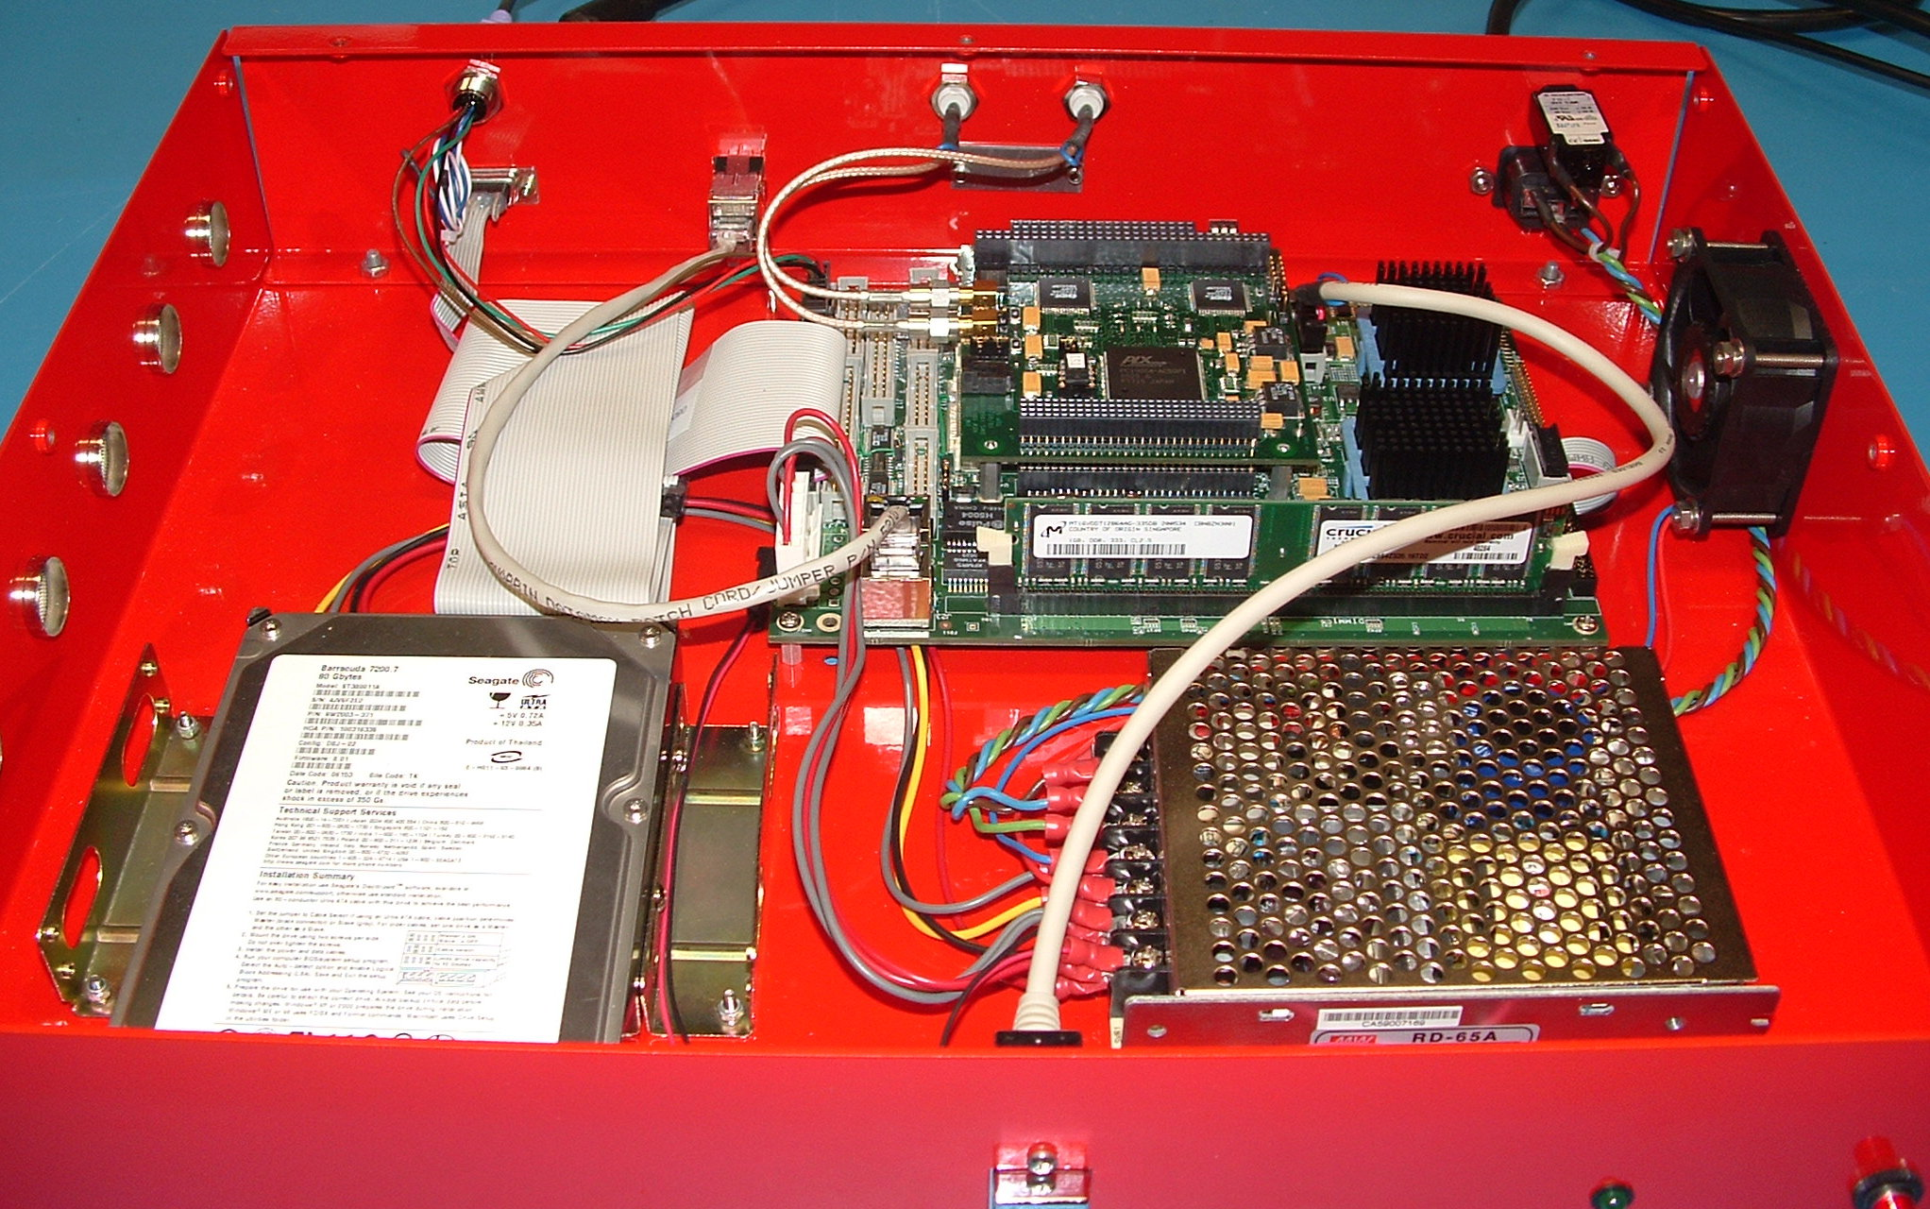
SSEC Data Ingestor SDI-104

Slide 28
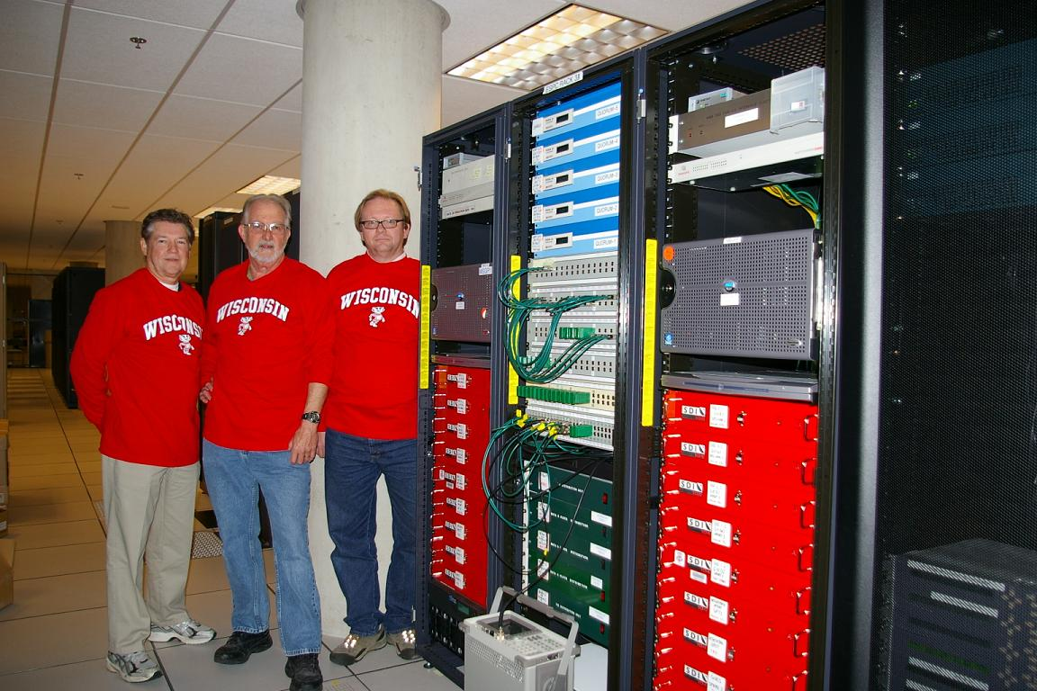
SSEC Data Ingestor Installations
SDI and SDI-104 ingestors are installed at:
SDI-104: SSEC (12), ESPC (26), SOCC(3), AWC (3), NWS-HNL (3), Guam (2), WTVT (1), Universal Weather (3), Kwaj (1), CIRA (3), Weathernews (1)
SDI: VAFB, SPC, McMurdo, Cape Canaveral, Athens, Spain, NOHRSC, White Sands, Meteorlogix, LSU, Alden, St. Louis Univ., Kwaj, Weathernews, Unidata
VisionTech (VTI): commercial reseller of our SDI-104 in Asia. Four systems in Japan.
NOAA Satellite Operations Facility
(NSOF)

Slide 29
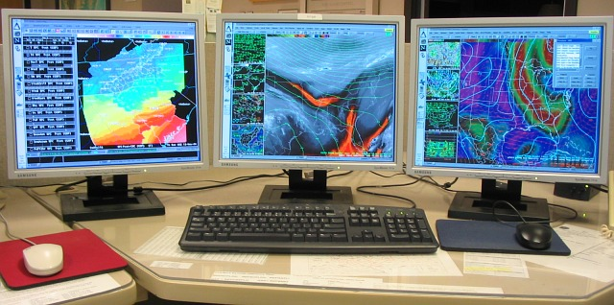
SSEC Data Ingestor McIDAS Connections
SDI and SDI-104 ingestors use McIDAS-X ADDE servers
In the transition from mainframe to distributed system, SDI was a key. It remains an integral part of Data Center.
The SDI-104 and McIDAS-X are used by NESDIS operations to provide real-time satellite data to the National Weather Service.

Slide 30
SSEC Data Ingestor Future
Several sites are still running the original SDI.
MUG support will end December 2013
Quotes for replacements have been sent out
GOES-R
GeoMetWatch/STORM

Slide 31
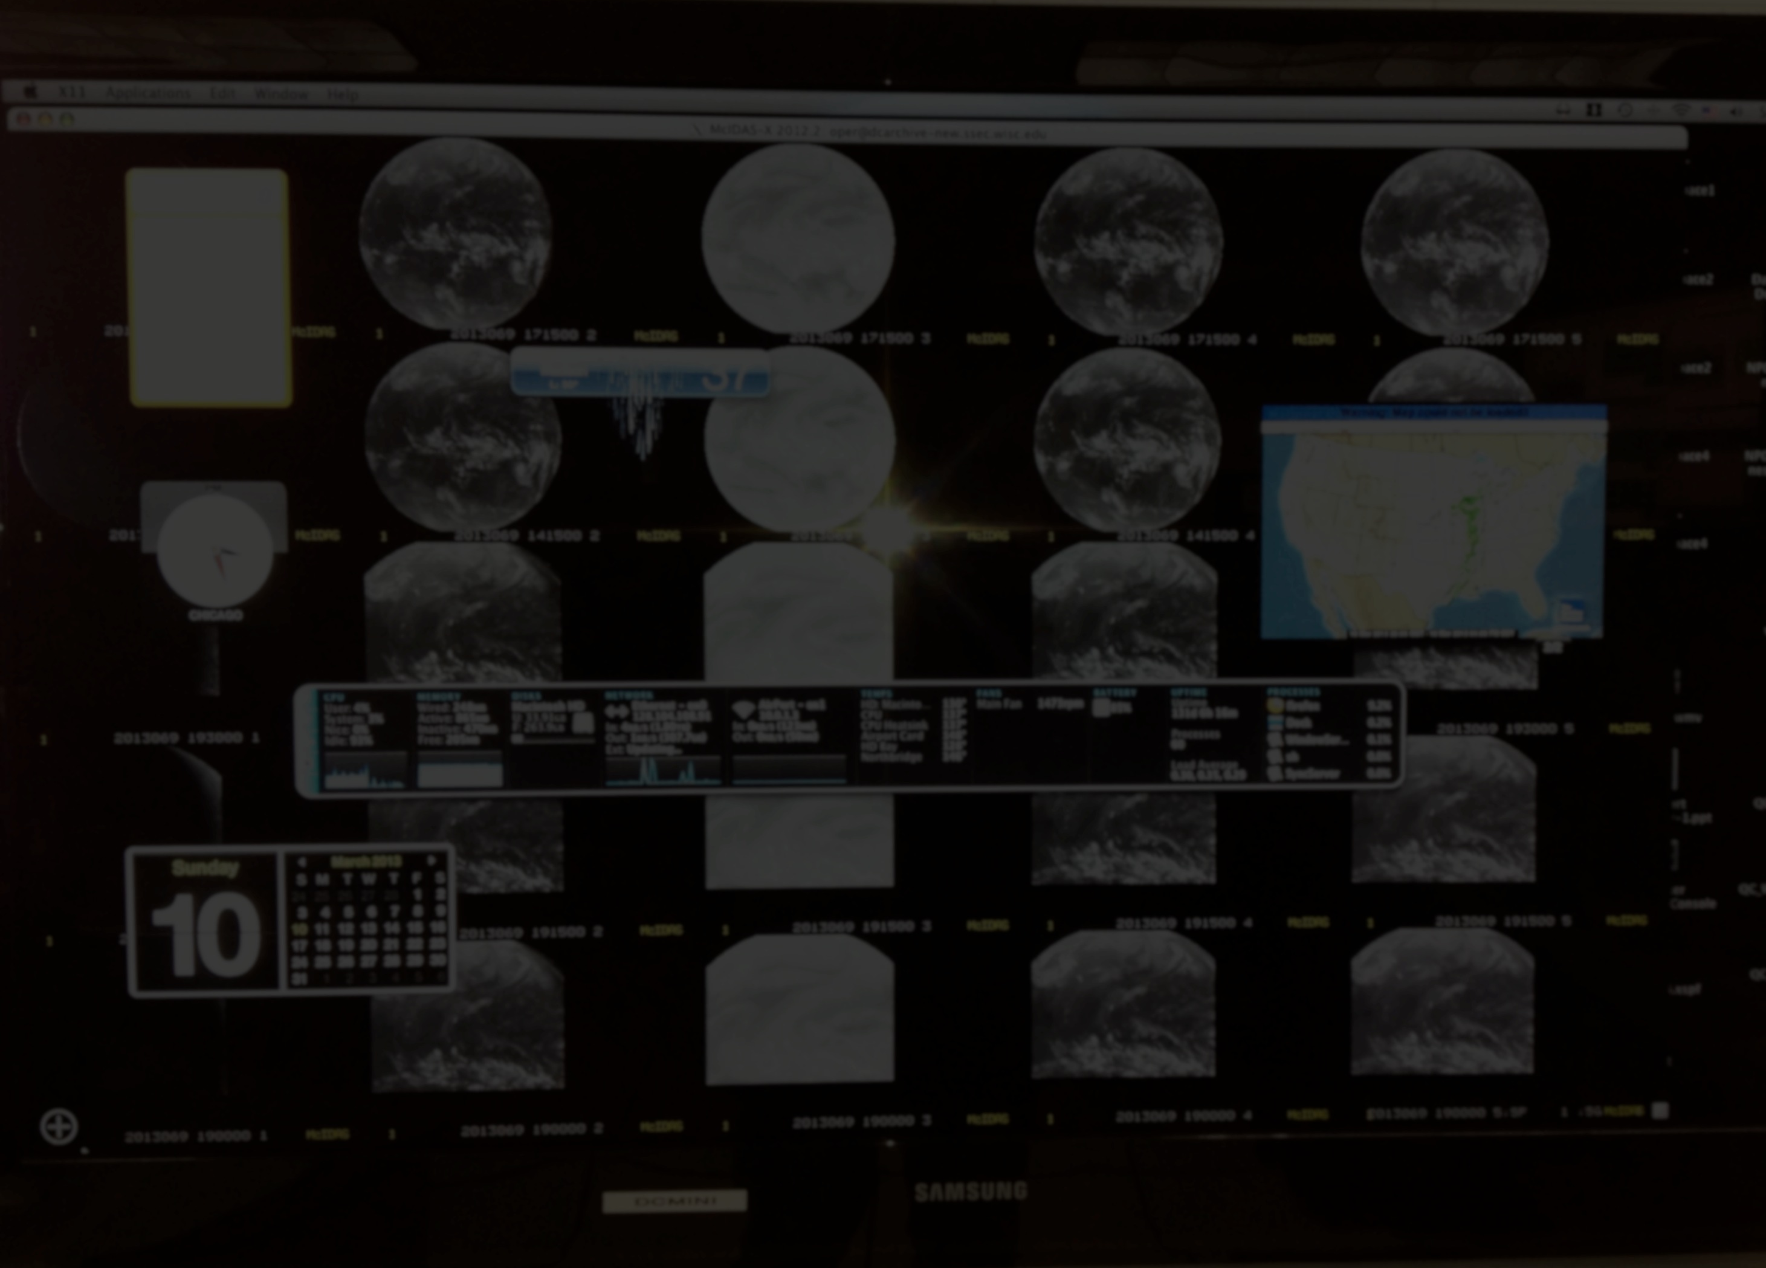
SSEC Data Center
J. Robaidek

Slide 32
Data Center Mission
To create and maintain the facilities, expertise, and technology necessary to provide SSEC scientists and collaborators with the highest quality geophysical data
To provide real-time data access, archive, and retrieval services to support SSEC’s scientific programs
The Data Center & McIDAS used to be inter-twined (McIDAS Operations) The Data Center is much more!

Slide 33
Data Center Unique Activities
Assist Satellite Operations Control Center and other agencies in satellite checkout and troubleshooting of related problems
Support to field experiments
Special archiving (e.g., GOES-14 for Sandy)
Provide Help Desk support to users of the SDI and assist in the generation of SDI user documentation
Assist McIDAS User Services with McIDAS testing

Slide 34
Data Center McIDAS Connections
McIDAS-X and McIDAS-V users retrieve data via ADDE
ADDE is the primary method to access real-time and archive holdings:
1.6 TB/day of real-time data (250 GB is brought in daily)
0.6 TB/day of archive data
35 GB/day by NOAA operations and researchers
Fee for real-time data
Limited free archive access with MUG support
Resulted in at least one new McIDAS-X site

Slide 35
Data Center McIDAS Connection
SDI: Ingests and serves satellite data in real-time
XCD: Decoding, storing, and serving weather data (observations, grids, text reports, etc.)
McIDAS-X is used to generate unique products:
Customers: Sony, WeatherBug, Boeing, Honeywell, Prada
This brings in $300K annually to the Data Center which supports staff and hardware upgrades
McIDAS-X and the SDI are critical to Data Center operations

Slide 36
McIDAS Advisory Committee (MAC)
R. Schaffer

Slide 37
McIDAS Advisory Committee Mission
The McIDAS Advisory Committee (MAC) was formed in June 2007 to give McIDAS-X users a mechanism to provide:
Input into the development of McIDAS-V
Feedback on beta software, so that McIDAS-V would meet the needs of the user
The current members:
Chairs: Joleen Feltz (CIMSS), Kris Bedka (NASA Langley)
SSEC, CIRA, ESPC, Unidata, EUMETSAT

Slide 38
McIDAS Advisory Committee Priorities (2008)
Multiple jobs with no interference, no excessive load
Automated processing
Efficient data format conversion tools
Full ADDE functionality
Large number of frames/loops
AWIPS compatibility
Hyperspectral image analysis capabilities
Documentation and training
Standard statistics for comparison/validation

Slide 39
McIDAS-V
D. Santek

Slide 40
McIDAS-V Motivation
McIDAS-X software (currently written in Fortran 77 and C) has a 40-year heritage resulting in limited extensibility potential
New visualization concepts cannot be incorporated
Forthcoming environmental satellite data cannot be utilized efficiently (GOES-R & JPSS operational systems)

Slide 41
McIDAS-V History
2003: Whittaker and Santek present a McIDAS-V plan to the Directors. $145K approved for investigation.
2005: A 4-year plan was developed:
Assumed six programmers working on the project 50% time.
Primarily adding user-level functionality, did not include:
Infrastructure work
Documentation, testing, training materials
Hyperspectral analysis
Many parts completed, however, directed funding and other priorities affected schedule

Slide 42
McIDAS-V Goals
McIDAS-V shall be a powerful and versatile software system for environmental data processing, analysis and visualization
McIDAS-V shall support existing and evolving needs of scientific research and algorithm/applications development for new programs, such as NPOESS and GOES-R as well as for retrospective data, such as that from GOES and POES
McIDAS-V shall support data fusion and algorithm interoperability from existing and future sources
The McIDAS team shall continue to fully support the MUG and McIDAS-X functionality as users transition to McIDAS-V
McIDAS-V shall support operational users by providing tools and interfaces that enable a natural transition path for research results into operations
McIDAS-V shall be used to educate students in remote sensing and physical sciences, and students must be integrally involved in its development, evolution and use

Slide 43
McIDAS-V Innovative
Develop new capability in visualization and data analysis: Move beyond 2D to 3D

Slide 44
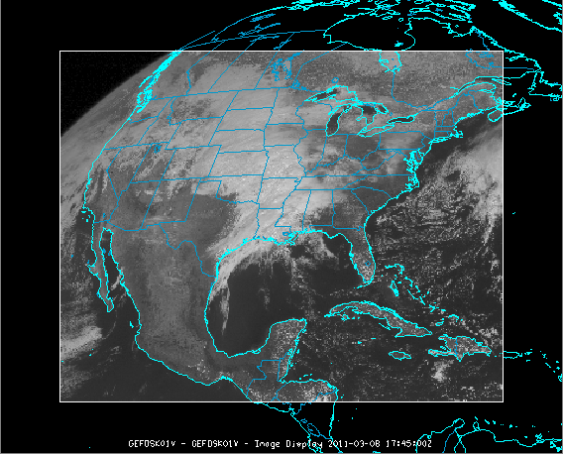
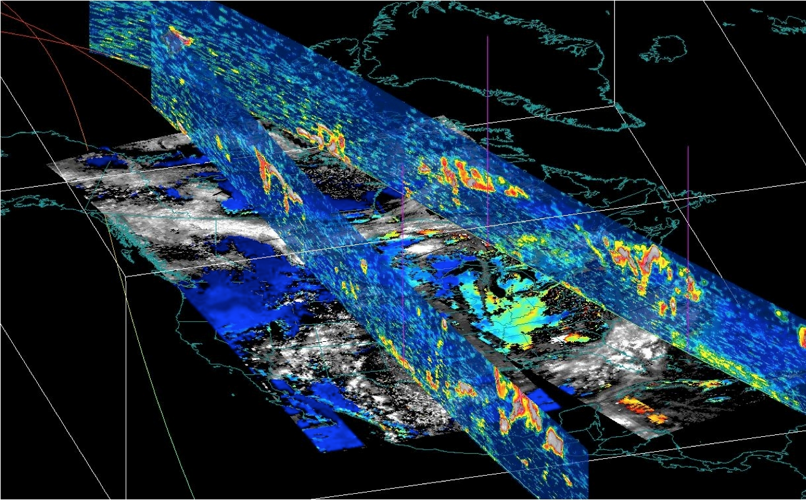
McIDAS-V Innovative

Slide 45
McIDAS-V Milestones
2006: Investigations of a “new approach” to data analysis and visualization
2007: Collaboration with Unidata to advance VisAD and IDV as the basis of McIDAS-V
2008: McIDAS-V becomes an “alpha”
January 2009: beta 1
January 2010: beta 5
September 2010: V1.0

Slide 46
McIDAS-V Current Users
In 2012:
McIDAS-V was downloaded by 4600 unique IP addresses
McIDAS-V was launched 340,000 times (will hit a lifetime total of 1,000,000 this month)
Education (AOS, Texas A&M, MissState, etc.)
Real-time: EUMETCast users
Automated: Mexico weather service

Slide 47
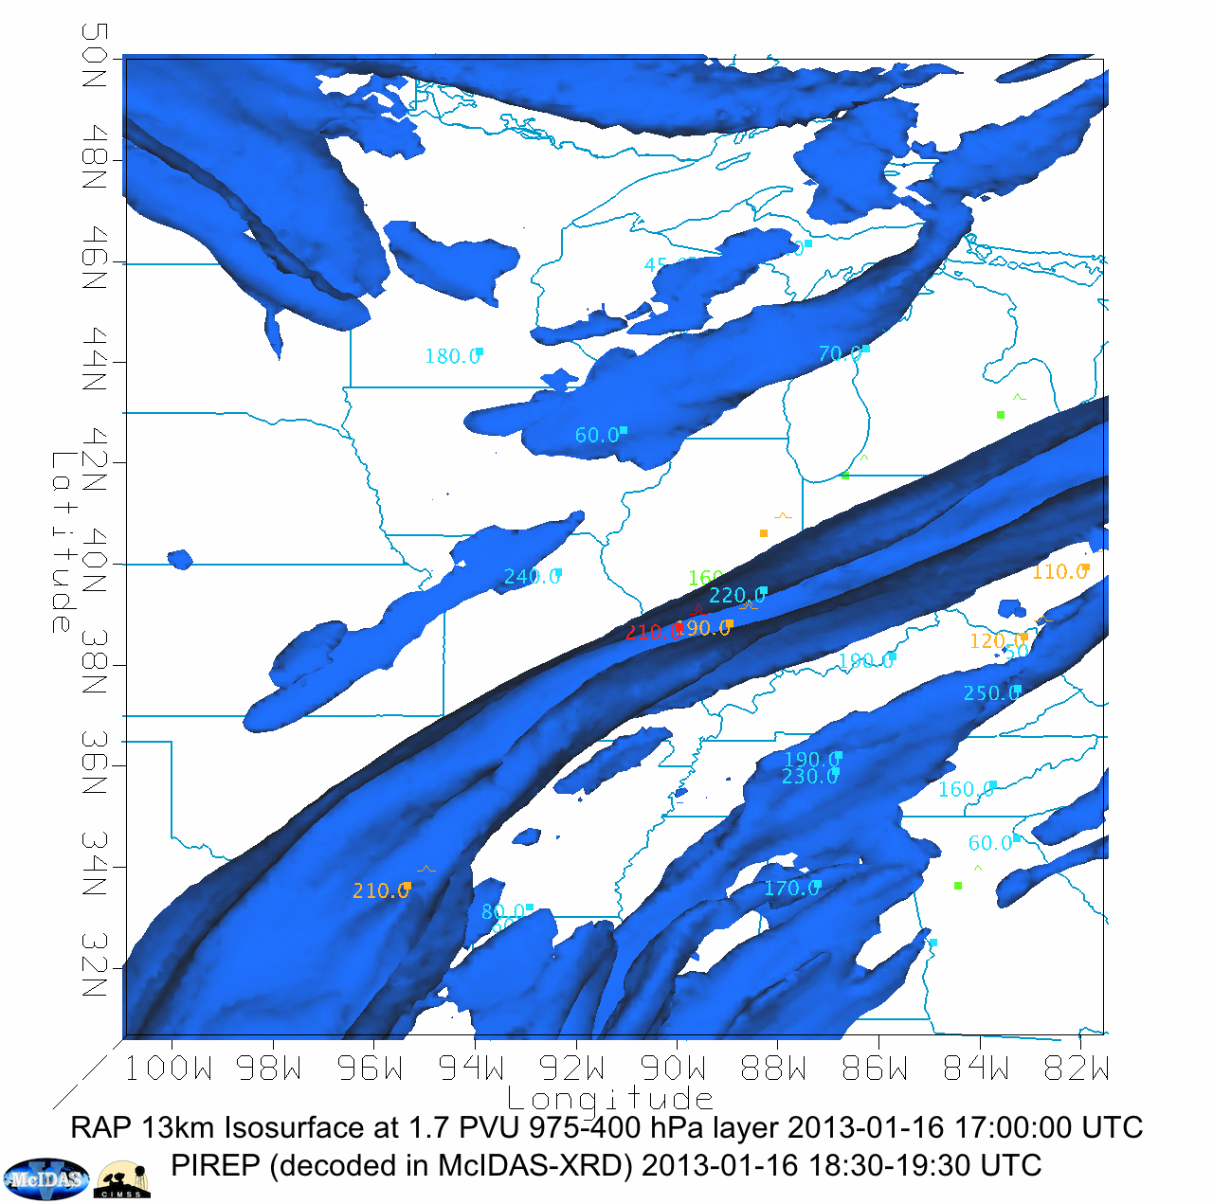
McIDAS-V Current Users
Research (in-house scientists, other research institutes)
Joleen Feltz

Slide 48
McIDAS-V Survey
Fall 2012: A survey was created for users of McIDAS software. The survey was integrated into the UW campus Qualtrix system.
December 2012: The survey was sent to:
Those on McIDAS email lists
A large group of scientists where it was uncertain if they ever used McIDAS
There were 69 responses to the McIDAS-V portion of the survey; about a 10% response.

Slide 49
McIDAS-V Survey
Usage
41% used McIDAS-V and not McIDAS-X
59% used both
41% used the software at least once a week
67% responders were in research; 30% in operations
89% used satellite data (88% geo; 44% polar)
Important attributes
89% wide variety of data types
74% imaging and animation tools
74% overlay multiple data types
70% ease of use
59% analysis tools

Slide 50
McIDAS-V Training
Used at WMO-sponsored satellite workshop in Beijing, China in 2011 and 2012. 18 countries represented; 50 attendees
MUG meetings
Ralf Bennartz, Steve Ackerman, and Mike Hiley are using McIDAS-V in international classrooms
Upcoming CIMSS Radiation Bootcamp

Slide 51
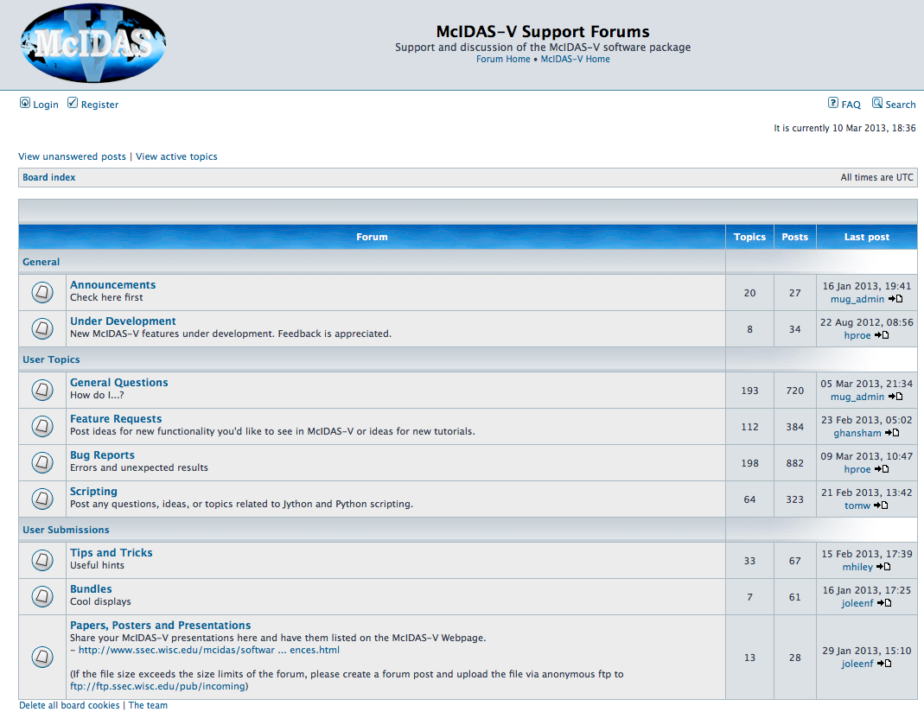
McIDAS-V Online Forums
Report bugs
User support
User-to-user support
850 members

Slide 52
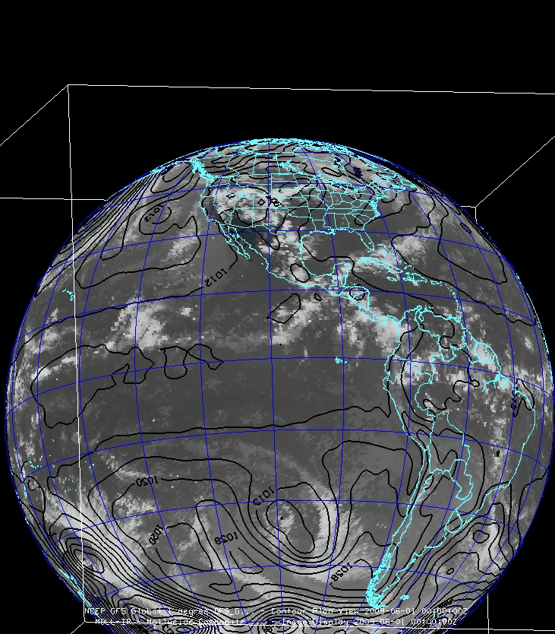
McIDAS-V Software Status
Four main components:
VisAD
IDV
HYDRA
Additional development

Slide 53
McIDAS-V Software Status: VisAD
VisAD was developed by Bill Hibbard. Open-source, Java library for building interactive and collaborative visualization and analysis tools:
Mathematical data model that embraces any numerical data set
General display model that supports 2- and 3-D displays, multiple data views, direct manipulation
Adapters for multiple data formats and access to remote data servers
It is currently maintained by Tom Rink and Tommy Jasmin

Slide 54
McIDAS-V Software Status: IDV
IDV built on VisAD (User Interface, etc.)
The IDV is maintained by Unidata, with input and suggestions from SSEC
Includes the netCDF Java library for reading many different data formats (netCDF, HDF, GRIB, BUFR, etc.)
Strong collaboration between SSEC and Unidata
Monthly telecons; occasional visits
Shared programmers forums
Common source control: we can modify IDV code

Slide 55
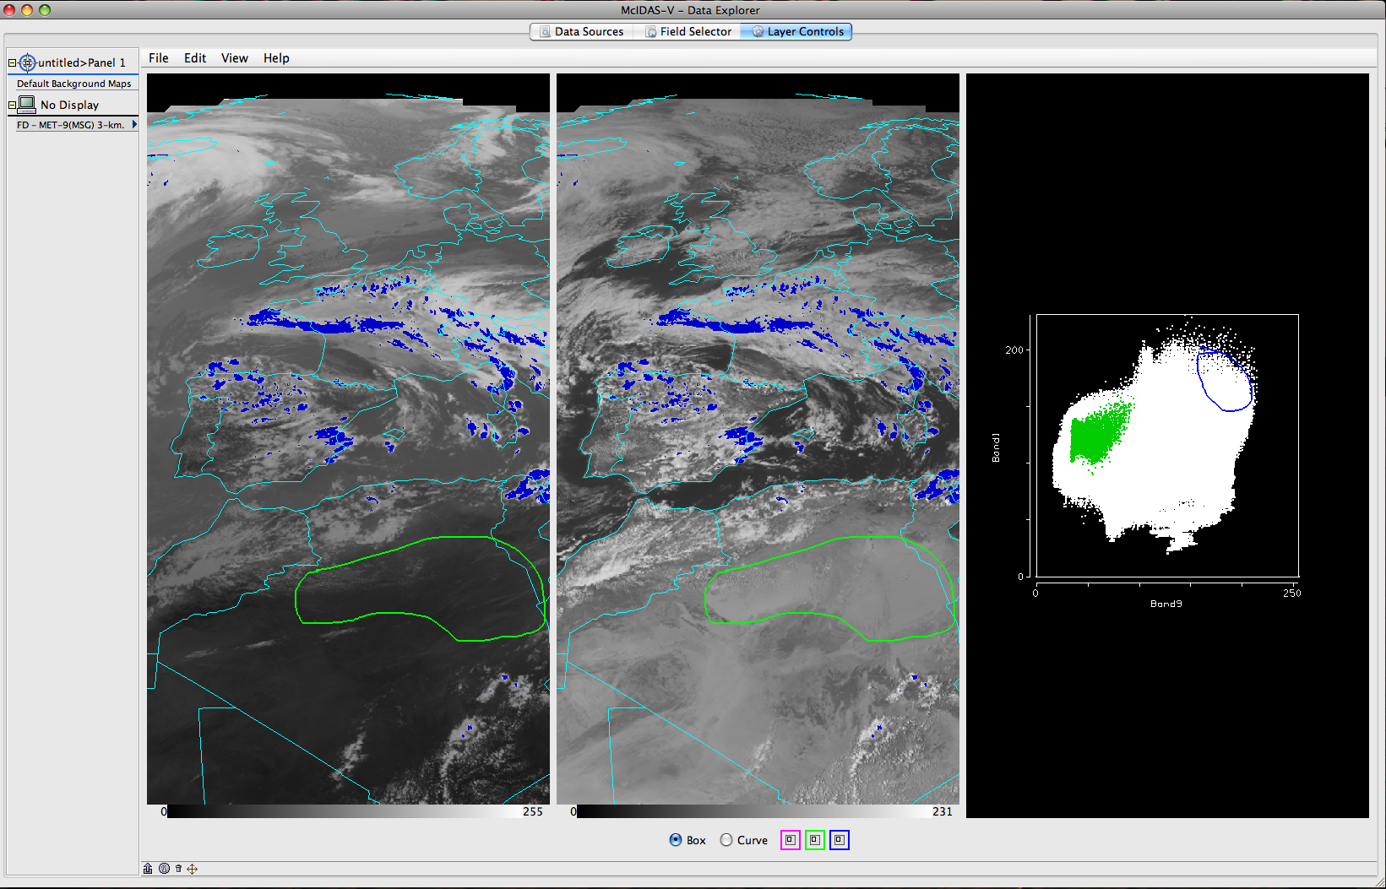
McIDAS-V Software Status: HYDRA
HYDRA: HYperspectral viewer for Development of Research Applications
Multi- and hyper-spectral data viewer and analysis package
Not yet fully integrated with McIDAS-V
Does not work with all data types
User Interface is different
More development needed
HYDRA is maintained by Tom Rink

Slide 56
McIDAS-V Software Status
New User Interface built on VisAD and IDV
The top-level McIDAS-V software and interface is maintained by the MUG programmers and others.
A new scripting capability was developed, replacing that in IDV
Current version: 1.2

Slide 57
McIDAS-V Achievements
Visualization (jagged edges)
Performance (image load limitations)
Level of stability for vsn 1.0
Scripting
Documentation and training materials
VIIRS (Suomi NPP)
Hyperspectral: AIRS, IASI, CrIS

Slide 58
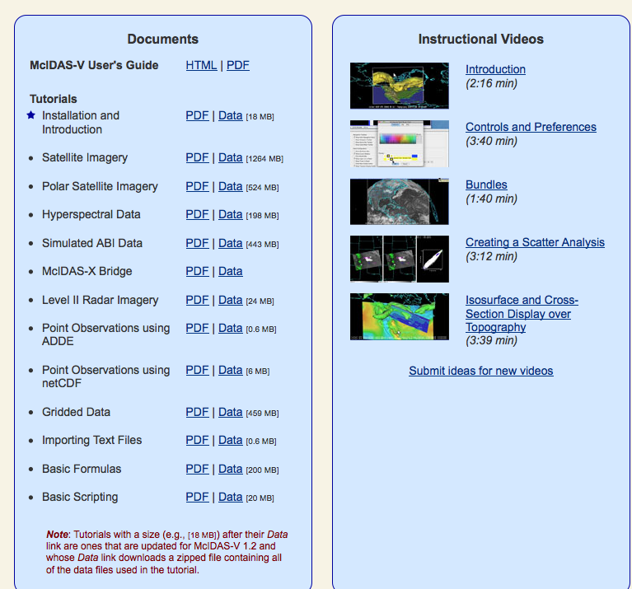
McIDAS-V Documentation/Training

Slide 59
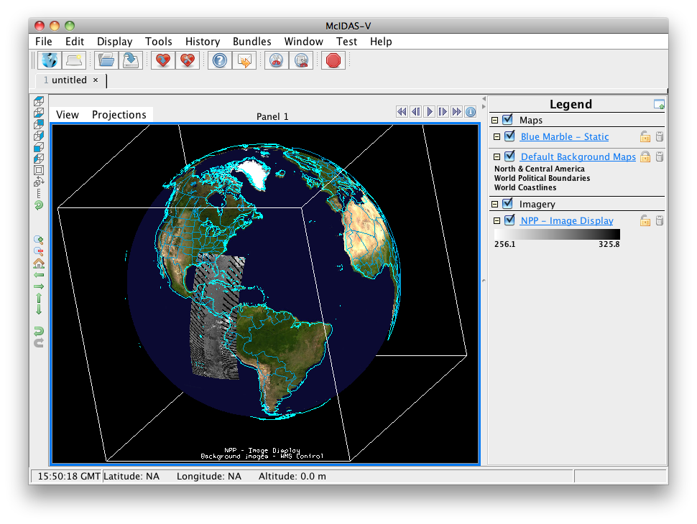
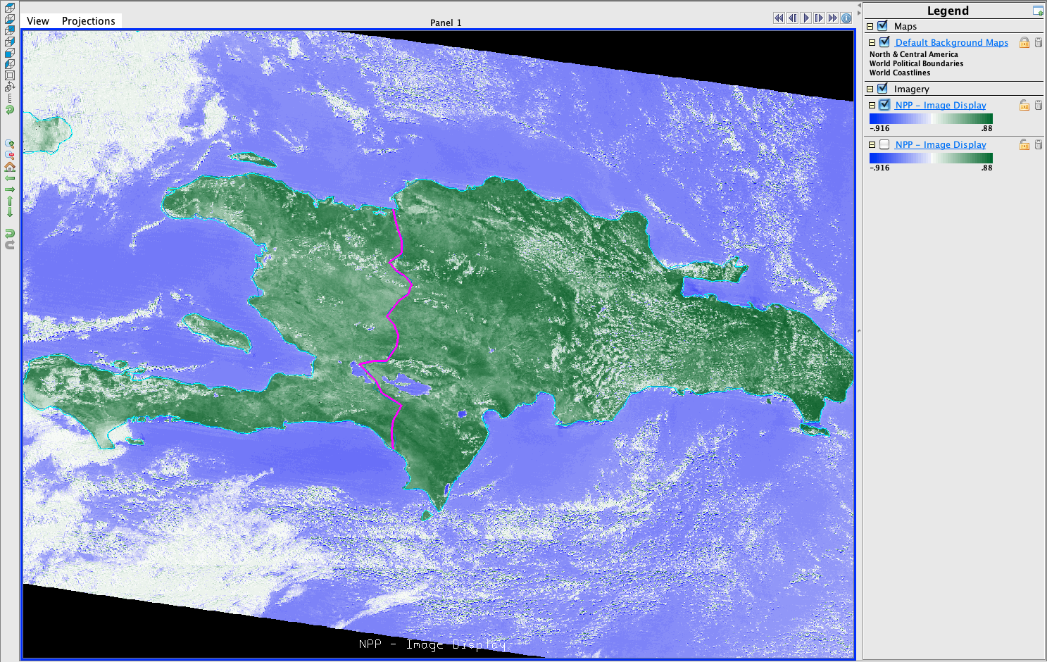
McIDAS-V Suomi NPP VIIRS

Slide 60
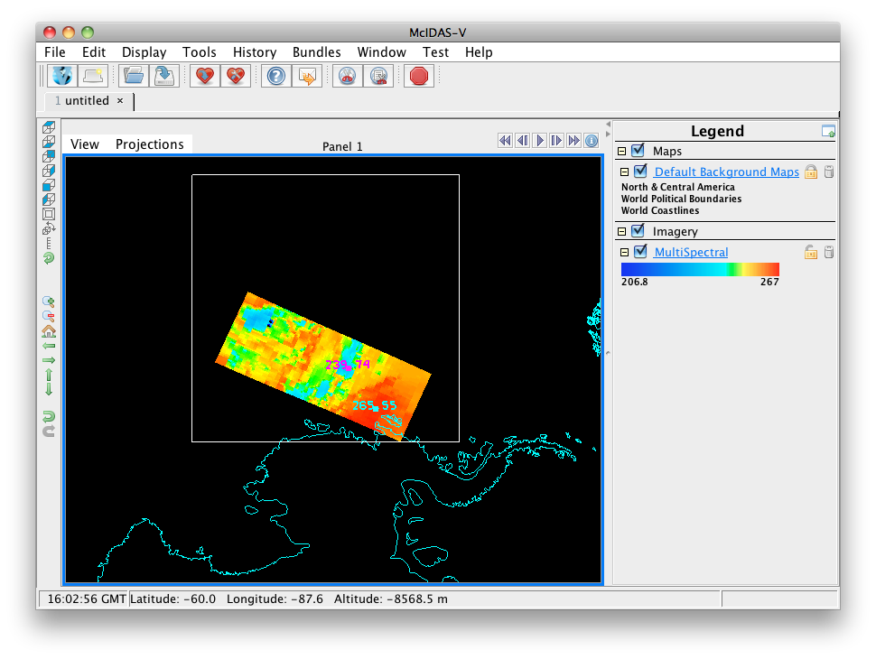
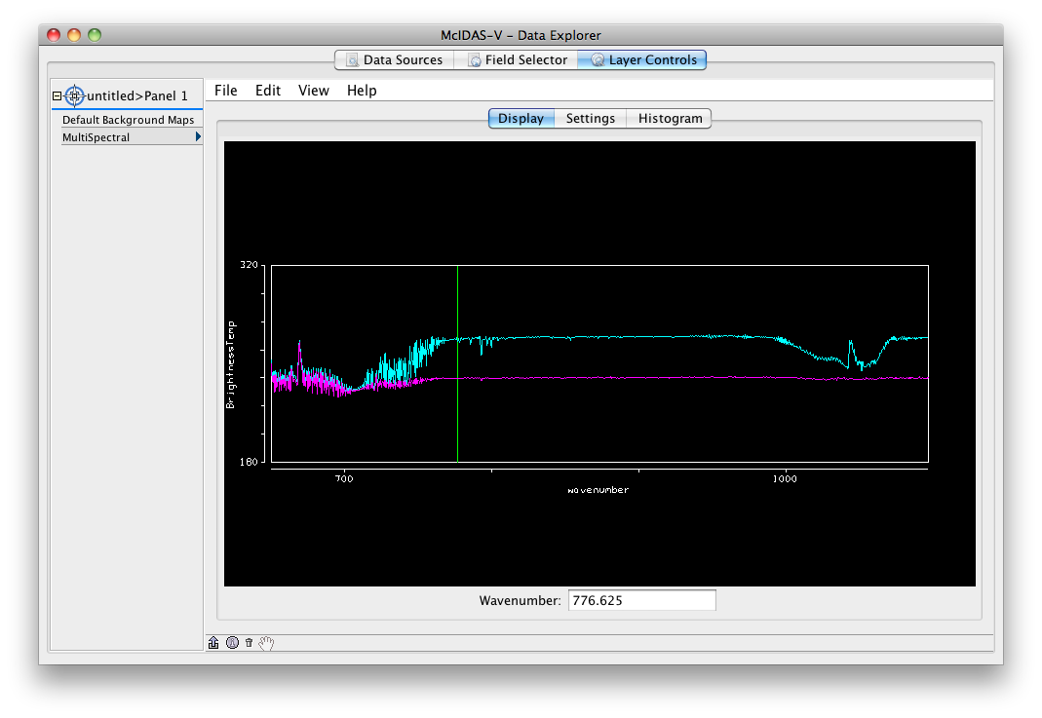
McIDAS-V Suomi NPP CrIS

Slide 61
McIDAS-V Technical Issues
Write once, run everywhere not totally true
Improve stability
Improve performance
Complete HYDRA integration
What is future of Java3D?
Generic file reader
Future ADDE servers

Slide 62
McIDAS-V Finances (2012)
McIDAS-V is supported by:
CIMSS projects (proposals)
GOES-R AWG/RR $240K; JPSS $80K for 2012/3
MUG $150K development; support/testing/doc $280K
Approved by the MUG user community in 2006
more than just research project (stable, supported system)
EUMETSAT small projects
Total: $750K+
Finances are stable for near future; may increase for JPSS

Slide 63
McIDAS-V Near Term Issues
The previous two slides described:
A number of technical issues (infrastructure)
Current funding (functionality)
Unfortunately, they do not overlap substantially
What does this mean? The technical issues are not receiving a focused effort which impacts:
The usability of McIDAS-V
Potential increases in our user base
McIDAS reputation
Not just funding, there is also a question of ownership and priority

Slide 64
McIDAS-V Near Term Solution
Problem: Until now, technical issues were assigned when:
A developer had some time and it overlapped with their current work
A project number was available
Solution: We need to appoint key McIDAS-V developers to:
Take responsibility for major components and/or technical issues
Make it a high priority commitment
Caveat: History tells us this will require re-prioritization and overhead funds

Slide 65
McIDAS-V Future
Engage younger generation:
Workshops and training
Classroom
Appeal to our scientists:
More data fusion
Move beyond 2D world
Address the technical issues to ensure a future:
Engage larger community
Step back and evaluate current state

Slide 66
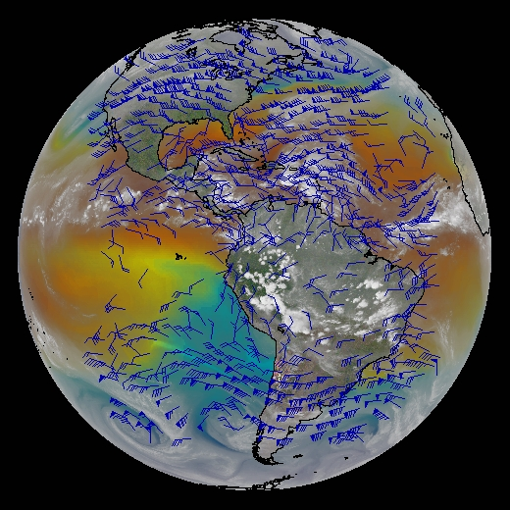
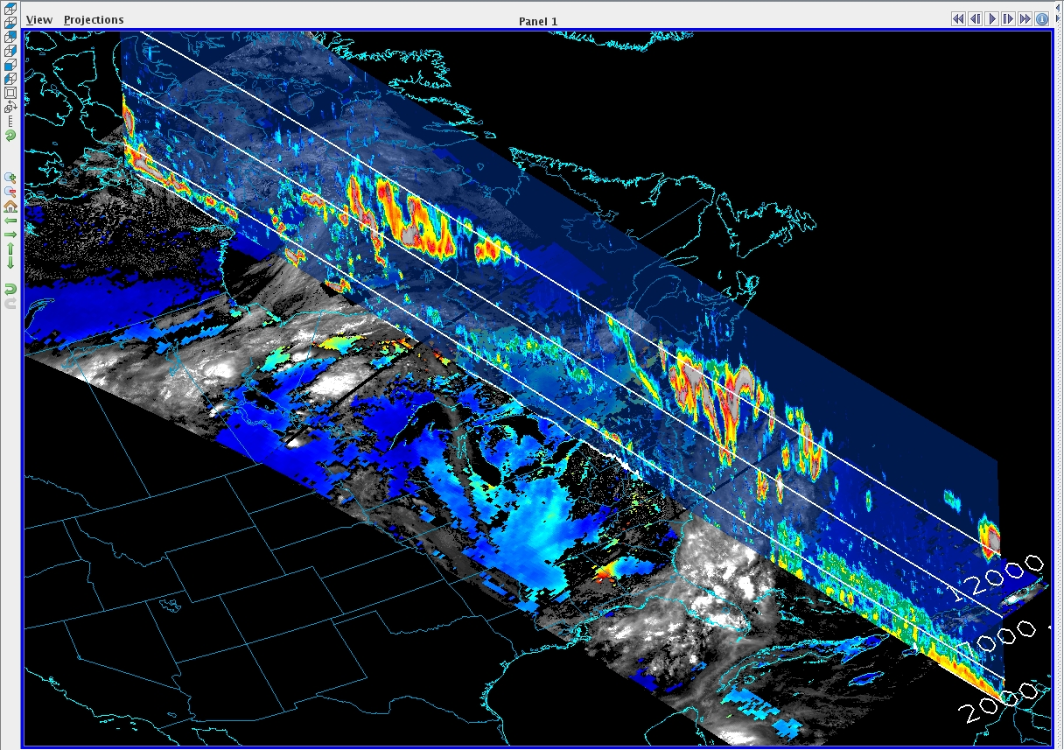
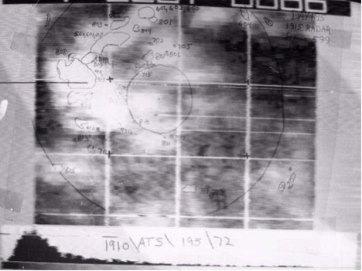
McIDAS Final Thoughts
McIDAS-X and McIDAS-V have a future
Secure more diverse funding resources
Expand and educate developer workforce
McIDAS Review Part 2: Technical
Detailed review of McIDAS-V
Date TBD

