Slide 1
Demonstration and evaluation of global VIIRS tandem winds from S-NPP and NOAA-20
David Santek¹, Jeff Key², Tim Olander¹, Dave Stettner¹,
Sharon Nebuda¹, Brett Hoover³, Steve Wanzong¹,
Rich Dworak¹, Iliana Genkova³, Régis Borde⁴
¹Cooperative Institute for Meteorological Satellite Studies, University of Wisconsin-Madison
²NOAA/National Environmental Satellite, Data, and Information Service, Madison, WI
³I.M. Systems Group (IMSG), Rockville, MD USA
⁴EUMETSAT, Darmstadt, Germany
JPSS 2023 Science Seminars 11 December 2023

Slide 2
Overview
Brief history of polar winds product
Single satellite winds
Multi-satellite winds (tandem triplet and doublet, triad)
NOAA-20 VIIRS doublet winds evaluation
Looking ahead

Slide 3
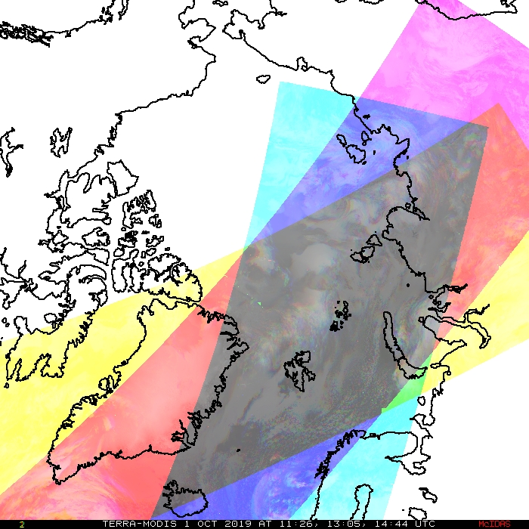
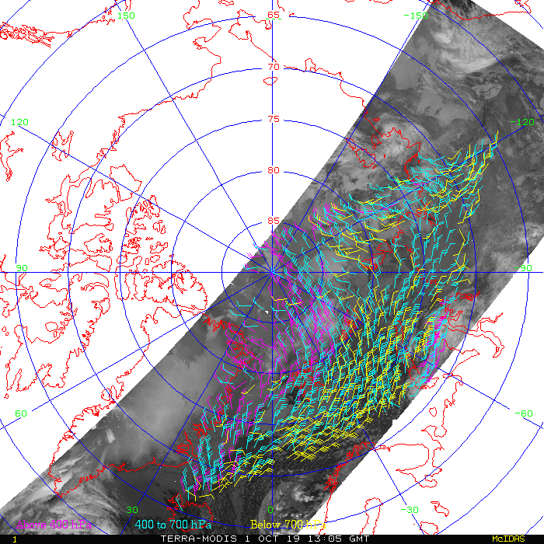
Background: Deriving Polar Winds
While geostationary satellites repeatedly image the same area, the swaths of polar-orbiters only partially overlap.
Single satellite: Swaths overlap every 100 minutes; only polar region
The method is to
Track cloud and water vapor features in three consecutive orbits.
Assign the wind vector height based on one or more methods
Perform consistency and quality control tests
Result: wind speed, direction, and pressure with quality indicators
The gray diamond is the area of overlap for three orbits.

Slide 4
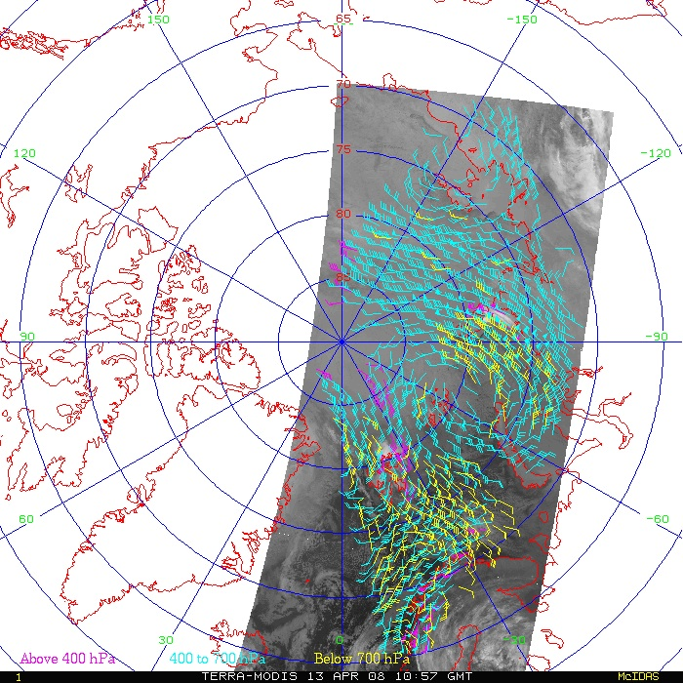
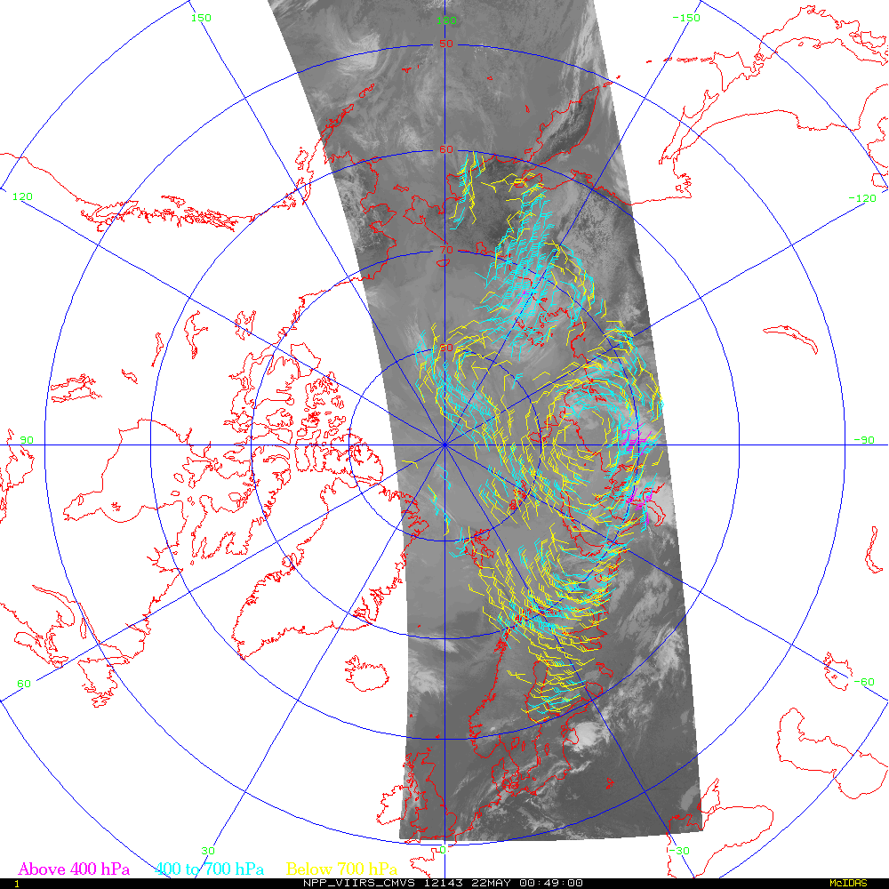
Main Product: Single-Satellite Winds
Single-satellite winds are derived from the Moderate Resolution Imaging Spectroradiometer (MODIS), the Advanced Very High Resolution Radiometer (AVHRR), and the Visible Infrared Imaging Radiometer Suite (VIIRS)
Terra MODIS
S-NPP VIIRS

Slide 5
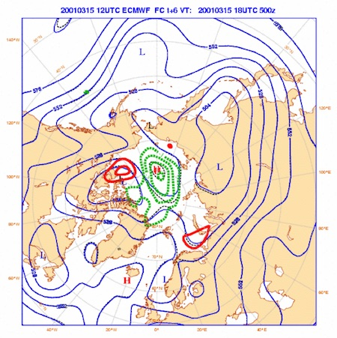
Operational NWP Users of Polar Winds
The various polar winds products are used by
13 NWP centers in 9 countries:
European Centre for Medium-Range Weather Forecasts (ECMWF)
NASA Global Modeling and Assimilation Office (GMAO)
Deutscher Wetterdienst (DWD)
Japan Meteorological Agency (JMA)
Canadian Meteorological Centre (CMC)
US Navy, Naval Research Lab, Fleet Numerical Meteorology and Oceanography Center (FNMOC)
Met Office (UK)
National Centers for Environmental Prediction (NCEP)
Météo-France
National Center for Atmospheric Research (NCAR)
Australian Bureau of Meteorology
China Meteorological Administration (CMA)
HydroMeteorological Center of Russia (Hydrometcenter)

Slide 6
Multi-satellite configuration
Mixed-satellite: Aqua and Terra MODIS in different orbits
Tandem triplet: Two satellites in similar orbits; a triplet of images from alternating satellites (A => B => A and B => A => B)
Tandem doublet: Two satellites in similar orbits; a pair of images
(A => B and B => A)
S-NPP, NOAA-20
Metop-B, Metop-C
Triad: Three satellites in similar orbits; a triplet of images
(A => B => C and possibly B => C => A and C => A => B)
S-NPP, NOAA-21, NOAA-20
Metop-A, Metop-B, Metop-C

Slide 7
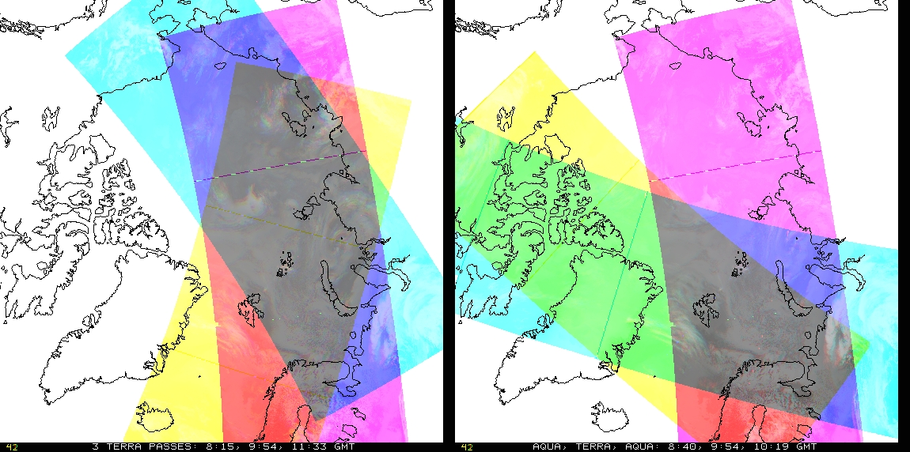
Mixed Satellite Overlap: MODIS
Terra only
Aqua, Terra, Aqua
MODIS Aqua and Terra data combined. Could be
A-T-A or T-A-T.
Pros: Lower latency (100 min rather than 200 for a triplet); somewhat lower latitude coverage (poleward of 65º or less).
Cons: Different orbits result in smaller area of overlap; fewer vectors each pass. Parallax correction and per-pixel times are necessary; orbits overlap in different directions.

Slide 8
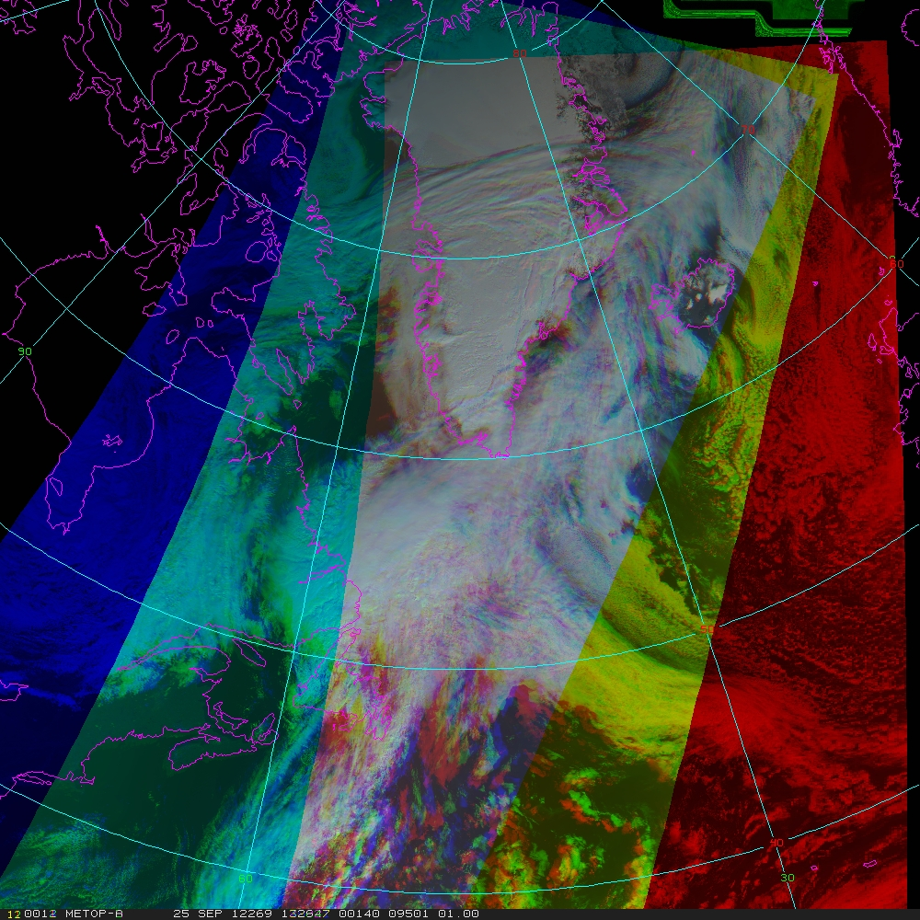
Tandem Satellite Triplet Overlap: Metop-A, -B, -A
Tandem formation: One satellite following the other separated by approximately 50 minutes.
Better spatial coverage than MODIS, further equatorward
Unlike MODIS, relative time difference between images is constant; flying tandem
50º N
The gray region is where winds are derived

Slide 9
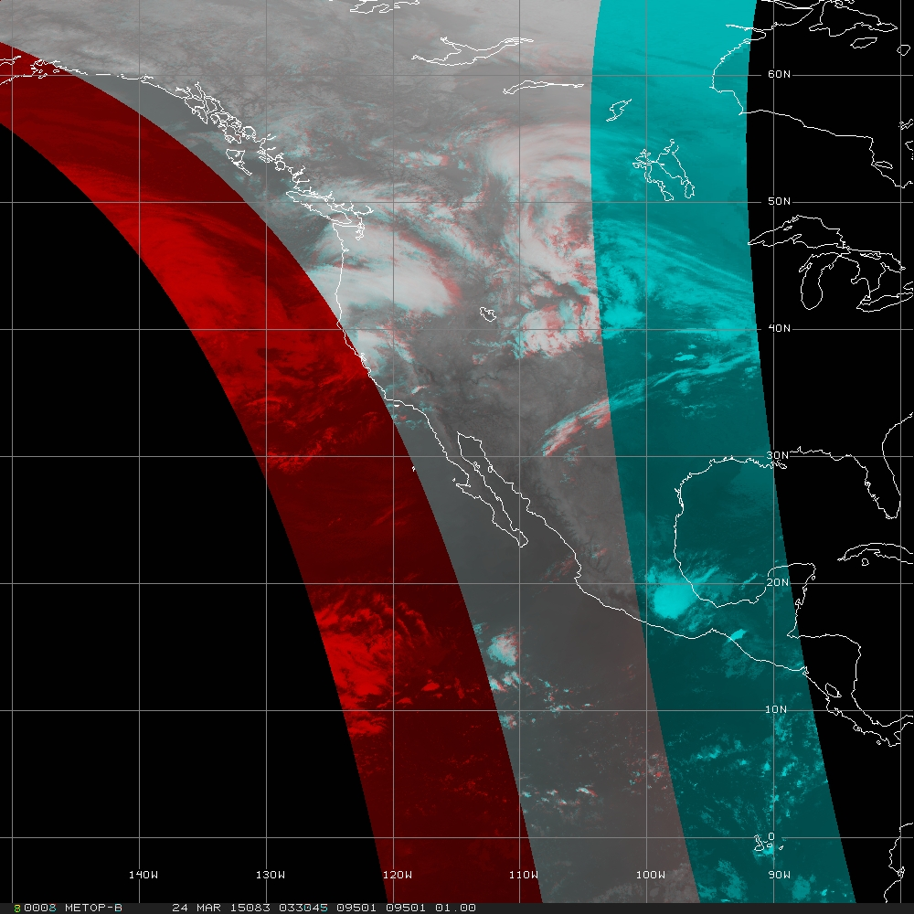
Tandem Satellite Doublet Overlap: Metop-A, -B
Tracking using image pairs increases spatial coverage (all latitudes)
Adjusting for viewing angle effect (parallax) becomes increasingly more important toward the equator
Quality Control has new challenges
Equator
The gray region is where winds are derived

Slide 10
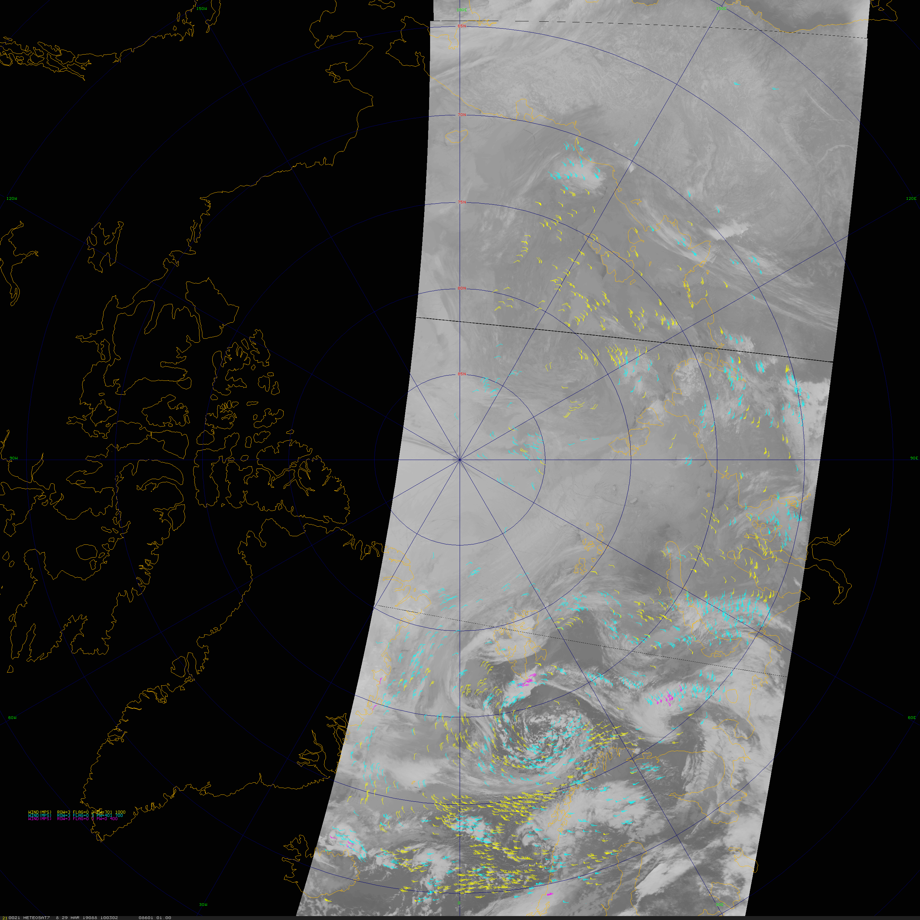
Satellite Triad Overlap: Metop-A, -B, -C
Three satellites in formation
Time separation approximately 1/3 of 100-minute orbit
Metop-C (10:03 UTC), -B (10:36), -A (11:06) 29 March 2019

Slide 11
VIIRS Polar Winds
The Suomi National Polar-orbiting Partnership (S-NPP) satellite was launched 28 October 2011.
The “nested tracking” algorithm developed for GOES-R is used for a higher-quality product.
VIIRS provides:
High spatial resolution (375 & 750 m)
Constrained pixel growth toward edge of swath
A wider swath
These instrument and algorithm features result in a larger number of more accurate wind vectors, than from MODIS and AVHRR

Slide 12
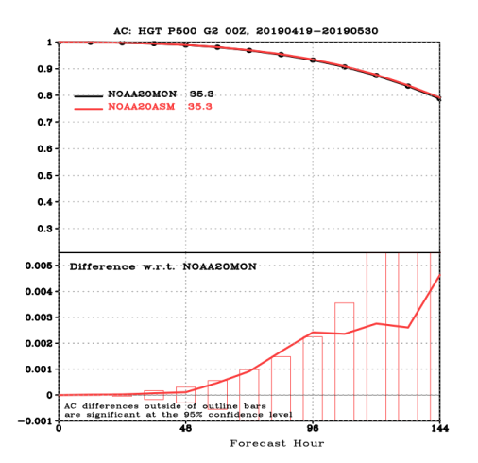
Single-satellite VIIRS Polar Winds Impact
Latest evaluation of NOAA-20 VIIRS winds in NCEP’s GFS/FV3: 19 Apr to 30 May 2019
Overall impact neutral to slightly positive
  Expected as the S-NPP winds were included
Global 500 hPa height Anomaly Correlation statistically significant impact in 72 to 96 hr forecast

Slide 13
What’s next for VIIRS polar winds?
Tandem triplet: Evaluating and planning the eventual transition to NESDIS operations
Higher quality due to shorter time interval between images
Increase in spatial coverage equatorward (from latitude 65º to 50º)
Tandem doublet winds from image pairs of VIIRS:
Experimental
Complete latitude coverage (‘global’)
Correcting for parallax
New Quality Control technique

Slide 14
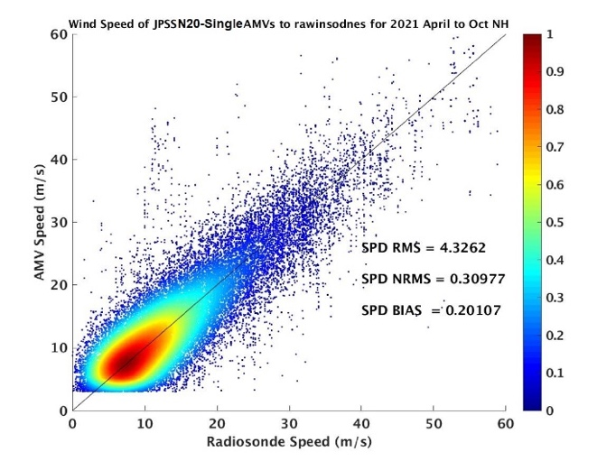
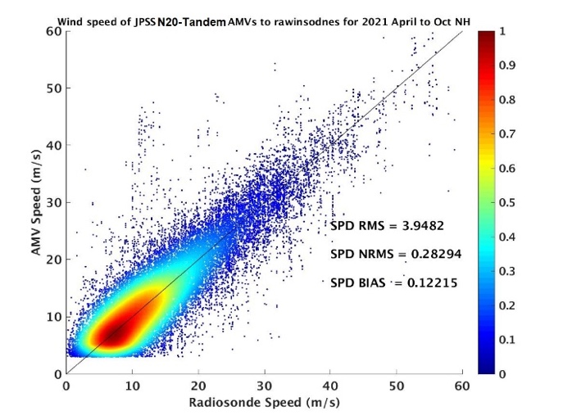
VIIRS Single vs Tandem Triplets Rawinsondes
April through October 2021 Arctic VIIRS AMV comparisons to rawinsondes:
Single-satellite (upper) and tandem triplet of alternating S-NPP/NOAA-20 VIIRS (lower).
  Wind speed density scatter plot
  AMV on y-axis and rawinsonde on x-axis
Speed bias reduced from 0.20 to 0.12 ms⁻¹
Speed RMS reduced from 4.32 to 3.94 ms⁻¹

Slide 15
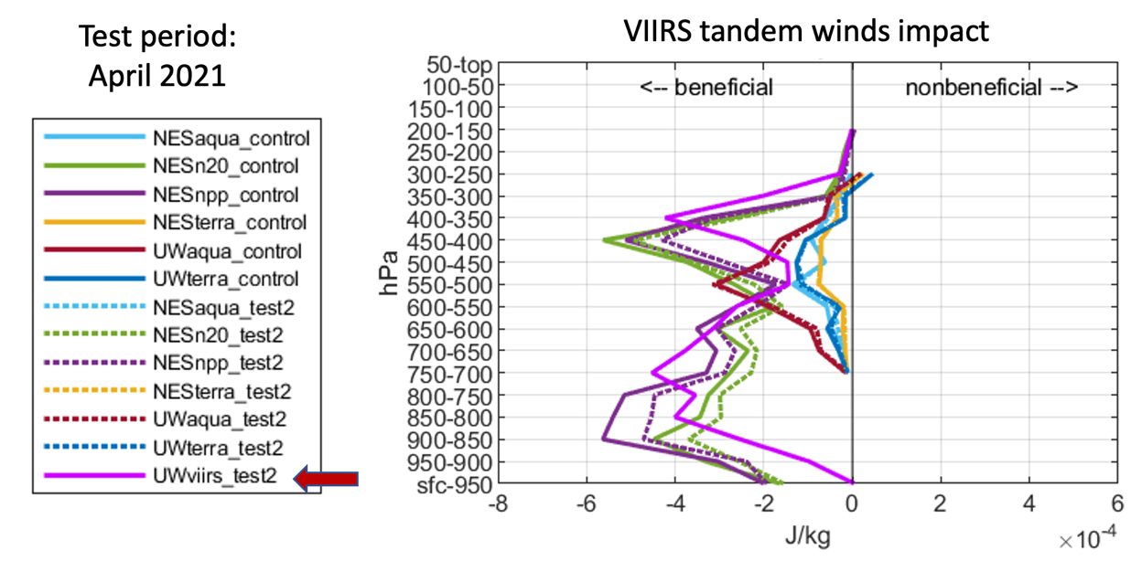
Assimilation of VIIRS tandem triplet winds
Impact of the VIIRS three-orbit tandem winds in an April 2021 test case at NRL.
Triplet of alternating SNPP/NOAA-20 VIIRS
The magenta "UWviirs_test2" line shows a beneficial impact of the new VIIRS triplet tandem winds (Courtesy of Rebecca Stone SAIC/NRL).

Slide 16
VIIRS doublet tandem winds
To prototype the derivation of winds from a pair of images, the following was done:
VIIRS granules were reprojected and composited into one of six predefined sectors (designated by dividing a satellite orbit into six latitude bands).
The heritage algorithm was used in triplet mode (subscript notation 1,2,3 is the time-ordered images), however, the first and third images were the same.
Gross error check: AMV is discarded if its u- or v-component deviates by more than 10 ms⁻¹ from the background model wind forecast.
Parallax correction: The lat₁,lon₁ and lat₂,lon₂ (of the tracked feature) were corrected for parallax based on the viewing angle from the satellite and the height of the AMV.
Quality Indicator: The QI is calculated, as per usual, except a proxy AMV is used for the 2nd vector.

Slide 17
VIIRS doublet tandem winds
Individual orbits from each satellite (S-NPP and NOAA20) are examined to determine the beginning and end times that correspond to the predefined sectors, each of which spans 60 degrees of latitude (~ 16 minutes):
North pole (60º N to 60º N, crossing the pole)
NHemi descending (60º N to equator)
SHemi descending (equator to 60º S)
South pole (60º S to 60º S, crossing the pole)
SHemi ascending (60º S to equator)
NHemi ascending (equator to 60º N)
For a day of VIIRS M15 (window IR) granules, each is reprojected into the appropriate sector, for which there are approximately 14 collections of sectors corresponding to 14 orbits per day.

Slide 18
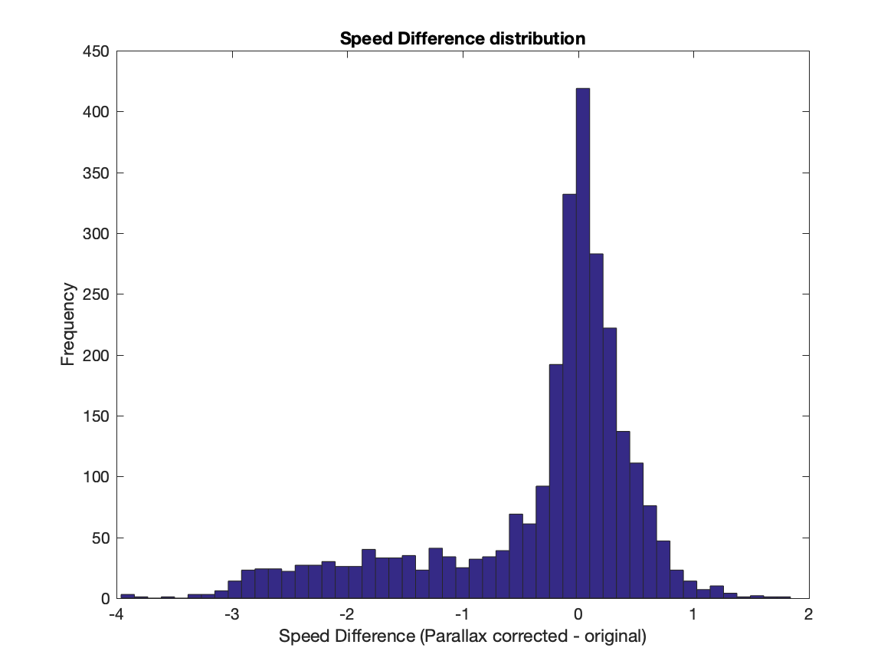
Parallax effects
One time period
Triplet of alternating S-NPP/NOAA-20 VIIRS
2700 vectors
Poleward of 60º latitude
In general, the largest adjustments to wind speed is to reduce the speed

Slide 19
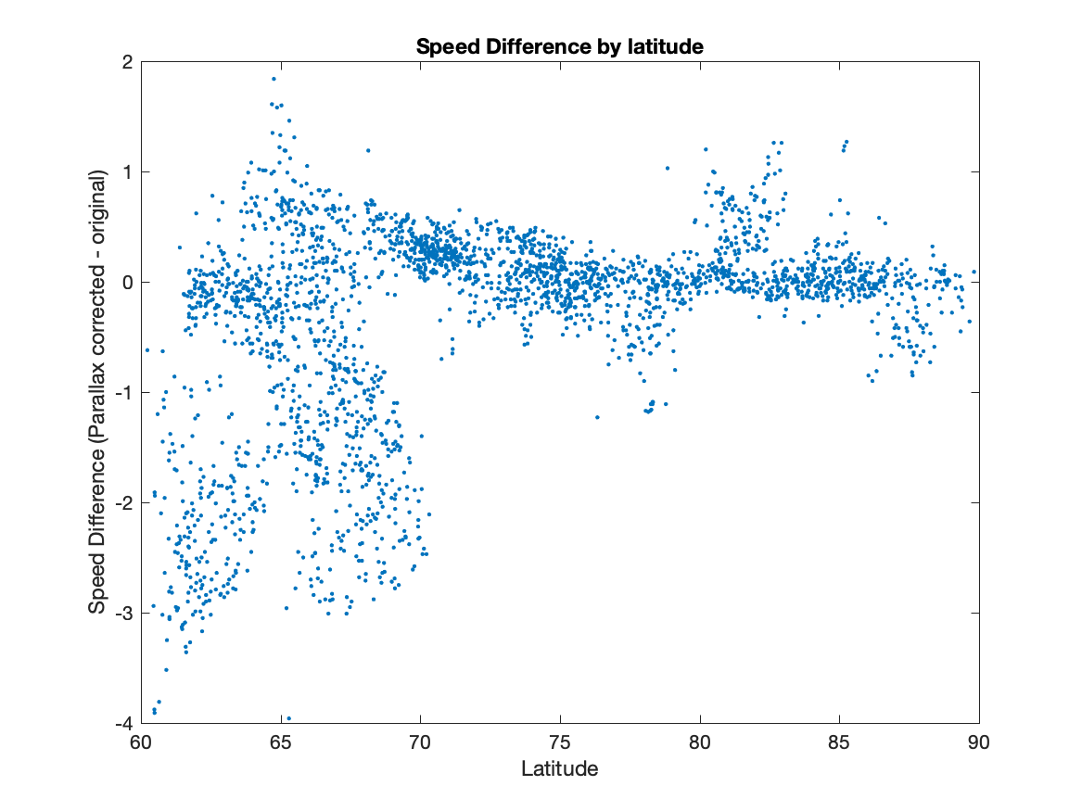
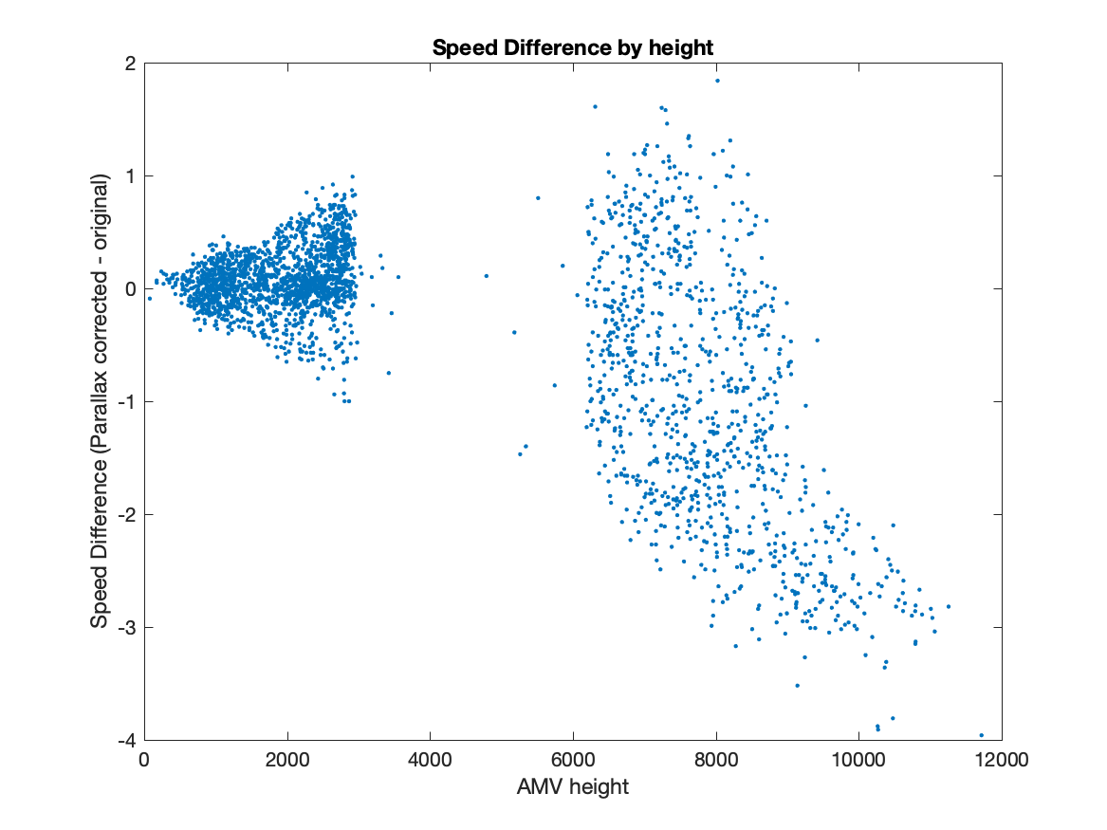
Parallax effects
The further equatorward, the larger the adjustment to the speed (potentially larger viewing angle differences)
The higher the cloud, the larger the adjustment to the speed (with larger viewing angle differences)

Slide 20
Tandem doublet winds: Quality Indicator (QI)
The quality of AMVs is determined by the consistency of the vector pairs derived by tracking features from a triplet of images.
The QI for each AMV is calculated by estimating consistency in the intermediate wind vector pairs and spatial coherence.
For the doublet winds, only a single vector results from each target. Therefore, a proxy wind is used as the 2nd vector.
Proxy wind dataset:
Collection of winds from polar (MODIS, AVHRR from both NOAA and Metop), geostationary satellites, and the Leo/Geo winds; so, there is global coverage.
  The single-satellite VIIRS winds are not part of the proxy winds.
For each doublet wind, its corresponding proxy wind is identified as the spatially closest satellite-derived AMV at the same nominal hour that is within 50 hPa and 150 km, with a QI ≥ 80.
  If a proxy wind is not found (meaning, all the thresholds are not met), that doublet AMV is discarded.

Slide 21
Tandem doublet winds: Case study
Six weeks of VIIRS granules were captured in real-time from 18 September to 03 November 2021.
10-11 October 2021 were missed and not recoverable
Winds were derived from image pairs (S-NPP -> NOAA-20 and NOAA-20 -> S-NPP)
More than 30 million raw winds derived; ~16 million met the quality control (QI ≥ 60)

Slide 22
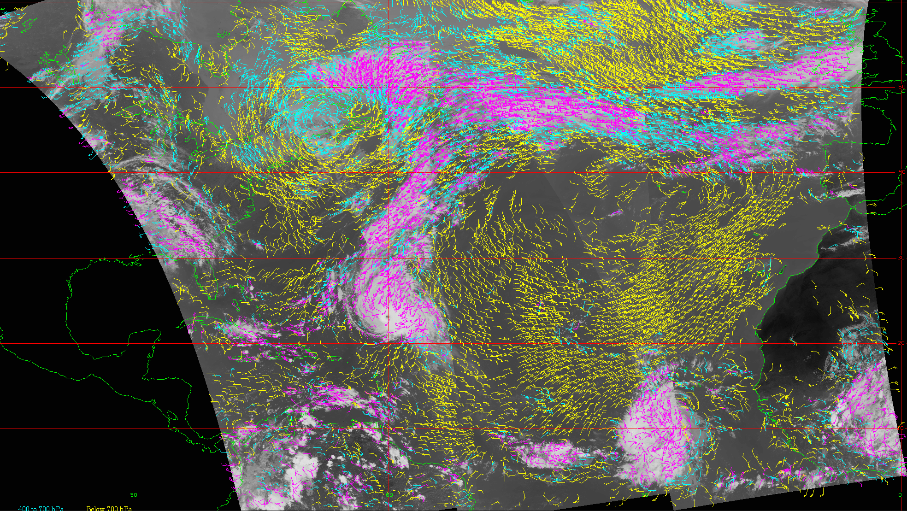
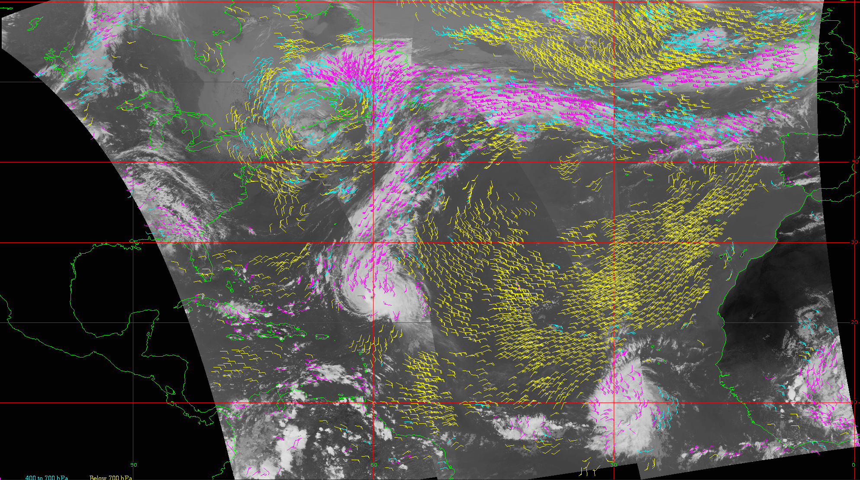
VIIRS triplet tandem winds
An example of VIIRS IR winds coverage using several orbits of alternating passes from S-NPP and NOAA-20, color-coded by height:
Yellow (below 700 hPa), cyan (400 to 700 hPa), magenta (above 400 hPa)
The left panel is all derived winds; the right panel is parallax-corrected, quality-controlled winds.

Slide 23
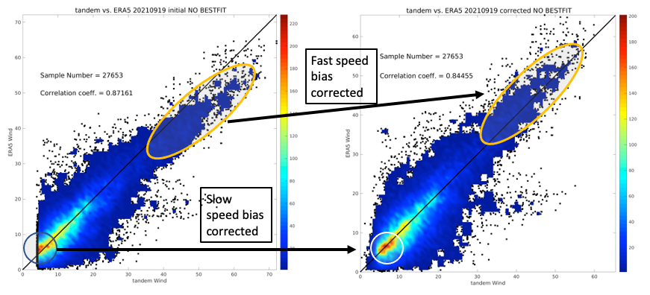
VIIRS doublet tandem winds parallax correction
ERA5 vs tandem doublet wind speed density plot for the raw winds (left) and parallax corrected (right). One day: 19 September 2021.
Circles in the lower left: Correction of a slow speed bias
Ellipses in the upper right: Correction of a fast speed bias.

Slide 24
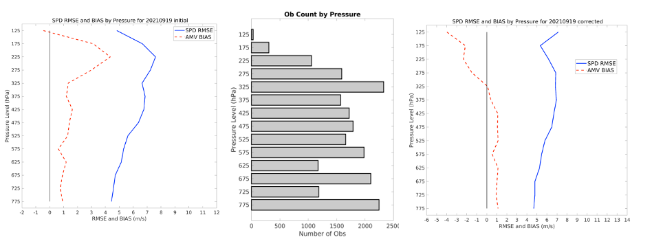
VIIRS doublet tandem winds parallax correction
Speed bias (red) and RMSE (blue) of the doublet winds as compared to ERA5. Initial winds (left) and parallax adjusted (right).
Raw doublet winds (no quality control) for 19 September 2021.
Parallax-corrected AMV speed bias is reduced with height, except it overshoots above 325 hPa
The middle panel is the number of doublet AMVs that are colocated with ERA5 grid points

Slide 25
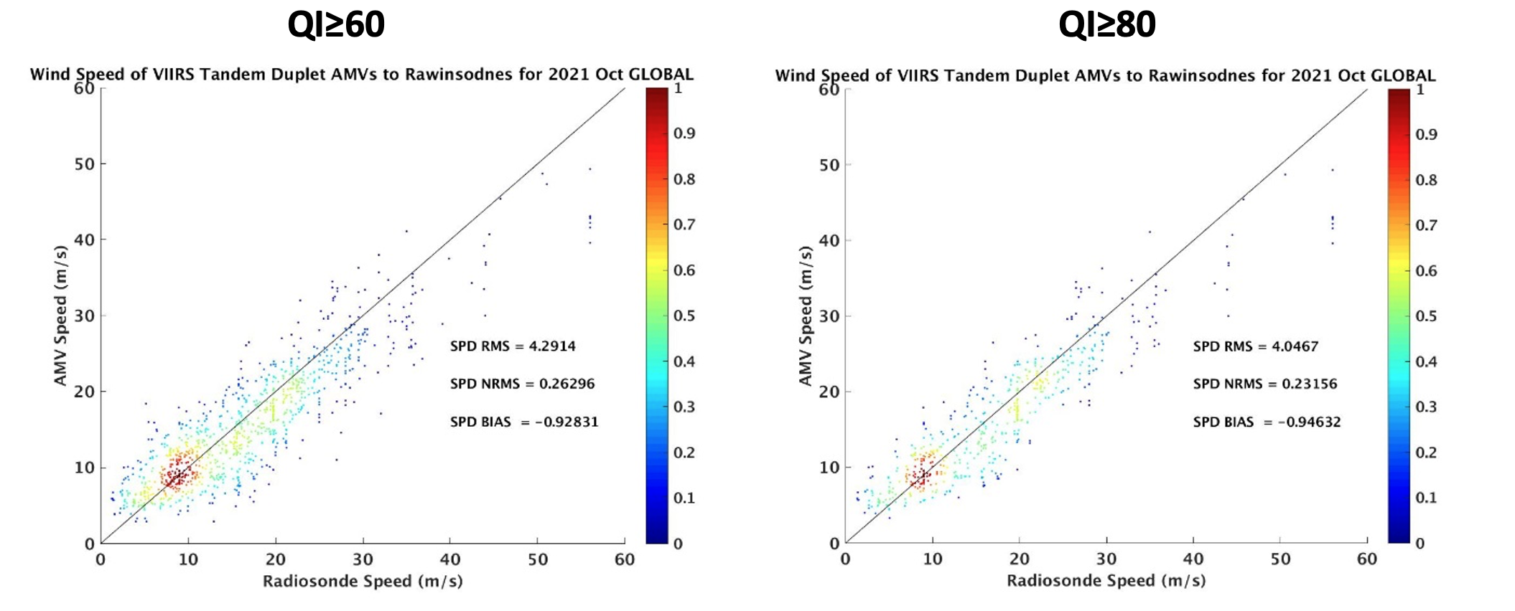
VIIRS doublet tandem winds: QI evaluation
Density scatter plot of VIIRS vs rawinsonde wind speed for QI ≥ 60 (left) and QI ≥ 80 (right) during October 2021.
The use of proxy winds to calculate the QI shows skill in identifying higher-quality AMVs:
Speed RMS is reduced from 4.29 ms⁻¹ to 4.05 ms⁻¹ for higher QI values

Slide 26
VIIRS doublet tandem winds
 | Vector Accuracy |  | Vector Precision |  | Sample sizes
QI | ≥60 | ≥80 | ≥60 | ≥80 | ≥60 | ≥80
All | 5.29 | 4.67 | 3.49 | 2.98 | 1036 | 568
High ≤400 hPa | 6.17 | 6.00 | 3.49 | 3.64 | 251 | 157
Mid 700 to 400 hPa | 5.62 | 4.88 | 3.20 | 2.56 | 447 | 199
Low >700 hPa | 4.21 | 3.50 | 3.58 | 2.25 | 338 | 212
Statistical comparisons of the global tandem doublet VIIRS AMVs compared to rawinsondes for October 2021.
The statistics are vector accuracy (mean vector difference), precision (RMS difference), and sample size .
Results are separated into two QI categories (≥ 60 and ≥ 80) and three layers: High ≤400 hPa, Mid 700-400 hPa, and below 700 hPa.
Again, higher QI values are associated with improved statistics of the AMVs compared to rawinsondes by layer, except for Vector Precision for high-level AMVs (highlighted in red).

Slide 27
VIIRS doublet tandem winds: Assimilation
The final step of the project was to assimilate the winds into the GDAS/GFS to quantify the NWP impact of the VIIRS doublet winds on the analysis and forecast:
Developed a GRIB encoder for the doublet winds for importing into the GDAS
Configured the FV3 GDAS on S4
Time period is 18 Sep to 01 Nov 2021:
  The first two weeks are model “spin-up”
  Statistics are based on 01 October to 01 November 2021
The Control run is the default GFS:
Did not contain VIIRS single-satellite polar winds.
The Experiment has the same configuration as control:
Addition of the global VIIRS doublet winds
AVHRR winds error profile is used

Slide 28
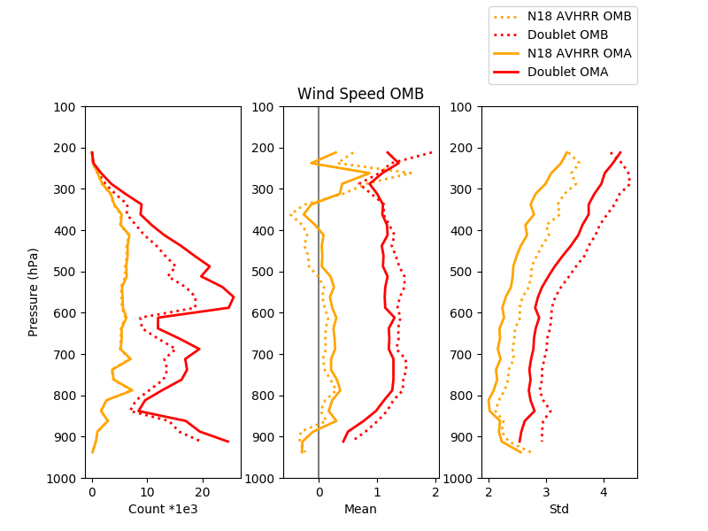
VIIRS doublet tandem winds: Assimilation Statistics
Polar Regions
GDAS/GFS observation minus background (OMB) and observation minus analysis (OMA) for 01 October to 01 November 2021:
NOAA-18 AVHRR winds (gold); VIIRS doublet winds (red)
Dashed lines (OMB); solid lines (OMA)
Good news:
  The assimilation of VIIRS doublet winds reduces the bias and standard deviation when comparing OMB to OMA
Expected issues:
  Quality of the VIIRS doublet winds is less than AVHRR (triplet)
  1 ms⁻¹ speed bias in the OMB and OMA vertical profiles; also evident in comparisons to rawinsondes and the ERA5 reanalysis.
Number of observations (left), OMB/OMA mean (middle), OMB/OMA standard deviation (right) for wind speed

Slide 29
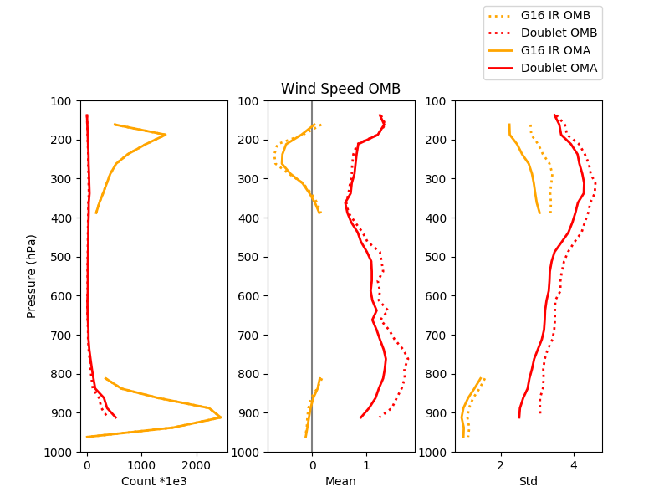
VIIRS doublet tandem winds: Assimilation Statistics
Middle Latitudes
GDAS/GFS observation minus background (OMB) and observation minus analysis (OMA) for 01 October to 01 November 2021:
GOES-16 ABI winds (gold); VIIRS doublet winds (red)
Dashed lines (OMB); solid lines (OMA)
Good news:
  The assimilation of VIIRS doublet winds reduces the bias and standard deviation when comparing OMB to OMA
Expected issues:
  Quality of the VIIRS doublet winds is less than ABI (triplet)
  1 ms⁻¹ speed bias in the OMB and OMA vertical profiles; also evident in comparisons to rawinsondes and the ERA5 reanalysis.
Number of observations (left), OMB/OMA mean (middle), OMB/OMA standard deviation (right) for wind speed. Note: GOES-16 AMVs from 400 to 800 hPa are not assimilated in the GDAS.

Slide 30
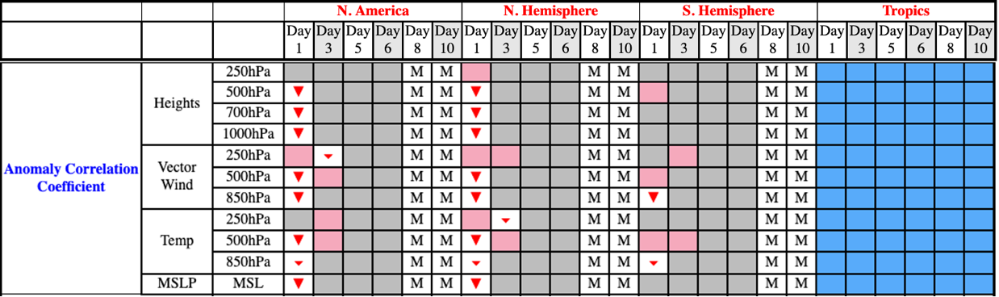
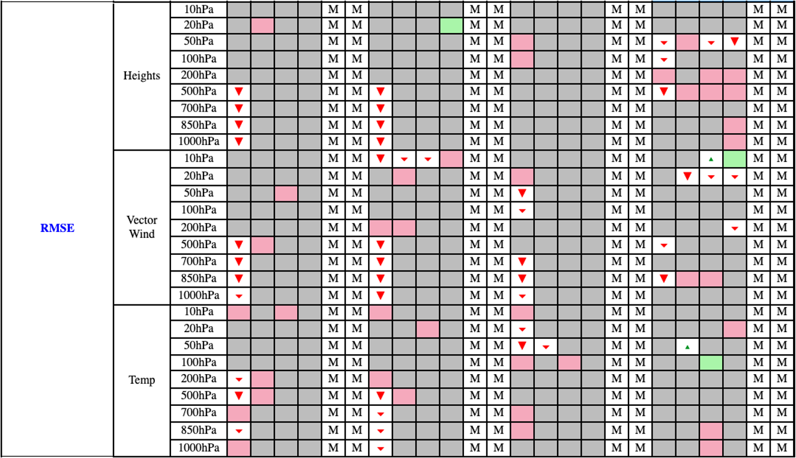
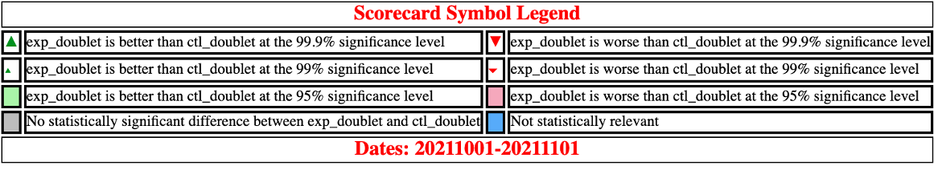
VIIRS doublet tandem winds: Forecast Statistics
  Overall, the forecast impact on the ACC and RMSE was neutral beyond the 24-hr forecast (Day 1):
  Large number of gray boxes in the GFS forecast scorecard.
  However, there are many red triangles (degradation) at Day 1 and a few green shaded boxes (improvement) at later forecast hours which indicate statistically significant changes.

Slide 31
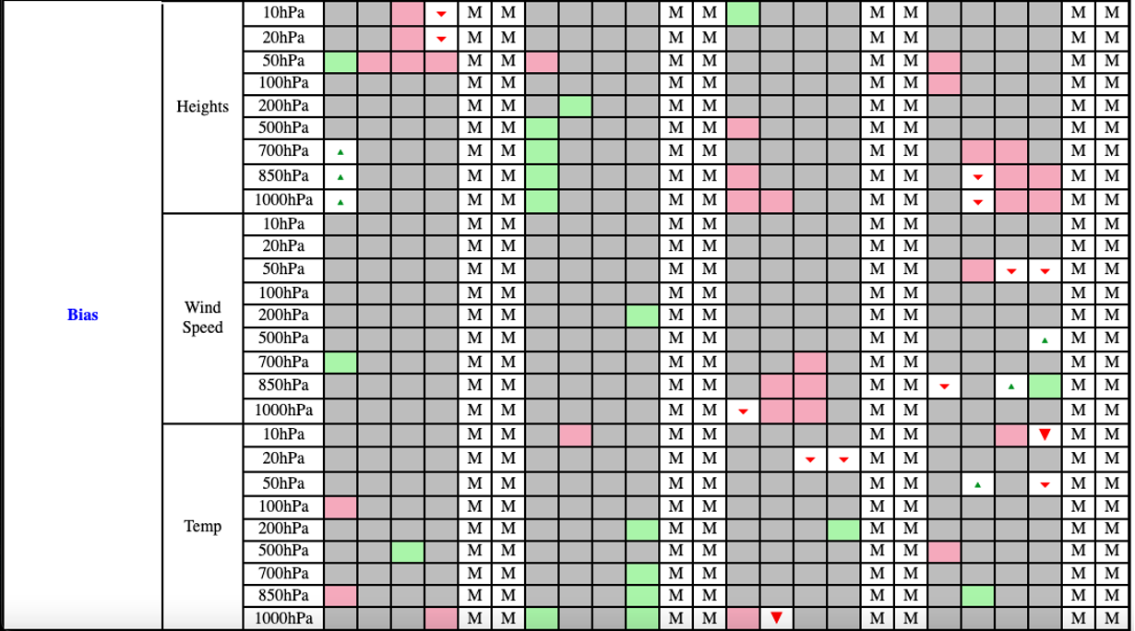
VIIRS doublet tandem winds: Forecast Statistics
  Overall, the forecast impact on the bias was neutral:
  Large number of gray boxes in the GFS forecast scorecard.
  However, there is a substantial mix of red (degradation) and green boxes (improvement) which denote statistically significant changes.

Slide 32
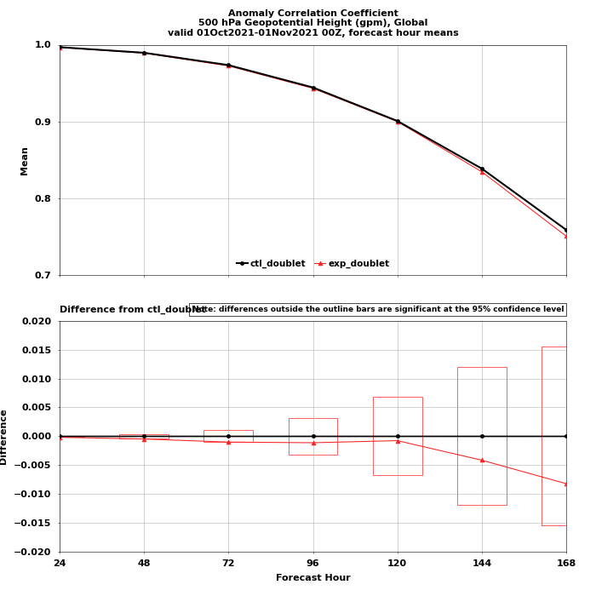
VIIRS doublet tandem winds: Forecast Statistics
Anomaly Correlation Coefficient (ACC) of the global 500 hPa geopotential height for the control (black) and experiment (red) from 01 October to 01 November 2021.
The upper panel is the die-off curve of the mean ACC vs forecast hour (24 to 168). The lower panel is the difference in the ACC between the experiment and control.
The VIIRS doublet AMVs have a marginally statistically significant degradation out to 72 hours, then a statistically neutral impact beyond 72 hours on the global 500 hPa geopotential heights

Slide 33
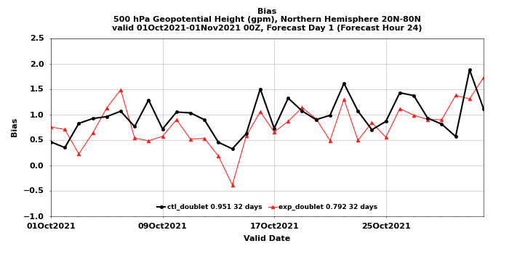
VIIRS doublet tandem winds: Forecast Statistics
The 24-hour forecast of GFS 500 hPa geopotential height bias over the northern hemisphere from 01 October to 01 November 2021. Control (black), experiment (red).
The VIIRS doublet winds exhibit a general improvement in the 500 hPa height bias at the 24-hour forecast.

Slide 34
Looking Ahead
Generating AMVs from a satellite triad:
Previously possible with Metop-A, -B, -C; Metop-A currently not operating
Future Metop-SG may have similar configuration for a short period of time (mixed Metop and Metop-SG)
May investigate current satellite triad for VIIRS while S-NPP is still operating
Currently, using the satellite triad to derive AMVs from CrIS retrievals
Generating simulated AMVs from Nature Runs using machine learning and optical flow
Possibly adapt to satellite triad of CrIS SFOV humidity retrievals

Slide 35
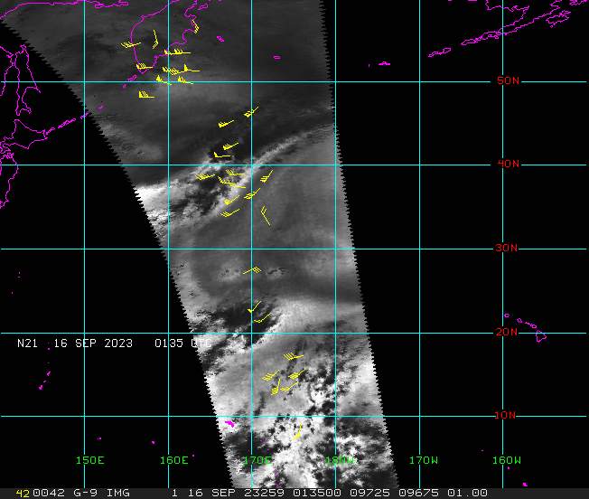
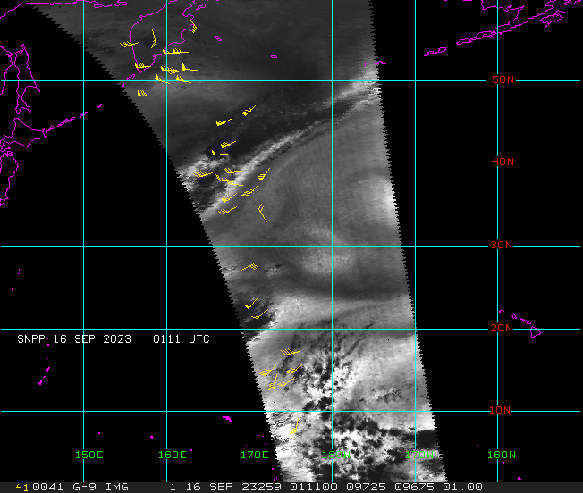
Satellite triad CrIS AMVs
Derive AMVs from humidity fields using single field of view (SFOV) CrIS retrievals, from a satellite triad:
Similar scheme as VIIRS doublet AMVs (sectorized processing), but using a satellite triad (S-NPP, NOAA-21, NOAA-20)
Example on the right showing the 3 passes, separated by ~25 minutes each, with AMVs overlayed
The dark areas are clouds, which need to be masked out
“CIMSS Research Toward Determining Global Three Dimensional Winds by Tracking Features In Temporal Sequences of Polar Weather Satellite Humidity and Ozone Retrievals FY23” NOAA POC: Satya Kalluri

Slide 36
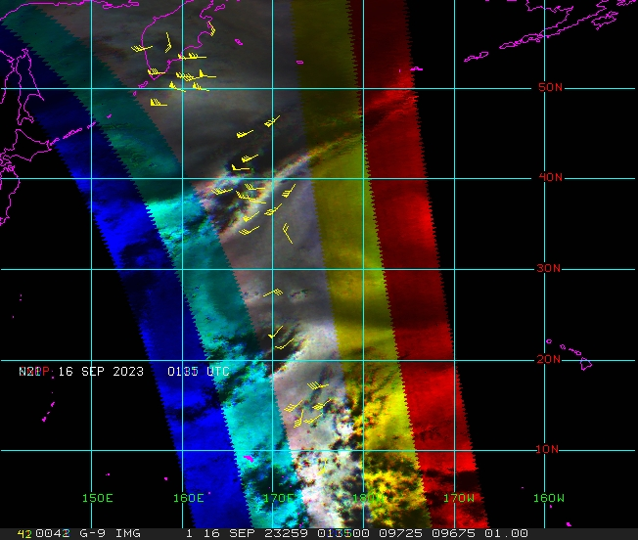
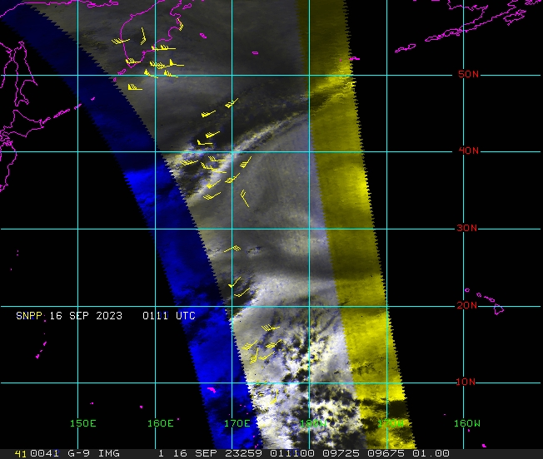
Satellite triad vs doublet CrIS overlap
The 3 swaths (left) are color-coded as RGB; the resulting gray overlap region is where AMVs can be generated. The right panel shows the coverage for 2 swaths, which would double the AMV coverage.

Slide 37
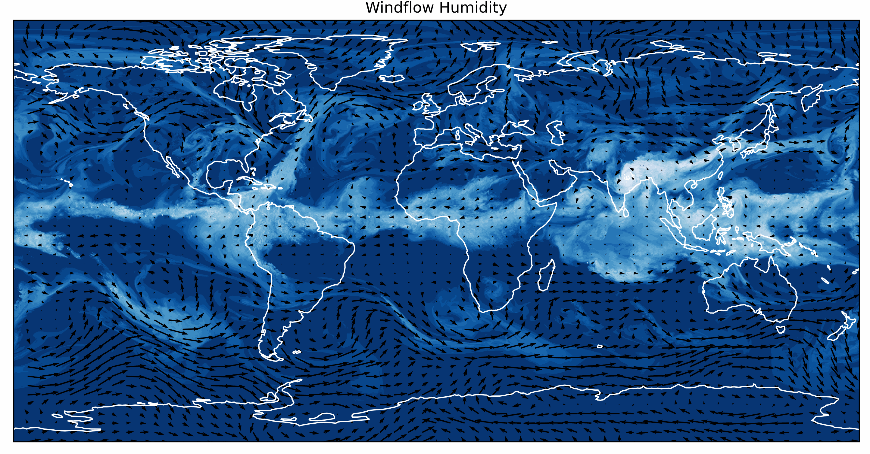

Simulated AMVs from Nature Run humidity fields
WindFlow: A machine learning, optical flow feature tracking system
Currently trained on 2 months of GEOS-5 Nature Run humidity grids
Configured WindFlow to operate on ECO1280 Nature Run humidity grids
Upper panel: WindFlow derived AMVs from a pair of ECO1280 humidity grids at 500 hPa
Lower panel: The ‘truth’ wind field from the ECO1280
  Visually, the agreement between the upper and lower panels is very good. No quality control was applied.
Applications:
Replace current winds algorithm to:
  Derive simulated AMVs from Nature Runs for informing AMV coverage for future satellite missions
  Derive AMVs from CrIS humidity retrievals
Advantages:
  Higher density AMVs
  Uniform coverage
  Potentially more accurate AMVs
“CIMSS Support for Generation of 3D Atmospheric Motion Vectors from the ECO1280 Nature Run” NOAA POC: Lidia Cucurull

Slide 38
Key Takeaways
VIIRS tandem triplet AMVs: The improved statistics as compared to rawinsondes and the beneficial impact at NRL will likely result in this product being generated at NESDIS operations.
VIIRS doublet AMVs GDAS/GFS experiment: The overall neutral impact of the VIIRS doublet AMVs is encouraging given the nature of the updates to the winds algorithm, parallax correction, quality control, and determination of the quality indicator. And, the use of a preliminary error profile for the assimilation.

Slide 39
Questions?

