Slide 1
Visualizing and Analyzing Satellite Data in McIDAS-V
30 September 2026
Dave Santek
Bob Carp

Slide 2
JPSS

Slide 3
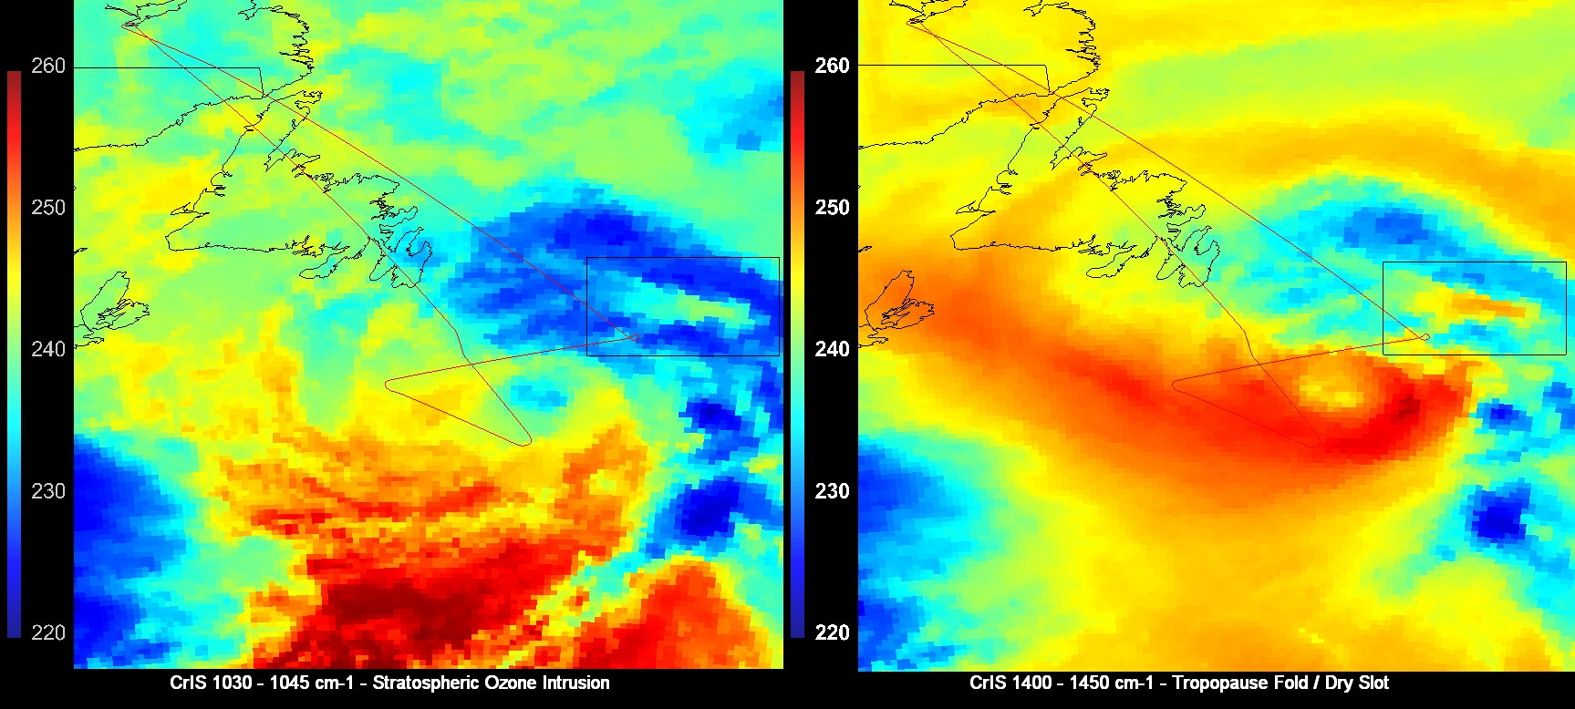
CrIS Convolution
Using HYDRA-2 in McIDAS-V, users can convolve across a range of wavenumbers to highlight different features at different levels of the atmosphere. In the above scene, the left panel shows stratospheric ozone intrusion. The right panel shows dry stratospheric air that has penetrated deep into the troposphere, allowing the sensor to detect temperatures closer to the surface

Slide 4
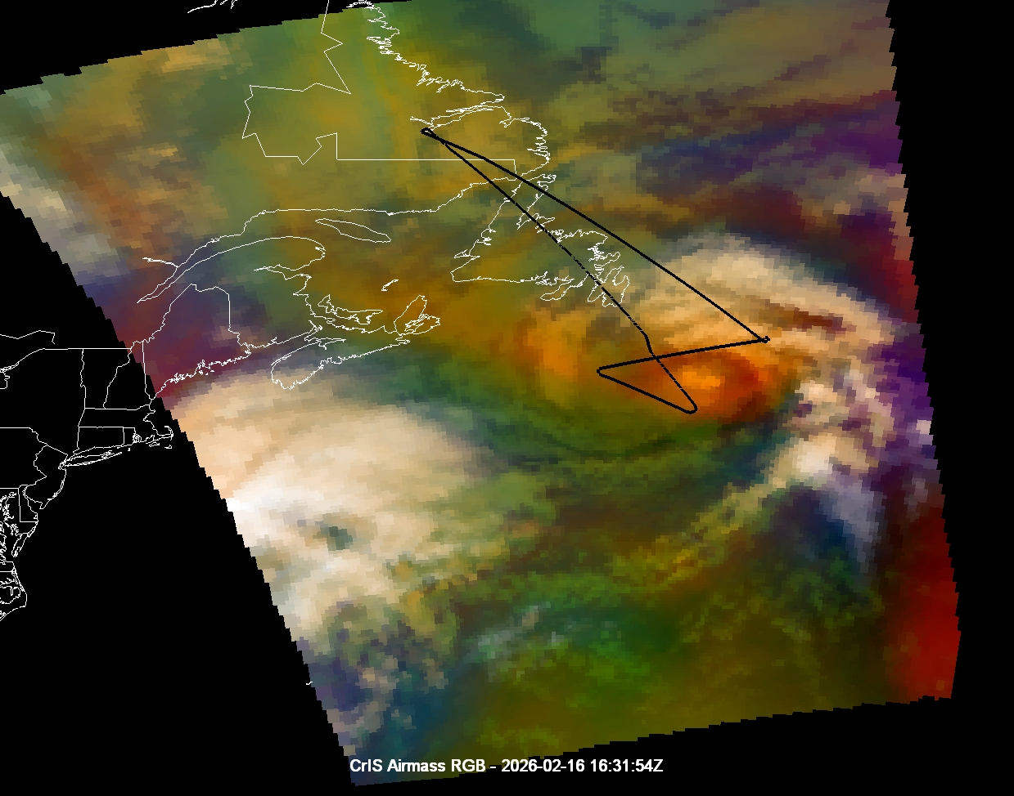
CrIS Airmass RGB
The figure to the left shows a CrIS Airmass RGB over a Tropopause Polar Vortex (TPV). This was created by using HYDRA-2 to convolve across wavenumbers to simulate broadband ABI channels used for the ABI Airmass RGB. The convolved CrIS data was then passed through the ABI Airmass RGB recipe to create the display.
This is useful as JPSS VIIRS data does not have any water vapor bands, which are necessary to produce a variety of RGBs.

Slide 5
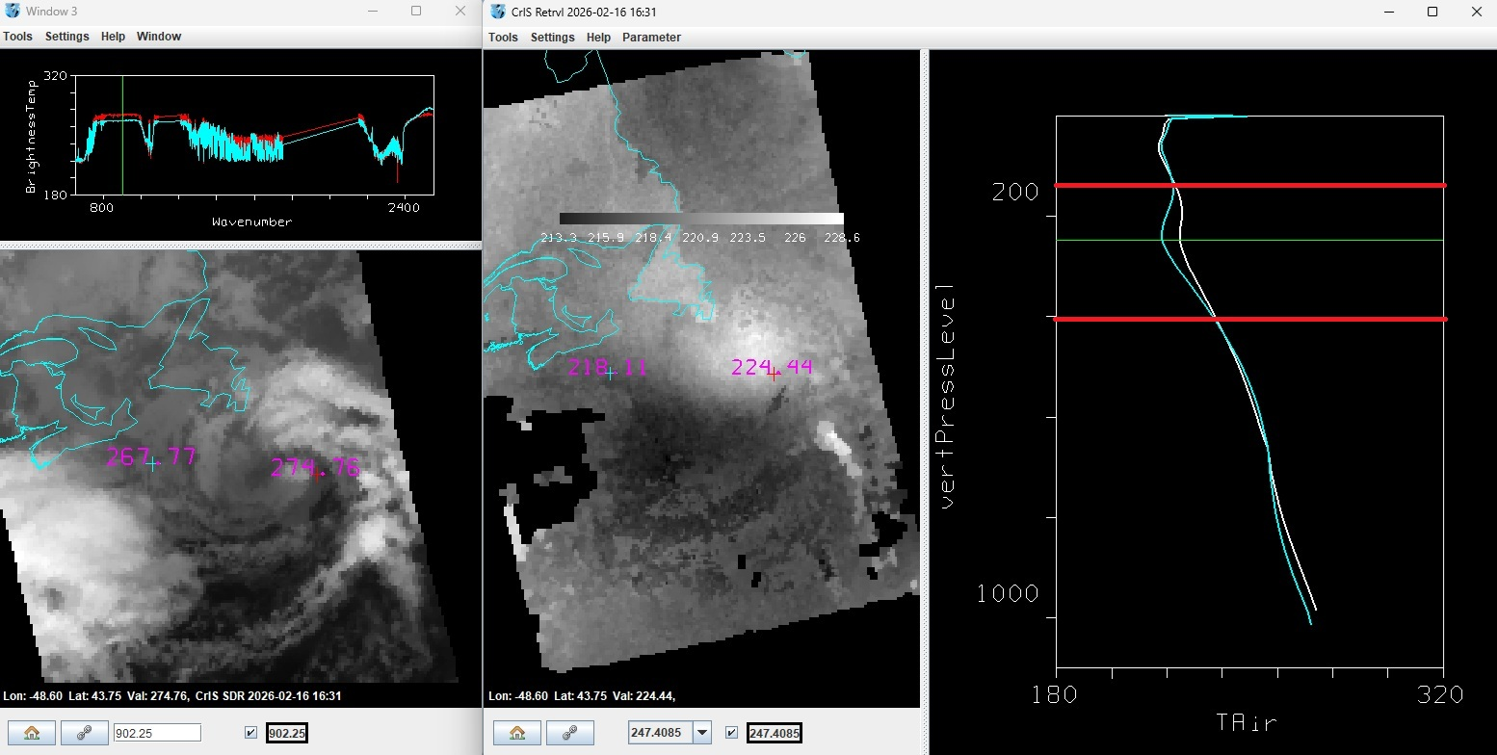
CrIS Retrieval in HYDRA2
Left: NOAA-20 MultiSpectral display of CrIS SDR data.
Right: Vertical profile of air temperature. White profile line is the probe over the TPV. Blue probe is west of the TPV. The two profiles are similar, except for a range between 150 and 350hPa (between red lines) where the temperature is warmer over the TPV. This may show warmer stratospheric air intruding lower into the atmosphere.

Slide 6
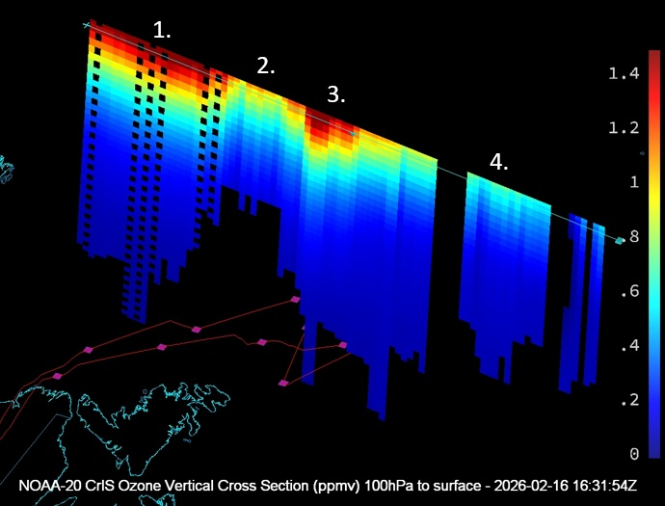
CrIS Retrieval Vertical Cross Section of Ozone
1: High ozone concentrations are stratospheric ozone inside the low polar tropopause / TPV environment.
2: Gap in high ozone concentrations. This marks the jet axis / baroclinic boundary.
3: High ozone concentrations are stratospheric ozone brought down into the troposphere by a tropopause fold.
4: Further south ozone concentrations are lower because no stratospheric ozone is being intruded. In this warmer airmass, the height of the tropopause is higher than in the colder, northern airmass.

Slide 7
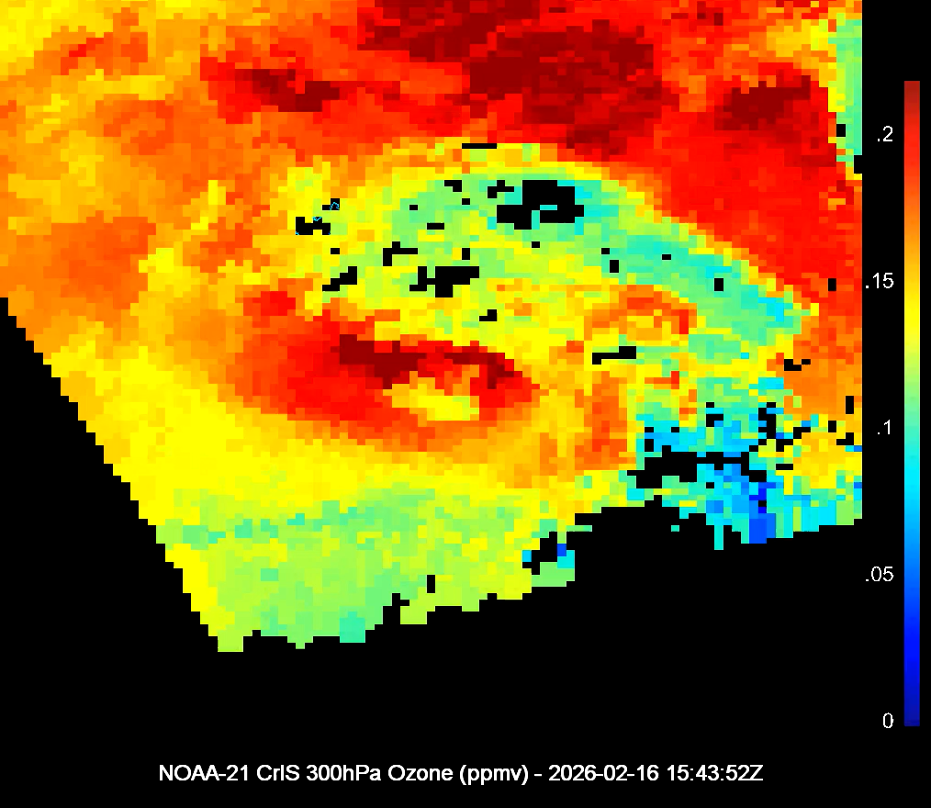
CrIS Retrieval 300hPa Ozone
This animation shows CrIS retrieval 300hPa ozone zoomed in over the center of the TPV.
Time 1: NOAA-21 from 15:43:52Z.
Time 2: NOAA-20 from 16:31:54Z.
The images show an eastward movement in the center of the TPV along with possible rotation.

Slide 8
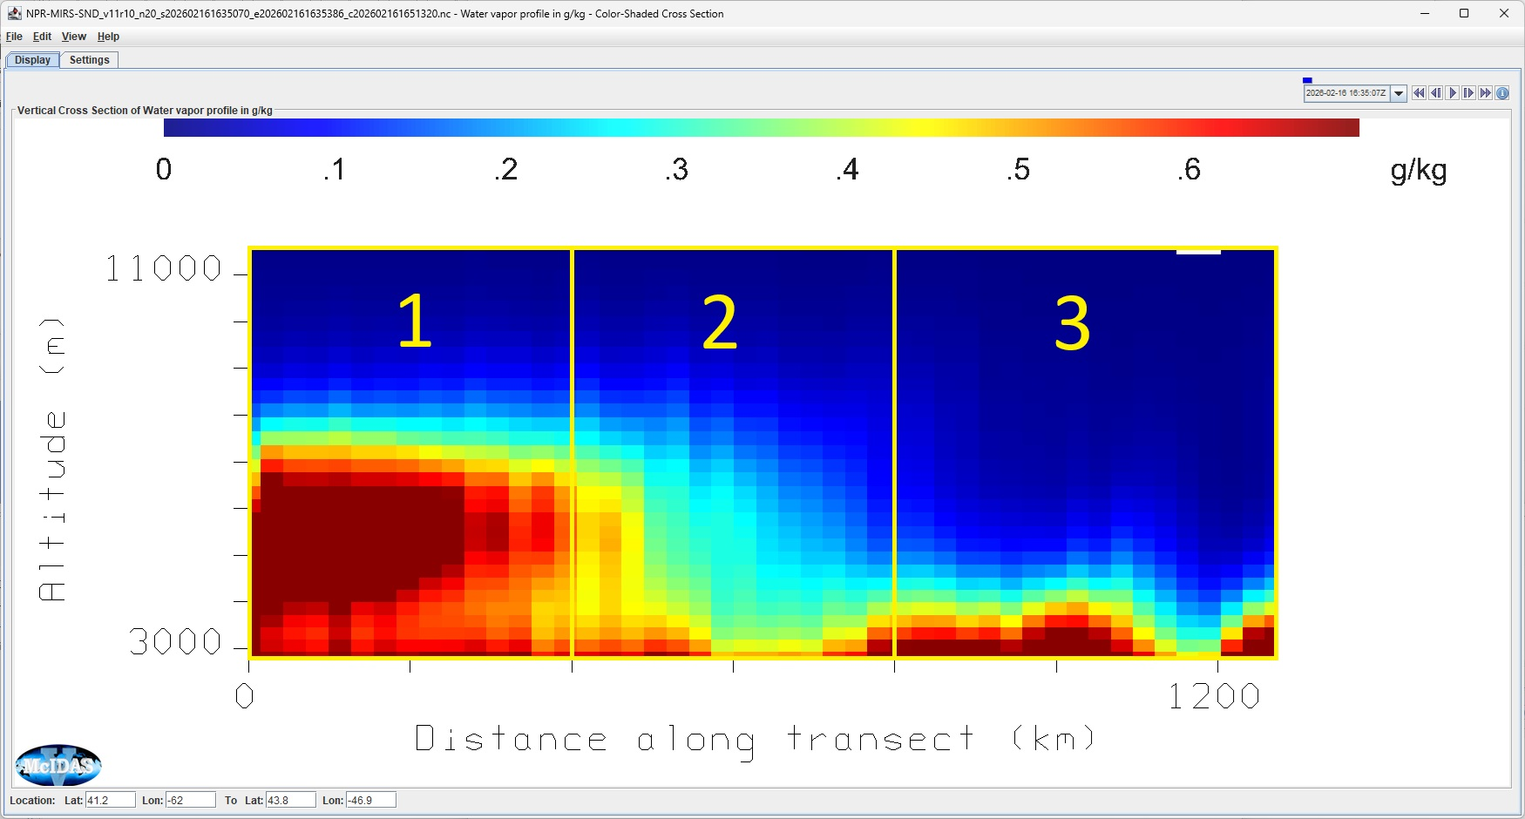
MiRS Water Vapor Vertical Cross Section
Panel 1 (0-400km): High concentration of water vapor trapped in the mid-to-lower troposphere.
Panel 2 (400-800km): Boundary between moist and dry air slopes down. The moisture ceiling collapses from 6,000 to below 3,000 meters. This is the physical tropopause fold.
Panel 3 (800-1200km): The core of the stratospheric dry intrusion extends down near the marine boundary layer. This is the stratospheric dry slot that matches with orange/red from the Airmass RGB.

Slide 9
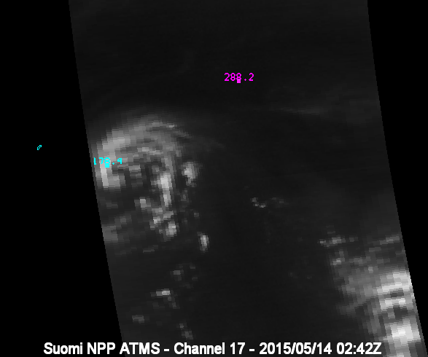
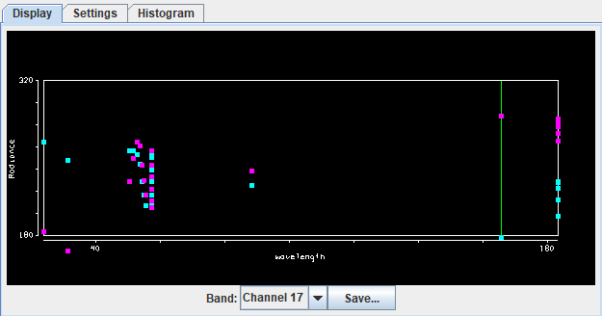
ATMS
Users can load and display ATMS data in McIDAS-V. The interactive display allows users to position data probes anywhere over the scene and see the brightness temperature at that location across all channels. The user can choose which channel is displayed and change the enhancement and range.

Slide 10
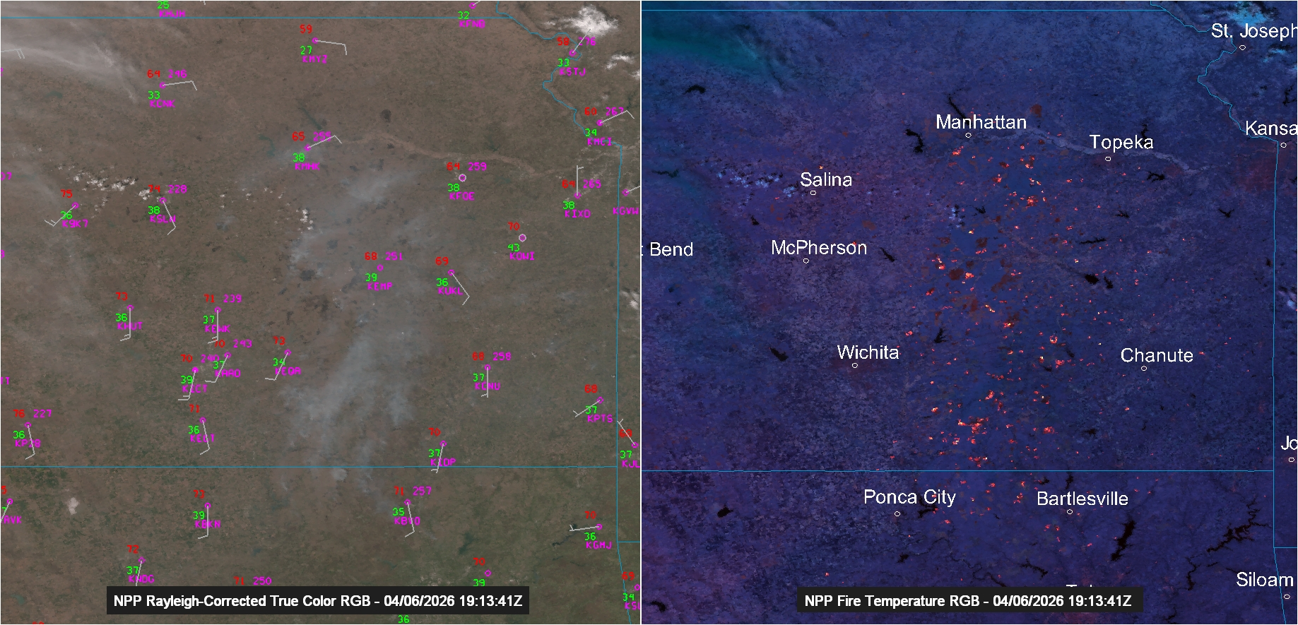
VIIRS
The above image shows Suomi NPP VIIRS Rayleigh Corrected True Color RGB (left) and a Fire Temperature RGB (right). The left image is overlaid with METARs and the right has city labels. A variety of RGB recipes for VIIRS data come packaged with the software and are easy to display as derived fields where the user does not need to individually select each band/calibration. Imagery EDRs and L2 EDR products are supported as well.

Slide 11
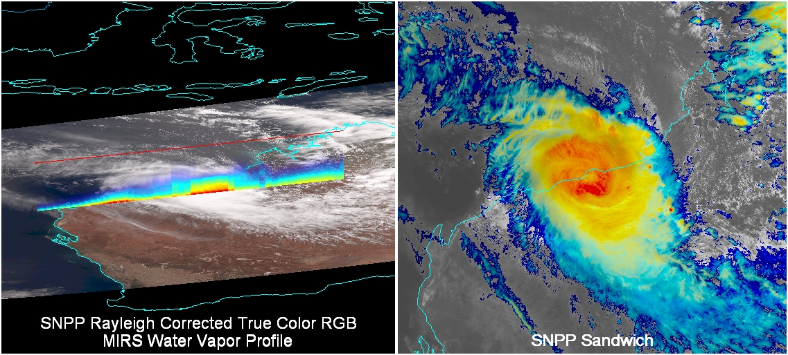
VIIRS and MiRS
The above images are from Tropical Cyclone Zelia in over Australia in February 2025. The left panel shows Suomi NPP VIIRS Rayleigh Corrected True Color RGB imagery overlaid with a vertical backscatter of water vapor. The right panel shows a sandwich RGB, which allows for observing visible data (grayscale enhancement) overlaid with infrared temperatures (rainbow enhancement).

Slide 12
Other LEOs

Slide 13
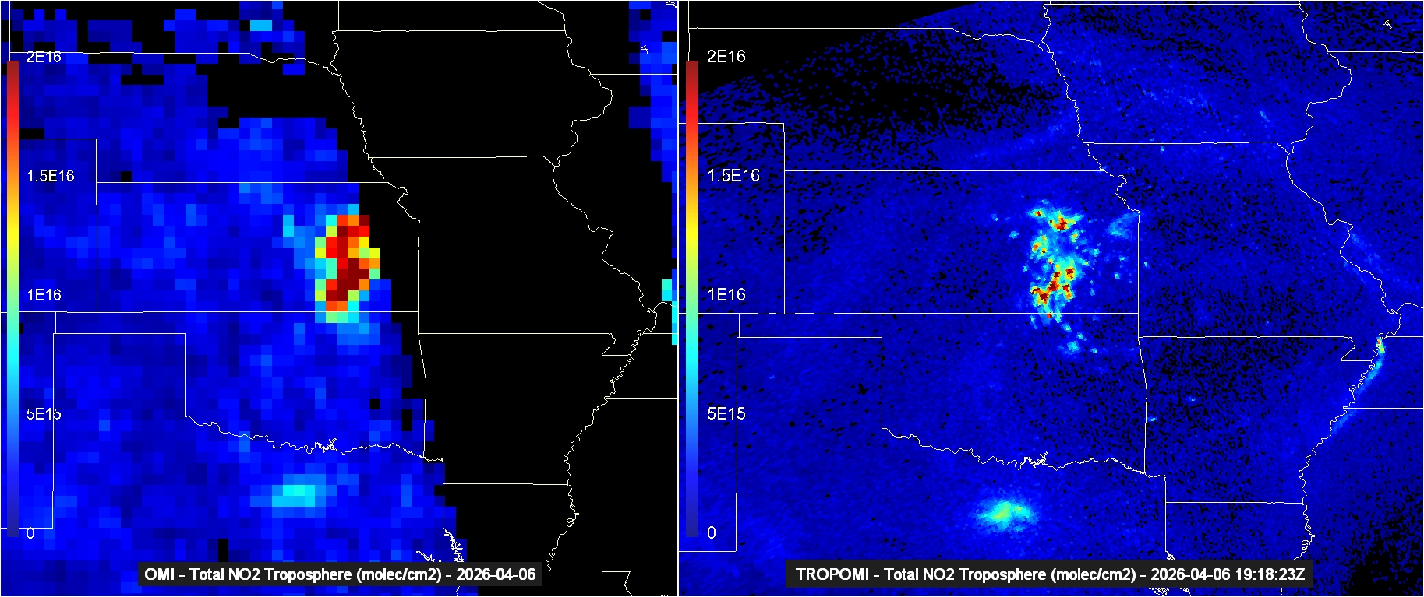
OMI and TROPOMI
The above image shows OMI tropospheric NO2 on the left and TROPOMI tropospheric NO2 on the right. Data from different satellites can be overlaid or displayed side-by-side to assist in analysis and verifying the fidelity of new instruments.

Slide 14
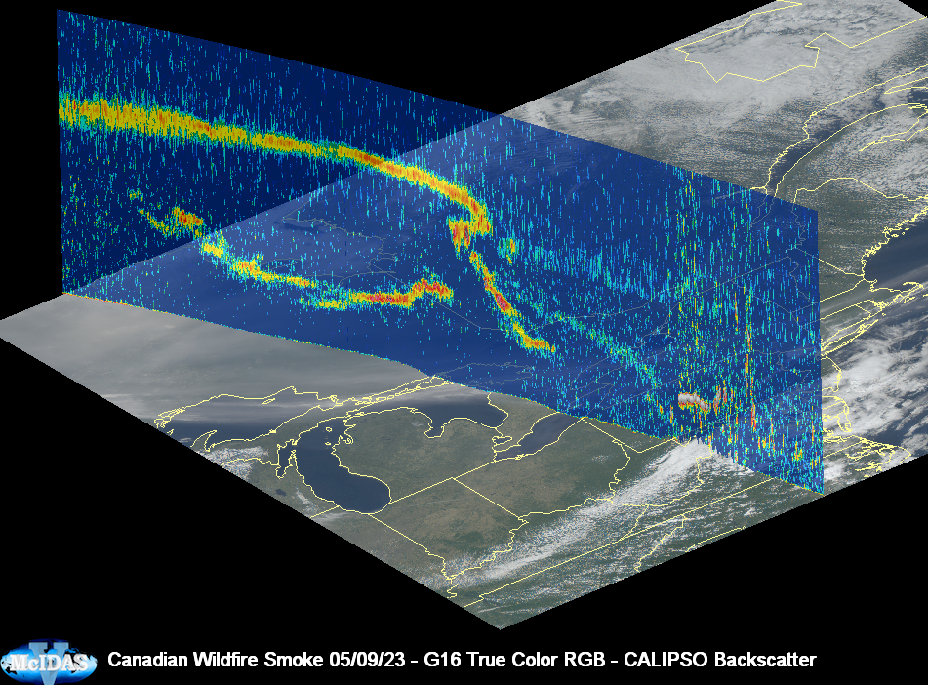
CALIPSO
The image on the left shows a CALIPSO backscatter pass overlaid on GOES East True Color RGB imagery from a Canadian wildfire event in June 2023.
Overlaying LEO data on GEO helps to provide context to the data. In this case, the GEO data gives the horizontal extent of the smoke, and the LEO gives information about the altitude and concentration of the smoke.

Slide 15
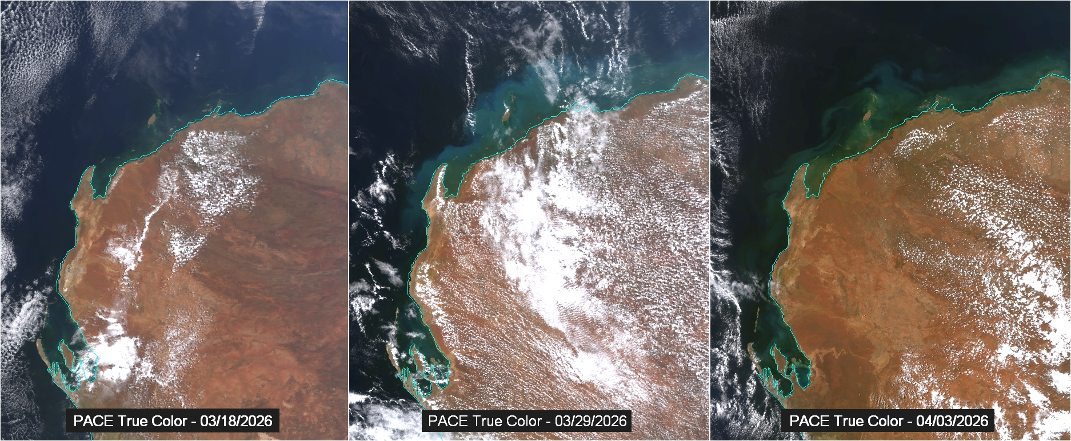
NASA PACE
The above images show PACE true color RGB imagery from before (left) and after (center and right) the passage of cyclone Narelle in northwestern Australia. PACE is an ocean color instrument and is useful to detect sediment, algae, and chlorophyl.

Slide 16
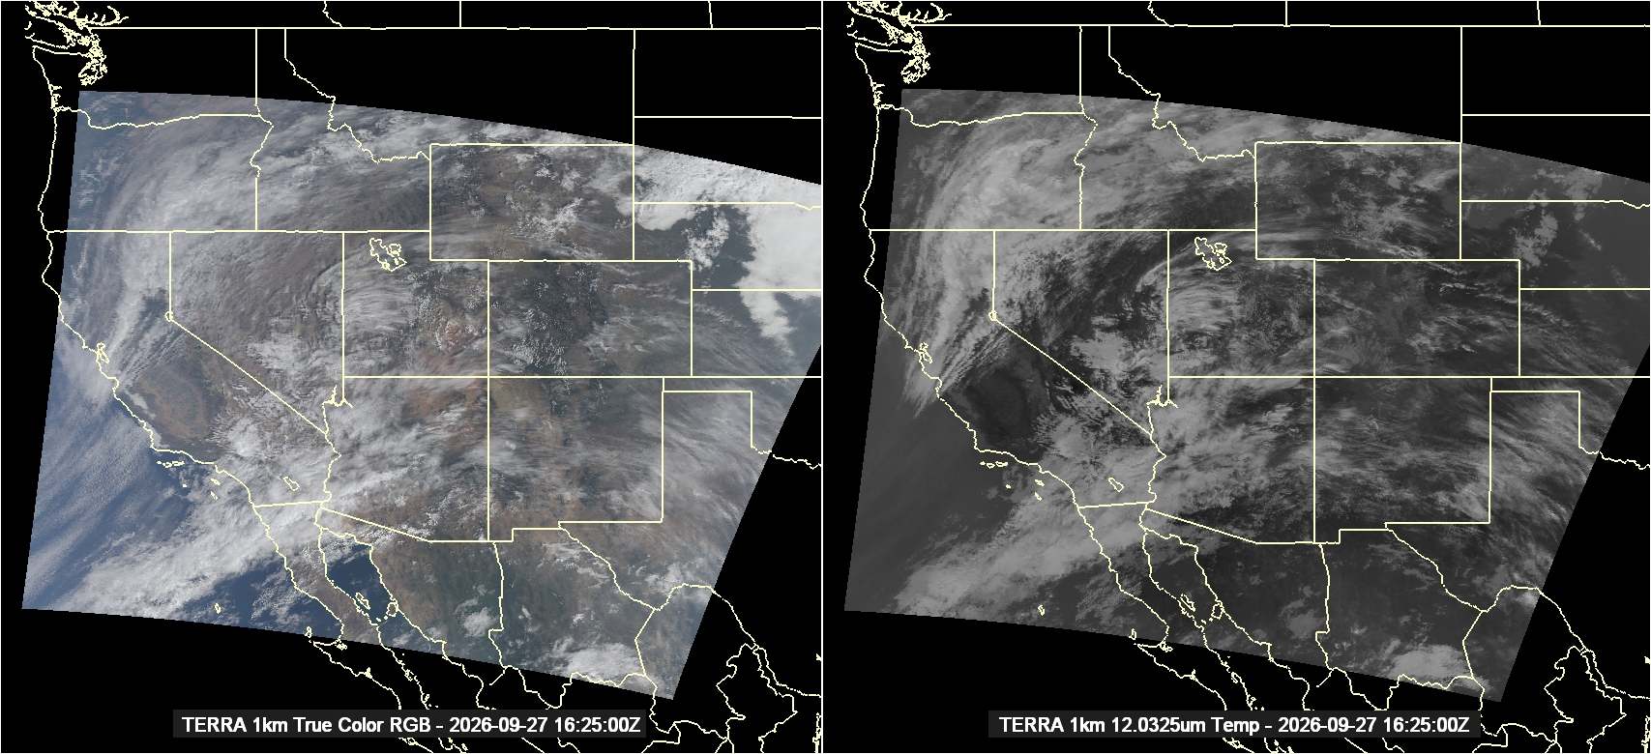
MODIS

Slide 17
GOES

Slide 18
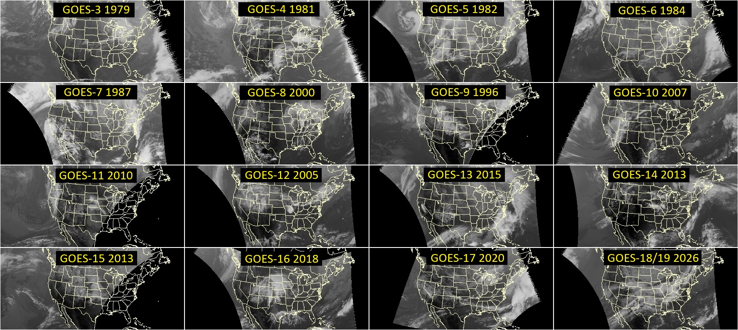
GOES Across Generations

Slide 19
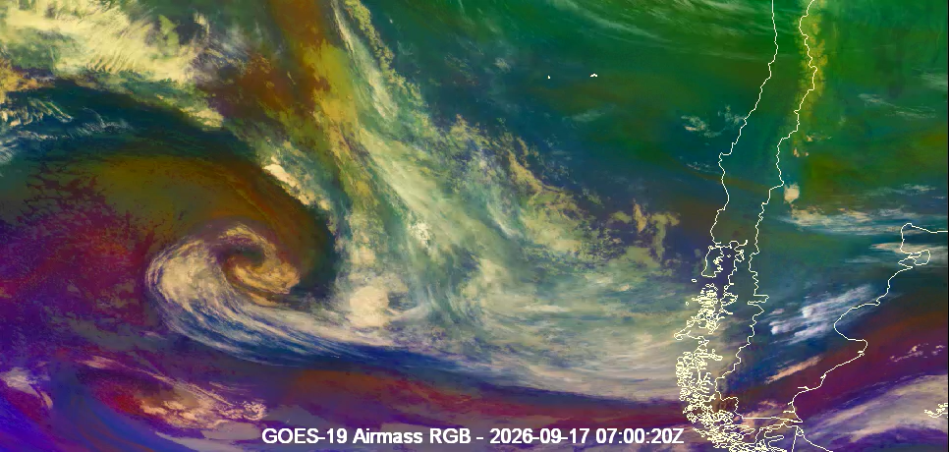
GOES-19
The animation above is an Airmass RGB loop of GOES-19 data. Users can load, display, and analyze data from all domains of the GOES-R series satellites. For L1b data, individual bands can be displayed as well as channel combinations and RGBs. Level 2 products are supported as well as GLM point and gridded data.

Slide 20
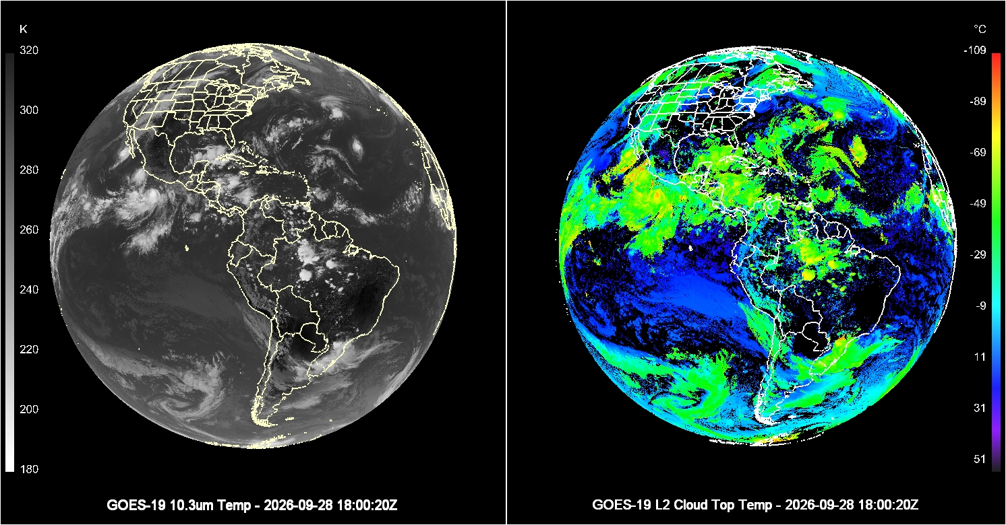
GOES-19 L2 Products

Slide 21
Other GOES

Slide 22
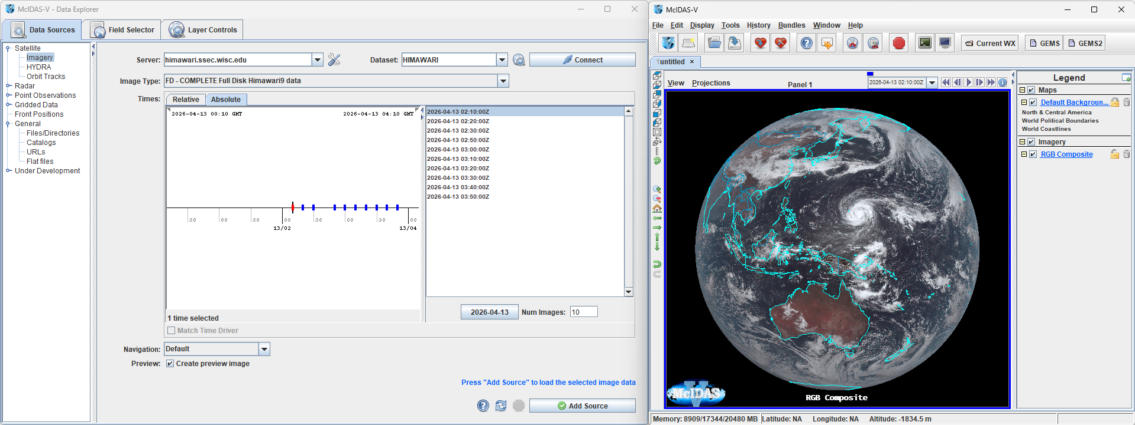
Himawari

Slide 23
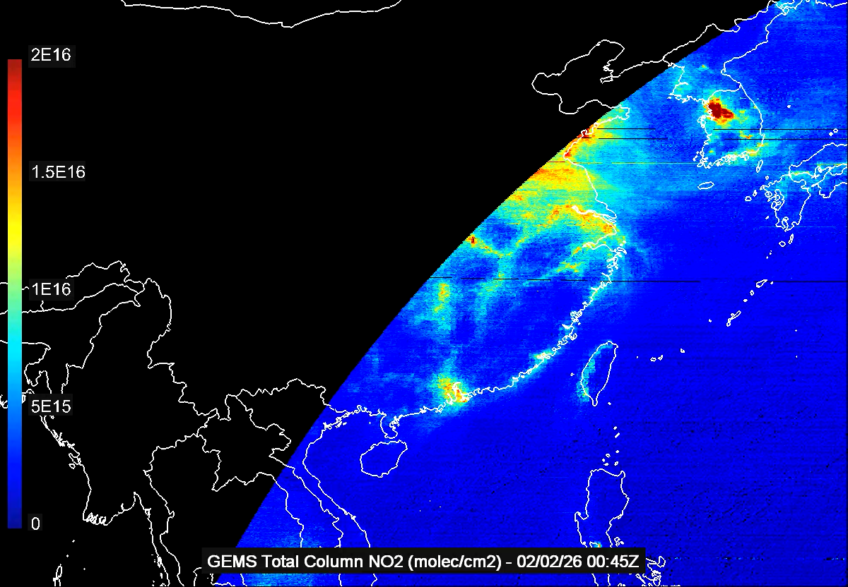
GEMS
This animation shows total column ozone from the GEMS instrument. GEMS is an instrument on the Korean GEO-KOMPSAT-2B geostationary satellite that is used to measure trace gases in the atmosphere.

Slide 24
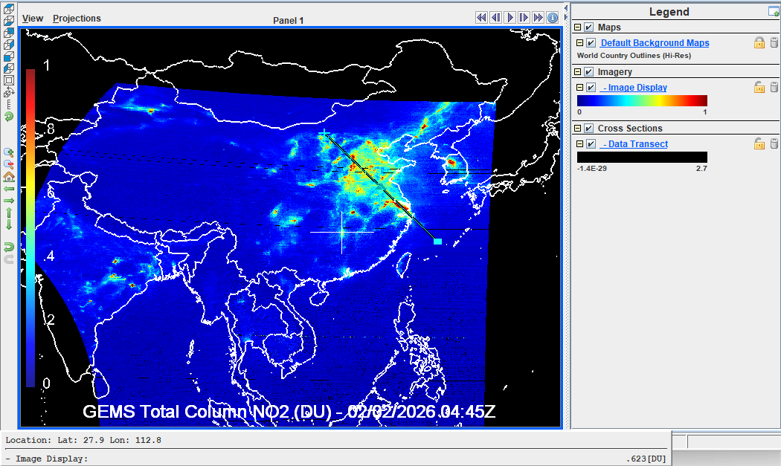
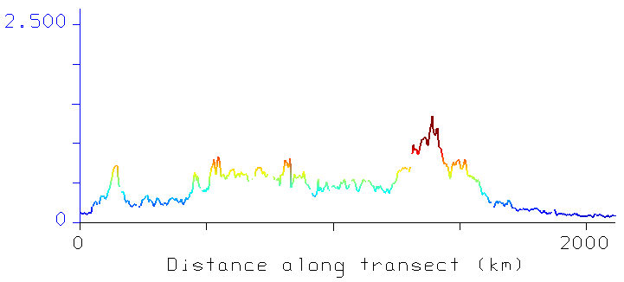
GEMS Analysis
This data transect display of GEMS data demonstrates one way McIDAS-V can be used to not just display data, but analyze it. The black transect line through the higher concentrations of NO2 in eastern Chine is shown as a transect on the right.

Slide 25
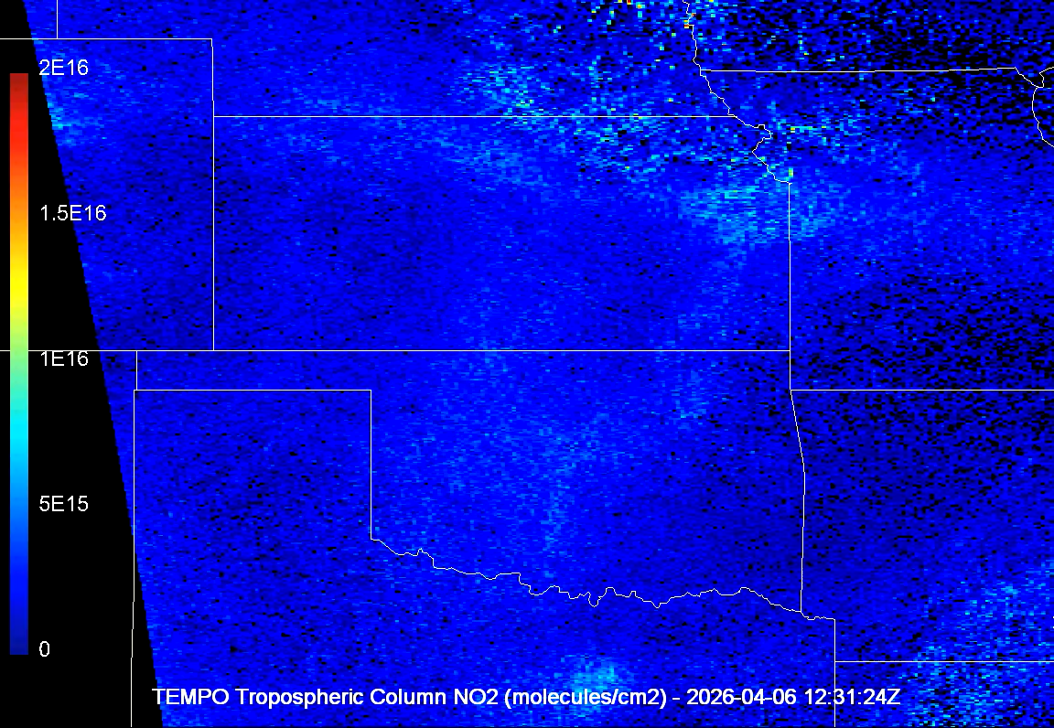
TEMPO
TEMPO is an instrument on the Intelesat 40e satellite and is used to detect trace gases in the atmosphere in hourly intervals over the United States. The image on the left shows the evolution of NO2 plumes from prescribed fires in Kansas in April 2026.

Slide 26

McIDAS-V Information
Main McIDAS-V Webpage
Supported Data Types
Satellite – Local and remote GEO and LEO, TLE
Radar – Local and remote L2 and L3
Point – Local and remote observations and soundings
Grid – Local and remote gridded data including .nc, .hdf, .grb1/2
Useful Links
General Information - https://www.ssec.wisc.edu/mcidas/software/v/
Documentation/Tutorials - https://www.ssec.wisc.edu/mcidas/software/v/doc/
Installers - https://www.ssec.wisc.edu/mcidas/software/v/download/
Support - https://www.ssec.wisc.edu/mcidas/support/

