Slide 1
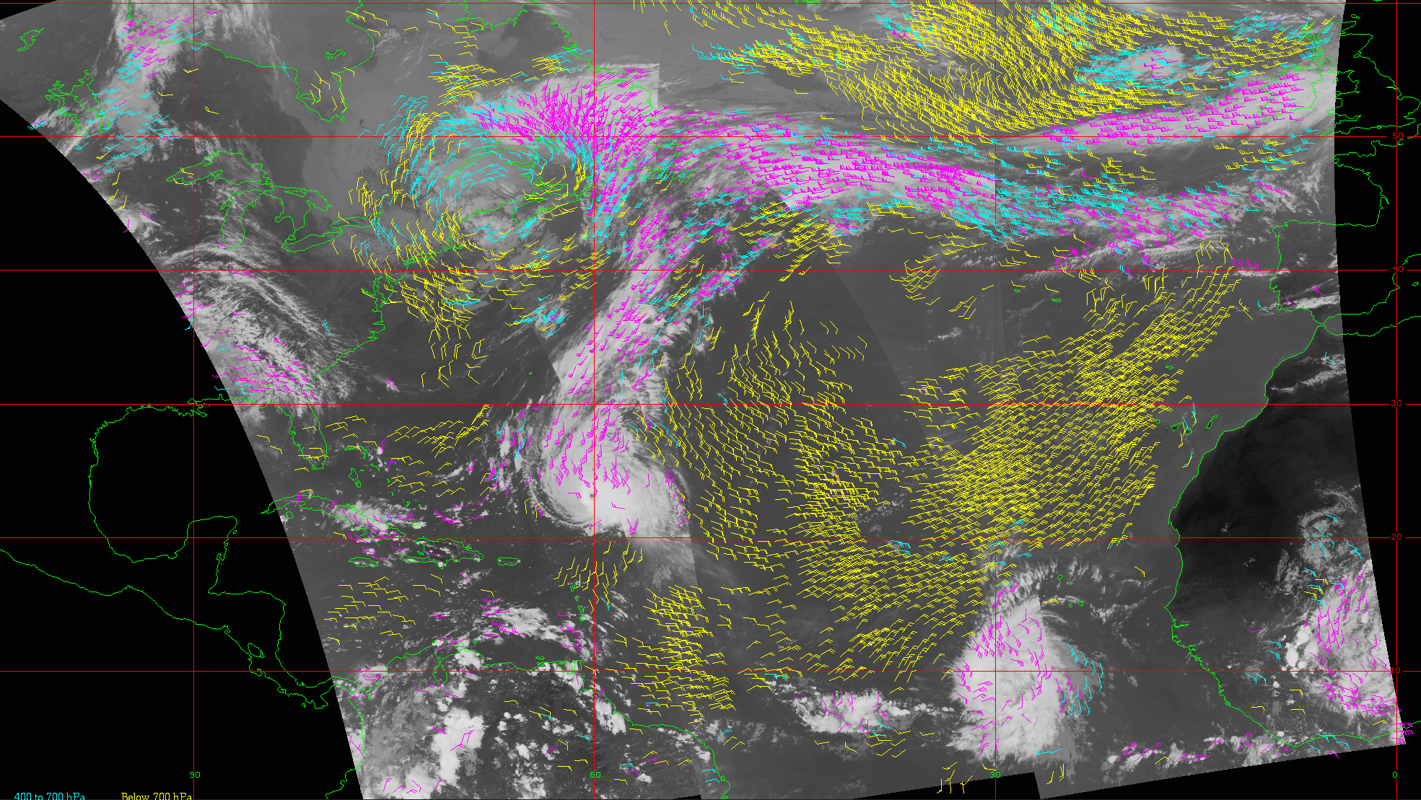
Global VIIRS Winds
D. Santek, Tim Olander, D. Stettner
Objective
Demonstrate and evaluate the derivation winds from alternating passes of VIIRS on S-NPP and NOAA-20, which are flying in tandem (similar orbit, separated by 50 minutes).
With the reduced time interval, the resulting winds will have lower latency, potentially higher quality, and global rather than only high-latitude coverage.
However, to achieve global coverage the wind derivation would operate on only a pair (doublet) of images instead of a the typical triplet.
An example of low-latitude coverage over the northern hemisphere Atlantic Ocean of VIIRS IR winds from alternating passes from S-NPP/NOAA-20, color-coded by height: Yellow ( > 700 hPa), cyan (400 - 700 hPa), magenta (< 400 hPa).
Approach
Modify the CIMSS heritage winds algorithm to operate on a pair of images, instead of a triplet.
Using a triplet of images results in a vector pair for each tracked feature, which is used in the quality control (QC). When using a pair of images, a proxy wind is used as the 2nd vector in the QC. Proxy winds are from other satellite-derived wind products.
In addition, a correction was made for parallax effects which is significant in low- to mid-latitudes for overlapping swaths from two satellites.
Outcomes
6-week case study 18 Sept to 03 Nov 2021.
Winds were derived from image pairs of S-NPP and NOAA-20. Result: 16 million quality controlled winds.
Comparison to rawinsondes speed showed a -1 ms⁻¹ bias and RMS difference of 4 ms⁻¹; slightly degraded compared to the operational VIIRS wind product.
GDAS/GFS experiment resulted in a generally neutral impact, although for Day1 there was a negative impact on wind and temperature RMSE, and a positive impact on the geopotential height bias.

